Slide 1
Designing Appropriate Academic Interventions Using the Taxonomy of Intervention Intensity
January 24, 2023
Caitlyn Majeika, PhD | Aleksis Kincaid, PhD | Kim St. Martin, PhD

Slide 2
Introductions
Caitlyn Majeika, PhD
National Center on Intensive Intervention (NCII)
Aleksis Kincaid, PhD
NCII
Kim St. Martin, PhD
Michigan Multi-Tiered System of Support (MTSS) Technical Assistance Center

Slide 3
Polls

Slide 4
Webinar Overview
1
Overview of the Academic Intervention Taxonomy Briefs
Taxonomy Briefs in Action
Questions and Answers
Setting the Stage: Review of Data-Based Individualization (DBI)
2
3
4

Slide 5
Learning Outcomes
After this webinar, participants will be able to . . .
List the six dimensions of the Taxonomy of Intervention Intensity through which educators can evaluate interventions.
Describe three ways to use the Intervention Taxonomy Briefs when considering programs for students with intensive academic needs.
List the strengths and weaknesses of an intervention based on the dimensions of the Taxonomy of Intervention Intensity.

Slide 6
Setting the Stage: Review of Data-Based Individualization

Slide 7
Data-Based Individualization
A systematic method for using data to determine when and how to provide more intensive intervention.
An ongoing process—not a single intervention.
Intended for students with severe and persistent learning and behavioral needs.

Slide 8
Five DBI Steps
Validated intervention program, delivered with fidelity
Progress monitoring
Informal diagnostic assessment
Adaptation to validated intervention
Continued progress monitoring, with adaptations occurring whenever needed to ensure adequate progress

Slide 9
Today’s Focus
Validated intervention program, delivered with fidelity
Progress monitoring
Informal diagnostic assessment
Adaptation to validated intervention
Continued progress monitoring, with adaptations occurring whenever needed to ensure adequate progress

Slide 10
Educators Who May Be Selecting Interventions
District academic coaches who identify interventions to purchase
A school MTSS team that creates a decision tree for selecting Tier 2 and Tier 3 interventions.
A teacher who selects the most appropriate intervention to address a student’s individualized education program (IEP) goals.

Slide 11
Validated Intervention Programs: Components to Consider
Evidence-based programs
Effect size
Opportunities to respond
Group size
Alignment with grade-level standards
Explicit instruction and modeling
Frequency and duration of intervention
Concrete learning opportunities
Break tasks into smaller steps
Connection to Tier 1 instruction

Slide 12
Validated Intervention Programs: Components to Consider
Effect size
Evidence-based programs
Opportunities to respond
It would be helpful if there was a framework to guide our thinking when we decide what interventions to use and how to adapt them.
Group size
Alignment with grade-level standards
Explicit instruction and modeling
Frequency and duration of intervention
Concrete learning opportunities
Break tasks into smaller steps
Connection to Tier 1 instruction

Slide 13
Key Considerations When Selecting or Evaluating Validated Interventions for DBI
Does evidence suggest that the intervention is expected to lead to improved outcomes (strength)?
Will the group size, duration, and frequency provide sufficient opportunities to respond (dosage)?
Does the intervention match the student’s identified needs (alignment)?
Does it assist the student in generalizing the learned skills to general education or other tasks (promoting transfer)?
Does the intervention include elements of explicit instruction (comprehensiveness)?
Does the student have opportunities to develop the behavior skills needed to be successful (behavioral support)? Can the intervention be easily integrated into academic instruction (academic support)?
Can the intervention be individualized with a data-based process to meet student needs (individualization)?

Slide 14
Taxonomy of Intervention Intensity
Strength
Dosage
Alignment
Promoting Transfer
Comprehensiveness
Behavioral/Academic Support
Individualization
Fuchs, Fuchs, and Malone (2017).

Slide 15
Academic Intervention Taxonomy Briefs

Slide 16
Purpose of the Academic Intervention Taxonomy Briefs
The briefs provide educators with information to evaluate the appropriateness of academic interventions available on the Academic Intervention Tools Chart for students who require intervention.
The information included in the briefs is organized along the dimensions of the Taxonomy of Intervention Intensity.
https://intensiveintervention.org/tools-charts/academic-intervention-taxonomy-briefs

Slide 17
Development of the Briefs
Vendors from the current Academic Intervention Tools Chart developed the briefs, using a standardized template provided by NCII.
The briefs were reviewed for accuracy and adherence to the Taxonomy of Intervention Intensity by content experts on our NCII team prior to publishing the final products.

Slide 18
Locate the Briefs on the Tools Chart
Linked at top of Academic Intervention Tools Chart
NCII Website

Slide 19
Locate the Briefs on the NCII Website
Linked in the main navigation menu
NCII Website

Slide 20
Academic Briefs Currently Available
Reading | Mathematics
Leveled Literacy Intervention Lexia Core5 Reading Lexia PowerUp Literacy Promoting Adolescent’s Comprehension of Text Read Naturally Live Seeing Stars Program: Symbol Imagery for Phonological and Orthographic Processing in Reading and Spelling Sound Partners Visualizing and Verbalizing Program for Language Comprehension and Thinking | Fraction Face-off! Fusion Whole Number Foundations Level 1 Hot Math Tutoring Number Rockets Pirate Math ROOTS Whole Number Foundations Level K Spring Math Strategic Instruction Multiplication With Regrouping Partial Products Algorithm Strategic Instruction Multiplication With Regrouping Standard Algorithm

Slide 21
The Briefs in Practice
Evaluate the appropriateness of interventions on the Academic Intervention Tools Chart for a specific student or group of students who require intervention.
Guide decisions about the selection or purchase of a new intervention.
Understand the strengths and weaknesses of an intervention based on the dimensions of the Taxonomy of Intervention Intensity.

Slide 22
Three Main Components of Each Brief
Introduction: Overview of the purpose of the briefs.
Program Information: Features of program implementation.
Taxonomy Dimensions: Details on how components of the intervention align with the dimensions of taxonomy.

Slide 23
Today’s Focus
Introduction: Overview of the purpose of the briefs.
Program Info: Features of program implementation.
Taxonomy Dimensions: Details on how components of the intervention align with the dimensions of taxonomy.

Slide 24
Strength

Slide 25
Strength: Definition
How well does the intervention work for students with intensive intervention needs (students below the 20th percentile)?
Considerations:
Has this intervention been evaluated empirically using scientifically sound, rigorous methodology?
What were the effects of the study?
For group design studies: What is the reported standardized mean effect size for this intervention, and what does it look like for students with intensive needs (below the 20th percentile)?
For single-case design studies: Is it identified as a promising or effective program by a reputable source?

Slide 26
Example of Strength From a Brief: Definition
Intervention Taxonomy Brief: Fraction Face-Off!

Slide 27
Example of Strength From a Brief: Evidence
Intervention Taxonomy Brief: Fraction Face-Off!

Slide 28
Example of Strength From a Brief: Outcomes
Intervention Taxonomy Brief: Fraction Face-Off!

Slide 29
Example of Strength From a Brief
How well does the intervention work for students with intensive intervention needs?
Intervention Taxonomy Brief: Fraction Face-Off!

Slide 30
Dosage

Slide 31
Dosage Definition
Dosage refers to the number of opportunities that a student has to respond and receive corrective feedback.
Each of the following might impact dosage:
Number of sessions (frequency of sessions)
Duration of sessions
Student-teacher ratio
Number of practice problems provided

Slide 32
Example of Dosage From a Brief
How many opportunities does a student have to respond and receive corrective feedback?
Intervention Taxonomy Brief: Fraction Face-Off!

Slide 33
Alignment

Slide 34
Alignment Definition
To what extent does the intervention
address the full set of a specific student’s academic deficits,
not address skills the student has already mastered, and
incorporate a focus on grade-level standards?

Slide 35
Example of Alignment From a Brief
Does the intervention address only the target skills?
Intervention Taxonomy Brief: Fraction Face-Off!

Slide 36
Promoting Transfer

Slide 37
Promoting Transfer Definition
To what extent does the intervention
help students transfer skills they learn to other formats and contexts,
help students realize the connection between mastered and related skills, and
demonstrate efficacy on standardized measures or measures of generalization?
“generalization”

Slide 38
Example of Promoting Transfer From a Brief
To what extent does the intervention plan for generalization of skills?
Intervention Taxonomy Brief: Fraction Face-Off!

Slide 39
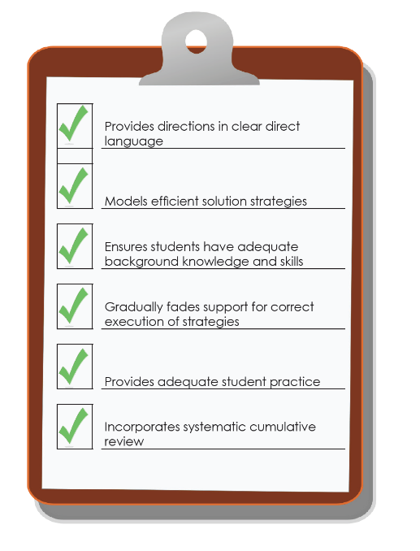
Comprehensiveness

Slide 40
Comprehensiveness = Explicit Instruction
Explicit instruction is “a way of teaching where the teacher selects an important objective, models the skills being taught, and provides scaffolded practice to help a student achieve mastery” (Kearns, 2018).
Explicit instruction has long been the gold standard when intervening with students with and at risk for learning disabilities (Ciullo et al., 2016; Scammacca et al., 2015).

Slide 41
Principles of Explicit Instruction
Provides directions in clear, direct language.
Models efficient solution strategies.
Ensures that students have adequate background knowledge and skills.
Gradually fades support for correct execution of strategies.
Provides adequate practice opportunities.
Incorporates systematic cumulative review.

Slide 42
Example of Comprehensiveness From a Brief
In what ways does the intervention include principles of explicit instruction?
Intervention Taxonomy Brief: Fraction Face-Off!

Slide 43
Behavioral Support

Slide 44
Behavioral Support in Academic Interventions
Behavioral support refers to the extent to which interventions incorporate
methods to promote self-regulation and executive function and
behavioral principles to minimize nonproductive behavior.

Slide 45
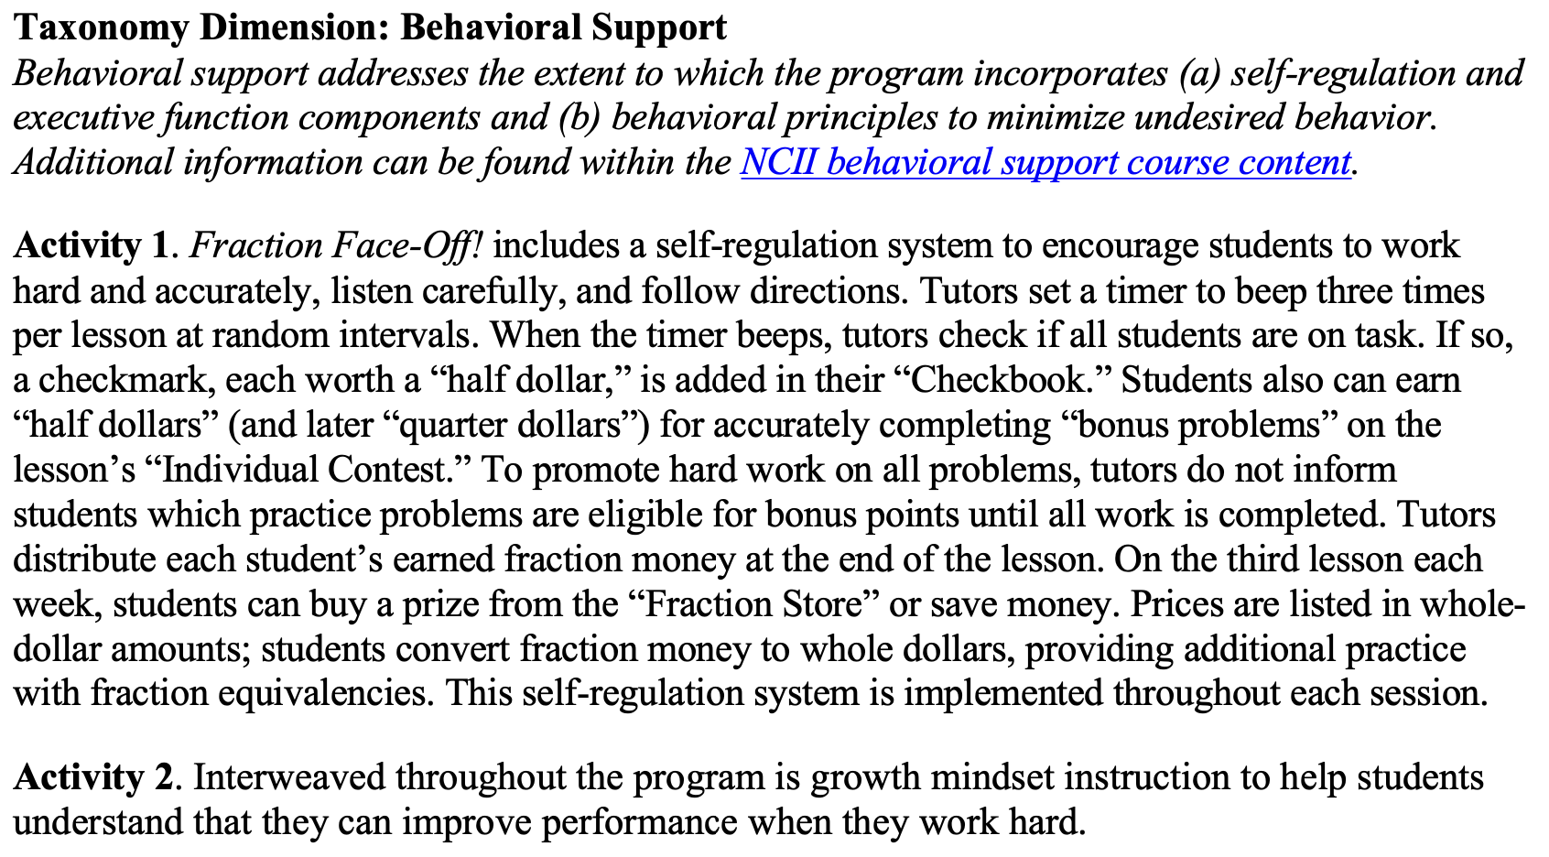
Example of Behavioral Support From a Brief
How does the intervention include behavioral support?
Intervention Taxonomy Brief: Fraction Face-Off!

Slide 46
Taxonomy Briefs in Action

Slide 47
Intervention Review and Selection
In collaboration with individuals across schools with content expertise, districts should work together to review, select, and de-select intervention resources.
Reviewing interventions through the lens of the Taxonomy of Intervention Intensity allows districts and schools to identify strengths and needs.
This rubric is only one component of a comprehensive review.
Taxonomy of Intervention Intensity: Academic Rating Rubric

Slide 48
Intervention Review Usability Testing
The Michigan MTSS Technical Assistance Center staff wanted to use the Academic Rating Rubric to determine how helpful it is in informing intervention selection, its ease of use, and additional support users could benefit from.
Usability Testing Results:
Access to intervention teacher materials and, at times, student materials would be a challenge for many.
Knowing where information about specific dimensions could also be a challenge (e.g., placement tests, behavioral supports).
It was suggested and affirmed that intervention resource developers could more easily supply the information to inform the rating in the rubric.
Background knowledge is helpful to have about the dimensions and how to score the rubric accurately (e.g., what the dimensions mean, how to discern what is present in the intervention materials compared with the intent of the dimension).

Slide 49
Taxonomy Briefs in Action: Considerations
Publishers and program developers have submitted the existing briefs.
There are effective intervention curriculum resources that have not been submitted for inclusion on the Academic Intervention Tools Chart and, therefore, do not have a completed taxonomy brief.
Just because you do not see an intervention resource of interest does not mean you need to stop the review process.
Using the Hexagon Tool coupled with the NCII Academic Rating Rubric can help inform your review, selection, and de-selection process.

Slide 50
Questions and Answers

Slide 51
Closing and Wrap-Up

Slide 52
Key Takeaways
No intervention is perfect! It is important to understand both the strengths and weaknesses.
The Academic Intervention Taxonomy Briefs can be used to evaluate the appropriateness of an intervention for a student or group of students.

Slide 53
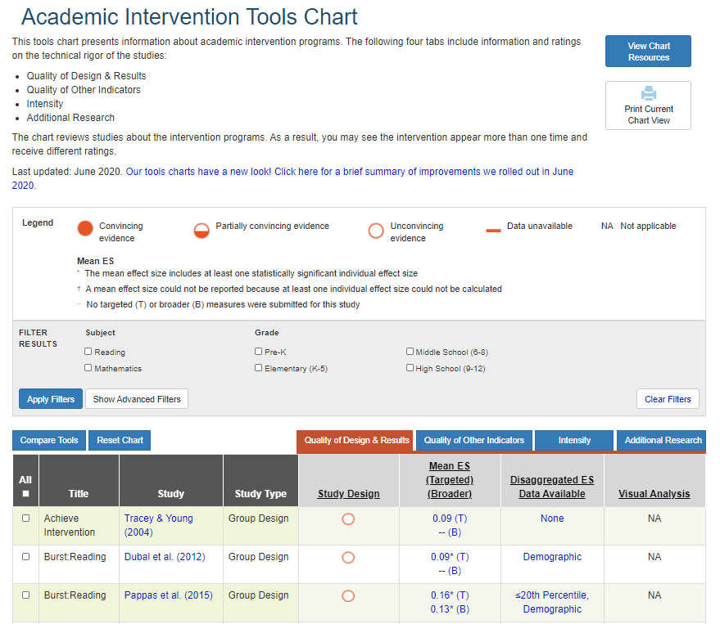
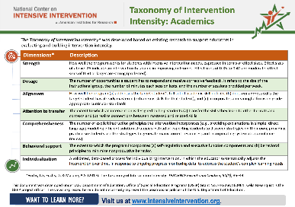
Resources
Resource | Image | Link
Academic Intervention Tools Chart |  | https://charts.intensiveintervention.org/aintervention
Taxonomy of Intervention Intensity |  | https://intensiveintervention.org/implementation-intervention/taxonomy-intervention-intensity
Academic Intervention Taxonomy Briefs |  | https://intensiveintervention.org/tools-charts/academic-intervention-taxonomy-briefs

Slide 54
References
Ciullo, S., Sabrina Lo, Y.-L., Wanzek, J., & Reed D. K. (2016). A synthesis of research on informational text reading interventions for elementary students with learning disabilities. Journal of Learning Disabilities, 49(3), 257–271. https://doi.org/10.1177/0022219414539566
Fuchs, L. S., Fuchs, D., & Malone, A. S. (2017). The taxonomy of intervention intensity. TEACHING Exceptional Children, 50(1), 35–43. https://eric.ed.gov/?id=EJ1160167
Kearns, D. (2018). Features of Explicit Instruction Course Content. https://intensiveintervention.org/training/course-content/explicit-instruction
Scammacca, N. K., Roberts, G., Vaughn, S., & Stuebing, K. K. (2015). A meta-analysis of interventions for struggling readers in Grades 4–12: 1980–2011. Journal of Learning Disabilities, 48(4), 369–390. https://doi.org/10.1177/0022219413504995

Slide 55
Thank You

Slide 56
NCII Disclaimer
This presentation was produced under the U.S. Department of Education, Office of Special Education Programs, Award No. H326Q260001. Celia Rosenquist serves as the project officer. The views expressed herein do not necessarily represent the positions or policies of the U.S. Department of Education. No official endorsement by the U.S. Department of Education of any product, commodity, service, or enterprise mentioned in this webinar is intended or should be inferred.

