Slide 1
Getting It Right From the Start
September 21, 2022
Why Embedding Data-Based Individualization in Teacher Education Matters
Denise Callwood-Brathwaite | Georgina Rivera-Singletary | Kelly Williams | Lindsey Hayes

Slide 2
About NCII
The mission of the National Center on Intensive Intervention (NCII) is to build knowledge and capacity of state and local leaders, faculty and professional development providers, educators, and other stakeholders to support implementation of intensive intervention for students with severe and persistent learning and/or social, emotional, or behavioral needs using data-based individualization (DBI).

Slide 3
Presenters
Dr. Denise Callwood-Brathwaite
Professor
Florida Memorial University
Dr. Kelly J. Williams
Assistant Professor
Dyslexia Graduate Certificate Coordinator
Indiana University
Lindsey Hayes
Educator Preparation Lead, National Center on Intensive Intervention
Dr. Georgina Rivera-Singletary
Associate Professor
Saint Leo University

Slide 4
Objectives
Discuss strategies to help teacher education faculty integrate the principles of intensive intervention within programs for aspiring and current teachers.
Share examples of how faculty have incorporated data-based individualization (DBI) into the design and delivery of their courses.
Identify supports and resources from the National Center on Intensive Intervention (NCII) to assist teacher education faculty.

Slide 5
Why Does Embedding DBI in Teacher Education Matter?

Slide 6
What Is Intensive Intervention?
Intensive intervention addresses severe and persistent learning and behavioral difficulties.
Driven by data
Characterized by increased intensity and individualization

Slide 7
Why Do We Need Intensive Intervention?
Validated programs are not universally effective programs; 3% to 5% of students need more help (NCII, 2013).
Students with intensive needs often require 10–30 times as much practice as their peers to learn new information (Gersten et al., 2009).
For students with intensive needs, co-occurring academic and behavioral needs are the rule, not the exception (Kuchle & Riley-Tillman, 2019).
Students with disabilities are among the groups most negatively impacted by COVID-19 learning loss (Morando-Rhim & Ekin, 2021).

Slide 8
What Is NCII’s Approach to Intensive Intervention?
DBI is a research-based process for individualizing and intensifying interventions for students with severe and persistent learning and behavioral needs.
The process integrates evidence-based intervention, assessment, and strategies.

Slide 9
Teacher Education Matters
If we need teachers who can
identify effective interventions,
administer and interpret valid and reliable data from a variety of sources,
develop hypotheses about student needs,
intensify and individualize interventions based on data and evidence,
deliver adaptations with fidelity,
then we need teacher education programs that are
grounded in a DBI approach,
practice-based, and
aligned with inservice expectations.

Slide 10
NCII Faculty Resources

Slide 11
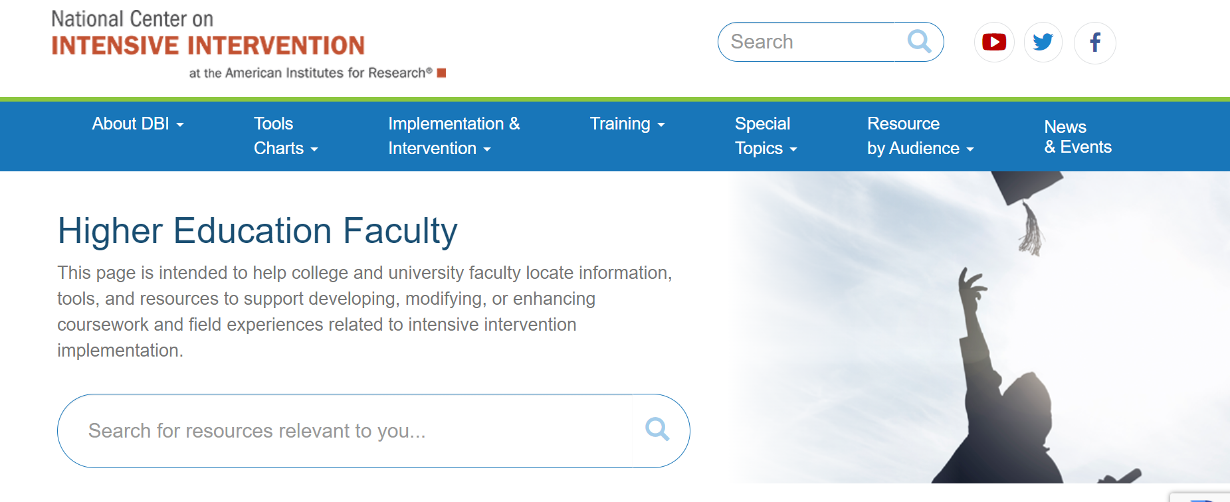
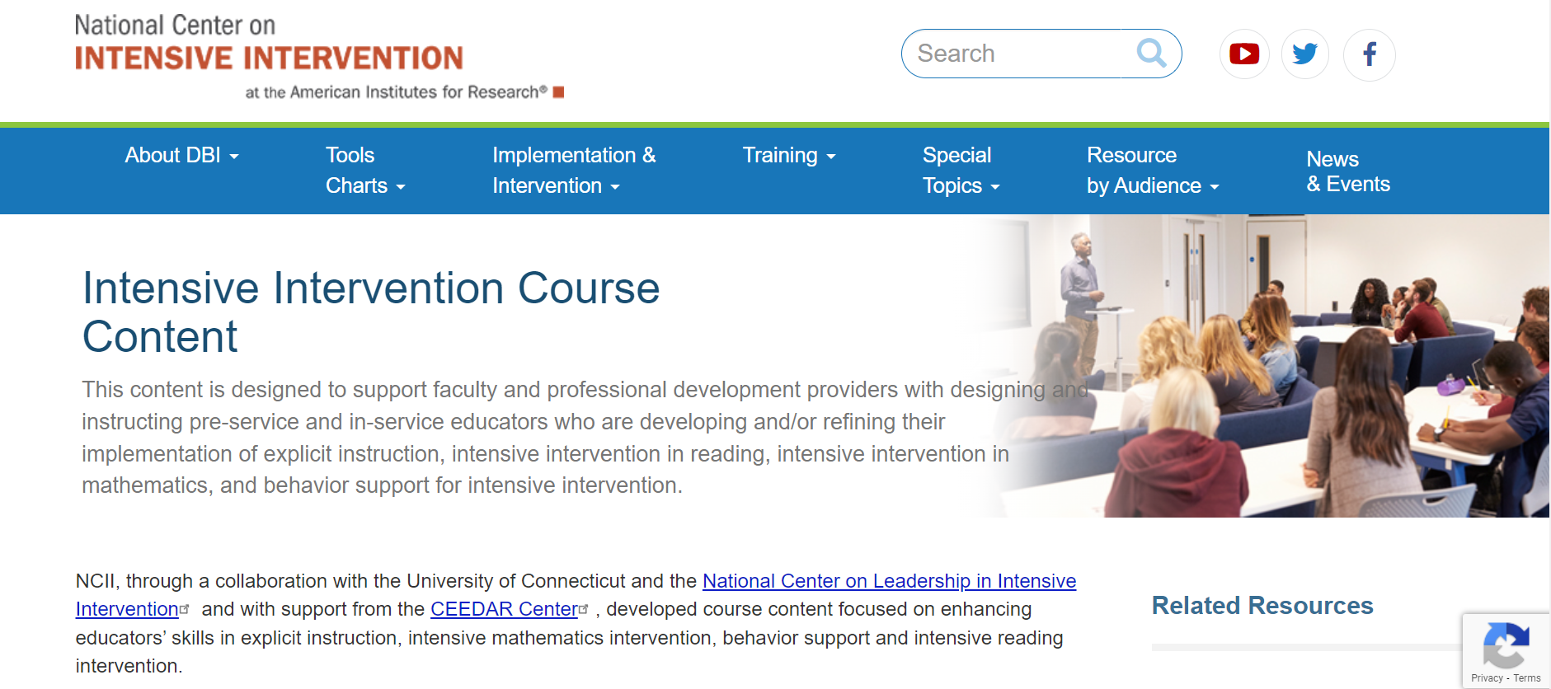
Faculty Resources

Slide 12
Faculty Community of Practice
Focus: Explore strategies for integrating DBI content into the design and delivery of reading courses
Time frame: Summer 2022—8 weeks
Participants: 21 faculty participants teaching reading methods and intervention courses
Final project: Course syllabus OR course artifact demonstrating integration of NCII’s Intensive Intervention in Reading Course Content

Slide 13
Faculty Presentations
Interconnected Teacher Preparation Experiences

Slide 14
Who We Are
Denise Callwood-Brathwaite, Professor of Exceptional Student Education, Florida Memorial University
Georgina Rivera-Singletary, Associate Professor, Graduate Education, Saint Leo University
Kelly J. Williams, Assistant Professor, Dyslexia Graduate Certificate Program Coordinator, Indiana University

Slide 15
Our Common Need and Vision
Commonality in our content:
Assessment as a driver of intervention
Individualized intervention planning
Our essential questions:
What do we want teachers to be able to do at the end of this experience? How do we begin with the end in mind?
As teacher educators, how do intensive intervention concepts connect across courses? How do we unite the resources used?

Slide 16
Setting the Foundation
Dr. Georgina Rivera-Singletary

Slide 17
Key Concepts
Establish the importance of data for instruction.
Focus on the use of assessment/progress monitoring for providing DBI instruction.
Understand the purpose of assessment for progress monitoring, with a focus on reliability and validity of assessment.
Choose assessment/progress monitoring tools that are appropriate for students.
Develop a resource to maintain effective use of assessment/progress monitoring.
Scaffolding their knowledge is KEY!

Slide 18
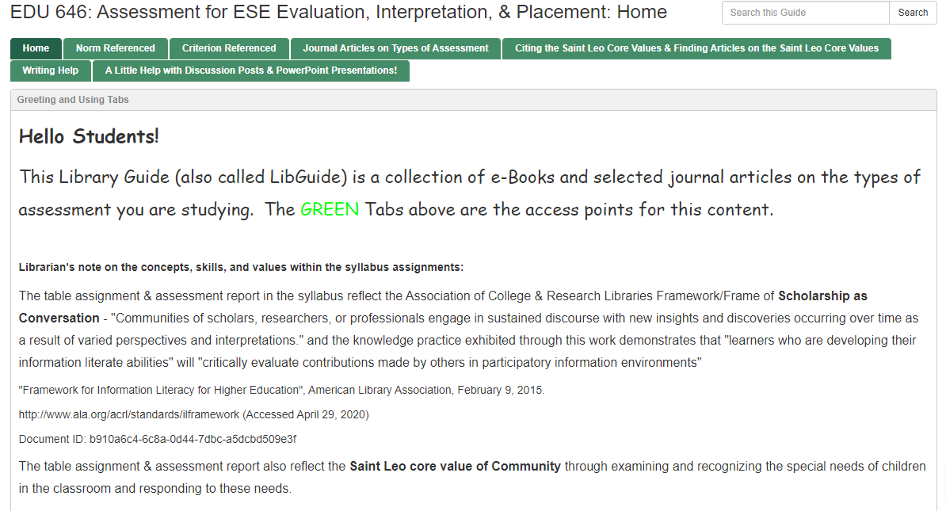
LibGuide
https://slulibrary.saintleo.edu/c.php?g=1029080

Slide 19
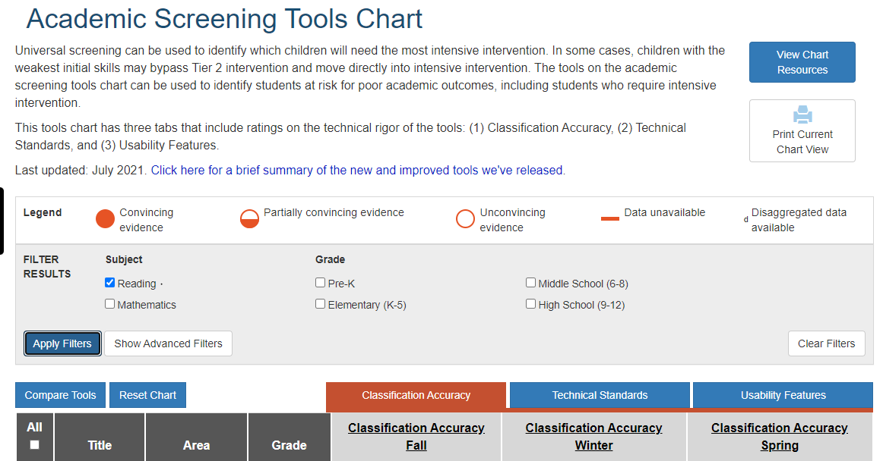
NCII Academic Screening Tools Chart
https://charts.intensiveintervention.org/ascreening

Slide 20
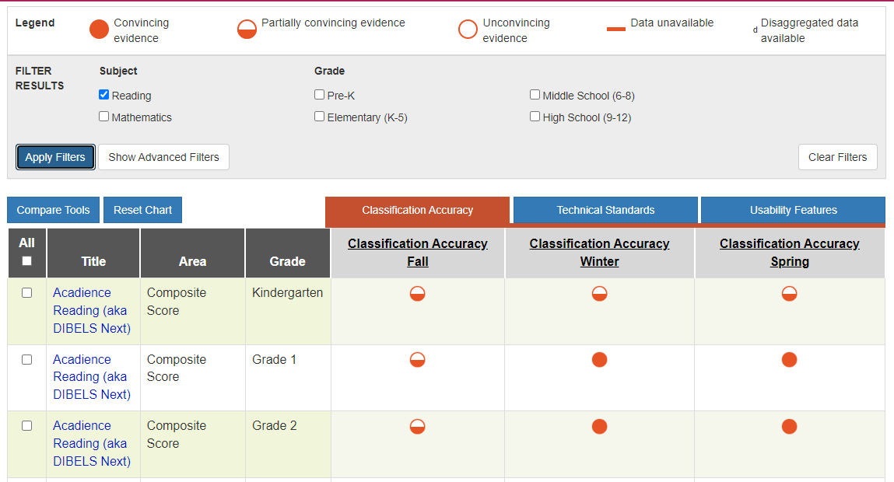
NCII Academic Screening Tools Chart

Slide 21
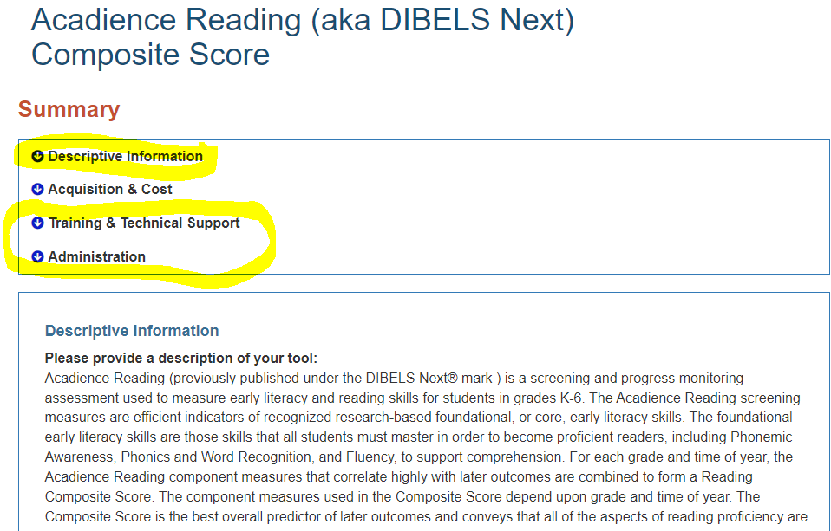
Exploring Tools
https://charts.intensiveintervention.org/screening/tool/?id=f24c475dd429f546

Slide 22
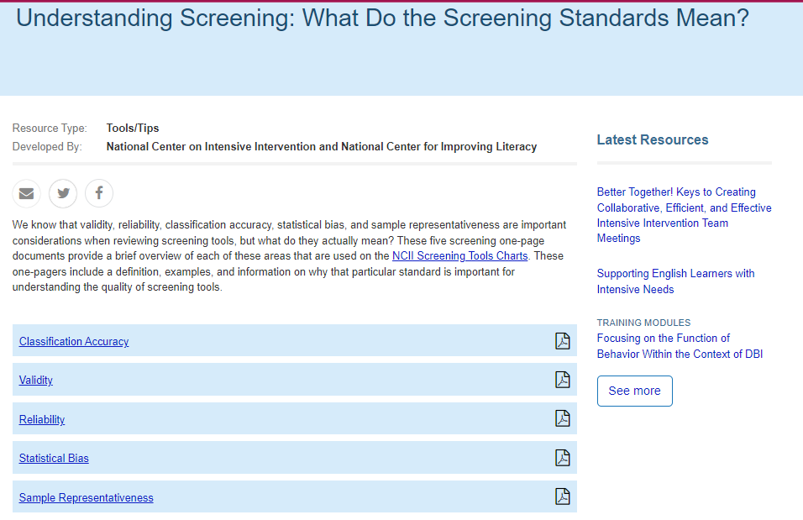
NCII Screening Brief
https://intensiveintervention.org/resource/screening-standards-overviews

Slide 23
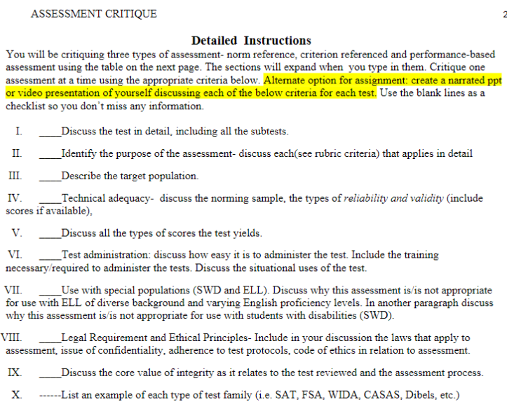
Course Assessment/
Progress Monitoring Chart
Assignment

Slide 24
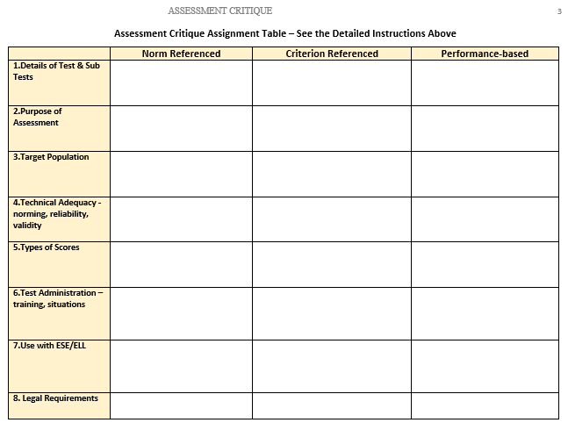
Assessment/Progress Chart Example: Page 1

Slide 25
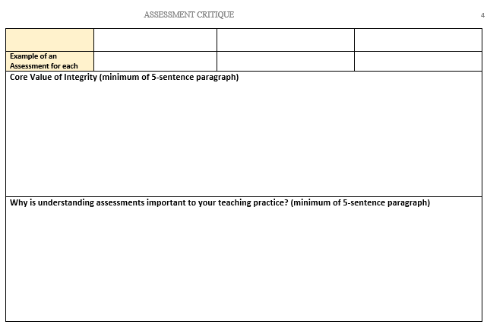
Assessment/Progress Chart Example: Page 2

Slide 26
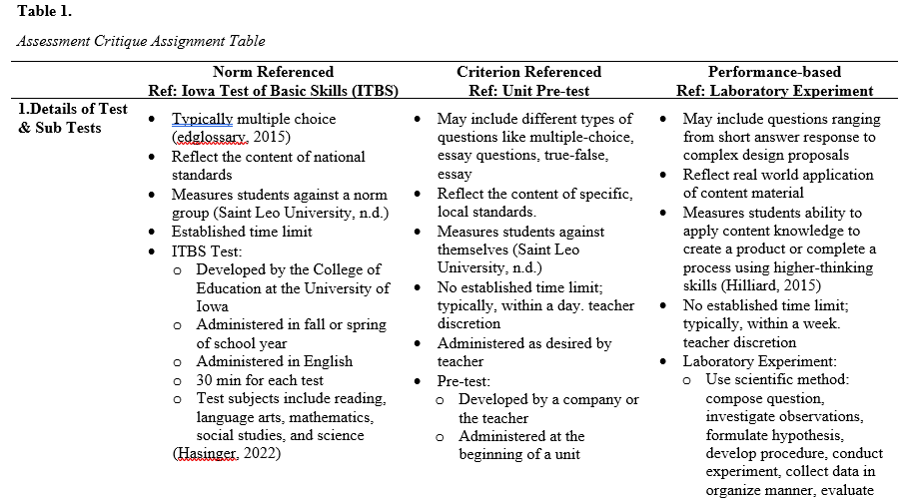
Course Assessment Chart: Student Sample

Slide 27
Digging Deeper into Data
Dr. Kelly Williams

Slide 28
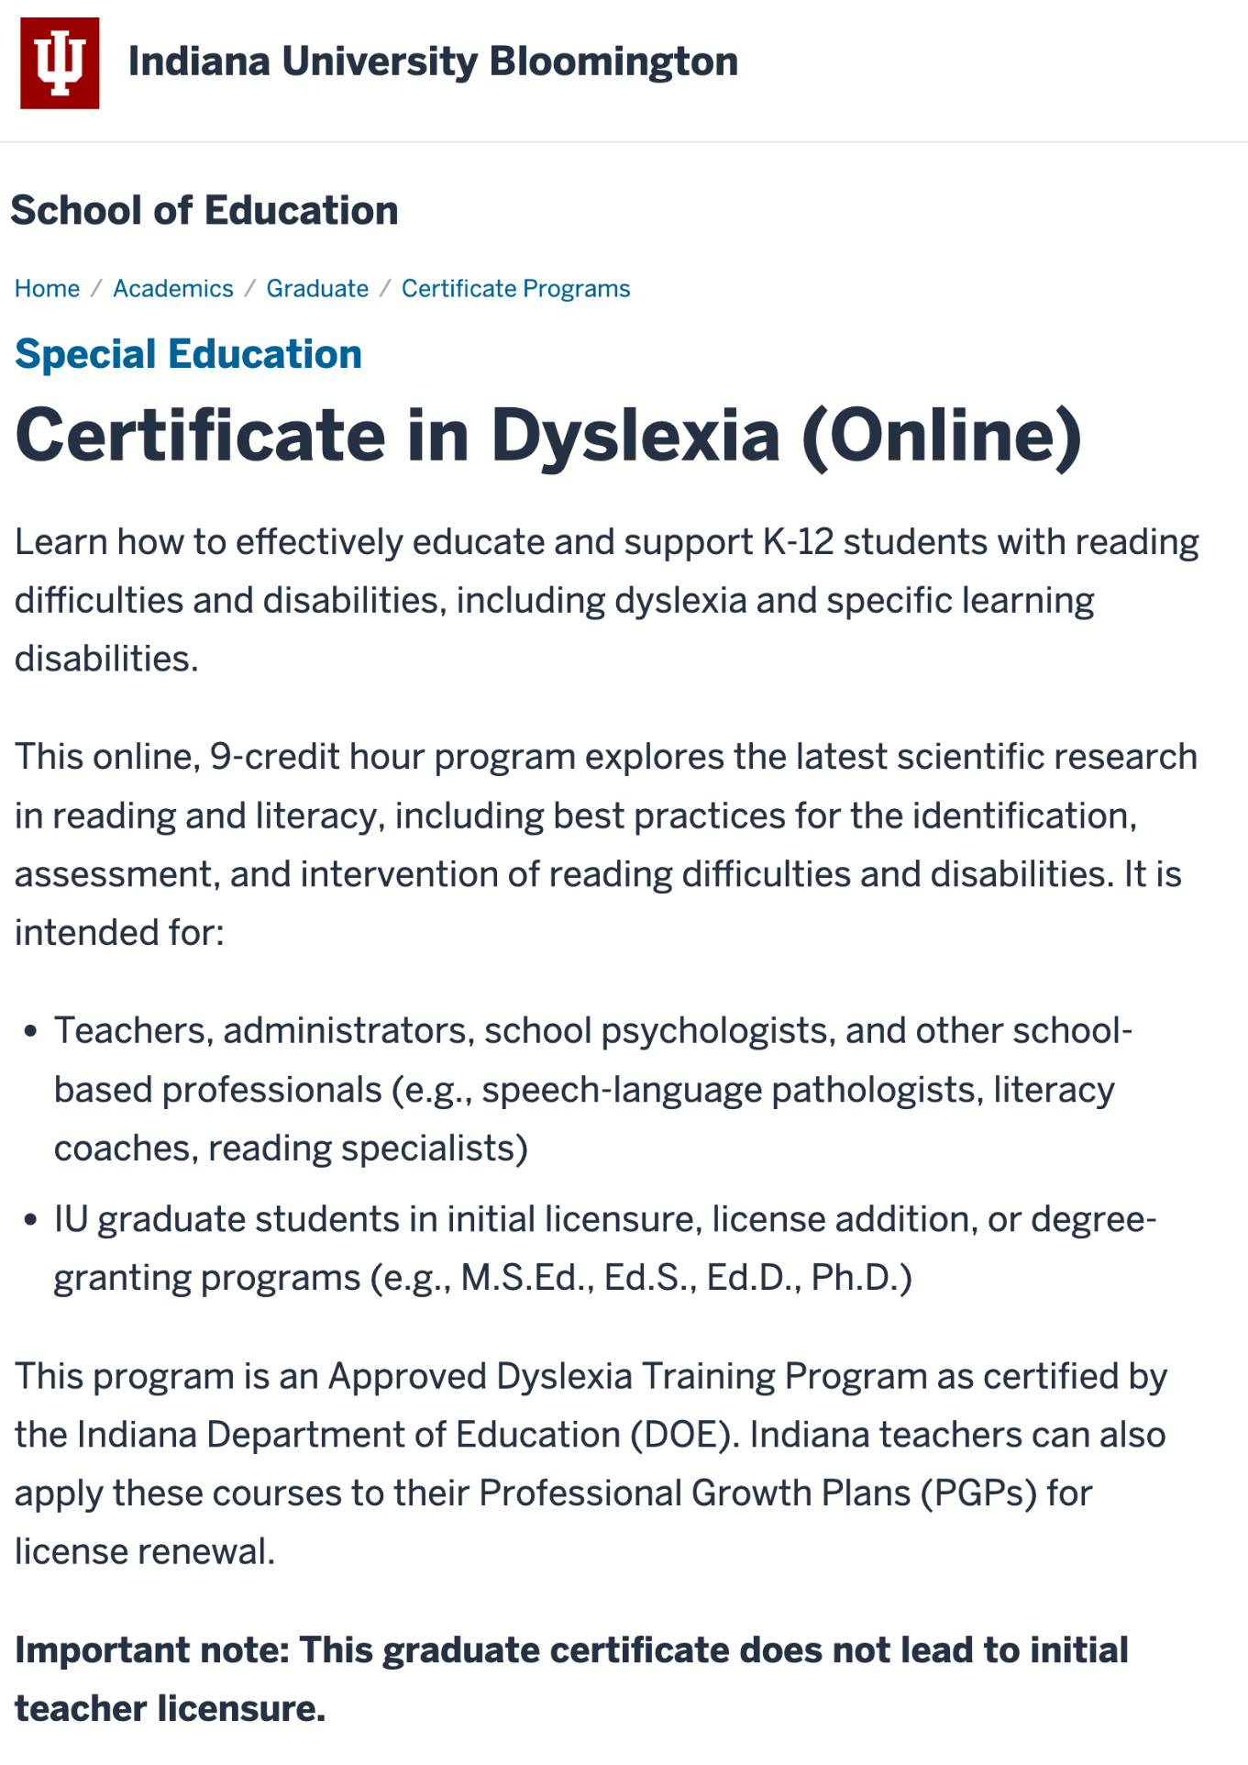
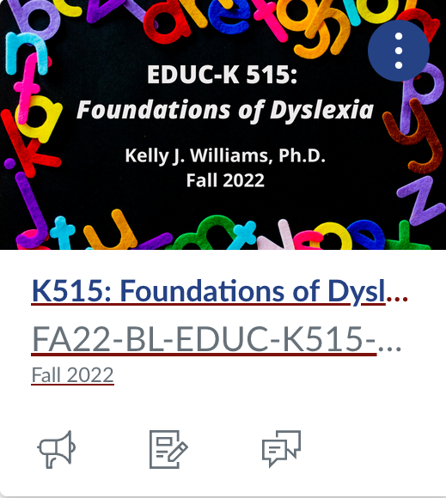
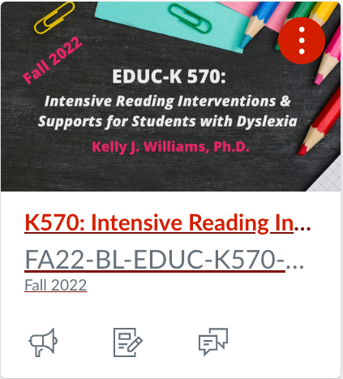
Dyslexia Graduate Certificate Program
Course 1
Course 2

Slide 29
Final Project: Assessment Case Study
Purpose/Goals
To administer, score, and interpret formal and informal reading and spelling assessments with a K–12 student with reading difficulties or a reading disability.
To use data to identify strengths and needs and make recommendations for instruction/intervention.
To plan for progress monitoring (e.g., identify measures, set/write instructional goals).

Slide 30
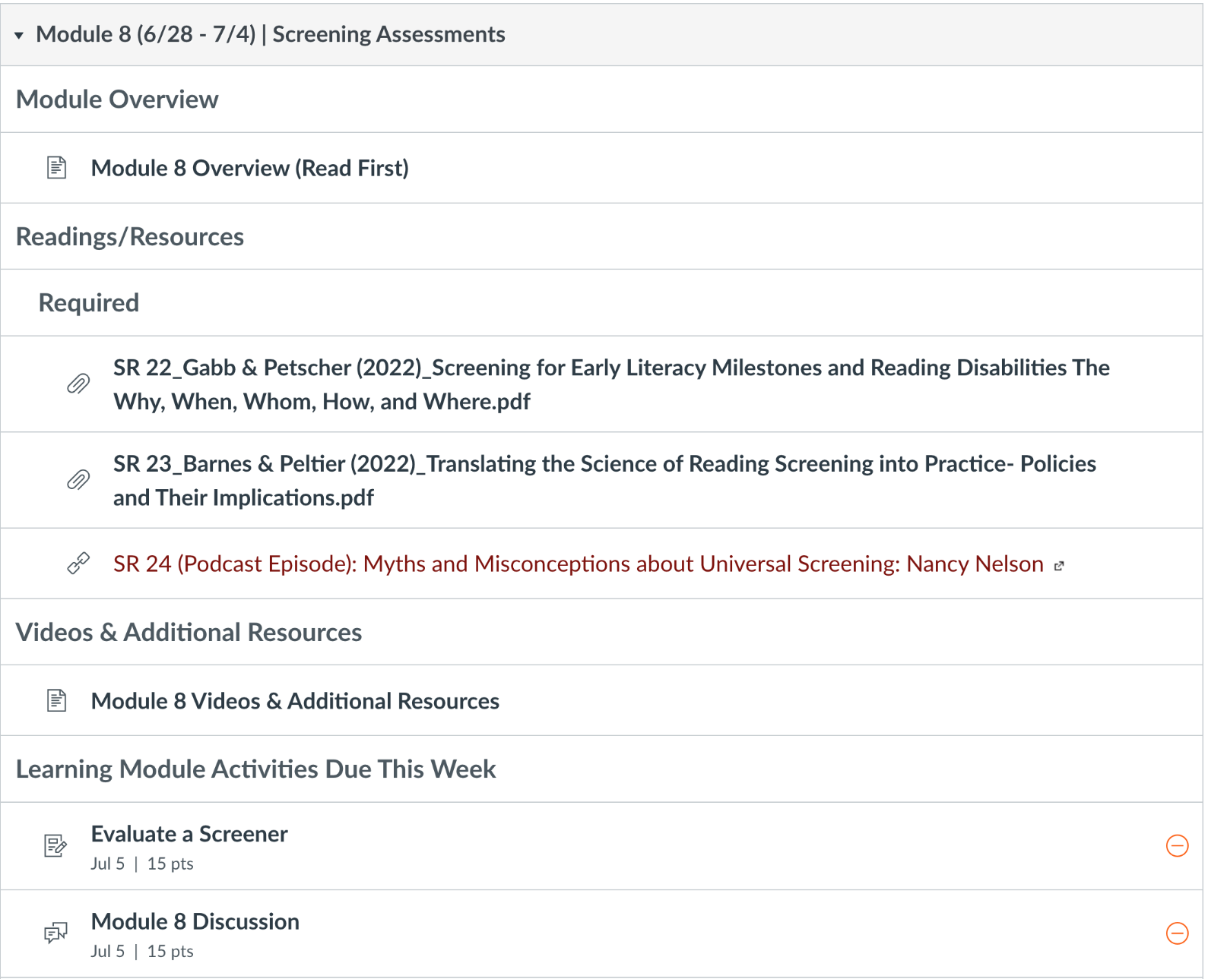
Screening

Slide 31
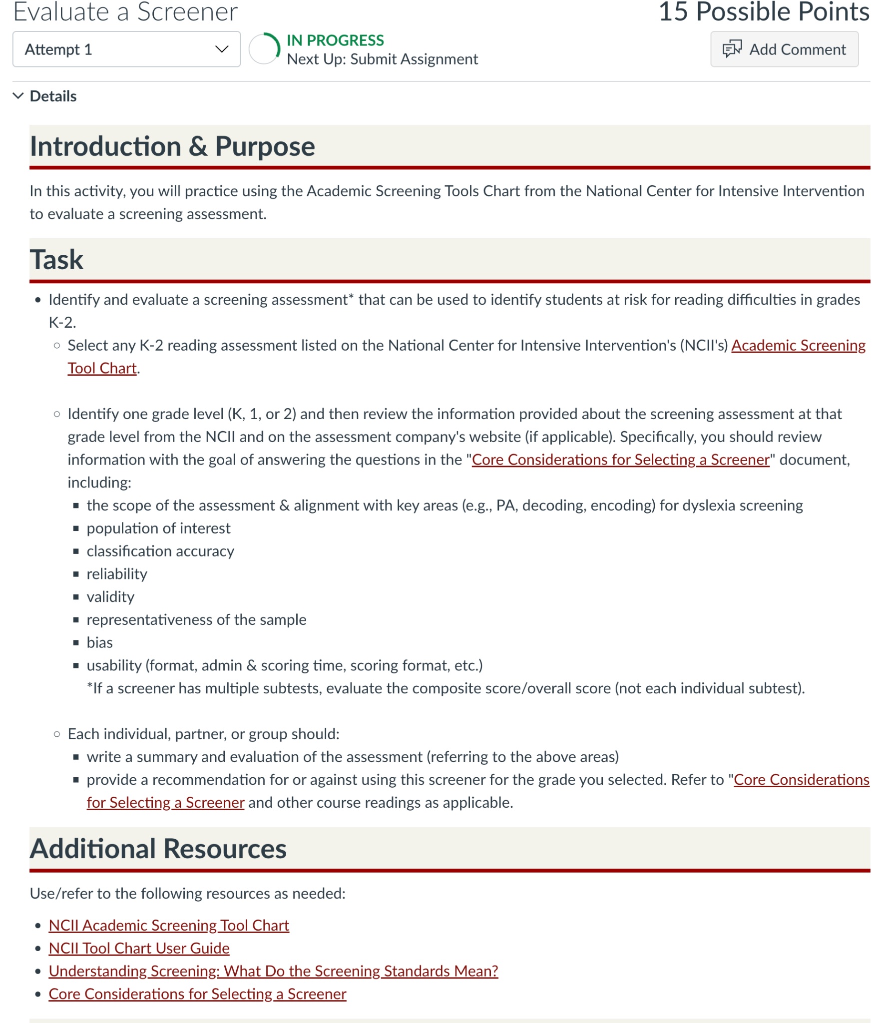
Screening Continued

Slide 32
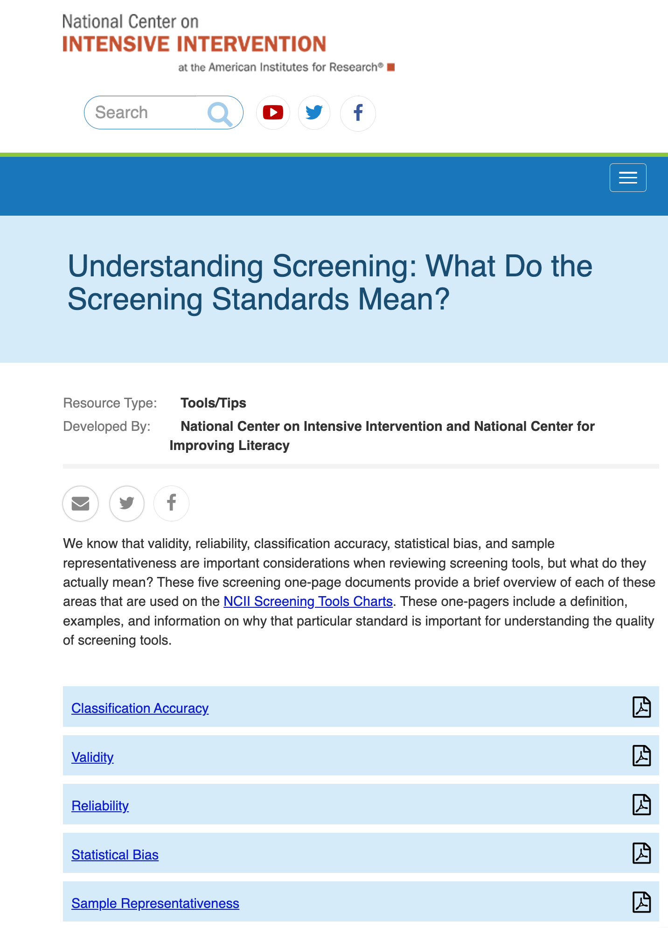
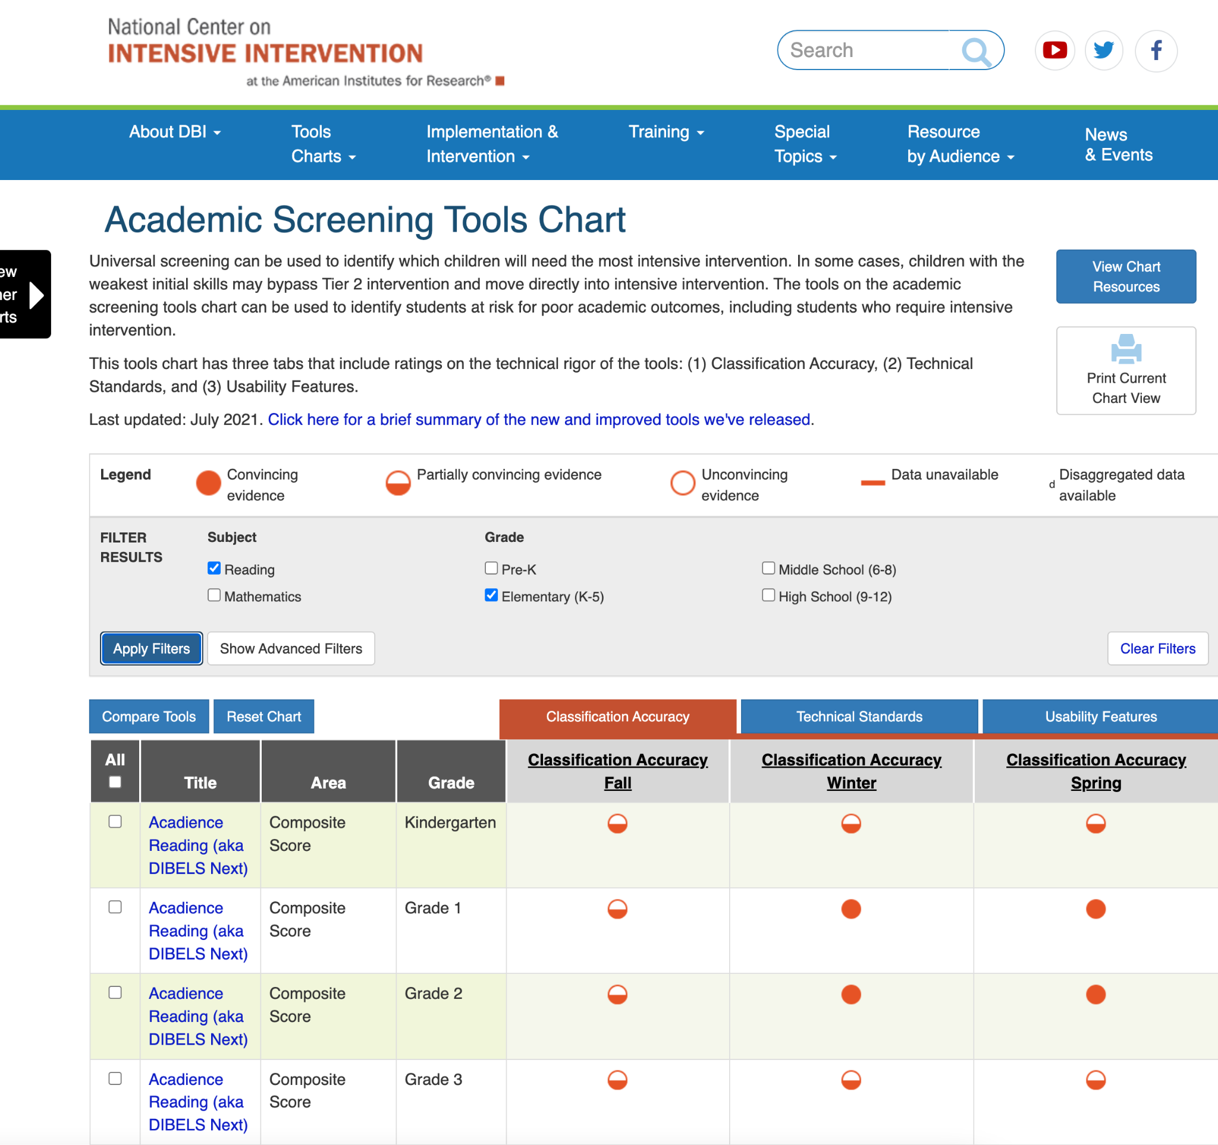
NCII Screening Resources

Slide 33
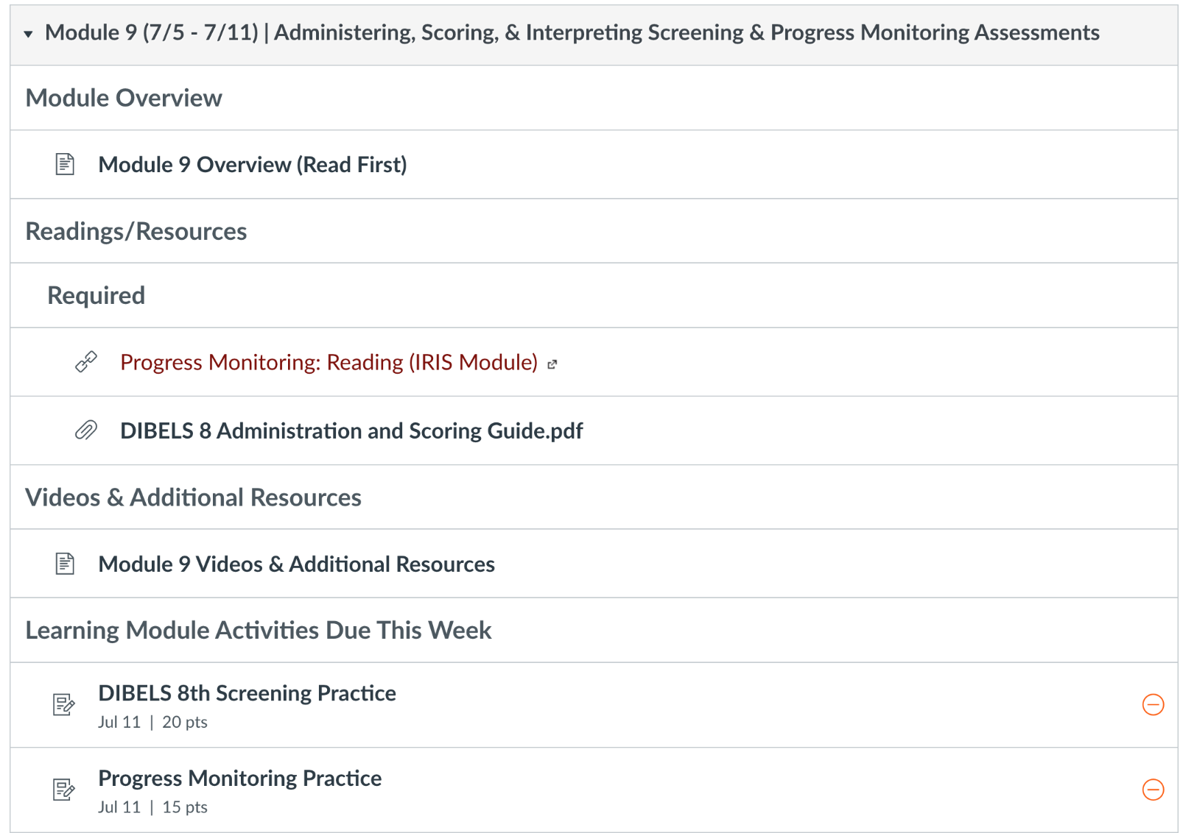
Curriculum-Based Measures (CBMs)

Slide 34
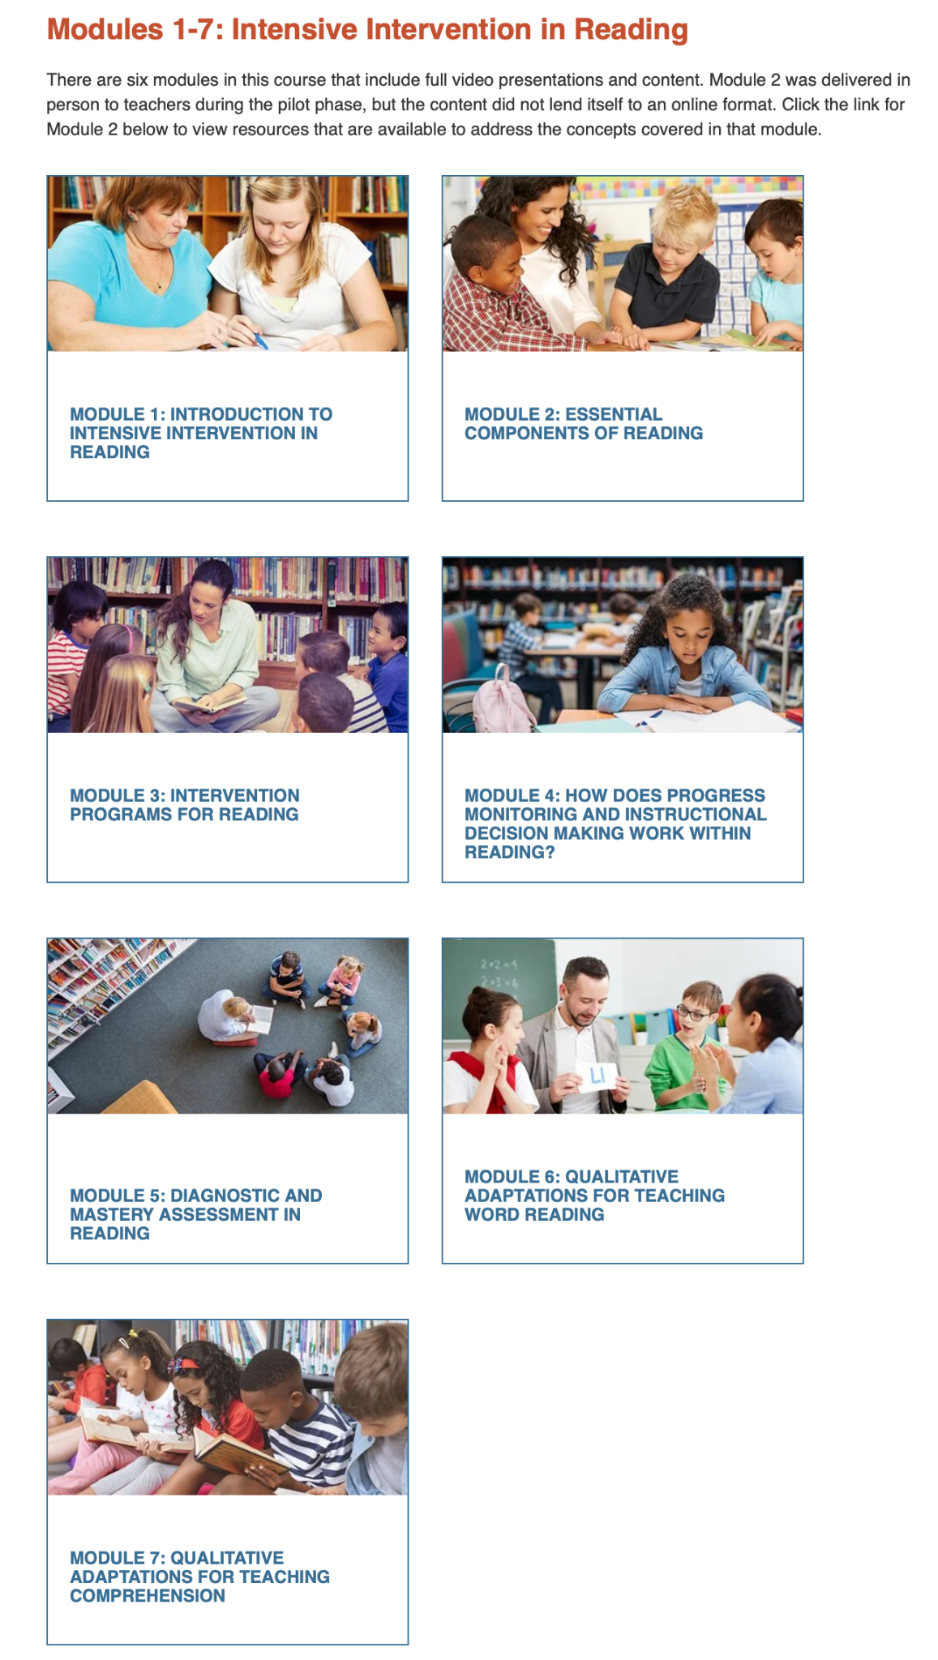
NCII Intensive Intervention in Reading Course

Slide 35
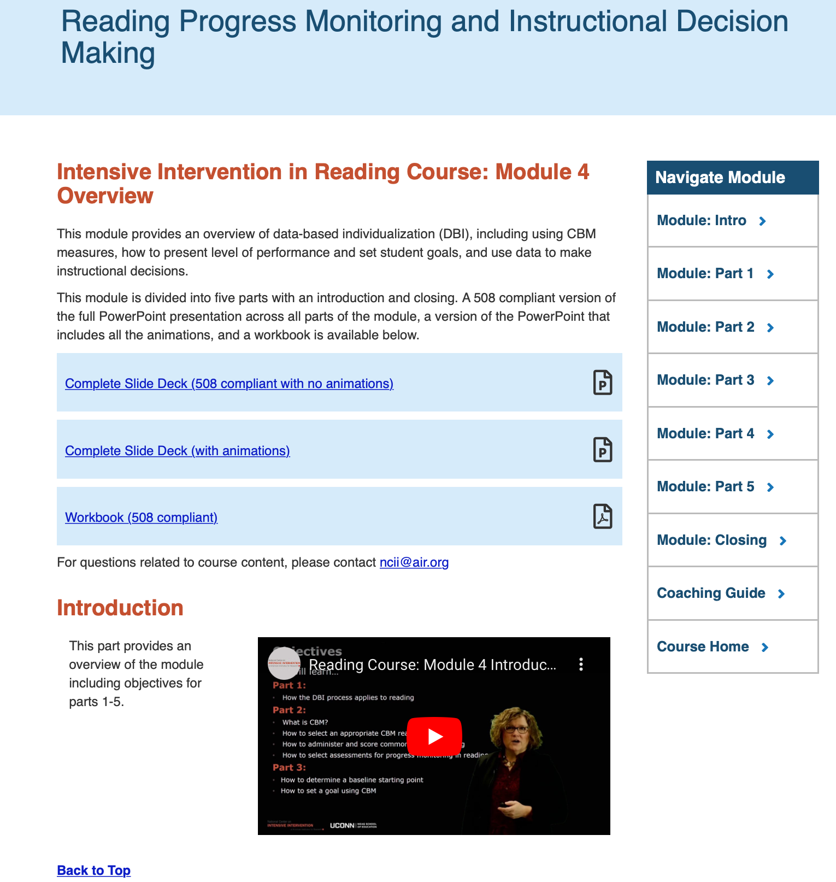
Adding NCII Resources to Canvas

Slide 36
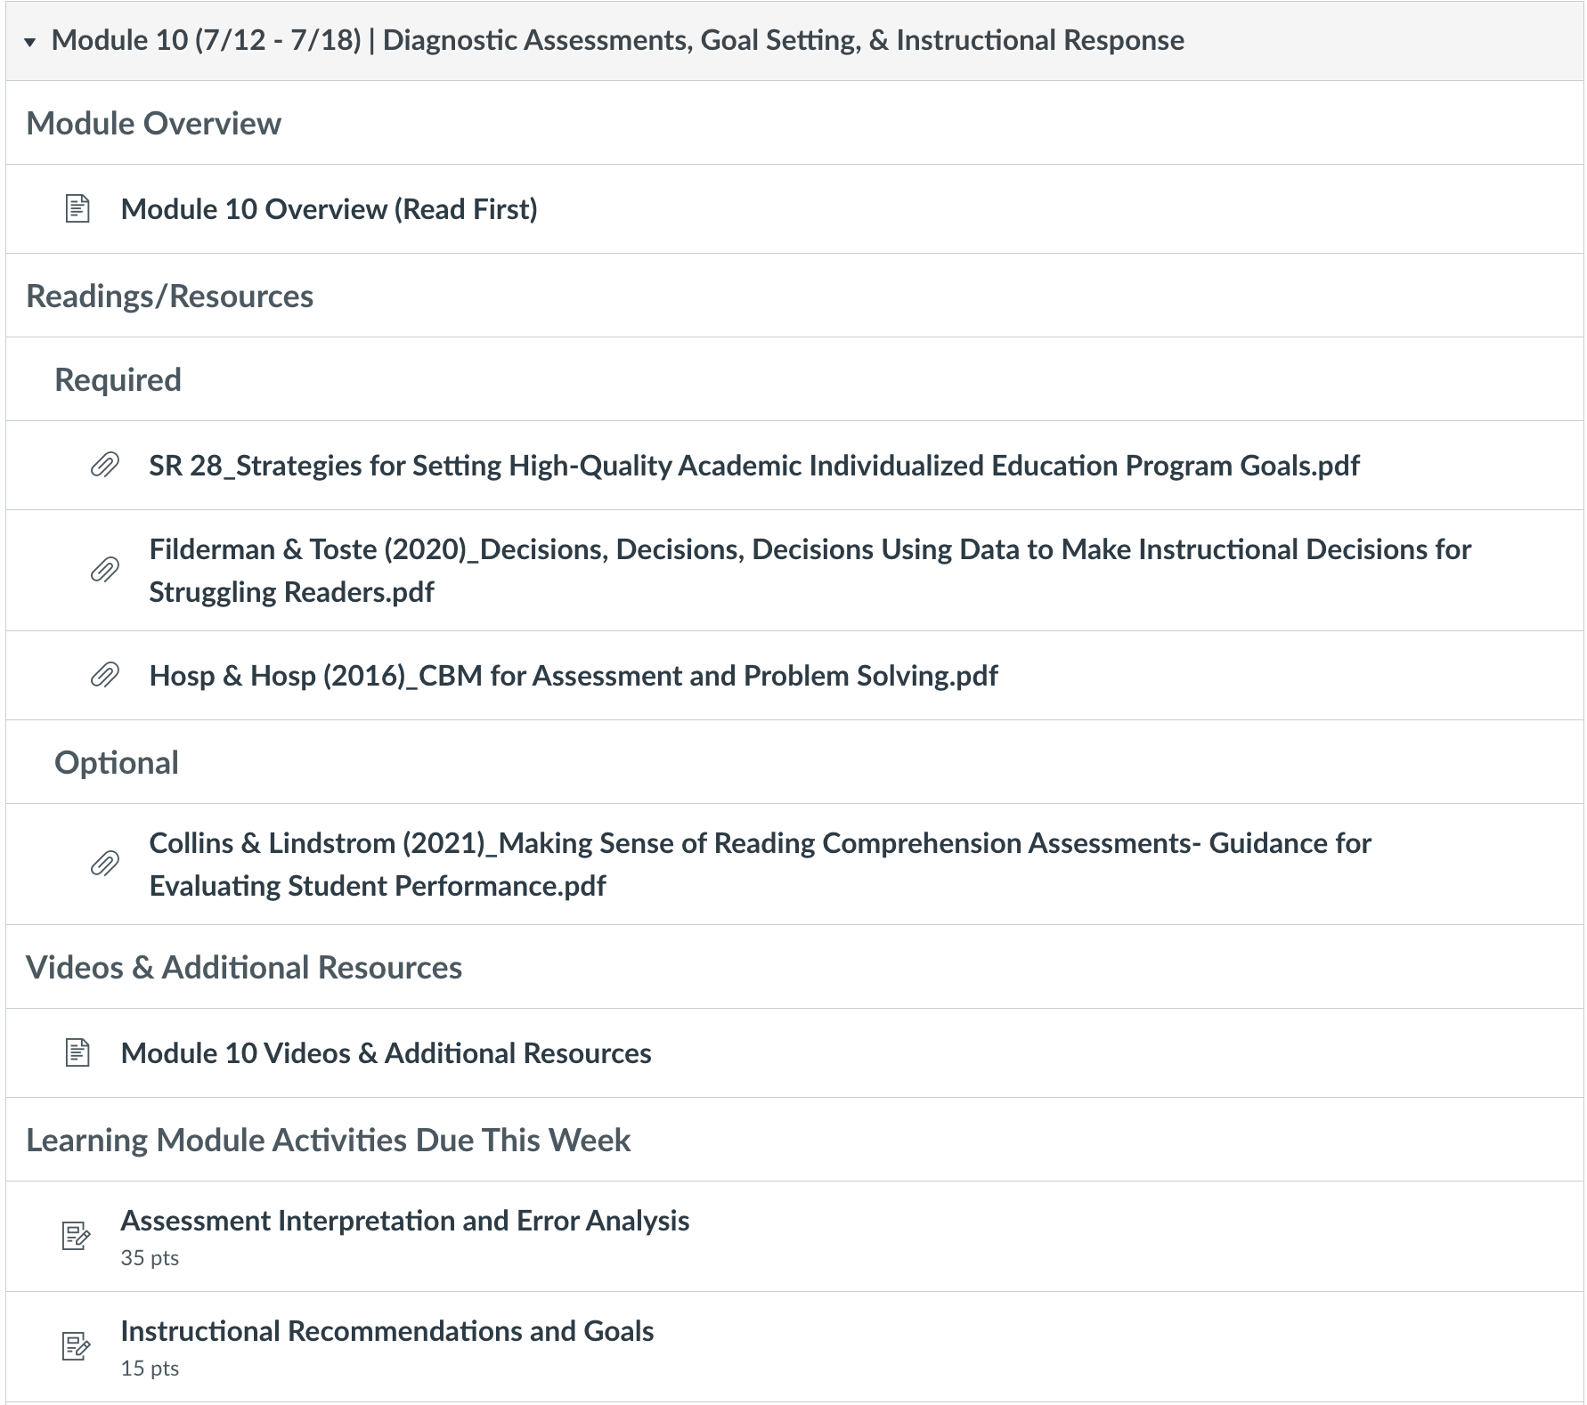
Diagnostic Data and Goal Setting

Slide 37
NCII Goal Setting Resources
Webinar and Slides

Slide 38
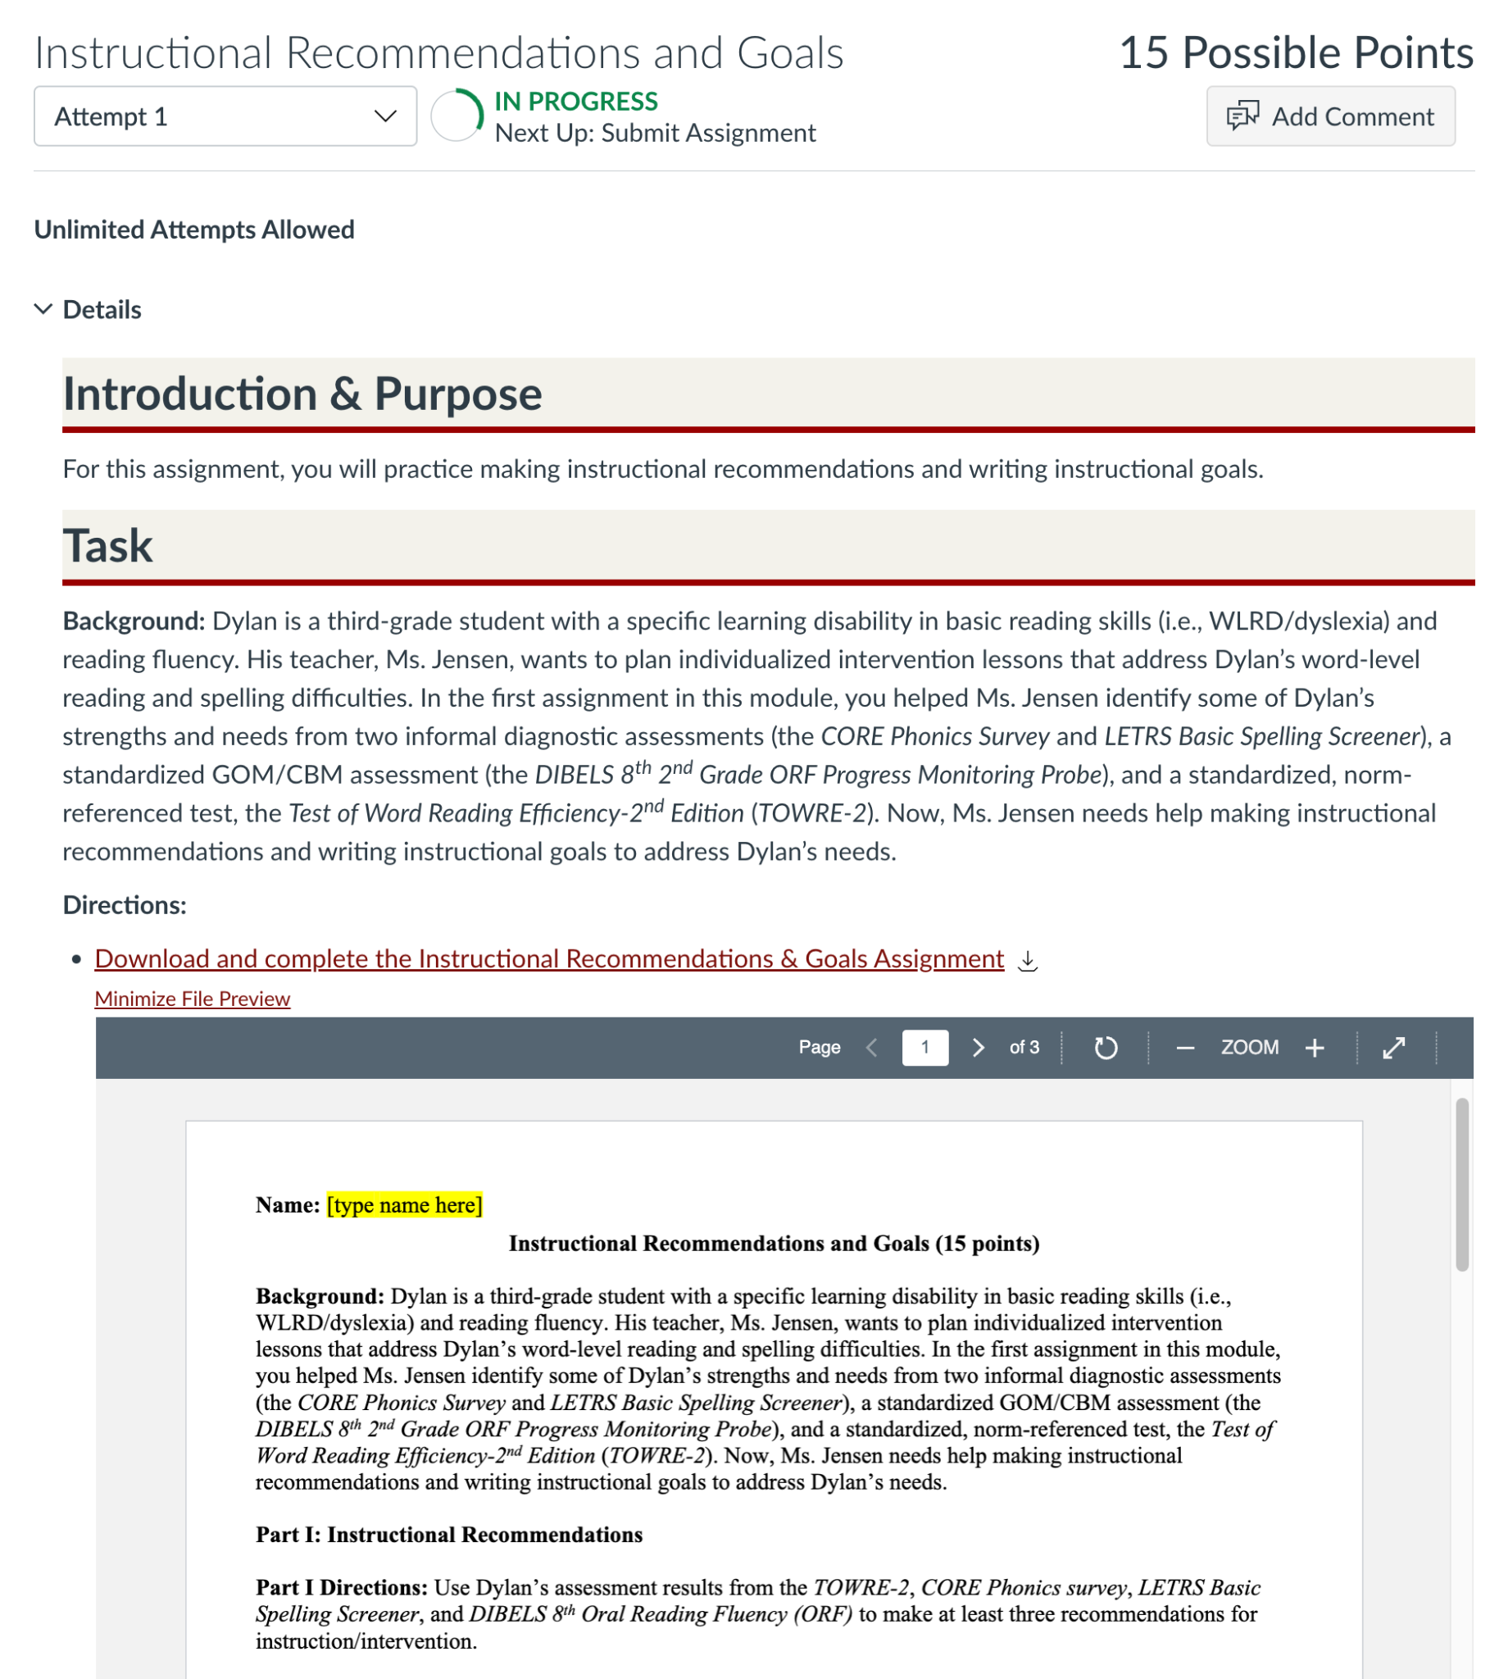
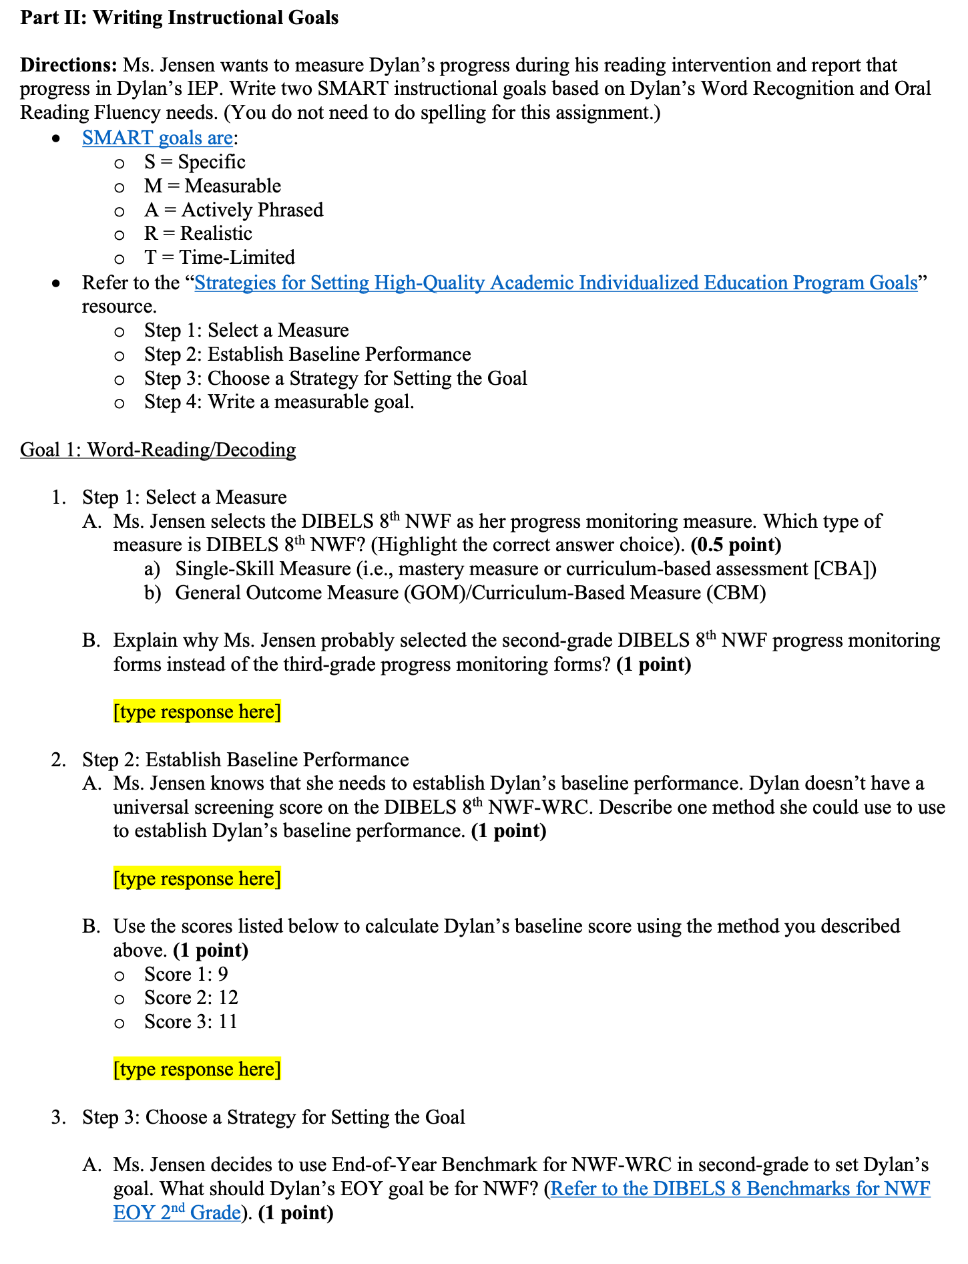
Instructional Recommendations and Goal-Setting

Slide 39
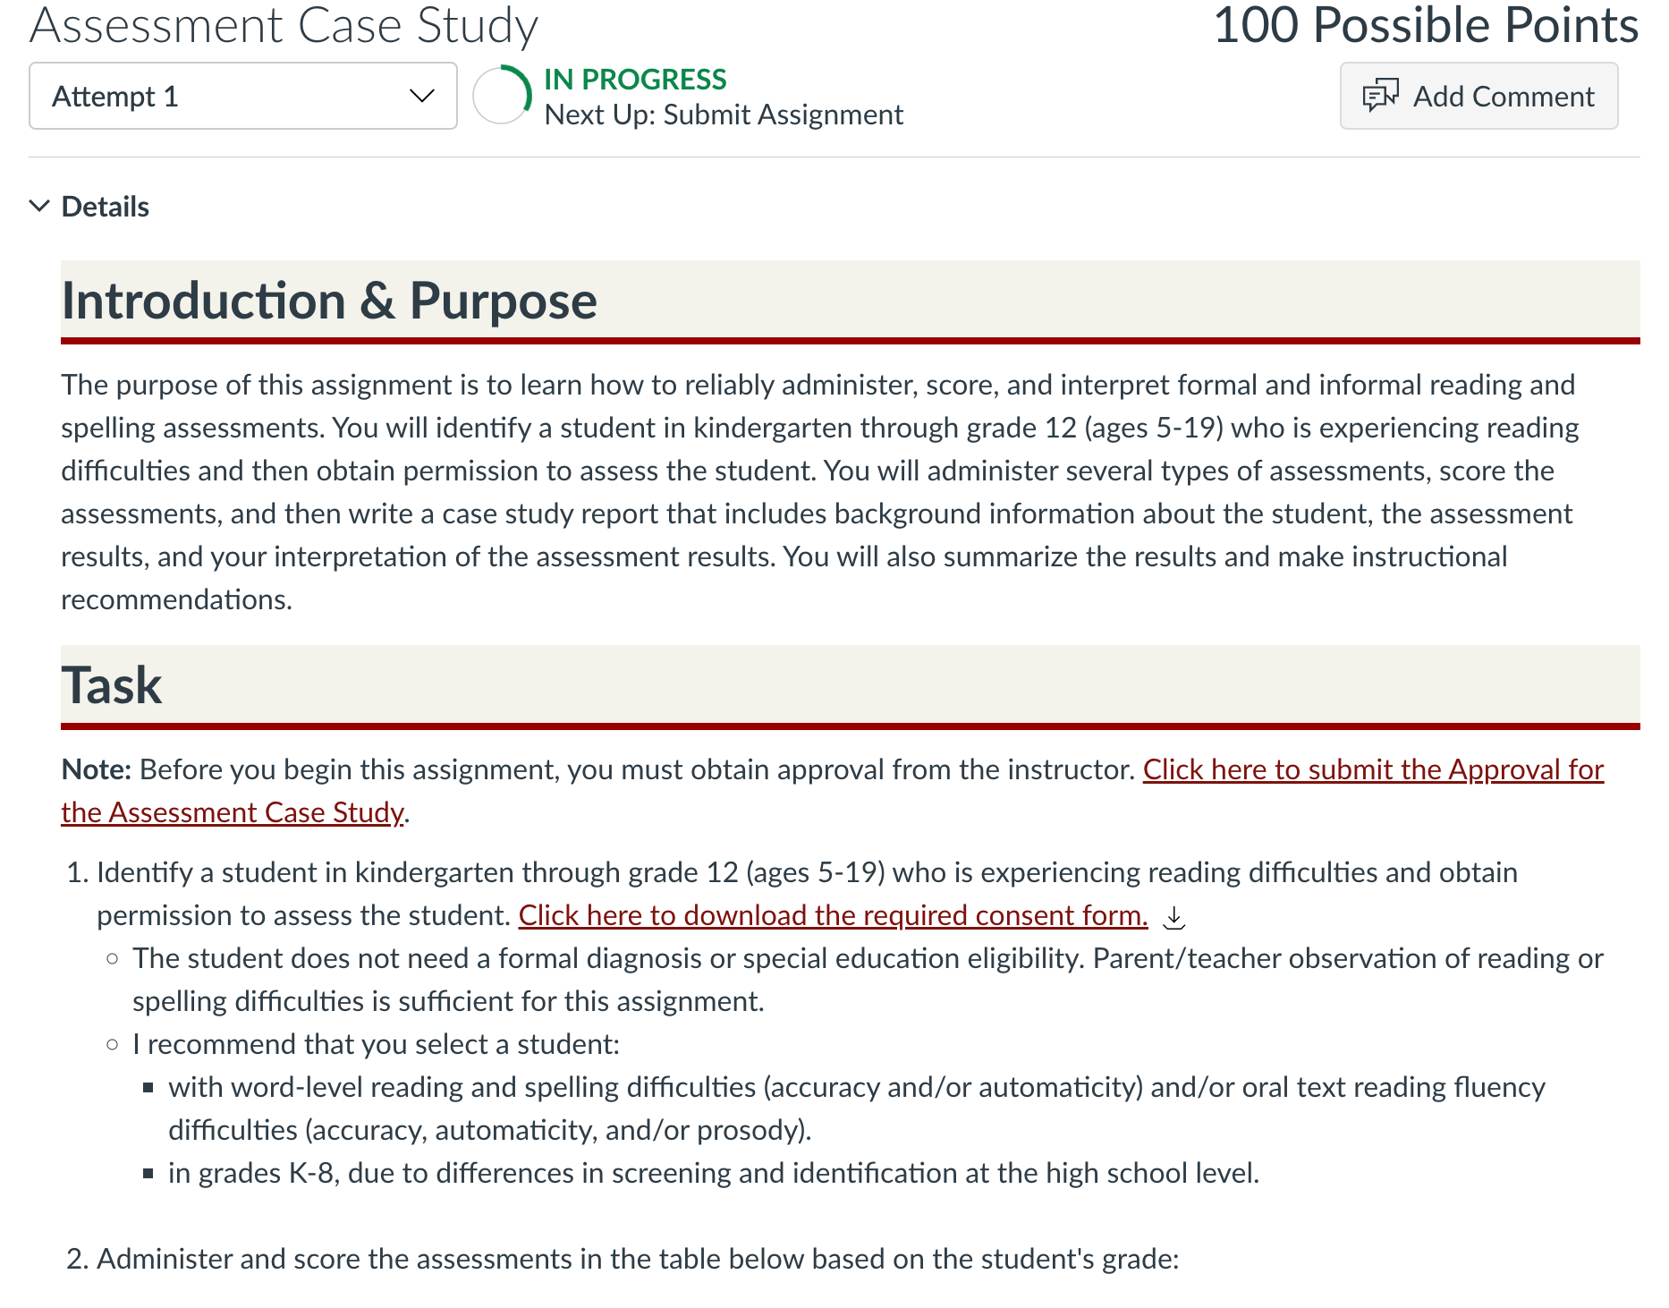
Putting It All Together: The Final Project

Slide 40
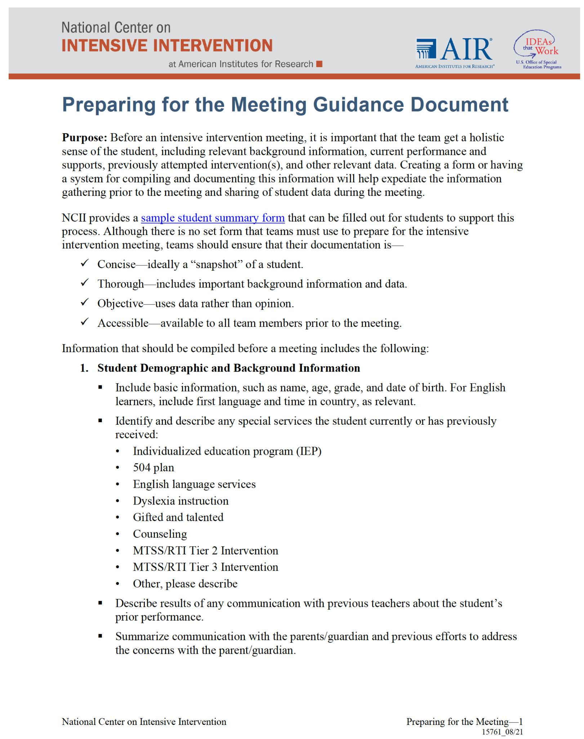
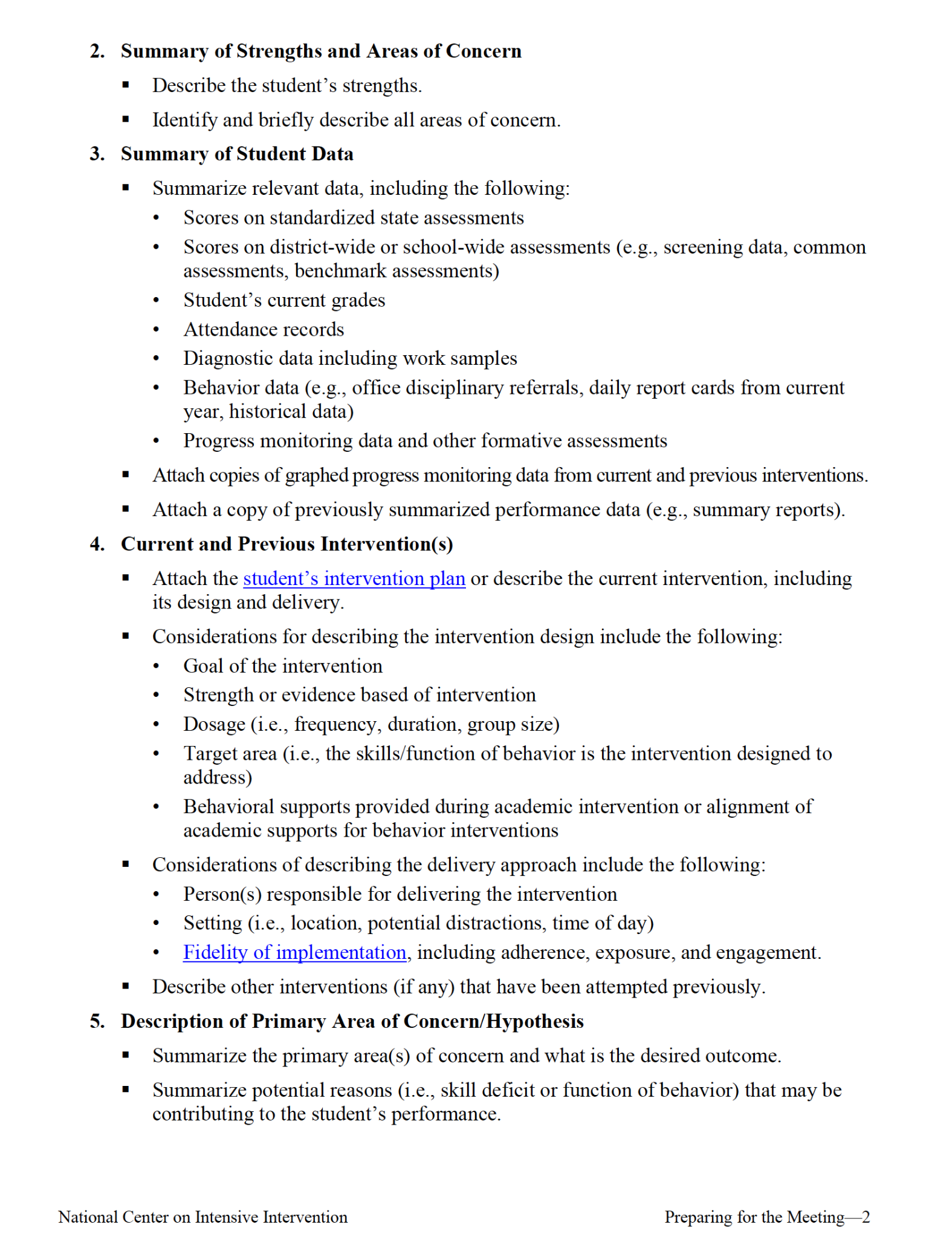
NCII Resources for the Final Project

Slide 41
Developing an Intensive Intervention Plan
Dr. Denise Callwood-Brathwaite

Slide 42
Intervention Pre-Planning Phase
Assignment Instructions: Given the struggling reader, it is necessary for your intensive intervention plan to be individualized. Based on the assessment data, develop an 8-week intervention plan, and include the following as part of your plan.
Describe the selected student’s literacy area(s) of weaknesses needing intervention.
Describe your process for selecting the intervention for the selected student.
Describe your process for adapting the intervention for the selected student.
Describe your general outcome mastery goals (represents the skill to which the student would eventually hope the intervention would transfer) for your selected student.
Describe your mastery monitoring goals (reflects the content of the instruction and what should be taking place during the intervention).
Describe the progress monitoring tool(s) selected.
Describe the important components of your intervention that you will execute (your peers will assess these when reviewing your videoed sessions).

Slide 43
NCII Resources Used in Intervention Pre-Planning
Component | NCII Resources
Self-Assessment | DBI Implementation Rubric and Interview
Selecting and Evaluating Validated Interventions | Taxonomy of Intervention Intensity Academic Rating Rubric and Academic Intervention Tools Chart
Planning and documentation of dimensions of the intervention | Student Intervention Plan or Small Groups or Individuals
Student demographic and background information | Student Summary Information
Specific Skill Instruction and Mastery Measure Plan | Skills Analysis in Reading and Spelling

Slide 44
Sample Intervention Plan

Slide 45
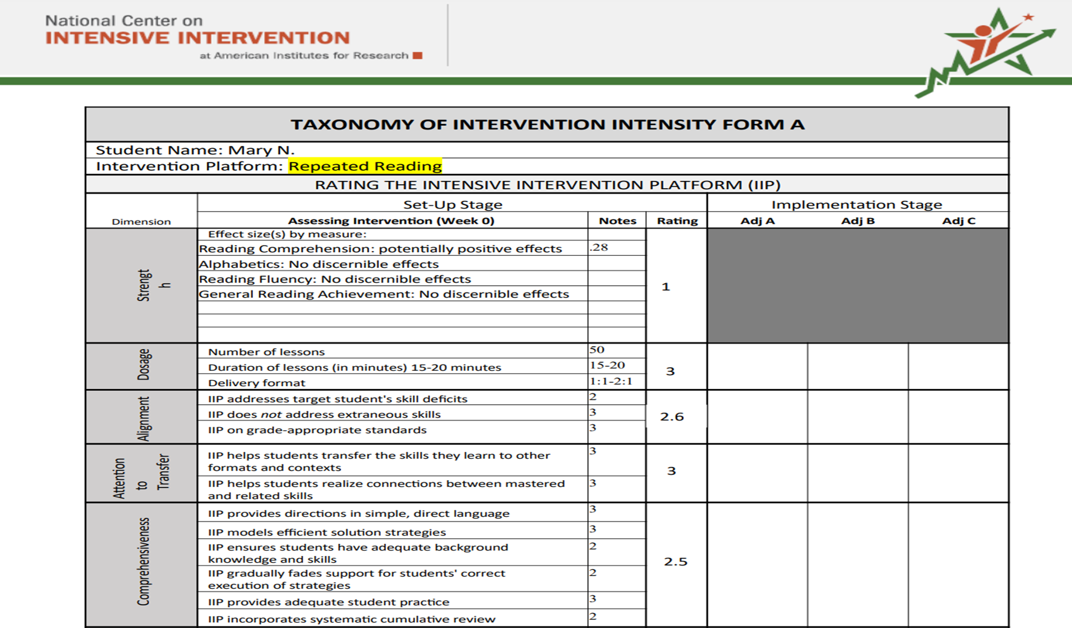
Sample Taxonomy Rating Rubric

Slide 46
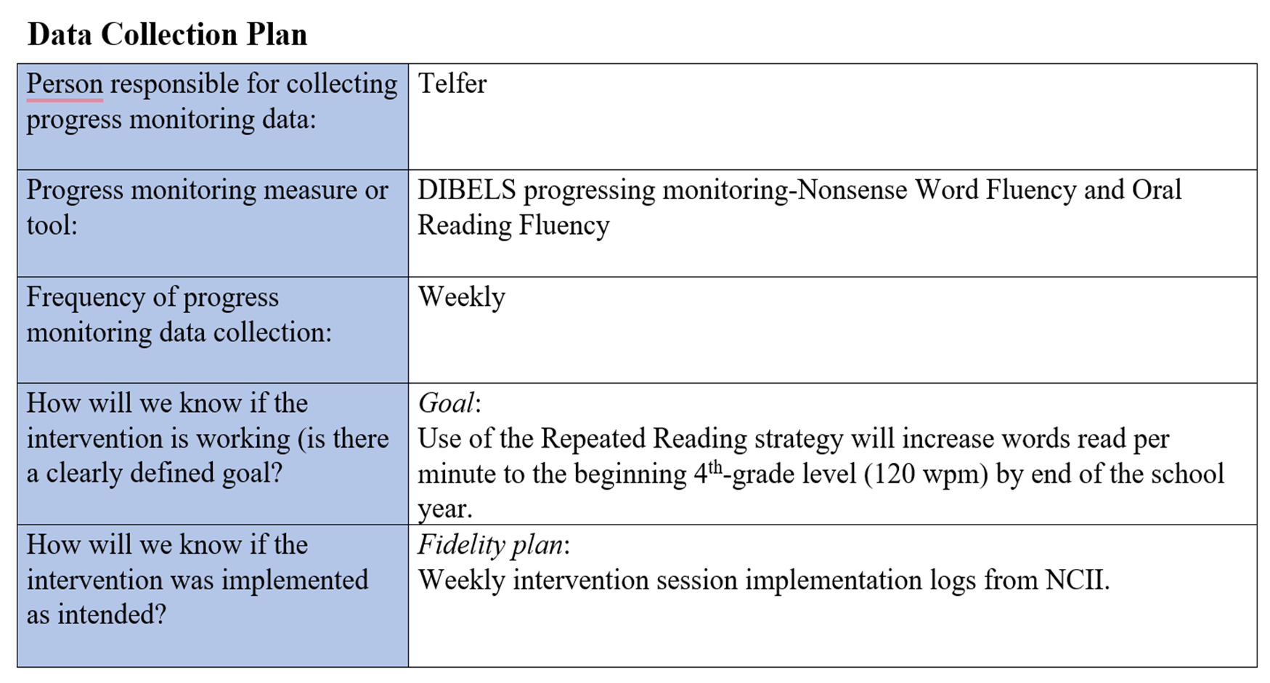
Sample Data Collection Plan

Slide 47
NCII Resources Used in the Intervention Phase
Component | NCII Resources
Adapting the intervention | Intervention Intensification Strategy Checklist
Monitoring fidelity | Five Elements of Fidelity: Data Collection
Documenting student progress | Student Intervention Implementation Log
Reflecting on instruction | Intervention session videos (guide developed from implementation logs)

Slide 48
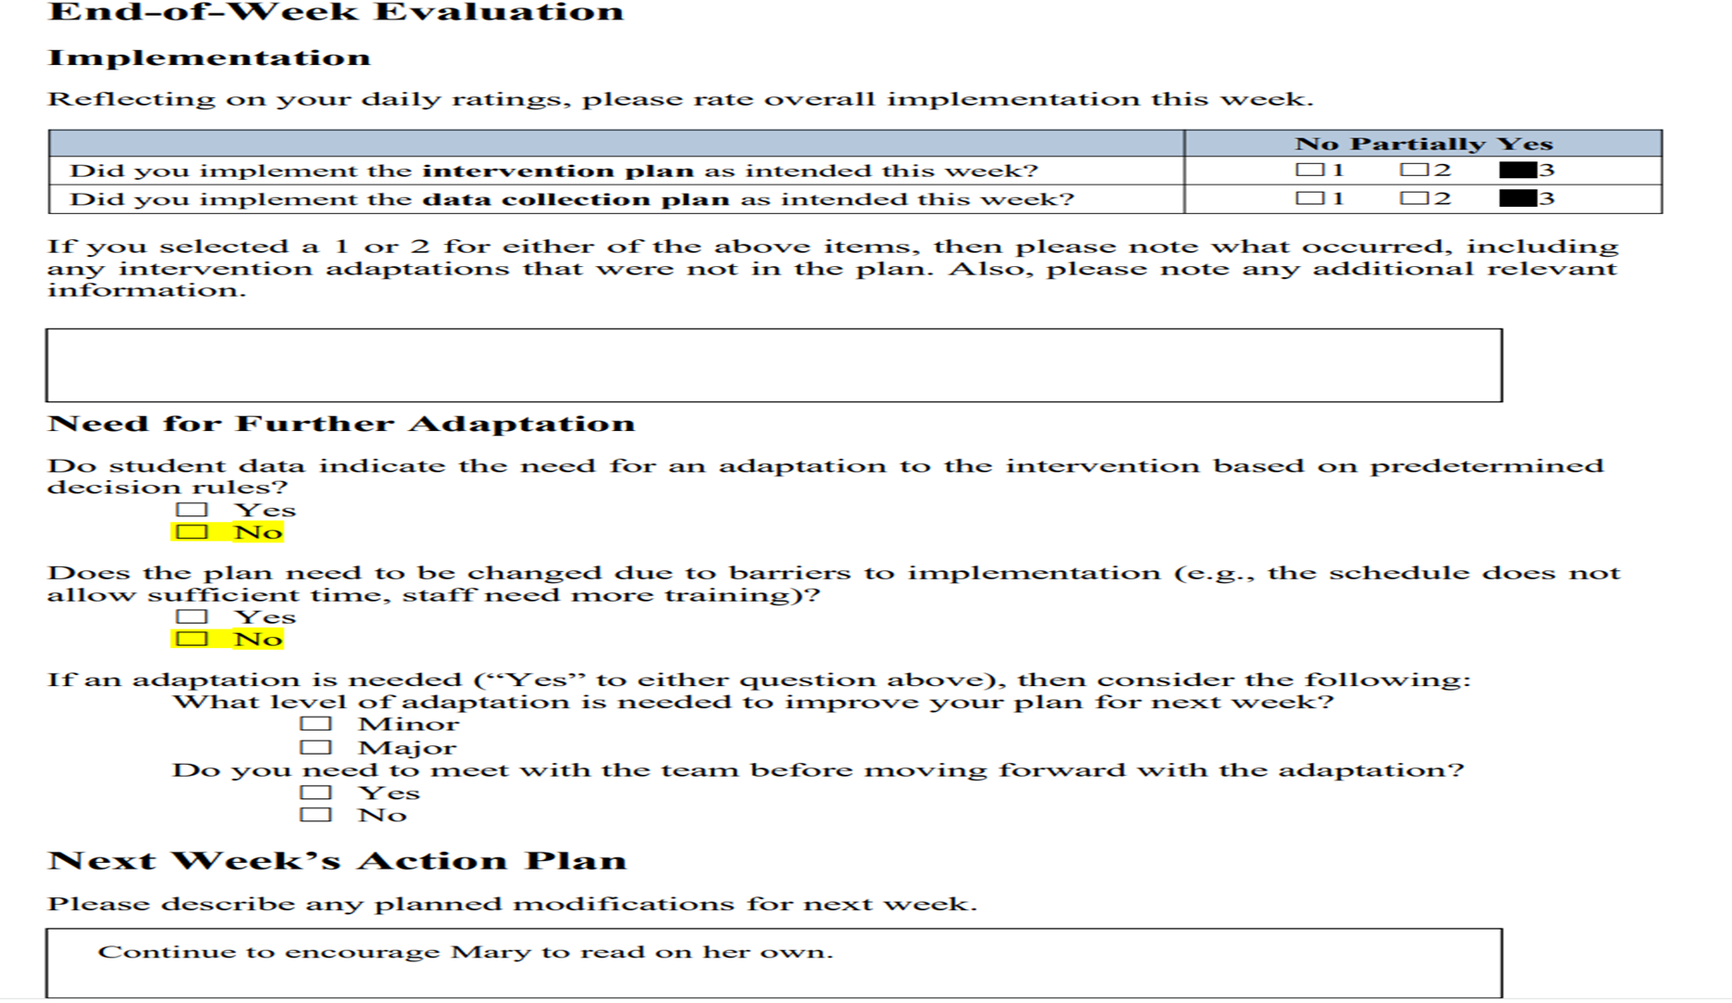
Sample Implementation Log

Slide 49
Sample Intervention Video Session Notes and Reflection

Slide 50
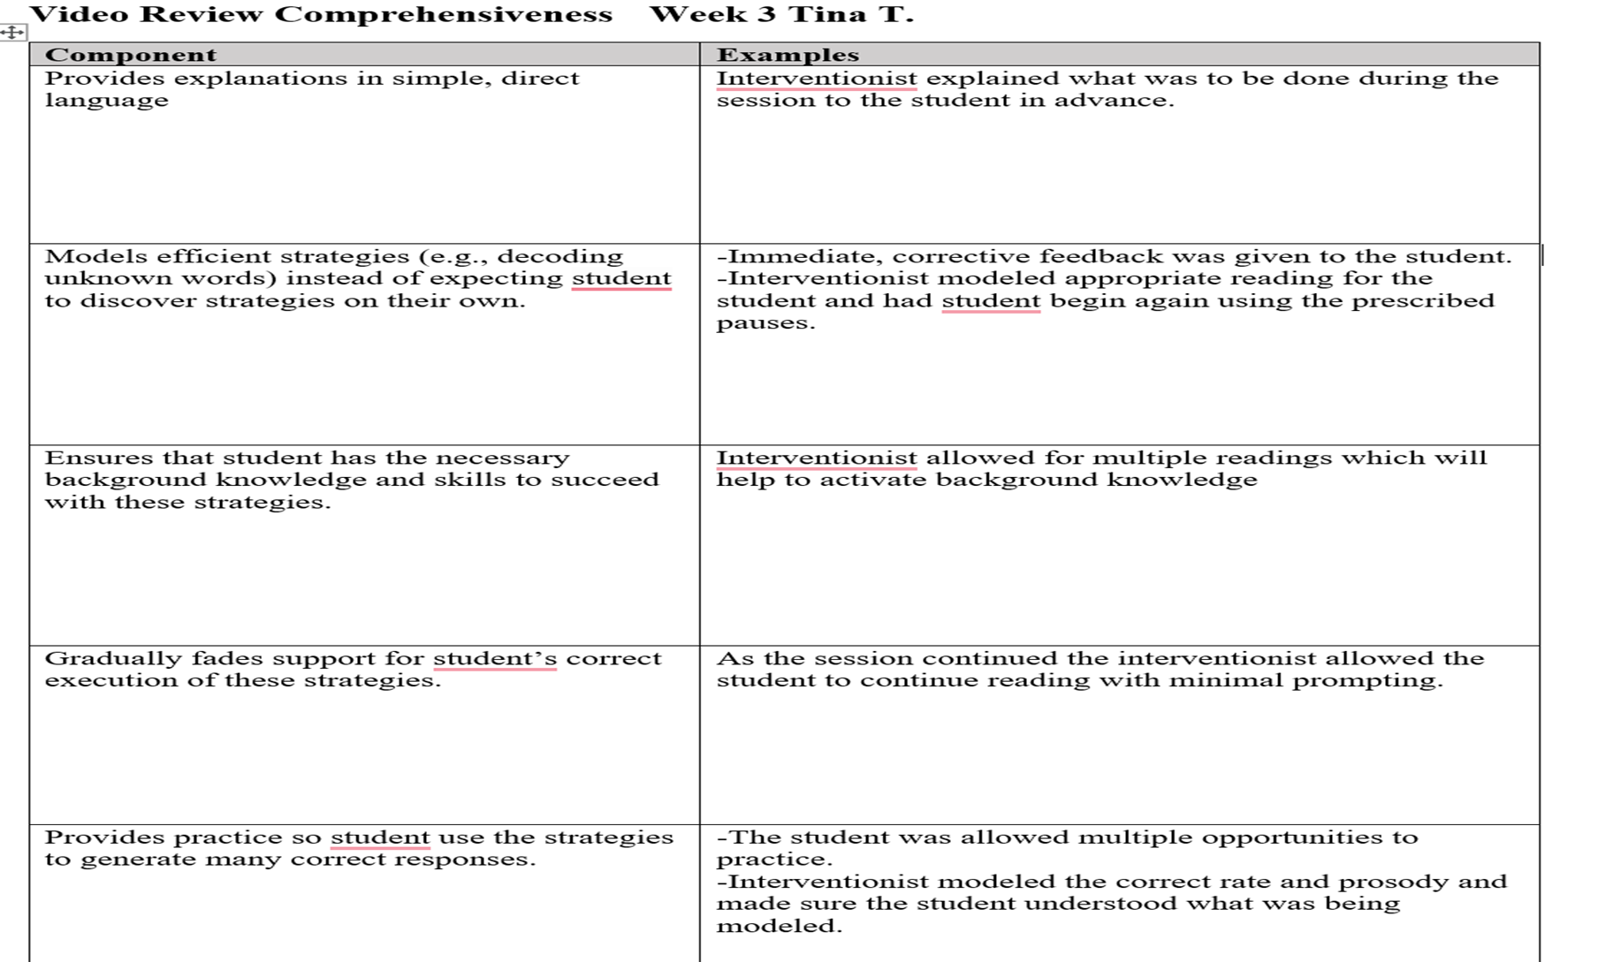
Sample Observation Feedback

Slide 51
Questions and Answers

Slide 52
Thank you

Slide 53
References
Gersten, R., Compton, D., Connor, C. M., Dimino, J., Santoro, L., Linan-Thompson, S., & Tilly, W. D. (2009). Assisting students struggling with reading: Response to intervention and multi-tier intervention for reading in the primary grades (NCEE 2009-4045). U.S. Department of Education, Institute of Education Sciences, National Center for Education Evaluation and Regional Assistance. https://ies.ed.gov/ncee/wwc/PracticeGuide/3
Kuchle, L. B., & Riley-Tillman, T. C. (2019). Integrating behavior and academics in intervention planning. In R. Z. Edmonds, A. G. Gandhi, & L. C. Danielson (Eds.), Essentials of intensive intervention (pp. 51–70). The Guilford Press. ​
Morando-Rhim, L. & Ekin, S. (2021). How has the pandemic affected students with disabilities? A review of evidence to date. Center on Reinventing Public Education. https://crpe.org/wp-content/uploads/final_swd_report_2021.pdf
National Center on Intensive Intervention. (2013). Data-based individualization: A framework for intensive intervention. American Institutes for Research. https://intensiveintervention.org/resource/data-based-individualization-framework-intensive-intervention

Slide 54
NCII Disclaimer
This presentation was produced under the U.S. Department of Education, Office of Special Education Programs, Award No. H326Q260001. Celia Rosenquist serves as the project officer. The views expressed herein do not necessarily represent the positions or policies of the U.S. Department of Education. No official endorsement by the U.S. Department of Education of any product, commodity, service, or enterprise mentioned in this resource is intended or should be inferred.

