Slide 1
Intensive Intervention in Mathematics
Fraction Concepts and Procedures
Copyright © 2020 American Institutes for Research. All rights reserved.
Notes:
The purpose of this module is to focus on the importance of fractions, including the prerequisite skills. Fractions have been cited as a key skill that students need in order to be more successful in advanced mathematics skills, including algebra. This module is designed to be completed during a full-day professional development, or it may be broken into smaller chunks. The afternoon is a chance for teachers to apply what was learned in the morning to math-specific case examples. These cases may also be given as part of this training and then discussed at a later time.
The handout includes background information, graphs to analyze, vocabulary tables, and student case studies.
Instructions for using the speaker notes
• Text formatted in standard font is intended to be read aloud or paraphrased by the facilitator.
• Text formatted in italics is intended as directions or notes for the facilitator; italicized text is not meant to be read aloud.
• Text formatted in underline indicates an appropriate time to click to bring up the next stage of animation in an animated slide.
Welcome participants to the training. Introduce yourself (or selves) as the facilitator(s) and briefly cite your professional experience in regard to mathematics instruction and intensive academic intervention in mathematics.
Although permission to reprint this publication is not necessary, the citation should be as follows: i3 Intensive Intervention in Mathematics. (2020). Intensive intervention in mathematics. Fraction concepts and procedures. Washington, DC: Education Innovation and Research Program, U.S. Department of Education.

Slide 2
Agenda
Morning
Fraction Content
  Why are fractions so difficult?
  Concepts vs. Procedures
  Fraction Vocabulary
  3rd-, 4th-, and 5th-grade CCSS in Fractions
Common Fraction Misunderstandings
  Whole Number Bias
Evidence-Based Curricula: Tier 2 Interventions
  Fraction Face Off! – Tier 2 program – Full training next fall
  TransMath® – Tier 1 program for struggling math students
Afternoon
Error Analysis and Student-Level Planning
  Case Examples
  Determining and Practicing Evidence-Based Approaches
Notes:
[Read slide.] This is a suggested agenda and can be altered to fit your needs.

Slide 3
Learning Outcomes
Participants will:
Understand challenges for students with mathematics difficulties when learning content in the fraction domain, specifically:
  Characteristics of fractions that make them difficult
  Concepts vs. procedures
  Mathematics vocabulary
  Whole number bias
Review two evidence-based curricula and discuss common strategies for increasing understanding of fractions
Apply error analysis to fraction procedure problems
Design instruction for specific error patterns
Notes:
[Read slide.]

Slide 4
Fraction Content
Notes:
[Read slide.]

Slide 5
Why Are Fractions So Difficult?
“The bane of elementary school students is, without a doubt, the fact that the concept of a fraction, unlike that of whole numbers, is an abstraction. Whereas the learning of whole numbers can be grounded on the counting of fingers, there is no obvious replacement of one’s fingers for the learning of fractions (p. 174).”
— Wu (2010)
Notes:
[Read slide.]

Slide 6

Learning a New Representation in Relation to Magnitude
One number is represented by two numerals separated by a fraction bar.
$\frac{3}{4}$ vs. 4
Numbers of the same magnitude can look different.
$\frac{3}{4}$ $\frac{9}{12}$ $\frac{15}{20}$ $\frac{75}{100}$
Notes:
Fractions are often difficult for students because it is a new way to think about numbers—for example, the fact that a number is now represented by two numerals, the numerator and denominator. This is new for students. Students are used to seeing numbers as individual digits, such as the number 4 or 168.
Students have been practicing comparing numbers for many years but will not be used to seeing the same value represented. With fractions, there can be many different representations of the same magnitude, whereas with whole numbers, there is not another whole number that can also equal “4.”

Slide 7

Learning a New Representation in Relation to Magnitude
Sometimes, when numerals get bigger, the fraction gets smaller.
$\frac{1}{4}$ $\frac{1}{6}$ $\frac{1}{8}$ $\frac{1}{20}$ $\frac{1}{50}$ $\frac{1}{100}$
BUT, not always the case!
$\frac{2}{4}$ < $\frac{6}{7}$ or $\frac{1}{2}$ < $\frac{11}{12}$
Notes:
[Spend a few minutes having participants consider the fractions on the slide.]
Another important concept and misconception for students is in understanding the relationship of the numerator to the denominator. Mastery of this relationship is crucial in understanding fraction size and magnitude. Specifically, an increase in denominator means that the “size of each piece” gets smaller. One way for students to think about this concept is to practice equal shares and “splitting” up a rectangular candy bar. Many students quickly see that the more people they need to share the item with, the smaller the pieces.
In addition, students must evaluate magnitude based on a relationship of two numbers instead of by the whole number counting scheme. For many students, they simply revert to what they know about numbers—meaning the larger the number, the greater the value, rather than understanding the relationship of the part to the whole. As students progress in understanding fractions, they must combine their knowledge of magnitude as well as equivalency.

Slide 8
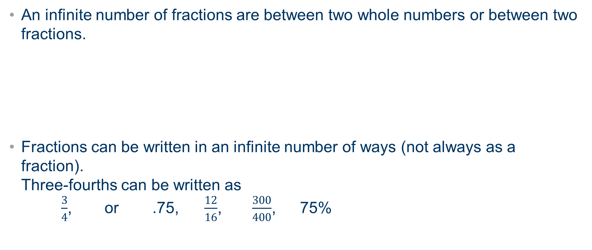
The Idea of Infinity Must Be Expanded in Two Key Ways
  An infinite number of fractions are between two whole numbers or between two fractions.
  Fractions can be written in an infinite number of ways (not always as a fraction).
  Three-fourths can be written as
  $\frac{3}{4}$, or .75, $\frac{12}{16}$, $\frac{300}{400}$, 75%
Notes:
Students have learned to accept infinity with whole numbers in that you can always “add one more.” Therefore, the number sequence keeps going and going, to infinity. With fractions, students now have to accept the idea of infinity in that you can always “split the number again” or “divide something into one more part” or more fair or equal shares. A fraction can be represented by many other different fractions, all having the same magnitude. This goes into the understanding that equivalent fractions can and do exist. This goes back to the earlier point: that fractions with the same magnitude can look different.

Slide 9
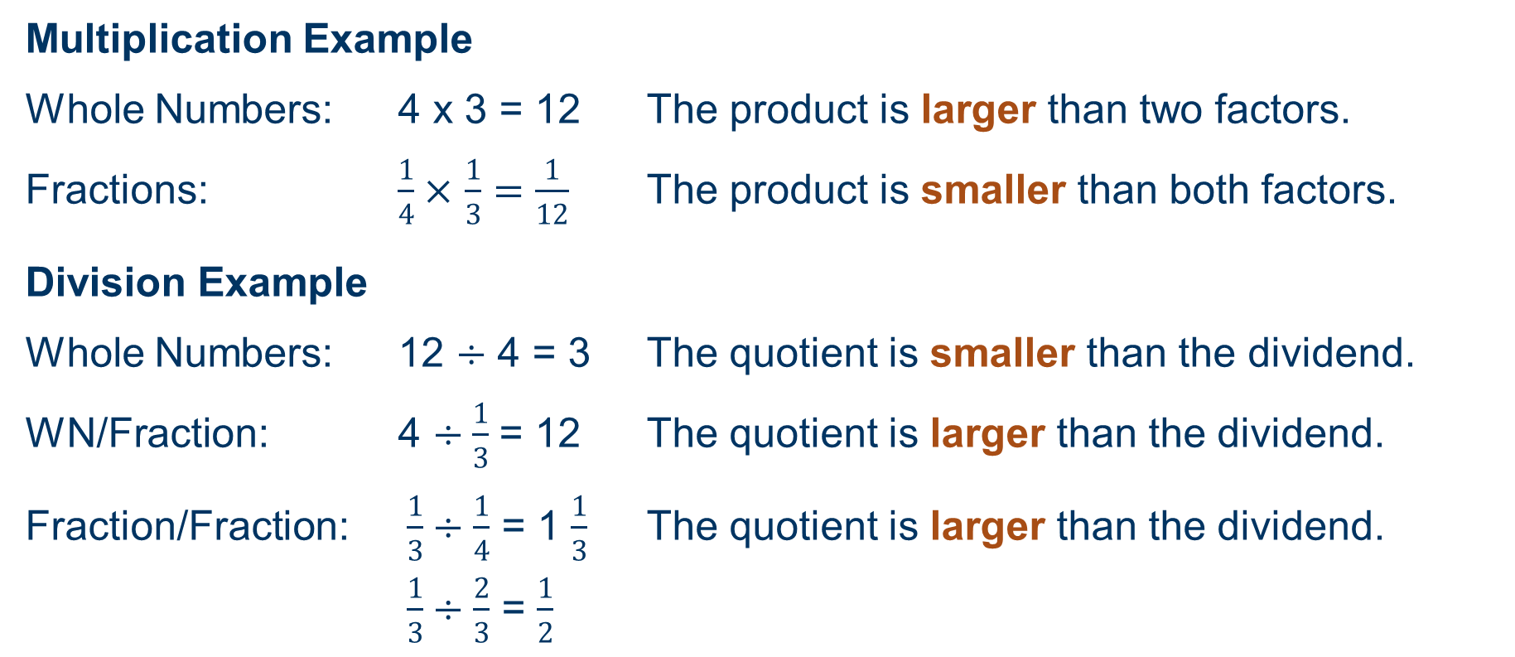
Fraction Operations Can Have a Reverse Pattern to That of Whole Numbers
Multiplication Example
Whole Numbers: 4 x 3 = 12 The product is larger than two factors.
Fractions: $\frac{1}{4}×$ $\frac{1}{3}=\frac{1}{12}$ The product is smaller than both factors.
Division Example
Whole Numbers: 12 $÷$ 4 = 3 The quotient is smaller than the dividend.
WN/Fraction: 4 $÷\frac{1}{3}$= 12 The quotient is larger than the dividend.
Fraction/Fraction: $\frac{1}{3}÷\frac{1}{4}$ = 1 $\frac{1}{3}$ The quotient is larger than the dividend.
$\frac{1}{3}÷\frac{2}{3}$ = $\frac{1}{2}$
Notes:
[Read slide. Review the patterns.]
Consider the patterns on the slide. What causes the greatest confusion for students? With division of fractions, be sure to point out that this pattern is true when the divisor is a proper fraction (<1); 1/3 divided by 4 gives us 1/12, which is smaller and follows the whole number division pattern. Therefore, dividing a number (whole number or fraction) by a FRACTION is what results in the opposite pattern.
Don’t confuse dividend and divisor (look at the last example); the quotient is larger than the dividend but smaller than the divisor.
How practical do you think these patterns are to teach? In what grade do you think these patterns should be taught, and when?

Slide 10
Concepts and Procedures
“Competence in mathematics domains rests on students developing and linking two types of knowledge: Conceptual and procedural.”
— Silver (1986)
Notes:
[Read slide.]
For more information, see:
Rittle-Johnson, B., Siegler, R. S., & Alibali, M. W. (2001). Developing conceptual understanding and procedural skill in mathematics: An iterative process. Journal of Educational Psychology, 93(2), 346.
Silver, E. A. (1986). Using conceptual and procedural knowledge: A focus on relationships. In J. Hiebert (Ed.), Conceptual and procedural knowledge: The case of mathematics (pp. 181–198). Lawrence Erlbaum Associates, Inc.

Slide 11
Conceptual and Procedural Knowledge Continuum
Conceptual Knowledge Procedural Skills
Procedural Skill: Ability to execute action sequences in order to solve problems
Conceptual Knowledge: Implicit or explicit understanding of the principles that govern a domain and the interrelations between units of knowledge in that domain
Source: Rittle-Johnson, Siegler, & Alibali (2001).
Notes:
[Introduction to next activity. Next slide lists concepts and procedures; slide after places them on the continuum.]
Conceptual knowledge and procedural skills are interrelated and often difficult to separate; therefore, let’s consider them on a continuum.
Based on these definitions, let’s generate some examples in fractions for what you consider conceptual knowledge and what you consider to be procedural skills. Let’s place these on a continuum.

Slide 12
Examples of Fraction Concepts and Procedures
Fraction Concepts
Magnitude understanding “fraction number sense”
Representations of fractions
  How the numerator and denominator relate to each other
Fraction equivalence
Fraction (in)equality
When and why common denominators matter
Fraction Procedures
Converting fractions from mixed to improper
Solving word problems with required calculations
Solving inequalities; evaluating magnitude (comparing or ordering)
Calculations
  Add, subtract, multiply, divide
  Includes proper, improper, or mixed numbers
Notes:
[Activity. Have chart paper or give small groups of participants an empty continuum line from the previous slide. Have participants write each concept along the continuum—meaning, is the skill developing more of a conceptual understanding or a procedure? Have teachers add specific examples or additional skills and then share with the larger group.]

Slide 13
Conceptual and Procedural Knowledge Continuum
Conceptual Knowledge Procedural Skills
Fraction (in)equality
Solving inequalities;
evaluating magnitude
The four operations
Fraction equivalence
Representing fractions
When and why common denominators matter
Solving word problems
Converting fractions from
mixed to improper
Magnitude understanding
Notes:
[Following the group share-out, display this slide and compare. Discuss any differences or similarities.]
You have this line in your packet to put the conceptual and procedural skills on the continuum. Consider your continuum and this continuum. How similar did you place the skills? How can this affect your teaching of fractions in core instruction? Intervention? Where do we see misconceptions forming?

Slide 14
Concepts and Procedures Develop Iteratively
Math Understanding
Concepts
Procedures
Concepts
Procedures
“[C]onceptual and procedural knowledge develop in a hand-over-hand process (p. 360).”
— Rittle-Johnson et al. (2001)
Ground in concepts – show procedures – revisit concepts – make connections between the two.
Notes:
Until recently, math instruction—and, specifically, fraction instruction focused on only on procedural skills. Many State standards include components for both concepts and procedures, but many times teachers lack an understanding of how to teach conceptually and procedures.
Rittle-Johnson and colleagues found that “conceptual and procedural knowledge develop in a hand-over-hand process (p. 360).” Gains in one type of knowledge support gains in the other type of knowledge. Instruction should therefore emphasize both.
With this hand-over-hand process, the State Standards should not only emphasize both but also go between and integrate concepts with procedures. I like to think of it as grounding instruction with fraction concepts, then working on procedures and explaining why/how certain rules govern procedures based on these concepts.

Slide 15
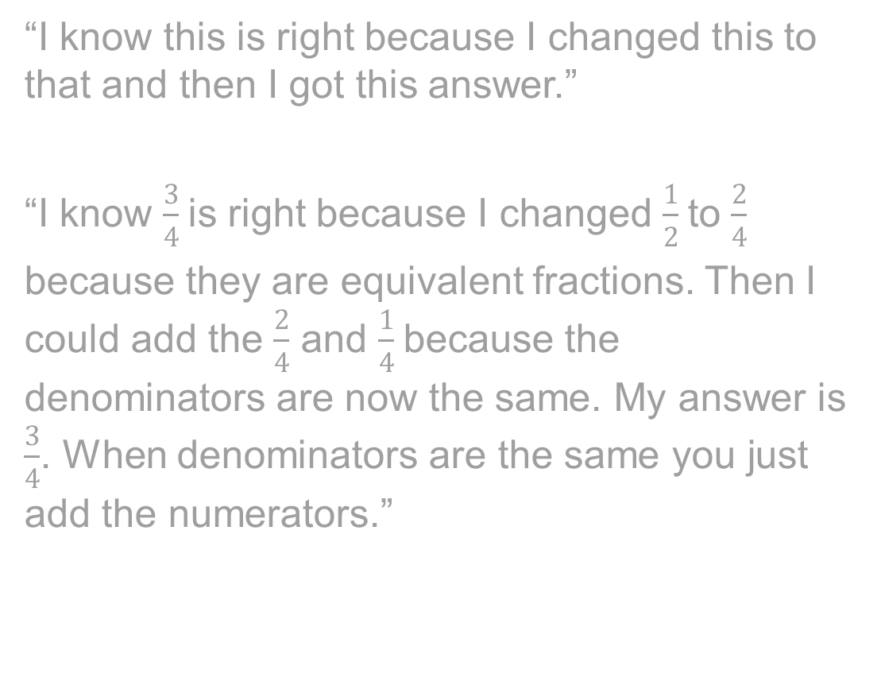
Fraction Vocabulary and Terminology
“I know this is right because I changed this to that and then I got this answer.”
“I know $\frac{3}{4}$is right because I changed $\frac{1}{2}$to $\frac{2}{4}$
because they are equivalent fractions. Then I could add the $\frac{2}{4}$ and $\frac{1}{4}$because the denominators are now the same. My answer is $\frac{3}{4}$. When denominators are the same you just add the numerators.”
Notes:
Animated slide. [Read first quote.] This is a student’s explanation of a problem. Can you guess what this problem might be? Do you feel confident that the student knows what he is doing?
[Click to reveal second quote.] This is another student’s explanation of the same problem. Can you guess what this problem might be? Do you feel confident that this student knows what he is doing?
What are some of the key differences in these explanations?

Slide 16
Mathematics Vocabulary: Why Is it Important?
Comprehending fraction concepts and procedures requires an understanding of specific fraction vocabulary words and terminology.
Using correct fraction vocabulary words enhances the teacher’s ability to precisely explain content to students.
College and career readiness standards and NCTM include understanding precise mathematics terminology in their standards.
Assessment increasingly includes the requirement for students to explain their thinking or their process of problem solving—using correct mathematics vocabulary increases precision.
Notes:
Mathematics has its own language. Using and understanding proper mathematics vocabulary enhances students’ specificity when explaining math concepts and helps pave the way for understanding content in more advanced sequences. Most college and career readiness standards (e.g., Common Core State Standards) and NCTM include the understanding of mathematically precise language as a necessary component. A deeper level of math comprehension is possible when we ask students to explain their work when using precise math vocabulary words, in addition to the teacher modeling math precise vocabulary.

Slide 17
Mathematics Vocabulary: Best Practices
Direct, Explicit Teaching
Student-friendly definition
Examples and nonexamples
Graphic organizers
Vocabulary charts
Use in a meaningful context
Model correct vocabulary during explanations.
Practice the vocabulary in context.
Create word walls or other vocabulary visuals for reinforcement.
Review and reinforce correct mathematics vocabulary.
Notes:
[Read slide.]

Slide 18
Mathematics Vocabulary: Students With MD
  Problem Areas
Students—
    often don’t generalize from definition to symbol.
    tend to use words inappropriately (over- or undergeneralization).
    do not use mathematically precise words (e.g., rely on pronouns: this, that, it).
    are unable to explain how a problem was completed.
  How to help
  Potential of the GRAPHIC ORGANIZER (Frayer model)
    Can be used across content areas.
    Provides a visual.
    Develops a deeper understanding of the word, not just a definition.
Note. MD = math difficulty.
Notes:
[Read problem areas.] For students with math difficulty, the use of graphic organizers, even in math, can be very beneficial. When using graphic organizers, teachers should model student-friendly language; include examples and nonexamples; and use graphs, pictures, and symbols when appropriate. How are you currently teaching math vocabulary?

Slide 19
Example of a Frayer Model for Fraction Vocabulary Term
Unit fraction
Student-friendly definition:
Means “a fraction where the numerator (top number) is 1”
Picture of symbol:
$\frac{1}{2}$ OR $\frac{1}{5}$
Picture of symbol:
1/2 OR 1/5
Example:
$\frac{1}{3}$ OR $\frac{1}{10}$
Example:
1/3 OR 1/10
Nonexample:
$\frac{3}{5}$ OR $\frac{5}{1}$
Nonexample:
3/5 OR 5/1
Notes:
This is a common graphic organizer used across curriculum areas.
For more information on math vocabulary, see the Early Childhood Math presentation on the NCII website, as well as additional math presentations as part of these modules.

Slide 20
Fraction Vocabulary
  Fractions are introduced in the Common Core State Standards curriculum in third grade.
  Integrating fractions into the math curriculum (when up until that point math focused on whole numbers) introduces new and complex vocabulary.
    As teachers, we must define abstract and interrelated concepts when fractions are introduced.
  New terms must be carefully introduced and defined to enable students to access the new material.
Notes:
[Read slide.] Fraction vocabulary requires the teacher to define abstract concepts instead of concrete ideas.

Slide 21
Fraction Vocabulary Activity
List as many fraction vocabulary terms you can think of in 1 minute.
How many did you write down?
Let’s see how we did....
Notes:
[Activity: Have the group brainstorm fraction vocabulary words for 1 minute. After 1 minute, have participants share.]
There is a blank sheet in your packet for this activity.
The next four slides are a way to create or generate a chart in your classroom.
Two purposes: for you to see an example AND for me to be sure all of you know the terms I’ll use during the presentation.

Slide 22
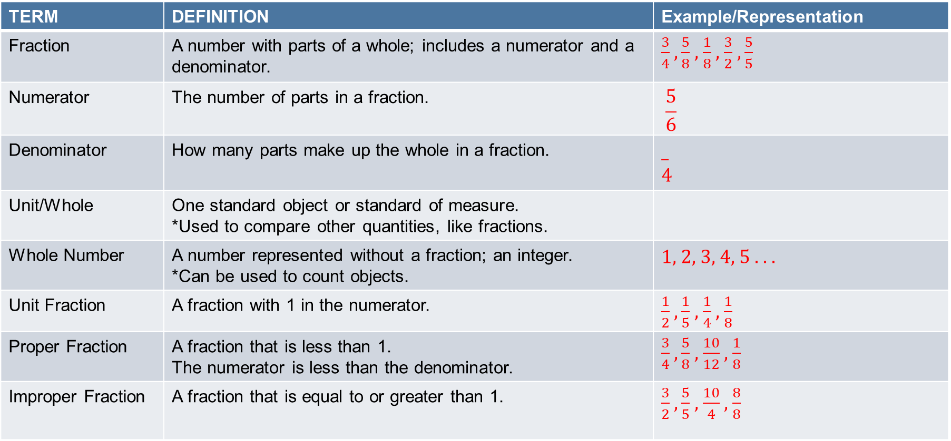
Fraction Vocabulary: Terminology for Concepts
TERM | DEFINITION | Example/Representation
Fraction | A number with parts of a whole; includes a numerator and a denominator. | $\frac{3}{4}$ $, \frac{5}{8}$ , $\frac{1}{8}$ , $\frac{3}{2}$ $, \frac{5}{5}$
Numerator | The number of parts in a fraction. | $$\frac{5}{6}$$
Denominator | How many parts make up the whole in a fraction. | _ 4
Unit/Whole | One standard object or standard of measure. *Used to compare other quantities, like fractions.
Whole Number | A number represented without a fraction; an integer. *Can be used to count objects. | 1, 2, 3, 4, 5 . . .
Unit Fraction | A fraction with 1 in the numerator. | $\frac{1}{2}$ $, \frac{1}{5}$ , $\frac{1}{4}$ , $\frac{1}{8}$
Proper Fraction | A fraction that is less than 1. The numerator is less than the denominator. | $\frac{3}{4}$ $, \frac{5}{8}$ , $\frac{10}{12}$ , $\frac{1}{8}$
Improper Fraction | A fraction that is equal to or greater than 1. | $\frac{3}{2}$ $, \frac{5}{5}$ , $\frac{10}{4}$ , $\frac{8}{8}$
Notes:
[Read slide.]

Slide 23
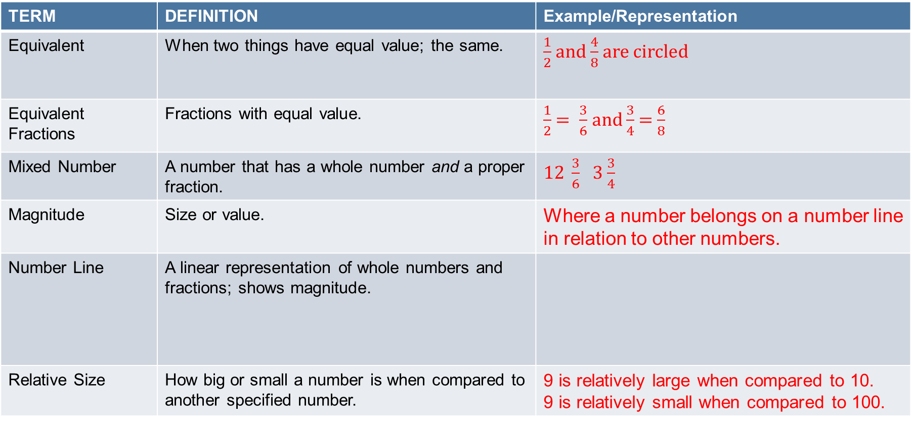
Fraction Vocabulary: Terminology for Concepts (Cont.)
TERM | DEFINITION | Example/Representation
Equivalent | When two things have equal value; the same. | $\frac{1}{2}$ and $\frac{4}{8}$ are circled
Equivalent Fractions | Fractions with equal value. | $\frac{1}{2}$ $= \frac{3}{6}$ and $\frac{3}{4}$ = $\frac{6}{8}$
Mixed Number | A number that has a whole number and a proper fraction. | $12 \frac{3}{6}$ 3 $\frac{3}{4}$
Magnitude | Size or value. | Where a number belongs on a number line in relation to other numbers.
Number Line | A linear representation of whole numbers and fractions; shows magnitude.
Relative Size | How big or small a number is when compared to another specified number. | 9 is relatively large when compared to 10. 9 is relatively small when compared to 100.
Notes:
[Read slide.]

Slide 24
Fraction Vocabulary: Terminology for Manipulatives
TERM | DEFINITION | Example
Fraction Tiles | Linear manipulative that defines one unit/whole. Shows different fraction quantities based on fixed denominators.
Fraction Circles | Circular manipulative that defines one whole as one circle. Shows different fraction quantities based on fixed denominators.
Cuisenaire® Rods | Collection of 10 rectangular rods. The smallest is 1 cm, and the largest is 10 cm. They can show different fraction quantities depending on how the unit/whole is defined.
Notes:
Let’s discuss the pros and cons of each of these manipulatives.

Slide 25
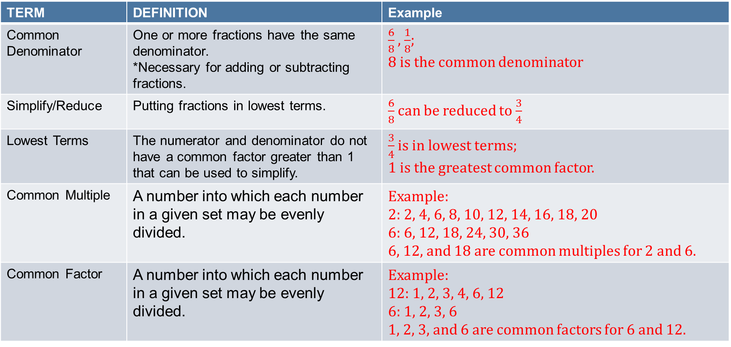
Fraction Vocabulary: Terminology for Procedures
TERM | DEFINITION | Example
Common Denominator | One or more fractions have the same denominator. *Necessary for adding or subtracting fractions. | $\frac{6}{8}$ , $\frac{1}{8}$; 8 is the common denominator
Simplify/Reduce | Putting fractions in lowest terms. | $\frac{6}{8}$ can be reduced to $\frac{3}{4}$
Lowest Terms | The numerator and denominator do not have a common factor greater than 1 that can be used to simplify. | $\frac{3}{4}$ is in lowest terms; 1 is the greatest common factor.
Common Multiple | A number into which each number in a given set may be evenly divided. | Example: 2: 2, 4, 6, 8, 10, 12, 14, 16, 18, 20 6: 6, 12, 18, 24, 30, 36 6, 12, and 18 are common multiples for 2 and 6.
Common Factor | A number into which each number in a given set may be evenly divided. | Example: 12: 1, 2, 3, 4, 6, 12 6: 1, 2, 3, 6 1, 2, 3, and 6 are common factors for 6 and 12.
Notes:
[Read slide.]

Slide 26
Fraction Vocabulary: Terminology for Procedures (Cont.)
TERM | DEFINITION | Example
Least Common Multiple (LCM) | The smallest common multiple of two or more denominators. *Used to determine common denominator. | 2: 2, 4, 6, 8, 10, 12, 14, 16, 18, 20 6: 6, 12, 18, 24, 30, 36 6 is the LCM for 2 and 6.
Greatest Common Factor (GCF) | Largest common factor for the numerator and the denominator. *Used to simply/reduce fractions. | 2: 1, 2 6: 1, 2, 3, 6 2 is the GCF for 2 and 6.
* Students often confuse GCF and LCM.
Notes:
[Read slide.]

Slide 27
Summary: Math Vocabulary Instruction
Math has its own language (words and symbols).
Use explicit instruction.
Model and practice correct vocabulary.
Link math vocabulary across curriculum.
Be intentional.
Notes:
Mathematics has a language that contains words and symbols. Explicit instruction is vital to deep understanding and generalization of skills within core instruction, as well as by connecting core and intervention support. Teachers and students need to practice and use the correct language beginning as soon as they enter school. There is no reason for teachers to use simple terms rather than the math precise words. Teachers also need to model and provide corrective feedback on precise language, link mathematical vocabulary across units and skill areas, and operate with intention.
Think about the example in the beginning; this is pretty typical of a student with MD (pronoun example). We can’t assume these students will pick up on vocabulary just because we model it; we need to be more intentional!
For students with MD, teachers cannot assume that students will develop or understand vocabulary on their own. Just like we need instruction for how to solve a word problem, we need to spend time instructing, practicing, modeling, and using mathematically precise language.

Slide 28
Common Core State Standards
CCSS that emphasize fractions:
Third Grade
Fourth Grade
Fifth Grade
Notes:
[Links to Common Core State Standards to review the fraction standards. Delete or substitute with your state standards if you are a state that does not follow CCSS.]

Slide 29
CCSS Overall Skill Progression
Big Idea | Third Grade | Fourth Grade | Fifth Grade
Fraction definitions and representations | Part/whole representation. Number line representation. |  | Division representation. fraction is a division problem.
Compare fractions or evaluate magnitude | Same numerator or Same denominator | Different numerators or Different denominators
Equivalence | Same size or same number line point; generate; use for reasoning and benchmarks | Decimals and fractions | Use for addition/subtraction.
Add/subtract fractions |  | Unit fraction-building Same denominators (proper or mixed) | Different denominators (proper or mixed)
Addition/subtraction word problems |  | Same denominators (proper or mixed) | Different denominators (proper or mixed)
Fraction multiplication |  | WN times fraction | Fraction times fraction
Fraction division |  |  | UF/WN or WN/UF; include in word problems.
Notes:
This is just a sample of big fraction ideas and how they progress through the grade levels, where certain fraction understandings get more difficult.

Slide 30
Part 2:
Common Fraction Misunderstandings
Notes:
[Read slide.]

Slide 31
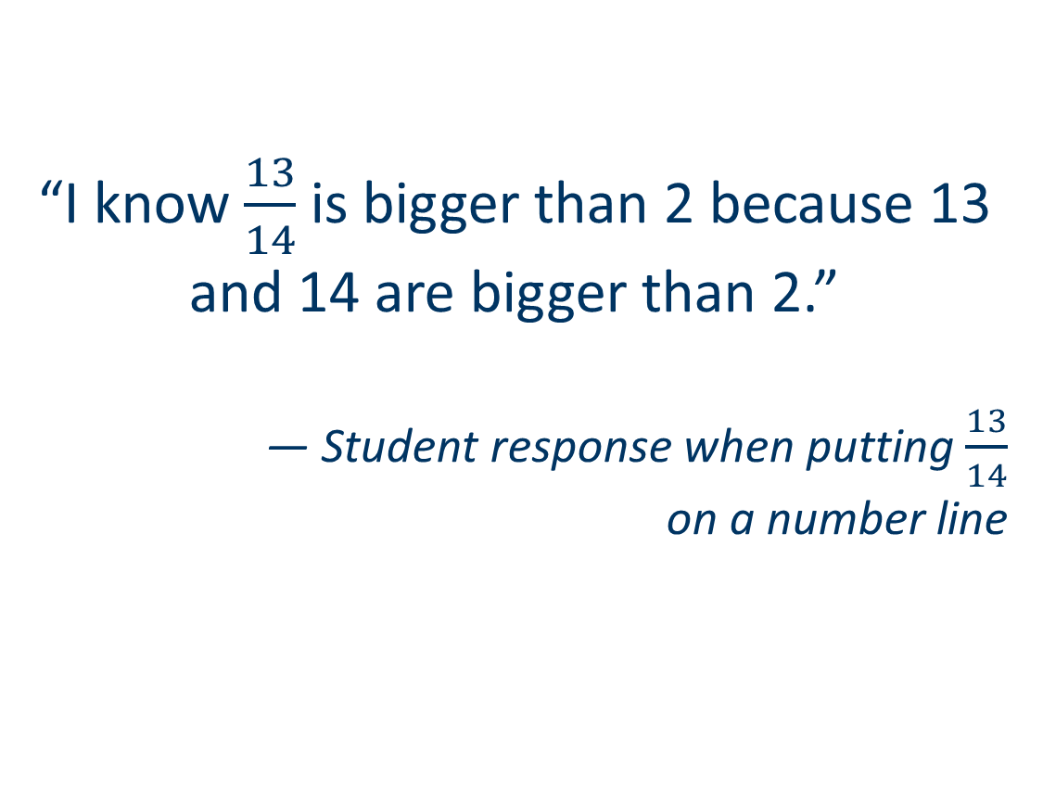
Whole Number
Bias
“I know $\frac{13}{14}$is bigger than 2 because 13 and 14 are bigger than 2.”
— Student response when putting $\frac{13}{14}$
on a number line
The Overgeneralization of Whole Number Concepts to Fractions
(Ni & Zhou, 2005)
Notes:
[Read slide.]

Slide 32
Magnitude Understanding Can Help Combat Whole Number Bias
Magnitude
Compare Fractions
Number Line
Order Fractions
Sources: Bailey, Hoard, Nugent, & Geary, 2012; Booth & Newton, 2012; Brown & Quinn, 2007; Siegler et al., 2012.
Notes:
Understanding that fractions have magnitude and can be ordered, compared, and placed on the number line is essential for
combatting whole number bias, which leads to
future success in higher level mathematics courses.
Let’s look at some examples and discuss.

Slide 33






Examples of Whole Number Bias
Putting Fractions on a Number Line
$\frac{1}{2}$
$\frac{1}{4}$
$\frac{1}{10}$
$\frac{1}{10}$
$\frac{1}{4}$
$\frac{1}{2}$
Notes:
Consider this example. Why might students struggle in placing fractions on a number line?
For more information, see Malone, A. S., & Fuchs, L. S. (2017). Error patterns in ordering fractions among at-risk fourth-grade students. Journal of Learning Disabilities, 50(3), 337–352.

Slide 34
Examples of Whole Number Bias (Cont.)
Comparing Two Fractions
5 > 1
6 > 2
1 < 2
2 < 6
This comparison
is consistent with
whole number
Principles.
This comparison
is inconsistent with
whole number
Principles.
Notes:
Consider how students apply whole number magnitude understandings to fractions. The first comparison is consistent with whole numbers—so students still get the right answer. The second comparison is inconsistent with whole numbers—students get wrong answer.

Slide 35




Examples of Whole Number Bias
Ordering Three Fractions From Least to Greatest
Relied on WN
denominator
magnitude.
$$\frac{1}{2} \frac{1}{10} \frac{1}{12}$$
$$\frac{1}{12} \frac{1}{10} \frac{1}{2}$$
Relied on WN
denominator
magnitude.
$$\frac{1}{2} \frac{2}{6} \frac{5}{8}$$
$$\frac{2}{6} \frac{1}{2} \frac{5}{8}$$
Notes:
How did these students order the fractions? [Click for animations.]

Slide 36




Examples of Whole Number Bias (Cont.)
Adding and Subtracting Fractions
$$\frac{3}{8}+\frac{4}{8}=\frac{7}{16}$$
$$\frac{3}{8}+\frac{4}{8}=\frac{7}{8}$$
Added across
denominators.
Added across
denominators;
did not rewrite
equivalent fraction.
$$\frac{2}{10}+\frac{1}{2}=\frac{3}{12}$$
$$\frac{2}{10}+\frac{1}{2}=\frac{7}{10}$$
Notes:
What misconceptions are the students applying to solve? [Click for animations.]

Slide 37
Cycle of Misunderstanding With Whole Number Bias
Instruction fails to emphasize fraction magnitude.
Students fail to consolidate principles of fractions and whole numbers.
Students fail to expand their concept of number to include fractions.
Students rely on whole number principles to determine fraction value.
Students commit whole number errors.
Source: Malone & Fuchs (in press).
Notes:
[Read slide.]

Slide 38
Over-generalizing Procedures
Extending the application of a rule to items that are excluded from it.
Notes:
[Read slide.]

Slide 39
Examples of Overgeneralization
Multiplying Fractions
Inverted second
fraction.
Performed
unnecessary
step.
Notes:
Just as we reviewed in order fractions and adding and subtracting fractions, student often overgeneralize rules when multiplying fractions. What do you notice about the way the students solved? [Click for animations.]

Slide 40
Examples of Overgeneralization (Cont.)
Dividing Fractions
Divided the
whole numbers.
Inverted both
fractions.
Notes:
How are students overgeneralizing these computations? [Click for animations.]

Slide 41
Part 3:
Evidence-Based Curriculum
Tier 2 Interventions and Instructional Approaches
Notes:
[Read slide.]

Slide 42
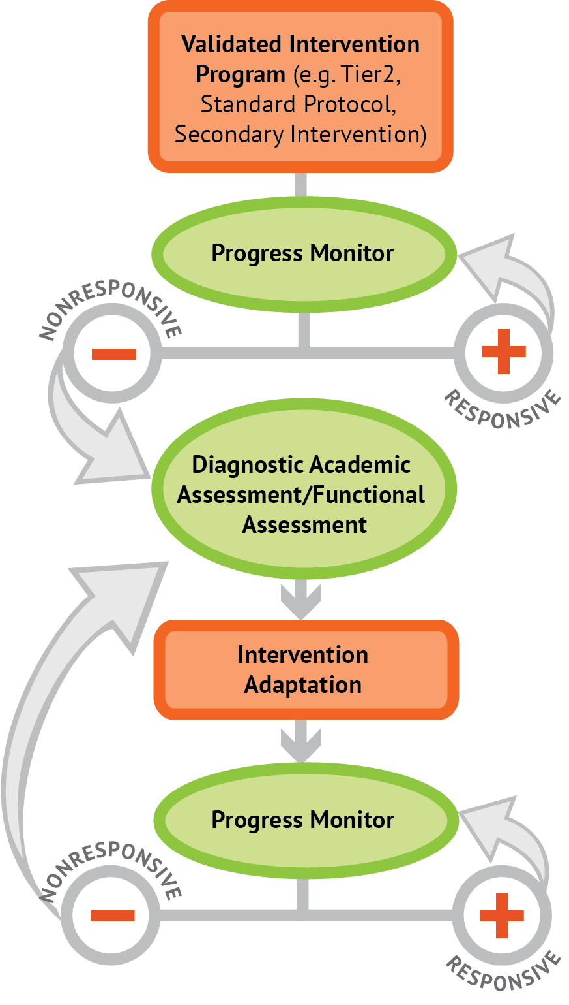
Data-Based Individualization
Notes:
We’re going to look at some instructional methods from two evidence-based, validated curricula.
Both of these emphasize number lines. Let’s look at the next slide to learn why number lines are important.

Slide 43
The Case for Number Lines
What is a fraction?
Teaching number lines can combat overgeneralizing the part/whole understanding of fractions.
The Research:
The ability to demonstrate the magnitude of a number (either a fraction or a whole number) on a number line with increasing accuracy is a solid indicator of the sophistication of a child’s understanding of number and arithmetic operations.
The shaded part!
It’s a pie!
Sources: Case et al., 1996; Siegler & Lorti-Forgues, 2014.
Notes:
Number lines were the major focus of three different national centers, short experiments directed by Siegler, and intervention studies directed by the Fuchs.
We’ll now focus on the work from the intervention strand at Vanderbilt University—Fraction Face Off!

Slide 44
Fraction Face-Off!
DBI
Tier 2
Fraction Face-Off!
General Classroom Instruction
Tier 2 Fraction Intervention,
Grades 3 and 4
(Fuchs, Schumacher, Malone, & Fuchs, 2016)
Note. DBI = data-based individualization.
Notes:
Tier 2 fraction intervention that Focuses on Grades 3 and 4 CCSS material

Slide 45
Fraction Face-Off! Big Ideas
Build conceptual understanding of fractions as numbers through multiple representations.
  Fraction circles
  Fraction tiles
  Number lines
Build from prior knowledge: part-whole
  Area models/shaded regions
  Focus of instruction in U.S.
Primary focus: magnitude understanding
  Number lines
  Comparing and ordering
  Focus of instruction in Asian countries
Notes:
[Read slide.]

Slide 46
Fraction Face-Off! Activities
Magnitude activities
Number line
Comparing
Ordering
Convert improper fractions to mixed numbers
Word problems; multiplicative reasoning
Computation (add and subtract)
Notes:
Fractions Face-Off! begins with comparing, number lines, and ordering, which are all magnitude activities. The program builds a foundation here before moving toward computation, then to converting improper fractions to mixed numbers, and then to word problems.

Slide 47
Benchmark Numbers
Using ½ as a benchmark:
  Teach fractions equivalent to ½ with multiplication, supported by fraction tiles, circles, and number lines.
  For fluency—teach the Doubling Rule:
    If the numerator is double the denominator, the fraction is equal to ½. Quick strategy for rewriting ½.
    Move toward fluent retrieval of one-half equivalencies.
Notes:
Using and understanding ½ as a benchmark is a HUGE part of the program with teaching magnitude and is relevant for comparing, ordering, and number line activities.

Slide 48
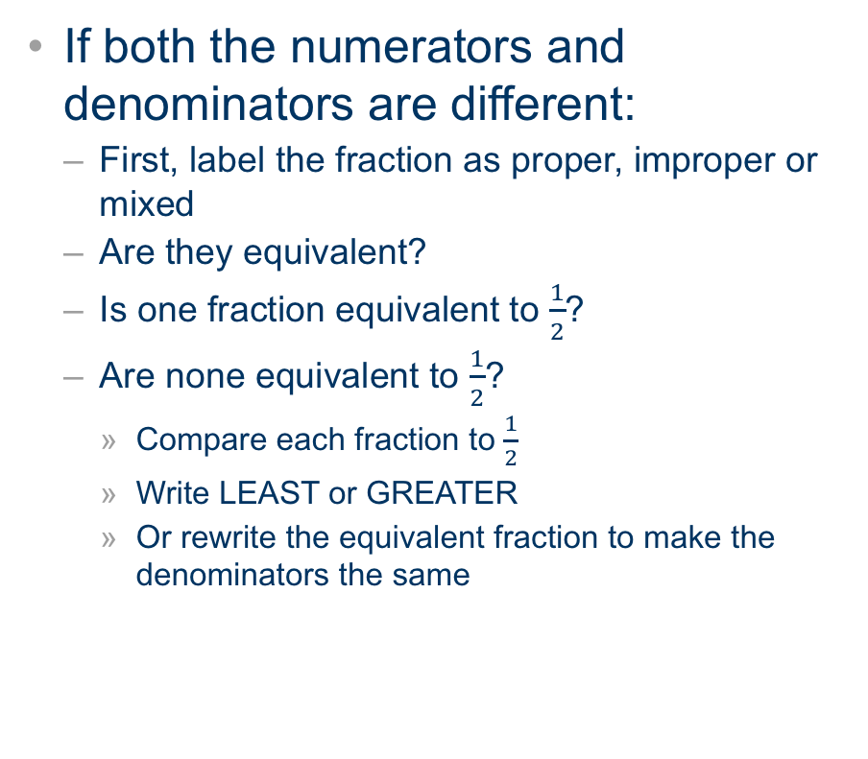
Teaching Strategies: Comparing Fractions
Students are given a “Comparing” card to be used to promote self-regulation of the skills needed to compare fractions.
First, students look at the denominator. If the denominator is the same:
  Same denominators?
    Bigger numerator = nigger fractions
  Same numerators?
    Fewer parts = bigger fractions
If both the numerators and denominators are different:
  First, label the fraction as proper, improper or mixed
  Are they equivalent?
  Is one fraction equivalent to $\frac{1}{2}$?
  Are none equivalent to $\frac{1}{2}$?
    Compare each fraction to $\frac{1}{2}$
    Write LEAST or GREATER
    Or rewrite the equivalent fraction to make the denominators the same
Fuchs, Schumacher, Malone, & Fuchs, 2016; Fraction Face-off! ©
Notes:
[Read slide.]

Slide 49
Comparing Fractions Using ½ as a Benchmark
<
Same denominator
Bigger numerator,
bigger fraction
Notes:
Let’s review this example of how we can use ½ to compare fractions. [Click for animations.]

Slide 50
Comparing Fractions Using ½ as a Benchmark (Cont.)
Same denominator
Bigger numerator,
bigger fraction
L
Notes:
[Review another example. Click for animations.]

Slide 51
Comparing Fractions Using ½ as a Benchmark (Cont.)
<
Same denominator
Bigger numerator,
bigger fraction
L
G
Notes:
[Review another example. Click for animations.]

Slide 52
Teaching Strategies: Ordering Fractions
Students are given an “Ordering” card to be used to promote self-regulation of the skills needed to order fractions.
First, they label the fractions as proper, improper, or mixed. All improper fractions are changed to mix.
  Then they compare – using the same same questions as the compare card.
  Utilizing the same process will lead to greater generalization and mastery of the skills
Fuchs, Schumacher, Malone, & Fuchs, 2016; Fraction Face-off! ©
Notes:
[Read slide.]

Slide 53
Ordering Fractions Using ½ as a Benchmark
_______ _______ _______
=
G
L
Notes:
We can also use ½ to expand from comparing to ordering fractions. [Click for animations.]

Slide 54
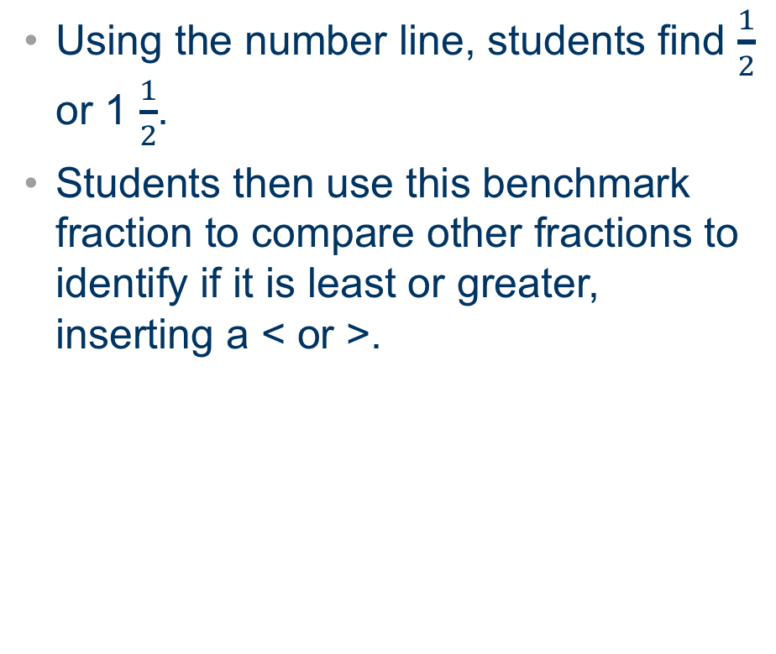
Teaching Strategies: Number Line
Students are given a “Number Lines” card to promote the skills and for self-regulation.
Students identify an appropriate number to use based on the fraction type: proper, improper, or mixed fraction. (changing improper to mixed fractions)
Using the number line, students find $\frac{1}{2}$ or 1 $\frac{1}{2}$.
Students then use this benchmark fraction to compare other fractions to identify if it is least or greater, inserting a < or >.
0
1
1
2
Fuchs, Schumacher, Malone, & Fuchs, 2016; Fraction Face-off! ©
Notes:
[Read slide.]

Slide 55
Placing Fractions on the Number Line:
Using ½ as a Benchmark
L
G
0
1
G
L
Notes:
Let’s review the application of ordering and comparing fractions by placing fractions on a number line. [Click for animations.]

Slide 56



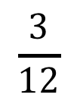



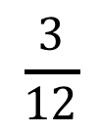
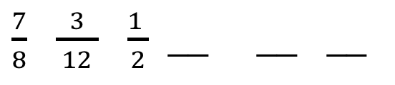
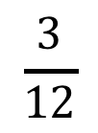
Building Magnitude Understanding
Least
Greatest
Ordering Fractions
Comparing Fractions
Placing Fractions on the Number Line
$\frac{7}{8}$ $\frac{3}{ 12 }$ $\frac{1 }{2}$ __ __ __
$$\frac{7}{8}$$
$$\frac{3}{12}$$
0
$\frac{1 }{2}$
1
$$\frac{3}{12}$$
$$\frac{1}{2}$$
$$\frac{1}{2}$$
$$\frac{7}{8}$$
$$\frac{3}{12}$$
$$\frac{7}{8}$$
Notes:
[Read slide.]

Slide 57
Fraction Skill: Computation
Limited instruction for computation.
Explain that denominators need to be the same.
  Demonstrate procedures with fraction circles.
Explain that an equivalent fraction is written to add correctly.
This builds on ½ as benchmark.
Notes:
[Read slide.]

Slide 58



Fraction Addition
$$\frac{2}{10}+\frac{1}{2} =$$
$$\frac{5}{10}$$
$$\frac{7}{10}$$
Are the denominators the same?
Is one of the fractions ½?
Rewrite an equivalent fraction for ½ to get same denominators.
Notes:
Let’s review how we can apply using the ½ benchmark fraction to add fractions. [Click for animations.]

Slide 59
Fraction Skill: Improper to Mixed
Fuchs, Schumacher, Malone, & Fuchs, 2016; Fraction Face-off! ©
Notes:
As we have reviewed, Fractions Face-Off! progresses from comparing to ordering and then to computations before moving to improper and mixed fractions. When we think about writing a mixed number as an improper fraction or writing an improper fraction as a mixed number, it is best to first demonstrate with fraction circles and then move to using addition skills. Begin by limiting whole numbers to 1 and improper fractions less than 2.

Slide 60
Word Problems: Multiplicative Reasoning
Word problem instruction uses schema-based instruction.
Students are taught to recognize and solve similar problem types and apply procedures appropriately.
Fuchs, Schumacher, Malone, & Fuchs, 2016; Fraction Face-off! ©
Notes:
[Read slide.]

Slide 61
Word Problems: Splitting
Splitting
Matt has 2 apples. He cut each apple into fifths. How many pieces of apple does Matt have?
Name the Problem Type
Focus on vocabulary (e.g., cutting, dividing, splitting, etc.).
What’s happening in the story?
Do we end up with pieces at the end?
Notes:
First, we need to have students identify the problem type. This is an example of a splitting problem. [Read slide.]

Slide 62
Word Problems: Splitting (Cont.)
Splitting
Matt has 2 apples. He cut each apple into fifths. How many pieces of apple does Matt have?
1. Underline what’s missing.
What is the story asking us to find?
This will help us label our answer in the end.
Notes:
Next, we need to underline what is missing. What is the story asking us to find? This will help us label our answer in the end.

Slide 63
Word Problems: Splitting (Cont.)
Splitting
Matt has 2 apples. He cut each apple into fifths. How many pieces of apple does Matt have?
Underline what’s missing.
What is the story asking us to find?
This will help us label our answer in the end.
Notes:
[Read slide.]

Slide 64
Word Problems: Splitting (Cont.)
Splitting
U
S
Matt has 2 apples. He cut each apple into fifths. How many pieces of apple does Matt have?
2. Circle what’s known.
Write Units.
Write Size.
What do we already know in the story?
Think about how to write words as numbers.
Notes:
[Read slide. Click for animations.]

Slide 65
Word Problems: Splitting (Cont.)
Splitting
U
S
Matt has 2 apples. He cut each apple into fifths. How many pieces of apple does Matt have?
U | S
2
3. Make a table.
4. Solve the problem.
1
1
10 pieces of apple
Notes:
[Read slide. Click for animations.]

Slide 66
Word Problems: Grouping
Grouping
Keisha is making 4 necklaces for friends. For each necklace, she needs 1/3 yard of string. How many yards of string does Keisha need?
Name the problem type.
Focus on story content: Does the story tell us about cutting, dividing, or splitting something? Or does the story tell us about grouping together parts of something to figure out an amount? What’s happening in the story?
Do we end up with pieces at the end? Or does the story ask us to find groups?
Notes:
The next problem type is grouping. Again, we start by having the student name the problem type by focusing on the story content. [Read slide.]

Slide 67
Word Problems: Grouping (Cont.)
Grouping
Keisha is making 4 necklaces for friends. For each necklace, she needs 1/3 yard of string. How many yards of string does Keisha need?
1. Underline what’s missing.
What is the story asking us to find?
This will help us label our answer in the end.
Notes:
[Read slide.]

Slide 68
Word Problems: Grouping (Cont.)
Grouping
Keisha is making 4 necklaces for friends. For each necklace, she needs 1/3 yard of string. How many yards of string does Keisha need?
1. Underline what’s missing.
What is the story asking us to find?
This will help us label our answer in the end.
Notes:
[Read slide. Click for animations.]

Slide 69
Word Problems: Grouping (Cont.)
Grouping
I
Keisha is making 4 necklaces for friends. For each necklace, she needs 1/3 yard of string. How many yards of string does Keisha need?
S
2. Circle what’s known.
Write Items.
Write Size.
Notes:
[Read slide. Click for animations.]

Slide 70
Word Problems: Grouping (Cont.)
Grouping
I
Keisha is making 4 necklaces for friends. For each necklace, she needs 1/3 yard of string. How many yards of string does Keisha need?
S
3. Make a table.
4. Solve the problem.
S
I
4
____ ____ ____ ____
yards of string
Notes:
[Read slide. Click for animations.]

Slide 71
Grouping: Non-unit Fractions
Non-unit Fractions (Grouping)
  Ray needs 2/3 of a cup of flour to make a loaf of bread. He’s making 4 loaves of bread. How many cups of flour does Ray need?
S
I
cups of flour
4
___ ___ ___ ___
Notes:
[Read slide. Click for animations.]

Slide 72
Fraction Face-Off! Wrap-Up
Major emphasis on magnitude;
uses benchmark fractions.
Procedures are broken down into steps with prompts.
Jumping-off point for DBI.
Notes:
In conclusion, you’ll notice that Fraction Face-Off! uses the benchmark fraction of 1/2 throughout the curriculum. A major emphasis on magnitude, procedures are broken down, prompt cards are used throughout. This program is a jumping-off point for DBI and includes several evidence-based approaches to incorporate into your instructions.

Slide 73
TransMath®
DBI
Tier 2
TransMath® (L2)
(Struggling Students in Tier 1)
Tier 1 Fraction Instruction
Spans Grades 3–8
(Woodward & Stroh, 2015)
Notes:
The next problem we are going to review, and that can be included in Tier 1 for struggling students, is TransMath. This program includes three levels and domains across math content. Today we will focus on fraction instruction and explain the three levels. The next few slides will be just a preview of the fraction principles because there is evidence behind the instructional methods.

Slide 74
TransMath®
Number lines to facilitate
magnitude
fraction patterns
comparing/benchmarks
improper
mixed numbers
equivalence
four operations
addition
subtraction
multiplication
division
Notes:
This is a broad overview of how Trans Math uses numbers to facilitate magnitude and operations.

Slide 75
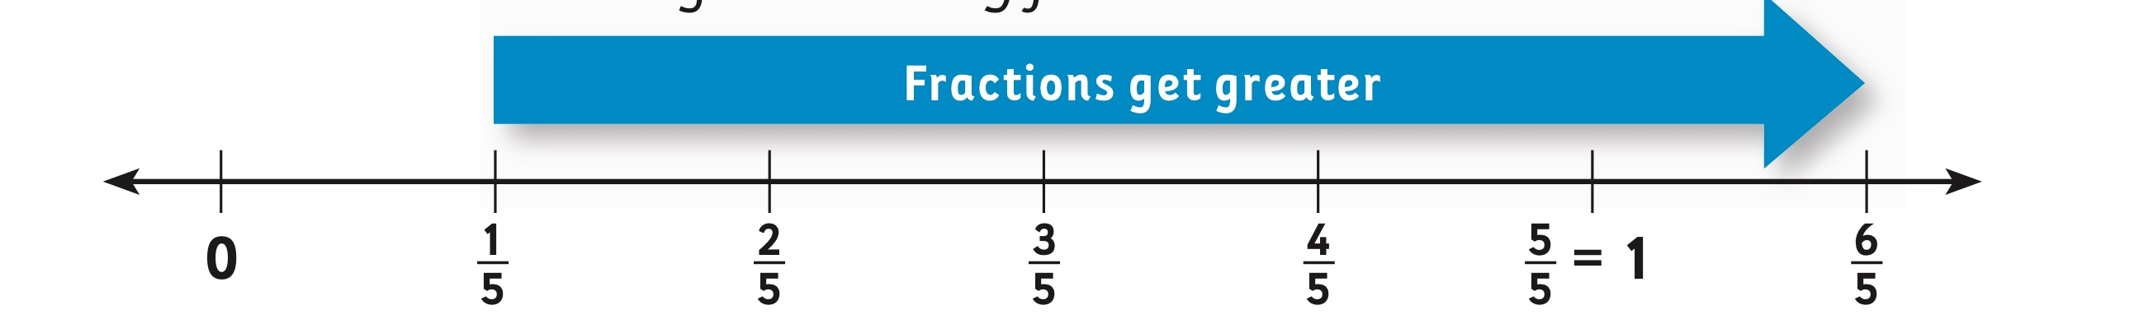
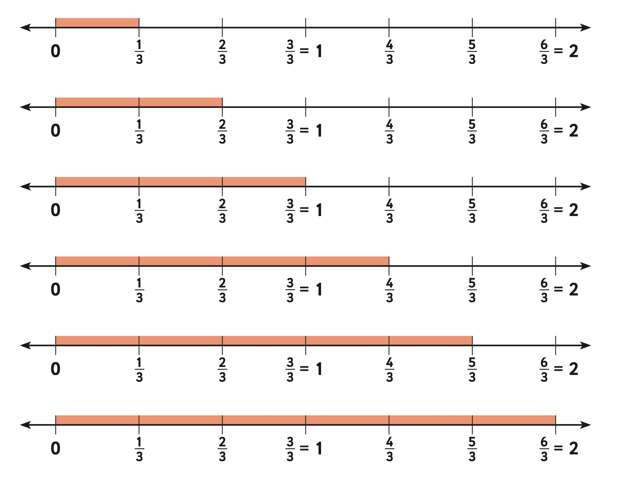
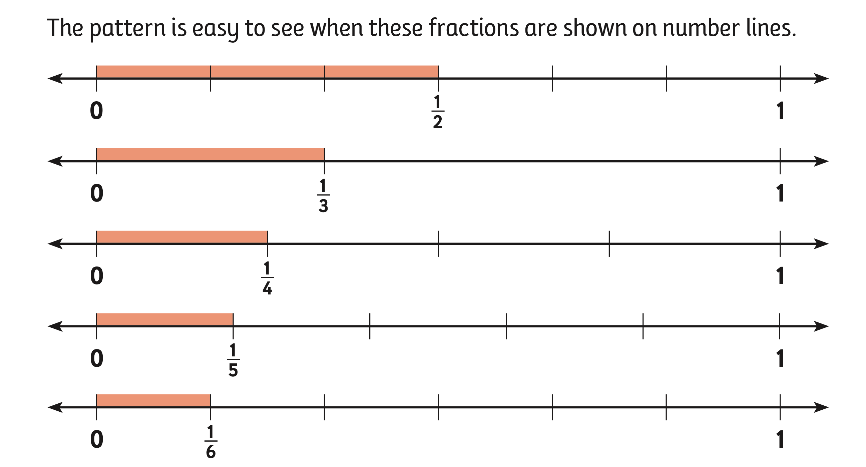
TransMath® Number Lines: Fraction Patterns
Notes:
[Discuss the pattern of same denominator. Discuss the pattern for unit fractions.]

Slide 76
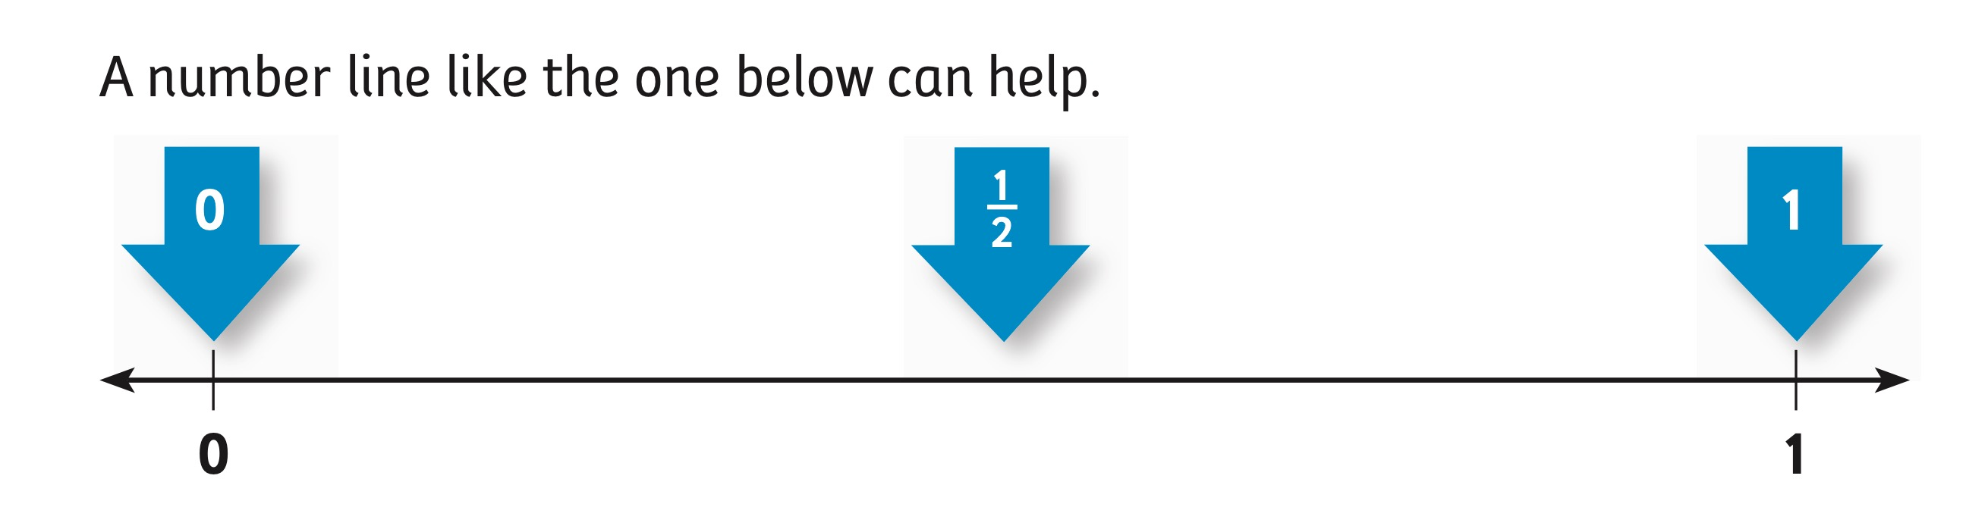
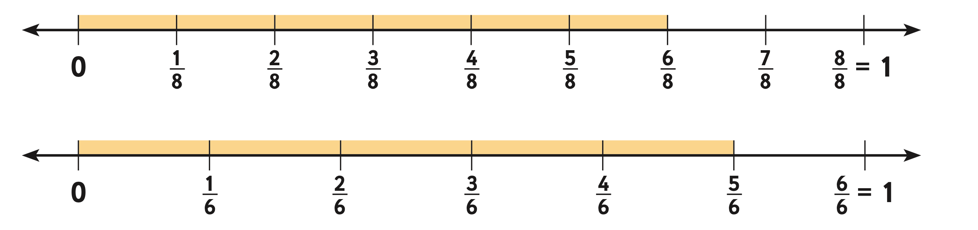
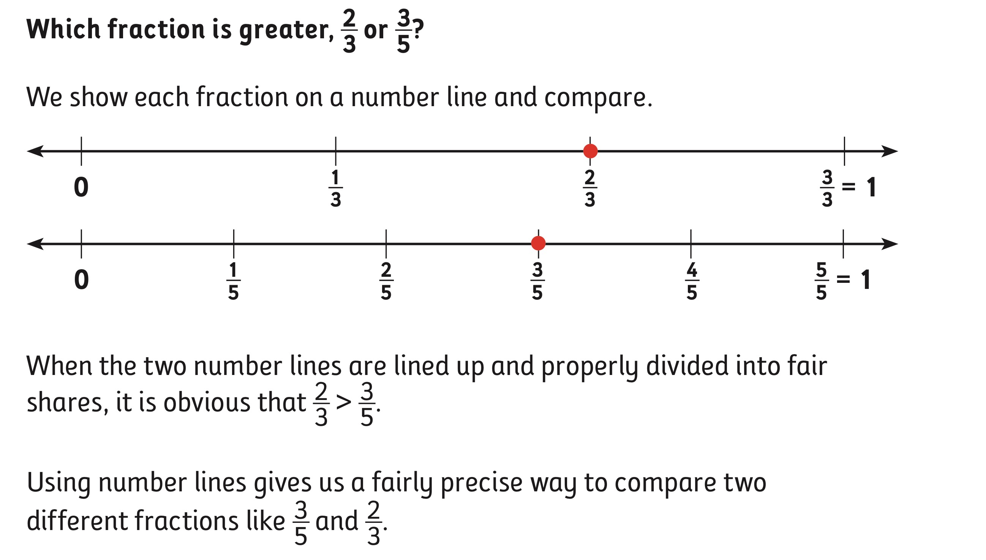
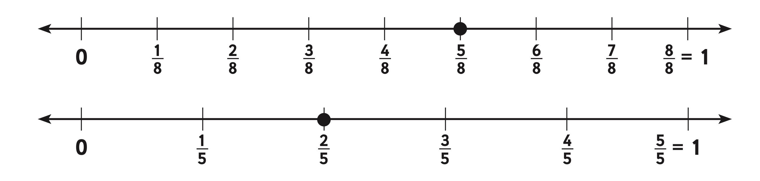
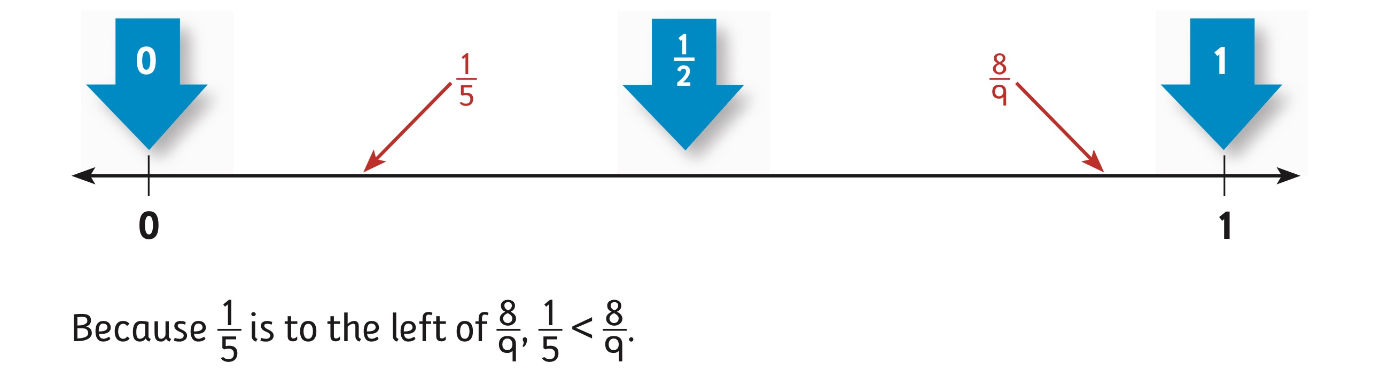
TransMath® Number Lines: Comparing/Benchmarks
Notes:
Similar to Fraction Face-Off!, TransMath uses number lines to compare fractions. The program uses benchmarks (0, ½, 1).
Students are directed to draw two number lines. What is some background knowledge students need in order to correctly draw number lines?

Slide 77
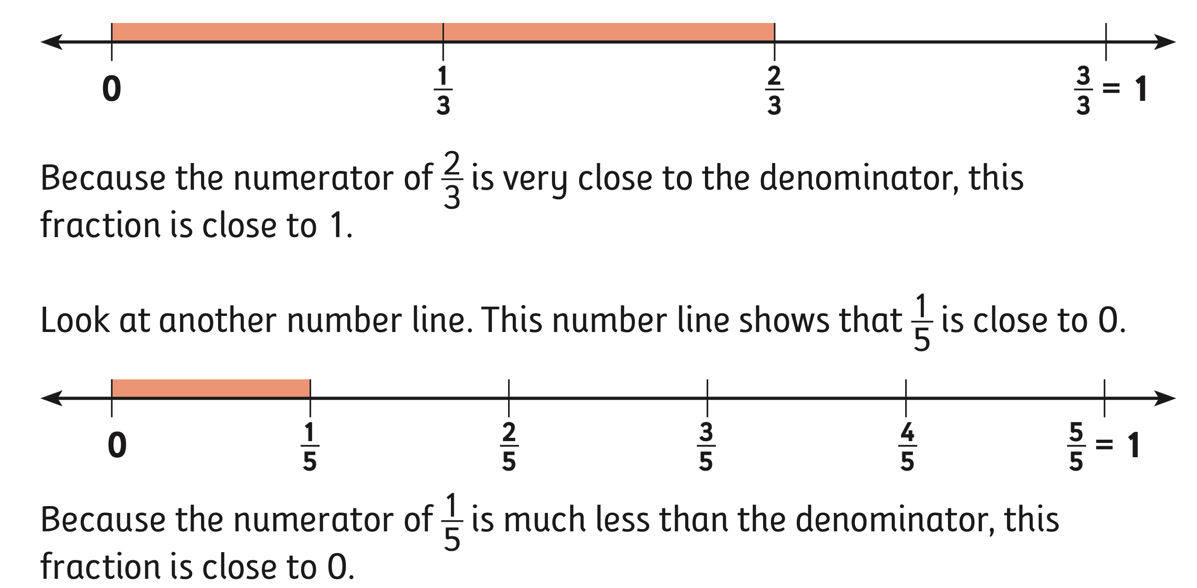
TransMath® Number Lines: 0 and 1 as benchmarks
Notes:
The next step is including benchmarks with relative size.

Slide 78
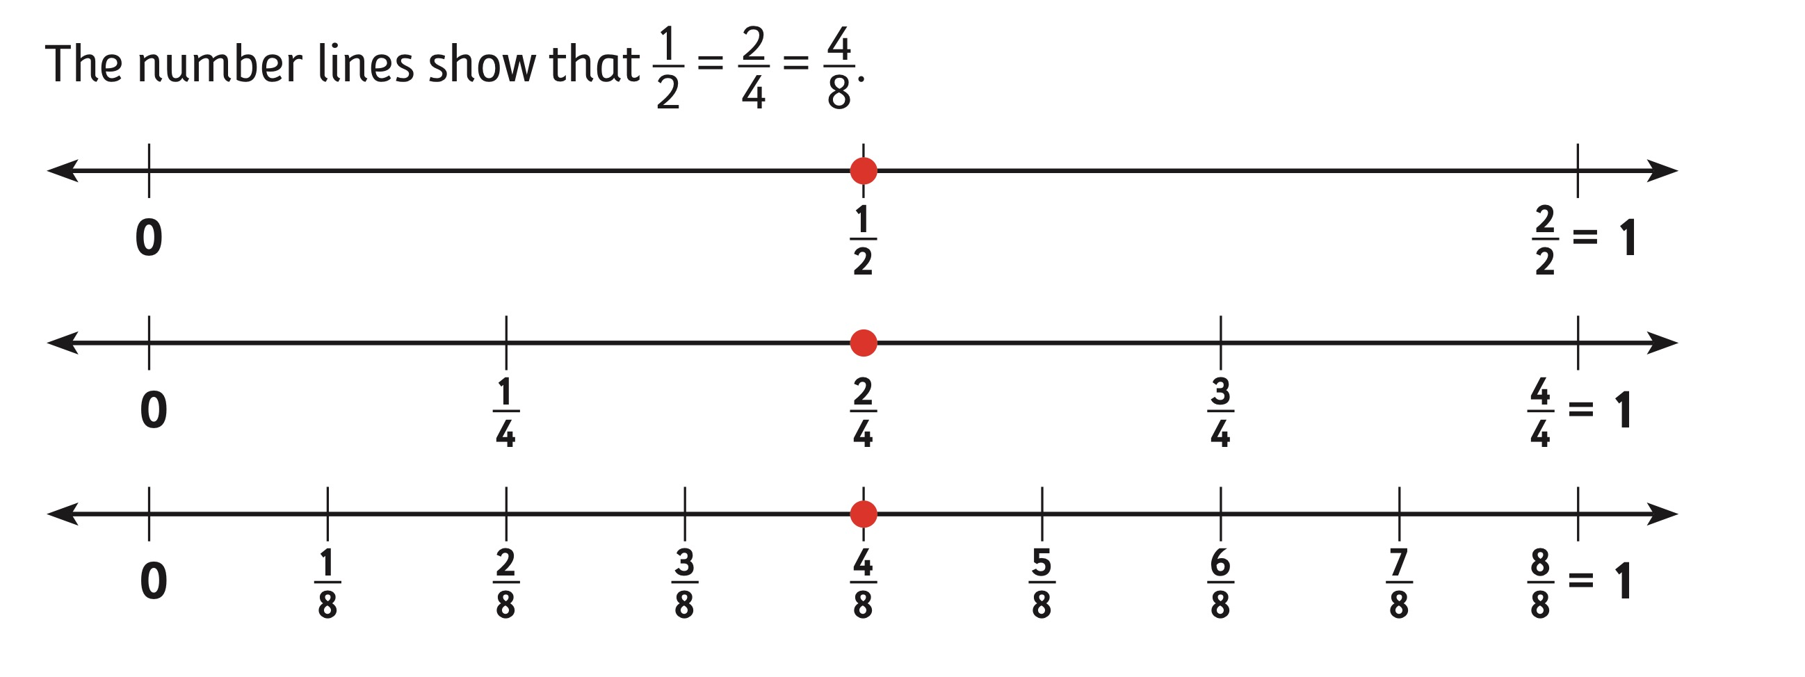
TransMath® Number Lines: Equivalence
Notes:
[Review slide.]

Slide 79
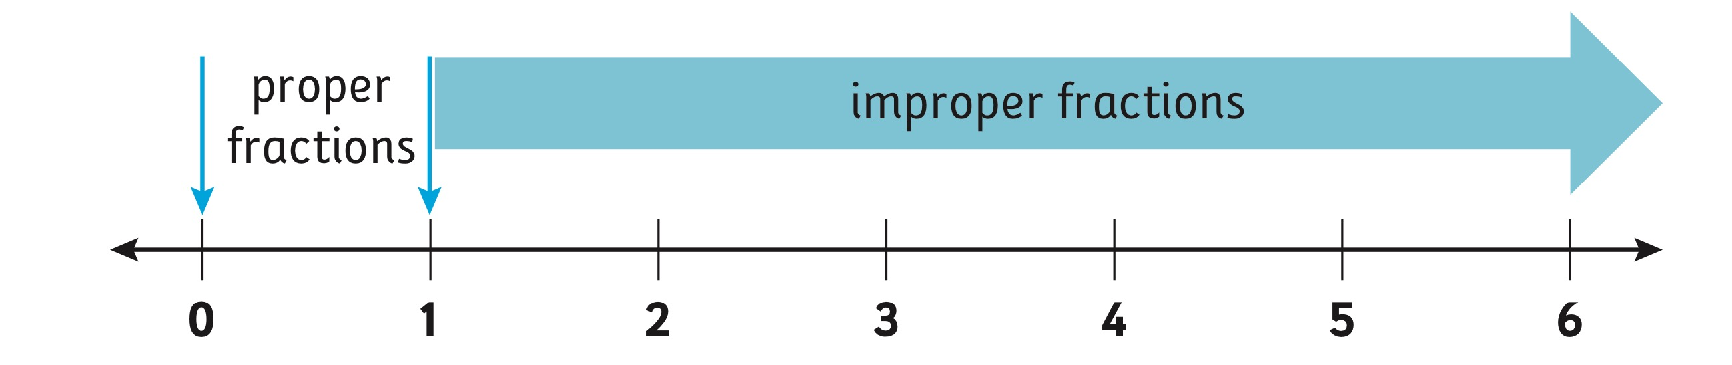
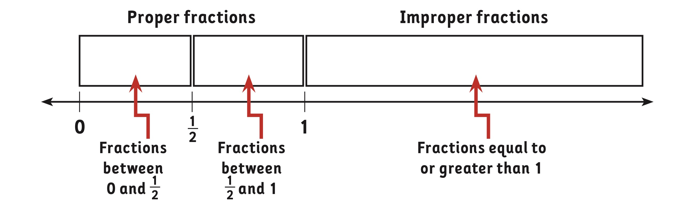
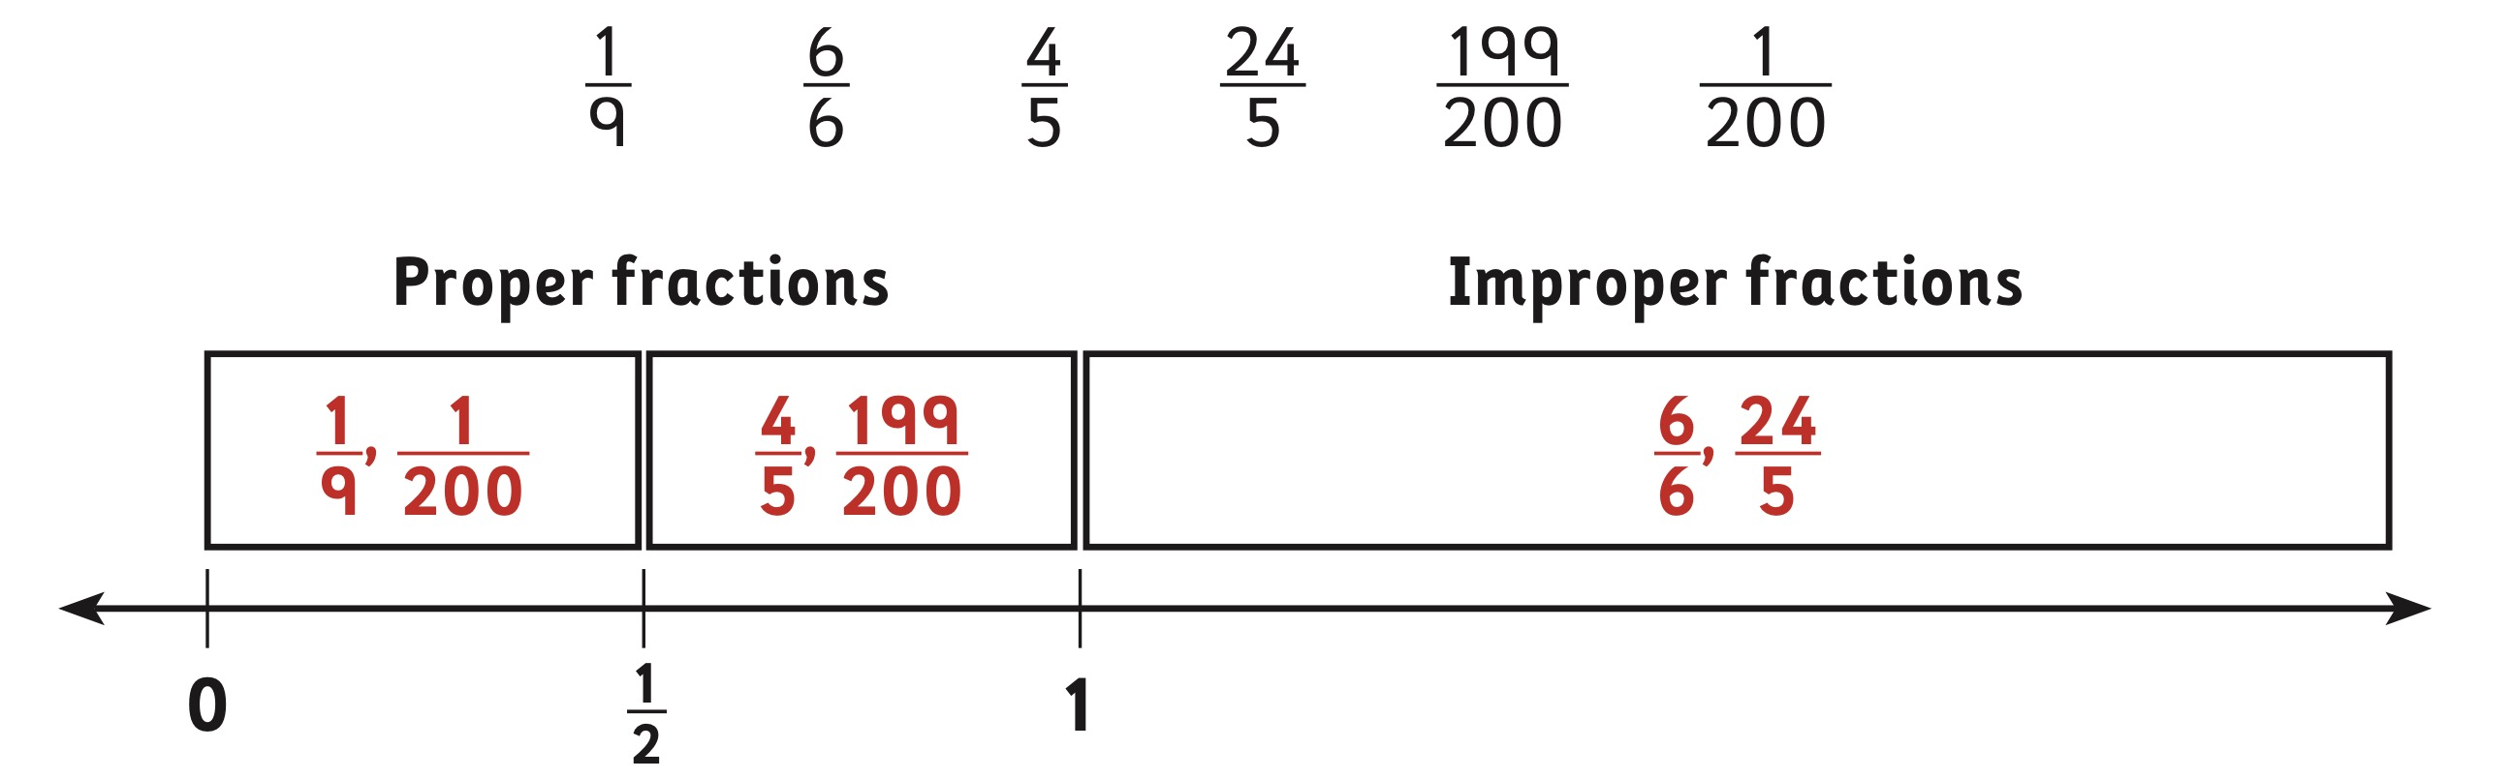
TransMath® Number Lines: Improper
Notes:
This is a potential activity and a teaching progression using numbers lines and benchmark fractions to show improper fractions.

Slide 80
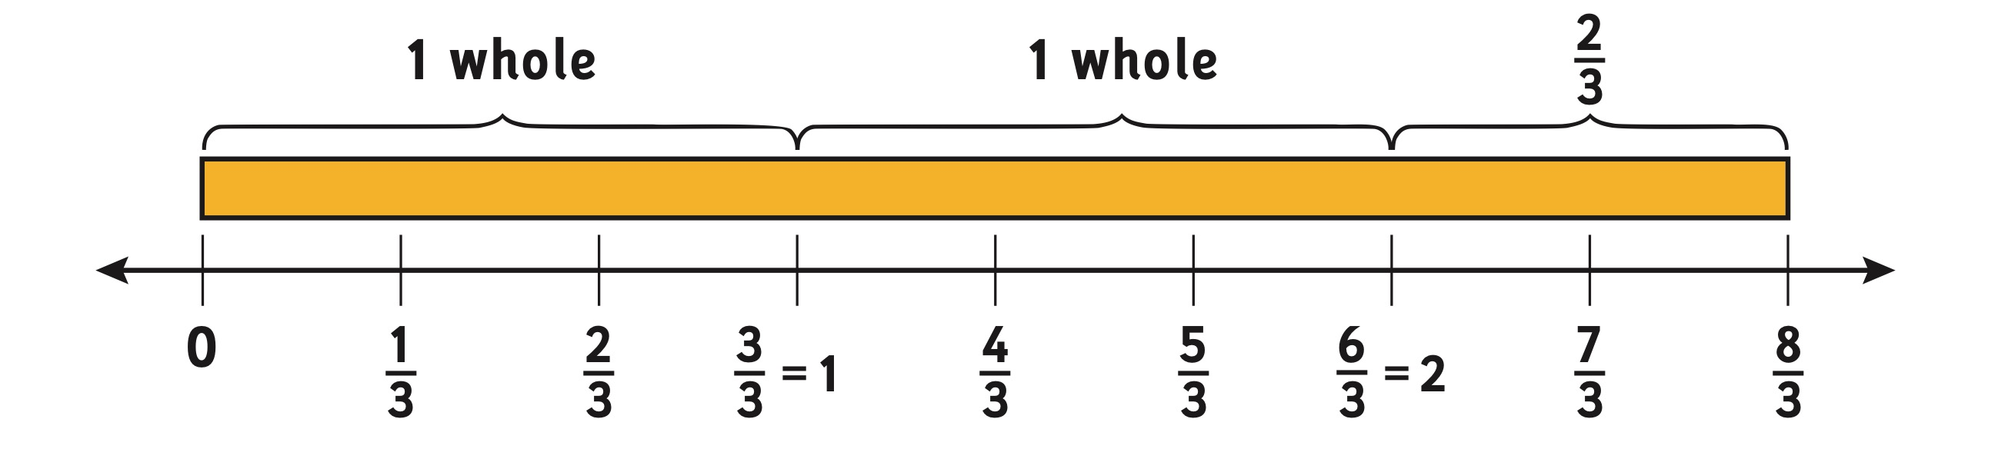
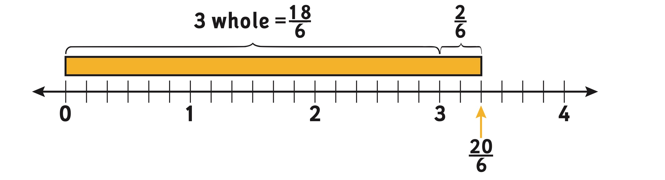
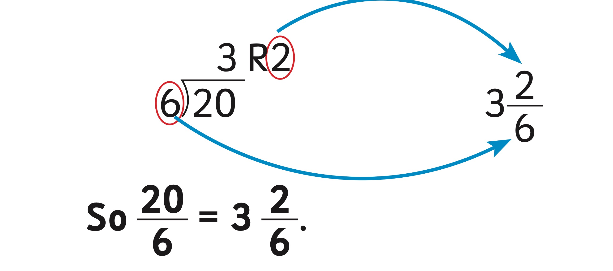
TransMath® Number Lines: Mixed Numbers
Notes:
[Review mixed numbers with improper equivalences.]

Slide 81
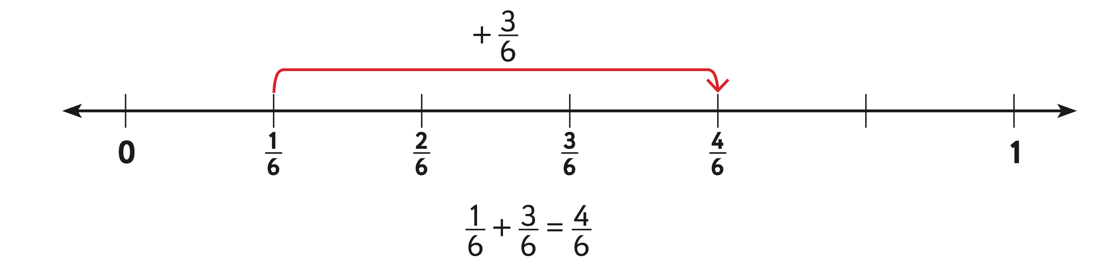
TransMath® Number Lines: Addition
Notes:
[Review the use of numbers lines to show addition of fractions with common denominators.]

Slide 82
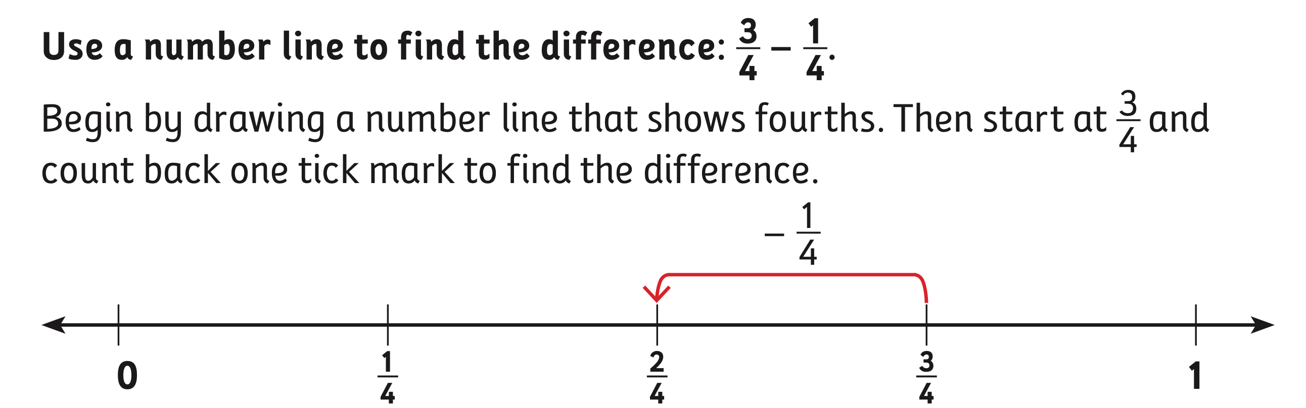
TransMath® Number Lines: Subtraction
Notes:
[Read slide.]

Slide 83
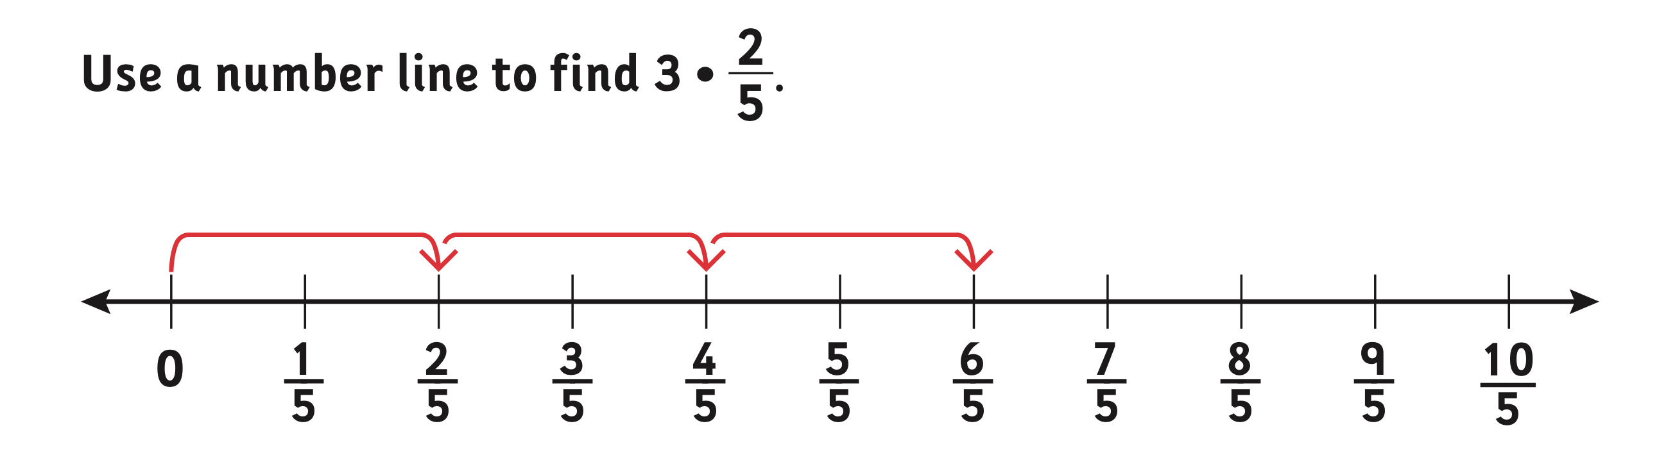
TransMath® Number Lines: Multiplication
Notes:
Number lines can also be used to show multiplication of fractions.

Slide 84
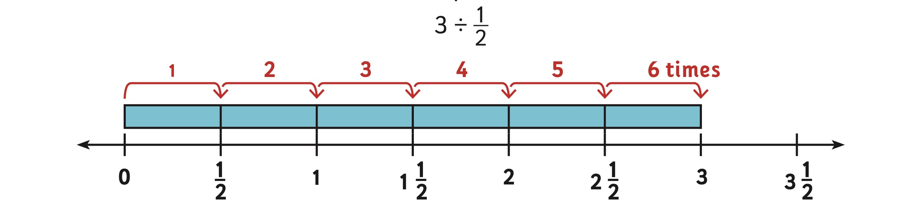
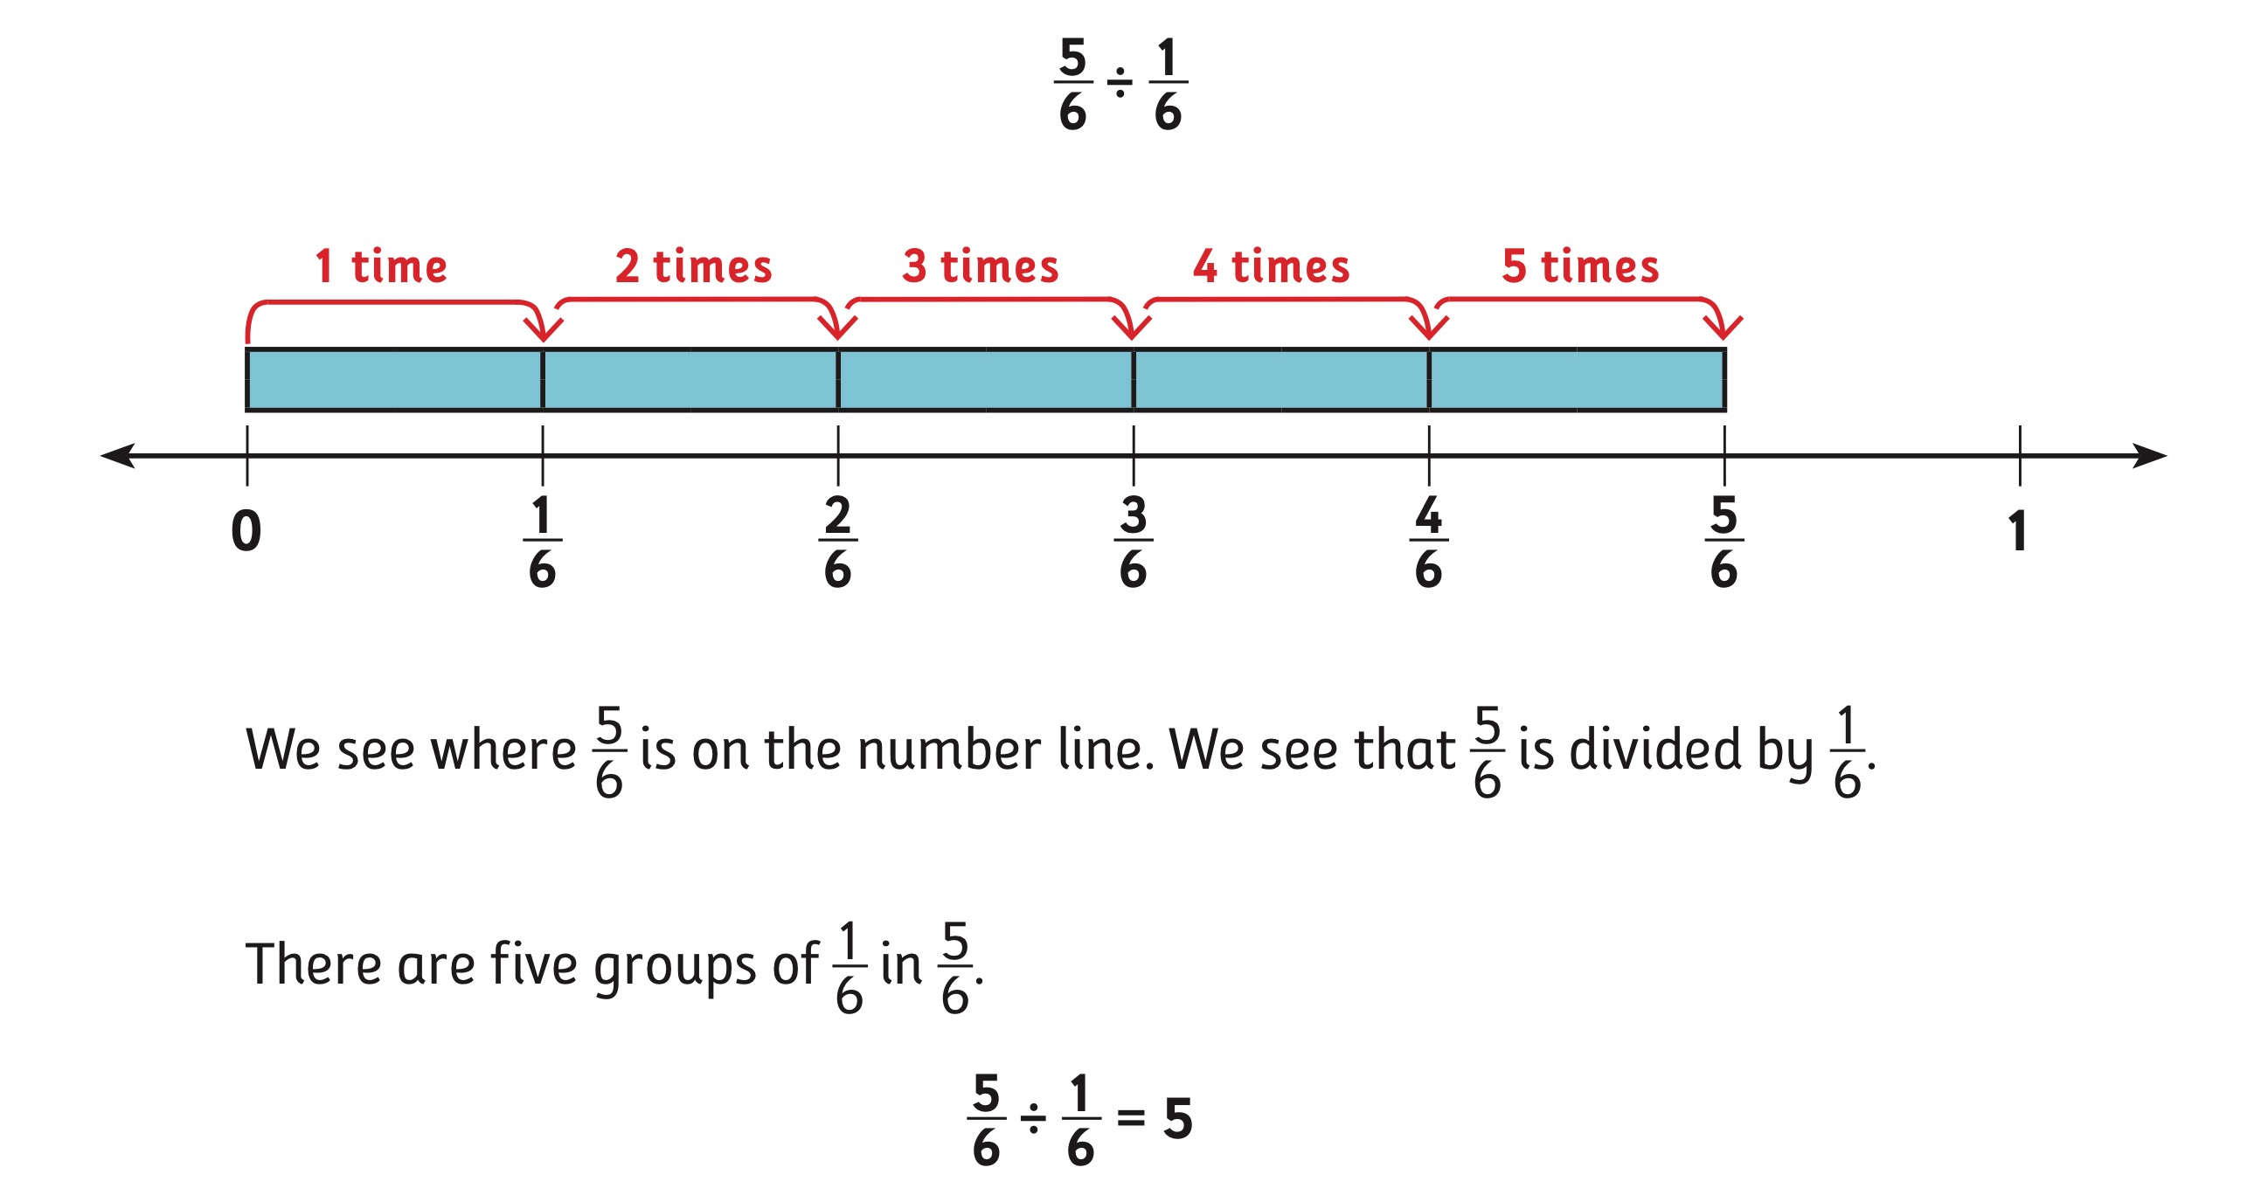
TransMath® Number Lines: Division
84
Notes:
[Read slide.]

Slide 85
Number Lines: Fraction Face-Off and TransMath®
0–1 is the whole.
Divided into fair shares.
Estimate placement with ½ as benchmark.
Incorporate improper fractions (go beyond 1).
Three categories of fractions.
Two number lines to compare.
Four operations.
Notes:
Progression of how numbers lines are used in both Fraction Face-Off! and TransMath
[Read slide.]

Slide 86
What Concepts Can We Reinforce With Number Lines?
Equivalence
Magnitude/order
Part/whole understanding
Idea of infinity
Others?
Notes:
[Read slide.]

Slide 87
Part 4:
Error Analysis and Instructional Decisions
Using Error Patterns for Planning Intensive Intervention
Notes:
[Read slide.]

Slide 88
Analyze This!
Addition
Subtraction
Multiplication
Division
Equivalence/Simplest Terms
Case Examples

Slide 89
Categories of Practice for Organizing and Planning Intensive Intervention
Change Dosage or Time
Change the Learning Environment to Promote Attention and Engagement
Combine Cognitive Processing Strategies with Academic Learning
Modify Delivery of Instruction
Quantitative
Qualitative
Source: Vaughn et al., 2013.
Notes:
Let’s review:
You’ve seen these four dimensions before. The third and fourth dimensions are consistent with qualitative changes, or adaptations that change the method or content of instruction/intervention delivered. We will focus on those dimensions when we think about analyzing errors and tailoring instruction to students’ specific needs.

Slide 90
Intervention Adaptation:
Review of Quantitative Changes
Quantitative adaptations alter—
  intervention frequency, length of sessions, or duration;
  group size; and
  heterogeneity of the intervention group.
Note: In many cases, quantitative changes may be necessary, but not sufficient, to facilitate progress for students with intensive needs.
Notes:
[Read slide.]

Slide 91
Intervention Adaptation:
Review of Qualitative Changes
Qualitative adaptations alter—
  instruction based on learner characteristics (e.g., addressing working memory, attention problems, or foundational skills required for target);
  skill level of interventionist;
  content delivery;
  the type or amount of adult feedback and error correction students receive,
  frequency/specificity of checks for retention; and
  the materials, curriculum, or whole intervention (could be a complete change in program).
Notes:
[Read slide.]

Slide 92
The Situation
  You’ve implemented Tier 2 intervention.
  You’ve monitored progress (inadequate growth).
  You’ve decreased group size (quantitative change).
  You’ve monitored progress (inadequate growth).
  What’s the next step?
You decide to make a qualitative change to your instruction based on analyzing errors that students make on fraction computation problems.
Notes:
[Read slide.]

Slide 93
Case Examples for Error Analysis
Identify the error
Follow error pattern to answer subsequent problems
Discuss what the student (mis)understood
Notes:
We are now going to apply our knowledge of fraction errors to case studies. In each case study we will examine the errors, follow the error patterns, and then identify what the student understood or a misconception they were applying to solve.

Slide 94
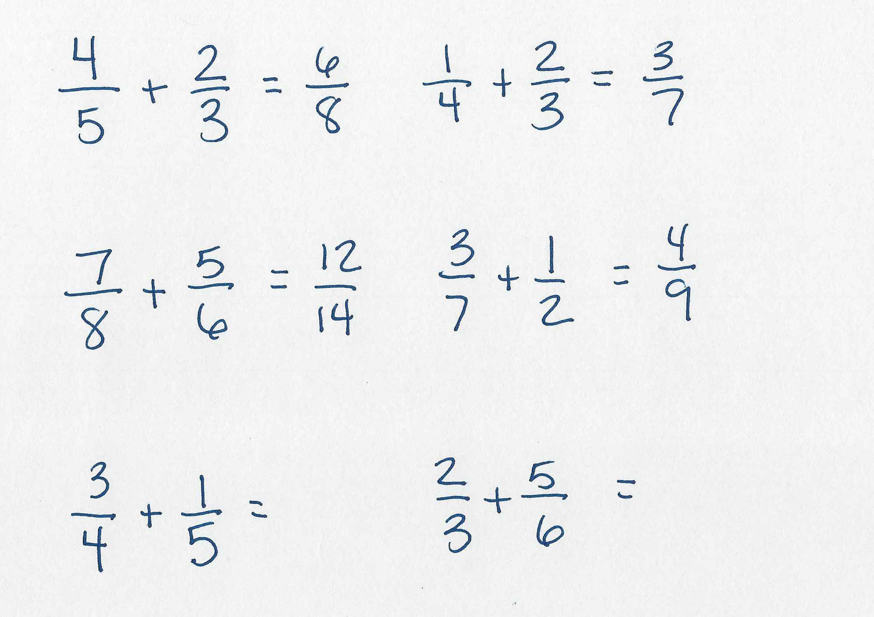
Mindy
Notes:
Let’s start with Mindy. What is the pattern? How is she solving? (Add across numerator; add across denominator.)
Apply the misconception of adding across numerators and denominators. What are the answers to the bottom two problems using this pattern? [4/9 and 7/9]

Slide 95
Mindy
Misunderstandings:
Likely operating with whole number bias
Overgeneralizing multiplication procedures
Relationship between numerator and denominator
Common denominators are required before adding
Understandings:
Basic addition
You add numerators
Notes:
[Read slide.]

Slide 96
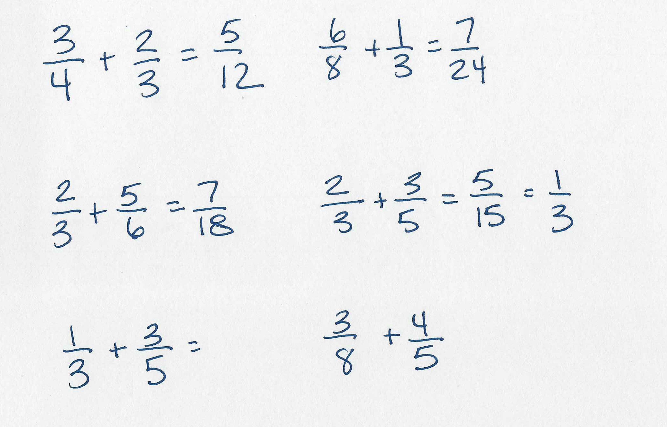
Sam
Notes:
What about Sam? What is the pattern? (Add across numerator; multiply denominator.)
What are the answers to the bottom two problems using this pattern? [4/15 and 7/40]

Slide 97
Sam
Understandings:
Basic addition
You add numerators
Basic multiplication
Sometimes you multiply denominators when you add fractions
Misunderstandings:
Common denominators are required before adding
Relationship between numerator and denominator
A fraction is one number
Notes:
[Read slide.]

Slide 98
Now It’s Your Turn!
We went through the addition examples together.
With a partner, go through the remaining 10 case examples and follow the three procedures:
Identify the error
Follow error pattern to answer subsequent problems
Discuss what the student (mis)understood
We’ll discuss after everyone has had a change to review the remaining 10 error patterns.
Notes:
[Read slide. Allow about 20–30 minutes for error analysis. Discuss as a group, having participants share the error, apply the pattern, and discuss the misconception/misunderstanding.]

Slide 99

Reid
Notes:
What is the pattern? (Change to a common denominator; keep numerator the same.)
What are the answers to the bottom problem using this pattern?
¾ = ¾; ½ = ¼
¾ + ¼ = 4/4

Slide 100
Reid
Understandings:
You must have a common denominator to subtract
When you subtract, the denominator does not change
You subtract the numerators
Misunderstandings:
Relationship between numerator and denominator
A fraction is one number
Notes:
[Read slide.]

Slide 101


Ann
Notes:
What is the pattern that Ann is displaying? (Correctly converts m to I, but then keeps the whole number; changes the smaller denominator to larger without considering the numerator and denominator relationship.)
What is the answer to the bottom problem using this pattern?
5 3/8 = 5 43/8
2 ½ = 2 5/8
Answer = 3 38/8

Slide 102
Ann
Misunderstandings:
An improper fraction does not have a whole number component
Relationship between numerator and denominator
  You can’t just rewrite a denominator without also changing the numerator
Understandings:
How to correctly convert from improper to mixed number
Multiplication
Addition
Notes:
[Read slide.]

Slide 103


Carol
Notes:
What about Carol? What is the pattern? (Subtracts across Ns and Ds and WNs. Disregards the need to regroup and subtract smaller from larger regardless of subtrahend and minuend.)
What are the answers to the remaining two problems using this pattern?
3 1/6
3 2/4

Slide 104
Carol
Understandings:
Subtraction basic facts
Misunderstandings:
Operating with whole number bias
Relationship between numerator and denominator
A fraction is one number
When regrouping is necessary
Notes:
[Read slide.]

Slide 105

Andy
Notes:
What is the pattern that Andy is demonstrating? (Does not regroup.)
What are the answers to the bottom two problems using this pattern?
2 2/5
1 1/3

Slide 106
Andy
Understandings:
Subtraction basic facts
Misunderstandings:
Regrouping
Place value with fractions
Notes:
[Read slide.]

Slide 107


Dan
Notes:
What is the pattern Dan is exhibiting? (Multiply all the numbers.)
What are the answers to the bottom two problems using this pattern?
72
360

Slide 108
Dan
Understandings:
Multiplication
Misunderstandings:
Relationship between numerator and denominator
A fraction is one number
Answer should be a fraction
Notes:
[Read slide.]

Slide 109


Lynn
Notes:
Review Lynn’s work. What is the pattern? (Multiply the N and D by the whole number, which results in an equivalent fraction, not a multiple of the original fraction.)
What are the answers to the bottom two problems using this pattern?
12/32
10/12

Slide 110
Lynn
Understandings:
Multiplication basic facts
Misunderstandings:
How to write a whole number in fraction form
Multiplying by a whole number and rewriting an equivalent fraction are different activities
Notes:
[Read slide.]

Slide 111


Lindsay
Notes:
Review Lindsay’s work. What is the pattern? (Divide across; ignore remainder.)
What are the answers to the bottom two problems using this pattern?
1/3
2/3

Slide 112
Lindsay
Understandings:
Division concept
Misunderstandings:
Divides across; misapplies multiplication procedures
What remainders mean in division
Notes:
[Read slide.]

Slide 113


Joy
Notes:
What is Joy’s pattern? (Invert the dividend and multiply when you should invert the divisor.)
What are the answers to the bottom two problems using this pattern?
16/15
2/4

Slide 114
Joy
Understandings:
Fraction division requires rewriting a fraction inverted
After inverting a fraction, you change the sign to multiplication
Misunderstandings:
Student rewrites the dividend instead of the divisor in division problem
Notes:
[Read slide.]

Slide 115

Toby
Notes:
What is the pattern? THIS one is tough and weird and sometimes results in the correct answer:
Interview student to get a sense of what they’re doing.
Toby is associating a certain factor/number with a larger number and just reduces to that—sometimes it works, sometimes not.
What are the answers to the bottom two problems using this pattern?
½
¼

Slide 116
Toby
Understandings:
Simplest terms makes the numerator and denominator smaller in a fraction
Misunderstandings:
To simplify, you must divide by the same number in the numerator and denominator
Simplest terms fraction and original are equivalent (have the same magnitude)
Notes:
[Read slide.]

Slide 117

Susan
Notes:
What is the pattern? How many times does the numerator go into the denominator? Susan is keeping the denominator the same. What’s the weird example?
What are the answers to the bottom two problems using this pattern?
2/6
1/6

Slide 118
Susan
Understandings:
Simplest terms makes the numerator smaller in a fraction
Misunderstandings:
When you simplify, the denominator will also change
To simplify, you must divide by the same number in the numerator and denominator
Simplest terms fraction and original are equivalent (have the same magnitude)
Notes:
[Read slide.]

Slide 119
Determining and Practicing Evidence-Based Approaches

Slide 120
Activity: Instructional Planning
Select two/three case examples (error patterns):
  Based on the error pattern and the understandings/misunderstandings.
  Design instructional modifications:
    Manipulatives?
    Number lines?
    What concepts to reinforce?
    What procedures to reinforce?
    Examples/nonexamples?
Notes:
Depending on time, we will do anywhere between one and three case examples.
Let’s practice with Mindy.

Slide 121
Mindy
Understandings:
Basic addition
You add numerators
Misunderstandings:
Likely operating with whole number bias
Overgeneralizing multiplication procedures?
The relationship between numerator and denominator
Common denominators are required before adding
Notes:
[Read slide.]

Slide 122
Teaching Concept of Fraction Addition: Fraction Tiles
Notes:
Let’s review this example taken from the NCII fraction module.
First example: Goes back to the idea of what you’re doing when adding unit fractions—part of CCSS; reinforces composing/decomposing.
Second example: Shows adding with different Ds; shows one way to get the answer.
What else could you add to this instruction to reinforce why you can’t and shouldn’t add across?

Slide 123







Teaching Procedures for Fraction Addition
$$\frac{4}{8}$$
$$\frac{3}{4}+\frac{4}{8}=$$
$$\frac{1}{8}$$
$$\frac{2}{8}$$
$$\frac{3}{8}$$
0
$$\frac{3}{4}$$
1
$\frac{10}{8}$
or
1 $\frac{2}{8}$
2
Notes:
How would you add 4/8 to ¾?

Slide 124
Linking Concepts and Procedures: Fraction Addition
Concepts
  Denominators must be the same to add
Procedures
  Ways to find common denominators (Tiles, number lines, rewrite equivalent fractions)
For the error of adding across, what concepts and procedures are required?
Any others?
124
Notes:
[Read slide.]

Slide 125
Your Turn!
You have some blank pages to design instruction.
Pick a case from error analysis.
Determine understandings and misunderstandings.
Think about how you would reinforce the concepts and procedures to demonstrate correct work.
Design instruction to meet these needs .
Ideally, select three cases (we’ll watch the time!).
These lesson plans can be rough—but mathematical correctness is key! Consider drawing and/or writing out procedural steps to reteach these concepts.
We will share some ideas.
Notes:
[Read slide. If teachers don’t know which cases to choose, they should focus on their grade level or revisit the CCSS for which concepts are relevant by grade.]

Slide 126
Debrief and Share
Any surprises?
What misconceptions were exhibited?
What were instructional needs?
Notes:
[Read slide.]

Slide 127
References
Geary, D. C., Hoard, M. K., Nugent, L., & Bailey, D. H. (2012). Mathematical cognition deficits in children with learning disabilities and persistent low achievement: A five year prospective study. Journal of Educational Psychology, 104, 206-223. https://doi.org/10.1037/a0025398
Booth, J. L., & Newton, K. J. (2012). Fractions: Could they really be the gatekeeper’s doorman? Contemporary Educational Psychology, 37(4), 247 - 253. https://doi.org/10.1016/j.cedpsych.2012.07.001
Brown, G. & Quinn, R.(2007). Investigating the relationship between fraction proficiency and success in algebra. The Australian Mathematics Teacher, 63(4), 8 – 15.
Case, R., Okamoto, Y., Griffin, S., McKeough, A., Bleiker, C., Henderson, B., . . . Keating, D. P. (1996). The role of central conceptual structures in the development of children's thought [Monograph]. Monographs of the Society for Research in Child Development, 61(1-2, Serial No. 246).
Fuchs, L., Schumacher, R., Malone, A., & Fuchs, D. (2015). Fraction face-off! Fraction foundation tutoring program for fourth grade. Nashville, TN Vanderbilt University.

Slide 128
References
Malone, A. S., & Fuchs, L. S. (2017). Error patterns in ordering fractions among at-risk fourth-grade students. Journal of Learning Disabilities, 50(3), 337–352.
Ni, Y. & Zhou, Y.D. (2005). Teaching and learning fraction and rational numbers: the origins and implications of whole number bias. Educational Psychologist, 40(1), 27 – 52.
Rittle-Johnson, B., Siegler, R. S., & Alibali, M. W. (2001). Developing conceptual understanding and procedural skill in mathematics: An iterative process. Journal of Educational Psychology, 93(2), 346.
Siegler, R., Duncan, G., & Davis-Kean, P. (2012). Early predictors of high school mathematics achievement. Psychological Science, 23(7), 691 – 700.

Slide 129
References
Siegler, R. S. & Lortie-Forgues, H. (2014). An integrative theory of numerical development. Child Development Perspectives, 8, 144-150. doi: 10.1111/cdep.12077
Silver, E. A. (1986). Using conceptual and procedural knowledge: A focus on relationships. In J. Hiebert (Ed.), Conceptual and procedural knowledge: The case of mathematics (pp. 181–198). Lawrence Erlbaum Associates, Inc.
Vaughn, S., Wanzek, J., Murray, C. S., & Roberts, G. (2012). Intensive interventions for students struggling in reading and mathematics: A practice guide. Portsmouth, NH: RMC Research Corporation, Center on Instruction. Retrieved from http://www.centeroninstruction.org/files/Intensive%20Interventions%20for%20Students%20Struggling%20in%20Reading%20%26%20Math.pdf
Woodward & Stroh. (2015). TransMath®. Voyager Sopris Learning®.
Wu. (2010). Teaching fractions: Is it poetry or mathematics? Conference presentation at National Council of Teachers of Mathematics, San Diego, CA.

Slide 130
Disclaimer
This module was produced under a grant from the Investing in Innovation Fund (i3), U.S. Department of Education, Award No. U411C140029.
The views expressed herein do not necessarily represent the positions or polices of the U.S. Department of Education. No official endorsement by the U.S. Department of Education of any product, commodity, service, or enterprise mentioned in this website is intended or should be inferred.

Slide 131
1000 Thomas Jefferson Street NW
Washington, DC 20007-3835
General Information: 202-403-5000 www.air.org

