Slide 1
Virtual Literacy Lesson
Supporting Foundational Reading Skills
Karen McWilliams, 504 Coordinator/ Dyslexia Teacher | Rochelle ISD, TX

Slide 2
Schedule
Stay in my area.
Follow directions the first time.
☺
Have fun!

Slide 3
Visual Drill
a

Slide 4
Consonant Digraphs

Slide 5
ch

Slide 6
sh

Slide 7
th

Slide 8
ph

Slide 9
wh

Slide 10
R-Controlled Vowels

Slide 11
ar

Slide 12
er

Slide 13
ir

Slide 14
or

Slide 15
ur

Slide 16
Schedule
Stay in my area.
Follow directions the first time.
☺
Have fun!

Slide 17
Say It and Move It

Slide 18
Say it and Move it

Slide 19
Schedule
Stay in my area.
Follow directions the first time.
☺
Have fun!

Slide 20
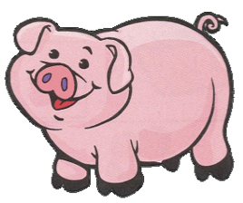
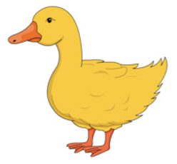
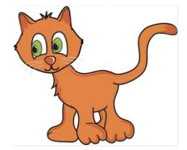
Sorting Game

Slide 21
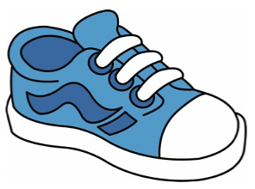
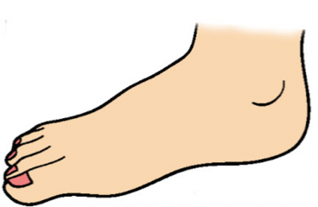
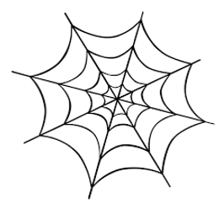
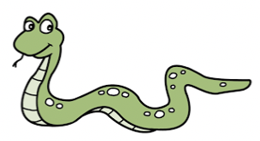
Sorting Game

Slide 22
Schedule
Stay in my area.
Follow directions the first time.
☺
Have fun!

Slide 23
Irregular Words
you

Slide 24
few

Slide 25
last

Slide 26
land

Slide 27
ask

Slide 28
world

Slide 29
own

Slide 30
add

Slide 31
below

Slide 32
while

Slide 33
answer

Slide 34
Schedule
Stay in my area.
Follow directions the first time.
☺
Have fun!

Slide 35
Sentence Writing
The cat is on
the mat.

Slide 36
Schedule
Stay in my area.
Follow directions the first time.
☺
Have fun!

Slide 37
Connected Text
http://textproject.org/assets/products/fyi-for-kids/FYI-for-Kids-Level-5-ALL.pdf
Notes:
For text at levels 1-4: http://textproject.org/teachers/students/fyi-for-kids/

Slide 38
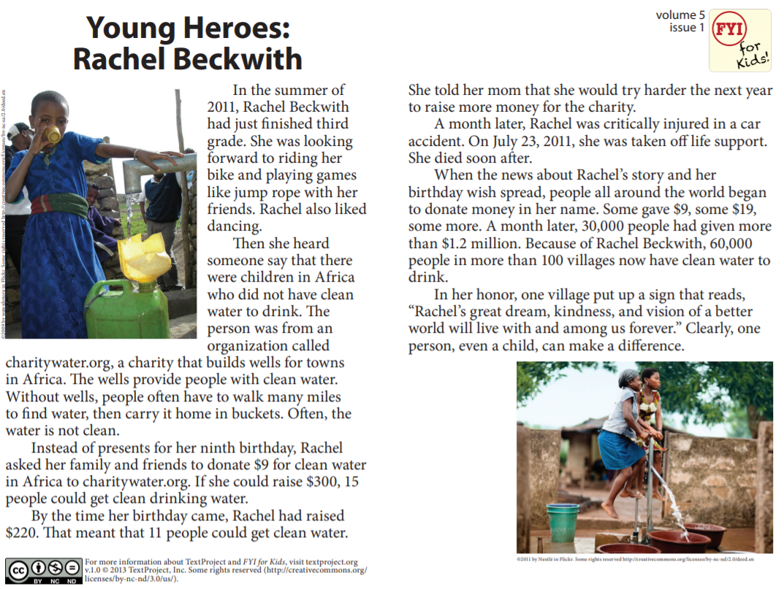
Connected Text

Slide 39
Schedule
Stay in my area.
Follow directions the first time.
☺
Have fun!

Slide 40
You did it!
FAVORITE THING SHOW & TELL!

