Slide 1
Introduction to Data-Based Individualization (DBI): Considerations for Implementation in Academics and Behavior
Notes:
Introduction to the module
This is the first in a series of training modules developed by the National Center on Intensive Intervention (NCII) aimed at district or school teams involved in initial planning for using DBI as a framework for providing intensive intervention in academics and behavior. The audience for this module may include the behavior support team, interventionists, special educators, school psychologists, counselors, and administrators, as appropriate. Subsequent modules will provide additional information about specific components of the DBI process. More information about NCII’s approach to intensive intervention can be found in the NCII concept paper Data-Based Individualization: A Framework for Intensive Intervention. The concept paper is available at http://www.intensiveintervention.org/sites/default/files/Data-based_Individualization_A_Framework.pdf.
Instructions for using the speaker notes
Text formatted in standard font is intended to be read aloud or paraphrased by the facilitator.
Text formatted in bold is excerpted directly from the presentation slides.
Text formatted in italics is intended as directions or notes for the facilitator; italicized text is not meant to be read aloud.
Text formatted in underline indicates an appropriate time to click to bring up the next stage of animation in an animated slide.
Speaker notes for Title Slide
Welcome participants to the training on Data-Based Individualization (DBI). Introduce yourself (or selves) as the facilitator(s) and briefly cite your professional experience with regard to intensive intervention and DBI
Please note that pen and paper will be required for the Think-Pair-Share activity (Slide 24).
The following handouts should be provided to participants:
“Handout 1: Instruction and Intervention Inventory” for Activity 1 (see Slide 34)
“Handout 2: Academic Intervention Progression” visual to accompany Academic Illustration (see Slide 36)
“Handout 3: Behavioral Progression” visual to accompany Behavior Illustration (see Slide 59)
While permission to reprint this publication is not necessary, the citation should be:
National Center on Intensive Intervention (July, 2013). Introduction to Data-Based Individualization (DBI): Considerations for Implementation in Academics and Behavior, DC: U.S. Department of Education, Office of Special Education Programs, National Center on Intensive Intervention.

Slide 2
Today’s Presentation
Overview
Rationale for intensive intervention
Introduction to Data-Based Individualization (DBI)
Academic illustration
Behavior illustration
Wrap-up
Notes:
Read slide.
The agenda may be changed to fit the time frame and focus of the training.
This module takes 2.5–3.5 hours to complete (including slide presentation and integrated activities). A good time to take a break is after Activity 1, before beginning the Academic Illustration (Slide 36). An alternative break time is after the Academic Illustration, before beginning the Behavior Illustration (Slide 59).

Slide 3
Learning Objectives:
By the end of today, participants will be able to…
Understand the rationale for intensive intervention.
Describe the progression of the DBI process.
Name two important features that distinguish secondary (e.g., Tier 2) from intensive intervention.
Provide examples of quantitative and qualitative intervention changes.
Notes:
The learning objectives for this training are:
Read slide to participants.

Slide 4
What is intensive intervention?
Intensive intervention is designed to address severe and persistent learning or behavior difficulties. Intensive interventions should be:
Driven by data
Characterized by increased intensity (e.g., smaller group, expanded time) and individualization of academic instruction and/or behavioral supports
Notes:
Read slide to highlight distinguishing characteristics of intensive intervention.

Slide 5
Rationale for Intensive Intervention
  Students with disabilities have a history of poor outcomes, compared to their peers without disabilities, in several areas:
    Academic achievement
    High school completion
    Postsecondary education
    Employment
    Involvement with the criminal justice system
Notes:
Read slide.

Slide 6
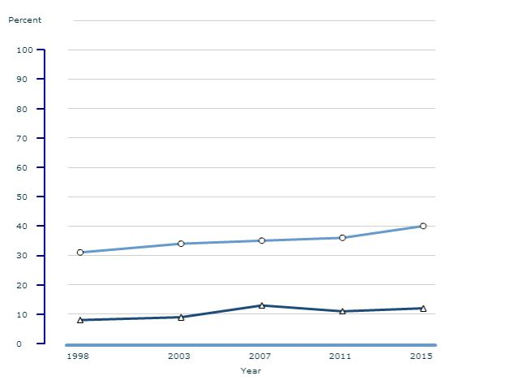
Example:
NAEP Reading, Percentage of Fourth-Grade Students at or Above “Proficient” (1998–2015)
Students w/ no identified disability
Students w/ disabilities
(http://nationsreportcard.gov/)
Notes:
This graph compares the performance across time of students with disabilities (bottom line) and without disabilities (top line) in fourth-grade reading on the National Assessment of Educational Progress (NAEP). 12 percent of fourth-graders with disabilities performed at or above the “Proficient” level on the NAEP in 2015, compared to 40 percent of their non-disabled peers. This proficiency rate is up from 11 percent in 2011 (p < .05). Patterns are similar at eighth grade (8 percent Proficient) and for mathematics (16 percent at fourth grade and 8 percent at eighth grade).
Continuing a decade long trend, NAEP data highlight a discrepancy of 30 percentage points between IEP students and total student performance (The NAEP Data Explorer Data; The Special Ed Connection, November 12, 2013). Whether measured by grade level proficiency, grade-point average, or credits earned, students with disabilities consistently
fall behind their classmates (Blackorby et al., 2007; Council for Exceptional Children, 2013; Newman et al., 2011a; USED, 2012b; Wagner et al., 2006).
(Downloaded from http://nationsreportcard.gov/).
Additional information:
The NAEP DATA explorer reports that 67 and 45 percent of fourth-graders with IEDs performed below “below basic” in reading and math respectively in 2015. Similarly, 63 and 68 percent of eighth-graders with IEPs performed below “below basic” in reading and math respectively in 2015.

Slide 7
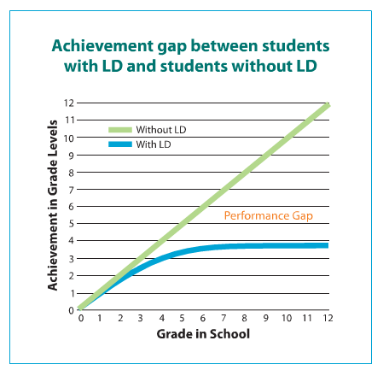
Rationale for Intensive Intervention: Growing Achievement Gap
(Cortiella, 2011, p. 15)
Notes:
The achievement gap between students with and without a learning disability (LD) increases as students advance from one grade to the next. By the secondary level, students with an LD are, on average, three years behind in reading and mathematics.

Slide 8
Rationale for Intensive Intervention: Dropout Rates
All students (2010): 7.4 percent
All students with disabilities (2006): 26.2 percent
  Learning disabilities: 25.1 percent
  Emotional disturbance: 44.9 percent
  Intellectual Disability (formerly mental retardation): 22.3 percent
  Other health impaired: 23.4 percent
(Aud et al., 2012; Planty et al., 2008)
Notes:
Note: There are differences in how “dropout” was defined in these sources (The Condition of Education 2012 and 2006), and 2006 was the latest available data broken out for students with disabilities.
In general, students with disabilities have a much higher dropout rate. Students in the Emotional Disturbance category had the highest dropout rate of all disability categories, followed by Learning Disabilities.

Slide 9
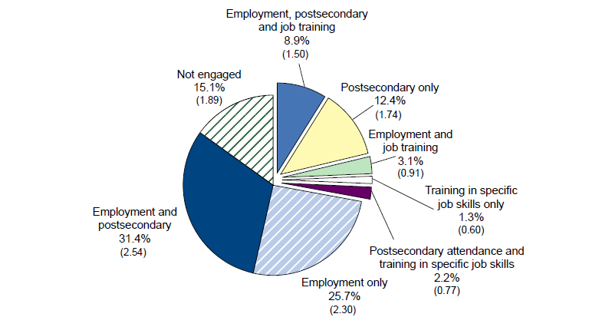
Rationale for Intensive Intervention: Modes of Postsecondary Engagement Among Students With Disabilities
Note: Standard errors are in parentheses.
(Sanford et al., 2011, p. 33)
Notes:
These data come from the National Longitudinal Transition Study-2 (NLTS-2).
This pie chart shows how young adults with disabilities were engaged after high school. Overall, 15 percent had not engaged in paid employment, job training, or postsecondary education since leaving high school. This is significantly higher than the rate of 5 percent for young adults in the general population. Furthermore, 25.7 percent of students with disabilities were engaged in employment only, suggesting lower wages than those who gained employment following postsecondary education (see next slide).

Slide 10
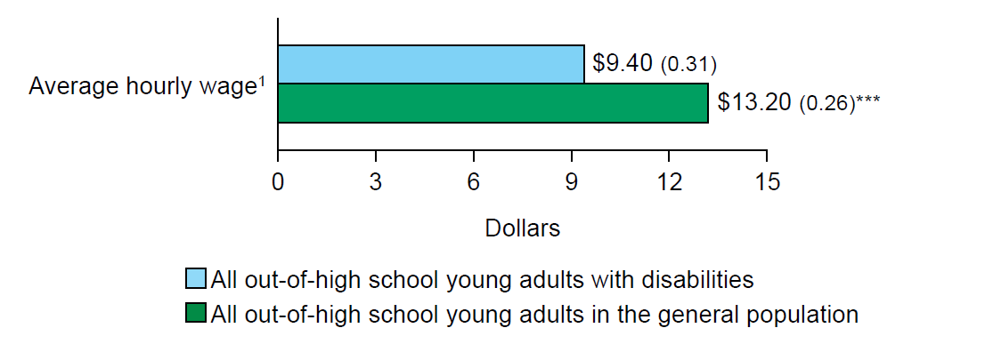
Need for Intensive Intervention: Wage Comparison by Disability Status
(**p < .01; Sanford et al., 2011, p. 27)
Notes:
These data come the National Longitudinal Transition Study-2 (NLTS2).
Students with disabilities earn lower wages than their peers without disabilities. When considered within the context of their low rate of participation in postsecondary education, this wage gap is likely to grow with time, as many students with disabilities will not develop the skills necessary to advance into higher paying jobs.

Slide 11
Percentage of Young Adults With Disabilities Who Have Ever Enrolled in Postsecondary Education
Notes:
These data come the National Longitudinal Transition Study-2 (NLTS2).
Only 54.9 percent of young adults with disabilities have ever enrolled in any postsecondary education, compared to 62.1 percent of young adults in the general population.

Slide 12
Need for Intensive Intervention: Percentage of Young Adults With Disabilities Completing Postsecondary School (Among Those Ever Enrolled)
Notes:
These data come the National Longitudinal Transition Study-2 (NLTS2).
Among young adults who ever enrolled in postsecondary college (54.9 percent of students with disabilities), completion rate is significantly lower among students with disabilities (38.4 percent) than young adults without disabilities (51.2 percent).

Slide 13
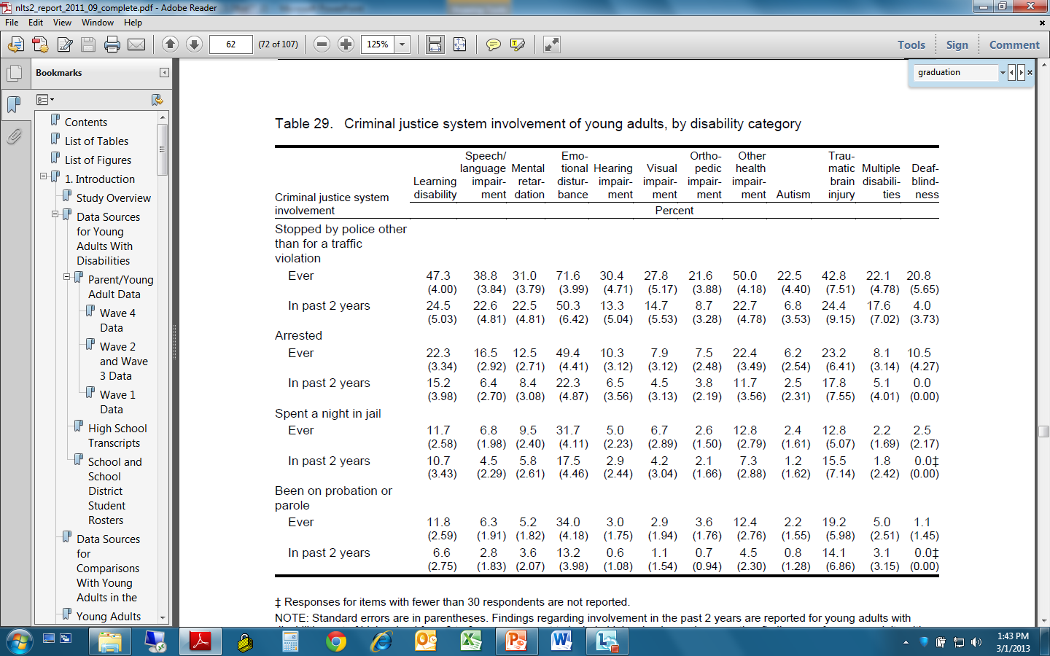
Need for Intensive Intervention: Interaction With Criminal Justice System
Arrested one or more times
Parole one or more times
Twenty-three percent of young adults with disabilities have been arrested at least once, approximately twice the rate for youth in the general population (12%; p < .001).
(Sanford et al., 2011)
Notes:
Twenty-three percent of young adults with disabilities have been arrested at least once, almost twice the rate for youth in the general population (12 percent). Rates for arrest and parole are highest among students identified as having Emotional Disturbance (49.4 percent).

Slide 14
What do these data suggest?
On average, students with disabilities continue to have low academic achievement.
Despite improvements over the past two decades, students with disabilities continue to drop out of school at unacceptably high rates.
Low postsecondary completion rates suggest many students with disabilities lack the skills and supports (social/emotional, financial, and academic) needed to graduate.
The low rates of postsecondary engagement among young adults with disabilities puts them at risk for a lifetime of unstable employment and low-wage work and may also contribute to high incarceration rates.
Our current K–12 system may not adequately prepare students with disabilities for school, work, and life.
Notes:
(Sanford et al., 2011)
Read slide.

Slide 15
What can we do?
Positive outcomes are possible!
Reading intervention research
  Intensive intervention is associated with improved reading across skills and grades
High-performing sites
  Students with disabilities in innovative districts are more likely to do well on state achievement tests
Notes:
While students with disabilities still face poorer outcomes on average, these outcomes can be improved.

Slide 16
Mean Effect Sizes for Students With Reading Difficulties Provided Intensive Interventions
Student Outcome | Early Elementary K–3 |  | Upper Grades 4–9
 | Mean ES | No. of Effects | Mean ES | No. of Effects
Comprehension | .46 | 25 | .09 | 37
Reading Fluency | .34 | 11 | .12 | 8
Word Reading | .56 | 53 | .20 | 22
Spelling | .40 | 24 | .20 | 5
Note: ES = effect size
(Wanzek et al., 2013)
Notes:
A meta-analysis of extensive interventions (75 or more sessions not part of the general curriculum) found positive results for students with learning disabilities or reading difficulties, with stronger effect sizes for early elementary.

Slide 17
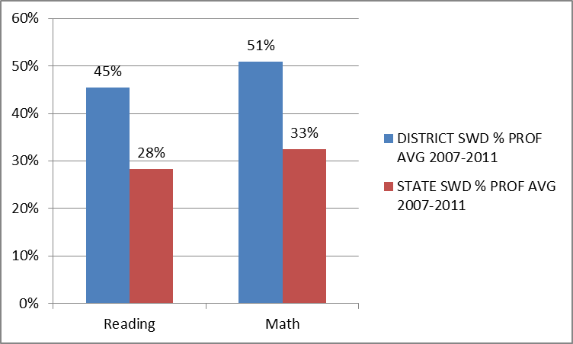
Okaloosa, Florida: Average percentage of students with disabilities achieving proficiency on the state reading and mathematics tests, compared to the state average: 2007–2011
Notes:
As part of its knowledge development activities, NCII identified high-performing districts. Okaloosa was the No. 1 ranked district in the state of Florida. The students with disabilities in this district were much likelier to achieve a proficient score on state tests compared to the state average.

Slide 18
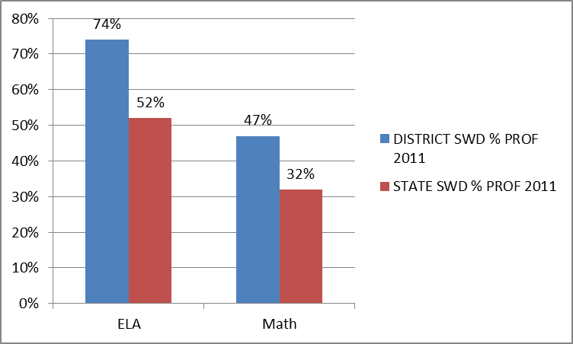
Jenison, Michigan: Average percentage of students with disabilities achieving proficiency on the state reading and mathematics tests, compared to the state average: 2011
Notes:
Jenison was nominated due to its involvement with MiBlisi, Michigan's Integrated Behavior and Learning Support Initiative. Jenison’s students with disabilities outperformed the state average in both mathematics and English language arts (ELA), with almost three quarters achieving proficiency in ELA.

Slide 19
Patterns Observed in High-Performing Sites
Intensive intervention is embedded within a multi-tiered system of support (MTSS) such as Response to Intervention (RTI) or positive behavioral interventions and supports (PBIS).
Progress monitoring data collected to determine response to intervention.
Challenges remain:
  Unclear distinction between secondary (Tier 2) and intensive (tertiary/Tier 3) interventions
  Intensity of intervention defined more often in “quantitative” ways than in “qualitative” ways
  Use of progress monitoring data more clearly defined and well established in reading than in mathematics or behavior
Notes:
Data-based individualization helps to address these challenges.

Slide 20
Introduction to Data-Based Individualization (DBI)
Notes:
Now that we have identified the challenges facing students with disabilities, and shown that positive outcomes are possible, we would like to introduce data-based individualization, NCII’s approach to intensive intervention.

Slide 21
NCII’s Approach to Intensive Intervention: Data-Based Individualization (DBI)
  Data-Based Individualization (DBI) is a systematic method for using data to determine when and how to provide more intensive intervention:
  Origins in data-based program modification/experimental teaching were first developed at the University of Minnesota (Deno & Mirkin, 1977) and expanded upon by others (Capizzi & Fuchs, 2005; Fuchs, Deno, & Mirkin, 1984; Fuchs, Fuchs, & Hamlett, 1989).
  DBI is a process, not a single intervention program or strategy.
  Not a one-time fix—ongoing process comprising intervention and assessment adjusted over time.
Notes:
Read slide.

Slide 22
Who needs intensive intervention?
Students with disabilities who are not making adequate progress in their current instructional program
Students who present with very low academic achievement and/or high-intensity or high-frequency behavior problems (typically those with disabilities)
Students in a tiered intervention program who have not responded to secondary intervention programs delivered with fidelity
Notes:
Note for second bullet:
The decision to move a student directly to an intensive intervention should be made on an individual and case-by-case basis. In most cases, data should be collected over time to help demonstrate that the student’s low achievement/behavior challenges are both significant AND persistent.

Slide 23
Is DBI the same as RTI?
Special education?
Many components of DBI are consistent with elements of special education and tiered service delivery systems.
Tiered Interventions (RTI, MTSS, PBIS)
Universal, secondary, and tertiary interventions
Progress monitoring
Team-based decisions based on data
Special Education
Individualized intervention
Progress monitoring
Team-based decisions based on data
Notes:
When thinking of students with the most intense needs, it may be natural to think of students who qualify for special education services, or those students who require the most intensive services available in tiered intervention systems such as Response to Intervention (RTI), multi-tiered system of support (MTSS), or positive behavioral interventions and supports (PBIS).
Many components of DBI are consistent with elements of special education and tiered service delivery systems. The individualization aspect of DBI is aligned with the principles of serving students with diverse needs.
Progress monitoring and team-based decisions based on data are shared, key components of DBI, tiered interventions, and special education. Students who are likely to benefit from DBI may be, but are not necessarily, receiving special education.
DBI is often built upon tiered systems, with strong universal and secondary interventions serving as precursors to individualization.

Slide 24
Think-Pair-Share
In what ways are Tier 3/intensive interventions in your school different from special education services? In what ways are they the same?
Notes:
Think about how intensive interventions and special education services in your school are different and similar.
Give participants approximately 20 seconds.
Pair and share with your neighbor/table and jot down your answer.
Give participants approximately two to three minutes.
Allow two or three pairs/tables to orally share their answers.

Slide 25
Five DBI Steps
Secondary intervention program, delivered with greater intensity
Progress monitoring
Informal diagnostic assessment
Adaptation
Continued progress monitoring, with adaptations occurring whenever needed to ensure adequate progress
Notes:
Throughout the DBI process, we use progress monitoring data to evaluate a student’s response to intervention, moving to the next component as needed:
Secondary intervention program, delivered with greater intensity. We usually begin by intensifying the secondary intervention already being used.
Progress monitoring data are used to evaluate the student’s response to the intensified intervention. If the student is still not showing enough progress, we collect and review additional data to determine specific skill deficits.
Informal diagnostic assessment data are used to identify skill deficits, which tell us how the intervention needs to be changed.
Adaptation. Based on data, we may choose to adapt the current intervention or try a new intervention.
Continued progress monitoring, with adaptations occurring whenever needed to ensure adequate progress.

Slide 26
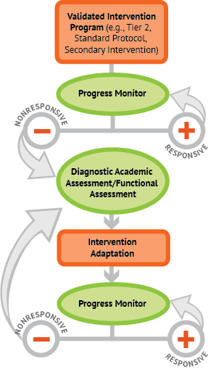

A Bird’s Eye View of DBI
Notes:
Animated slide. Click at underlined text.
NCII uses this graphic to illustrate the progression of DBI. We begin with a secondary intervention program, delivered with greater intensity, and progress monitor to determine the student’s response. If the student is responsive, we can continue the current intervention or consider reducing intensity as goals are met (depending on rate and duration of response and nature of skill deficits). If the student is not sufficiently responsive, we gather additional information through informal diagnostic assessment, which identifies student needs to guide intervention adaptations. We continue progress monitoring to make decisions about whether or not the student is responding to the adapted intervention.

Slide 27
Before we begin DBI…
Start with a standardized secondary program (if available; e.g., Check-in/Check-out, Good Behavior Game, Number Rockets*).
Progress monitor to evaluate the student’s response to the secondary intervention.
*NCII does not endorse products. These are noted for illustrative purposes only.
Notes:
In most cases, we want to give students the chance to respond to a secondary intervention appropriate to their needs before we determine that they need intensive, individualized interventions. After we go over the DBI steps, we will talk more about what we mean by secondary interventions.

Slide 28
What are secondary interventions?
Standardized, evidence-based interventions designed for at-risk students
Often referred to as…
  Tier 2 or strategic intervention
  Remedial curriculum
Common examples
  Leveled Literacy Intervention (LLI)
  Wilson Just Words
  Check-in/Check-out
  Corrective Math
Notes:
Secondary interventions are standardized, evidence-based interventions designed for at-risk students. They are sometimes scripted and involve detailed lesson components and a specific scope and sequence.

Slide 29
Thinking About Intervention Levels/Tiers
 | Primary (T1) | Secondary (T2) | Intensive (T3)
Instruction/ Intervention Approach | Comprehensive research-based curriculum | Standardized, targeted small-group instruction | Individualized, based on student data
Group Size | Class-wide (with some small group instruction) | 3–7 students | No more than 3 students
Monitor Progress | 1x per term | At least 1x per month | Weekly
Population Served | All students | At-risk students | Significant and persistent learning needs
Notes:
Review table. Highlight the differences between the tiers in terms of:
Increasingly focused/tailored approach
Decreasing group size
Increasing frequency of progress monitoring
Increasing student need

Slide 30
Key Questions About the Secondary Intervention
  Has the student been taught using an evidence-based secondary intervention program (if available) that is appropriate for his or her needs?
  Has the program been implemented with fidelity?
    Content
    Dosage/schedule
    Group size
  Has the program been implemented for a sufficient amount of time to determine response?
Notes:
In most cases, we would not determine that a student requires data-based individualization until we have evidence that she or he is not responding to secondary intervention. Key questions in reviewing this evidence include—
Has the student been taught using an evidence-based secondary intervention program (if available) that is appropriate for his or her needs? The secondary intervention should match the student’s identified needs.
Has the program been implemented with fidelity? Fidelity addresses whether or not the intervention is being delivered as planned.
Content. Are all key components being delivered per instructions?
Dosage/schedule. Has the intervention been delivered as intended in terms of frequency and length of sessions?
Group size. Is the group the size recommended by the intervention developer? You might also want to consider the group composition—do these students have similar needs that match the intervention? Do any students have competing behavior issues?
Has the program been implemented for a sufficient amount of time to determine response? Consider this question in terms of how long the intervention is intended to be implemented and also in terms of having enough data to detect a change in performance.

Slide 31

Why start with a standardized, evidence-based program?
When properly aligned to students’ needs, they tend to work—teachers don’t need to “reinvent the wheel.”
They are efficient—teachers can plan instruction for groups rather than individual students.
Many require only a modest amount of training—often, paraeducators can help with delivery.
Often inexpensive.
Notes:
Read slide.

Slide 32
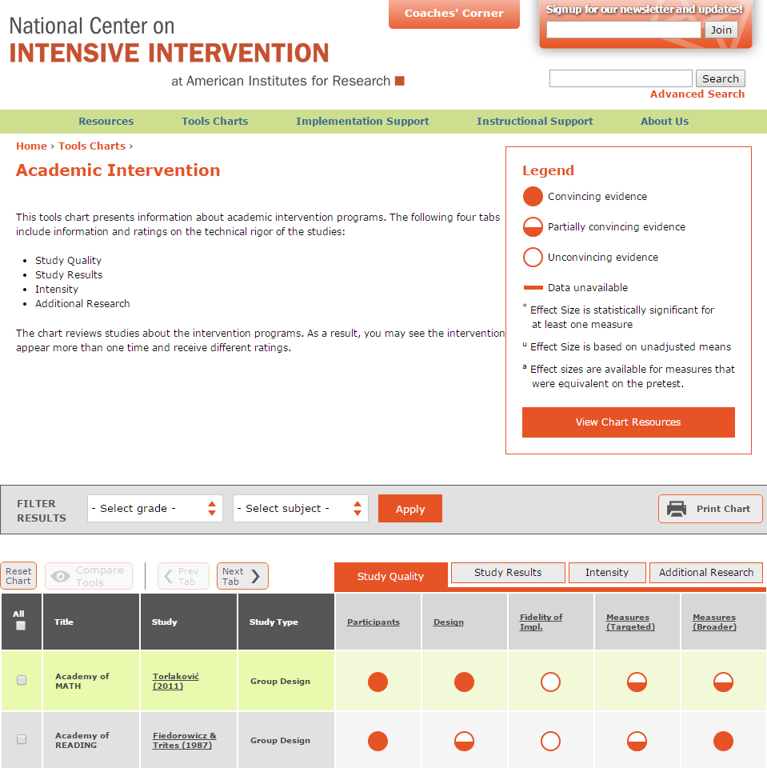
NCII’s Intervention Tools Chart Provides Reviews of Secondary Intervention Programs
http://www.intensiveintervention.org/resources/tools-charts
Notes:
See the NCII website for training resources for using the tools charts. Tools charts are updated annually, so check the site for changes and new content.

Slide 33
Can I still implement DBI if I don’t have a complete menu of standardized programs?
Yes!
Use them when available and consider augmenting current offerings if there are content areas where you have insufficient resources.
Also consider—
  Remediation materials that came with your core program
  Expert recommendations (if evidence-based programs are not available) from Institute of Education Sciences (IES) practice guides, reputable professional organizations, etc.
  Standards-aligned materials
  Collect data to determine whether most students are profiting.
Notes:
Sources for recommendations include:
What Works Clearing house http://ies.ed.gov/ncee/wwc/, which includes IES practice guides

Slide 34
Handout 1: Instruction and Intervention Inventory (Optional)
See “Instruction and Intervention Inventory” handout.
As a team, take 10 minutes to discuss:
  Core program offerings (do this quickly and then focus on interventions at Tiers 2 and 3).
  Available standardized intervention programs in your school in reading, mathematics, and behavior (for Tier 2).
  Supports provided at the intensive (Tier 3) level.
  Areas in need of additional resources at either the Tier 2 or Tier 3 intervention levels.
Notes:
Use Handout 1—Instruction and Intervention Inventory.
The purpose of this optional activity is to have teams:
Consider current secondary practices and how they differ from current Tier 3/ intensive practices.
Begin to think about the role of standardized versus individualized intervention as critical features when planning secondary and intensive intervention groups.
Begin to identify current strengths and needs in their current intervention system.
After teams have discussed the handout for ~10 minutes, bring the group together for a short conversation, if time allows.
Possible questions:
Are you satisfied with current intervention offerings at your school?
What are some advantages/disadvantages of standardized programs?
Do you know if the interventions used at your school are being implemented as planned?
Session length and frequency
Group size
Following standard instructions
What additional information do you need to gather?

Slide 35
Academic Illustration of DBI
Notes:
We will now use an academic case example to illustrate the DBI process.

Slide 36
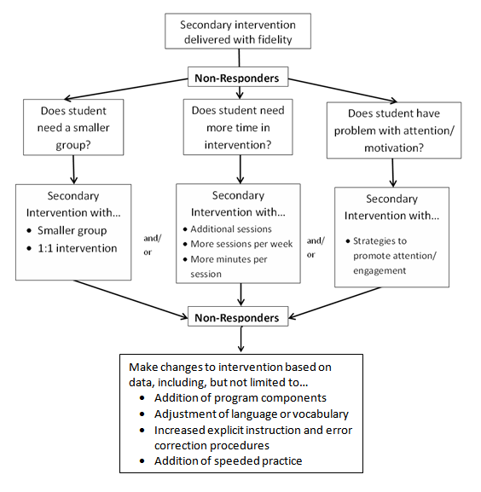
Sample Academic Intervention Progression
Notes:
Animated slide. Click at underlined text to bring up next arrow.
See Handout 2—Academic Intervention Progression for a larger, printable version of this slide.
In this academic illustration, we will walk you through the DBI process for a student having reading difficulties. As in the previous DBI graphic, we begin with a secondary intervention delivered with fidelity. Progress monitoring data identify students who are not responding. Diagnostic assessment helps us determine the student’s needs, and these needs guide our adaptation to the intervention. We continue progress monitoring to determine if the student is responding to the adaptation. If not, we will make more data-based changes.

Slide 37
Secondary Intervention Program:
Student Example—Kelsey
Background: Kelsey presented serious reading problems, reading at an early second-grade level at the beginning of fourth grade.
Intervention program: Kelsey’s teacher selected a research-validated program that addressed phonological awareness, word study, and fluency skills.
Notes:
Read slide.

Slide 38
Secondary Intervention Program: Kelsey
Fidelity
    Group size: six students
    Session length: 20–40 minutes per session
    Frequency: three to four sessions per week
    Program duration: seven weeks
    Instructional content and delivery: explicit instruction covering all components laid out in the instruction manual
    Progress monitoring: Passage Reading Fluency (PRF)
Notes:
Kelsey’s teacher made sure to implement the program with fidelity by following key components (review slide).
Caveat: A small number of students may present with very significant academic or behavioral difficulties where a standardized secondary intervention is unlikely to be effective. Intervention teams may choose to bypass the secondary intervention program in favor of moving directly to intensive intervention in these instances. However, decisions to bypass a standardized secondary program should be made on an individual, case-by-case basis. Progress monitoring data should be reviewed regularly to determine if the student is making progress in his or her intervention program.

Slide 39
Progress Monitoring:
Does Kelsey need DBI?
Reliable and valid tool: Kelsey’s teacher implemented formal progress monitoring using PRF assessments that were a match for her reading skills.
Detect improvement: This progress monitoring tool is appropriate to her skill level, allowing her teacher to detect changes in Kelsey’s reading.
Rate of progress: Based on Kelsey’s progress monitoring graph, she was not progressing at the rate needed to meet her goal.
Notes:
Read slide.

Slide 40
Progress Monitoring:
Kelsey’s Reading
Notes:
This graph shows Kelsey’s reading progress monitoring data using Passage Reading Fluency, with scores in correct words read per minute. The first three scores, before the first vertical line, show her baseline reading assessments. The X on this line shows her average baseline score. This score is connected with her target score, the X on the far right, to form the goal line. The second set of scores was collected during Kelsey’s time in secondary intervention. You can see that all of these scores are below the goal line, suggesting that Kelsey is not responding to the secondary intervention and that she requires an instructional change (the dotted vertical line) to make progress.

Slide 41
Progress Monitoring: Determining Kelsey’s Need for DBI
Notes:
Animated slide. Click at underlined text.
Kelsey’s teacher has determined that the secondary reading intervention has been delivered with fidelity, but Kelsey’s response is not sufficient. She needs more intensive supports, and her teacher will begin the DBI process.

Slide 42
Intervention Adaptation/Change
When appropriate, use data to make adjustments/adaptations to the secondary intervention program to meet the unique needs of the individual.
In some cases, however, data may indicate that the student requires a different intervention program or approach.
Consider two types of intervention change:
  Quantitative changes to setting or format
  Qualitative changes to delivery
Notes:
Read slide.

Slide 43
Try quantitative change(s) first…
    Increase intervention frequency, length of sessions, or duration.
    Decrease group size.
    Decrease heterogeneity of the intervention group.
Note: In many cases, quantitative changes may be necessary, but not sufficient, to facilitate progress for students with intensive needs.
Notes:
Intervention frequency = sessions per week
Length = minutes per session
Duration = number of sessions/how long the student receives the intervention

Slide 44
Consider qualitative changes second…
Qualitative adaptations may be made to the intervention program that alter—
Instruction based on learner characteristics (e.g., addressing working memory or attention problems)
Skill level of interventionist
Content delivery
How students respond
The amount of adult feedback and error correction students receive
Frequency/specificity of checks for retention
The materials, curriculum, or whole intervention (could be a complete change in program)
Notes:
Read slide.

Slide 45
Intensify the Secondary Intervention: Begin With Quantitative Changes
Notes:
Animated slide. Click at underlined text.
Because Kelsey was not responding to the standardized secondary intervention, her teacher decided to intensify it. She believed that Kelsey might benefit from more time in intervention and increased the length of each session. She will continue progress monitoring to determine Kelsey’s response to the intensified intervention.
Note that while Kelsey’s teacher has many possible changes she can make, she is starting with just one. Making too many changes at once is hard to implement and also makes it hard to know which specific adaptations, if any, are affecting a student’s performance.

Slide 46
Quantitative Intervention Adaptation:
Kelsey
Kelsey’s teacher intensified her instruction by adding an additional 15 minutes of instruction per session. Despite this change in intervention length, Kelsey continued to make insufficient progress.
Notes:
Kelsey’s teacher began the DBI process by intensifying the secondary intervention with a quantitative change—increasing each intervention session by 15 minutes. She continued to collect progress monitoring data and found that this change was not yielding enough progress.

Slide 47
Kelsey’s Progress Monitoring Graph
Notes:
The third section of the graph shows Kelsey’s reading performance while receiving additional time in the secondary intervention. Her scores continued to fall below the goal line, suggesting another instructional change is needed. Her teacher decided additional instructional changes were needed.

Slide 48
Diagnostic Assessment: What changes are needed to support Kelsey?
Notes:
Before making qualitative changes, Kelsey’s teacher conducted informal diagnostic assessment to identify Kelsey's specific needs.

Slide 49
Informal Diagnostic Assessment
Progress monitoring assessments help teams determine when an instructional change is needed.
Informal diagnostic assessments allow teams to use available data (e.g., progress monitoring data, informal skill inventories, work samples) to help determine the nature of the intervention change needed.
Notes:
Diagnostic assessment does not have to be exhaustive. It is meant to identify skill deficits to guide us toward appropriate intervention adaptations.

Slide 50
Informal Diagnostic Assessment
Potential data sources:
Classroom-based assessments
Error analysis of progress monitoring data
Student work samples
Standardized measures (if feasible)
Notes:
These are examples of data sources that might be used in diagnostic assessment. You might use one or more of these, or a different data source. Read list. In error analysis, we look at the errors students are making to see if we can identify a pattern that would suggest a skill to be targeted.

Slide 51
Informal Diagnostic Assessment: Kelsey
To determine the nature of the instructional change needed, Kelsey’s teacher conducted an error analysis of Kelsey’s most recent PRF data.
She also administered a phonics survey to determine Kelsey’s decoding strengths and weaknesses.
Notes:
Read slide.

Slide 52
Intervention Adaptation:
Use Diagnostic Information to Adapt the Intervention
Notes:
Once Kelsey’s teacher has identified Kelsey’s needs through diagnostic assessment, she will adapt the intervention using qualitative changes that address those needs.

Slide 53
Intervention Adaptation: Kelsey
Diagnostic assessment showed that Kelsey had difficulty applying decoding strategies to vowel teams. Her teacher applied the following intensive intervention principles to intensify her decoding instruction:
Incorporated fluency practice of newly taught teams, with specified mastery criteria
Provided explicit instruction and error correction
Frequently checked for retention with reteaching as needed
Notes:
Read slide.

Slide 54
Kelsey’s Intervention Adaptation
Notes:
While this graphic shows several of many possible qualitative changes, Kelsey’s teacher selected only a few that directly tied to the decoding concerns identified using diagnostic assessment.

Slide 55
Ongoing Progress Monitoring
Is Kelsey responding to the adapted instruction?
Is her response sufficient?
Notes:
Kelsey’s teacher will continue progress monitoring to determine Kelsey’s response to the adapted intervention.

Slide 56
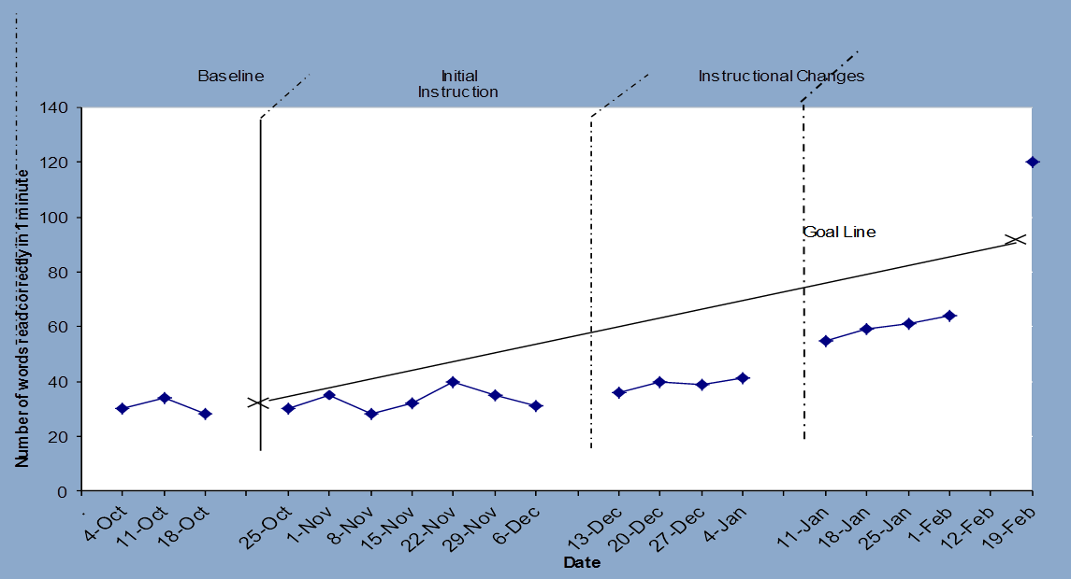
Progress Monitoring:
Kelsey’s Reading
Notes:
The final section of this graph corresponds to Kelsey’s reading performance while receiving the adapted intervention that incorporated qualitative changes. While she is improving with the program, she is not improving fast enough to meet her goal. Her four most recent progress monitoring scores were all below the goal line.

Slide 57
Evaluation of Kelsey’s Progress
Kelsey’s reading is improving but not fast enough to achieve her goal. Another instructional change is needed.
Kelsey’s teacher may collect additional diagnostic data if needed to make an informed instructional change.
Kelsey’s teacher will continue to collect progress monitoring data and meet with the intervention team to evaluate progress and modify the plan as needed.
Notes:
Read slide.

Slide 58
Behavior Illustration of DBI
Notes:
We now will use a behavior example to illustrate the DBI process.

Slide 59
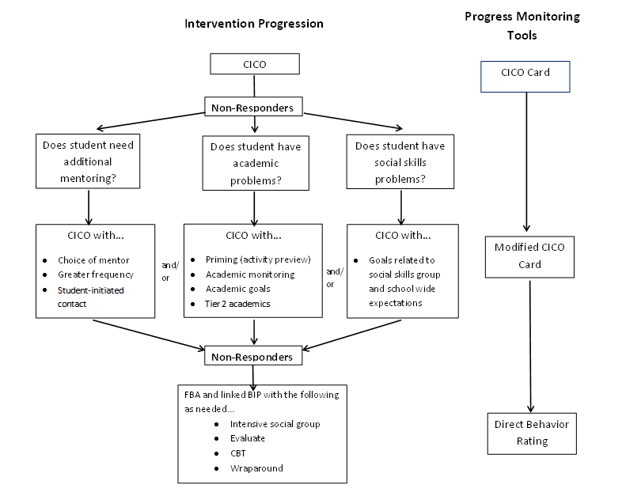
Sample Behavioral Progression
*NCII does not endorse products. We use Check-in/Check-out (CICO) for illustrative purposes only.
Notes:
Animated slide. Click at underlined text.
See Handout 3—Behavior Progression for a larger, printable version of this slide.
Our behavioral illustration occurs in a school that uses Check-in/Check-out (CICO) as a secondary intervention for behavior. The CICO card also provides progress monitoring data. The left side of the graphic depicts the intervention progression. The right shows how progress monitoring tools may change as the intervention changes.
When a student is not responsive to the standard CICO intervention, the team will ask why the student is not responding and adapt the intervention. If this is not sufficient, the team may conduct a functional behavior assessment and use it to develop an individualized behavior intervention plan.

Slide 60
Secondary Intervention:
Student Example—Ryan
Background: Ryan was identified as having externalizing behavior problems in January of his fourth-grade year due to an excessive number of office disciplinary referrals (ODRs) and frequently instigated fights with other students.
Intervention program: Because of Ryan’s excessive ODRs, a Check-in/Check-out (CICO) system was implemented.
Notes:
For more information on CICO, see these and other resources from the OSEP Technical Assistance Center on Positive Behavioral Interventions and Supports (PBIS), http://www.pbis.org/.
School-Wide Tier II Interventions: Check-In Check-Out Getting Started Workbook. http://www.pbis.org/common/pbisresources/presentations/8APBS_Tier2_GettingStartedWorkbook.pdf
Presentations on CICO
Check In Check Out: A Targeted Intervention (PBIS in Costa Mesa, CA), http://www.pbis.org/pbis_resource_detail_page.aspx?Type=1&PBIS_ResourceID=183
The Behavior Education Program (BEP): Advanced Training on a Check In/Check Out Intervention for Students at Risk (Chicago Forum-07), http://www.pbis.org/pbis_resource_detail_page.aspx?Type=1&PBIS_ResourceID=688
The Behavior Education Program (BEP): Basic Steps of Check In/Check Out (Chicago Forum-07), http://www.pbis.org/pbis_resource_detail_page.aspx?Type=1&PBIS_ResourceID=669
Check In Check Out: A Targeted Intervention (PBIS in Costa Mesa, CA), http://www.pbis.org/pbis_resource_detail_page.aspx?Type=1&PBIS_ResourceID=183

Slide 61
Secondary Intervention: Ryan
Check-in/Check-out Procedures
Dedicated staff person “checks in” with the student to get ready for the day
Teachers provide feedback on student goals (aligned to school-wide expectations) throughout the day
Dedicated staff person “checks out” with the student to reflect on the day
Student accumulates points that can be traded at predetermined times for activities, prizes, or free time
Staff collect data daily and review student progress weekly
Notes:
Read slide.

Slide 62
Ryan’s Check-in/Check-out Card
GOALS | Period 1 | Period 2 | Period 3 | Lunch | Recess | Period 4 | Period 5
Be Safe | 0 1 2 | 0 1 2 | 0 1 2 | 0 1 2 | 0 1 2 | 0 1 2 | 0 1 2
Be Respectful | 0 1 2 | 0 1 2 | 0 1 2 | 0 1 2 | 0 1 2 | 0 1 2 | 0 1 2
Work Hard | 0 1 2 | 0 1 2 | 0 1 2 | 0 1 2 | 0 1 2 | 0 1 2 | 0 1 2
TOTAL
0 = Goal not met
1 = Goal partially
met
2 = Goal fully met
Notes:
While Ryan is receiving CICO as a standardized secondary intervention, his progress is being monitored with the school’s standard CICO card. It has not been customized at this point.
For each period of the school day, the appropriate teacher will rate how well, on a scale of 0–2, Ryan met the three school-wide expectations.

Slide 63
Progress Monitoring: Is the secondary intervention working?
Notes:
Animated slide. Click at underlined text.
The team will collect progress monitoring and fidelity data to determine if CICO is working for Ryan. If he is not responding sufficiently to meet his goal, the team will intensify the secondary intervention.

Slide 64
Progress Monitoring: Ryan
Progress monitoring tool: Check-in/Check-out point card, collected at regular intervals throughout the day
Measure(s):
Percentage of daily Check-in/Check-out points
ODRs: collected on all students
Fidelity checks to ensure that components of Ryan’s intervention are executed in accordance with the team’s plan
Notes:
Two measures of Ryan’s behavior are collected—the points earned on his CICO card and his office discipline referrals (ODRs). His teacher uses a brief, self-assessment checklist to verify that the intervention is implemented according to recommended procedures.

Slide 65
Progress Monitoring:
Is CICO working for Ryan?
Notes:
Although some progress was evident, Ryan continued to have an unacceptable number of ODRs based on school cut points, and he met his daily report card goal of earning 80 percent of his CICO points only 40 percent of the time.

Slide 66
Next Steps: Ryan
Despite secondary interventions delivered with fidelity, Ryan continued to make insufficient progress.
The intervention team decided that more intensive supports were needed.
The team needs to meet to review data and use it to hypothesize what modifications may be effective.
Notes:
Read slide.

Slide 67
Assess Student Needs:
Why is the secondary intervention not working?
Notes:
Because Ryan was not responding to CICO, the intervention needed to be adapted. The team thought that merely intensifying the CICO intervention with quantitative changes would not be enough and decided to collect more data about his skill deficits.

Slide 68
Team Problem Solving:
What could be intensified to make the intervention more effective for Ryan?
The team met to analyze Ryan’s progress.
Review student data:
  Ryan’s CICO cards showed that he had difficulty earning points for “Be Respectful.”
Define the problem:
  Ryan’s teachers noted that Ryan often disrupts class with both verbal (yelling out) and physical (throwing pencils, touching peers) outbursts.
Hypothesis:
  Ryan will benefit from social skills instruction surrounding appropriate ways to get attention from others, as well as instruction and monitoring in goals specific to his needs.
Notes:
Read slide.

Slide 69
Intensify the Secondary Intervention
Notes:
The team hypothesized that Ryan has social skills deficits, so they decided to add social skills group instruction to CICO. His progress will be monitored with a modified CICO card that reflects the intervention adaptation.

Slide 70
Intensify the Intervention: Ryan
Social skills group: Ryan will join a social skills group working on showing respect with language and physical interaction.
Social goals: Ryan will work toward specific goals related to his social skills curriculum and school-wide expectations.
Ryan’s Modified CICO Card
GOALS |  | Period 1 | Period 2 | Period 3 | Lunch | Recess | Period 4 | Period 5
Be Safe | Keep hands and feet to yourself. | 0 1 2 | 0 1 2 0 1 2 | 0 1 2 0 1 2 | 0 1 2 0 1 2 | 0 1 2 0 1 2 | 0 1 2 0 1 2 | 0 1 2 0 1 2
 | Use strategies to cool down. | 0 1 2
Be Respectful | Use kind words. | 0 1 2 0 1 2 | 0 1 2 0 1 2 | 0 1 2 0 1 2 | 0 1 2 0 1 2 | 0 1 2 0 1 2 | 0 1 2 0 1 2 | 0 1 2 0 1 2
 | Give others space.
Work Hard | Ask for help when you need it. | 0 1 2 0 1 2 | 0 1 2 0 1 2 | 0 1 2 0 1 2 | 0 1 2 0 1 2 | 0 1 2 0 1 2 | 0 1 2 0 1 2 | 0 1 2 0 1 2
 | Follow directions the first time.
TOTAL
Notes:
The CICO card is modified, but overall goals still reflect school-wide expectations. The specific skills associated with each goal are being taught in Ryan’s social skills group.

Slide 71
Progress Monitoring: Ryan
Notes:
This graph shows that Ryan met his CICO points goal on 5 of 10 days. He received two ODRs during that time.

Slide 72
Next Steps: Ryan
Ryan is making some progress and is now meeting his CICO goal 50 percent of the time.
However, the team determined that the rate of Ryan’s progress is insufficient, and he continues to receive ODRs almost weekly.
After one or two more attempts to modify Ryan’s secondary (i.e., Tier 2) intervention, the team should move to a more intensive (i.e., Tier 3) intervention.
  The team may also need to determine if a referral to special education is warranted.
Notes:
Read slide.

Slide 73
Collect More Information to Inform Intervention Change
Notes:
Because Ryan did not respond to adapted CICO, the team decided to conduct an FBA to guide the development of a Behavior Intervention Plan (BIP).

Slide 74
Functional Behavior Assessment (FBA): Ryan
Behavior | Function
Pushing peers while in line Pulling peers’ hair during lessons Yelling out Hiding under desk Running out of class | Gain attention from peers Avoid difficult tasks/gain attention from peers
Notes:
After clearly defining Ryan’s problem behavior and gathering more information (teacher and parent reports, observations of student behavior, review of existing data), the team began to analyze the function of Ryan’s behavior.
In determining the function of Ryan’s behavior, the team will be better equipped to address Ryan’s problem behaviors by encouraging replacement behaviors that serve the same function.
Review table.

Slide 75
Developing a Behavior Intervention Plan for Ryan
The next step is to develop a behavior plan based on the FBA.
The plan should be clearly linked to the hypothesized function(s) of behavior.
The plan should be ambitious but feasible, targeting prioritized behaviors and setting achievable goals.
The plan will draw from principles of intensive intervention.
Notes:
Read slide.

Slide 76
Ryan’s Behavior Intervention Plan
Explicitly teach positive replacement behaviors.
  Initiating contact with peers.
  Appropriately making requests.
  Instruction includes examples, a rationale for why the behaviors are important, modeling, and practice.
Continue check-ins with modified goals.
  Increased opportunity for practice and prompting.
  Reinforcement for appropriate behavior.
Notes:
Ryan’s Behavior Intervention Plan addresses the functions noted in the FBA:
Gain attention from peers.
Avoid difficult tasks.
Read slide.

Slide 77
Monitoring Progress for Intensive Intervention: Direct Behavior Rating (DBR)
The team defined two behaviors to track using DBR:
  Disruptive behavior
  Academic engagement
Teachers also kept a tally of appropriate requests for assistance.
Notes:
DBR uses ratings of a general outcome behavior following a specified observation period (e.g., lunch, class period).

Slide 78
Evaluation of Ryan’s Progress
Review of Ryan’s DBR and ODR data after six weeks indicated that his behavior plan was working.
DBR data reached typical class levels (80 percent for academic engagement, 10 percent for disruptive behavior).
ODRs decreased.
Reached his goals on his daily report card 90 percent of the time.
Notes:
Read slide.
Ryan’s behavior has markedly improved and the team thinks the plan is working. However, this is not to say that his behavior is perfect. Teams should remember that we are not expecting students like Ryan to become the best behaved student in the class but to behave in a manner more similar to their peers.

Slide 79
Evaluation of Ryan’s Progress
Ryan’s teachers reported that he was making progress in his social interactions. A tally kept by Ryan’s teacher indicated that he appropriately asked for help with a task when he did not understand 70 percent of the time.
The team determined that Ryan continued to need this level of support to be successful, so they decided to continue to implement the plan, as well as collect and regularly evaluate progress data.
Notes:
Read slide.
In most cases, students who need DBI will require ongoing support, not a temporary intervention. It is important to continue monitoring progress and adjusting the intervention if data indicate that changes are needed.

Slide 80
In Summary
DBI is an ongoing process that comprises ongoing assessment, intervention, evaluation, and adjustment to maximize student outcomes.
Intensive interventions will not look the same for all students. They are individualized based on unique needs.
Students requiring intensive intervention are likely to need it for a significant time.
Notes:
Read slide.

Slide 81
Things to Remember
DBI is intense—relatively few students should need it (3 percent to 5 percent of the school population).
Academic and behavior supports do not exist in isolation.
Don’t make too many intervention adaptations at the same time.
Notes:
DBI is intense—relatively few students should need it.
If more than 3 to 5 percent of students in a school appear to require DBI, consider evaluating core instruction, school-wide behavior supports, and secondary intervention programs.
Academic and behavior supports do not exist in isolation.
They are often most successful when combined to meet students’ individual needs.
Don’t make too many intervention adaptations at the same time.
It may be tempting to try everything at once because you want to help a student as soon as possible, but if you make all possible changes at the same time, you won’t know which ones the student needs (any improvement in performance could be the result of one or more adaptations). Fewer changes may also make implementation more sustainable.

Slide 82
Keep in mind…
Every student presents unique needs. While our examples provide an illustration of the DBI process, it will vary based on individual needs. Some DBI processes will be much more involved than others.
Areas of need may vary by domain. For example, a student may require intensive intervention in reading but not in mathematics. Data should drive these determinations.
Notes:
Read slide.

Slide 83
Quick Quiz
Name the five components of the DBI process.
What are two features that distinguish secondary (Tier 2) and intensive (Tier 3) interventions?
What is the difference between a quantitative and qualitative change to instruction/intervention? Give an example of each type of change.
Notes:
Five components:
Secondary intervention program, delivered with greater intensity
Progress monitoring
Diagnostic assessment
Adaptation
Continued progress monitoring, with adaptations occurring whenever needed to ensure adequate progress
Intensive interventions have increased in intensity and are individualized, whereas secondary interventions are standardized. Increased intensity may reflect group size, length and frequency of intervention sessions, and frequency of progress monitoring. Implications for cost and efficiency.
Quantitative—changes in amounts/numbers (e.g., group size, frequency of intervention, duration of intervention);
Qualitative—changes in content/format (e.g., materials, interventionist, delivery method, student response format)

Slide 84
Disclaimer
This module was produced under the U.S. Department of Education, Office of Special Education Programs, Award No. H326Q110005. Celia Rosenquist serves as the project officer.
The views expressed herein do not necessarily represent the positions or polices of the U.S. Department of Education. No official endorsement by the U.S. Department of Education of any product, commodity, service or enterprise mentioned in this website is intended or should be inferred.

Slide 85
References
Aud, S., Hussar, W., Johnson, F., Kena, G., Roth, E., Manning, et al. (2012). The condition of education 2012 (NCES 2012-045). Washington, DC: National Center for Education Statistics, Institute of Education Sciences, U.S. Department of Education. Retrieved from http://nces.ed.gov/pubs2012/2012045.pdf
Capizzi, A. M., & Fuchs, L. S. (2005). Effects of curriculum-based measurement with and without diagnostic feedback on teacher planning. Remedial and Special Education, 26(3), 159–174.
Cortiella, C. (2011). The state of learning disabilities. New York: National Center for Learning Disabilities. Retrieved from http://www.ncld.org/images/stories/OnCapitolHill/PolicyRelatedPublications/stateofld/2011_state_of_ld_final.pdf
Deno, S. L., & Mirkin, P. K. (1977). Data-based program modification: A manual. Minneapolis, MN: Leadership Training Institute for Special Education.

Slide 86
References
Fuchs, L. S., Deno, S. L., & Mirkin, P. K. (1984). The effects of curriculum-based measurement evaluation on pedagogy, student achievement, and student awareness of learning. American Educational Research Journal, 21(2), 449–460.
Fuchs, L. S., Fuchs, D., & Hamlett, C. L. (1989). Effects of instrumental use of curriculum-based measurement to enhance instructional programs. Remedial and Special Education, 10, 43–52.
Planty, M., Hussar, W., Snyder, T., Provasnik, S., Kena, G., Dinkes, R., et al. (2008). The condition of education 2008 (NCES 2008-031). Washington, DC: National Center for Education Statistics, Institute of Education Sciences, U.S. Department of Education. Retrieved from http://nces.ed.gov/pubs2008/2008031.pdf

Slide 87
References
Sanford, C., Newman, L., Wagner, M., Cameto, R., Knokey, A.-M., and Shaver, D. (2011). The post-high school outcomes of young adults with disabilities up to 6 years after high school: Key findings from the National Longitudinal Transition Study-2 (NLTS2) (NCSER 2011-3004). Menlo Park, CA: SRI International. Retrieved from http://www.nlts2.org/nlts2/reports/2011_09/nlts2_report_2011_09_complete.pdf
Wanzek, J., Vaughn, S., Scammacca, N. K., Metz, K. L., Murray, C. S., Roberts, G., et al. (2013). Extensive reading interventions for students with reading difficulties after grade 3. Review of Educational Research, 83, 163–195. doi: 10.3102/0034654313477212

Slide 88

A
f
National Center on Intensive Intervention
1000 Thomas Jefferson Street NW
Washington, DC 20007-3835
866-577-5787
www.intensiveintervention.org
ncii@air.org

