Slide 1
Count Me In!
August 2019
Supporting Students in Your Class
with Math Difficulty
Sarah Powell, Associate Professor, The University of Texas at Austin

Slide 2
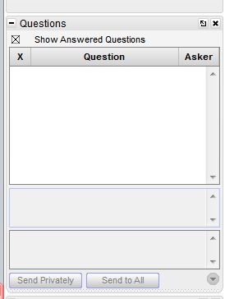
Webinar Format & Questions
Throughout the presentation, submit your questions into the question pod.
For technical issues/questions, a webinar team member will try to assist you as soon as possible.
For content related questions, there will be a time for Q&A at the end of the presentation. Submit your questions and we will share them with the presenters.

Slide 3
Today’s Overview
Overview of Mathematics Course
Description of content within each module
Review of other resources
Questions

Slide 4
NCII Math Course
https://intensiveintervention.org/intensive-intervention-math-course

Slide 5
Overview of Course

Slide 6
Modules

Slide 7
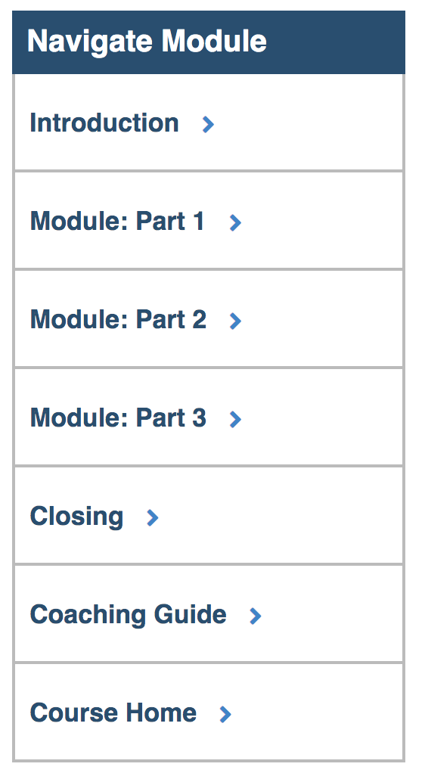
Within Each Module

Slide 8
Using Each Module…
This is the video of the entire part of this module.
These are the Word versions of each activity (from the Workbook).
This is a single video (usually teacher/child examples).

Slide 9
Module 1: Developing a Scope and Sequence
This is the outline of the three parts of the module.

Slide 10
Module 1: Developing a Scope and Sequence
Each Introduction video provides a brief overview of the content within each Module.

Slide 11
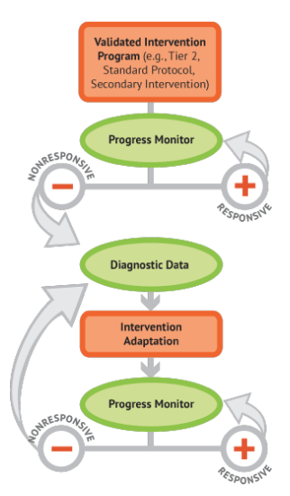
Module 1: Developing a Scope and Sequence
The NCII DBI framework is introduced in this video.

Slide 12
Module 1: Developing a Scope and Sequence

Slide 13
Module 1: Developing a Scope and Sequence

Slide 14
Module 1: Developing a Scope and Sequence

Slide 15
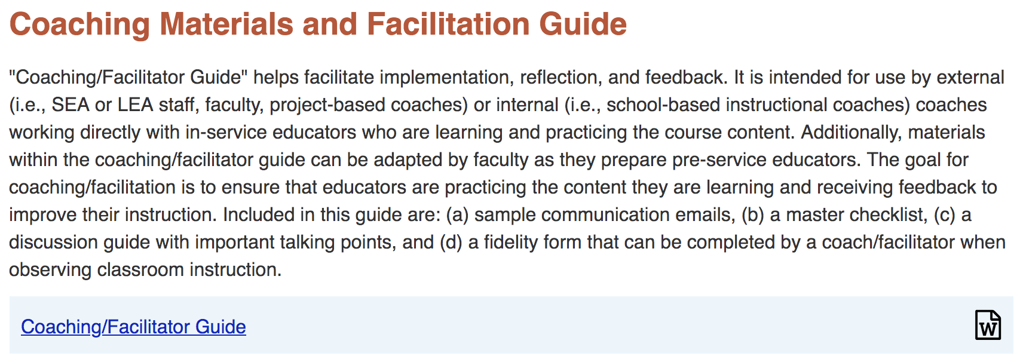
Module 1: Developing a Scope and Sequence
This is provided at the end of each module. Most helpful for Coaches.

Slide 16
Module 2: Mathematics Progress Monitoring
This is the assessment module!

Slide 17
Module 2: Mathematics Progress Monitoring

Slide 18
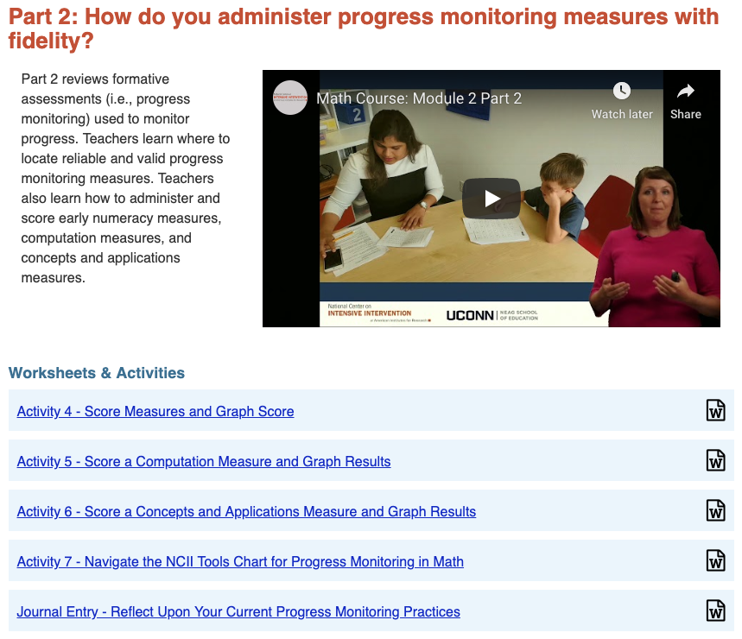
Module 2: Mathematics Progress Monitoring

Slide 19
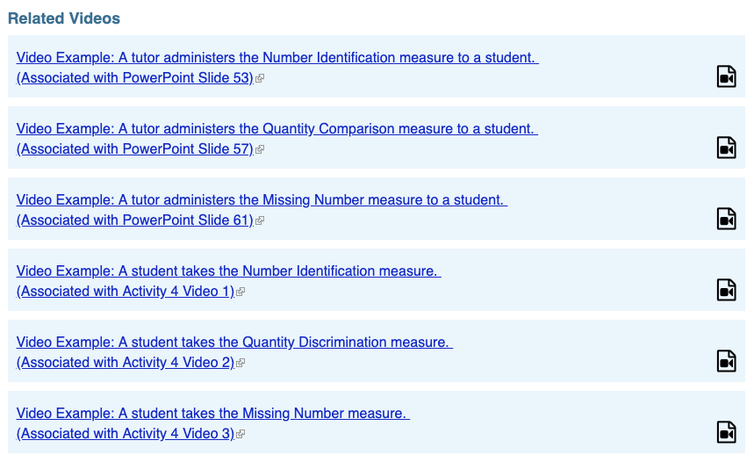
Module 2: Mathematics Progress Monitoring

Slide 20
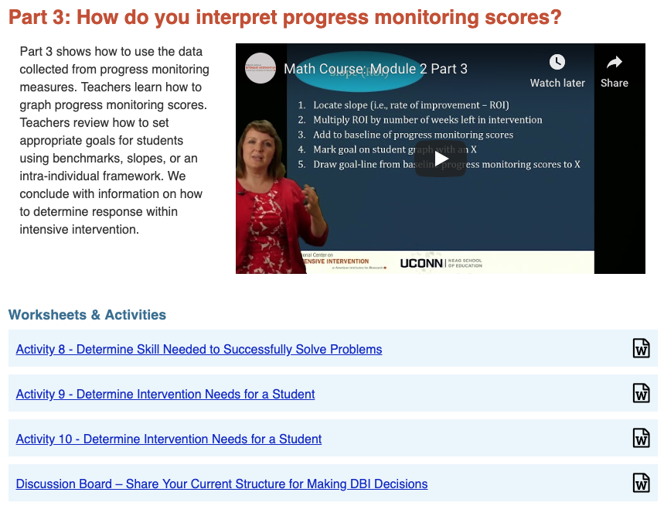
Module 2: Mathematics Progress Monitoring
Connects data to instructional decision making

Slide 21
Module 3: Selecting and Evaluating Evidence-Based Practices
This is the first instruction module! (Followed by 4, 5, 6, and 7)

Slide 22
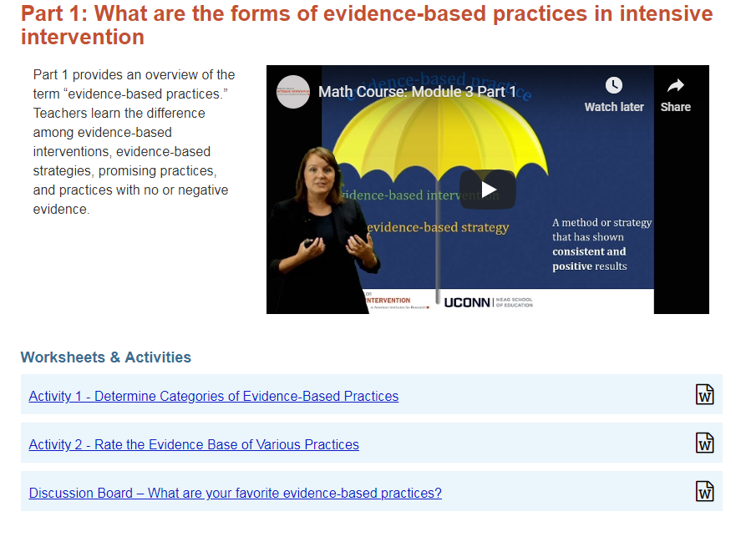
Module 3: Selecting and Evaluating Evidence-Based Practices

Slide 23
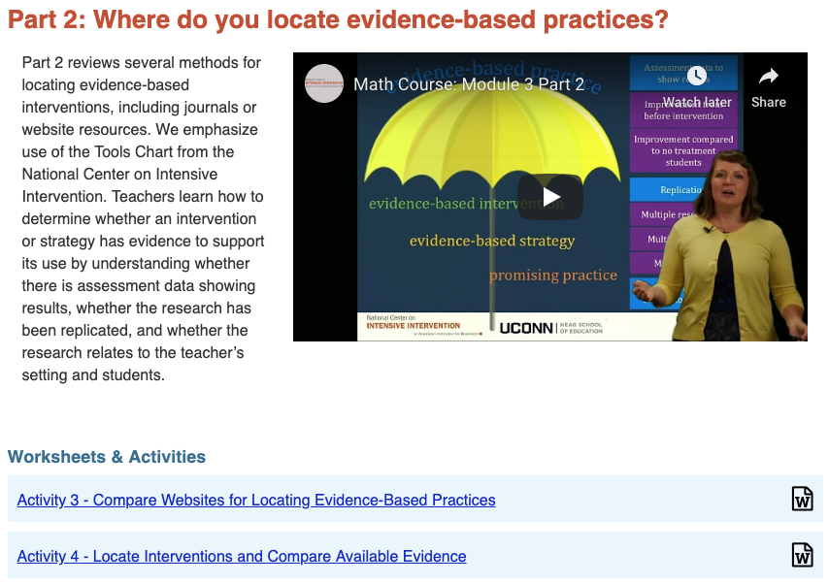
Module 3: Selecting and Evaluating Evidence-Based Practices

Slide 24
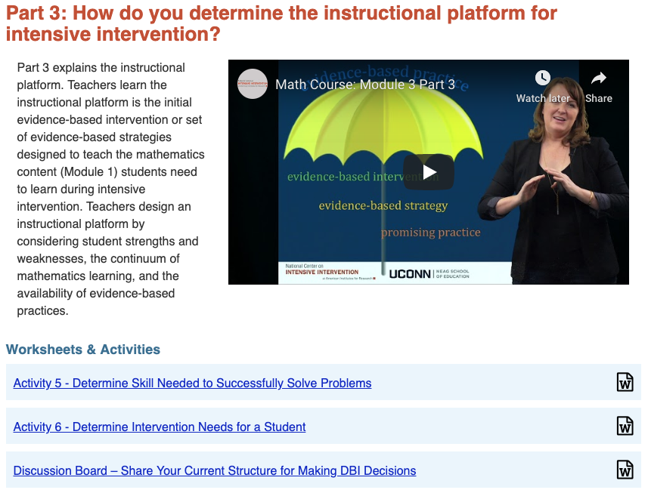
Module 3: Selecting and Evaluating Evidence-Based Practices

Slide 25
Module 4: Instructional Delivery
Modules 4 and 5 provide an overview of the instructional platform.

Slide 26
Module 4: Instructional Delivery
Essential information about explicit instruction - uses same framework as Features of Explicit Instruction Course Content from NCII.

Slide 27
Explicit Instruction
https://intensiveintervention.org/intensive-intervention-features-explicit-instruction

Slide 28
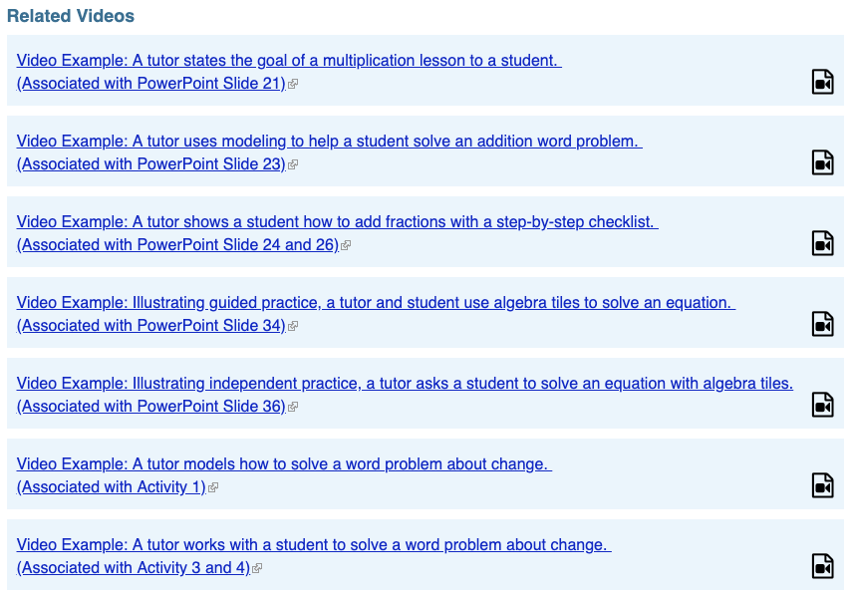
Module 4: Instructional Delivery

Slide 29
Module 4: Instructional Delivery

Slide 30
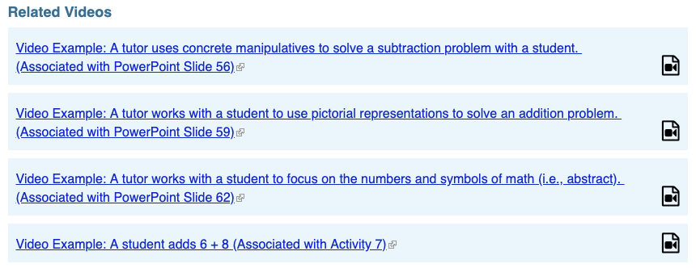
Module 4: Instructional Delivery
Examples of concrete, representational, and abstract

Slide 31
Module 4: Instructional Delivery
Good activity to use with Hughes et al. (2016) or Powell et al. (2018) – both in Teaching Exceptional Children.

Slide 32
Module 5: Instructional Strategies
Modules 4 and 5 provide an overview of the instructional platform.

Slide 33
Module 5: Instructional Strategies

Slide 34
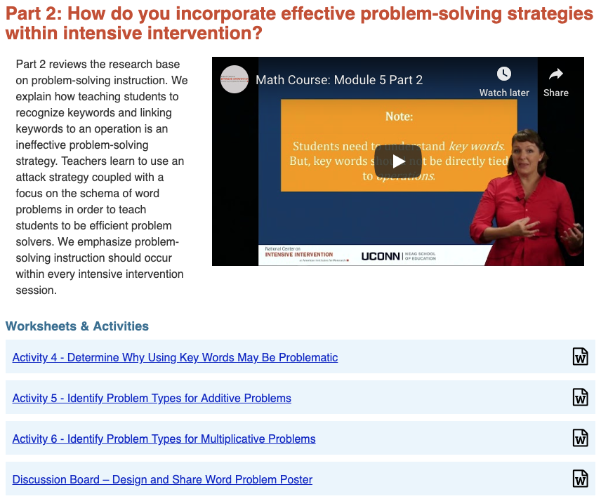
Module 5: Instructional Strategies
If you ever wanted a review on word-problem schemas, here it is.

Slide 35
Module 5: Instructional Strategies

Slide 36
Module 6: Whole-Number Content
Modules 6 and 7 help increase
teacher knowledge about content.

Slide 37
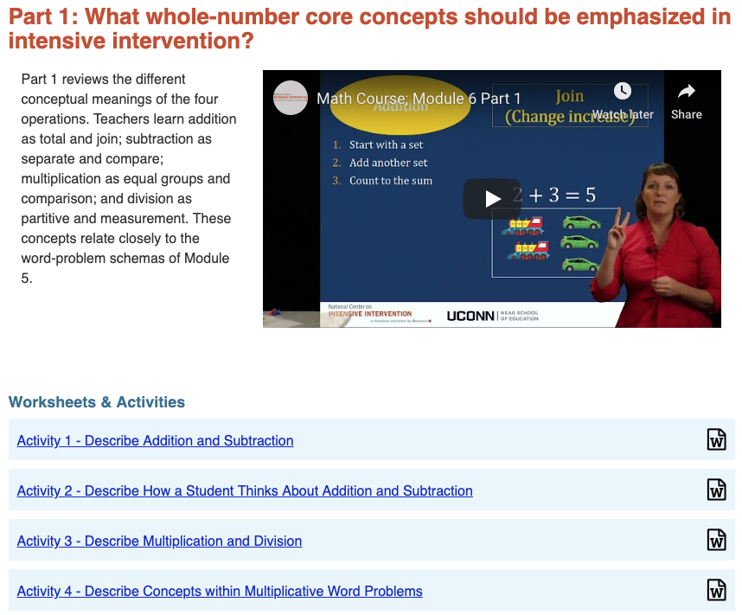
Module 6: Whole-Number Content
Focused on conceptual understanding – directly related to word-problem schemas

Slide 38
Module 6: Whole-Number Content
Encourages use of alternate algorithms

Slide 39
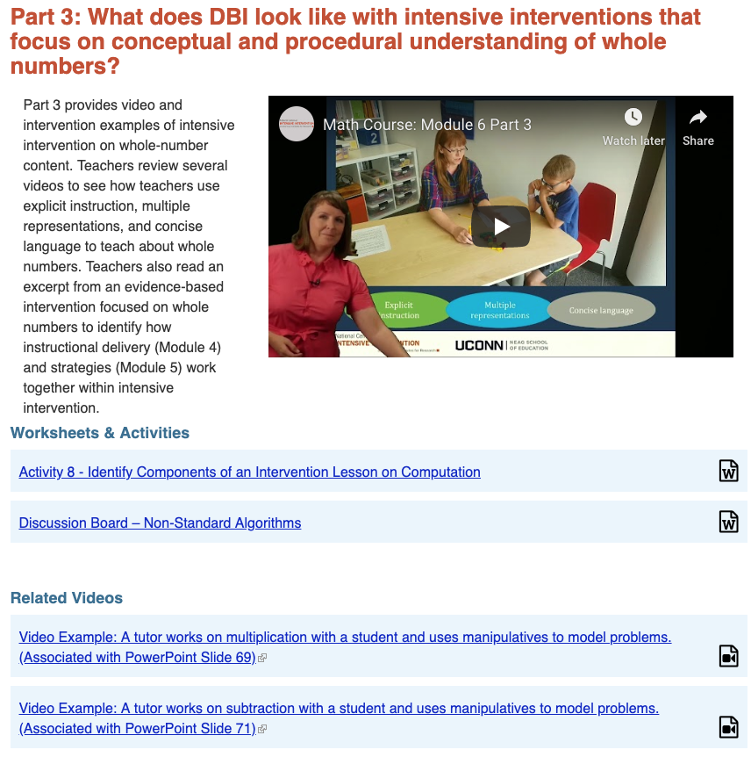
Module 6: Whole-Number Content
Includes video examples with tutors and students

Slide 40
Module 7: Rational-Number Content
Modules 6 and 7 help increase
teacher knowledge about content.

Slide 41
Module 7: Rational-Number Content
Really big emphasis on fractions

Slide 42
Module 7: Rational-Number Content
Helps explain the procedures used with fraction computation

Slide 43
Module 7: Rational-Number Content
Includes video examples with tutors and children

Slide 44
Module 8: DBI for Intensive Mathematics Intervention

Slide 45
Module 8: DBI for Intensive Mathematics Intervention

Slide 46
Module 8: DBI for Intensive Mathematics Intervention

Slide 47
Module 8: DBI for Intensive Mathematics Intervention
Helpful review of all eight modules – consider watching first?

Slide 48
Modules

Slide 49
Other Resources

Slide 50
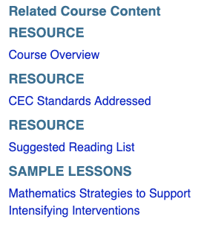
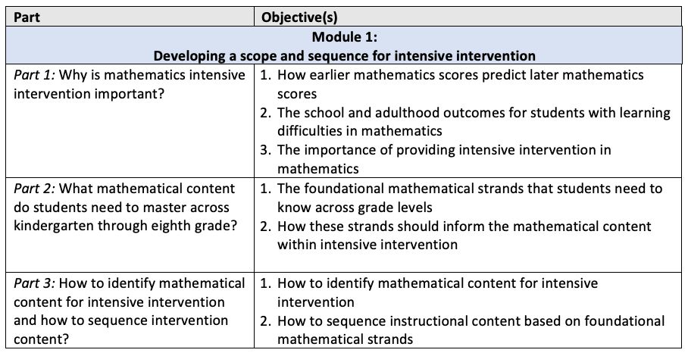
Course Overview

Slide 51
Preparation Standards

Slide 52
Readings

Slide 53
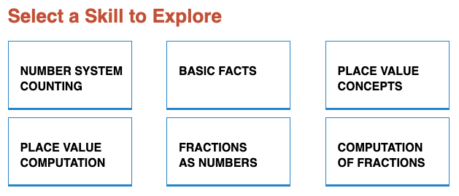
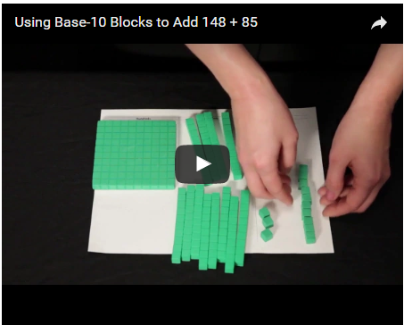
Lessons and Videos

Slide 54
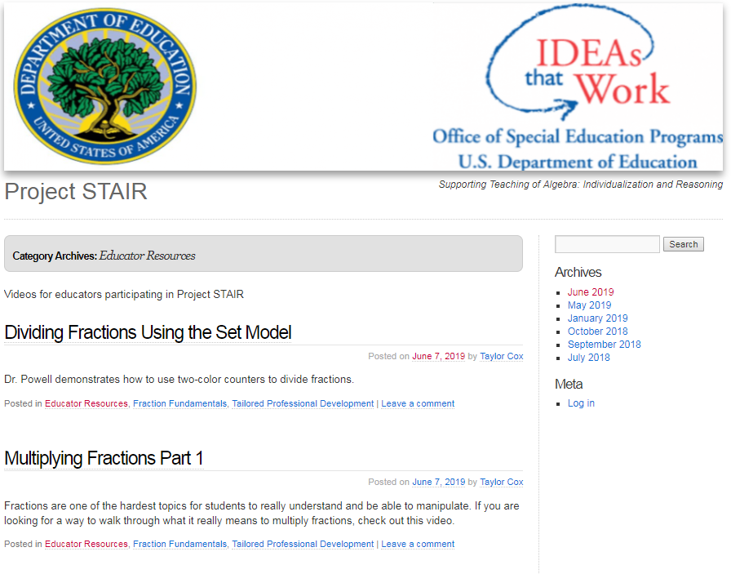
Project STAIR
https://blog.smu.edu/projectstair/

Slide 55
Questions?

Slide 56
Sarah R. Powell
Associate Professor
srpowell@austin.utexas.edu
@sarahpowellphd

Slide 57
NCII Disclaimer
This presentation was produced under the U.S. Department of Education, Office of Special Education Programs, Award No. H326Q160001. Celia Rosenquist serves as the project officer. The views expressed herein do not necessarily represent the positions or policies of the U.S. Department of Education. No official endorsement by the U.S. Department of Education of any product, commodity, service, or enterprise mentioned in this webinar is intended or should be inferred.

