Slide 1
Module 2
Mathematics Progress Monitoring and Determining Response

Slide 2
Slide 2
Link to Video: https://youtu.be/Z48vgcjX6vE

Slide 3
Objectives
PART 1: What are the different types of assessments used to monitor student progress in mathematics within DBI?
PART 2: How do you administer progress monitoring measures with fidelity?
PART 3: How do you interpret progress monitoring scores?

Slide 4
Activities
PART 1: What are the different types of assessments used to monitor student progress in mathematics within DBI?
Compare general outcome measures and single-skill measures
Interpret a diagnostic assessment score report
Conduct a survey of assessments in your school

Slide 5
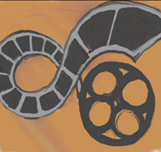
Activities
PART 2: How do you administer progress monitoring measures with fidelity?
Administration of progress monitoring measures
Score and graph early numeracy measures
Score and graph computation measure; score and graph concepts and applications measure
Survey progress monitoring measures on the NCII website
Reflect upon your progress monitoring practices

Slide 6
Activities
PART 3: How do you interpret progress monitoring scores?
Create a graph and set goals using three methods
Make decisions about response based on data points
Make decisions about response based on a trendline
Share, with your classmates, your decision-making structure within DBI

Slide 7
Reading
Lembke, E. S., Strickland, T. K., & Powell, S. R. (2016). Monitoring student progress to determine instructional effectiveness. In B. S. Witzel (Ed.), Bridging the gap between arithmetic and algebra (pp. 139–155). Arlington, VA: Council for Exceptional Children.

Slide 8
Classroom Application
Start (or continue) implementing progress monitoring measures on a weekly basis
Start (or continue) graphing data
Start (or continue) making decisions about progress

Slide 9
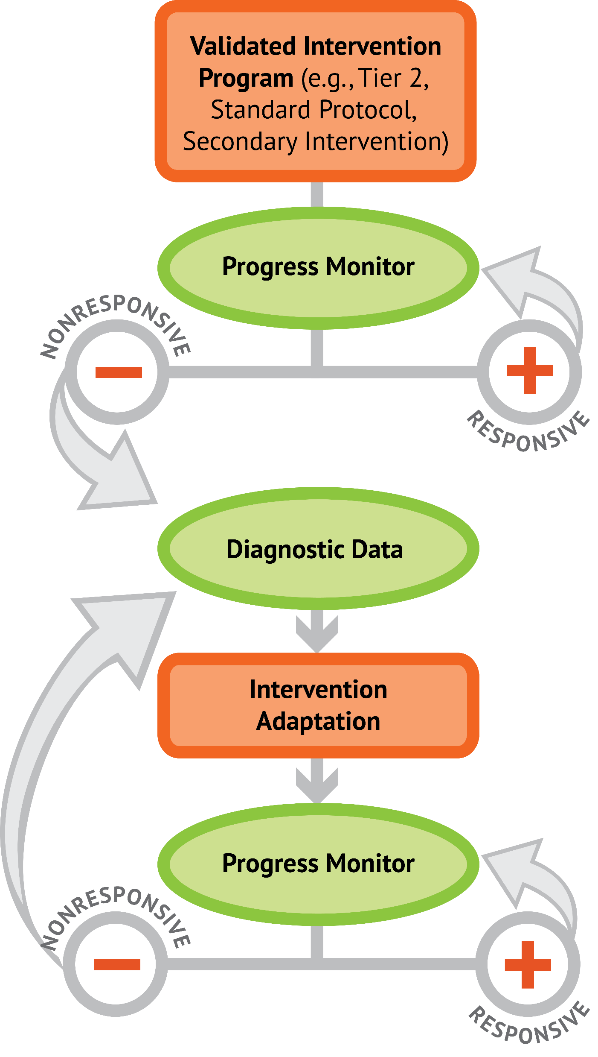
Slide 9
1: Developing a scope and sequence for intervention
2: Progress monitoring and determining response
3: Selecting evidence-based practices for the instructional platform
4: Instructional delivery: explicit instruction, multiple representations, language
5: Instructional strategies: fluency building, problem solving, motivation
6: Whole number content
7: Rational number content
8: DBI and mathematics: fidelity, adaptations

Slide 10
Welcome!
Let’s get started on Module 2!

Slide 11
Slide 11
Part 1

Slide 12
What are the different types of assessments used to monitor student progress in mathematics within DBI?
Module 2, Part 1

Slide 13
Part 1 Objectives
In this part, you’ll learn—
The definition of a formative assessment and the difference between general outcome measures and skill-specific measures
The definition of a diagnostic assessment
The definition of a summative assessment

Slide 14
Where Are We?

Slide 15
Formative Assessment
Data gathered during learning to make judgments for learning.
Progress monitoring measures are a type of formative assessment.

Slide 16
Progress Monitoring Measures
General Outcome Measures
Assess grade-level mathematics curriculum
Curriculum-based measurement (CBM) is a type of general outcome measure
Single-skill Measures
Assess a single mathematics skill (e.g., addition facts, division with two-digit divisors)

Slide 17
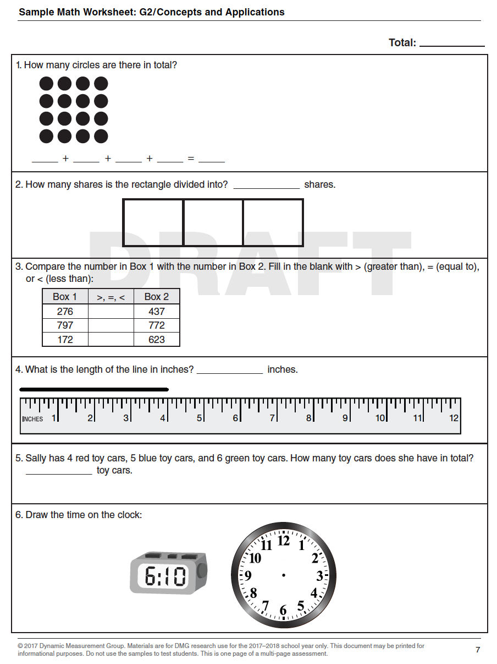
Progress Monitoring Measures
General Outcome Measures
Assess grade-level mathematics curriculum
Have equivalent, alternate forms
Curriculum-based measurement (CBM) is a type of general outcome measure
https://dibels.org/DIBELS_Math_Early_Release_Fact_Sheet.pdf

Slide 18
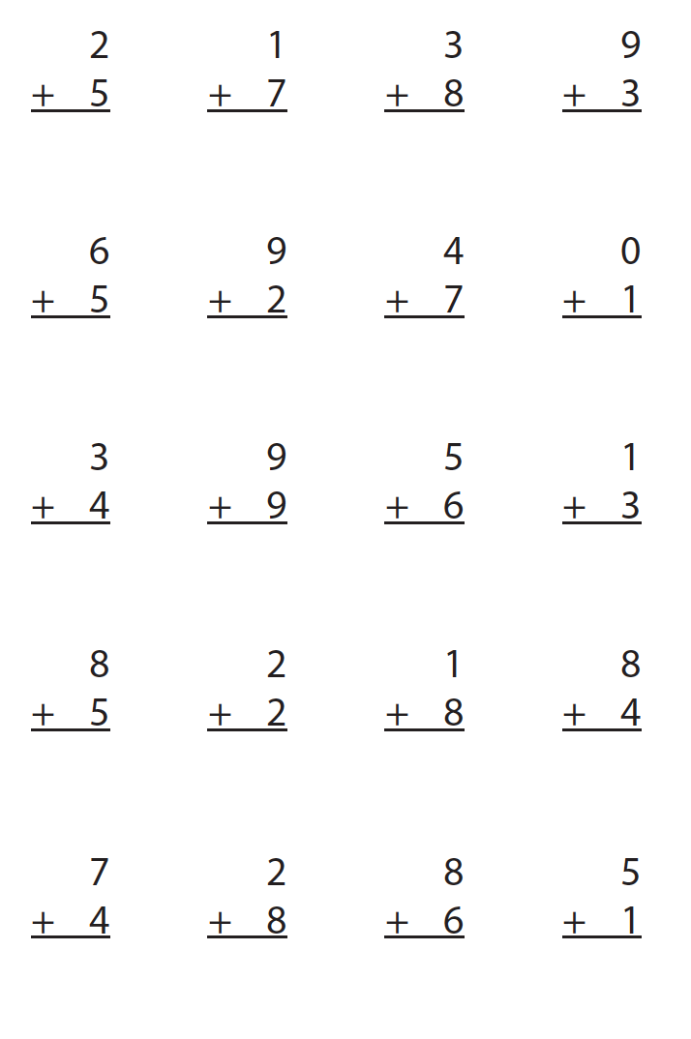
Progress Monitoring Measures
Single-skill Measures
Assess a single mathematics skill (e.g., addition facts, division with two-digit divisors)

Slide 19
Formative Assessment
Data gathered during learning to make judgments for learning.

Slide 20
Formative Assessment

Slide 21
Formative Assessment
General outcome measures are a better type of progress monitoring measure.
Such measures, which measure the grade-level curriculum, allow teachers to understand growth across the year, not just in a single skill.

Slide 22
Formative Assessment
General outcome measure

Slide 23
Formative Assessment
Single-skill measure

Slide 24
Formative Assessment
Formative assessment is the cornerstone of the DBI process.
It’s used to make decisions about progress and whether an instructional adaptation is necessary.
Formative assessment also allows for timely decisions.

Slide 25
Formative Assessment
Decisions about Maria’s response need to be made here.

Slide 26
Formative Assessment
Decisions about Maria’s response should NOT be made here.

Slide 27
Formative Assessment
In sum:
Should use general outcome measures
Progress monitoring data determines response or nonresponse
Decisions about adaptations are timely and based on data

Slide 28
Slide 28
Workbook Activity #1
Look at the examples of formative assessments. Is each an example of a general outcome measure or single-skill measure?

Slide 29
Diagnostic Assessment
Data gathered before or during learning to understand strengths and weaknesses.

Slide 30
Diagnostic Assessment
Decisions about Maria’s response need to be made here.

Slide 31
Diagnostic Assessment
We need to adapt the intervention. A diagnostic assessment provides information about areas for targeted intensive intervention.

Slide 32
Diagnostic Assessment
Good diagnostic measures:
Measure multiple areas of mathematics
Are reliable and valid
Provide detailed score profiles

Slide 33
Diagnostic Assessment
Examples include the following:
Test of Early Mathematics Ability
Early Math Diagnostic Assessment
KeyMath
Test of Mathematical Abilities

Slide 34
Diagnostic Assessment
In sum:
Should be comprehensive
Should provide strengths and weaknesses profile
Used to inform adaptations and content of intervention
Number and Operations
Geometry
Measurement
Algebra
Data Analysis

Slide 35
Slide 35
Workbook Activity #2
Look at the sample diagnostic assessment score report. What are the student’s strengths? What are the student’s weaknesses?

Slide 36
Summative Assessment
Data gathered after learning.
Summative assessment isn’t a part of the DBI model, but all students engage in summative assessments.
Information from summative assessments can be used as a diagnostic, if scored quickly.

Slide 37
Slide 37
Workbook Activity #3
You will conduct a survey of the assessments available at your school.
Fill in the table about your current formative, diagnostic, and summative assessments. Then, fill in your assessment needs for DBI.

Slide 38
A Few Considerations
Within DBI, formative and diagnostic assessments are essential.
You can’t do DBI without progress monitoring occurring regularly (i.e., weekly).
You can’t do adaptations without a diagnostic and continued progress monitoring.

Slide 39
Part 1’s Checklist: What are the different types of assessments used to monitor student progress in mathematics within DBI?
Use formative assessments to help make ongoing decisions about response or nonresponse
Use diagnostic assessments to understand student strengths and weaknesses that inform adaptations to instruction
Use summative assessments to gauge end-of-year learning

Slide 40
Slide 40
Part 2

Slide 41
How do you administer progress monitoring measures with fidelity?
Module 2, Part 2

Slide 42
Part 2 Objectives
In this part, you’ll learn—
How to administer and score early numeracy progress monitoring measures
How to administer and score computation progress monitoring measures
How to administer and score concepts and applications progress monitoring measures

Slide 43
Where Are We?

Slide 44
Progress Monitoring

Slide 45
What is Progress Monitoring?
Tests/measures/probes administered frequently
Compare scores to understand mathematics growth
Must be reliable and valid
Must have alternate forms

Slide 46
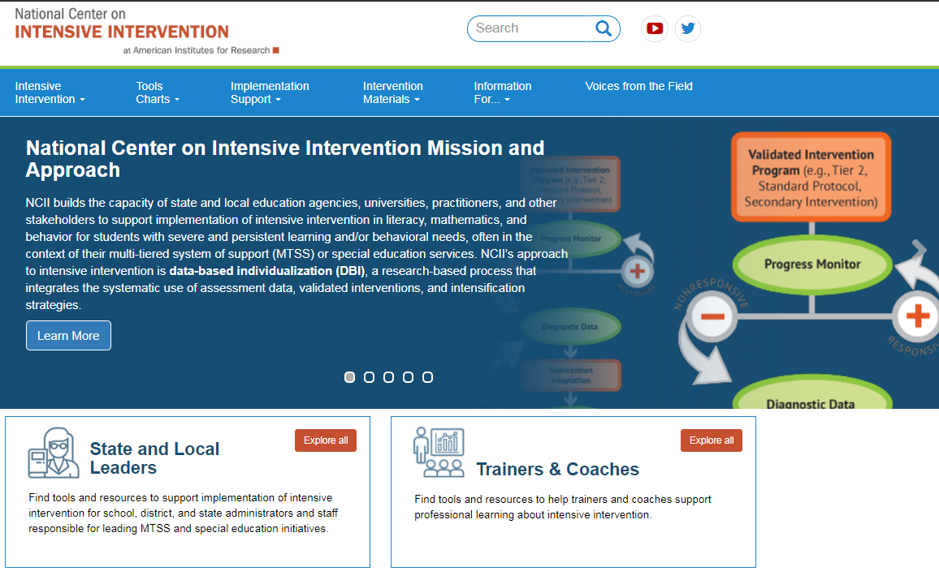
Where to Find Progress Monitoring Measures?
National Center on Intensive Intervention
www.intensiveintervention.org

Slide 47
Progress Monitoring Suggestions
Name | Grade
Early Numeracy Measure Number Identification; Quantity Discrimination; Missing Number | K
Computation | 1-2
Concepts and Applications | 3-8
www.intensiveintervention.org

Slide 48
Progress Monitoring Considerations
Skills to be measured—age and grade appropriate
Cost and training requirements
Administration and scoring time
Data management
Technical rigor (consider population)
Reliability
Validity
Evidence of being sensitive to change
Alternate/parallel forms

Slide 49
Early Numeracy Measures

Slide 50
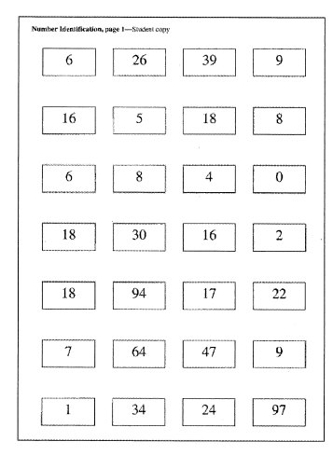
Number Identification
Student orally identifies written numbers for 1 min.
www.progressmonitoring.org

Slide 51
Number Identification
Scoring Considerations
If the student does not respond after 3 seconds, then point to the next item and say, “Try this one.”
Do not correct errors.
Teacher scores the task, putting a slash through incorrect items on score sheet.
At 1 min, draw a line under the last item completed.
Teacher counts the number of items that the student answered correctly in 1 min.
www.progressmonitoring.org

Slide 52
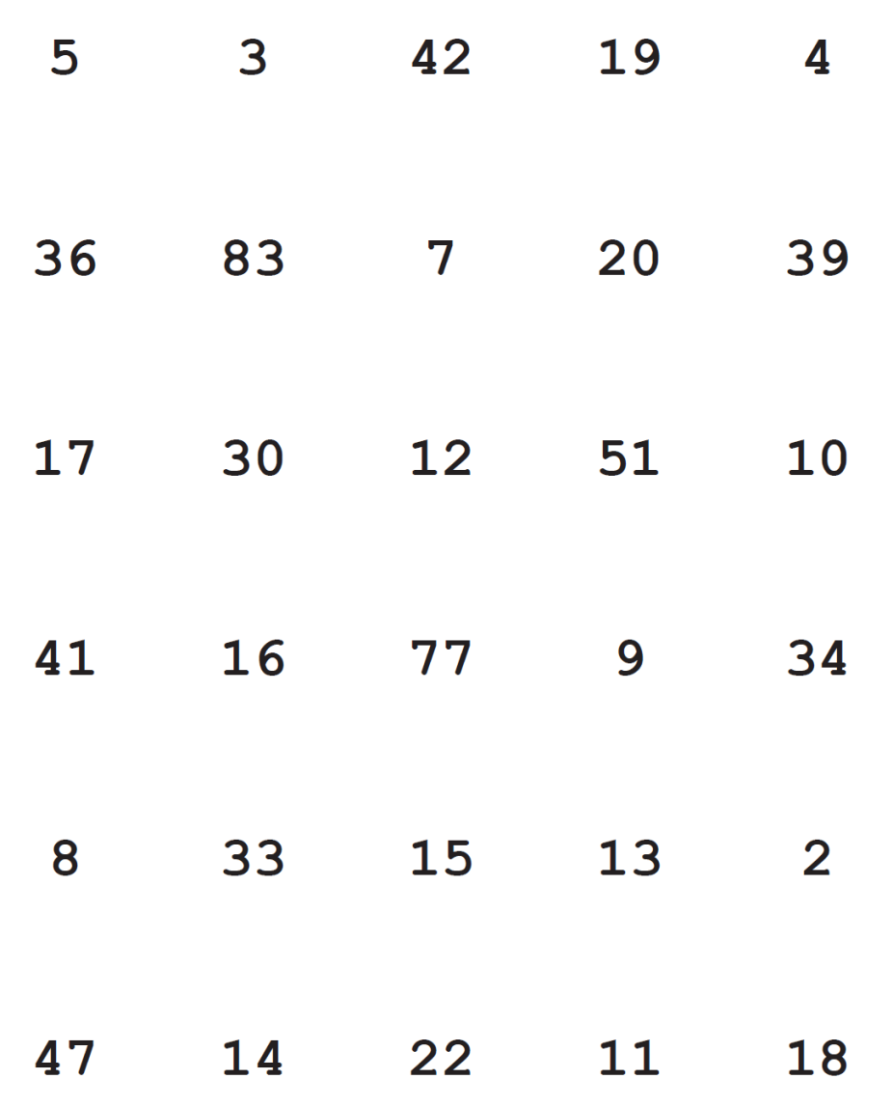
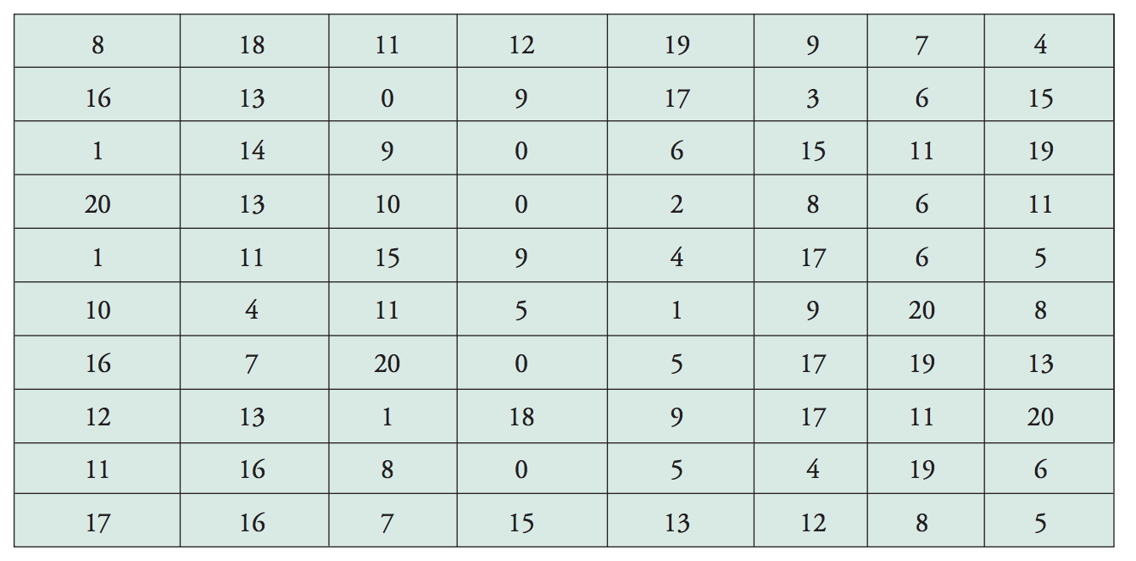
Number Identification
http://www.aimsweb.com/wp-content/uploads/Test-of-Early-Numeracy-TEN-Manual.pdf
https://dibels.org/DIBELS_Math_Early_Release_Fact_Sheet.pdf

Slide 53
Slide 53
Link to Video: https://youtu.be/c5cKCjAwjeY

Slide 54
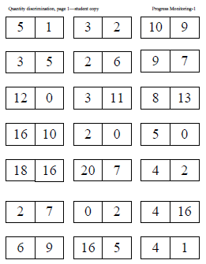
Quantity Discrimination
Student orally identifies the greater number (in a pair) for 1 min.
www.progressmonitoring.org

Slide 55
Quantity Discrimination
Scoring Considerations
If the student does not respond after 3 seconds, then point to the next item and say, “Try this one.”
Do not correct errors.
Teacher scores the task, putting a slash through incorrect items on score sheet.
At 1 min, draw a line under the last item completed.
Teacher counts the number of items that the student answered correctly in 1 min.
www.progressmonitoring.org

Slide 56
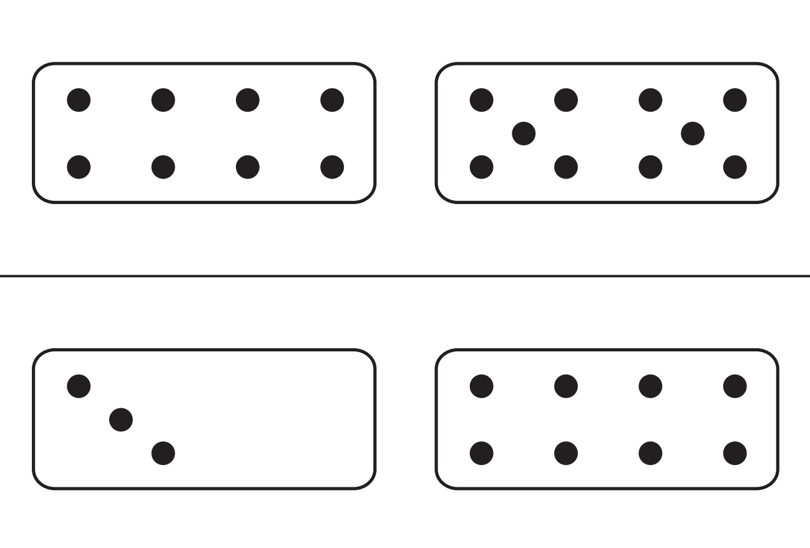
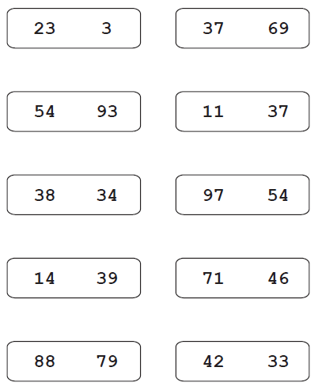
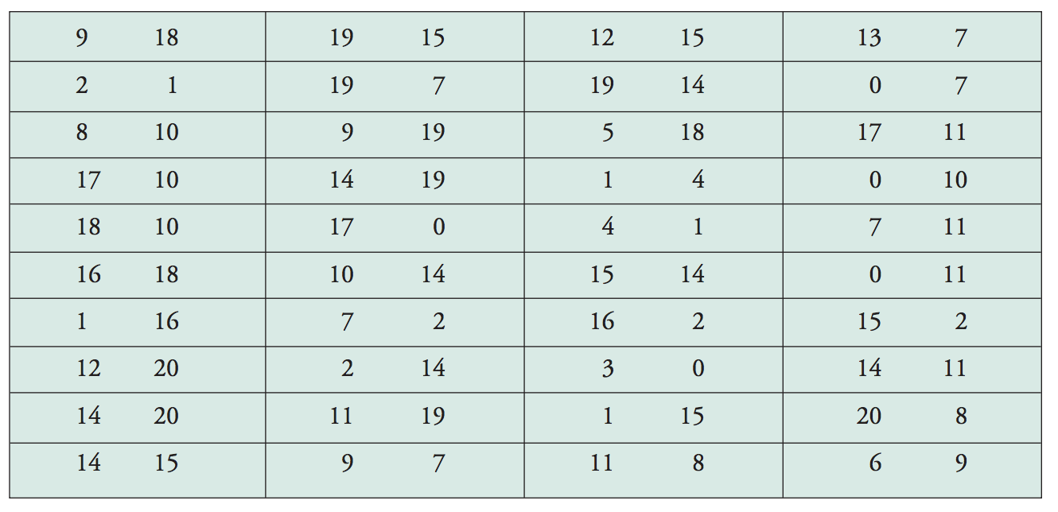
Quantity Discrimination
http://www.aimsweb.com/wp-content/uploads/Test-of-Early-Numeracy-TEN-Manual.pdf
https://dibels.org/DIBELS_Math_Early_Release_Fact_Sheet.pdf

Slide 57
Slide 57
Link to Video: https://youtu.be/LDe-AcB6T7w

Slide 58
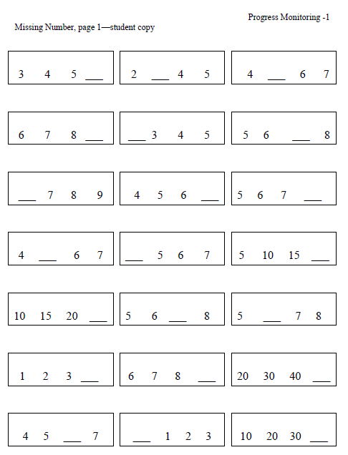
Missing Number
Student orally identifies the missing number (in a sequence) for 1 min.
www.progressmonitoring.org

Slide 59
Quantity Discrimination
Scoring Considerations
If the student does not respond after 3 seconds, then point to the next item and say, “Try this one.”
Do not correct errors.
Teacher scores the task, putting a slash through incorrect items on score sheet.
At 1 min, draw a line under the last item completed.
Teacher counts the number of items that the student answered correctly in 1 min.
www.progressmonitoring.org

Slide 60
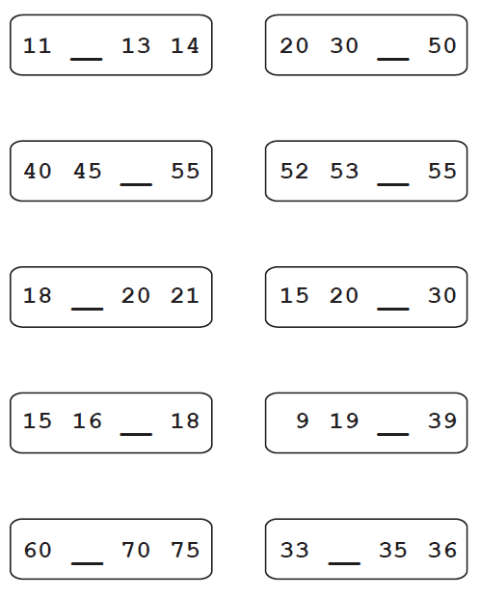
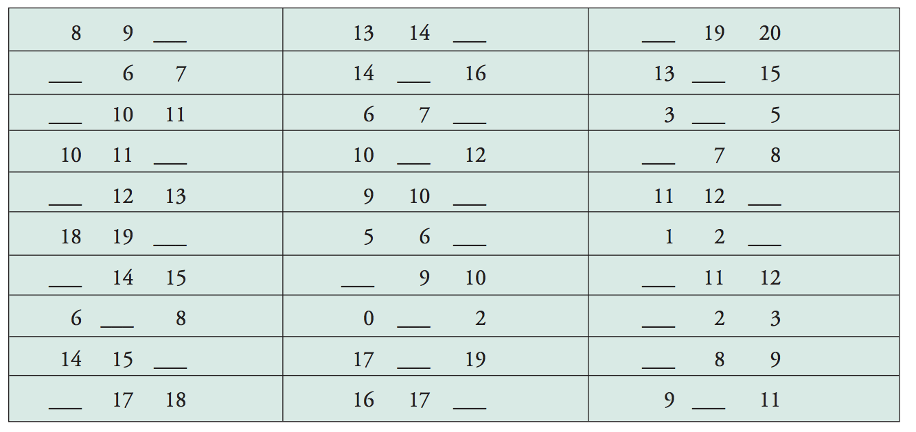
Missing Number
http://www.aimsweb.com/wp-content/uploads/Test-of-Early-Numeracy-TEN-Manual.pdf
https://dibels.org/DIBELS_Math_Early_Release_Fact_Sheet.pdf

Slide 61
Slide 61
Link to Video: https://youtu.be/tWLPtorzqGo

Slide 62
Slide 62
Workbook Activity #4
Watch the videos and score each early numeracy measure.
Video 1 Link: https://youtu.be/2YidrJ3zabQ
Video 2 Link: https://youtu.be/tof8mNnzvZw
Video 3 Link: https://youtu.be/CxeZ35d6h18

Slide 63
Computation Measure

Slide 64
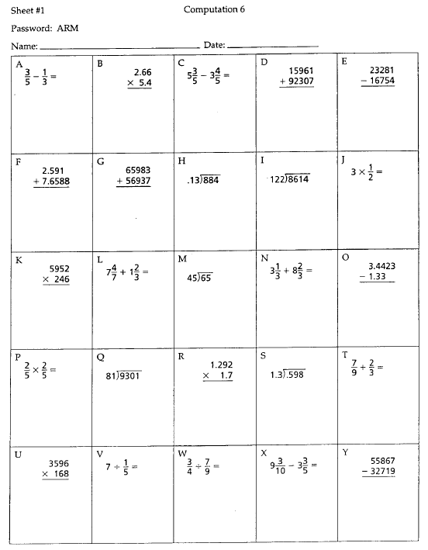
Computation
Student works on grade-level computation problems for a set amount of time.
Time limits are set and usually vary from 2-6 min.
Measure can be administered to a group.
http://www.proedinc.com/customer/productView.aspx?ID=1431

Slide 65
Computation
6709
– 4523
2186
Problem: 1
Digits: 4
Students can receive 1 point for each problem answered correctly.
Alternatively, students can receive 1 point for each digit answered correctly.
Number of correct answers within the time limit is the student’s score.
6709
– 4523
2286
Problem: 0
Digits: 3
6709
– 4523
2226
Problem: 0
Digits: 2

Slide 66
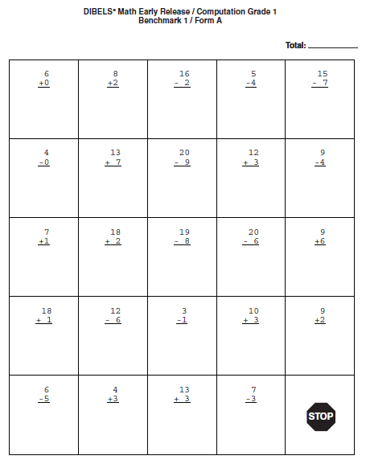
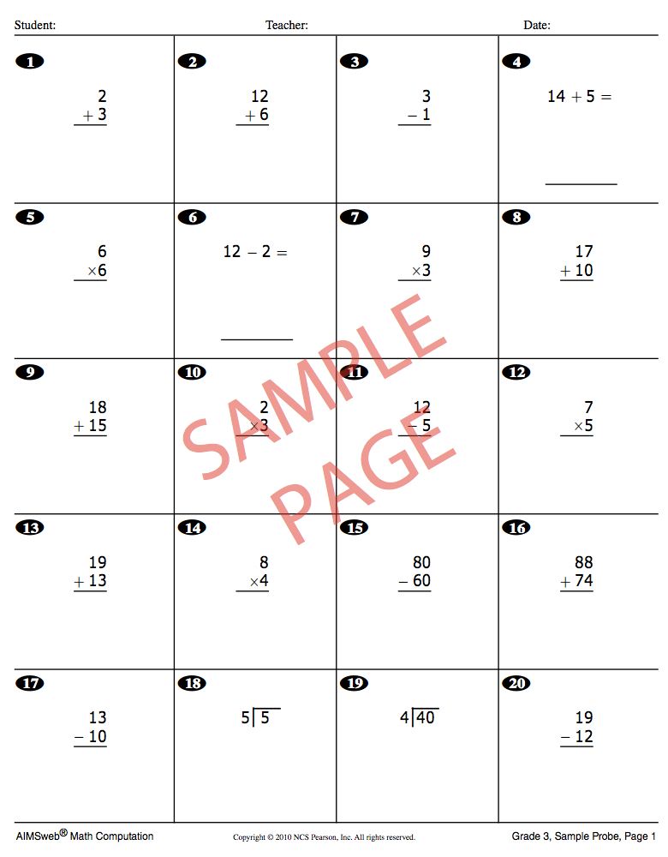
Computation
http://www.aimsweb.com/wp-content/uploads/MCOMP-Grade-3-Sample.pdf
https://dibels.org/DIBELS_Math_Early_Release_Fact_Sheet.pdf

Slide 67
Slide 67
Workbook Activity #5
Look at this Computation measure.
Score the measure by problems correct.
Score the measure by digits correct.
Graph the digits correct score on the student’s graph.

Slide 68
Concepts and Applications Measure

Slide 69
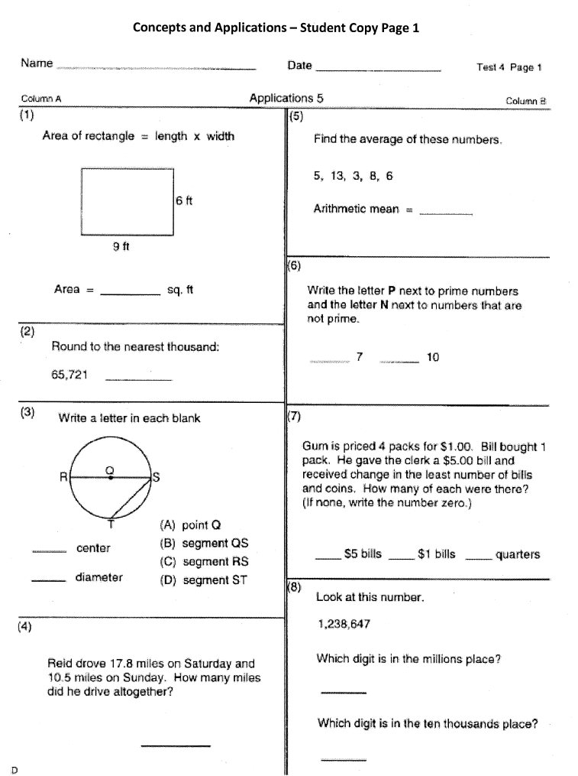
Concepts and Applications
Student works on grade-level applications problems for a set amount of time.
Time limits are set and usually vary from 5-8 min.
Measure can be administered to a group.
http://www.proedinc.com/customer/productView.aspx?ID=1431

Slide 70
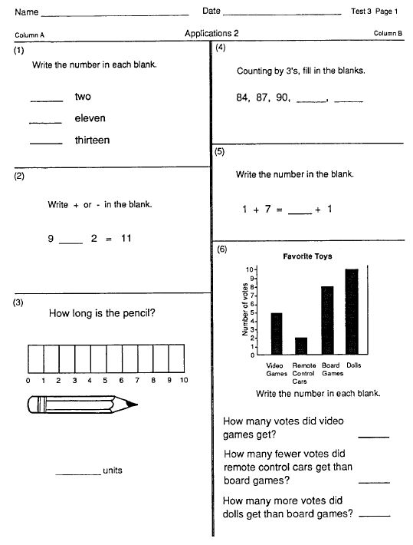
Concepts and Applications
Students can receive 1 point for each blank answered correctly.
Number of correct answers within the time limit is the student’s score.
http://www.proedinc.com/customer/productView.aspx?ID=1431

Slide 71
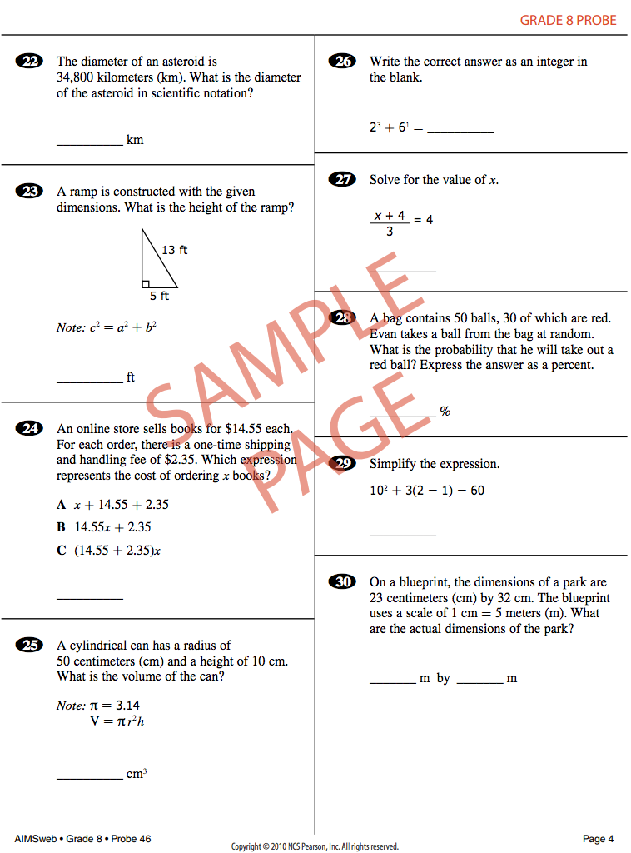
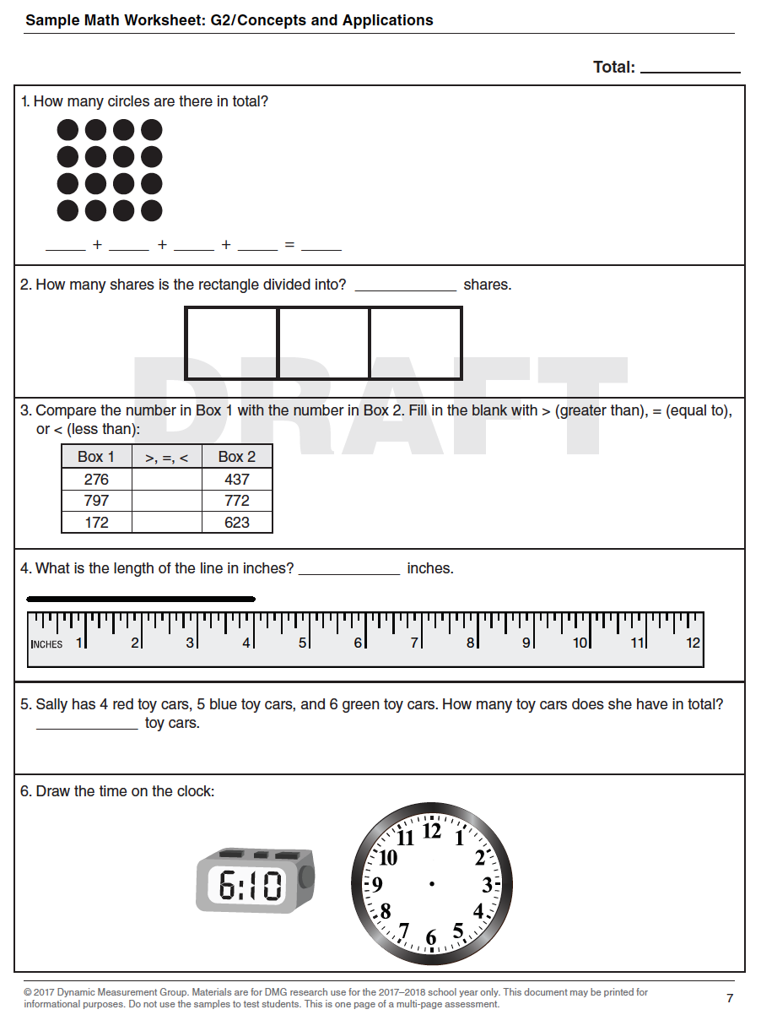
Concepts and Applications
http://www.aimsweb.com/wp-content/uploads/MCAP-Grade-8-Sample.pdf https://dibels.org/DIBELS_Math_Early_Release_Fact_Sheet.pdf

Slide 72
Slide 72
Workbook Activity #6
Look at this Concepts and Applications measure.
Score the measure by blanks correct.
Graph the blanks correct score on the student’s graph.

Slide 73
To Review
Early Numeracy measures for students who aren’t ready for addition and subtraction.
Computation measures or Concepts and Applications measures for students in grades 1-8.
You should only administer one type of measure. It’s not necessary to administer more.

Slide 74
To Review
All measures need to be administered as outlined by the developer of the measure.
Read all directions verbatim.
Time measure for set amount of time.
Score as directed.

Slide 75
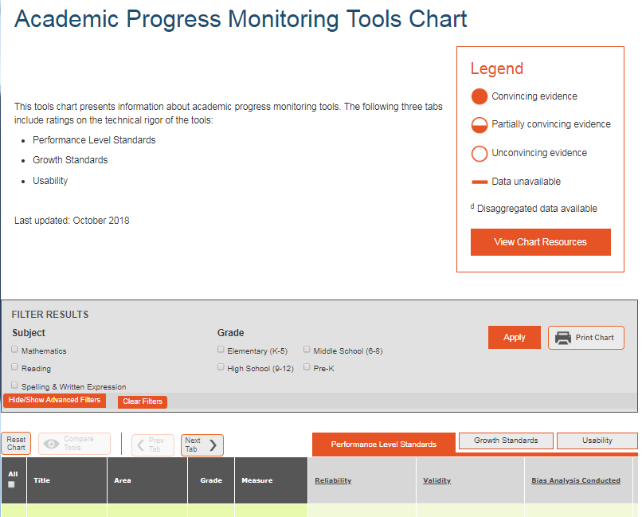
To Review
Must be reliable and valid
Must have alternate forms
www.intensiveintervention.org

Slide 76
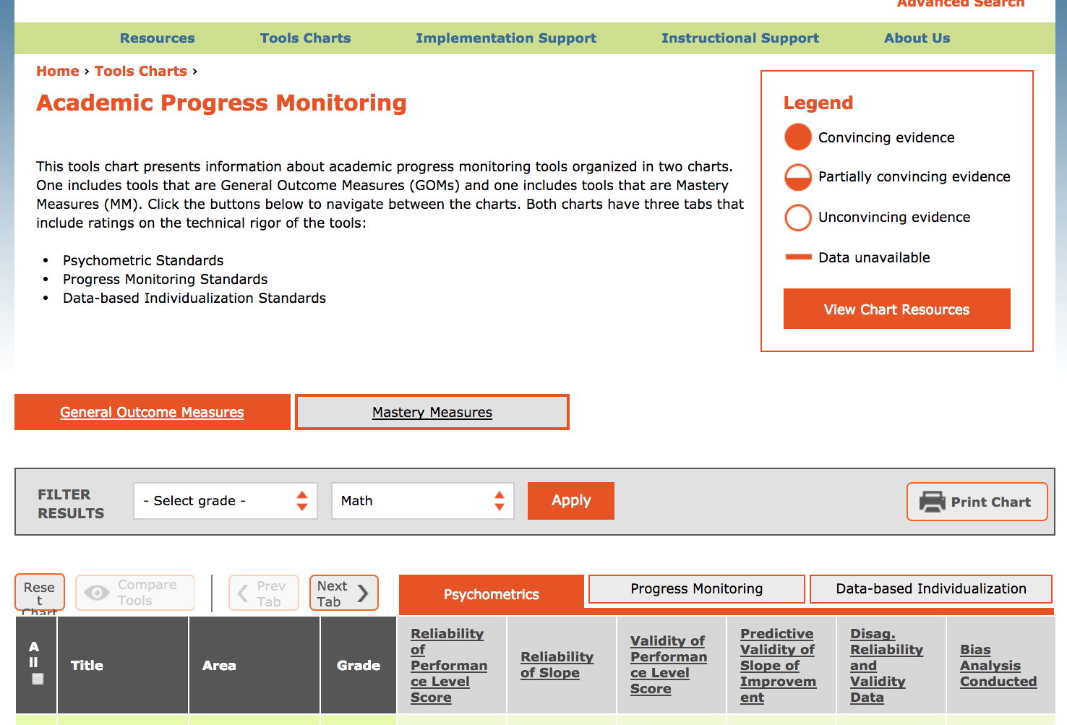
Slide 76
Workbook Activity #7
Visit the Academic Progress Monitoring Tools Chart.
Fill in the table for the mathematics measures available for the grade levels you teach.
Consider the Psychometrics of the measures.
Consider the use for Progress Monitoring.
Consider the use for Data-based Individualization.

Slide 77
To Review
You can’t do DBI without progress monitoring occurring regularly (i.e., weekly).
You can’t do adaptations without a diagnostic and continued progress monitoring.

Slide 78
Part 2’s Checklist: How do you administer progress monitoring measures with fidelity?
Select progress monitoring measures that are reliable and valid and have alternate forms
Administer progress monitoring measures with fidelity
Score progress monitoring measures and graph student scores

Slide 79
Journal Entry
Reflect upon your current progress monitoring practices.
What measures are available to you?
How do you administer measures with fidelity?
What measures would you like to use?
How can you improve upon your progress monitoring practices?
Why is progress monitoring an essential part of DBI?

Slide 80
Slide 80
Part 3

Slide 81
How do you interpret progress monitoring scores?
Module 2, Part 3

Slide 82
Part 3 Objectives
In this part, you’ll learn—
How to graph progress monitoring scores
How to interpret progress monitoring scores
How assessment data are used within a DBI framework

Slide 83
Where Are We?

Slide 84
Decision Making
Is Maria making adequate progress?

Slide 85
Graphing
Most progress monitoring measures come with scoring programs.
But, you can also graph scores on your own.

Slide 86
Graphing
x-axis: Weeks of instruction

Slide 87
Slide 87
Workbook Activity #8a
Create a graph with the provided Quantity Discrimination scores for Lincoln.
x-axis: Weeks of instruction

Slide 88
Slide 88
Workbook Activity #8
Some examples…

Slide 89
Slide 89
Workbook Activity #8
Some examples…

Slide 90
Slide 90
Workbook Activity #8
Some examples…

Slide 91
Setting Goals
Once the scores are graphed, it’s time to set goals.
Is Maria making adequate progress?

Slide 92
Setting Goals
Several options for setting goals
Benchmark
Slope (ROI)
Intra-individual

Slide 93
Setting Goals
Several options for setting goals
Benchmark
Activity #8b
Slope (ROI)
Activity #8c
Intra-individual
Activity #8d

Slide 94
Slide 94
Benchmark
Identify appropriate grade-level benchmark
Mark benchmark on student graph with an X
Draw goal-line from baseline progress monitoring scores to X

Slide 95
Slide 95
Benchmark
Identify appropriate grade-level benchmark
Grade | Computation | Concepts and Applications
1 | 20 digits | 20 points
2 | 20 digits | 20 points
3 | 30 digits | 30 points
4 | 40 digits | 30 points
5 | 30 digits | 15 points
6 | 35 digits | 15 points
http://www.rti4success.org/resource/rti-implementer-series-module-2-progress-monitoring

Slide 96
Slide 96
Benchmark
Identify appropriate grade-level benchmark
Grade | Computation | Concepts and Applications
1 | 20 digits | 20 points
2 | 20 digits | 20 points
3 | 30 digits | 30 points
4 | 40 digits | 30 points
5 | 30 digits | 15 points
6 | 35 digits | 15 points
Maria: 2nd-grade student using Computation
http://www.rti4success.org/resource/rti-implementer-series-module-2-progress-monitoring

Slide 97
Benchmark
Mark benchmark on student graph with an X
Draw goal-line from baseline progress monitoring scores to X
X

Slide 98
Slide 98
Workbook Activity #8b
Using Lincoln’s graph, mark the benchmark using the provided information.

Slide 99
Setting Goals
Several options for setting goals
Benchmark
Slope (ROI)

Slide 100
Slide 100
Slope (ROI)
Locate slope (i.e., rate of improvement – ROI)
Multiply ROI by number of weeks left in intervention
Add to baseline of progress monitoring scores
Mark goal on student graph with an X
Draw goal-line from baseline progress monitoring scores to X

Slide 101
Slide 101
Slope (ROI)
Locate slope (i.e., rate of improvement – ROI)
Grade | Computation—Slope for Digits Correct | Concepts and Applications — Slope for Points
1 | 0.35 | No data available
2 | 0.30 | 0.40
3 | 0.30 | 0.60
4 | 0.70 | 0.70
5 | 0.70 | 0.70
6 | 0.40 | 0.70
http://www.rti4success.org/resource/rti-implementer-series-module-2-progress-monitoring

Slide 102
Slide 102
Slope (ROI)
Locate slope (i.e., rate of improvement – ROI)
Grade | Computation—Slope for Digits Correct | Concepts and Applications — Slope for Points
1 | 0.35 | No data available
2 | 0.30 | 0.40
3 | 0.30 | 0.60
4 | 0.70 | 0.70
5 | 0.70 | 0.70
6 | 0.40 | 0.70
Maria: 2nd-grade student using Computation
http://www.rti4success.org/resource/rti-implementer-series-module-2-progress-monitoring

Slide 103
Slide 103
Slope (ROI)
Locate slope (i.e., rate of improvement – ROI) 0.30

Slide 104
Slide 104
Slope (ROI)
Locate slope (i.e., rate of improvement – ROI) 0.30
Multiply ROI by number of weeks left in intervention 0.30 $×$

Slide 105
Slide 105
Slope (ROI)
Number of weeks left in intervention

Slide 106
Slide 106
Slope (ROI)
Locate slope (i.e., rate of improvement – ROI) 0.30
Multiply ROI by number of weeks left in intervention 0.30 $×$ 10 = 3

Slide 107
Slide 107
Slope (ROI)
Locate slope (i.e., rate of improvement – ROI) 0.30
Multiply ROI by number of weeks left in intervention 0.30 $×$ 10 = 3
Add to baseline of progress monitoring scores 3 +

Slide 108
Slide 108
Slope (ROI)
Baseline: 7 + 5 + 8 = 20
20 $÷3=6.7$

Slide 109
Slide 109
Slope (ROI)
Locate slope (i.e., rate of improvement – ROI) 0.30
Multiply ROI by number of weeks left in intervention 0.30 $×$ 10 = 3
Add to baseline of progress monitoring scores 3 + 6.7 = 9.7

Slide 110
Slide 110
Slope (ROI)
Mark goal on student graph with an X
Draw goal-line from baseline progress monitoring scores to X
X

Slide 111
Slide 111
Workbook Activity #8c
Using Lincoln’s graph, mark the goal using slope (ROI) with the provided information.

Slide 112
Setting Goals
Several options for setting goals
Benchmark
Slope (ROI)
Intra-individual

Slide 113
Slide 113
Intra-individual
Identify student’s (slope)
Multiply slope by 1.5
Multiply by number of weeks until end of intervention
Add to student’s baseline score
Mark goal on student graph with an X
Draw goal-line from baseline progress monitoring scores to X

Slide 114
Slide 114
Intra-individual
Identify student’s (slope)
SLOPE CALCULATION:
3rd median – 1st median
#data points – 1

Slide 115
Slide 115
Intra-individual
SLOPE CALCULATION:
3rd median – 1st median
#data points – 1
Identify student’s (slope)
6.5 – 4.5
6 – 1
(4 + 5) $÷$ 2 = 4.5
0.4
(8 + 5) $÷$ 2 = 6.5

Slide 116
Slide 116
Intra-individual
Identify student’s (slope) 0.4

Slide 117
Slide 117
Intra-individual
Identify student’s (slope) 0.4
Multiply slope by 1.5 0.4 $×$ 1.5 = 0.6

Slide 118
Slide 118
Intra-individual
Identify student’s (slope) 0.4
Multiply slope by 1.5 0.4 $×$ 1.5 = 0.6
Multiply by number of weeks in intervention 0.6 $×$

Slide 119
Slide 119
Intra-individual
Number of weeks left in intervention

Slide 120
Slide 120
Intra-individual
Identify student’s (slope) 0.4
Multiply slope by 1.5 0.4 $×$ 1.5 = 0.6
Multiply by number of weeks in intervention 0.6 $×$ 10 = 6

Slide 121
Slide 121
Intra-individual
Identify student’s (slope) 0.4
Multiply slope by 1.5 0.4 $×$ 1.5 = 0.6
Multiply by number of weeks in intervention 0.6 $×$ 10 = 6
Add to student’s baseline score 6

Slide 122
Slide 122
Intra-individual
Baseline: 7 + 5 + 8 = 20
20 $÷3=6.7$

Slide 123
Slide 123
Intra-individual
Identify student’s (slope) 0.4
Multiply slope by 1.5 0.4 $×$ 1.5 = 0.6
Multiply by number of weeks in intervention 0.6 $×$ 10 = 6
Add to student’s baseline score 6 + 6.7 = 12.7

Slide 124
Slide 124
Intra-individual
Mark goal on student graph with an X
Draw goal-line from baseline progress monitoring scores to X
X

Slide 125
Slide 125
Workbook Activity #8d
Using Lincoln’s graph, mark the goal determined with the intra-individual framework.

Slide 126
To Review
Several options for setting goals
Benchmark
Slope (ROI)
Intra-individual

Slide 127
Determining Response

Slide 128
Determining Response
Four most recent, consecutive scores
Trendline

Slide 129
Determining Response
Four most recent, consecutive scores
If at least 6 weeks of instruction have occurred:
If all four most recent scores fall above the goal-line, increase the goal.

Slide 130
Determining Response
Four most recent, consecutive scores
Raise the goal
X

Slide 131
Determining Response
Four most recent, consecutive scores
If at least 6 weeks of instruction have occurred:
If all four most recent scores fall above the goal-line, increase the goal.
If all four most recent scores fall below the goal-line, adapt the intervention.

Slide 132
Determining Response
Four most recent, consecutive scores
Adaptation
X

Slide 133
Determining Response
Four most recent, consecutive scores
If at least 6 weeks of instruction have occurred:
If all four most recent scores fall above the goal-line, increase the goal.
If all four most recent scores fall below the goal-line, adapt the intervention.
If the four most recent scores fall both above and below the goal-line, continue monitoring data.

Slide 134
Determining Response
Four most recent, consecutive scores
Continue monitoring
X

Slide 135
Slide 135
Workbook Activity #9
Look at the graphs for these students. What decisions would you make about the progress of each student?

Slide 136
Determining Response
Four most recent, consecutive scores
Trendline

Slide 137
Determining Response
Trendline
If the trend-line is steeper than the goal line, then increase the goal.

Slide 138
Determining Response
Trendline
Raise the goal
X

Slide 139
Determining Response
Trendline
If the trend-line is steeper than the goal line, then increase the goal.
If the trend-line is flatter than the goal line, then adapt the intervention.

Slide 140
Determining Response
Four most recent, consecutive scores
Adaptation
X

Slide 141
Determining Response
Trendline
If the trend-line is steeper than the goal line, then increase the goal.
If the trend-line is flatter than the goal line, then adapt the intervention.
If the trend-line and goal-line are fairly equal, continue monitoring progress.

Slide 142
Determining Response
Four most recent, consecutive scores
Continue monitoring
X

Slide 143
Slide 143
Workbook Activity #10
Look at the graphs for these students. What decisions would you make about the progress of each student?

Slide 144
To Review
Several options for setting goals
Benchmark
Slope (ROI)
Intra-individual

Slide 145
To Review
Four most recent, consecutive scores
Trendline

Slide 146
Part 3’s Checklist: How do you interpret progress monitoring scores?
Set goals using:
Benchmark
Slope (rate of improvement)
Intra-individual framework
Make timely decisions about progress using:
Four most recent, consecutive scores
Trendline

Slide 147
Discussion Board
Share your current structure for making DBI decisions.
Who administers progress monitoring measures?
Who makes the decisions about response?
When and how are decisions made?

Slide 148
Slide 148
Closing

Slide 149
Objectives
PART 1: What are the different types of assessments used to monitor student progress in mathematics within DBI?
PART 2: How do you administer progress monitoring measures with fidelity?
PART 3: How do you interpret progress monitoring scores?

Slide 150
Slide 150
Link to Video: https://youtu.be/Z48vgcjX6vE

Slide 151
Parts 1 and 2

Slide 152
Part 1’s Checklist: What are the different types of assessments used to monitor student progress in mathematics within DBI?
Use formative assessments to help make ongoing decisions about response or nonresponse
Use diagnostic assessments to understand student strengths and weaknesses that inform adaptations to instruction
Use summative assessments to gauge end-of-year learning

Slide 153
Part 2’s Checklist: How do you administer progress monitoring measures with fidelity?
Select progress monitoring measures that are reliable and valid and have alternate forms
Administer progress monitoring measures with fidelity
Score progress monitoring measures and graph student scores

Slide 154
Part 3

Slide 155
Part 3’s Checklist: How do you interpret progress monitoring scores?
Set goals using:
Benchmark
Slope (rate of improvement)
Intra-individual framework
Make timely decisions about progress using:
Four most recent, consecutive scores
Trendline

Slide 156
Classroom Application
Start (or continue) implementing progress monitoring measures on a weekly basis
Start (or continue) graphing data
Start (or continue) making decisions about progress

Slide 157
Looking Ahead

Slide 158
Slide 158
1: Developing a scope and sequence for intervention
2: Progress monitoring and determining response
3: Selecting evidence-based practices for the instructional platform
4: Instructional delivery: explicit instruction, multiple representations, language
5: Instructional strategies: fluency building, problem solving, motivation
6: Whole number content
7: Rational number content
8: DBI and mathematics: fidelity, adaptations

Slide 159
Module 3
Hughes, E. M., Powell, S. R., Lembke, E. S., & Riley-Tillman, T. C. (2016). Taking the guesswork out of locating evidence-based practices for diverse learners. Learning Disabilities Research and Practice, 31, 130–141. doi:10.1111/ldrp.12103

Slide 160
See You Soon!

