Slide 1
What Is an Evidence-Based Behavior Intervention?
Choosing and Implementing Behavior Interventions That Work
Dr. Chris Riley Tillman, University of Missouri
Dr. Allison Gandhi, National Center on Intensive Intervention
      June 11, 2014

Slide 2
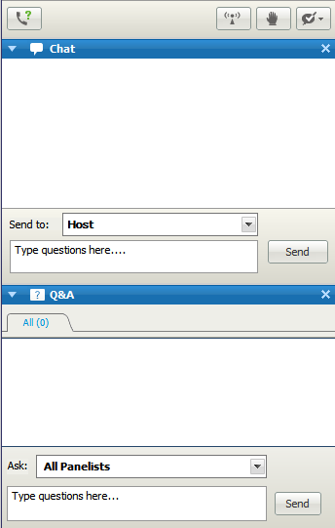
A note about questions…
Please type questions related to technical issues in the Chat box.
Please type questions related to webinar content in the Q&A box.
Notes:
To help us be the most responsive to your requests throughout this webinar, we ask that you please type any questions related to technical issues or general questions in the chat box on your screen. We ask that you use the Q&A box to type questions related to the webinar content, that you would like our presenters and center staff to address.

Slide 3
In Today’s Webinar…
Framing the need for evidence-based interventions (EBIs)
National Center on Intensive Intervention (NCII) Behavior Interventions Tools Chart
Selecting appropriate EBIs
Examples of EBIs
Relevant resources

Slide 4
Behavior Intervention Challenges
The Current Dilemma for Educational Professionals
  More cases
  Higher levels of accountability
  And traditional methods assume there is lots of time…
Notes:
1) Problem Solving Models (RTI) essentially mean interventions for everyone in need
Essentially any child not responding is considered in need.
2) No Child Left Behind and IDEA mandate accountability, or that we have defensible outcome data on all interventions
3) Traditional models have been focused on spending a great deal of time coming up with recommendations about a child's needs
Assessment orientation – Hours of assessment and report writing followed but meeting time
Traditional Consultation orientation – A number of consultation sessions allowing a consultee to come up with intervention idea

Slide 5
Selecting Interventions Quickly:
“The Reasonable Hypothesis”
Time is a precious commodity.
Efficient approach
  Test easiest hypothesis first.
  Implement intervention.
  Monitor and evaluate outcomes.
If approach fails, attempt something more progressive.
Notes:
Time is a precious commodity. Educators need to be efficient when problem solving.
Under many circumstances, the most efficient thing to do is to test the easiest hypothesis first, implement an intervention, and monitor and evaluate outcomes.
If that approach fails to improve student performance, then something progressively more time intensive can be attempted until the probable cause of failure is identified.
Also, easier solutions are more likely to be implemented consistently while solutions which are more time consuming or technically difficult for teachers and support personnel are less likely to be implemented correctly (Gresham, 1989).

Slide 6
NCII’s Approach: Data-Based Individualization (DBI)
1. Secondary intervention program, delivered with greater intensity
3. Informal diagnostic assessment
4. Adaptation
2. Progress monitoring
5. Continuous progress monitoring with adaptations occurring as needed to ensure adequate progress
Notes:
These are the 5 steps of the DBI process. Note that as part of this process, it is important to start with a “secondary intervention program”. In behavior, we often don’t hear the term “secondary intervention program” related to behavior. This really means that it is important to start with an evidence-based intervention. (Describe the rest of the DBI process referring to secondary intervention programs as “evidence-based interventions”.)

Slide 7
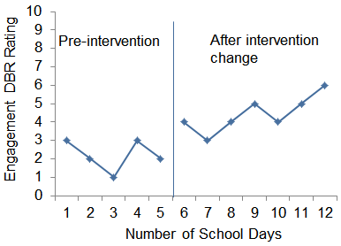
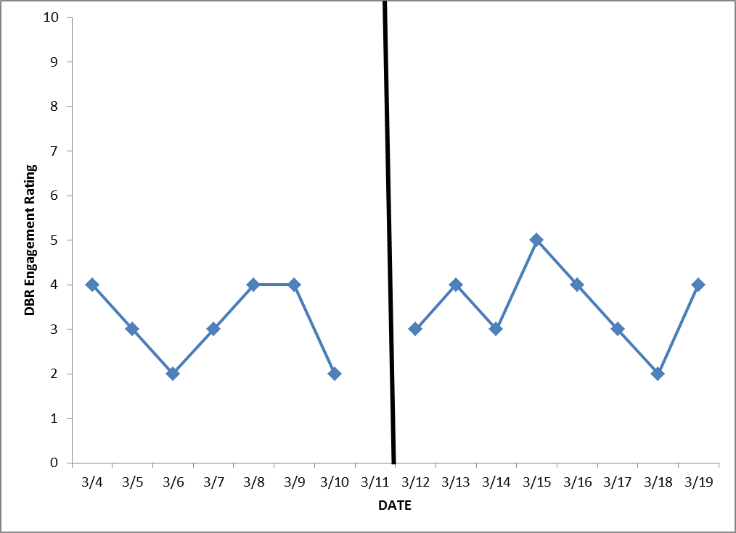
Adapting Behavior Interventions
Intensify current intervention.
Change to a new intervention.
Appropriate when the current intervention is yielding some progress but slowly.
Appropriate when the current intervention is yielding little or no progress.
Pre-intervention
After intervention change

Slide 8
Selecting EBIs for Behavior
1. Identification of Hypothesized Function
2. Selection of Relevant Intervention Based on Function
3. Assessment and Monitoring
4. Analysis Focusing on Both Effectiveness and Function
Notes:
Note that this graphic represents what the DBI process looks like when designing and delivering an intensive intervention for behavior with the DBI process. When we use the DBI process to address academic challenges, we want to make sure that the evidence-based intervention is an appropriate fit for the student’s specific academic needs. Similarly, in behavior it is crucial to make sure that the evidence based intervention is an appropriate match for the student. In this webinar, we’ll briefly discuss the importance of selecting appropriate EBIs in behavior by identifying the function of a child’s behavior as well as share guidance for selecting relevant EBIs and resources that can help in this selection. We will also discuss a few examples of EBIs in behavior.
(Notes from a previous NCII training that could be helpful to share here.) It is also worth noting that “evidence based” as construct changes when it comes to a child with intensive needs. More specifically, in some ways, evidence based for a individual child with intensive needs isn’t really evidence based until we have evidence that it works or is effective for the individual child. These students at Tier 3 have been resistant to interventions at Tier 1 and Tier 2 so it is likely that they may also be resistant (only initially we hope) to intervention or strategies at Tier 3 as well.
It is critical when at the initial stages of selecting EBI’s or interventions that the ones selected have some existing evidence, are related to function and likely to work.
(Use this to lead into the introduction of the NCII Tools Chart.)

Slide 9
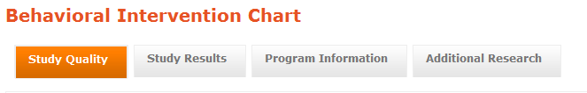
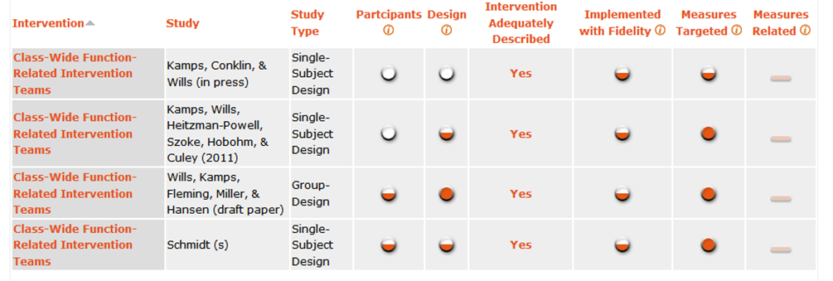
NCII Tools Chart on Behavioral Interventions

Slide 10
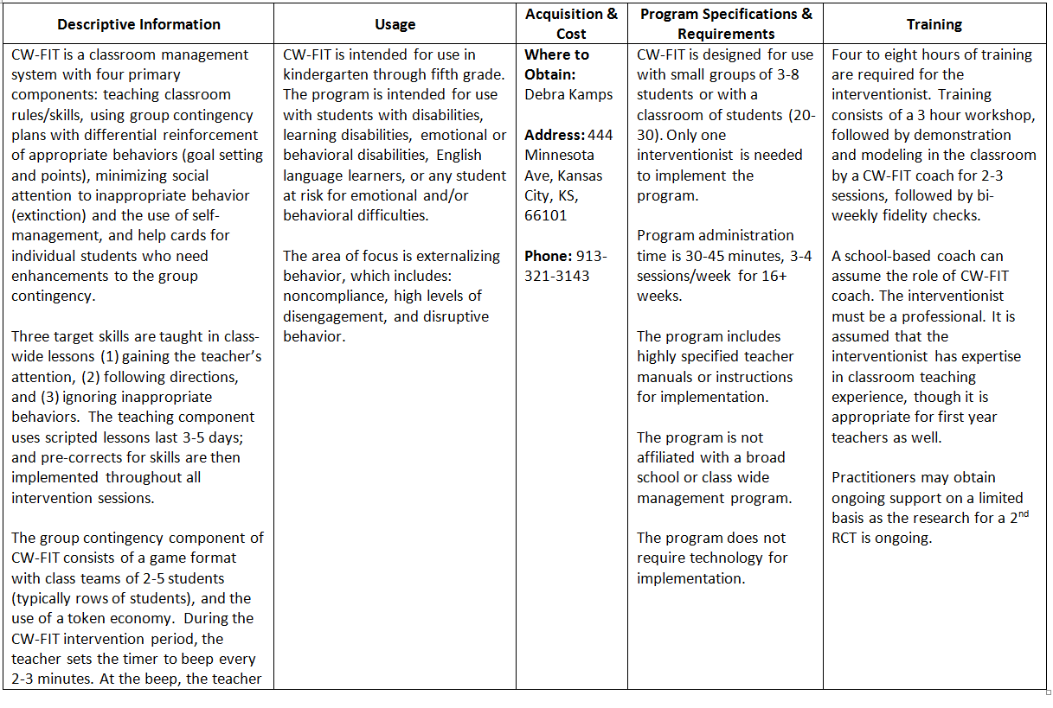
Implementation Table
Intervention | Study | Study Type | Study Quality
 |  |  | Participants | Design | Fidelity of Implementation | Measures Targeted | Measures Broader
Class-Wide Function-Related Intervention Teams | Kamps, Conklin, & Wills (in press) | Single Case | ○ | ○ | ◐ | ◐ | —
 | Kamps, Wills, Heitzman-Powell, Szoke, Hobohm, & Culey (2011) | Single Case | ○ | ◐ | ◐ | ● | —
 | Wills, Kamps, Fleming, Miller, & Hansen (draft paper) | Group | ◐ | ● | ◐ | ● | —
 | Schmidt (s) | Single Case | ◐ | ◐ | ◐ | ● | —
Notes:
Implementation Table Pop-up

Slide 11
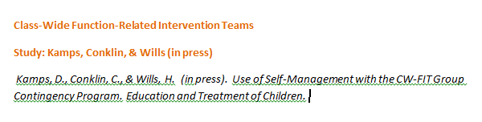
Study Citation
Intervention | Study | Study Type | Study Quality
 |  |  | Participants | Design | Fidelity of Implementation | Measures Targeted | Measures Broader
Class-Wide Function-Related Intervention Teams | Kamps, Conklin, & Wills (in press) | Single Case | ○ | ○ | ◐ | ◐ | —
 | Kamps, Wills, Heitzman-Powell, Szoke, Hobohm, & Culey (2011) | Single Case | ○ | ◐ | ◐ | ● | —
 | Wills, Kamps, Fleming, Miller, & Hansen (draft paper) | Group | ◐ | ● | ◐ | ● | —
 | Schmidt (s) | Single Case | ◐ | ◐ | ◐ | ● | —
Notes:
Study citation pop-up

Slide 12
Study Quality: Participants
Intervention | Study | Study Type | Study Quality
 |  |  | Participants | Design | Fidelity of Implementation | Measures Targeted | Measures Broader
Class-Wide Function-Related Intervention Teams | Kamps, Conklin, & Wills (in press) | Single Case | ○ | ○ | ◐ | ◐ | —
 | Kamps, Wills, Heitzman-Powell, Szoke, Hobohm, & Culey (2011) | Single Case | ○ | ◐ | ◐ | ● | —
 | Wills, Kamps, Fleming, Miller, & Hansen (draft paper) | Group | ◐ | ● | ◐ | ● | —
 | Schmidt (s) | Single Case | ◐ | ◐ | ◐ | ● | —
Notes:
Participants column header pop-up

Slide 13
Study Quality: Design
Intervention | Study | Study Type | Study Quality
 |  |  | Participants | Design | Fidelity of Implementation | Measures Targeted | Measures Broader
Class-Wide Function-Related Intervention Teams | Kamps, Conklin, & Wills (in press) | Single Case | ○ | ○ | ◐ | ◐ | —
 | Kamps, Wills, Heitzman-Powell, Szoke, Hobohm, & Culey (2011) | Single Case | ○ | ◐ | ◐ | ● | —
 | Wills, Kamps, Fleming, Miller, & Hansen (draft paper) | Group | ◐ | ● | ◐ | ● | —
 | Schmidt (s) | Single Case | ◐ | ◐ | ◐ | ● | —
Notes:
Design column header pop-up

Slide 14
Study Quality: Fidelity of Implementation
Intervention | Study | Study Type | Study Quality
 |  |  | Participants | Design | Fidelity of Implementation | Measures Targeted | Measures Broader
Class-Wide Function-Related Intervention Teams | Kamps, Conklin, & Wills (in press) | Single Case | ○ | ○ | ◐ | ◐ | —
 | Kamps, Wills, Heitzman-Powell, Szoke, Hobohm, & Culey (2011) | Single Case | ○ | ◐ | ◐ | ● | —
 | Wills, Kamps, Fleming, Miller, & Hansen (draft paper) | Group | ◐ | ● | ◐ | ● | —
 | Schmidt (s) | Single Case | ◐ | ◐ | ◐ | ● | —
Notes:
Fidelity column header pop-up

Slide 15
Study Quality: Measures
Intervention | Study | Study Type | Study Quality
 |  |  | Participants | Design | Fidelity of Implementation | Measures Targeted | Measures Broader
Class-Wide Function-Related Intervention Teams | Kamps, Conklin, & Wills (in press) | Single Case | ○ | ○ | ◐ | ◐ | —
 | Kamps, Wills, Heitzman-Powell, Szoke, Hobohm, & Culey (2011) | Single Case | ○ | ◐ | ◐ | ● | —
 | Wills, Kamps, Fleming, Miller, & Hansen (draft paper) | Group | ◐ | ● | ◐ | ● | —
 | Schmidt (s) | Single Case | ◐ | ◐ | ◐ | ● | —
Notes:
Measures column header pop-up

Slide 16
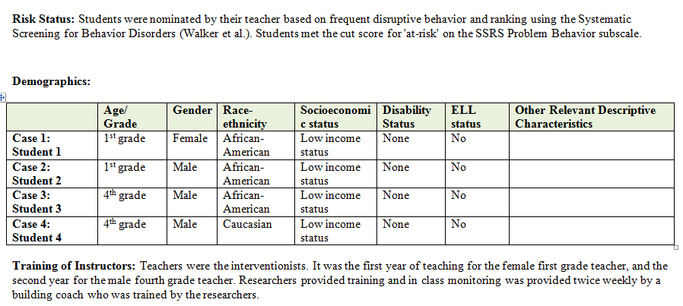
“Pop-Up” Data: Participants
Intervention | Study | Study Type | Study Quality
 |  |  | Participants | Design | Fidelity of Implementation | Measures Targeted | Measures Broader
Class-Wide Function-Related Intervention Teams | Kamps, Conklin, & Wills (in press) | Single Case | ○ | ○ | ◐ | ◐ | —
 | Kamps, Wills, Heitzman-Powell, Szoke, Hobohm, & Culey (2011) | Single Case | ○ | ◐ | ◐ | ● | —
 | Wills, Kamps, Fleming, Miller, & Hansen (draft paper) | Group | ◐ | ● | ◐ | ● | —
 | Schmidt (s) | Single Case | ◐ | ◐ | ◐ | ● | —
Notes:
Single Case Participants Pop-up

Slide 17
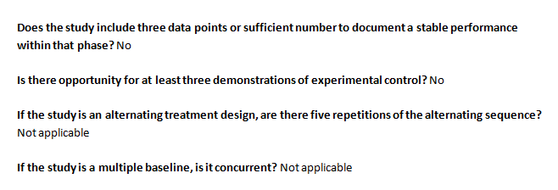
“Pop-Up” Data: Design
Intervention | Study | Study Type | Study Quality
 |  |  | Participants | Design | Fidelity of Implementation | Measures Targeted | Measures Broader
Class-Wide Function-Related Intervention Teams | Kamps, Conklin, & Wills (in press) | Single Case | ○ | ○ | ◐ | ◐ | —
 | Kamps, Wills, Heitzman-Powell, Szoke, Hobohm, & Culey (2011) | Single Case | ○ | ◐ | ◐ | ● | —
 | Wills, Kamps, Fleming, Miller, & Hansen (draft paper) | Group | ◐ | ● | ◐ | ● | —
 | Schmidt (s) | Single Case | ◐ | ◐ | ◐ | ● | —
Notes:
Single Case Design Pop-up

Slide 18

“Pop-Up” Data: Fidelity of Implementation
Intervention | Study | Study Type | Study Quality
 |  |  | Participants | Design | Fidelity of Implementation | Measures Targeted | Measures Broader
Class-Wide Function-Related Intervention Teams | Kamps, Conklin, & Wills (in press) | Single Case | ○ | ○ | ◐ | ◐ | —
 | Kamps, Wills, Heitzman-Powell, Szoke, Hobohm, & Culey (2011) | Single Case | ○ | ◐ | ◐ | ● | —
 | Wills, Kamps, Fleming, Miller, & Hansen (draft paper) | Group | ◐ | ● | ◐ | ● | —
 | Schmidt (s) | Single Case | ◐ | ◐ | ◐ | ● | —
Notes:
Single Case Fidelity Pop-up

Slide 19
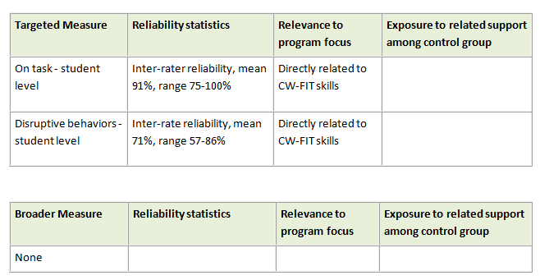
“Pop-Up” Data: Measures
Intervention | Study | Study Type | Study Quality
 |  |  | Participants | Design | Fidelity of Implementation | Measures Targeted | Measures Broader
Class-Wide Function-Related Intervention Teams | Kamps, Conklin, & Wills (in press) | Single Case | ○ | ○ | ◐ | ◐ | —
 | Kamps, Wills, Heitzman-Powell, Szoke, Hobohm, & Culey (2011) | Single Case | ○ | ◐ | ◐ | ● | —
 | Wills, Kamps, Fleming, Miller, & Hansen (draft paper) | Group | ◐ | ● | ◐ | ● | —
 | Schmidt (s) | Single Case | ◐ | ◐ | ◐ | ● | —
Notes:
Single Case Measures Pop-up

Slide 20
Study Results
Intervention | Study | Study Type | Study Results
 |  |  | Mean ES - Targeted | Measure ES - Broader | Visual Analysis (Single-Case Designs) | Disaggregated Outcome Data Available for Demographic Subgroups
Class-Wide Function-Related Intervention Teams | Kamps, Conklin, & Wills (in press) | Single Case | n/a | n/a | ◐ | n/a
 | Kamps, Wills, Heitzman-Powell, Szoke, Hobohm, & Culey (2011) | Single Case | n/a | n/a | ◐ | n/a
 | Wills, Kamps, Fleming, Miller, & Hansen (draft paper) | Group | 0.93* | — | n/a | No
 | Schmidt (s) | Single Case | n/a | n/a | ◐ | n/a
Notes:
Study Results Tab

Slide 21
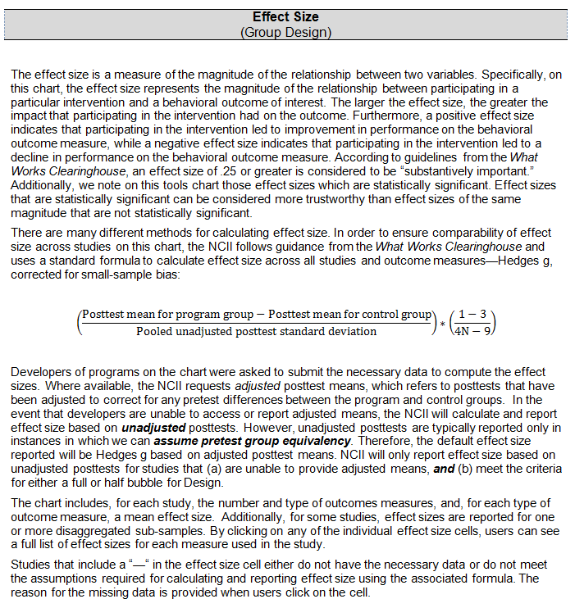
Study Results: Effect Size
Intervention | Study | Study Type | Study Results
 |  |  | Mean ES - Targeted | Measure ES - Broader | Visual Analysis (Single-Case Designs) | Disaggregated Outcome Data Available for Demographic Subgroups
Class-Wide Function-Related Intervention Teams | Kamps, Conklin, & Wills (in press) | Single Case | n/a | n/a | ◐ | n/a
 | Kamps, Wills, Heitzman-Powell, Szoke, Hobohm, & Culey (2011) | Single Case | n/a | n/a | ◐ | n/a
 | Wills, Kamps, Fleming, Miller, & Hansen (draft paper) | Group | 0.93* | — | n/a | No
 | Schmidt (s) | Single Case | n/a | n/a | ◐ | n/a
Notes:
ES column header pop-up

Slide 22
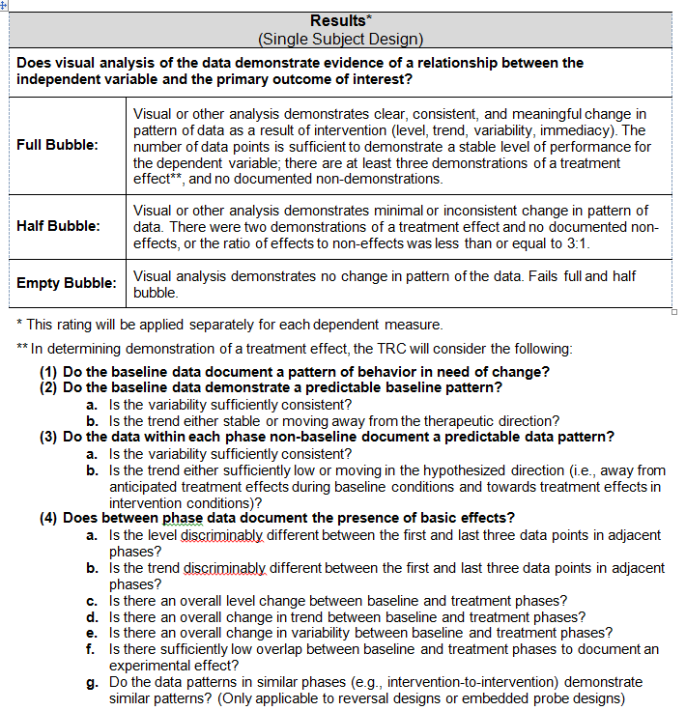
Study Results: Visual Analysis
Intervention | Study | Study Type | Study Results
 |  |  | Mean ES - Targeted | Measure ES - Broader | Visual Analysis (Single-Case Designs) | Disaggregated Outcome Data Available for Demographic Subgroups
Class-Wide Function-Related Intervention Teams | Kamps, Conklin, & Wills (in press) | Single Case | n/a | n/a | ◐ | n/a
 | Kamps, Wills, Heitzman-Powell, Szoke, Hobohm, & Culey (2011) | Single Case | n/a | n/a | ◐ | n/a
 | Wills, Kamps, Fleming, Miller, & Hansen (draft paper) | Group | 0.93* | — | n/a | No
 | Schmidt (s) | Single Case | n/a | n/a | ◐ | n/a
Notes:
Visual Analysis column header pop-up

Slide 23
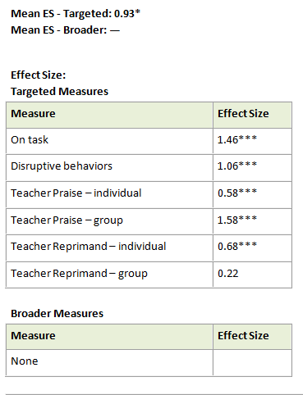
Effect Size “Pop-Up”
Intervention | Study | Study Type | Study Results
 |  |  | Mean ES - Targeted | Measure ES - Broader | Visual Analysis (Single-Case Designs) | Disaggregated Outcome Data Available for Demographic Subgroups
Class-Wide Function-Related Intervention Teams | Kamps, Conklin, & Wills (in press) | Single Case | n/a | n/a | ◐ | n/a
 | Kamps, Wills, Heitzman-Powell, Szoke, Hobohm, & Culey (2011) | Single Case | n/a | n/a | ◐ | n/a
 | Wills, Kamps, Fleming, Miller, & Hansen (draft paper) | Group | 0.93* | — | n/a | No
 | Schmidt (s) | Single Case | n/a | n/a | ◐ | n/a
Notes:
Group Design: Study Results ES Pop-up

Slide 24
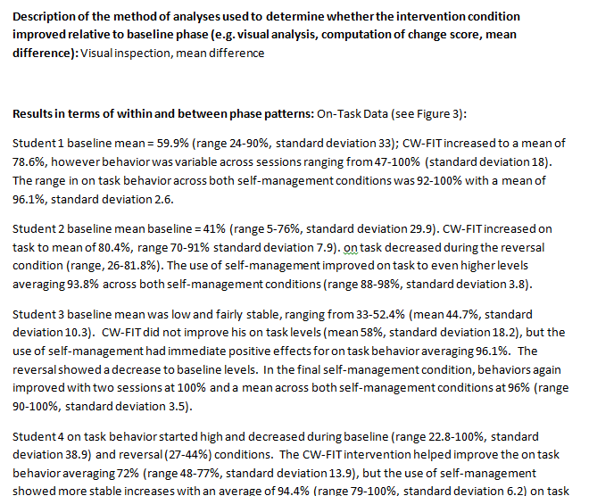
Visual Analysis “Pop-Up”
Intervention | Study | Study Type | Study Results
 |  |  | Mean ES - Targeted | Measure ES - Broader | Visual Analysis (Single-Case Designs) | Disaggregated Outcome Data Available for Demographic Subgroups
Class-Wide Function-Related Intervention Teams | Kamps, Conklin, & Wills (in press) | Single Case | n/a | n/a | ◐ | n/a
 | Kamps, Wills, Heitzman-Powell, Szoke, Hobohm, & Culey (2011) | Single Case | n/a | n/a | ◐ | n/a
 | Wills, Kamps, Fleming, Miller, & Hansen (draft paper) | Group | 0.93* | — | n/a | No
 | Schmidt (s) | Single Case | n/a | n/a | ◐ | n/a
Notes:
Single Case: Study Results Visual Analysis Pop-up

Slide 25
Program Information
Intervention | Study | Study Type | Program Information
 |  |  | Target Behavior(s) | Delivery | Fidelity of Implementation Checklist Available | Minimum Interventionist Requirements
Class-Wide Function-Related Intervention Teams | Kamps, Conklin, & Wills (in press) | Single Case | Externalizing | Small groups (n = 3-25), Classrooms | Yes | Paraprofessional 4–8 hours of training
 | Kamps, Wills, Heitzman-Powell, Szoke, Hobohm, & Culey (2011) | Single Case | Externalizing | Small groups (n = 3-25), Classrooms | Yes | Paraprofessional 4–8 hours of training
 | Wills, Kamps, Fleming, Miller, & Hansen (draft paper) | Group | Externalizing | Small groups (n = 3-25), Classrooms | Yes | Paraprofessional 4–8 hours of training
 | Schmidt (s) | Single Case | Externalizing | Small groups (n = 3-25), Classrooms | Yes | Paraprofessional 4–8 hours of training
Notes:
Program Information Tab

Slide 26
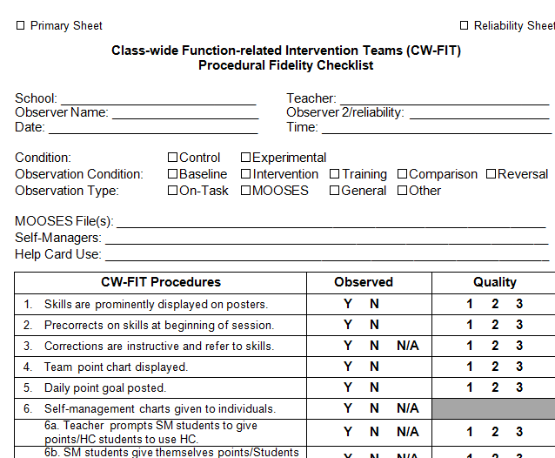
Program Information “Pop-Up” Data
Intervention | Study | Study Type | Program Information
 |  |  | Target Behavior(s) | Delivery | Fidelity of Implementation Checklist Available | Minimum Interventionist Requirements
Class-Wide Function-Related Intervention Teams | Kamps, Conklin, & Wills (in press) | Single Case | Externalizing | Small groups (n = 3-25), Classrooms | Yes | Paraprofessional 4–8 hours of training
 | Kamps, Wills, Heitzman-Powell, Szoke, Hobohm, & Culey (2011) | Single Case | Externalizing | Small groups (n = 3-25), Classrooms | Yes | Paraprofessional 4–8 hours of training
 | Wills, Kamps, Fleming, Miller, & Hansen (draft paper) | Group | Externalizing | Small groups (n = 3-25), Classrooms | Yes | Paraprofessional 4–8 hours of training
 | Schmidt (s) | Single Case | Externalizing | Small groups (n = 3-25), Classrooms | Yes | Paraprofessional 4–8 hours of training
Notes:
Fidelity Checklist Pop-up

Slide 27
Additional Research
Intervention | Study | Study Type | Additional Research
 |  |  | Additional Research Studies on the Intervention | Intervention Reviewed by What Works Clearinghouse
Class-Wide Function-Related Intervention Teams | Kamps, Conklin, & Wills (in press) | Single Case | 1 Study | No
 | Kamps, Wills, Heitzman-Powell, Szoke, Hobohm, & Culey (2011) | Single Case | 1 Study | No
 | Wills, Kamps, Fleming, Miller, & Hansen (draft paper) | Group | 1 Study | No
 | Schmidt (s) | Single Case | 1 Study | No
Notes:
Additional Research Tab

Slide 28
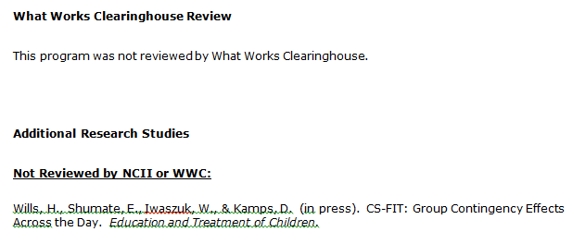
Additional Research “Pop-Up” Data
Intervention | Study | Study Type | Additional Research
 |  |  | Additional Research Studies on the Intervention | Intervention Reviewed by What Works Clearinghouse
Class-Wide Function-Related Intervention Teams | Kamps, Conklin, & Wills (in press) | Single Case | 1 Study | No
 | Kamps, Wills, Heitzman-Powell, Szoke, Hobohm, & Culey (2011) | Single Case | 1 Study | No
 | Wills, Kamps, Fleming, Miller, & Hansen (draft paper) | Group | 1 Study | No
 | Schmidt (s) | Single Case | 1 Study | No
Notes:
Additional Research Pop-up

Slide 29
NCII Tools Chart: Cautions
The tools chart is not an exhaustive list of behavioral interventions.
All submitted products are reviewed and results posted; in other words, not all interventions on the chart have positive reviews!
When reviewing and selecting EBIs, consider your population and the function of the behavior you are addressing.
The tools chart is not intended to solve all your problems. However, it is a good place to start.

Slide 30
What Are EBIs in Schools?
Tier 3 (5%)
Functionally Based EBI
Tier 2 (15%)
Functionally Related Small-Group and Individual EBI
Tier 1 (80%)
Evidence-Based Curricula
Tier 1—Whole-school best practices
Tier 2—Functionally related small-group practices
Tier 3—Individually and functionally based EBI
NOTE: EBIs are very different things in Tiers 1 and 2 than Tier 3! This is a critical and not well-understood issue.

Slide 31
Tiers 2 and 3—EBI Fine Print I
EBIs are validated for a specific purpose with a specific population.
Implication
  EBIs are only useful for a range of problems and, as such, must be paired up with the right situation.
    A hammer is an effective tool, but not with a screw.

Slide 32
Tiers 2 and 3—EBI Fine Print II
EBIs assume implementation integrity.
Implication
  Changing parts of an intervention, while typical, can invalidate the EBI.
  Ways to change an intervention
    Frequency
    Materials
    Target
    Style

Slide 33
Tiers 2 and 3—EBI Fine Print III
EBIs are typically validated with large-group research or a series of small-group studies.
Implication
  EBIs have been documented as likely effective, not surely effective.
  Even the most effective interventions are often ineffective with a specific case.
  As such, you cannot assume an EBI will always work.

Slide 34
Implications of the Fine Print
A list of EBIs is just a nice place to start.
Additional needed steps
  Select the EBI that makes sense for the current case.
  Implement the EBI with integrity.
  Evaluate the effectiveness in some manner to see if it worked.

Slide 35
General Goal of
Intervention Selection
Make a sound decision quickly.
Try the selected intervention.
Evaluate the intervention.
Recycle or escalate if necessary.

Slide 36
Functional EBI Selection With Extended Analysis
Practical Functional Assessment and Analysis
or

Slide 37
Let’s Talk About
“Functional Assessment”
What does this term refer to?
What does this look like in practice?
What happened to the “analysis”?

Slide 38
School-Based Functional Assessment in 2012
A “high-incidence” approach
  Flexible rather than prescriptive
  Focused on “intervention effectiveness” rather than functional documentation
  Multi-function
Followed by functional analysis rather than done in isolation

Slide 39
Common Reasons Why
Students Misbehave
Class-wide problems exist.
Students have not learned the proper behavior.
Inappropriate behavior removes students from what they do not want to do (escape).
Inappropriate behavior gets students something (typically attention).
They have not had to do the behavior in that way before.

Slide 40
Selecting EBIs That
Align With Function
Examples
  Good Behavior Game
  Check In Check Out (CICO)
  Non-contingent reinforcement (NCR)—attention seeking
  Antecedent modification—escape
  Instructional match—prerequisite or skill/ability
http://miblsi.cenmi.org/
Notes:
What we’re going to do in the next section is discuss a few important considerations when delivering intensive interventions and then give you a few specific classroom examples that address escape, attention, and instruction cases. Please refer to Handout 3 – Examples of EBI’s. There are four examples in total we will review.
CICO
NCR
Antecedent Modification
Instructional Match

Slide 41
Class-wide Problems
Sometimes multiple children in the classroom are exhibiting similar behavior problems.
Solution: A class-wide behavior intervention!
EBI Network Intervention: Good Behavior Game
  http://ebi.missouri.edu/wp-content/uploads/2011/09/Good-Behavior-Game.pdf

Slide 42
Selecting EBIs That
Align With Function
What is CICO?
  Empirically supported strategy for reducing problem behavior
  Relatively quick and easy; provides structure
  Increases positive adult contact
    Excellent intervention when function of behavior is attention seeking
    Also useful for kids who escape because they do not want to do a task if teacher praise is more reinforcing than the task is punishing
http://miblsi.cenmi.org/
Notes:
CICO is one intervention with many names – e.g. The Behavior Education Program (BEP); Check, Connect, and Expect; Hello, Update, Goodbye (HUG)
Listed are some of the key features of CICO:
Check-In Check-Out (CICO) is commonly used because of the research-base supporting the positive impact for students. It is also a quick and easy intervention that requires minimal amounts of time before and after school and provides that predictability and structure to the students’ day. It increases the frequency of positive adult contact for the student that is structured to encourage, motivate, and support the student
CICO is LIKELY TO WORK when the reason or purpose of the behavior is tied to or because a student is wanting attention of some kind (e.g., the function of behavior is attention based). It is a functionally derived intervention but in order for it to be TRULY FUNCTIONALLY EFFECTIVE, the function of the behavior has to be attention based in some way – otherwise, it will be ineffective.

Slide 43
Selecting EBIs That
Align With Function
Who is CICO for?
  Engages in externalizing behaviors
  Less than 15 percent of students
  Students with multiple referrals (two to five majors)
  Students who receive several “minor” referrals
  Students who receive referrals in multiple settings
  Students who find adult attention rewarding
http://miblsi.cenmi.org/
Notes:
CICO is a commonly used Tier 2 intervention and this is a good place to start but when it comes to those students who need intensive intervention – this may not be enough on its own. Typically, en route to a Tier 3 Intervention, you can implement individual level changes such as change CICO adult, add peer support, add extra ‘check-in’ etc.

Slide 44
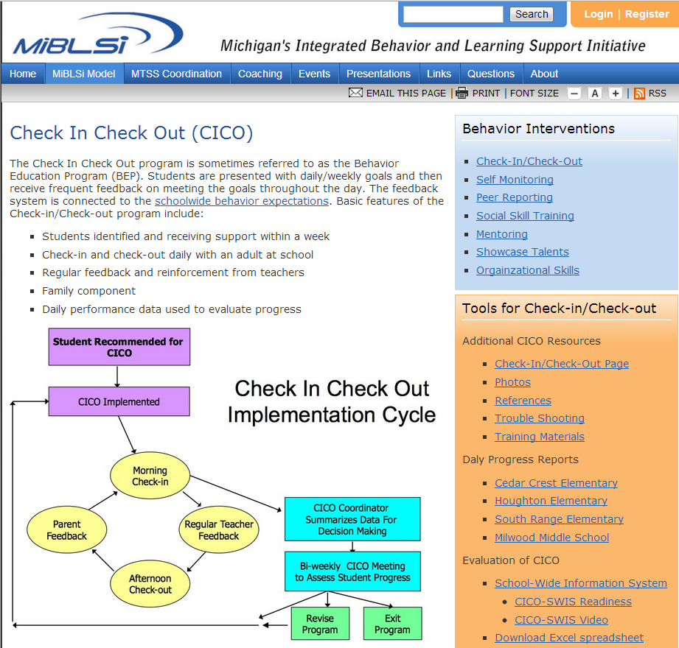
http://miblsi.cenmi.org/
Notes:
All this information about CICO is available on the MiBLSi website. http://miblsi.cenmi.org/

Slide 45

Selecting EBIs That
Align With Function
Non-contingent reinforcement (NCR)
Notes:
This is a visual example of NCR. Hopefully this picture looks familiar like something you’ve seen in your own classrooms etc. This picture was borrowed from google images for illustrative purposes only but does anyone recognize our little friend and let’s call him Johnny?
CLICK TO SHOW ARROW
Remind participants NCR is Example #2 in Handout 3: Examples of EBI’s.

Slide 46
Selecting EBIs That
Align With Function
Brief description of NCR
  Giving students access to a reinforcer frequently enough that they are no longer motivated to exhibit disruptive behavior to obtain that same reinforcer
    For example, saturate the environment with the reinforcer BEFORE the behavior occurs.
ebi.missouri.edu
Notes:
NCR is a powerful method to reduce problem behavior. NCR involves giving the student access to a reinforcer frequently enough that they are no longer motivated to exhibit disruptive behavior to obtain that same reinforcer

Slide 47
Selecting EBIs That
Align With Function
Example: Student wants teacher attention and calls out or engages in disruptive behaviors to get attention consistently during a group activity such as art or story time.
Possible Solution: Teacher provides appropriate attention prior to the child “asking” for attention with the “problem behavior,” such as having the student sit with the teacher while she is reading the book.
Notes:
Review the example and work through it with the group (e.g. pairs, small groups, teams, etc.)

Slide 48

Selecting EBIs That
Align With Function
Antecedent modification
http://ebi.missouri.edu/
Notes:
Handout 3– Example #3

Slide 49
Selecting EBIs That
Align With Function
Brief description of antecedent modification
  Students do not have to do something when they exhibit the problem behavior.
  The problem behavior is “working” for students by allowing them to escape something they do not want to do.
http://ebi.missouri.edu/
Notes:
Read slide on Antecedent modification.
Antecedent modification is typically associated with escape based behaviors.

Slide 50
Selecting EBIs That
Align With Function
Example
  Student wants to escape a non-preferred activity, such as mathematics or gym. Every time the teacher announces the start of the specific activity, the student starts engaging in disruptive behaviors (e.g., runs away, shouts out, pretends to sleep).
Possible Solutions
  Minimize need for the escape by making the target activity less punishing!
  Alter antecedents to increase task engagement, appropriate behaviors, and general success.
    For example, preteaching, offering choices, and modeling
http://ebi.missouri.edu/

Slide 51
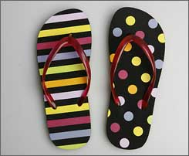

Selecting EBIs That
Align With Function
Instructional Match
Notes:
Remind participants that information is available in Handout 3 . Instructional match is example #4 in the handout.

Slide 52
Selecting EBIs That
Align With Function
Brief description and function
  Escape behavior related to academic tasks that are simply “too hard”
    Instructional materials are too difficult.
    Child may not have the prerequisite skills.
  Children who are failing academically are frustrated and often act out!
http://ebi.missouri.edu/
Notes:
A mismatch between student skill and level of difficulty of task – the assessment of a student’s current instructional level is INACCURATE in some way (e.g., knowledge, difficulty, pace, level, etc.)

Slide 53
Selecting EBIs That
Align With Function
Examples
  Addition mathematics problems without being able to count
  Journal writing without being able to form two- or three-word sentences
  Drawing without fine motor skills, such as pencil grip
  Running without proper gait
    Can only walk on tippy toes
Possible Solutions
  Preteach content or skill.
  Reduce the task difficulty.
  Break down tasks into smaller, more manageable subtasks.
  Administer a curriculum-based assessment or measurement to determine the appropriate instructional level.
http://ebi.missouri.edu/
Notes:
Read slide.
Activity: Ask the group or do a think / pair/ share about which solutions they might pair with each example and why.

Slide 54
NCII Tools Chart

Slide 55

The Evidence Based
Intervention (EBI) Network
http://ebi.missouri.edu/

Slide 56
EBI Network
Created and maintained by the University of Missouri, Indiana University, and East Carolina University school psychology programs.
Presents EBI associated with the five common reasons for academic and social behavior problems each year.

Slide 57

EBI Network Main Page

Slide 58

EBI Network Academic
Interventions Page

Slide 59

EBI Network Behavioral Interventions Page

Slide 60
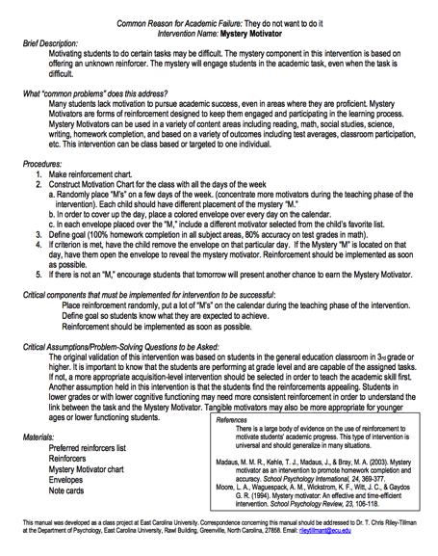
EBI Network Sample Intervention Brief

Slide 61
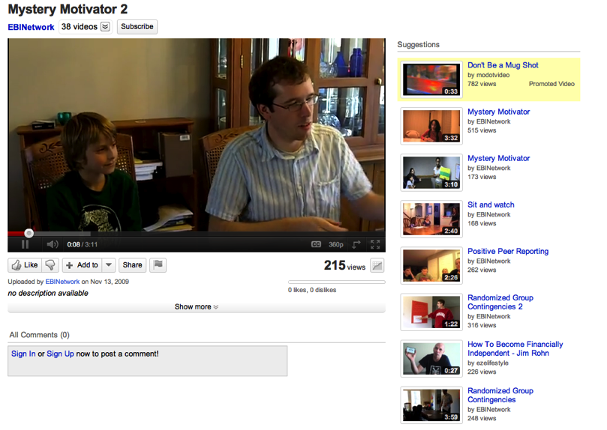
EBI Network Sample Intervention Modeling YouTube Video

Slide 62
Additional Resources
DBI Training Modules
  Using Functional Behavior Assessment for Diagnostic Assessment in Behavior
  http://www.intensiveintervention.org/resource/using-fba-diagnostic-assessment-behavior-dbi-training-series-module-6
  Designing and Delivering Intensive Intervention in Behavior
  http://www.intensiveintervention.org/resource/designing-and-delivering-intensive-intervention-behavior-dbi-training-series-module-8

Slide 63


Additional Resources
Ask the Expert Videos
http://www.intensiveintervention.org/resources/ask-the-expert
    Dr. Chris Riley-Tillman—How does the use of evidence-based practices and the approach to instruction and intervention change as behavior or academic issues become more severe?
    Dr. Lee Kern—Why is it important for schools to focus on intensive behavioral interventions?

Slide 64
Questions?
Allison Gandhi
agandhi@air.org
Chris Riley-Tillman
rileytillmant@missouri.edu
1000 Thomas Jefferson St. NW
Washington, DC 20009
www.intensiveintervention.org
ncii@air.org
Notes:
Facilitators: Add your name to this slide.

Slide 65
Although permission to redistribute this webinar is not necessary, the citation should be:
National Center on Intensive Intervention. (2014). What is an Evidence- Based Behavior Intervention? Choosing and Implementing Behavior Interventions That Work. Washington, DC: U.S. Department of Education, Office of Special Education Programs, National Center on Intensive Intervention.

Slide 66
NCII Disclaimer
This presentation was produced under the U.S. Department of Education, Office of Special Education Programs, Award No. H326Q110005. Celia Rosenquist serves as the project officer. The views expressed herein do not necessarily represent the positions or polices of the U.S. Department of Education. No official endorsement by the U.S. Department of Education of any product, commodity, service, or enterprise mentioned in this website is intended or should be inferred.

