Slide 1
Is Intensive Intervention Special Education? Defining Services for Students with Disabilities
Lou Danielson & Teri Marx, American Institutes for Research
J. David Sienko, Rhode Island Department of Education
Glenna Gallo, NASDSE/Washington State Board of Education

Slide 2
No Time Like the Present
Recent Supreme Court ruling – potential implications:
In the future, progress (documented through data) on an IEP could be the foundation for ascertaining if the FAPE standard was met.
Pushes educators to provide higher quality instruction to ensure that students with disabilities meet challenging standards.

Slide 3
Defining Special Education

Slide 4
How does your State…
…define special education?
Notes:
Share out.

Slide 5
Specially-Designed Instruction (SDI)
“adapting, as appropriate to the needs of an eligible child under this part, the content, methodology or delivery of instruction (i) to address the unique needs of the child that result from the child’s disability; and (ii) to ensure access of the child to the general curriculum, so that the child can meet the educational standards within the jurisdiction of the public agency that apply to all children.” (Section 300.39(b)(3) of Title 34, Code of Federal Regulations).

Slide 6
Standards-Aligned IEPs and SDI (RI)
Step 1: What are the Common Core State Standards (CCSS)?
Step 2. Assess Student to Determine Where Student is Functioning in all areas
Step 3. Use Data to Establish Present Levels of Functional Performance and Academic Achievement in all areas
Step 5. Establish Type of Data to be Collected, How Often, and Progress Monitoring
Step 4. Prioritize and Use Present Levels of Performance to Develop Goals

Slide 7
SDI in Rhode Island
Step 6.
- Identify Specifically Designed Instruction and Include Related Services
- Identify the instruction and classroom assessment Accommodations and Program Modifications to Provide Access and Progress in the General Curriculum
- Identify Assistive Technology devices and services need for instructions or assessment
- Determine Accommodations for State and Local Assessment
Example of Specially designed instruction:
Supplemental systematic intensive small, group instruction using evidence based reading strategies for informational text and vocabulary. 1.5 hours per day/5 days per week/4 weeks per month

Slide 8
SDI in Utah
Is…
Is Not…
In addition to core instruction (supplemental)
A service
What a teacher does
Based on teaching specific skills a student does not have in order to access and make progress in the general curriculum
Unique instruction written into the IEP that is provided to the student to allow him/her to progress toward annual goal(s)
Specific to the student (individualized)
Instruction that allows a student to make progress in the general curriculum and close the gap in academic performance as compared to his/her general education peers
In place of core instruction (supplant)
A place
What a student does
Not a restatement of the academic content standards being taught
A commercial program
A schedule
An excuse for setting low expectations or teaching below grade level (not making grade level content available/accessible to students with disabilities)

Slide 9
Setting the Stage for SDI

Slide 10
What Makes…
…special education different from other supports provided to students?
Notes:
Share out.

Slide 11
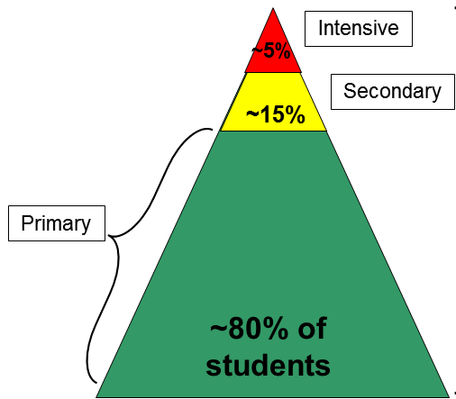
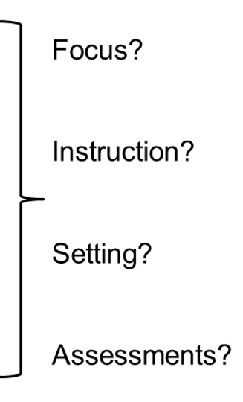
Multi-tiered System of Supports (MTSS)
11

Slide 12
State Perspectives
In MTSS, educators implement with fidelity the hallmarks of both RTI and PBIS into a merged model to improve student outcomes. • Team approach
• Universal screening
• Data-based decisions
• Evidence-based practices
• Progress monitoring

Slide 13
How are You…
…currently supporting students who are non-responsive or persistently struggling?
Notes:
Share out.

Slide 14
State Systemic Improvement Plan – Implementation Efforts
Support for LEA Implementation of Evidence-Based Practices (EBPs)
Pilot projects based on LEA data and needs
Intensive support provided by USBE
Book study with administrators, educators, and parents/families
Facilitate an annual co-teaching cohort of general and special education teachers focusing on both EBPs in co-teaching, as well as mathematics content, instruction, and intervention using EBPs
Workshops, webinars and lesson studies on the implementation of EBPs in mathematics
Professional development on Universal Design for Learning
Align courses for special education preservice programs and mathematics endorsement courses

Slide 15
SSIP –

Slide 16
A Common, Data-Driven Process

Slide 17
The National Center on Intensive Intervention (NCII)
Notes:
Why intensive intervention is important
What intensive intervention looks like through the DBI process
Considerations for implementation
Resources

Slide 18
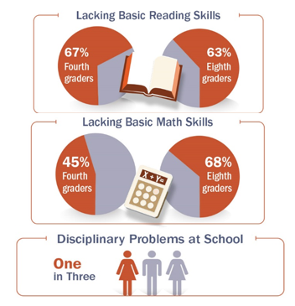
Slide 2

Slide 19
Slide 19
More Help
More Practice
Validated programs are not universally effective programs; 3 to 5 percent of students need more help (Fuchs et al., 2008; NCII, 2013).
Students with intensive needs often require 10–30 times more practice than peers to learn new information (Gersten et al., 2008).

Slide 20
What is Intensive Intervention?
Intensive intervention addresses severe and persistent learning and/or behavior difficulties.
Driven by data
Characterized by increased intensity and individualization

Slide 21
Intensive Intervention…
Is…
Individualized based on student needs
More intense, often with substantively different content AND pedagogy
Involves more frequent and precise progress monitoring
Is Not…
A single approach
A manual
A preset program
Always one on one instruction
More of the same Tier 1 instruction
More of the same Tier 2 instruction

Slide 22
Students who Need Intensive Intervention
Not meeting IEP goals
Persistently low academic achievement
High frequency/intensity behavior
Nonresponsive to interventions delivered with fidelity

Slide 23
“Comorbidity is the rule, not the exception.”

Slide 24
Data-Based Individualization (DBI)
Notes:
Data-Based Individualization (DBI): A systematic method for using data to determine when and how to provide more intensive intervention:
DBI Assumptions
Students with disabilities who require special education need specially designed instruction to progress toward standards.
A data-driven, systematized approach can help educators develop programs likely to yield success for students with intensive needs (including those with and without disabilities).

Slide 25
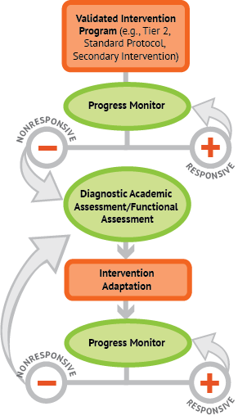
DBI Integrating data-based decision making across academics and social behavior

Slide 26
More Than Just Collecting the Data
Notes:
Lifelock TV commercial where they highlight

Slide 27
What does it take to implement DBI in LEAs?
Essential Elements

Slide 28
Discussion Questions
Are your definitions of special education similar? Different?
What makes special education different from other supports provided to students?
Is special education truly the most intensive level of support provided? How do you know?
Do you provide guidance around a process/approach similar to DBI to your LEAs?
What questions do you still have?

Slide 29
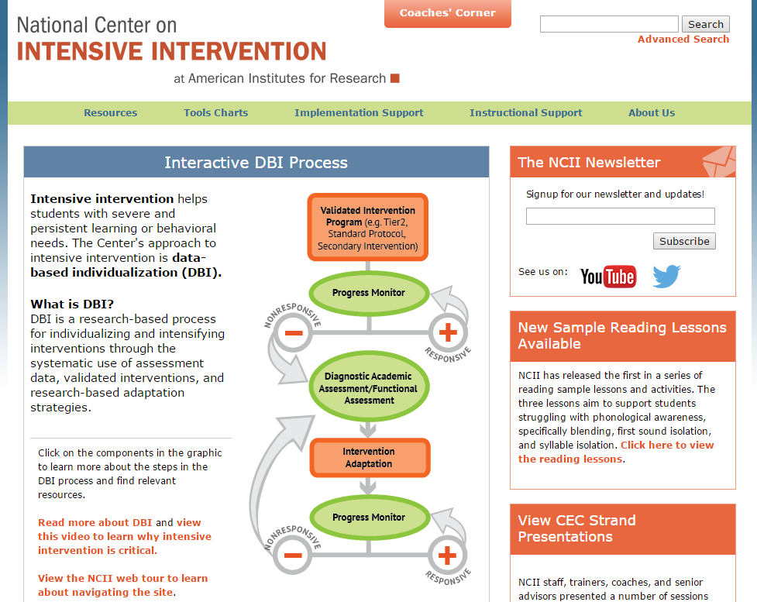
slide
WWW.INTENSIVEINTERVENTION.ORG

Slide 30
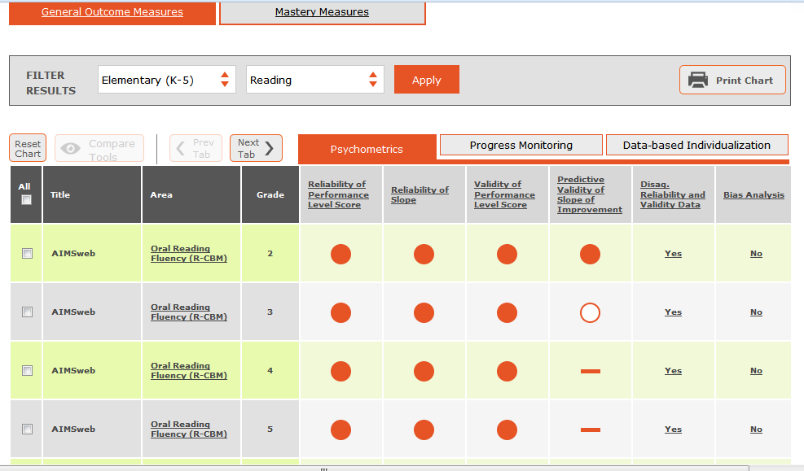
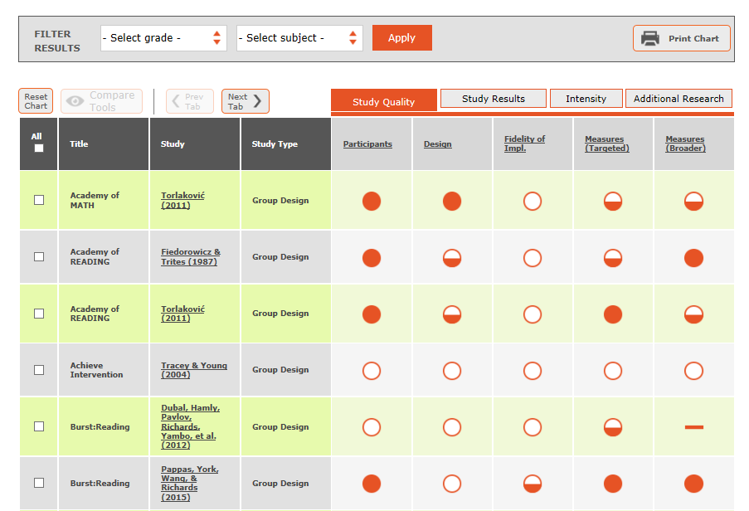
Tools Charts
Academic Intervention
Academic Progress Monitoring
Behavior Intervention
Behavior Progress Monitoring
Academic Screening
Coming Soon:
Behavior Screening
Postsecondary Transitions (potential)

Slide 31
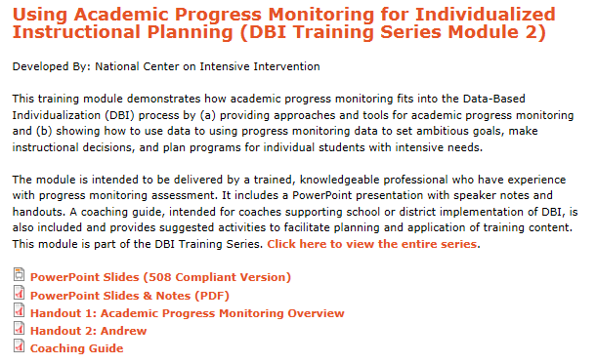
Implementation Resources: Training Materials
Ask the Expert Videos
DBI Training Series
Webinars

Slide 32
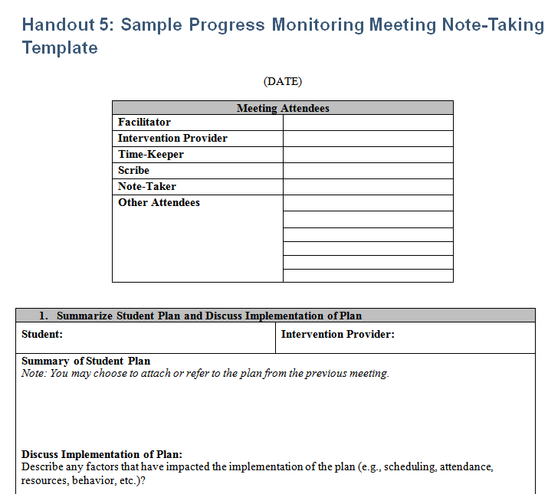
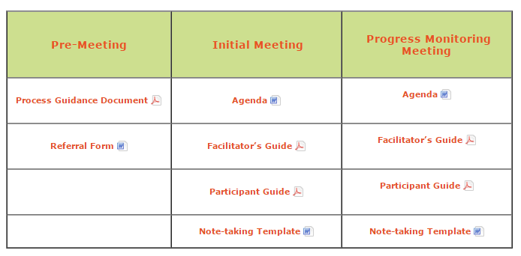
Implementation Resources: Data Meetings

Slide 33
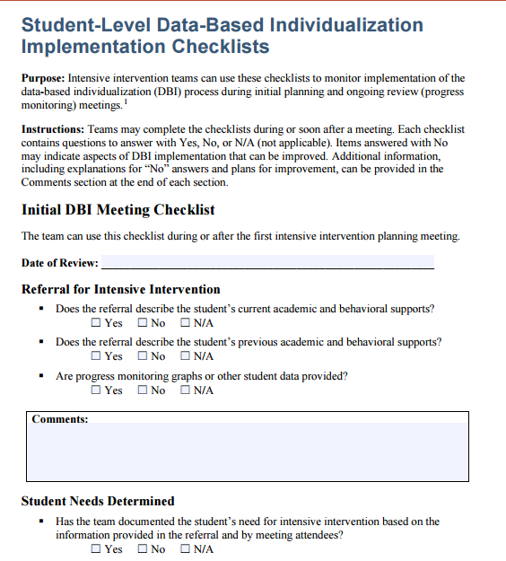
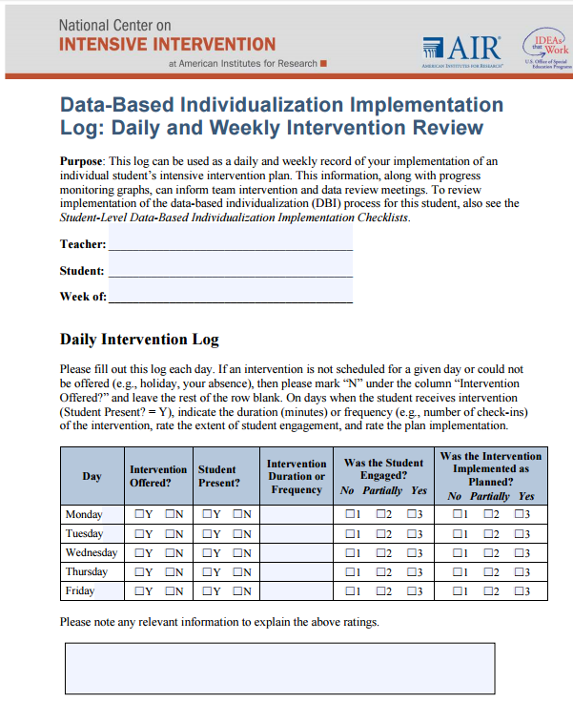
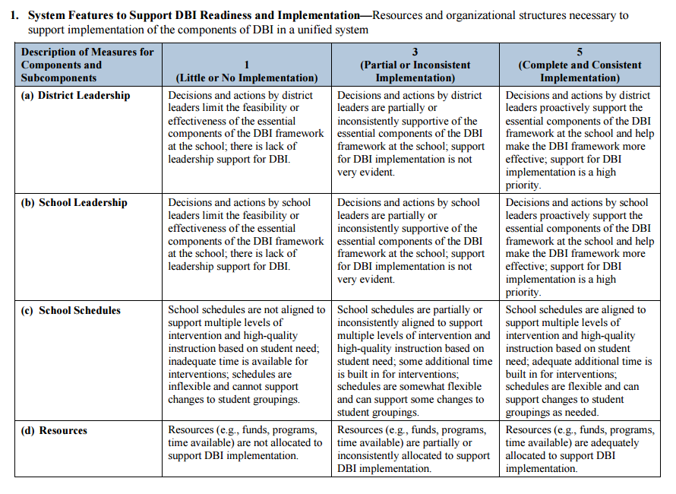
Implementation Resources: Fidelity Materials

Slide 34
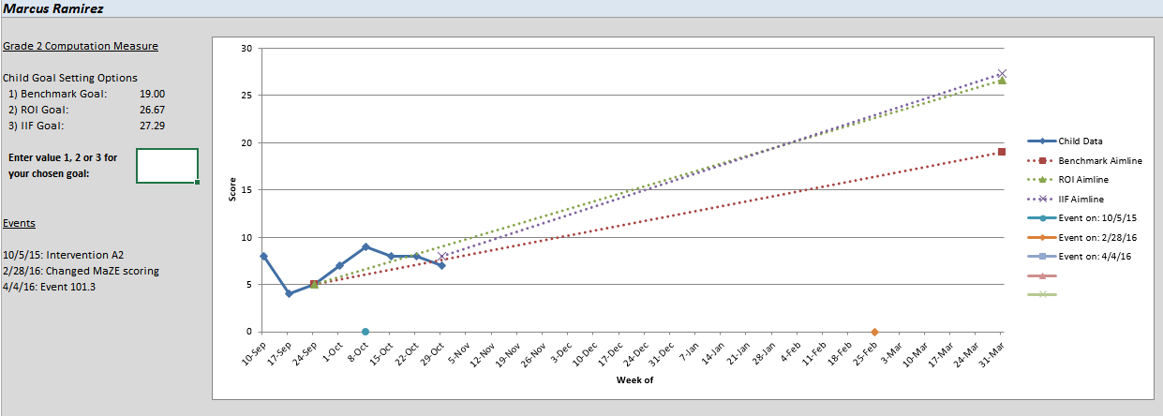
Instructional Resource: Graphing Tool

Slide 35
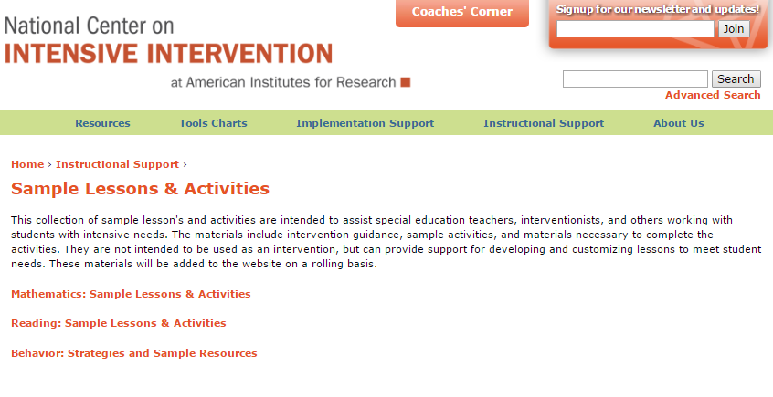
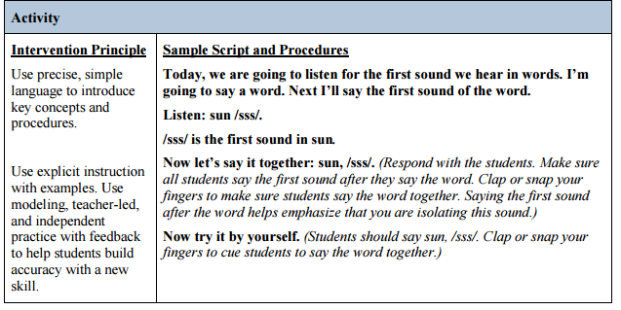
Instructional Resources: Guides

Slide 36
Instructional Resources: Math Videos

Slide 37
Stay Up to Date: Newsletter
Sign up for our Newsletter and email list to receive regular updates

Slide 38
Disclaimer
This module was produced under the U.S. Department of Education, Office of Special Education Programs, Award No. H326Q160001. Celia Rosenquist serves as the project officer. The views expressed herein do not necessarily represent the positions or policies of the U.S. Department of Education. No official endorsement by the U.S. Department of Education of any product, commodity, service, or enterprise mentioned in this website is intended or should be inferred.

Slide 39
Contact US
Teri Marx, Ph.D.
tmarx@air.org
National Center on Intensive Intervention
1000 Thomas Jefferson Street NW
Washington, DC 20007-3835
www.intensiveintervention.org
ncii@air.org
@TheNCII

