Slide 1
Writing Better, How Can Teachers Use Data to Individualize Instruction in Writing
Kristen L. McMaster, University of Minnesota
Erica S. Lembke, University of Missouri

Slide 2
NCII & CEC’s Division for Research

Slide 3
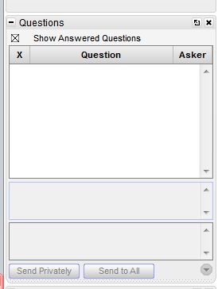
Webinar Format & Questions
Throughout the presentation, submit your questions into the question pod.
For technical issues/questions, a webinar team member will try to assist you as soon as possible.
For content related questions, there will be a time for Q&A at the end of the presentation. Submit your questions and we will share them with the presenters.

Slide 4
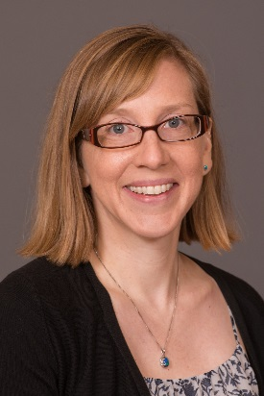
Presenters
Dr. Kristen McMaster is a Professor in the Department of Educational Psychology at the University of Minnesota
Dr. Erica Lembke is a Professor and Chair in the Department of Special Education at the University of Missouri.

Slide 5
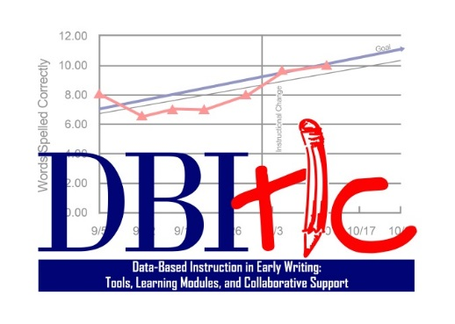
Acknowledgements
DBI-TLC Research Team
University of Minnesota:
Britta Bresina, Jaehyun Shin, Kyle Wagner, Elizabeth Lam, Seyma Birinci
-University of Missouri:
Carol Garman, Kim Moore, Alex Smith, Erica Mason, Jessica Simpson
The research reported here was supported by the Institute of Education Sciences, U.S. Department of Education, through Grant R324A130144 to the University of Minnesota. The opinions expressed are those of the authors and do not represent views of the Institute or the U.S. Department of Education.

Slide 6
Presentation Overview
Assessment
Instruction
Supporting children with intensive early writing needs
Data-based decision making
Notes:
:05
I will begin by discussing the importance of responsive writing instruction for inclusive education.

Slide 7
Presentation Overview
Assessment
Instruction
Supporting children with intensive early writing needs
Data-based decision making
Notes:
I will then show how responsive writing instruction is comprised of…

Slide 8
Presentation Overview
Assessment
Instruction
Supporting children with intensive early writing needs
Data-based decision making
Notes:
Assessment…

Slide 9
Presentation Overview
Assessment
Instruction
Supporting children with intensive early writing needs
Data-based decision making
“Simple View” of Writing
Notes:
And instruction, and that writing assessment and instruction can be guided by a “simple view” of writing that helps us know what types of skills to assess and teach to improve overall writing performance.

Slide 10
Presentation Overview
Assessment
Instruction
Supporting children with intensive early writing needs
Data-based decision making
“Simple View” of Writing
PROCESS
MATERIALS
Notes:
Finally, I will discuss how assessment and instruction can be used as part of a data-based decision making process, and will share some materials that you are welcome to use.
Emphasize that I will only be providing a brief overview, and that they can access the manual and materials if they’d like to learn more about all of these components.

Slide 11
Why writing?
Learning to write is critical to students’
~ Overall literacy development
~ Integrating knowledge and thinking critically
~ Ability to communicate what they know
~ Success in school and later life
Assessment
Instruction
Supporting children with intensive early writing needs
Data-based decision making

Slide 12
Why writing?
Many students experience difficulty with writing
~ But can make great improvements with early identification, instruction, and progress monitoring
Assessment
Instruction
Supporting children with intensive early writing needs
Data-based decision making
Notes:
:08

Slide 13
Simple View of Writing
Assessment
Instruction
Supporting children with intensive early writing needs
Data-based decision making
Text Generation
Transcription
Constrained by Attention and Memory
Self Regulation
“Simple View”
of writing
Notes:
In thinking about what types of writing skills to assess and teach young children, I find this framework called the ‘simple view of writing’ to be very helpful. Basically, the simple view of writing specifies that there are 3 main components to writing.

Slide 14
Simple View of Writing
Text Generation
Constrained by Attention and Memory
Self Regulation
Transcription
Transcribing words into text (handwriting, spelling)
Notes:
First, transcription skills are the basic writing skills that involve turning words into actual text—through handwriting and spelling.

Slide 15
Simple View of Writing
Text Generation
Transcription
Constrained by Attention and Memory
Self Regulation
Turning ideas into text (words, sentences, passages)
Notes:
Text generation involves turning ideas into text—in other words, thinking of the words, sentences, and whole passages that will be written to convey ideas and knowledge.

Slide 16
Simple View of Writing
Text Generation
Transcription
Constrained by Attention and Memory
Self Regulation
Goal setting, planning, organizing, self-monitoring, self-evaluating, revising, and self-rewarding
Notes:
And self regulation has to do with what the writer does to prepare for and monitor his or her writing process, and includes setting goals for writing, planning, organizing, etc.

Slide 17
Simple View of Writing
Text Generation
Transcription
Constrained by Attention and Memory
Self Regulation
Notes:
:10
All three components are constrained—or limited—by attention and memory. That is, children have a limited amount of attention and memory to devote to any particular task, and so when one skill, such as transcription, is particularly difficult for a child, he or she will need to focus on that particular skill, and will have limited attention and memory to devote to other skills, such as text generation. So it’s important for children to become proficient in each of the three areas in order to become proficient overall all in writing.

Slide 18
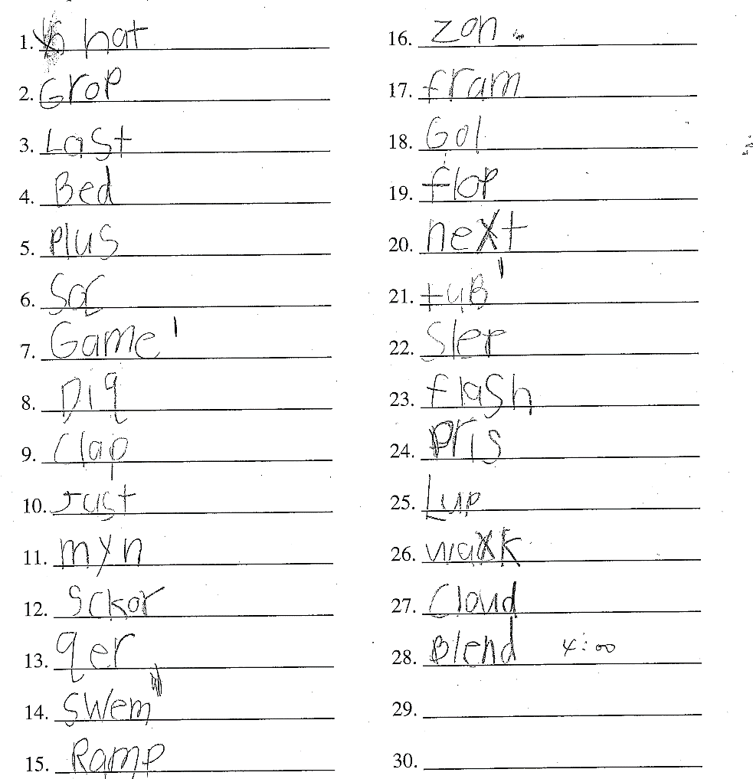
Simple View of Writing: Assessment
Word Dictation (word level)
Text Generation
Transcription
Constrained by Attention and Memory
Self Regulation
Notes:
:15
My colleagues and I have used this simple view of writing to develop assessments of writing skills of very young children. For example, to assess children’s basic transcription skills at the word level, we have developed a word dictation test. This measure involves dictating each word to the child, and the child writes each word. The child is given 3 minutes to spell as many of the words as possible. I’ll explain how this assessment is scored in just a moment.

Slide 19
Simple View of Writing: Assessment
Picture-Word (sentence level)
Text Generation
Transcription
Constrained by Attention and Memory
Self Regulation
Notes:
A slightly more advanced assessment is a picture-word task, which measures both transcription and text generation skills at the sentence level. The student is given a series of pictures and words, and the student is to write a sentence about each picture. Again, they write as much as possible in 3 minutes.

Slide 20
Simple View of Writing: Assessment
Story Prompt (passage level)
Text Generation
Transcription
Constrained by Attention and Memory
Self Regulation
Notes:
And a still more advanced task that assesses transcription and text generation is a story prompt, where students’ are given three minutes to write in response to a story prompt like this one.

Slide 21
Simple View of Writing: Assessment
Each task is designed to support self-regulation using word, picture, or story prompts
Text Generation
Transcription
Constrained by Attention and Memory
Self Regulation
Notes:
While we don’t have a specific assessment of self-regulation, each of the tasks is designed to support self regulation by providing different types of prompts designed to help children get ideas of what to write.

Slide 22
Simple View of Writing: Assessment
Scoring:
Total words written (WW)
Words spelled correctly (WSC)
Correct letter sequences (CLS; Word Dictation)
Correct word sequences (CWS; Picture Word and Story Prompt)
Text Generation
Transcription
Constrained by Attention and Memory
Self Regulation
Notes:
All of the assessments are scored by counting specific aspects of students writing, including…

Slide 23
Scoring Picture Word
Read the entire written sample.
Count the number of words written.
Underline (in red) incorrectly spelled words
Mark the end and/or beginnings of each sentence with a | (in blue).
Mark CWS and IWS
Notes:
NOTES (AC): MAKE SURE TO SCORE A SAMPLE TOGETHER AS A GROUP BEFORE HAVING THEM DO IT ALONE.

Slide 24
Scoring CBM-W (Picture Word)
Words Written (WW): The total number of words written in the sample.
A “word” is defined as a sequence of letters separated by a space from another sequence of letters.

Slide 25
Scoring Procedures (Picture Word)
Words spelled correctly (WSC):
The number of correctly spelled words written in the sample.
In some studies, words correct are counted regardless of whether they are used correctly within the context of the sentence (e.g., “I saw a bare when I was camping.”), and in others, only when the words are used correctly within the context.
Notes:
We score words spelled correctly as a spell checker would. So regardless of the context, if it is a word then it is counted as spelled correctly.
MH

Slide 26
Scoring CBM-W (Picture Word)
Correct Word Sequences (CWS): Any two adjacent words that are correct in terms of spelling, grammar, capitalization, and punctuation
Incorrect Word Sequences (IWS): Any two adjacent words that are incorrect in terms of spelling, grammar, capitalization, and punctuation
Notes:
Now let’s talk about the next procedure---CWS and IWS

Slide 27
Scoring Procedures (Picture Word)
Example:
The man saw a ∨ bare∨ in the tree and ∨ begn ∨ to run .
Notes:
We begin by underlining the incorrectly spelled words and putting the red carats before and after to denote incorrect word sequence.
Possibly take slides out and just demonstrate an example on the whiteboard

Slide 28
Scoring Procedures (PW)
Example:
^The^man^saw^a ∨ bare ∨ in^the^tree^and ∨ begn ∨ to^run^.
CWS=9, IWS=4
Notes:
Here we insert the blue inverted carats to denote correct word sequences—taking into account capitalization, punctuation, etc.
Continue on whiteboard example

Slide 29
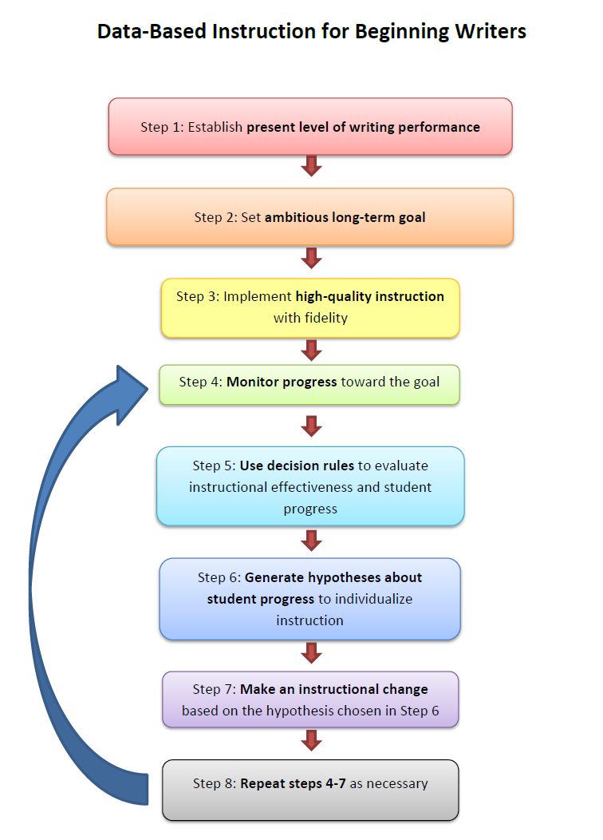
Process: Data-Based Instruction
Assessment
Instruction
Supporting children with intensive early writing needs
Data-based decision making
PROCESS
Notes:
:36
There are 8 steps to a data-based instructional approach for beginning writers.

Slide 30
Case Example: Molly
Notes:
:37
To illustrate how a teacher might use DBI, let’s take the case example of Molly. Today, we’ll just briefly go through each of the 8 DBI steps with this case example.

Slide 31
Molly’s case study
Molly is an 8-year-old student who is having difficulty with writing.
Molly’s teacher, Mr. O'Reilly, has decided to use Data-Based Instruction to help improve Molly’s writing.
Notes:
:38

Slide 32
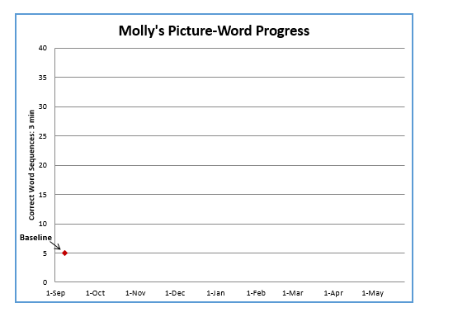
Step 1: Establish current level of writing performance (baseline).
Notes:
:39
Her teacher decides to use the Picture Word task, and administers three prompts. She scores each prompt using Correct Word Sequences (CWS), a standard CBM scoring method. On the three prompts, Molly obtains 5, 7 and 4 Correct Word Sequences. Molly's teacher plots the median, 5 CWS, on the graph as Molly’s BASELINE (red diamond on the graph).

Slide 33
One of Molly’s CBM Baseline Prompts
ˆ
ˆ
ˆ
ˆ
ˆ
ˆ
ˆ
ˆ
ˆ
ˆ
ˆ
ˆ
ˆ
ˆ
ˆ

Slide 34
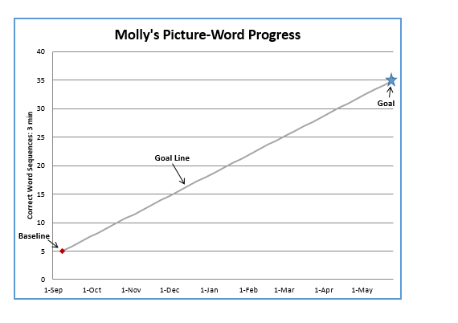
Step 2: Set an ambitious long-term goal.
Notes:
:40
Molly's teacher wants to determine a reasonable, but ambitious, goal for Molly to grow in writing over the school year. She determines a goal based on what typical students Molly’s age can write by the end of the school year, and plots this LONG-TERM GOAL on the graph (blue star) at the end of the school year. She draws a GOAL LINE from the BASELINE to the LONG-TERM GOAL.

Slide 35
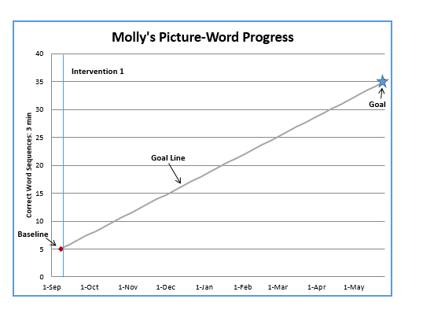
Step 3: Implement high quality instruction with fidelity based on student needs.
Notes:
:41
Molly's teacher draws a vertical line after the baseline, and labels the new section INTERVENTION 1. She decides to focus on spelling and sentence construction—skills determined by Molly’s IEP team to be critical for Molly’s success in school. She uses these skill areas to design a Writing Instructional Plan (see Writing Intervention Toolkit). She implements this plan 3 times per week, 30 minutes per session.

Slide 36
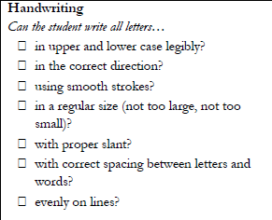
Handwriting: Does Molly…
?
a
a
So, Molly appears to have relative strengths in handwriting.
a
a
a
a
Notes:
:42
(Go through each part of the checklist. Allow teachers to respond to each item before displaying the ?, checkmark, or X)

Slide 37
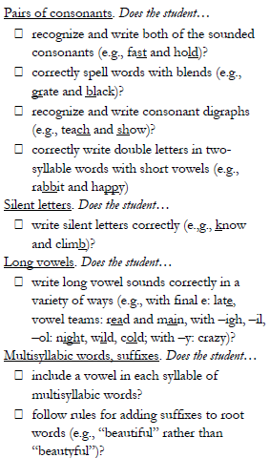
Spelling: Does Molly…
?
X
So, Molly appears to have a mix of strengths and weaknesses in spelling, but I need to know more…
a
?
?
X
a
a
Notes:
(Go through each part of the checklist. Allow teachers to respond to each item before displaying the ?, checkmark, or X)

Slide 38
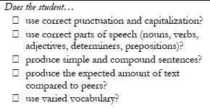
Text Generation: Does Molly…
So, Molly appears to have a mix of strengths and weaknesses in text generation, but I need to know more…
X
a
X
?
?
(kind of)
Notes:
(Go through each part of the checklist. Allow teachers to respond to each item before displaying the ?, checkmark, or X)

Slide 39
How does Mr. O'Reilly decide what to do?
After considering Molly’s strengths and weaknesses, he decides to focus his instruction on
Spelling words with long vowels and consonant blends
Sentence construction (using caps and punctuation)
Sentence combining (to make more complex sentences)

Slide 40
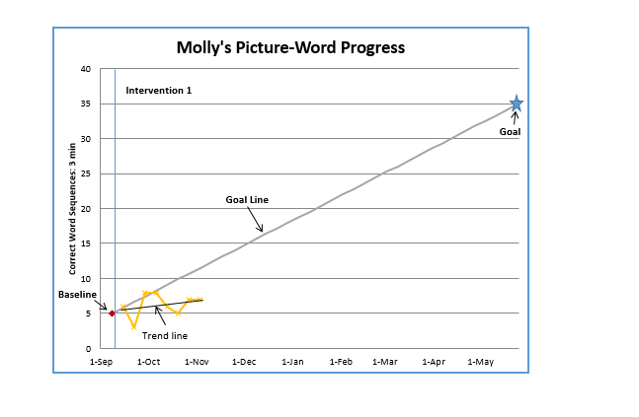
Step 4: Monitor student progress toward the goal.
Notes:
:42
Molly's teacher monitors Molly’s progress toward the goal by giving a 3-minute CBM Picture-Word prompt each week. She continues to score each prompt using CWS. She plots Molly’s progress monitoring score each week in the INTERVENTION 1 section on the graph. After collecting and plotting multiple data points (best practice suggests 8 data points or weekly progress monitoring scores), Molly's teacher adds a trend line.

Slide 41
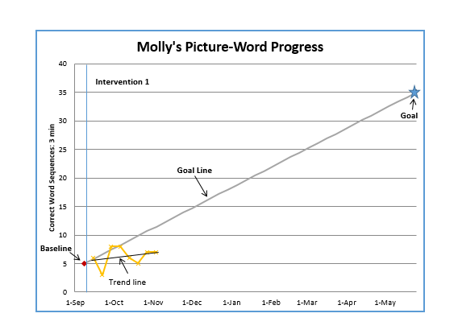
Step 5: Use decision rules to evaluate student progress & instructional effectiveness.
Notes:
A “decision rule” is a rule that tells when to make an instructional change. Molly's teacher uses a decision rule that says that if the trend line is less steep than the goal line, she should CHANGE INSTRUCTION. Molly's teacher sees that Molly’s progress falls below the goal line. So, she decides to make an instructional change.
Possible question from group:
Answer:

Slide 42
Compare student’s trend line to goal line
Notes:
From Decision-Making Rubric . . . Discuss Direct teachers to Decision Making Rubric
Three possible decisions
Now we’re going to apply what you just learned.

Slide 43
Step 5: Use decision rules to evaluate student progress & instructional effectiveness.
Notes:
:43
A “decision rule” is a rule that tells when to make an instructional change. Molly's teacher uses a decision rule that says that if the trend line is less steep than the goal line, she should CHANGE INSTRUCTION. Molly's teacher sees that Molly’s progress falls below the goal line. So, she decides to make an instructional change.
Possible question from group:
Answer:

Slide 44
Step 6: Generate hypotheses to individualize instruction.
Notes:
Based on her examination of Molly’s progress monitoring data collected during intervention, and using the Decision-Making Rubric (in Decision-Making Toolkit) as a guide, Molly's teacher generates several hypotheses about why Molly is making insufficient progress, but then chooses the one that suggests that Molly needs more time in her current intervention.

Slide 45
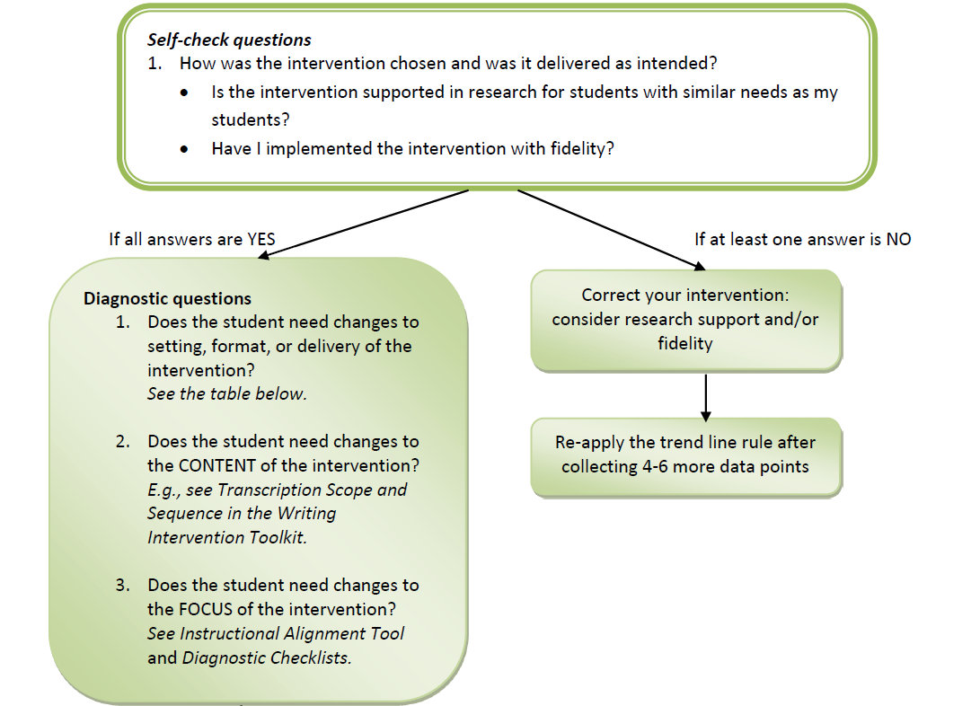
Generate Hypotheses
If an instructional change is needed:
Use self-check questions
Notes:
(Refer teachers back to Decision-Making Rubric)

Slide 46
Generate Hypotheses
If an instructional change is needed:
Use self-check questions
Notes:
(Refer teachers back to Decision-Making Rubric)

Slide 47
Generate Hypotheses
If an instructional change is needed:
Use self-check questions
Notes:
(Refer teachers back to Decision-Making Rubric)

Slide 48
Generate Hypotheses
The student needs a change to
Setting or format (instructional arrangement)
Delivery (instructional explicitness)
Notes:
(Refer teachers back to rubric.)

Slide 49
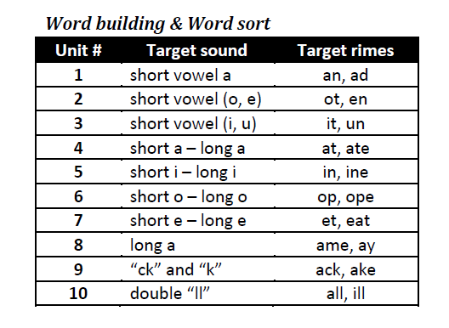
Generate Hypotheses
The student needs a change to content
Notes:
Content is the actual sounds, letters, words, etc. used in instruction. So, maybe the intervention doesn’t need to change, but the student needs practice on different content. This is a snapshot from the transcription scope and sequence that the teacher might consult to determine better content focus.

Slide 50
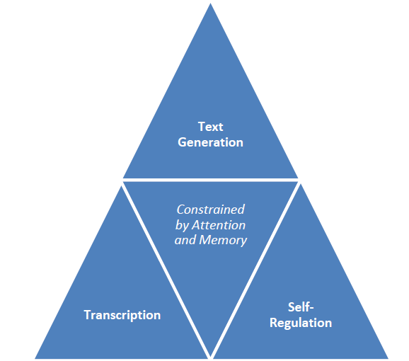
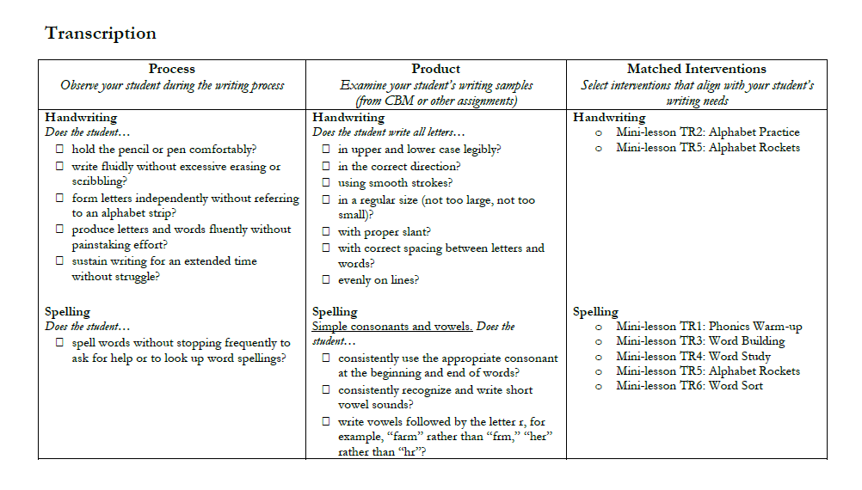
Generate Hypotheses
The student needs a change in focus
Notes:
Focus is the writing component that is being addressed (transcription, text generation, self-regulation). (Remind teachers of the Diagnostic checklists in these three areas that they can re-use to determine students’ current strengths and needs)

Slide 51
What Does Mr. O'Reilly Do?
He generates three hypotheses (all related to setting/format):
The intervention content and focus is good, but a change in format is needed:
Molly isn’t motivated.
Molly’s group size is too large.
Molly needs more time in current intervention.
Notes:
She rejects the hypothesis that Molly isn’t motivated, because Molly always tries hard and seems to enjoy working with Mr. O'Reilly. She thinks the group size might be too large AND that Molly needs more time, but she can’t change her entire schedule. So, she decides to go with the hypothesis that Molly needs a little extra 1:1 instruction.

Slide 52
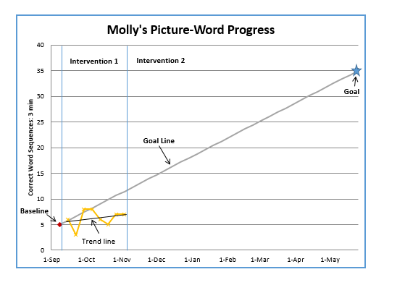
Step 7: Make instructional changes based on hypotheses.
Notes:
:45
Molly's teacher increases the frequency of intervention from 3 to 5 days per week. She draws a vertical line after INTERVENTION 1 and labels the new section INTERVENTION 2.

Slide 53
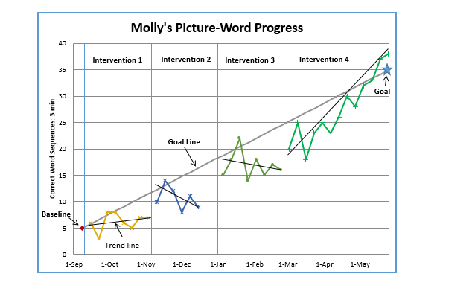
Step 8: Repeat the process!
Notes:
:46
After collecting several weekly data points in Intervention 2, it is clear that increasing the frequency of instruction is not sufficient to improve Molly’s progress. Molly's teacher continues to use the Data-Based Decision-Making Rubric (in DBDM Toolkit) and generates a new hypothesis—that Molly needs more explicit instruction with additional modeling and practice. She adds this change to her instruction, and continues to monitor Molly’s progress during INTERVENTION 3. During Intervention 3, Molly’s progress increases; however, her performance is still below the goal line. Thus, Molly's teacher develops a new hypothesis—that Molly needs additional reinforcement for working on her writing, and would benefit from monitoring and charting her own progress toward her goal. She adds this change to her instruction, and continues to monitor Molly’s progress during INTERVENTION 4. Finally, Molly meets and exceeds her goal. Now Molly's teacher can re-visit the Guide to Determining Present Level of Writing Performance to establish her next area of focus for Molly.

Slide 54
Results from DBI-TLC project

Slide 55
Setting & Participants
Two school districts in the Midwestern U.S.
23 special education teachers
56 children with disabilities in grades 1-5, with various disabilities that affected their writing skills
Teachers were assigned randomly to DBI-TLC or ‘business-as-usual’ control

Slide 56
Procedures
When | What Teachers Did
August | Completed pre-test: Knowledge & Skills Attended Workshops 1 & 2--(DBI Overview, CBM, Intro to Early Writing Intervention)
 | Collected baseline data with 1-3 selected students Received coaching support
Late September | Attended Workshop 3 (Individualizing Early Writing Intervention)
 | Implemented intervention and collected data for 8 weeks Received coaching support
November-Early December | Attended Workshop 4 (Data-based Decision-making)
 | Continued implementing DBI with coaching support for 20 weeks total
March | Completed posttest & coaching survey
May | Attended focus groups

Slide 57
Feasibility: Time to Implement

Slide 58
Feasibility: Time to Implement

Slide 59
Feasibility: Time to Implement

Slide 60
Feasibility: Time to Implement

Slide 61
Results from DBI Knowledge and Skills Test (taken by all teachers)
p < .05, ES = 3.05

Slide 62
Word Dictation: Correct Letter Sequences

Slide 63
Picture-Word: Correct minus Incorrect Word Sequences

Slide 64
Story Prompt: Words Written

Slide 65
Accessing Materials http://arc.missouri.edu/dbi_early.aspx http://www.cehd.umn.edu/edpsych/dbi-tlc/ http://dbitlc.missouri.edu
Assessment
Instruction
Supporting children with intensive early writing needs
Data-based decision making
“Simple View” of Writing
PROCESS
MATERIALS
Notes:
:47
As I mentioned, my colleagues and I have developed materials for teachers to use to implement this process. If you would like access to these materials, you can [go to website] and request materials using this form. I’ll just briefly show you the variety of materials that we have.

Slide 66
Questions? And thanks!

Slide 67
Register For the Second Webinar in the Writing Series
Writing Better: What Teachers Can Do Today To Enhance Their Students’ Writing?
On October 26, from 3:00-4:00 pm ET, Dr. Steve Graham will share an evidence-based framework for providing effective writing instruction. This will include the presentation of a variety of techniques that teachers can use today to improve their students’ writing.
Register: https://register.gotowebinar.com/register/8575553365450479618

Slide 68
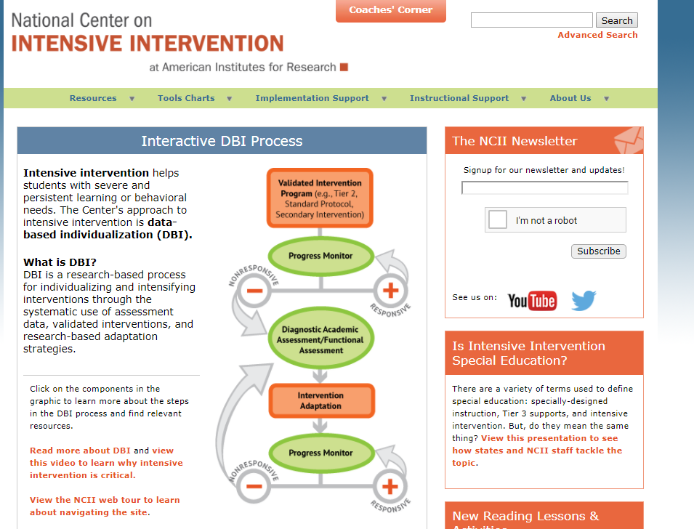
Connect to NCII
Visit the NCII website: intensiveintervention.org
Sign up for our newsletter and announcements
Follow us on YouTube and Twitter
YouTube Channel: National Center on Intensive Intervention
Twitter handle: @TheNCII

Slide 69
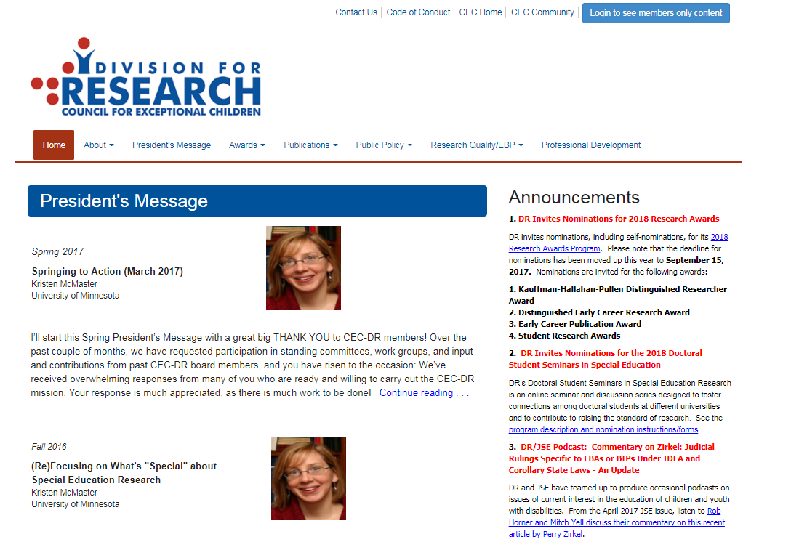
Connect to CEC’s DR
Visit the CEC’s DR website http://www.cecdr.org/home
Follow on Twitter & Facebook
Twitter handle @CECDResearch
Facebook: Division for Research CEC DR

Slide 70
Disclaimer
This presentation was produced under the U.S. Department of Education, Office of Special Education Programs, Award No. H326Q160001. Celia Rosenquist serves as the project officer.
The views expressed herein do not necessarily represent the positions or policies of the U.S. Department of Education. No official endorsement by the U.S. Department of Education of any product, commodity, service, or enterprise mentioned in this webinar is intended or should be inferred.
70

Slide 71
Address
1000 Thomas Jefferson Street NW
Washington, DC 20007-3835
www.intensiveintervention.org
ncii@air.org
Twitter: @TheNCII

