Slide 1
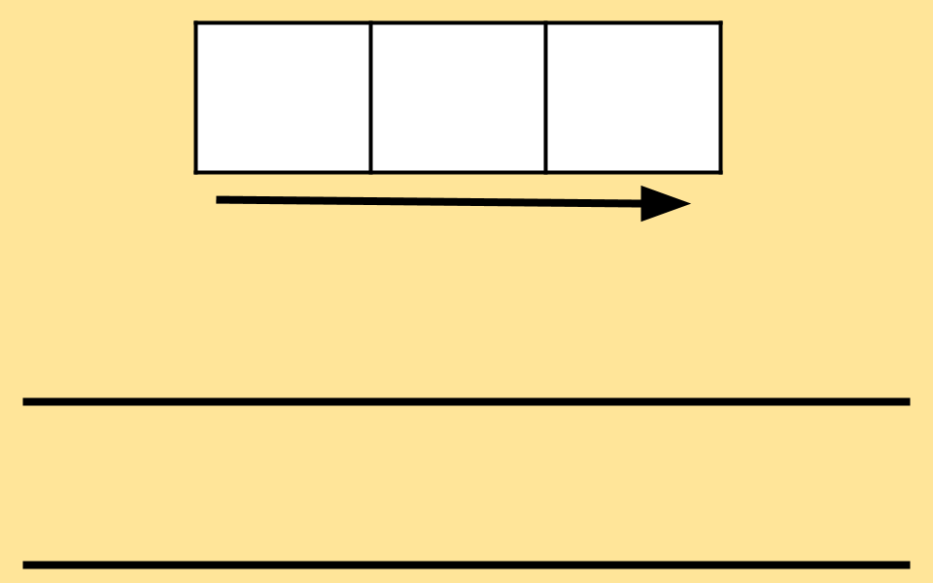
Example phonemes
b
i
t
d
r
p
s
a

Slide 2
Blank phonemes

