Slide 1
Secondary Interventions: Setting the Foundation for Intensive Support
The National Center on Intensive Intervention (NCII)
Notes:
Note: Text formatted in standard font is intended to be read aloud by the facilitator.
Text formatted in bold is excerpted directly from the presentation slides. Text formatted in italics is intended as directions or notes for the facilitator; italicized text is not meant to be read aloud.
The recommended timeframe for this presentation is 30-60 minutes, with an additional 30-60 minutes for activities.
Introduce yourself (or selves) as the facilitator(s) and briefly cite your professional experience in regard to RTI and/or intensive intervention implementation.
The goal of today’s session is to explain the purpose and rationale for secondary interventions, (a) as part of a larger multi-tiered system of support, and, (b) in laying the groundwork for effective intensive intervention. This module is part of a larger set of trainings that cover different elements of the data-based individualization process for delivering intensive intervention.
While permission to reprint this publication is not necessary, the citation should be:
National Center on Intensive Intervention (October, 2013). Secondary Interventions: Setting the Foundation for Intensive Support. Washington, DC: U.S. Department of Education, Office of Special Education Programs, National Center on Intensive Intervention.

Slide 2
In Today’s Session…
Introduction
Rationale for Secondary Interventions
Elements of Secondary Interventions
Evidence Base
Fidelity
Beyond Secondary Interventions
Notes:
Today we’ll begin with a brief introduction, and then discuss the purpose and rationale for secondary interventions within a tiered system of support, such as RTI or PBIS. We’ll discuss elements that should be in place for secondary interventions to function effectively, including the evidence base and implementation fidelity. We’ll include some suggestions and a sample activity for teams to practice identifying an appropriate secondary intervention for a specific student.
Lastly, we’ll discuss the ways in which secondary interventions set the groundwork for intensive interventions, through the data-based individualization process. We’ll end with some considerations for what to do when secondary interventions are insufficient for meeting student needs.

Slide 3
Introduction
Notes:
To introduce this session we’ll answer the question, “what are secondary interventions?”.

Slide 4
What Are Secondary Interventions?
Standardized, evidence-based interventions designed for at-risk students.
Often referred to as…
Tier 2 intervention
Strategic intervention
Remedial curriculum
Common examples
Wilson Just Words
Check-in/Check-out
Corrective Math
Notes:
Secondary interventions are standardized, evidence-based interventions designed for at-risk students. They are sometimes scripted, and involve detailed lesson components and a specific scope and sequence.
In this module, we refer to these programs as “secondary interventions.” However, you may also have heard the terms tier 2 intervention, strategic intervention, or remedial curriculum. Some common examples of secondary intervention programs include “Wilson Just Words” for reading, “Check-in/Check-out” for behavior, and “Corrective Math” for mathematics.
Gauge participants’ level of familiarity with secondary interventions. Ask participants if secondary interventions are used in their school/district and if so, what they refer to them as. Ask participants to name examples of secondary interventions that they use or know of.

Slide 5
Rationale for Secondary Interventions
Notes:
So, what is the purpose of secondary interventions, and how do they relate to intensive intervention?

Slide 6
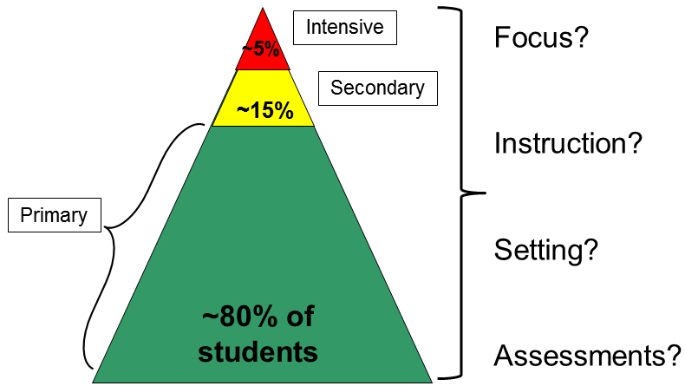
Secondary Interventions in the Context of Multi-Tiered Supports
6
Notes:
This graphic illustrates the estimated population of students who will require secondary interventions. The yellow portion of the triangle represents the group of students for whom the primary level of support was not sufficient; approximately 15%. Secondary interventions are designed to provide an additional layer of support to these students.
The tiers represented by the this triangle are fluid and directly affect one another. For instance, if a school’s core or primary level of instruction is not sufficiently meeting student needs, then a higher percentage of students will be insufficiently responsive to core instruction and will require secondary interventions. Keep in mind the interconnected nature of these tiers as we review characteristics of each tier of support.
In the next few slides we will take a look at the focus, instruction, setting, and assessments specific to each level of support: primary, secondary, and intensive. We’ll also discuss the relationship between secondary interventions and intensive interventions.
Note: While participants may be familiar with this triangle and the approximate percentages of students represented at each tier, keep in mind that these percentages may vary depending on the school and the school population. Schools that are new to RTI and schools with large at-risk populations may find that they have a higher percentage of students requiring secondary and intensive interventions.

Slide 7
Primary Tier (aka Tier 1, Core Instruction)
 | DESCRIPTION
FOCUS | All students
INSTRUCTION | District curriculum and instructional practices that are research based, are aligned with state or district standards and incorporate differentiated instruction
SETTING | General education
ASSESSMENTS | Screening, continuous progress monitoring, and outcome measures or summative assessments (used sparingly)
Notes:
First, we are going to talk about the primary tier in more detail. Primary prevention (also referred to as tier 1 or core instruction) is high-quality core instruction that meets the needs of most students. You’ll see that the focus is on all students. The instruction is typically a district curriculum and should include instructional practices that are research based, and be aligned with state or district standards. The setting for primary prevention is the general education classroom. For assessments, all students receive screening and progress monitoring assessments, as well as outcome measures or summative assessments on occasion.
Note that the focus of the primary tier is for ALL students, including those with disabilities, learning differences, or language barriers. You can increase access for all students through differentiated instruction, linguistically and culturally responsive practices, and the use of accommodations or modifications.
This may involve teacher-directed instruction combined with mixed instructional groupings, team teaching, peer tutoring, learning centers, and accommodations to ensure that all students have access to the instructional program. As I’ve mentioned, providing this differentiation and accommodations is NOT the same as providing more intensive interventions to students with learning disabilities, and is part of the core instruction that is required for all students.

Slide 8
Secondary Tier (aka Tier 2 or Secondary Intervention)
 | DESCRIPTION
FOCUS | Students identified through screening as at risk for poor learning outcomes *Typically 15–20% of student population
INSTRUCTION | Targeted, evidence-based supplemental instruction delivered to small groups
SETTING | General education classroom or other regular education location within the school
ASSESSMENTS | Progress monitoring, diagnostic, screening
Notes:
We will now move on to discuss the secondary tier, also referred to as tier 2 or secondary interventions. Interventions at the secondary tier address the learning or behavioral challenges of most at-risk students. These are for students who have been identified through screening as at risk for poor learning outcomes. The instruction is targeted, evidence-based, and supplemental to core instruction. These interventions are delivered to small groups and also occur in either the general education classroom or another general education setting, such as an intervention block. The types of assessments used in the secondary tier are the same as the primary tier, but progress monitoring occurs with greater frequency to measure student responsiveness to the secondary intervention.

Slide 9
Intensive Tier (aka Tier 3 or Tertiary Intervention)
 | DESCRIPTION
FOCUS | Students who have not responded to primary or secondary level prevention, or with very low performance levels *Typically 3–5% of student population
INSTRUCTION | Individualized instruction delivered to small groups or individually and intensified by making adaptations based on student data
SETTING | General education or special education setting
ASSESSMENTS | Progress monitoring, diagnostic, screening
Notes:
Lastly, we’ll discuss the intensive tier, also referred to as tier 3 or tertiary intervention. Intervention at the intensive level meets the needs of students who have not responded to primary or secondary interventions, or students who present with very low performance levels. Note that this is typically only 3-5% of the student population. Instruction at this level is individualized, and can be delivered to a small group or to an individual. Instruction should be more intensive than the secondary tier, and the adaptations that are made to intensify instruction should be based on student data. Intensive intervention can occur in either the general or special education setting, and involves the same types of assessments as secondary. However, at the intensive tier, progress monitoring should occur with greater frequency (once a week is recommended) and diagnostic assessments may also be needed more frequently to determine which instructional adaptations may be needed.

Slide 10
Distinction Between Secondary and Intensive Intervention
 | Secondary (Tier 2) | Intensive (Tier 3)
INSTRUCTION | Follow standardized evidence-based programs as designed | Use standardized evidence-based program as a platform, but adapt instruction based on student data
Duration and timeframe | Use duration and timeframe defined by developer | Increase frequency and/or duration to meet student needs
Group size | 3–7 students (as defined by developer) | Decrease group size to meet student needs (no more than 3 (elementary level)
Progress Monitoring | At least once per month | Weekly
Population served | At-risk (typically 15–20% of student population) | Significant and persistent learning and/or behavior needs (typically 3–5% of student population)
Notes:
While the focus of this webinar is on secondary interventions, it is important to note the features that distinguish secondary from intensive interventions. As we discussed, it is important that students who require additional support receive secondary interventions. If secondary interventions are insufficient, each feature of the intervention is intensified to provide tier 3 or intensive intervention. You’ll notice that the main distinction between the two is that secondary intervention components are generally standardized, while intensive intervention components are more individualized. While the instruction of secondary interventions follows a standardized evidence-based program as it was designed, instruction at the intensive level involves adapting that standardized program based on student data, to meet the unique needs of the student.
At the intensive level, intervention is typically made more intensive by increasing the frequency and/or duration of instruction and/or decreasing the group size to meet student needs. While monitoring progress at least once a month is generally sufficient for the secondary level, at the intensive level progress monitoring data should be collected weekly. Lastly, you’ll note that the population served by secondary interventions includes students who have been identified as at-risk in a particular content area. This is typically about 15-20% of the student population. The population served by intensive interventions includes students with significant and persistent learning and/or behavioral needs, which is typically only 3-5% of the student population.

Slide 11
Why Are Secondary Interventions So Important?
Meet the needs of at-risk students
Efficient use of time and resources
Identification for intensive intervention
Specific learning disability identification
Notes:
Why are secondary interventions so important? By providing secondary interventions in academics and behavior to students who are flagged as “at risk”, schools are able to effectively meet the needs of the majority of these students and begin to close the performance gap that may exist between them and their grade-level peers.
Because secondary interventions are standardized and are often scripted and include resources, they provide a means for schools to meet the needs of at-risk students and allow resources (including teachers’ time) to be used more efficiently. Effective secondary intervention programs provide teams with a more accurate picture of which students require intensive intervention. Additionally, data collected on a student’s response to an evidence-based secondary intervention program may be used as part of the Specific Learning Disability (SLD) identification process in your district or state, in accordance with state law.
Take time to note the identification policies and processes in your state, and how secondary interventions may play a role in these processes.

Slide 12
Elements of Secondary Interventions
Notes:
Now we’ll discuss some key elements of secondary interventions.

Slide 13
Elements of Secondary Interventions
Evidence-Based Intervention
Fidelity
Adherence
Student Engagement
Program Specificity
Quality of Delivery
Exposure
Notes:
Secondary interventions should be evidence-based, and also conducted with fidelity.

Slide 14
Elements of Secondary Interventions
Evidence-Based Intervention
Fidelity
Adherence
Student Engagement
Program Specificity
Quality of Delivery
Exposure
Notes:
First let’s take a look at what it means for a secondary intervention to be evidence-based.

Slide 15
Varying Evidence Standards
Research-Based Curricula
Evidence-Based Intervention
Recommended for primary prevention across subjects
Components have been researched and found to be generally effective
Curriculum materials have not been rigorously evaluated as a package
Recommended for secondary and tertiary prevention
Materials evaluated using rigorous research design
Evidence of positive effects for students who received the intervention
Notes:
So what does it mean for an intervention to be evidence-based? To better explain this, I’ll provide a quick comparison between the different levels of evidence that are recommended across tiers. NCII recommends different evidence standards for different tiers.
On the left side of your screen, you’ll see the research-based curricula. This is recommended for the primary prevention level, or core instruction, across subjects. This means that the components have been researched and found to be generally effective, although the curriculum materials have not been rigorously evaluated as a package.
On the right side of your screen you’ll see evidence-based intervention. Evidence-based interventions are recommended for secondary and intensive levels of prevention. These materials are evaluated using rigorous research design, and there is evidence of positive effects for students who received the intervention. This means that programs used as secondary interventions have been rigorously evaluated as a whole, and that the specific intervention program was found to have positive effects for students receiving the intervention program.
At the intensive level, evidence-based interventions are used as a platform or starting point, and then adapted based on student data to meet unique student needs.

Slide 16
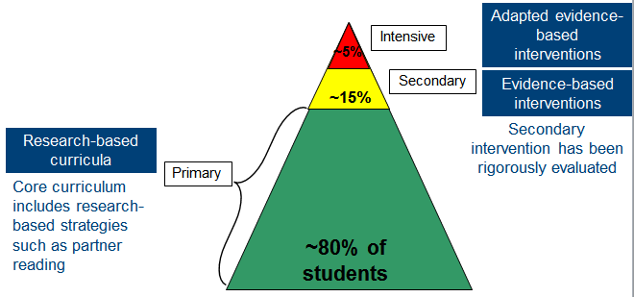
Varying Evidence Standards (Examples)
Notes:
This graphic illustrates an example of what a school’s reading instruction may look like at each tier. As you’ll see, the evidence standards for the instruction vary by tier. At the primary level, reading instruction consists of research-based curricula. This means that the core curriculums are not evidence-based as a whole, but typically include research-based strategies and practices such as explicit instruction or partner reading.
At the secondary level, interventions should be evidence-based interventions, researched as a whole for their effect on student learning outcomes.
Finally, at the intensive level, a school should use an adapted evidence-based intervention. Adaptations should be based on data to meet the unique needs of that student. Perhaps this means that a student is receiving a secondary intervention but with a greater frequency or with qualitative adaptations in the way instruction is delivered.

Slide 17
What to Look For When Examining the Evidence Base
Type/Source
Population
Desired Outcomes
Effects
NCII Interventions Tools Chart
http://www.intensiveintervention.org/chart/instructional-intervention-tools
What Works Clearinghouse
http://ies.ed.gov/ncee/wwc/findwhatworks.aspx
Best Evidence Encyclopedia
http://www.bestevidence.org/
Notes:
In order to ensure that a secondary intervention program is evidence-based, teams should convene to review the existing research on that particular program.
You can focus your efforts by looking at these areas when examining the evidence base:
First, consider the type of information and source from which you are gathering this information. Is the information coming from the intervention vendor or a reputable website? Also ask yourself, what type of evidence is available? Did the study involve experimental design, where the intervention group was compared to an equivalent control group?
Next, consider the population. For which populations has the program been researched and found effective? Is the sample described? Is the population similar to or representative of your student population? Are there different effects for different population groups?
It is important to consider whether or not the desired outcomes assessed in a study are relevant to the outcomes you hope to achieve with an intervention.
Finally, consider the effects. Were the effects of the study large enough to be meaningful? Consider established guidelines for effect sizes when reviewing evidence on effectiveness. Sites including NCII’s Interventions Tools Chart, the What Works Clearinghouse, and the Best Evidence Encyclopedia all offer guidance when interpreting effect sizes.

Slide 18
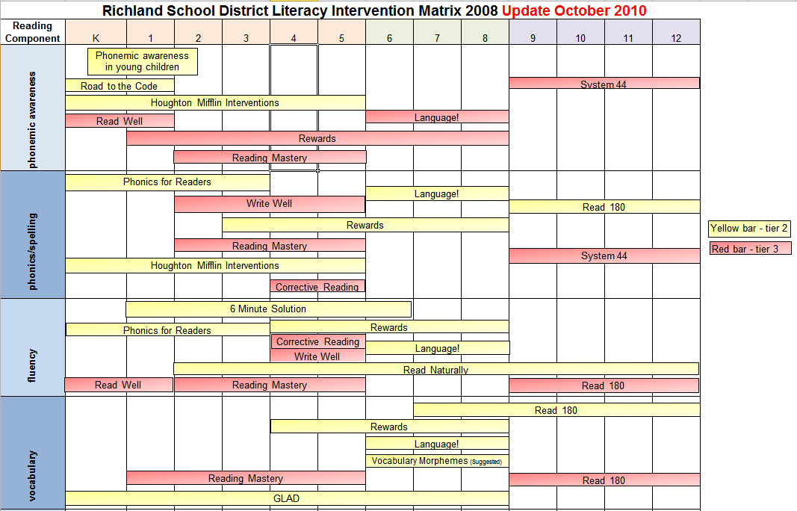
Resource: Richland School District Literacy Intervention Matrix http://www.rsd.edu/teach-learn/response-to-intervention.html
http://www.rsd.edu/
Notes:
If your district does not currently have a menu of interventions in each content area, NCII recommends gathering a team to compile a district intervention menu. The menu displayed above was created by Richland School District in Washington State, and provides an example of what a district intervention menu may look like. The school’s website can be found at the link at the top of the slide.
Note: The district’s literacy and mathematics intervention matrices are located on the school website at this link: http://www.rsd.edu/teach-learn/response-to-intervention.html
Take time to discuss with participants whether or not their district currently has a menu of interventions available, as well as the potential benefits of having a district-wide intervention menu.

Slide 19
Activity: Selecting Evidence-Based Interventions
Optional activity for teams
Purpose: practice identifying evidence-based secondary interventions to meet the needs of a sample student.
Time: 30–60 minutes
Notes:
This optional activity, available as a downloadable handout, provides teams with an opportunity to practice identifying an appropriate evidence-based intervention for a student’s unique needs. Based on the number of interventions reviewed, teams should allot 30 to 60 minutes to complete the activity.
Note: Make sure the “Selecting Evidence-based Interventions” activity handout is available to participants. Participants will need access to the internet in order to complete this activity.

Slide 20
What If Evidence-Based Interventions Aren’t Available?
Use them when available and consider augmenting current offerings, if feasible.
Also consider:
Remediation materials that came with your core program materials
Expert recommendations (if evidence-based programs are not available)
Standards-aligned materials
Collect data to determine whether most students are profiting.
Notes:
Perhaps in your school or district, pre-packaged evidence-based intervention programs aren’t available.
NCII recommends that schools use evidence-based intervention programs when available, and consider augmenting current offerings if feasible. If evidence-based interventions aren’t available, consider using remediation materials that came with your core program materials, expert recommendations, or standards-aligned materials.
Most importantly, always collect data to determine whether most students are profiting from the instruction you’re providing. If the data reveal that most students are not profiting from your instruction, you will need to refine your instruction until you find that most students are profiting.

Slide 21
Elements of Secondary Interventions
Evidence-Based Intervention
Fidelity
Adherence
Student Engagement
Program Specificity
Quality of Delivery
Exposure
Notes:
Now let’s discuss what it means to deliver secondary interventions with fidelity.

Slide 22
What Is Fidelity?
Degree to which the program is implemented the way intended by program developer.
Fidelity = Consistency and Accuracy
Fidelity = Integrity
Gersten et al., 2005; Mellard & Johnson, 2007; Sanetti & Kratochwill, 2009
Notes:
Fidelity refers to how closely prescribed procedures are followed, and in the context of schools, the degree to which teachers implement programs the way they were intended by the program developers. It also relates to the quality of the implementation.
This means that teachers are implementing the intervention with consistency and accuracy, and are adhering to the instructional plan with integrity.
Note: Throughout discussions of fidelity it is important to ensure that teachers believe that they work in an open, non-threatening environment that values their skills and expertise and where they can learn from their colleagues. With a system of open communication and productive feedback, fidelity checks of classroom techniques and the essential components of multi-tiered systems of support can be a useful and supportive way for teachers to collaborate and become a stronger teaching network. This may be a useful discussion point for some groups.

Slide 23
Why Is Fidelity Important?
Ensures that instruction has been implemented as intended
Allows us to link student outcomes to instruction
Helps in the determination of intervention effectiveness and instructional decision-making
Positive student outcomes depend on level of fidelity of intervention implementation
(Pierangelo & Giuliani, 2008)
Notes:
Why is fidelity important? If teachers aren't consistent and accurate in delivering secondary interventions, they aren’t able to confidently explain a student's lack of response to an intervention. Did the student make insufficient progress because they require more intensive intervention? Or, did the student make insufficient progress because the secondary intervention wasn’t delivered with fidelity? Without practicing consistency and integrity in intervention delivery, we can't link, or attribute, student outcomes to the instruction provided. Fidelity allows us to evaluate the effectiveness of the secondary intervention and tells us when a student may require a more intensive level of intervention.
Furthermore, Pierangelo and Giuliani (2008) concluded that positive student outcomes are particularly dependent on aspects of fidelity within the framework of a tiered support system. One of these aspects is fidelity of implementation at the classroom or teacher level.

Slide 24
Five Elements of Fidelity
Student Engagement: How engaged and involved are the students in this intervention or activity?
Adherence: How well do we stick to the plan, curriculum, or assessment?
Program specificity: How well is the intervention defined and different from other interventions?
Exposure/Duration: How often does a student receive an intervention? How long does an intervention last?
Quality of Delivery: How well is the intervention, assessment, or instruction delivered? Do you use good teaching practices?
(Dane & Schneider, 1998; Gresham et al., 1993; O’Donnell, 2008)
Notes:
This graphic provides one example of a way to think about fidelity, and includes the elements of adherence, exposure, quality of delivery, program specificity, and student engagement.
Schools should have procedures in place to monitor the fidelity of their implementation of secondary interventions. While these don’t have to be formal, it is important to consider whether or not they’re implementing programs the way that they are intended to be delivered. In the midst of all of the responsibilities of educators, small checks can make a big difference in keeping services for students on track.
Note: The notes on each element on fidelity are animated to pop up with each click. Click ahead each time you discuss a new element of fidelity, and click again to close that element.
(Click) When we discuss adherence we are focused on how well we stick to the plan/curriculum/assessment, or implementing the plan/curriculum/assessment as it was intended to be implemented based on research. For a secondary intervention, this may mean how well teachers implement all pieces of an intervention, in the way they were intended to be implemented. This doesn’t necessarily mean that teachers should follow a script word for word, but that covering certain content with appropriate pacing and relevant language and techniques are important. (Click)
2. (Click) Duration/Exposure refers to how often a student receives an intervention and how long an intervention lasts. When thinking about fidelity we are considering whether the exposure/duration being used with a student matches the recommendation by the author/publisher of the curriculum.
In the case of secondary interventions, developers and researchers typically specify the required exposure/duration that is needed for the intervention to be effective for most students. If the intervention developer calls for the intervention 3 days a week for 45 minutes each day, is the student receiving this dosage? (Click)
3. (Click) Not only is it important to adhere to the plan/curriculum/assessment, but it is also import to look at the quality of delivery. This refers to how well the intervention, assessment, or instruction is delivered. For example, do you use good teaching practices? Quality instructional delivery also means that teachers are engaged in what they’re teaching, and animated in their delivery, not simply reading from a script. Providing teachers with constructive feedback on their instructional delivery is one way to improve the quality of delivery for secondary interventions. (Click)
4. (Click) Another component is program specificity, or how well the intervention is defined and how different it is from other interventions. Having clearly defined interventions/assessments allows teachers to more easily adhere to the program as defined. Is the intervention a good match for the student’s needs? Or does every low reader get the same intervention? (Click)
5. (Click) Just as quality of delivery is critical, it also is important to also focus on student engagement, or how engaged and involved the students are in the intervention or activity. Following a prescribed program alone is often not enough. Consider whether or not competing behaviors make it difficult for students to take part in the intervention as designed. During the delivery of secondary interventions, teachers may need to use behavior management strategies to manage student behaviors, including providing choice, adding elements of competition, and offering frequent opportunities to respond. (Click)

Slide 25
Beyond Secondary Interventions
Notes:
As we’ve discussed, there is a population of students for whom secondary interventions will not be sufficient. These students will require intensive intervention. However, for intensive interventions to function effectively and efficiently, it is important to make sure that a solid foundation of secondary interventions has been established.

Slide 26
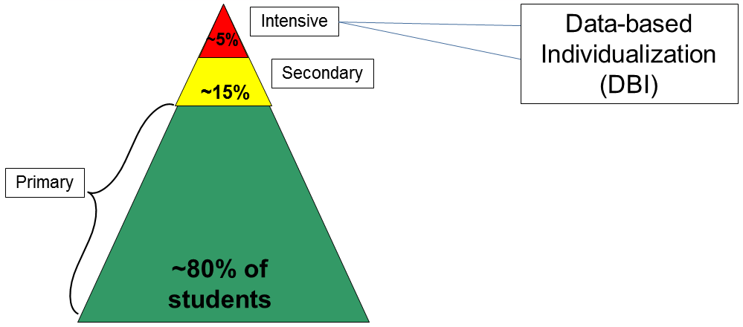
What Should I Do If Secondary Interventions Aren’t Sufficient?
Notes:
As I’ve mentioned, there is a percentage of students for whom evidence-based interventions delivered with fidelity will not be sufficient. These students require more individualized support. For these students, NCII recommends intensive intervention through the data-based individualization or DBI process. The mission of NCII is to deliver intensive intervention to students with the most severe and persistent learning and/or behavioral needs. NCII’s approach for delivering intensive intervention is grounded in the data-based individualization (or DBI) process.

Slide 27
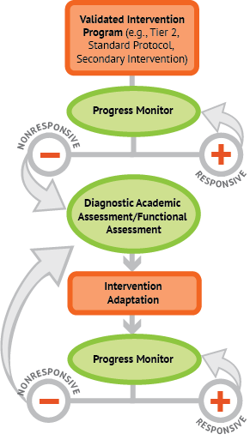
How do secondary interventions fit into the DBI process?
Notes:
This graphic provides a closer look at the DBI process, and notes the places in which secondary interventions fit into the process.
Before a team decides that a student requires intensive intervention in a certain content area, the team should consider whether or not the student has received a secondary intervention program with consistency and fidelity.
The DBI process begins when data show that a student is making insufficient progress in response to a secondary intervention program that is evidence based and delivered with fidelity. The first step in this process is to implement the intervention with greater intensity (e.g., smaller group size, more time), and to progress monitor frequently. If the student continues to be non-responsive, diagnostic data are collected and analyzed to identify the specific skill deficits that need to be targeted. The results of the diagnostic assessment, in combination with the teacher’s analysis of what features of the intervention need to be modified to better support the student, help staff determine how to individualize the secondary intervention program to meet the individual student’s unique needs. Upon implementing the intervention adaptation, the teacher continues to progress monitor at regular intervals to help determine whether additional changes to the individualized intervention are required to support adequate student response.
As you can see, secondary interventions play a significant role in the DBI process. A student’s responsiveness to secondary intervention determines whether or not intensive intervention is needed. The secondary intervention program is also the platform or starting point for intensive intervention, which is intensified and/or adapted to meet a student’s unique needs.
For more information about the DBI process, please review or direct participants to the Introduction to Data-Based Individualization (DBI): Considerations for Implementation in Academics and Behavior module.

Slide 28
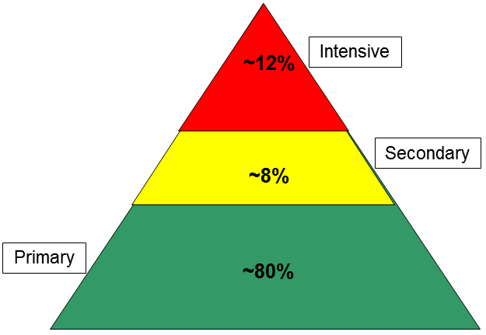
Why Are Secondary Interventions So Important?
Poor implementation
Strain on resources and efficiency
Teacher burn-out
Notes:
As the DBI process illustrates, Secondary interventions have important implications for a school’s ability to deliver effective intensive intervention. Secondary interventions also affect a school’s ability to deliver instruction and support at each tier. This graphic illustrates a potential strain that could be caused by poor implementation of secondary interventions. Poorly implemented secondary interventions will result in less students responding sufficiently, and therefore more students requiring intensive intervention. Intensive interventions are designed to provide a great deal of individualization and are meant for only 3-5% of the total student population. Attempting to deliver intensive interventions to more than 3-5% of the student population places a strain on resources and on efficiency, and can lead to teachers feeling burned-out.

Slide 29
Intensifying Secondary Interventions
Examples of intensification strategies:
Decrease group size.
Increase frequency or duration of sessions.
Change interventionist to someone with greater expertise.
Break tasks into smaller steps, compared to less intensive levels of instruction or intervention.
Provide concrete learning opportunities (including role play and use of manipulatives).
Use explicit instruction and modeling with repetition to teach a concept or demonstrate steps in a process.
Notes:
When secondary interventions are insufficient for meeting student needs, teachers should make adaptation to intensify the intervention. After making these adaptations, teachers should continue to collect progress monitoring data to determine if the adapted intervention is sufficient in meeting the student’s need. Some examples of adaptations include—
Decrease group size
Increase frequency/duration of sessions
Change interventionist to someone with greater expertise
Break tasks into smaller steps, compared to less intensive levels of instruction/intervention.
Provide concrete learning opportunities (including role play and use of manipulatives).
Use explicit instruction and modeling with repetition to teach a concept or demonstrate steps in a process.

Slide 30
To Learn More About Intensive Intervention and DBI…
NCII Module Topics:
Introduction to Data-based Individualization
Academic and Behavioral Progress Monitoring for Intensive Interventions
Academic and Behavioral Diagnostic Assessment
Designing and Delivering Intensive Intervention in Academics and Behavior
www.intensiveintervention.org
Notes:
To learn more about intensive intervention and the DBI process, NCII offers other learning modules as part of a series on Intensive Intervention. Modules on the topics of an Introduction to Data-based Individualization, Progress Monitoring, Diagnostic Assessment, and Designing and Delivering Intensive Interventions are available in both academic and behavioral content areas. These modules can be accessed on the Center’s website, www.intensiveintervention.org. Each of these modules discusses a component of the DBI process.

Slide 31
Prioritizing Your Next Steps…
Complete the “Secondary Interventions Needs Inventory” to guide reflection on current secondary intervention practices in your school or district.
Share responses as a team
Prioritize and plan for next steps with district or school leadership or coach
Notes:
As we wrap up this training, it can be helpful for school or district teams to prioritize areas of focus and plan next steps related to improving secondary interventions. The “Secondary Interventions Needs Inventory” handout is meant to guide teams in their reflection on current secondary intervention practices. After completing this short needs inventory questionnaire, NCII recommends that teams share their responses and then meet with leadership or coaches to prioritize and plan for their next steps related to improving secondary interventions.
Trainers may decide to pause and give teams time to complete the “Secondary Interventions Needs Inventory” at this point in the training, or recommend that they complete this after the training. Be sure the have copies of this handout on hand.

Slide 32
In Summary
Secondary Interventions…
Set the foundation for intensive intervention.
Should be evidence based, and implemented with fidelity.
Have important implications for identification.
Notes:
In summary, implementing effective secondary interventions is crucial for schools to establish a foundation for intensive intervention. When secondary interventions are evidence-based and are implemented with fidelity, schools are able to meet the needs of most at-risk students and obtain a clearer sense of which students require intensive intervention. Furthermore, the way secondary interventions are implemented has important implications on identification of students. IDEA regulations for identifying students with specific learning disabilities no longer require the use of the discrepancy model, and allow for the use of a process based on the child’s response to scientific, research-based intervention. With this in mind, it is crucial for schools to have effective systems for evidence-based secondary interventions in place, as a child’s responsiveness to these interventions has a large impact on their identification and future services.

Slide 33
Disclaimer
This module was produced under the U.S. Department of Education, Office of Special Education Programs, Award No. H326Q110005. Celia Rosenquist serves as the project officer.
The views expressed herein do not necessarily represent the positions or polices of the Education Department. No official endorsement by the Education Department of any product, commodity, service, or enterprise mentioned in this website is intended or should be inferred.

Slide 34
References
Dane, A. V., & Schneider, B. H. (1998). Program integrity in primary and early secondary prevention: Are implementation effects out of control? Clinical Psychology Review, 18, 23–45.
Gersten, R., Fuchs, L. S., Compton, D., Coyne, M., Greenwood, C., & Innocenti, M. S. (2005). Quality indicators for group experimental and quasi-experimental research in special education. Exceptional Children, 71, 149–164.
Gresham, F. M., Gansle, K. A., & Noell, G. H. (1993). Treatment integrity in applied behavior analysis with children. Journal of Applied Behavior Analysis, 26, 257–263.
Mellard, D. F., & Johnson, E. (2007). RTI: A practitioner’s guide to implementing response to intervention. Thousand Oaks, CA: Corwin Press.
O’Donnell, C. L. (2008). Defining, conceptualizing, and measuring fidelity of implementation and its relationship to outcomes in K–12 curriculum intervention research. Review of Educational Research, 78, 33–84.

Slide 35
References
PBS Newshour. (2008). ‘Checklist manifesto’ author pairs simplicity with lifesaving. Retrieved from http://www.pbs.org/newshour/bb/health/jan-june10/gawande_02-08.html
Pierangelo, R., & Giuliani, G. (2008). Frequently asked questions about response to intervention: A step-by-step guide for educators. Thousand Oaks, CA: Corwin Press.
Richland School District. (2010). Richland School District Math Intervention Matrix. Retrieved from http://www.rsd.edu/files/files/mathmatrix.pdf.
Sanetti, L., & Kratochwill, T. R. (2009). Toward developing a science of treatment integrity: Introduction to the special series. School Psychology Review, 38(4), 445-459.
Zingmark, London, Smart, Rumsey, & Bolz (2008). Richland School District Literacy Intervention Matrix. Richland School District. Retrieved from http://www.rsd.edu/files/files/litmatrix.pdf.

Slide 36
.
National Center on Intensive Intervention (NCII)
ncii@air.org
1050 Thomas Jefferson St. NW
Washington, DC 20007
800-356-2735
www.intensiveintervention.org

