Slide 1
Module 2 Behavioral Theory II
Jennifer Freeman, PhD
Don Briere, PhD
Brandi Simonsen, PhD

Slide 2
Acknowledgements
Much of the content shared in this module was developed by members of the OSEP-funded National Technical Assistance Center for Positive Behavioral Interventions and Supports.
Thank you to:
Members of classroom workgroup:
Brandi Simonsen, Jennifer Freeman, Jessica Swain-Bradway, Robert Putnam, Heather George, Steve Goodman, Barb Mitchell, Kimberly Yanek, Kathleen Lane & Jeffrey Sprague
Members of the Northeast PBIS Network:
Susannah Everett, Adam Feinberg, George Sugai, Brandi Simonsen & Jennifer Freeman

Slide 3
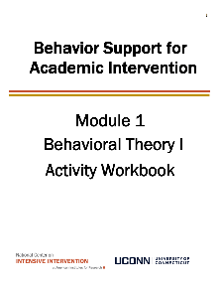
Orientation to Module Tools and Resources
Module Videos
Module Workbook
Including behavioral terms “cheat sheet” on page 5
Module Readings and Additional Resources

Slide 4
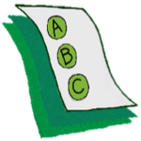
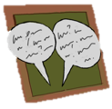
Orientation to Module Elements
Activities
Module Quiz – Self Assessment
Do you know the basic content presented in this module?
Discussion Board Post
Workbook Quiz
Stop and Jot

Slide 5
Getting the Most Out of This Module
Pre-service
Become fluent with content and basic theory
New Teachers
Focus on moving from knowledge to practice
Experienced Teachers
Use activities as a self-reflection opportunity
Consider how you might coach or teach the skills/content to a new teacher in your building
Set a new implementation goal for yourself
Review resources provided to extend your learning with respect to culturally and contextually relevant implementation
Look for examples of implementation in your clinic placements
Video record or ask for feedback on your implementation of key practices during your student teaching
Set implementation goals and either self-monitor or ask for peer/coach feedback on your use of key skills
When a practice isn’t working, use your understanding of theory to help you modify or intensify a practice to improve outcomes

Slide 6
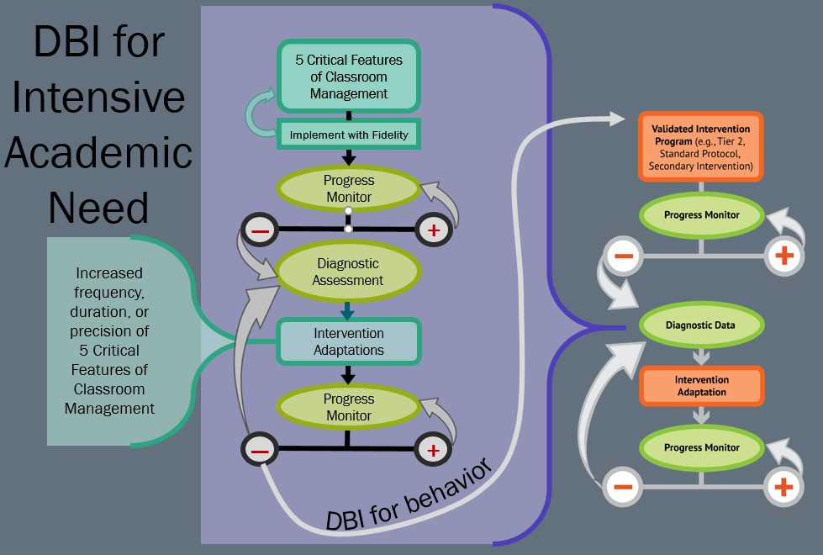
DBI for Intensive Academic Need

Slide 7
Module Objectives
By the end of Module 2 you should be able to:
Define and identify elements of the four-term (SE-A-B-C) contingency
Define and describe procedures involved with teaching:
Shaping
Chaining
Prompting
Stimulus control
Phases of learning
Part 1
Part 2

Slide 8
Behavioral Theory II
Part 1
What are Setting Events and How do They Help Explain Behavior?

Slide 9
Building Blocks of Behavior

Slide 10
Building Blocks of Behavior: Focus on Setting Events
Building Blocks of Behavior
Focus on Setting Events
Setting Event
Antecedent
Behavior
Consequence
Antecedent condition or event that temporarily alters the value of the consequence.
Can occur at the same time and/or same place as the S^{D}
You may be sick or tired in school when given a task, which may decrease the value of typical reinforcers for task completion (and increase value of nap)
Can occur earlier and/or in a different location from the S^{D}
If you fight with a family member before school, it may decrease the value of adult attention for appropriate social skills (and increase value of escape)
Setting events may be environmental, physiological, or social
Setting events help explain variations in behavior
For our purposes, the terms setting event and motivating operations (MO) can be used interchangeably

Slide 11
Antecedents vs. Setting Events
Antecedents - occur immediately before and act as “triggers” for problem behavior
Setting Events – indirectly “set-up” the problem behavior by temporarily altering the value of maintaining consequences.

Slide 12
“Don”
When Don’s teacher gives him a difficult task, he engages in disruptive behavior. His teacher ignores his behavior and Don is able to avoid doing his task. Over time, he is more likely to engage in disruptive behavior when given a task. Don is especially likely to engage in disruptive behavior when he is tired.

Slide 13
Breakdown of Example: Don

Slide 14
“Brandi”
During unstructured time with her peers, Brandi teases her peers. They tease her back and provide animated attention. In the future, Brandi continues to tease her peers. She is especially likely to engage in this behavior when she has spent the morning engaged in teacher directed instruction or in independent work.

Slide 15
Breakdown of Example: Brandi

Slide 16
Activity 2.1: Stop and Jot Your examples of setting events
Develop an example of a student with whom you’ve worked who exhibits problematic behaviors that are affected by a setting event.
Include information about the behaviors and context (ABC’s).
Please pause the video to complete Activity 2.1

Slide 17
Activity 2.1: Review
Additional Examples of Common Setting Events
Setting Event (SE)
Antecedent (S^{D})
Behavior(s)
Consequence
Lack of Sleep
Independent Math worksheet
Rips up worksheet
No work - sits at desk
1
Argument on bus
Greeted by teacher
Says "Leave me Alone!"
Walks alone to class
2
Weekend away at ...
Whole-class mini-lesson
Talks with peers
Gains attention
3

Slide 18
A quick preview of how we use all of this to guide interventions

Slide 19
Proactive and Reactive Classroom management strategies
SETTING EVENT
MANIPULATIONS
ANTECEDENT
MANIPULATIONS
WAYS TO TEACH
BEHAVIORS
CONSEQUENCE
MANIPULATIONS
Minimize the likelihood the SE will happen
Neutralize the effects if SE does occur
Withhold the Antecedent when SE is present
Add prompts and increase reinforcement for desired behaviors when SE is present
WAYS TO
MAKE
PROBLEM
BEHAVIOR
IRRELEVANT
(PROMPTS)
WAYS TO
MAKE
PROBLEM
BEHAVIOR
INEFFICIENT
(SHAPING & CHAINING)
WAYS TO
MAKE
PROBLEM
BEHAVIOR
INEFFECTIVE
Reactive Classroom Management Strategies
Proactive Classroom Management Strategies

Slide 20
Understanding Function
By understanding function, we can intervene more effectively.
How can we prevent?
What should we teach the student to do instead?
How do we respond to make sure the new skill “works”?
Antecedent
Behavior
Consequence
We can make simple tweaks to the antecedents, behaviors, and consequences, to prevent, teach, and respond, respectively.

Slide 21
Let’s practice
During teacher lecture, Martha repeatedly and loudly calls out (without raising her hand). Each time, the teacher gives her a look, a redirection, or occasionally calls on her.
Provide attention ahead of lecture and frequent eye contact during
Teach and prompt hand raising
Call on her ONLY when she raises her hand (otherwise ignore)
Prevent?
Teach?
Respond/
Reinforce?

Slide 22
Let’s practice
When given a difficult writing assignment Susannah regularly throws her pencil down, rips up her paper, and puts her head down. Her teacher ignores this behavior (and Susannah never completes her assignment)
Modify writing assignment
Teach and prompt her to ask for help/break
Give immediate help/break when asked. Otherwise, redirect to task.
Prevent?
Teach?
Respond/
Reinforce?

Slide 23
Practice Prevent, Teach, Respond
Let’s practice
In the hallway with peers, Tim often teases, trips, or pushes a student who talks and walks a little slower than others. Each time, Tim’s peers laugh and pat him on the back.
Increase prompts and active supervision in hallway
Teach and prompt respectful behavior toward all peers
Group contingency: peers reinforced for supporting good choices (and ignoring teasing)
Prevent?
Teach?
Respond/
Reinforce?

Slide 24
Non-examples of Function-Based Approach
Jasper, I’m taking your book away because you obviously aren’t ready to learn.
Quincy, you skipped 2 school days, so we’re going to suspend you for 2 more.
You want my attention?! I’ll show you attention,…let’s take a walk down to the office and have a little chat with the principal.

Slide 25
Behavioral Theory II
Part 2
What are the basic teaching procedures we will use?

Slide 26
Module Objectives
By the end of Module 2 you should be able to:
Define and identify elements of the four-term (SE-A-B-C) contingency
Define and describe procedures involved with teaching:
Shaping
Chaining
Prompting
Stimulus control
Phases of learning
Part 1
Part 2

Slide 27
What are the typical outcomes of teaching?

Slide 28
What are the typical outcomes of teaching

Slide 29
Behavioral procedures involved in teaching

Slide 30
What behavioral procedures are involved in teaching?
Behavior may be shaped along a number of dimensions
Topography (what it looks like)
Duration (time between beginning and end of response)
Latency (time between S^{D} and response)
Frequency/Rate (fluency of response)
Force (intensity)
Behavior
Consequence
Teach simple behaviors
Shaping
Improve performance of behaviors
Writing
Reinforcing successive approximations of a desired behavior
What does it look like?
(Cooper et al,. 2007, p. 421-422)

Slide 31
Real life examples of skills you can teach through shaping

Slide 32
Activity 2.2: Discussion Board Shaping
Share a situation in which you have used (or would use) shaping to teach a new behavior or improve performance of an existing behavior.
Explain why shaping would be an appropriate approach to teach that skill.
Please pause the video to complete Activity 2.2

Slide 33
Activity 2.2: Review
Consider your example from Activity 2.2
Recall - shaping involves reinforcing successive approximations of a desired behavior.
An Additional Example
Consider you are a classroom teacher and would like your class to line-up more quickly for lunch. You could SHAPE this whole-group expectation focusing on latency. First, you establish current performance. Say it takes 45 seconds to line up. Next, establish a group target, say 15 seconds to line up is your goal. Then, work systematically toward that goal. To do this, you would SHAPE or reinforce the group if they were able to line up within progressively shorter intervals of time (e.g., 40 seconds, then 35 seconds, then 30 seconds, etc...)
Notes:
Also preview that these same teaching procedures can be effective for SEL or Executive functioning skills

Slide 34
What behavioral procedures are involved in teaching?
What behavioral procedures are involved in teaching?
When teaching complex behaviors, break the behaviors down into their component parts.
We do this by performing a task analysis.
Determine prerequisite skills/concepts
List materials
List and order components of task
Behavior
Consequence
Teach simple behaviors
Shaping
Improve performance of behaviors
Task Analyzing
What does it look like?
Teach complex sequences of behavior
Problem Solving

Slide 35
What behavioral procedures are involved in teaching?
What behavioral procedures are involved in teaching?
Once the task is broken down (analyzed), build the chain
Chaining is systematically reinforcing components of a complex behavior so that participant builds (or chains) all the components and can ultimately perform complex behavior.
Behavior
Consequence
Teach simple behaviors
Shaping
Improve performance of behaviors
What does it look like?
Teach complex sequences of behavior
Task Analyzing
Chaining

Slide 36
More on chaining

Slide 37
Real life examples of skills you can teach through chaining

Slide 38
Activity 2.3: Workbook Quiz Shaping or Chaining
Please pause the video to complete Activity 2.3
Which method would you use to teach each of the following?
Teaching a student to solve a math equation
Teaching a student to play a musical note appropriately (assuming they can position fingers appropriately)
Teaching a student to write a research paper
Teaching a student to enter the classroom appropriately
Chaining
Shaping
Chaining
Shaping

Slide 39
What behavioral procedures are involved in teaching
What behavioral procedures are involved in teaching?
Antecedent
Behavior
Consequence
Establishing Stimulus Control
Increase the likelihood that behaviors occur under the correct stimulus conditions
Teach simple behaviors
Shaping
Improve performance of behaviors
Greeting
Teach complex sequences of behavior
Task Analyzing
Chaining

Slide 40
3 Types of Antecedents

Slide 41
What behavioral procedures are involved in teaching?

Slide 42
What behavioral procedures are involved in teaching?

Slide 43
What behavioral procedures are involved in teaching?
What behavioral procedures are involved in teaching?
Antecedent
Behavior
Consequence
Establishing Stimulus Control
Reinforce only when the discriminative stimulus is present
X
OTHER
Responses
Discriminative
Stimulus (S^{D})
Do not reinforce when S⬇ is present
Do not reinforce when other behaviors are used in presence of discriminative stimulus
”what’s up”

Slide 44
What behavioral procedures are involved in teaching?
What behavioral procedures are involved in teaching?
Antecedent
Behavior
Consequence
Establishing Stimulus Control
Discriminative
Stimulus (S^{D})
Reinforcement
Response
Stimulus control has been established when a behavior occurs more often in the presence of a specific antecedent stimulus (S^{D}).
“Good morning
Dr. Principal”

Slide 45
What behavioral procedures are involved in teaching?

Slide 46
What behavioral procedures are involved in teaching?

Slide 47
What behavioral procedures are involved in teaching?

Slide 48
“Real-life” examples behaviors typically under stimulus control
Check E-mail
Answer the phone
Popcorn with movies
Say 4
Stop the car
Eat Dessert

Slide 49
What behavioral procedures are involved in teaching?
What behavioral procedures are involved in teaching?
Antecedent
Behavior
Consequence
Establishing Stimulus Control
Increase the likelihood that behaviors occur under the correct stimulus conditions
Teach simple behaviors
Shaping
Improve performance of behaviors
Prompting
Teach complex sequences of behavior
Task Analyzing
Presenting an additional stimulus to increase the probability that the S^{D} will occasion the desired response
Chaining

Slide 50
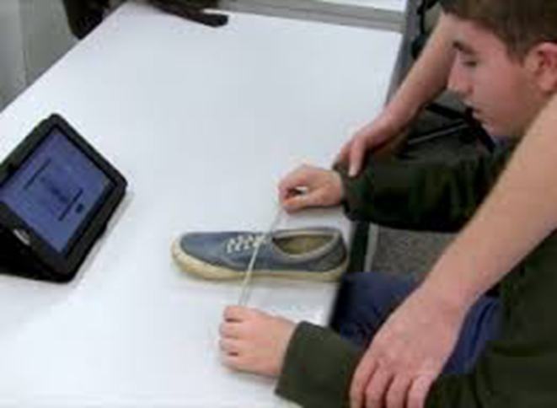
What behavioral procedures are involved in teaching?
What behavioral procedures are involved in teaching?
Types of Prompts
Antecedent
Behavior
Consequence
What does it look like?
Verbal
Visual
Gestural
Modeling
Prompting
Physical Guidance
Presenting an additional stimulus to increase the probability that the S^{D} will occasion the desired response
(Simonsen & Myers, 2015)

Slide 51
What behavioral procedures are involved in teaching?
What behavioral procedures are involved in teaching?
Types of Prompts
Antecedent
Behavior
Consequence
What does it look like?
Verbal
Guidelines:
Choose the “just right” prompt (not too much, not too little)
Fade as quickly as possible
Most-to-least
Least-to-most
Time delay
Visual
Gestural
Prompting
Modeling
Physical Guidance
(Simonsen & Myers, 2015)

Slide 52
Activity 2.4: Discussion Board Prompting and Stimulus Control
Describe a situation in which you want to establish stimulus control.
Describe how you would establish stimulus control.
How you would use and fade prompts?
Please pause the video to complete Activity 2.4

Slide 53
Activity 2.4: Review
Consider the situation you identified.
To establish stimulus control for your situation, you will look to reinforce the behavior when the discriminative stimulus (Sd) is present.
Your goal is to increase the likelihood that your selected behavior occurs under certain conditions.
This is accomplished when you consciously provide or withhold reinforcement in the presence of varying antecedent conditions.
Your goal is to TEACH toward the stimulus control. You do this by remaining consistent and clear.

Slide 54
What is the ultimate goal of all instruction?
What is the ultimate goal of all instruction?
Focus on phases of learning
Antecedent
Behavior
Consequence
Establishing Stimulus Control
Increase the likelihood that behaviors occur under the correct stimulus conditions
Teach simple behaviors
Shaping
Improve performance of behaviors
Prompting
Teach complex sequences of behavior
Task Analyzing
Chaining

Slide 55
What is the ultimate goal of all instruction – focus on phases of learning
What is the ultimate goal of all instruction?
Acquisition
Fluency
Maintenance
Generalization
Focus on phases of learning
Student is able to solve the math equation accurately
“Increase rate of correct responses to ‘automatic’ or functional level”
“Perform skill overtime without reteaching”
“Stimulus generalization”
“Response adaptation”
“Increase accuracy of new skill”
Student is able to complete math homework (solving many equations) in a reasonable amount of time
After spending time on other math topics the student is able to solve the math equation without re-teaching
(Simonsen & Myers, 2015)

Slide 56
What is the ultimate goal of all instruction – generalization is the ultimate goal.

Slide 57
How do we move students toward generalization?
Acquisition
Fluency
Maintenance
Generalization
shaping
chaining
prompting
shaping
prompting
prompting
general case programming

Slide 58
Activity 2.5: Stop and Jot Phases of learning
For each phase of learning identify one of your own skills you believe fits that phase. Why?
Please pause the video to complete Activity 2.5

Slide 59
Activity 2.5 Review
Acquisition
Fluency
Maintenance
Generalization
Skill: Learning a foreign language
Skill: Carry on a conversation in a foreign language
Skill: Use foreign language without having to study
Skill: Travel to a different country with slightly different accent and still being able to carry on a conversation.

Slide 60
Module Objectives
By the end of Module 2 you should be able to:
Define and identify elements of the four-term (SE-A-B-C) contingency
Define and describe procedures involved with teaching:
Shaping
Chaining
Prompting
Stimulus control
Phases of learning
Part 1
Part 2

Slide 61
Building Blocks of Behavior
Four-Term Contingency
Setting Event
Antecedent
Behavior
Consequence
Antecedent condition or event that temporarily alters the value of the consequence.
A “stimulus that precedes a behavior.”
An ”observable and measurable act of an individual (also called a response).”
A stimulus change that occurs contingent on a behavior.
(Alberto & Troutman, 2006)

Slide 62
What behavioral procedures are involved in teaching?
What behavioral procedures are involved in teaching?
Antecedent
Behavior
Consequence
Establishing Stimulus Control
Increase the likelihood that behaviors occur under the correct stimulus conditions
Teach simple behaviors
Shaping
Improve performance of behaviors
Prompting
Teach complex sequences of behavior
Task Analyzing
Chaining

Slide 63
What is the ultimate goal of all instruction – focus on phases of learning
What is the ultimate goal of all instruction?
Focus on phases of learning
Acquisition
Fluency
Maintenance
Generalization
“Increase accuracy of new skill”
“Increase rate of correct responses to ‘automatic’ or functional level”
“Perform skill over time without reteaching”
“Stimulus generalization”
“Response adaptation”
(Simonsen & Myers, 2015)

Slide 64
Next Steps
Take Module 2 Quiz

