Slide 1

Error Analysis in Writing: Using Writing Errors to Intensify Intervention
June 24, 2026
Katie Valentine, PhD, NCSP

Slide 2

Katie Valentine
Assistant Professor
kvalentine2@fsu.edu

Slide 3
Agenda
Brief overview of data-based individualization & error analysis
How do I administer and score a student writing sample?
What do the data show about a student’s skills? A framework for error analysis
How do I use this for instruction?
Resource sharing

Slide 4
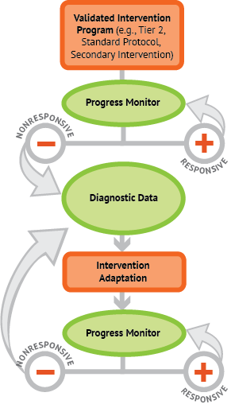
Data-Based Individualization
A systematic, explicit process of reviewing data, adjusting instruction and intensifying supports based on data.
Diagnostic data: where does the intervention need to be targeted?

Slide 5
Error Analysis Helps Move Toward Instruction
Scores
Skills

Slide 6
Where do I obtain a student writing sample?
Writing Assessment & Data Sources
Curriculum-based measures in written expression (CBM-WE)
  Prompt, set time for writing (3-15 minutes), quantitative scoring methods
  Flexible by grade level, genre
  Designed to be administered multiple times and detect change (Espin et al., 2005)

Slide 7
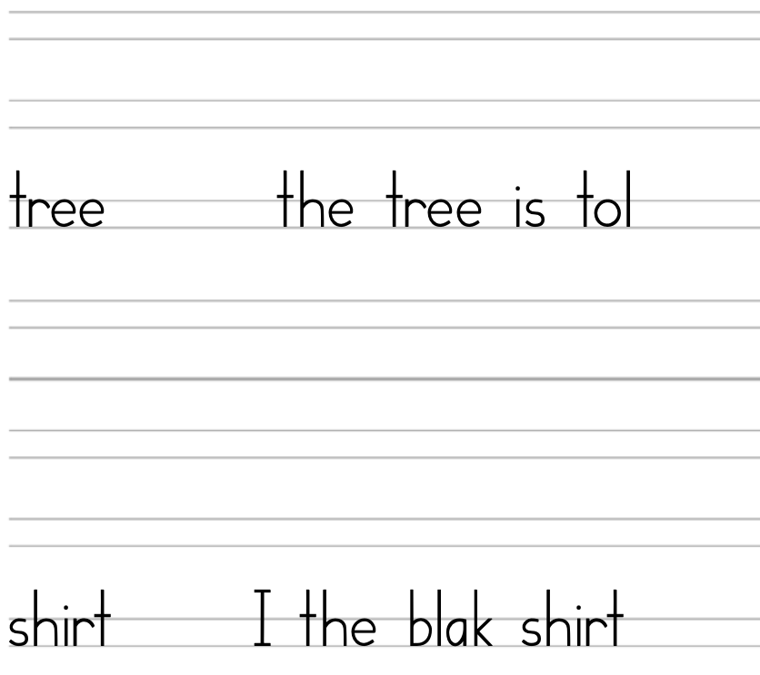
CBM-WE Example Grades K-3
Student… | Struggles with Transcription | Struggles with Text Generation
Is developing word-level writing | Word Dictation
Is developing sentence-level writing | Picture-Word | Picture-Word
Is developing passage-level writing |  | Story Prompt
Picture Word
(with student response)
Adapted from Early Writing Project, McMaster & Lembke, 2018

Slide 8
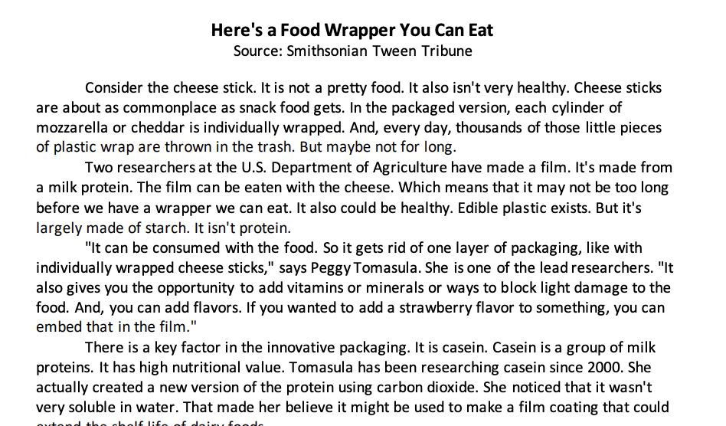
Example Source-Based Informational CBM-WE
Text Source
Prompt (Troia et al., 2022)
Write an informative paper that will help others learn about edible food packaging. Be sure to use information from the article you just read to give reasons why edible wrappers are an exciting development in food packaging.
Remember, a well written informative paper (1) has a clear main idea and stays on topic, (2) includes a good introduction and conclusion, (3) uses information from the article stated in your own words plus your own ideas, and (4) follows the rules of writing.
Source: Writing Architect

Slide 9
Scoring CBM-WE with CIWS
Correct Minus Incorrect Word Sequences (CIWS)
Writing Sequence: The connection between two adjacent writing units (words or punctuation)
Look for correct spelling, capitalization, punctuation, semantics (meaning)
  ^He ^ wants ^ to X mack X his ^ family ^ happy ^.
    Correct sequences= 6
    Incorrect sequences = 2
    CIWS = 4
Highest criterion validity when compared to other scoring procedures
  Correlation coefficients from 0.58 in K-2 to 0.65 in 9-12 (Romig et al., 2017)

Slide 10
Scoring CBM-WE with TIDE
🔴 Topic
🟡 Idea
🟢 Detail
🔵 Ending
TIDE text structure, not capturing word or sentence accuracy
Reading every day is one of the best ways to get smarter. For exampel, scientists found that kids who read for just twenty minutes a day learn almost two million new words every year! Learning all these new words helps you do beter in school because you can understand your textbooks much easier reading also exercises your brain, which makes you a better problem solver and helps you think faster when you are lerning new things. In conclusion, opening a book is like giving your brain a workout that helps you grow smarter every day.
TIDE has strong correlations with state tests and other measures of writing

Slide 11
What do the data show about a student’s skills?
A framework for error analysis in writing

Slide 12
Levels of Language
WRITING

Slide 13
Levels of Language 2
Word-level
Spelling
Vocabulary
Capitalization
Sentence-level
Punctuation
Semantics (meaning)
Sentence structure
Text-level
Genre
Structure
Organization and cohesion
Sub-word level
Handwriting
Typing
WRITING

Slide 14
Step 1: Administer and Score Writing Probe
Examples scored with CIWS (56 CWS – 16 IWS = 40 CIWS) and TIDE.
^Polar ^ bears ^ have ^ special ^ bodies ^. ^ The ^ bodies ^ help ^ them X surviv X in ^ the X freeze X arctic ^. ^ For X exaple X, ^ they ^ have ^ a ^ thick ^ layer ^ of ^ fat ^ under ^ their ^ skin ^ called X bluber X, ^ plus ^ two ^ layers ^ of ^ heavy ^ fur ^. ^ This ^ is ^ like X X sleeping ^ bag ^ and ^ it ^ keeps ^ their ^ body ^ heat X traped X inside ^ so ^ they ^ don't ^ freeze X X this X make X polar ^ bears ^ the ^ perfect ^ animals ^ for ^ the ^ coldest ^ place ^ on ^ Earth ^!
Polar bears have special bodies. The bodies help them surviv in the freeze arctic. For exaple, they have a thick layer of fat under their skin called bluber, plus two layers of heavy fur. This is like sleeping bag and it keeps their body heat traped inside so they don't freeze this make polar bears the perfect animals for the coldest place on Earth!

Slide 15
Step 2: Analyze sub-word level (Transcription)
Average Characters Per Minute on Handwriting Copy Task
Transcription measures
  Examples: WIAT Alphabet Writing Fluency (Pearson, 2020), Early Writing Project (McMaster & Lembke (2018)
  Count of characters in 1 min.
Free typing program fluency task (e.g., typing.com)
Observe handwriting/typing
  Typing speed similar to handwriting (Freeman et al., 2005)
Grade | Boys | Girls | All Students
1 | 17 | 21 | 19
2 | 32 | 37 | 34
3 | 45 | 50 | 47
4 | 60 | 66 | 63
5 | 71 | 75 | 73
6 | 78 | 91 | 85
7 | 91 | 109 | 100
8 | 112 | 118 | 115
9 | 114 | 116 | 118
(Graham, Berninger, Weintraub, & Schafer, 1998)

Slide 16
Step 3: Analyze word level (Spelling)
Phonological
  Phonemes (sounds) build words
  Look for sounds added or missing
Orthographic
  Structure (”rules”) of a written language
  Look for misrepresented structures (ee , ea , etc.)*
  *these may be phonologically plausible
Morphological
  Units that carry meaning (base words, prefixes, plural markers, etc.) & can change the way a word is used in a sentence
  Look for errors in combining base words with prefixes/suffixes, tense, form
See Williams & Novelli (2025) for specific framework for spelling error analysis.

Slide 17
Step 3: Analyze word level (Spelling) 2
Phonological
  Phonemes (sounds) build words
  Look for sounds added or missing
Orthographic
  Structure (”rules”) of a written language
  Look for misrepresented structures (ee , ea , etc.)*
  *these may be phonologically plausible
Morphological
  Units that carry meaning (base words, prefixes, plural markers, etc.) & can change the way a word is used in a sentence
  Look for errors in combining base words with prefixes/suffixes, tense, form
^Polar ^ bears ^ have ^ special ^ bodies ^. ^ The ^ bodies ^ help ^ them X surviv X in ^ the X freeze X arctic ^. ^ For X exaple X, ^ they ^ have ^ a ^ thick ^ layer ^ of ^ fat ^ under ^ their ^ skin ^ called X bluber X, ^ plus ^ two ^ layers ^ of ^ heavy ^ fur ^. ^ This ^ is ^ like X X sleeping ^ bag ^ and ^ it ^ keeps ^ their ^ body ^ heat X traped X inside ^ so ^ they ^ don't ^ freeze X X this X make X polar ^ bears ^ the ^ perfect ^ animals ^ for ^ the ^ coldest ^ place ^ on ^ Earth ^!
See Williams & Novelli (2025) for specific framework for spelling error analysis.

Slide 18
Step 3: Analyze word level (Vocabulary)
Word complexity & variety of word choice
Provide feedback on this regardless of spelling
Look for:
  Connective words (because, however, for example)
  Use of morphemes to use different forms of a base word in writing (transport → transportation)
^Polar ^ bears ^ have ^ special ^ bodies ^. ^ The ^ bodies ^ help ^ them X surviv X in ^ the X freeze X arctic ^. ^ For X exaple X, ^ they ^ have ^ a ^ thick ^ layer ^ of ^ fat ^ under ^ their ^ skin ^ called X bluber X, ^ plus ^ two ^ layers ^ of ^ heavy ^ fur ^. ^ This ^ is ^ like X X sleeping ^ bag ^ and ^ it ^ keeps ^ their ^ body ^ heat X traped X inside ^ so ^ they ^ don't ^ freeze X X this X make X polar ^ bears ^ the ^ perfect ^ animals ^ for ^ the ^ coldest ^ place ^ on ^ Earth ^!

Slide 19
Step 4: Analyze sentence level (Punctuation, Syntax)
Sentence structure
  Clauses build sentences
  Can be manipulated and re-ordered to change sentence types
Look for:
  Missing words or word endings (verb tenses)
  Varied sentence structures
  Punctuation to facilitate sentence building
  Increasingly complex sentence structures. By upper elementary, written sentences, more complex than spoken

Slide 20
Step 4: Analyze sentence level (Punctuation, Syntax) 2
^Polar ^ bears ^ have ^ special ^ bodies ^. ^ The ^ bodies ^ help ^ them X surviv X in ^ the X freeze X arctic ^. ^ For X exaple X, ^ they ^ have ^ a ^ thick ^ layer ^ of ^ fat ^ under ^ their ^ skin ^ called X bluber X, ^ plus ^ two ^ layers ^ of ^ heavy ^ fur ^. ^ This ^ is ^ like X X sleeping ^ bag ^ and ^ it ^ keeps ^ their ^ body ^ heat X traped X inside ^ so ^ they ^ don't ^ freeze X X this X make X polar ^ bears ^ the ^ perfect ^ animals ^ for ^ the ^ coldest ^ place ^ on ^ Earth ^!
Sentence structure
  Clauses build sentences
  Can be manipulated and re-ordered to change sentence types
Look for:
  Missing words or word endings (verb tenses)
  Varied sentence structures
  Punctuation to facilitate sentence building
  Increasingly complex sentence structures. By upper elementary, written sentences, more complex than spoken

Slide 21
Step 5: Analyze text level
Structure and genre elements, not spelling or grammar
Look for
  How each element is included (or not)
  Cohesion/relevance of elements to one another or prompt
  Connective words
  Complexity of elements (e.g., adding additional interpretation, thoughts, or reactions to facts)

Slide 22
Step 5: Analyze text level (Structure)
🔴 Topic
🟡 Idea
🟢 Detail
🔵 Ending
Structure and genre elements, not spelling or grammar
Look for
  How each element is included (or not)
  Cohesion/relevance of elements to one another or prompt
  Connective words
  Complexity of elements (e.g., adding additional interpretation, thoughts, or reactions to facts)
Polar bears have special bodies. The bodies help them surviv in the freeze arctic. For exaple, they have a thick layer of fat under their skin called bluber, plus two layers of heavy fur. This is like sleeping bag and it keeps their body heat traped inside so they don't freeze this make polar bears the perfect animals for the coldest place on Earth!

Slide 23
Putting it together: Levels of Language Error Analysis
Level of Language | Score | Patterns in Error Analysis | Instructional Goal
Sub-word | Observation of handwriting & typing | Typing fluency slower than handwriting
Word | 12 Word IWS | Multiple orthographic errors (double consonant) Morphological errors & phonological errors also present
Sentence | 4 Sentence IWS | Missing word, one missing punctuation
Text | 4 TIDE elements | All elements present and sophisticated. Some connectives.

Slide 24
Setting Instructional Goals

Slide 25
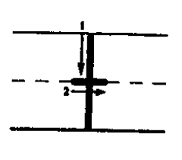
Sub-Word Level (Transcription)
Explicit instruction in handwriting and typing
  Handwriting: Letter formation paths with directional arrows that show the stroke direction, placement, and order; structured sequence with practice opportunities
  Typing: Home row, touch typing instruction with practice opportunities
Source: Graham & Harris CASL Handwriting Program

Slide 26
Word Level (Spelling, Vocabulary)
Concept maps, Frayer model for teaching vocabulary in context
Morphology instruction (e.g., Greek & Latin roots) integrates spelling & vocabulary
Explicit teaching of orthographic spelling rules, especially when adding morphemes to a word (e.g., doubling last consonant when adding suffix)
Teach strategy for planning for language use in writing
  Identify “essential words”
  Language box in graphic organizer
Frayer Model
Definition
Facts
Term
Examples
Non-examples

Slide 27
Sentence Level (Punctuation, Syntax)
Explicit instruction in sentence formation
  Every sentence has a subject and a verb (a “who” and a “do”)
Sentence repeating, combining, and expanding
Connective
Sentence 1
Sentence 2
More Complex Sentence

Slide 28
Text Level (Structure)
Teach multiple genres using genre-specific text structures
  Start with one structure per genre
    Informational: TIDE (Topic, Idea, Detail, Ending)
    Persuasive: TREE (Tell, Reason, End it, Explain)
    Narrative: CSPACE
  Teach using exemplar texts (can use previous years’ writing samples), highlighting elements
  Align graphic organizers to the structure

Slide 29
Text-Level (connections to comprehension)
Informational structures:
  Compare
  Cause/Effect
  Problem/Solution
  Sequence
  Description
Use the text structure to "get the gist” (Wijekumar, 2017)
  Knowledge Acquisition and Transformation
  Previously called Intelligent Tutoring for the Structure Strategy

Slide 30
How to prioritize?
Count data/Density of errors are useful
Strongest predictors of writing proficiency (word level accuracy and complexity; text structure)
“Low hanging fruit” (handwriting/typing fluency)
^Polar ^ bears ^ have ^ special ^ bodies ^. ^ The ^ bodies ^ help ^ them X surviv X in ^ the X freeze X arctic ^. ^ For X exaple X, ^ they ^ have ^ a ^ thick ^ layer ^ of ^ fat ^ under ^ their ^ skin ^ called X bluber X, ^ plus ^ two ^ layers ^ of ^ heavy ^ fur ^. ^ This ^ is ^ like X X sleeping ^ bag ^ and ^ it ^ keeps ^ their ^ body ^ heat X traped X inside ^ so ^ they ^ don't ^ freeze X X this X make X polar ^ bears ^ the ^ perfect ^ animals ^ for ^ the ^ coldest ^ place ^ on ^ Earth ^!

Slide 31
Putting it together: Levels of Language Error Analysis & Instructional Goals
Level of Language | Score | Patterns in Error Analysis | Instructional Goal
Sub-word | Observation of handwriting & typing | Typing fluency slower than handwriting | Student will participate in typing club for 20 minutes daily for 6 weeks. Monitor with typing fluency assessments in online program.
Word | 12 Word IWS | Multiple orthographic errors (double consonant) Morphological errors & phonological errors also present | Spelling pattern of doubled consonants when adding –ing or –ed to a base words will be explicitly taught with modeling & spelling practice with feedback. Monitor with CIWS & word-level error analysis.
Sentence | 4 Sentence IWS | Missing word, one missing punctuation | Continued practice & core support in sentence-level writing.
Text | 4 TIDE elements | All elements present and sophisticated. Some connectives. | Continued practice & core support in text-level writing.

Slide 32
Summary: Levels of Language & Error Analysis
Scores
Skills
Administer and Score Writing Assessment
Error Analysis with Levels of Language
Prioritize and Develop Instructional Goals
Word-level
Spelling
Vocabulary
Capitalization
Sentence-level
Punctuation
Semantics (meaning)
Sentence structure
Text-level
Genre
Structure
Organization and cohesion
Sub-word level
Handwriting
Typing
WRITING

Slide 33
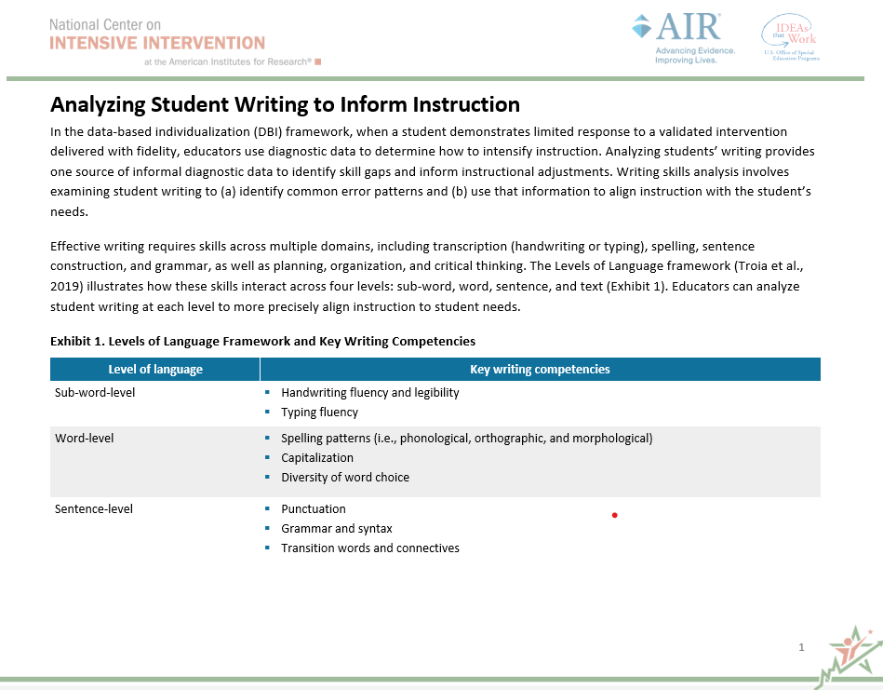
NCII Resource: Analyzing Student Writing to Inform Instruction
This resource describes how to analyze student writing samples to inform instructional changes within a student’s writing intervention.
Coming Soon!

Slide 34
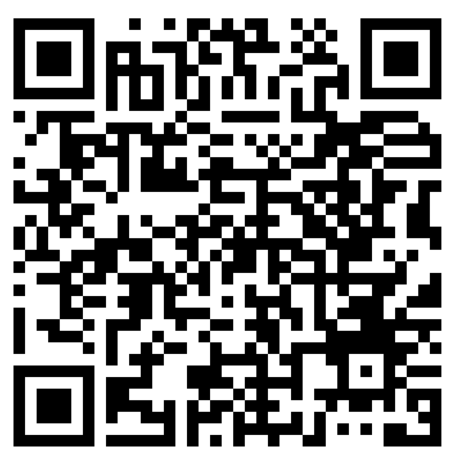
Event Survey
Please fill out this survey to help us improve future events!

Slide 35
Katie Valentine 2
Assistant Professor
kvalentine2@fsu.edu

