Slide 1

Using the Tools Charts to Communicate About Academic Screening Tools
June 2026
Caitlyn Majeika | Aleksis Kincaid

Slide 2


Introductions
Caitlyn Majeika, PhD, BCBA
Research Translation and Capacity-building Specialist
Aleksis Kincaid, PhD
Knowledge Development Task Lead

Slide 3
How much of your job involves communicating with a variety of audiences?
None
Some
A Good Amount
It’s Literally All I Do
Use your fingers to show us your response!

Slide 4
Goal of Today’s Session
Improve knowledge of and ability to communicate about technical standards on NCII’s tools charts.
Today’s Focus: Academic Screening Tools Chart

Slide 5
Academic Screening
Screening uses a systematic, process for identifying students who may be at risk for poor learning outcomes including academic, behavioral, school completion, and college and career readiness outcomes.
Center on MTSS https://mtss4success.org/sites/default/files/2023-05/what-is-screening.pdf

Slide 6
Reflect on Your Role Within an SEA
How are you communicating about academic screening?
With what audiences do you share information about screening tools?
What challenges arise when communicating across audience types?

Slide 7
Turn & Talk
Share your responses with someone from a different SEA.
  How are you communicating about academic screening?
  With what audiences do you share information about screening tools?
  Do you have state legislation or policy around academic screening?

Slide 8

Academic Screening and DBI
Early identification and intervention supports students’ academic success.
Screening tools are designed to efficiently identify students who will need additional supports.
Identifying which students need intervention allows schools to direct limited resources effectively.

Slide 9
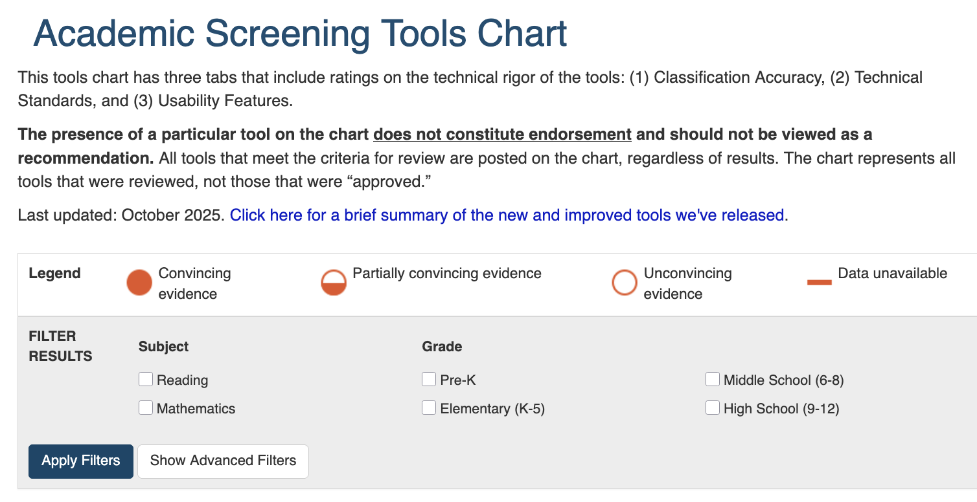
Purpose of NCII Tools Charts
NCII’s tools charts assist educators and families in becoming informed consumers who can select academic and behavioral assessment tools and interventions that meet standards for technical rigor and address their specific needs.

Slide 10
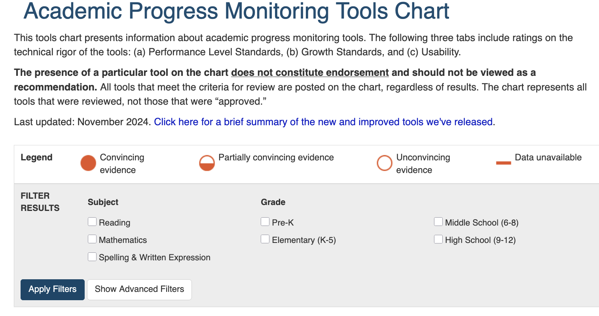
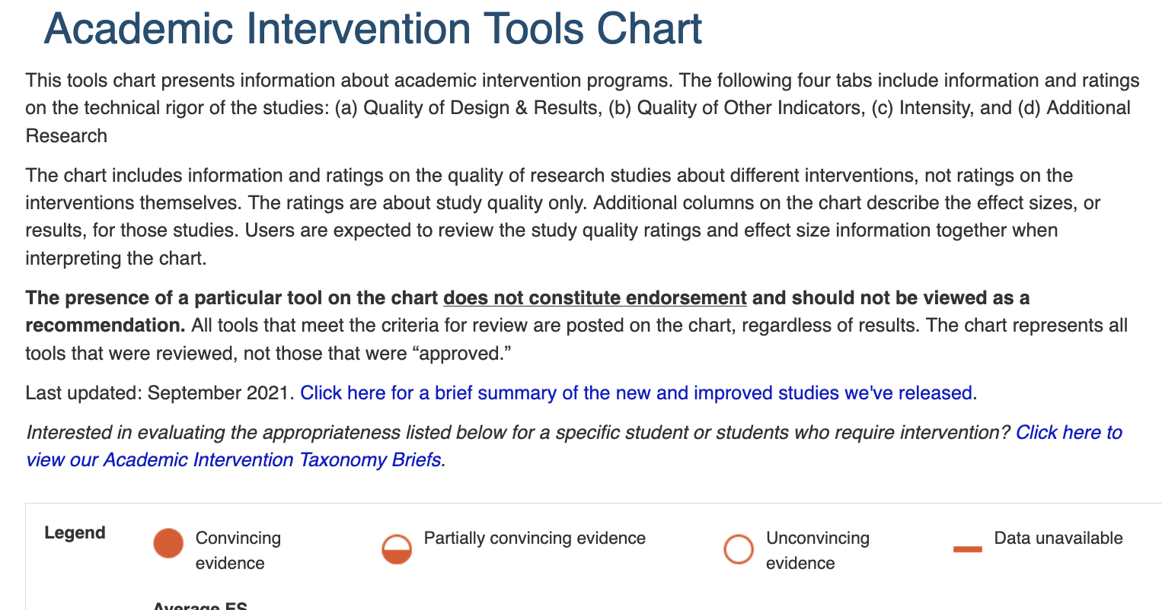
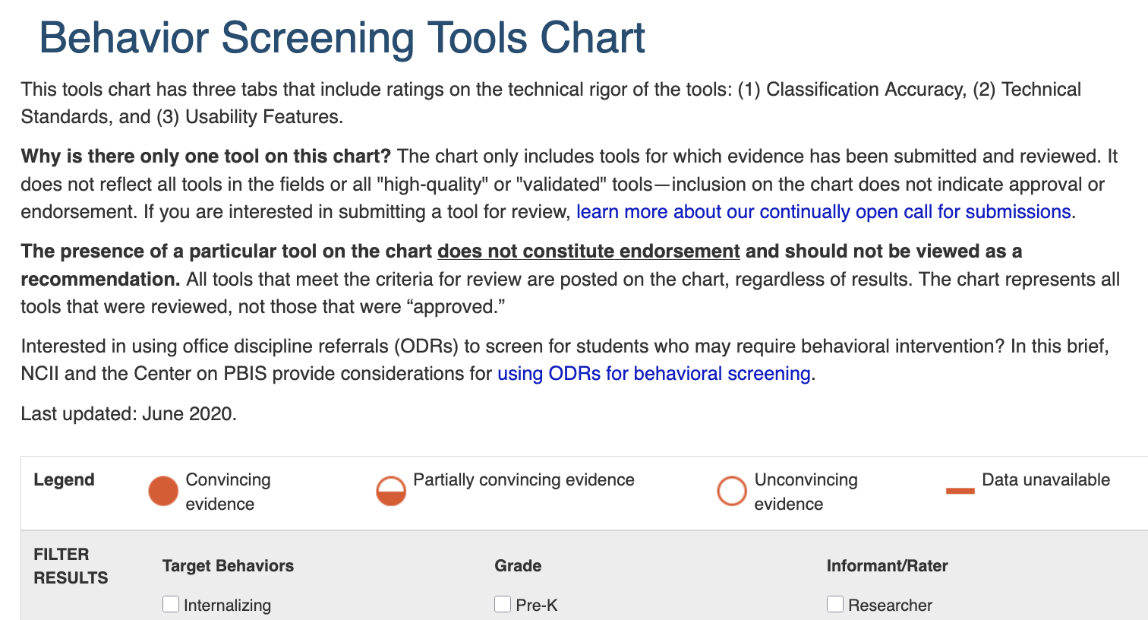
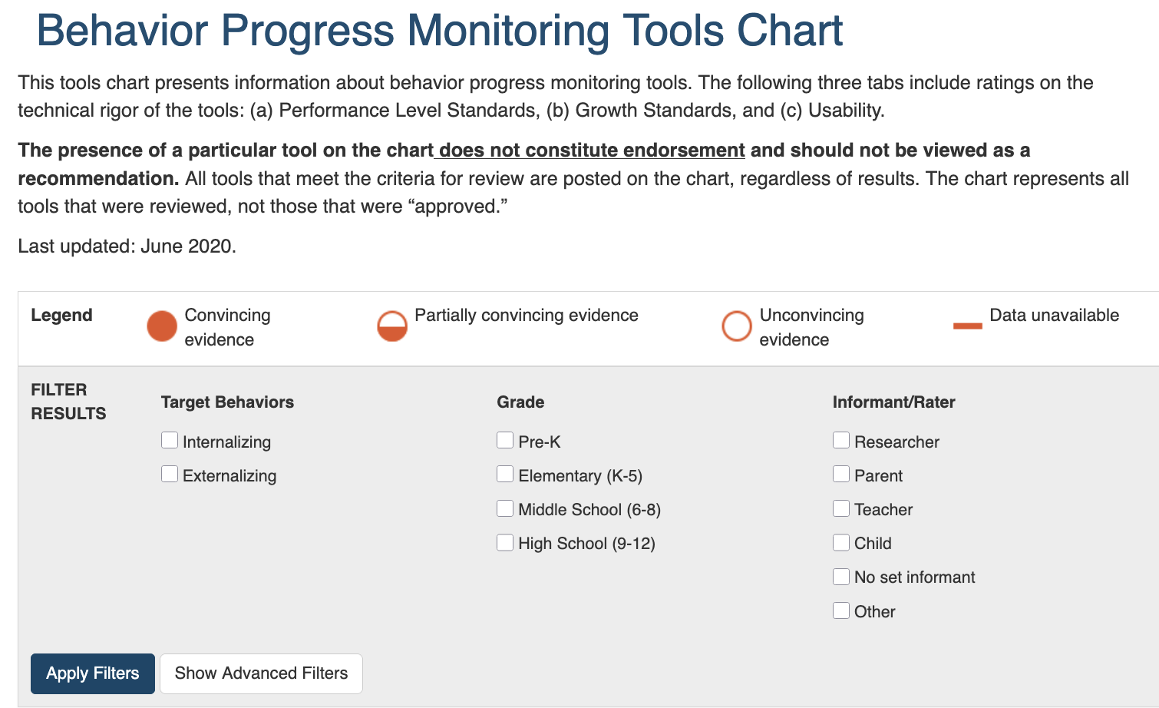
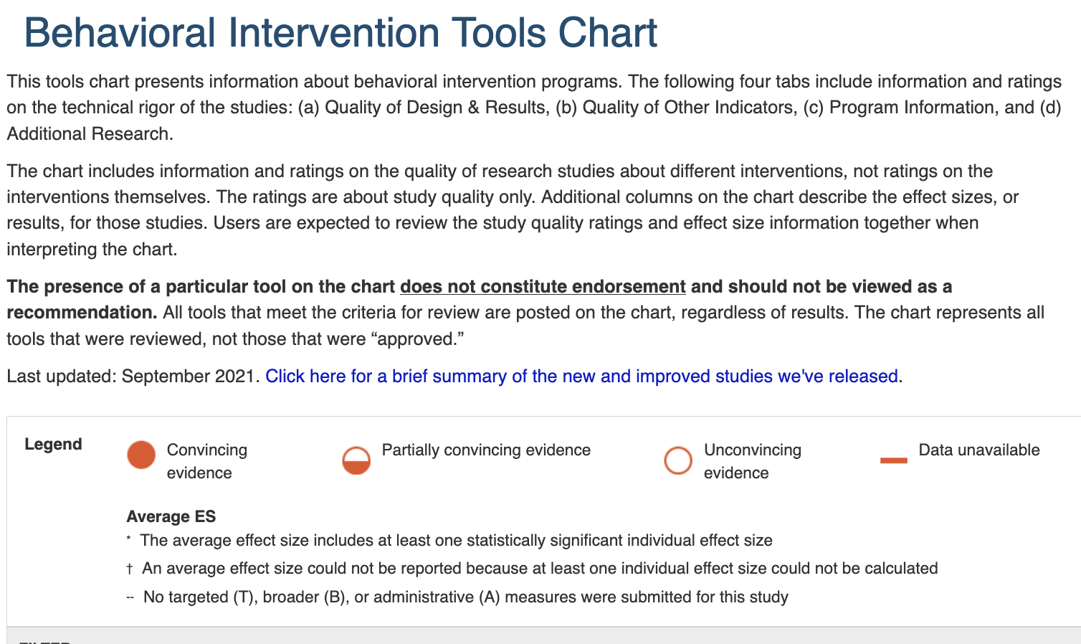
Suite of Tools Charts
Academic Screening
Academic Progress Monitoring
Academic Intervention
Behavior Screening
Behavior Progress Monitoring
Behavior Intervention

Slide 11



Tools Charts & Consumer Reports Comparison

Slide 12
Tools Chart Review Process
Call for submissions
Eligibility screening
Review by Technical Review Committee (TRC)
Publication on tools chart
Vendors of evidence-based tools invited to respond to calls for submissions
NCII staff review submissions for eligibility against our criteria.
Final list of tools and their ratings are published.
TRCs review tools against rigorous evidence standards.

Slide 13
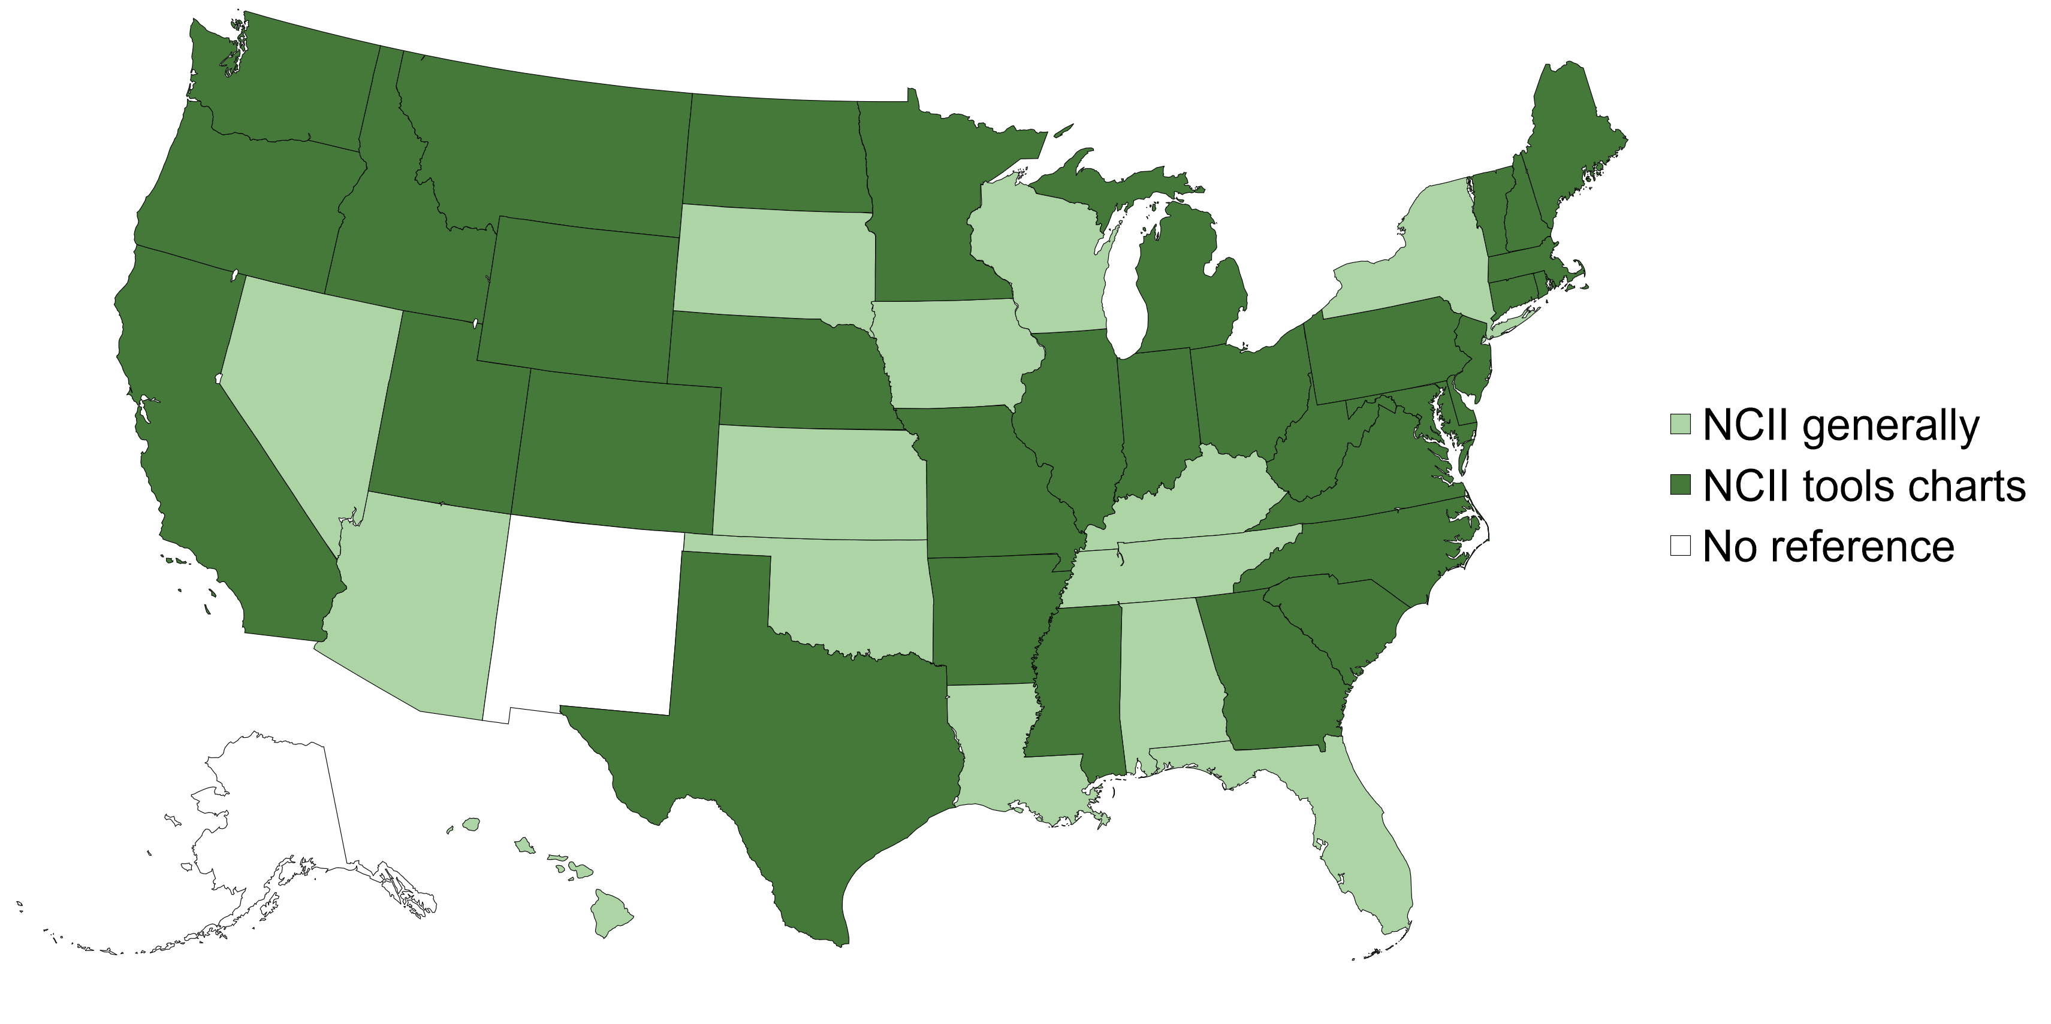
Tools Chart Impact Across States
State Education Agency (SEA) Websites Mentioning NCII or Tools Charts
Data gathered spring 2024

Slide 14
Specific Tools Chart References on SEA Websites
Tools Chart | Percentage of SEA Websites
Academic Screening | 47.1%
Academic Progress Monitoring | 27.5%
Academic Intervention | 25.5%
Behavior Progress Monitoring | 9.8%
Behavior Screening | 7.8%
Behavior Intervention | 7.8%
Data gathered spring 2024

Slide 15

What about state legislation?
Delaware, Indiana, and Massachusetts referenced the tools charts in their state legislation.
References are all related to literacy screening and interventions.
Data gathered spring 2024

Slide 16

Accurate Communication is Key!

Slide 17
Turn & Talk 2
With a partner, discuss the misconception that a tools chart is a list of “approved” assessments.
  What are reasons some have this misconception?
  How is the tools chart different than an approved list of tools a state may have?

Slide 18
Tools Charts in Action: Nebraska
Goal: Support statewide, consistent K–3 reading screening by grounding Nebraska Department of Education (NDE) decisions in shared, evidence‑based criteria.
Methods: NCII supported NDE leaders to use the academic screening tools chart and conduct expert review of classification accuracy, reliability, and validity.
Outcomes: NDE identified six approved screening tools and NCII developed an internal talking points document to guide communication about screening tools to a variety of audiences.

Slide 19
Tools Charts in Action: Michigan
Goal: Support the adoption of academic screening tools that aligned with Michigan’s legislation around dyslexia screening.
Methods: NCII supported MDE leaders through training and technical assistance on NCII standards and review processes related to academic screening and progress monitoring.
Outcomes: MDE conducted an independent review of academic screening and progress monitoring suites after adapting NCII standards to meet state requirements.

Slide 20
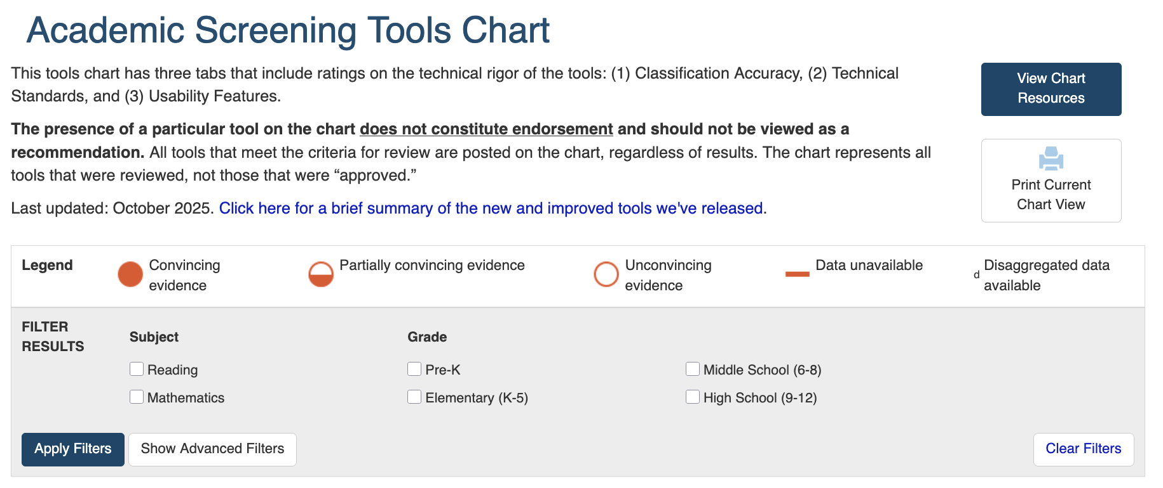
Academic Screening Tools Chart

Slide 21
Bubble Ratings
Rating | Description | General Interpretation
 | Convincing evidence. |  | Good to go!
 | Partially convincing evidence. |  | Yield & learn more.
 | Unconvincing evidence. |  | Stop & consider.
 | Data unavailable

Slide 22
Technical Standards for Screening Tools
Today’s focus!
Classification Accuracy
Reliability
Validity
Bias Analysis
Sample Representativeness

Slide 23
Technical Standard #1: Classification Accuracy
The main goal of classification accuracy is to understand how well scores on a screening assessment correctly identify students who are at risk versus those not at risk.

Slide 24

Classification Accuracy In the Wild!

Slide 25
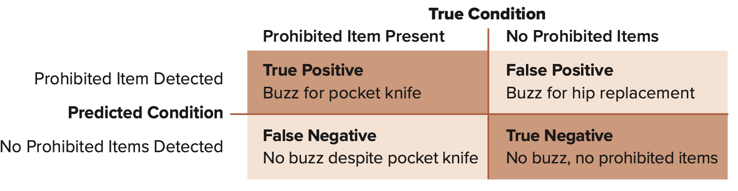
Classification Accuracy In the Wild! 2

Slide 26
Why is classification accuracy important?
Measures with strong classification accuracy:
  Maximize rates of true positive (correctly classifying a student as at risk) and true negative (correctly classifying a student as not at risk) classifications.
  Minimize rates of false positive (incorrectly classifying a student as at risk when he is not at risk) and false negative (failing to classify a student as at risk when he is at risk) classifications.

Slide 27
Sensitivity & Specificity
Sensitivity and specificity rates help gauge which tests can achieve a high rate of accurate classifications.
Sensitivity
Specificity
The probability of correctly identifying a problem (i.e., the proportion of true positives that the screener correctly identifies).
The probability of correctly identifying that there is not a problem (i.e., the proportion of true negatives that the screener correctly identifies).

Slide 28
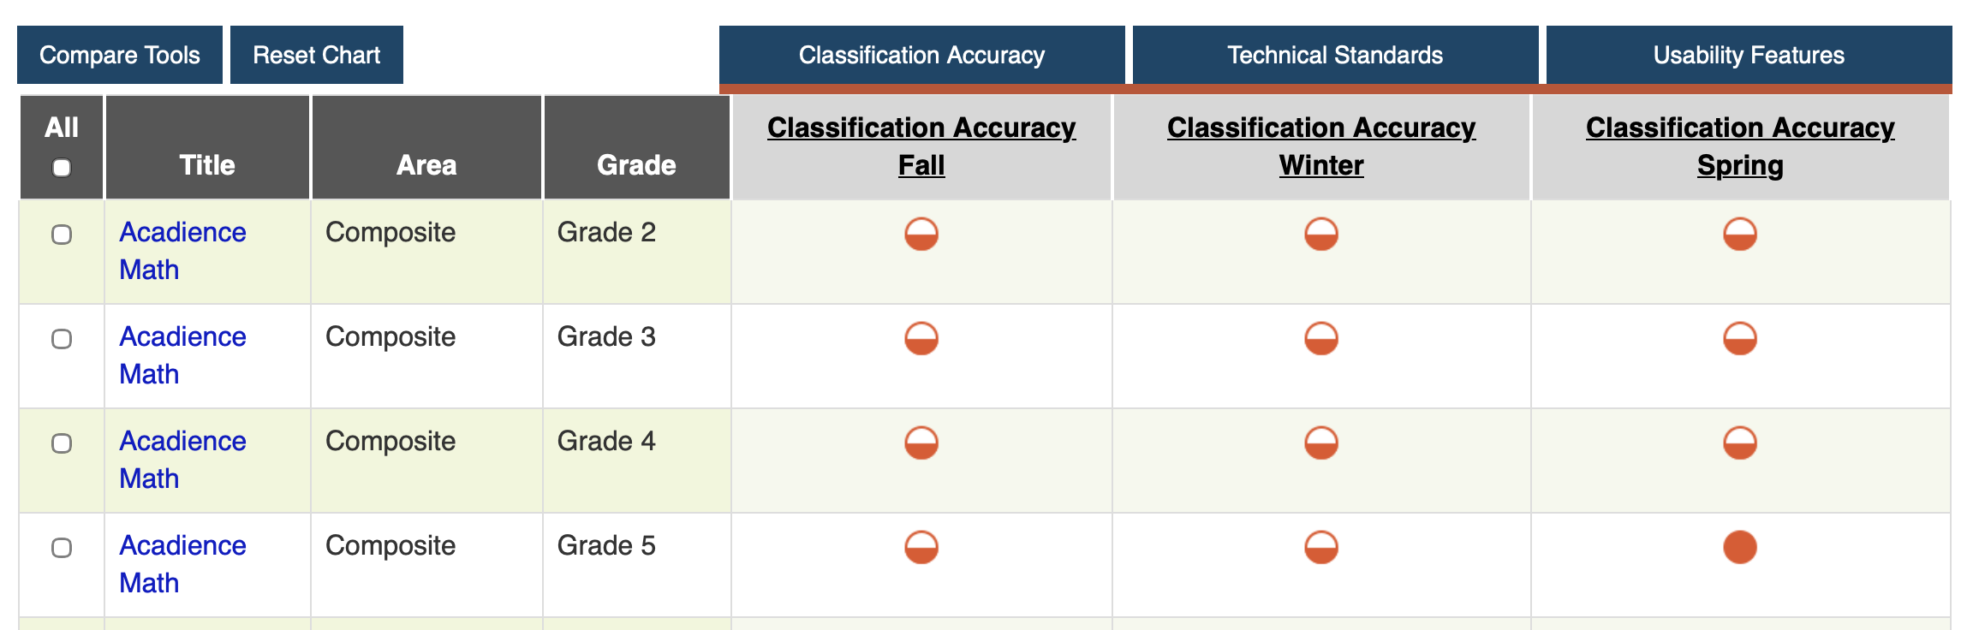
Classification Accuracy on Our Tools Chart

Slide 29
Turn & Talk 3
With a partner:
Rehearse saying a one sentence definition of classification accuracy you can use with educators.
Brainstorm other examples of classification accuracy ”in the wild”!

Slide 30
Technical Standard #2: Reliability
Reliability is the consistency of a set of scores that are designed to measure the same thing.

Slide 31

Reliability In the Wild!

Slide 32
Why is reliability important?
To make judgements about whether a student is truly at risk for poor academic performance, and therefore needs intervention, we should ensure that the screening tool we are using provides consistent information.

Slide 33
Types of Reliability
Form of Reliability | Defining Features
Internal consistency | How well a set of item scores correlate with other item scores on the same test.
Alternate form reliability | How well scores on two different versions, or forms, of the same test correlate with each other .
Inter-rater reliability | The consistency with which different observers rate the same behavior.
Does every screening tool need to have high reliability across all types?

Slide 34
Technical Standard #3: Validity
Validity is broadly defined as how well something measures what it is supposed to measure. While reliability is evaluated through the consistency of scores, validity is concerned with how well a set of scores reflects the intended construct or domain being assessed.

Slide 35

Validity In the Wild!

Slide 36
Types of Validity Evidence
Form of Validity | Key Questions | Example Evidence
Content | Does the content of the test match what the test is trying to measure? | Experts in reading instruction agree that the content of a reading screener matches the stated purpose of the test.
Structural | Do respondents’ scores on a test group together in ways that we would expect based on theory? | Factor analysis shows that students’ scores on items measuring the same skill (e.g., phonological awareness) are strongly correlated.
Generalizability | How well does the interpretation of scores generalize across different samples and different time points? | When analyzing the validity of the screener, researchers conducted a study using a large, nationally representative sample.

Slide 37
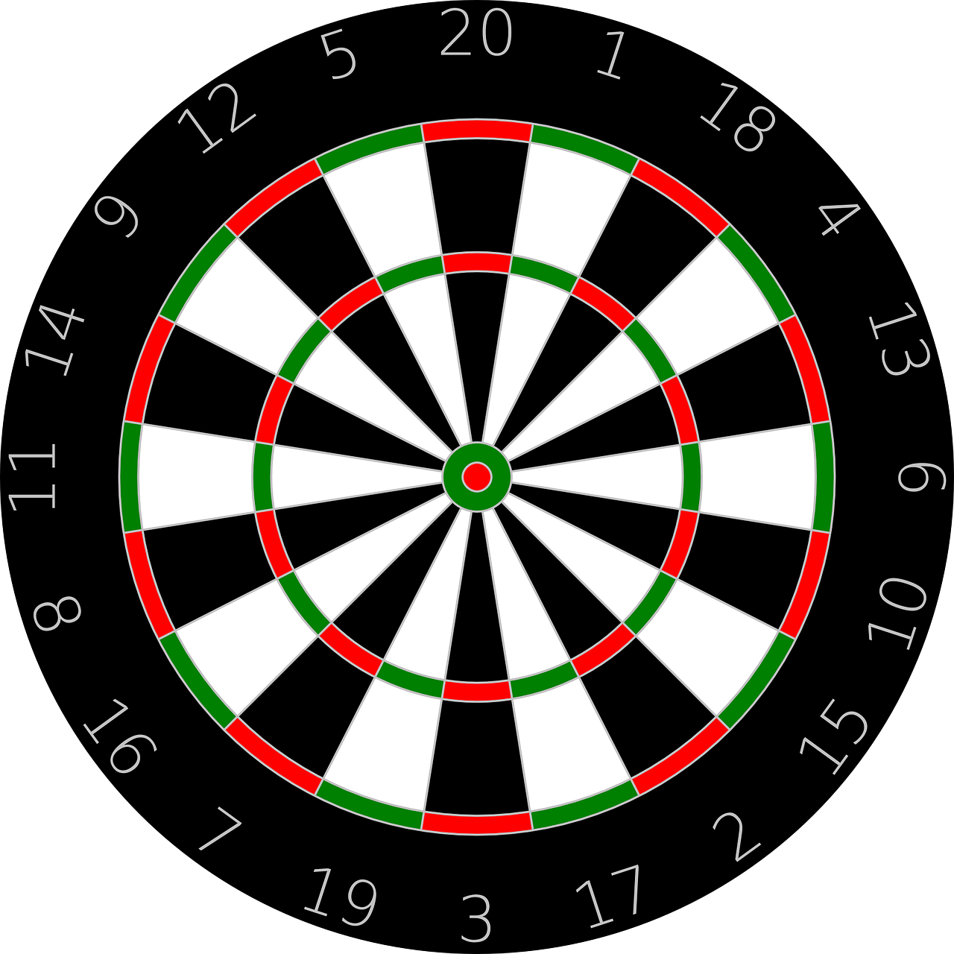
Reliability vs. Validity
not valid or reliable
reliable, not valid
valid and reliable

Slide 38
Turn & Talk 4
With a partner:
Rehearse saying a one sentence definition of reliability and validity you can use with educators.
Brainstorm other examples of reliability and validity in the wild!

Slide 39
Questions

Slide 40
Wrap Up & Additional Resources

Slide 41
Academic Screening Recap
Early identification and intervention supports students’ academic success.
Screening tools are designed to efficiently identify students who will need additional supports.
Identifying which students need intervention allows schools to direct limited resources effectively.

Slide 42
Turn & Talk 5
With a partner:
Identify one key takeaway from the academic screening overview
Share how what you learned today can be used to support educators in your state

Slide 43
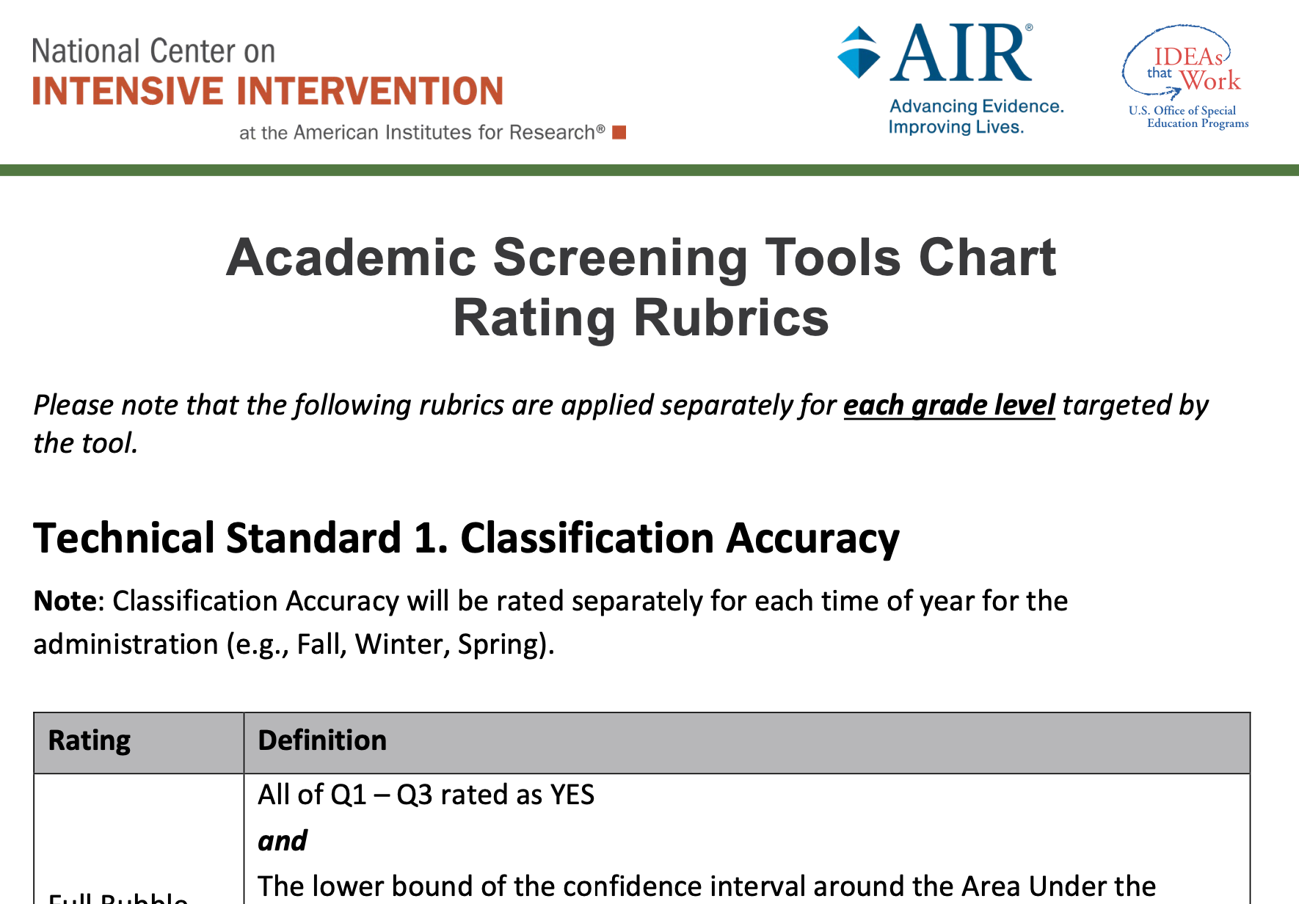
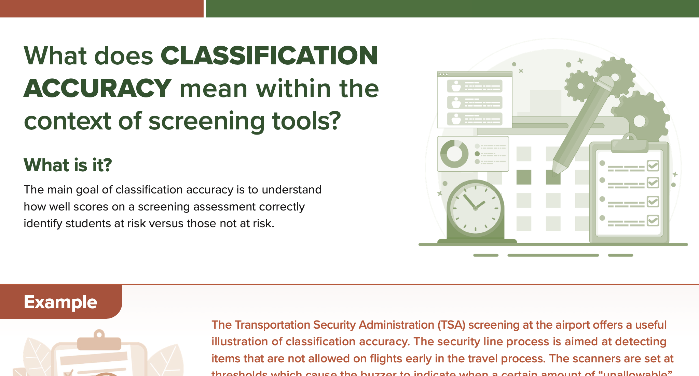
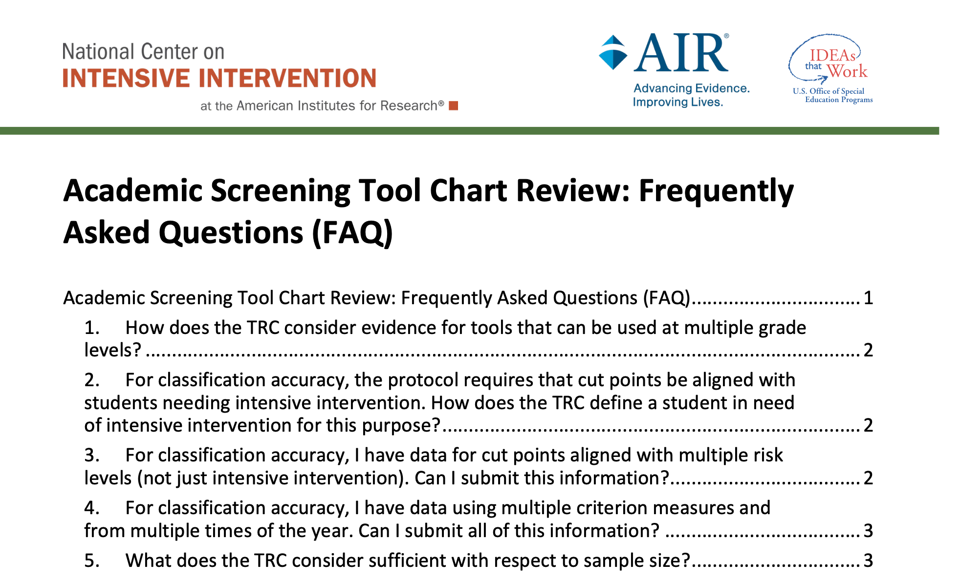
Academic Screening Tools Chart Resources
Academic Screening Tools Chart
Academic Screening Rating Rubric
Screening Standards One Pagers
Academic Screening FAQ

