Slide 1

Error Analysis in Math:
June 3, 2026
Using Student Work to Intensify Intervention
Alison M. Hardy | Sarah R. Powell

Slide 2


Alison M. Hardy
Sarah R. Powell
Assistant Professor
alisonhardy@utexas.edu
Professor
srpowell@utexas.edu

Slide 3
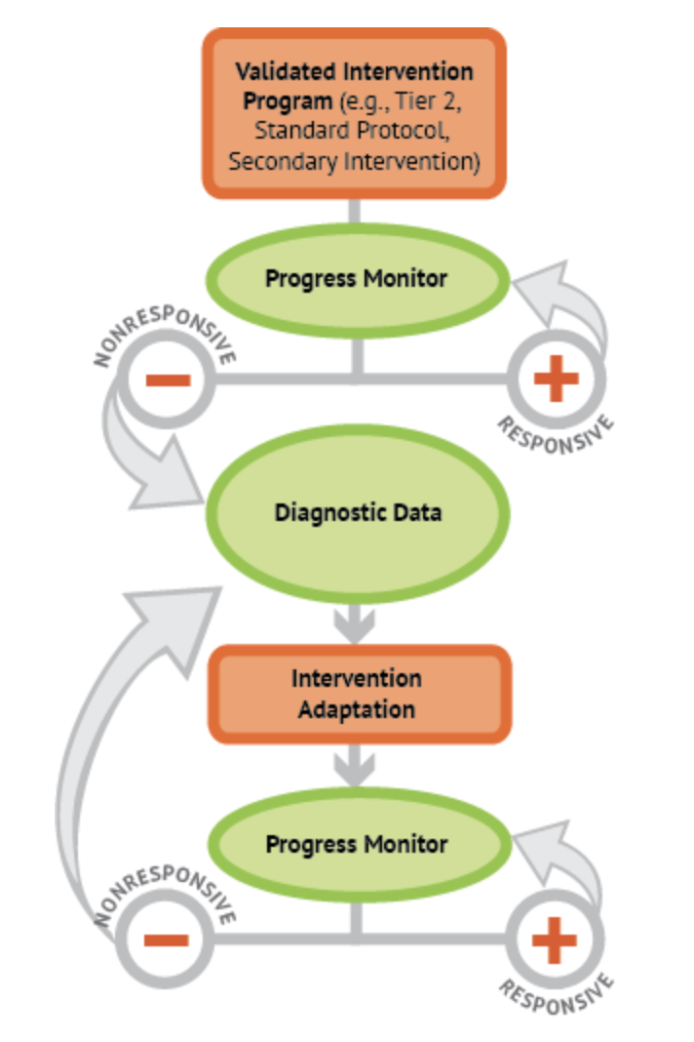
Error Analysis
A process for analyzing student work to:
identify what types of errors a student is making and why
better align an intervention with the student’s needs

Slide 4
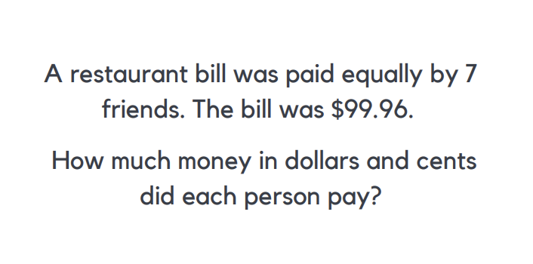
Error Analysis in Math
Teachers and interventionists can conduct error analyses for all math concepts and skills. This webinar focuses on computation and word problems:
Addition and Subtraction
Multiplication and Division
Word Problems

Slide 5
Error Analysis in Math 2
First, select student work to analyze
(at least 3–5 problems of the same domain).
Score items (for computation, use correct digits).
Identify errors.
      Slips – Careless errors, often a result of organization
      Bugs – A pattern of similar errors, indicative of a misconception or lack of procedural fluency
Plan targeted instruction to address errors and misconceptions.
Brown & Skow, 2016

Slide 6

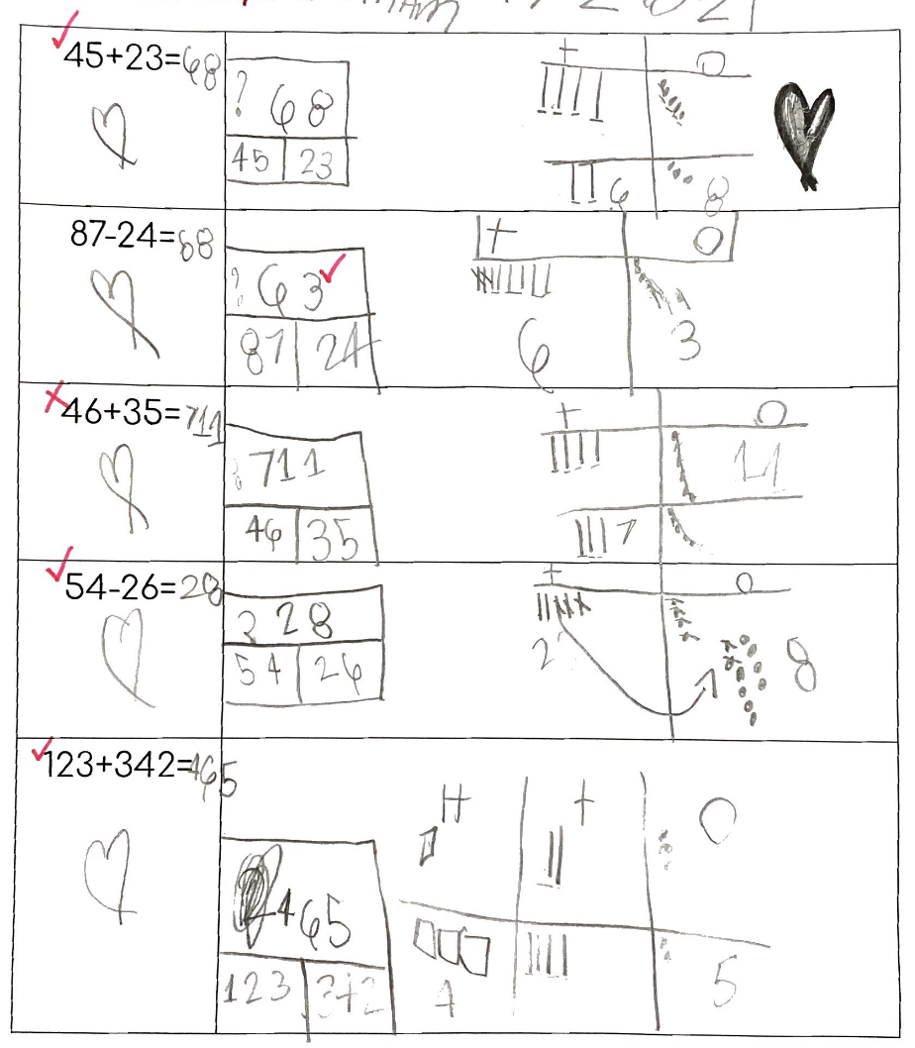
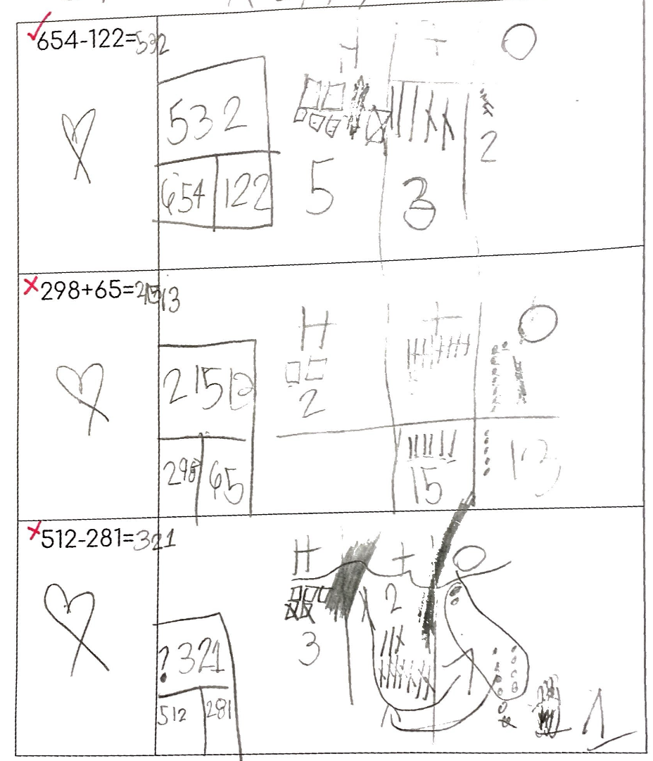
Case Study: A Grade 2 student is receiving an intervention focused on adding and subtracting within 1,000 using base-ten models.
Addition and Subtraction
Score
Identify errors
Plan instruction

Slide 7

Case Study: A Grade 2 student is receiving an intervention focused on adding and subtracting within 1,000 using base-ten models. 2
Addition and Subtraction
✓
✓
✓
✓
Score
Identify errors
Plan instruction
✗
✓
Correct answer:
81
✗

Slide 8
Case Study: A Grade 2 student is receiving an intervention focused on adding and subtracting within 1,000 using base-ten models. 3
Addition and Subtraction
✓
✓
Score
Identify errors
Plan instruction
✓
✓
✓

Slide 9
Case Study: A Grade 2 student is receiving an intervention focused on adding and subtracting within 1,000 using base-ten models. 4
Addition and Subtraction
✓
✓
✓
Score
Identify errors
Plan instruction

Slide 10
Case Study: A Grade 2 student is receiving an intervention focused on adding and subtracting within 1,000 using base-ten models. 5
Addition and Subtraction
✗
✗
✗
✓
✗
Correct answer:
363
Score
Identify errors
Plan instruction
✗
✗
✓
Correct answer:
231

Slide 11
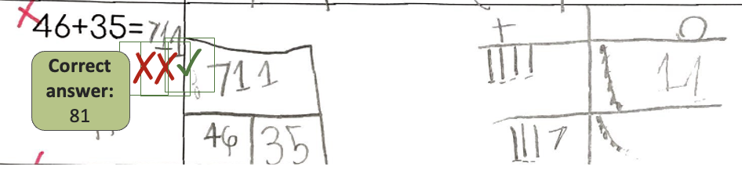
Case Study: A Grade 2 student is receiving an intervention focused on adding and subtracting within 1,000 using base-ten models. 6
Addition and Subtraction
Did not regroup 10 ones into one ten.
Instead, wrote 11 in the one’s place and then added the tens.
Score
Identify errors
Plan instruction
What error(s) did this student make?
Share in the chat.

Slide 12
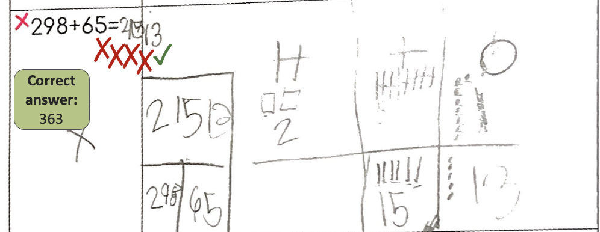
Case Study: A Grade 2 student is receiving an intervention focused on adding and subtracting within 1,000 using base-ten models. 7
Addition and Subtraction
Score
Identify errors
Plan instruction
Did not regroup 10 ones into one ten.
Did not regroup 10 tens into one hundred.
Wrote 13 in the one’s place and 15 in the ten’s place.

Slide 13
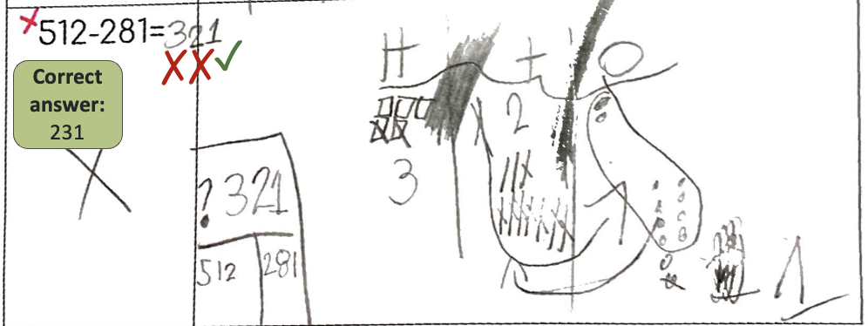
Case Study: A Grade 2 student is receiving an intervention focused on adding and subtracting within 1,000 using base-ten models. 8
Addition and Subtraction
Score
Identify errors
Plan instruction
Regrouped a ten into 10 ones when they didn’t need to (tried to regroup them back into a ten).
Drew 10 more tens without removing a hundred.
Thought they had one less ten than they did.

Slide 14
Case Study: A Grade 2 student is receiving an intervention focused on adding and subtracting within 1,000 using base-ten models. 9
Addition and Subtraction
Items solved correctly:
45 + 23 =
87 – 24 =
54 – 26 =
123 + 342 =
654 – 122 =
What do you notice?
Share in the chat.
Items solved incorrectly:
46 + 35 =
298 + 65 =
512 – 281 =
Score
Identify errors
Plan instruction

Slide 15
Case Study: A Grade 2 student is receiving an intervention focused on adding and subtracting within 1,000 using base-ten models. 10
Addition and Subtraction
Items solved correctly:
45 + 23 =
87 – 24 =
54 – 26 =
123 + 342 =
654 – 122 =
Slip or bug?
Share in the chat.
Items solved incorrectly:
46 + 35 =
298 + 65 =
512 – 281 =
Score
Identify errors
Plan instruction

Slide 16
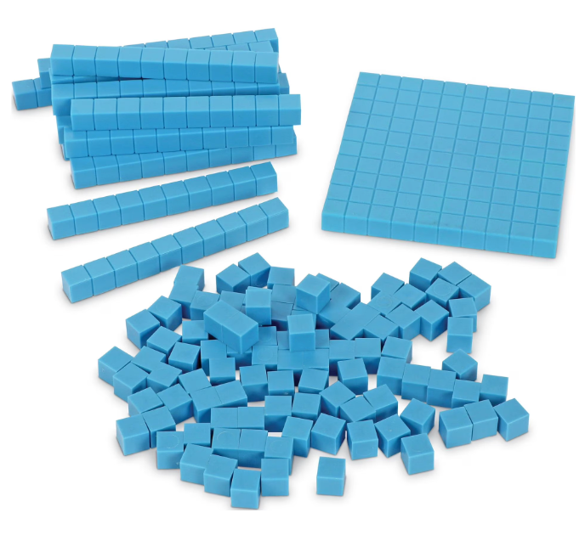
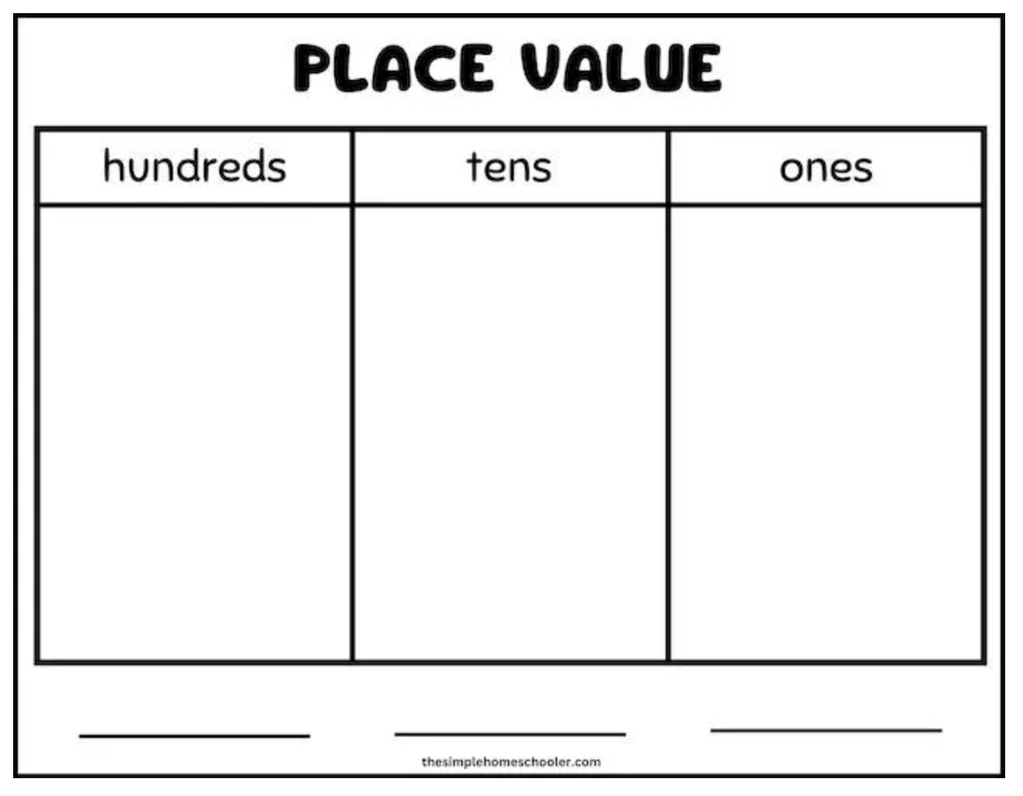
Case Study: A Grade 2 student is receiving an intervention focused on adding and subtracting within 1,000 using base-ten models. 11
Addition and Subtraction
Potential strategies
Provide explicit instruction (modeling and guided practice) on regrouping
Incorporate concrete base-ten blocks and place-value charts
Support the student in verbalizing the process of regrouping using precise mathematics vocabulary
Provide sufficient interleaved practice opportunities to support computational fluency
Score
Identify errors
Plan instruction

Slide 17
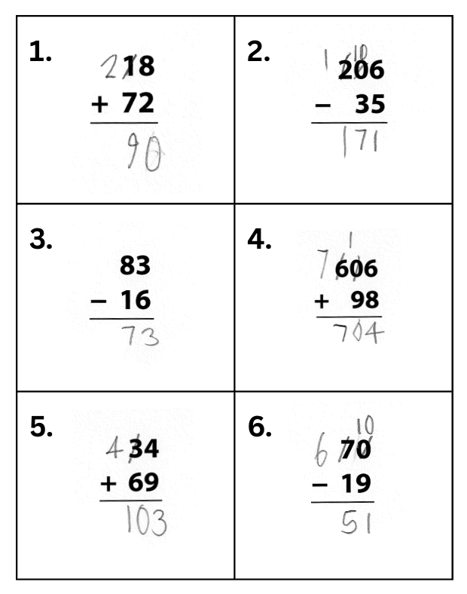
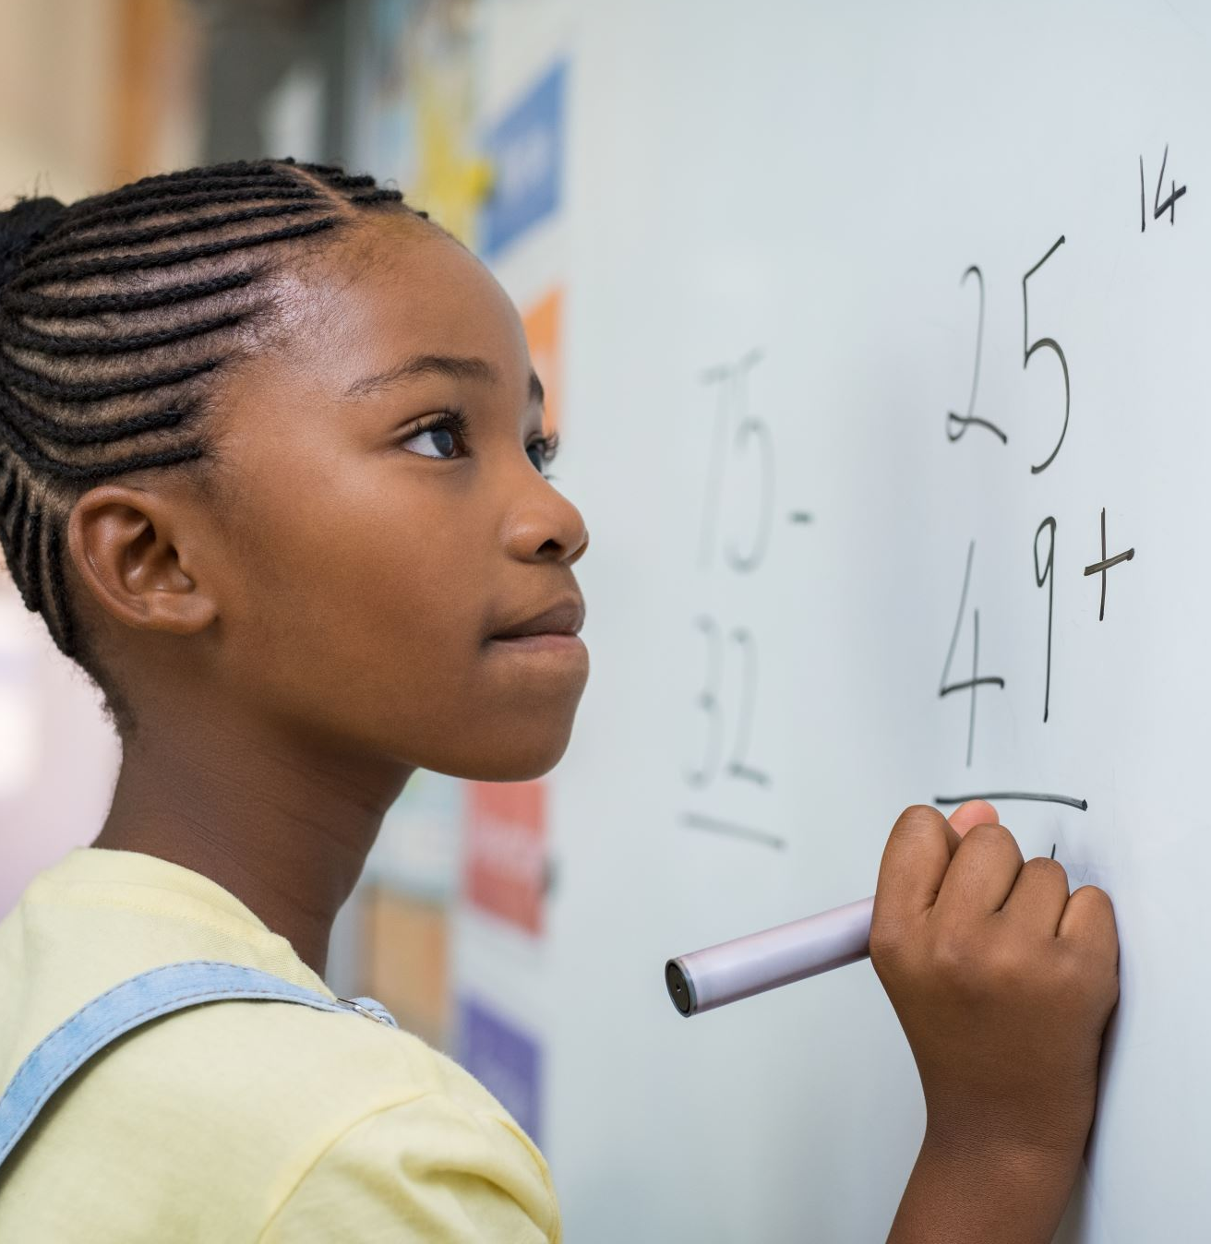
Case Study: A Grade 3 student is receiving an intervention focused on adding and subtracting using the standard algorithm.
Addition and Subtraction
Score
Identify errors
Plan instruction

Slide 18
Case Study: A Grade 3 student is receiving an intervention focused on adding and subtracting using the standard algorithm. 2
Addition and Subtraction
✓
✓
✓
✓
✓
Score
Identify errors
Plan instruction
Correct answer:
67
✗
✗
✓
✓
✓
✓
✓
✓
✓
✓

Slide 19
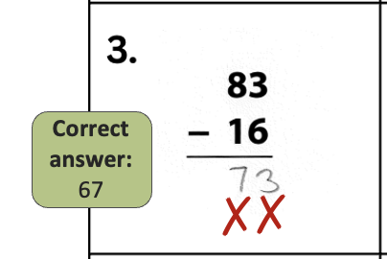
Case Study: A Grade 3 student is receiving an intervention focused on adding and subtracting using the standard algorithm.
3
Addition and Subtraction
What error(s) did this student make?
Share in the chat.
Score
Identify errors
Plan instruction
Instead of regrouping, the student switched the digit in the subtrahend with the digit in the minuend.
Without regrouping, the student’s digit in the ten’s place was incorrect, too.

Slide 20
Case Study: A Grade 3 student is receiving an intervention focused on adding and subtracting using the standard algorithm. 4
Addition and Subtraction
Items solved correctly:
18 + 72 =
206 – 35 =
606 + 98 =
34 + 69 =
70 – 19 =
Item solved incorrectly:
83 – 16 =
What do you notice?
Share in the chat.
Score
Identify errors
Plan instruction

Slide 21
Case Study: A Grade 3 student is receiving an intervention focused on adding and subtracting using the standard algorithm. 5
Addition and Subtraction
Sometimes, additional information is needed to determine if an error is a slip or a bug.
  See if the student can identify and explain their mistake.
  Administer additional items and complete a diagnostic interview.
Score
Identify errors
Plan instruction

Slide 22
Case Study: A Grade 3 student is receiving an intervention focused on adding and subtracting using the standard algorithm. 6
Addition and Subtraction
If the student can identify their mistake and solve additional, similar problems correctly, this error would be classified as a slip.
Score
Identify errors
Plan instruction

Slide 23
Case Study: A Grade 3 student is receiving an intervention focused on adding and subtracting using the standard algorithm. 7
Addition and Subtraction
Often, slips can be addressed by teaching students how to better organize their work or use self-monitoring strategies.
Score
Identify errors
Plan instruction

Slide 24

Case Study: A Grade 3 student is receiving an intervention focused on adding and subtracting using the standard algorithm.
8
Addition and Subtraction
Often, slips can be addressed by teaching students how to better organize their work or use self-monitoring strategies.
Score
Identify errors
Plan instruction
For example, a teacher might encourage this student to always check their work and put a star by each item after they check it.

Slide 25

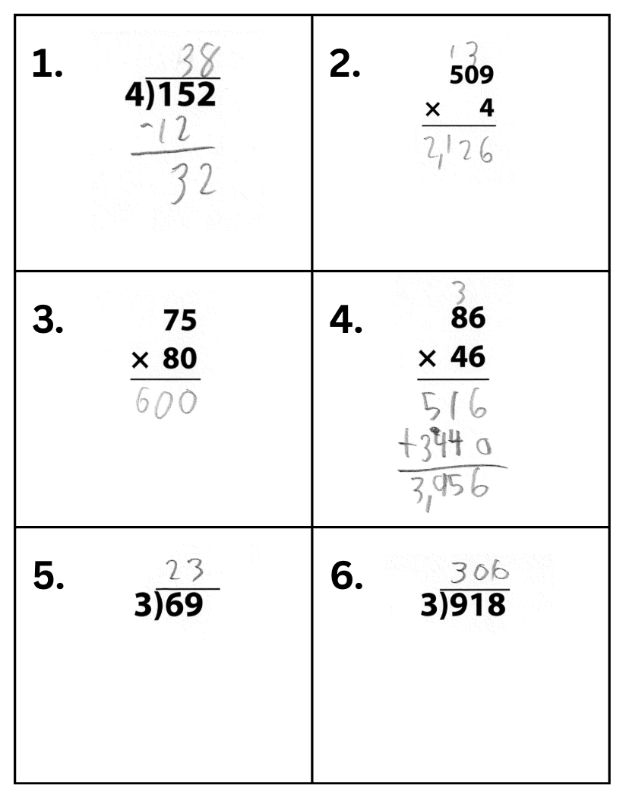
Case Study: A Grade 4 student is receiving an intervention focused on multiplying and dividing whole numbers.
Multiplication and Division
Score
Identify errors
Plan instruction

Slide 26
Case Study: A Grade 4 student is receiving an intervention focused on multiplying and dividing whole numbers. 2
Multiplication and Division
✓
✓
Multiplication (standard algorithm):
Score digits from right to left
Division (standard algorithm):
Score digits from left to right
Correct answer:
2,036
✓
✗
✗
✓
Score
Identify errors
Plan instruction
Correct answer:
6,000
✗
✓
✓
✓
✓
✓
✓
✓
✓
✓
✓
✓

Slide 27
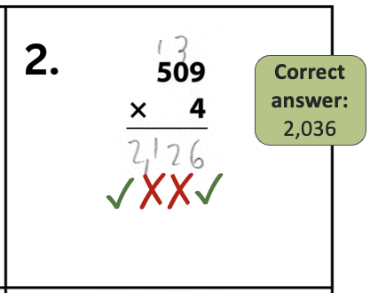
Case Study: A Grade 4 student is receiving an intervention focused on multiplying and dividing whole numbers. 3
Multiplication and Division
What error(s) did this student make?
Share in the chat.
Score
Identify errors
Plan instruction
Instead of multiplying the 4 in the second factor with the 0 in the first factor, and then adding the 3, they multiplied the 4 and 3.

Slide 28
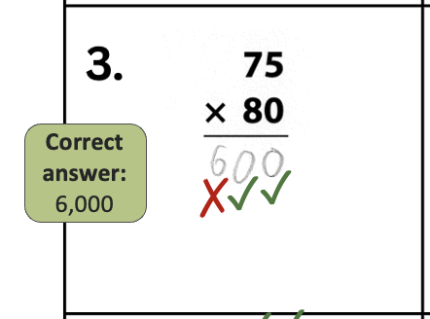
Case Study: A Grade 4 student is receiving an intervention focused on multiplying and dividing whole numbers. 4
Multiplication and Division
What error(s) did this student make?
Share in the chat.
Score
Identify errors
Plan instruction
The student forgot to place a zero in the one’s place as a placeholder, before continuing to multiply with the 8.

Slide 29
Case Study: A Grade 4 student is receiving an intervention focused on multiplying and dividing whole numbers. 5
Multiplication and Division
Items solved correctly:
152 ÷ 4 =
86 × 46 =
69 ÷ 3 =
918 ÷ 3 =
Item solved incorrectly:
509 × 4 =
75 × 80 =
What do you notice?
Share in the chat.
Score
Identify errors
Plan instruction

Slide 30
Case Study: A Grade 4 student is receiving an intervention focused on multiplying and dividing whole numbers. 6
Multiplication and Division
Item solved incorrectly:
509 × 4 =
75 × 80 =
There may not always be a clearly identifiable misconception.
In this case, the student experienced difficulties multiplying whole numbers with zeroes.
Because this happened more than once, you might consider it a bug.
Score
Identify errors
Plan instruction

Slide 31
Case Study: A Grade 4 student is receiving an intervention focused on multiplying and dividing whole numbers. 7
Multiplication and Division
Potential strategies
Have the student solve similar problems using a different strategy (e.g., area model or partial products).
Provide explicit instruction (modeling and guided practice) on using the standard algorithm to multiply whole numbers with zeros
Support the student in making connections between the other strategies and the standard algorithm
Provide sufficient practice opportunities to support computational fluency
Score
Identify errors
Plan instruction

Slide 32
Word Problems
Word Problems
Word-problem solving is a multi-faceted process.
Students may struggle to read and comprehend word problems, as well as set up and solve them.
Diagnostic interviews may be particularly helpful with word-problem error analyses.
Score
Identify errors
Plan instruction

Slide 33
Word Problems 2
Word Problems
If a student is unable to explain their reasoning for why they solved a word problem the way they did, they would likely benefit from an attack strategy (i.e., a meta-cognitive strategy for solving a word problem step-by-step).
Score
Identify errors
Plan instruction
We also recommend schema instruction:
Teaching students to identify word problems by their type,
and to solve them using schema-specific strategies.

Slide 34
Word Problems 3
Word Problems
Once students have foundational strategies, error analyses on work samples can better inform an intervention.
Look for error patterns:
  Schema
  Single- or multi-step
  Location of the unknown
  Vocabulary
  Computational demand
Score
Identify errors
Plan instruction

Slide 35

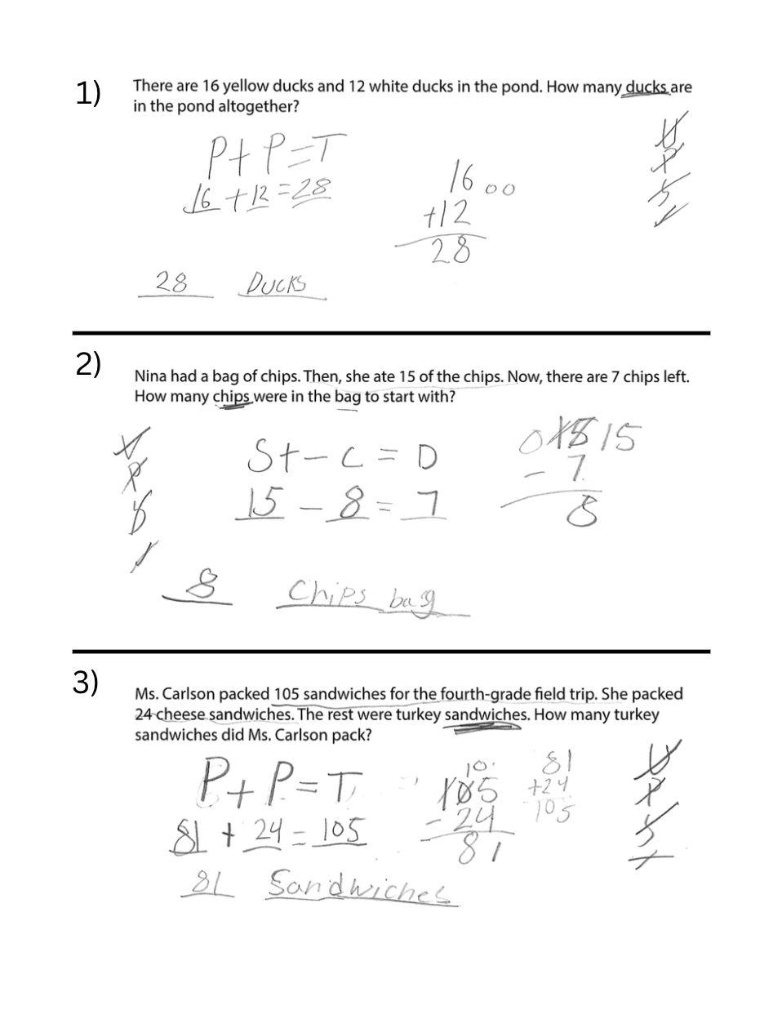
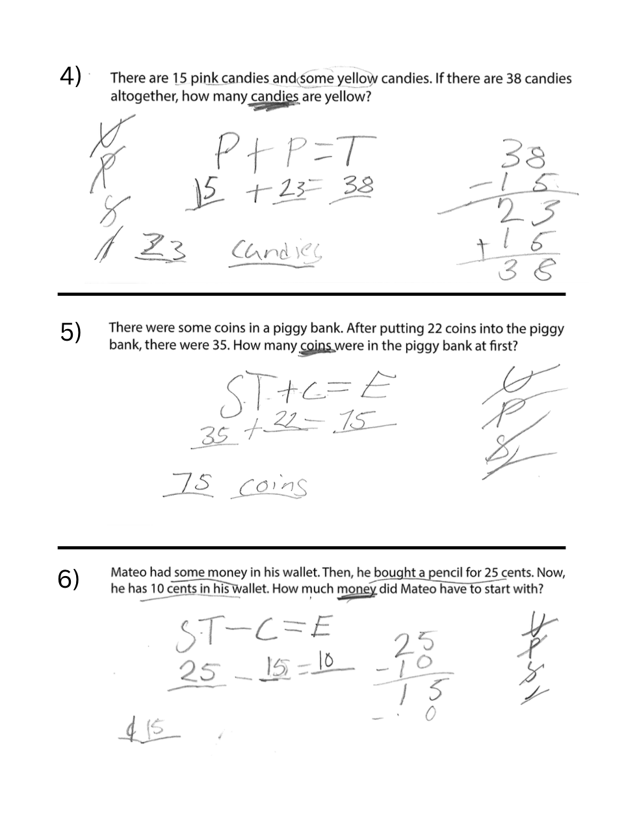
Case Study: A Grade 5 student is receiving an intervention focused on single-step word problems.
Word Problems
Score
Identify errors
Plan instruction

Slide 36
Case Study: A Grade 5 student is receiving an intervention focused on single-step word problems. 2
Word Problems
✓
✓
Score
Identify errors
Plan instruction
✗
✗
✓
✗

Slide 37
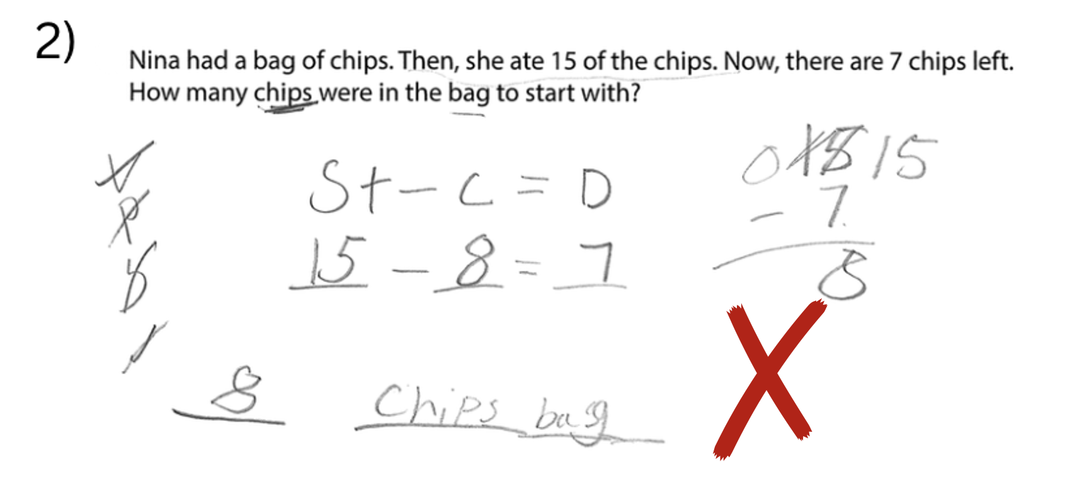
Case Study: A Grade 5 student is receiving an intervention focused on single-step word problems. 3
Word Problems
Schema: Change
Unknown: Start amount
Score
Identify errors
Plan instruction
Used an attack strategy
Identified the schema correctly
Placed the numbers in the equation incorrectly
Answer is not reasonable

Slide 38
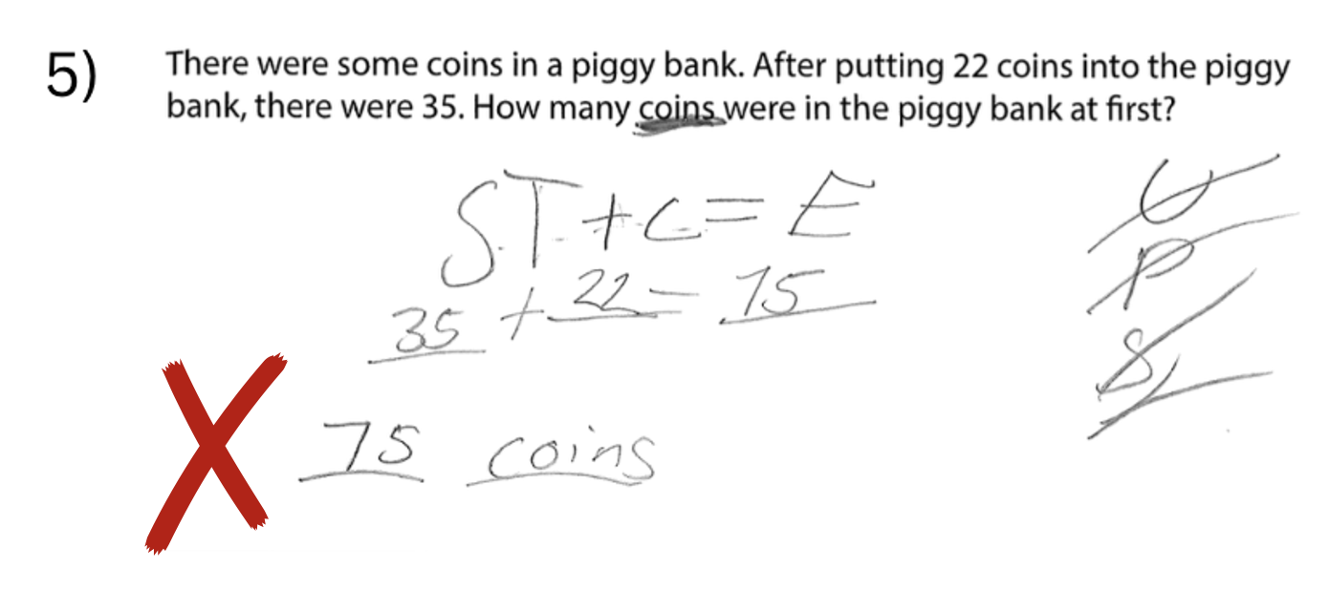
Case Study: A Grade 5 student is receiving an intervention focused on single-step word problems. 4
Word Problems
Schema: Change
Unknown: Start amount
Score
Identify errors
Plan instruction
Used an attack strategy
Identified the schema correctly
Placed the numbers in the equation incorrectly
Answer is not reasonable

Slide 39
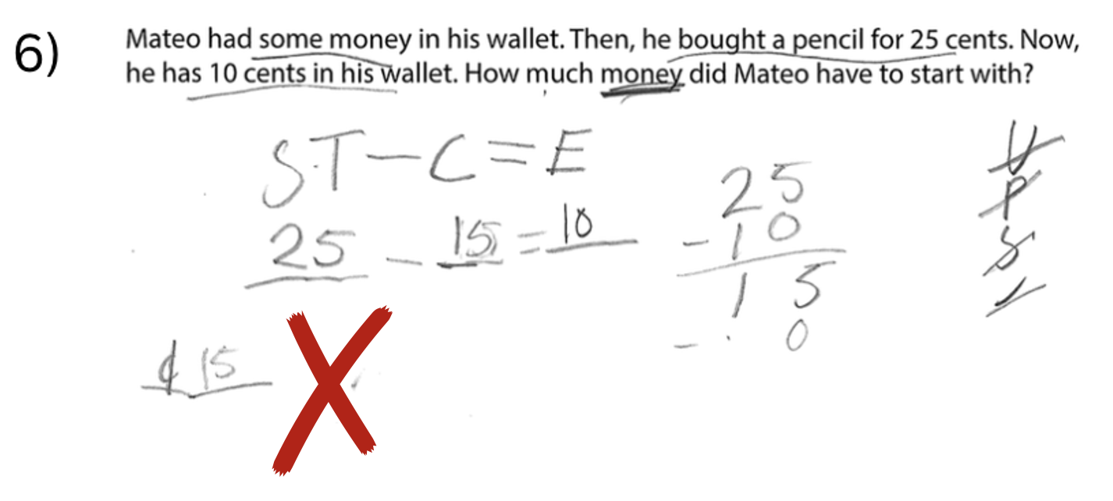
Case Study: A Grade 5 student is receiving an intervention focused on single-step word problems. 5
Word Problems
Schema: Change
Unknown: Start amount
Score
Identify errors
Plan instruction
Used an attack strategy
Identified the schema correctly
Placed the numbers in the equation incorrectly
Answer is not reasonable

Slide 40
Case Study: A Grade 5 student is receiving an intervention focused on single-step word problems. 6
Word Problems
Items solved correctly:
3 Total problems
1 with a missing total
2 with a missing part
Score
Identify errors
Plan instruction
Item solved incorrectly:
3 Change problems with a missing start amount

Slide 41
Case Study: A Grade 5 student is receiving an intervention focused on single-step word problems. 8
Word Problems
Potential strategies
Provide explicit instruction (modeling and guided practice) on solving Change problems with a missing start amount
Teach the student to consider the reasonableness of their answers, and reassess their equations when they’re not
Provide sufficient practice opportunities to support fluency
Score
Identify errors
Plan instruction
If Nina ate 15 chips, could there have only been 7 chips at first?
Could Mateo have bought a pencil for 25 cents if he only had 15 cents?

Slide 42
Summary
Error analysis is a process for analyzing student work to:
identify what types of errors a student is making and why
better align an intervention with the student’s needs
First, select student work to analyze
(at least 3–5 problems of the same domain; Brown & Skow, 2016).
Score items (for computation, use correct digits).
Identify errors.
      Slips – Careless errors, often a result of poor organization
      Bugs – A pattern of similar errors, indicative of a misconception or lack of procedural fluency
Plan targeted instruction to address errors and misconceptions.

Slide 43
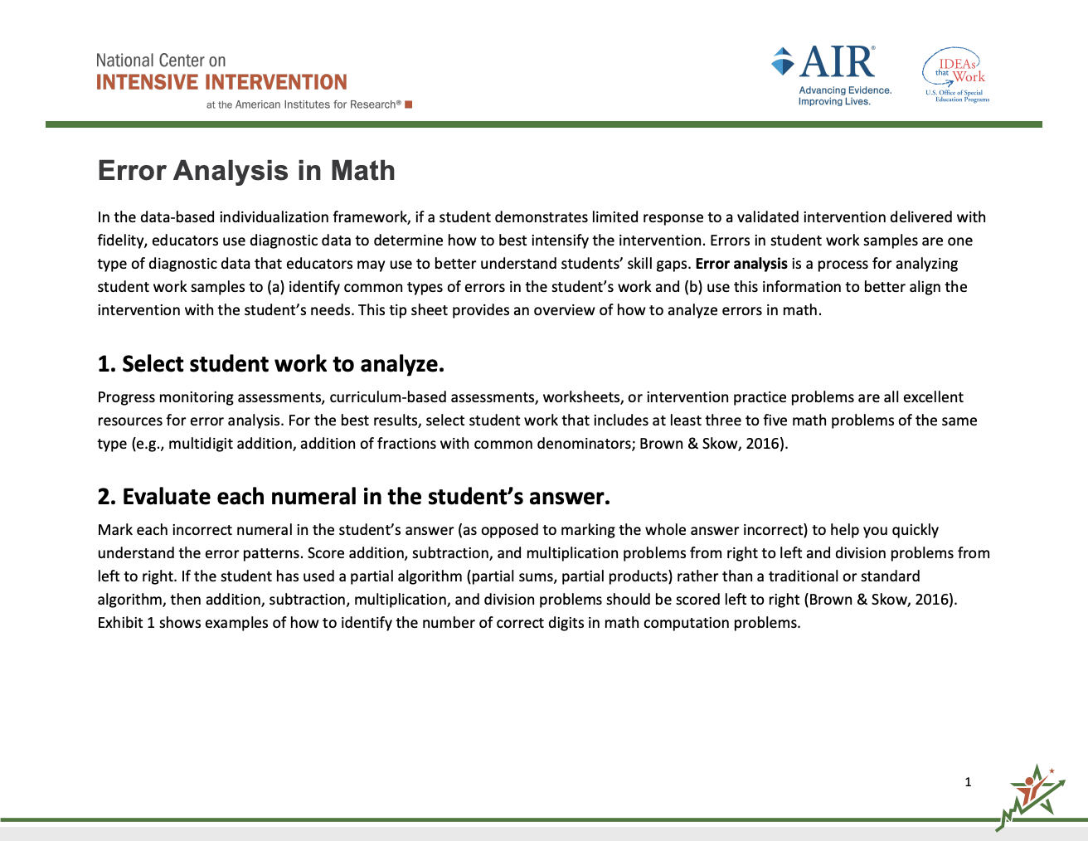
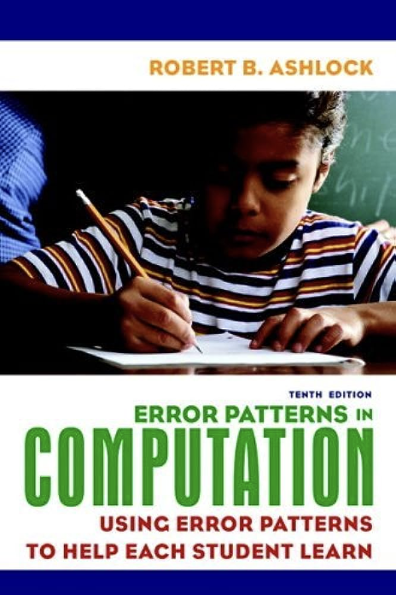
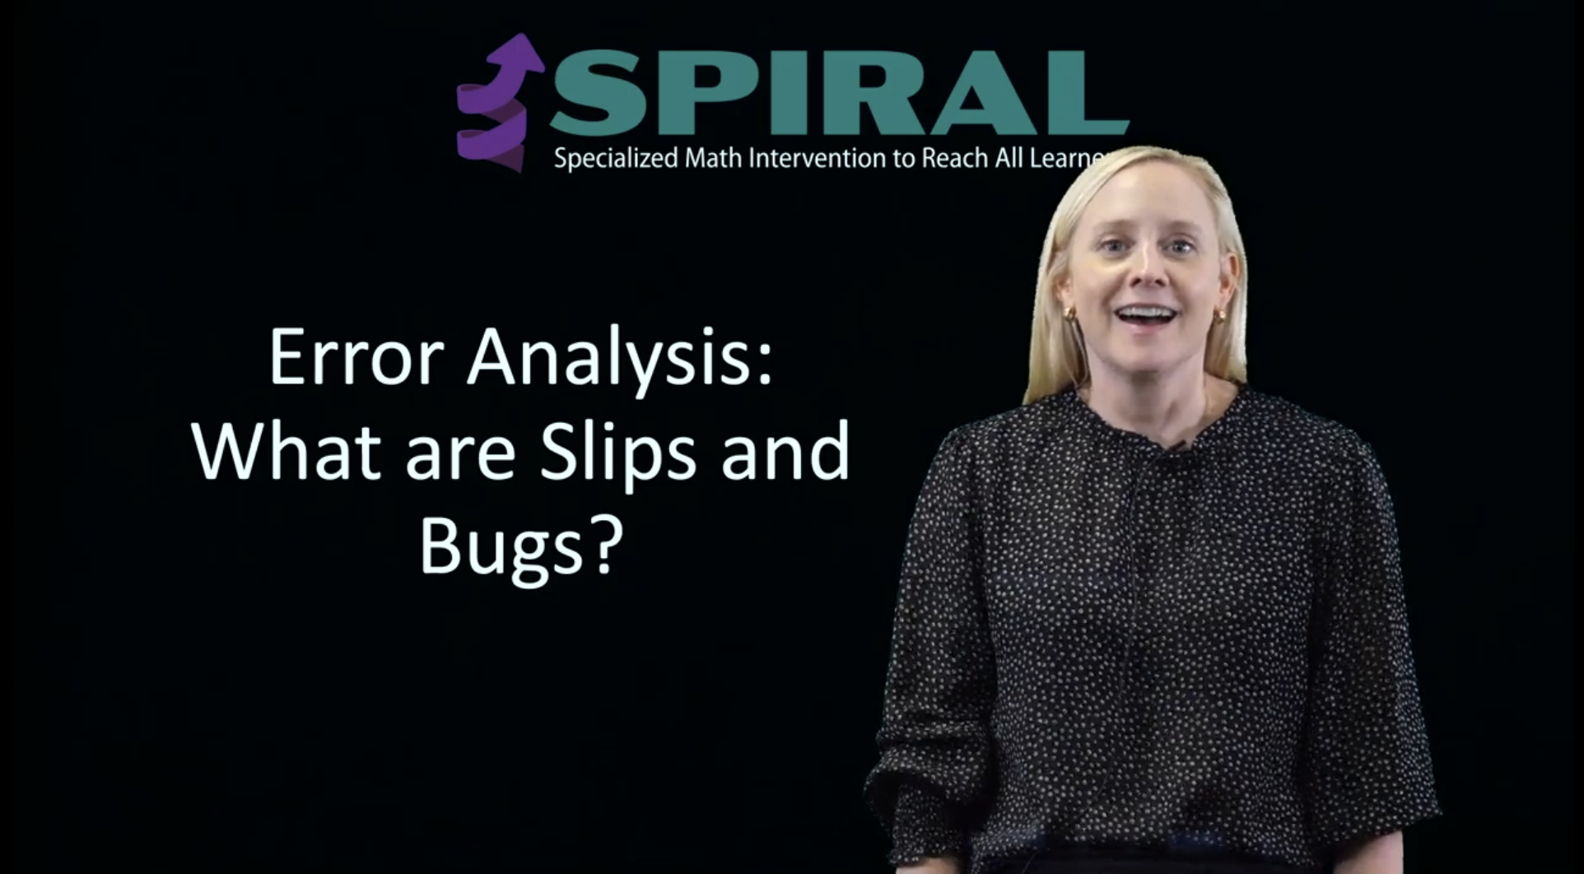
Continued Learning
NCII Error Analysis in Math Tip Sheet
https://intensiveintervention.org/sites/default/files/2025-10/math-error-analysis.pdf
Error Patterns in Computation:
Using Error Patterns to Help Each Student Learn
Robert B. Ashlock
Project SPIRAL Video:
What are Slips and Bugs?
Spiral Videos

Slide 44
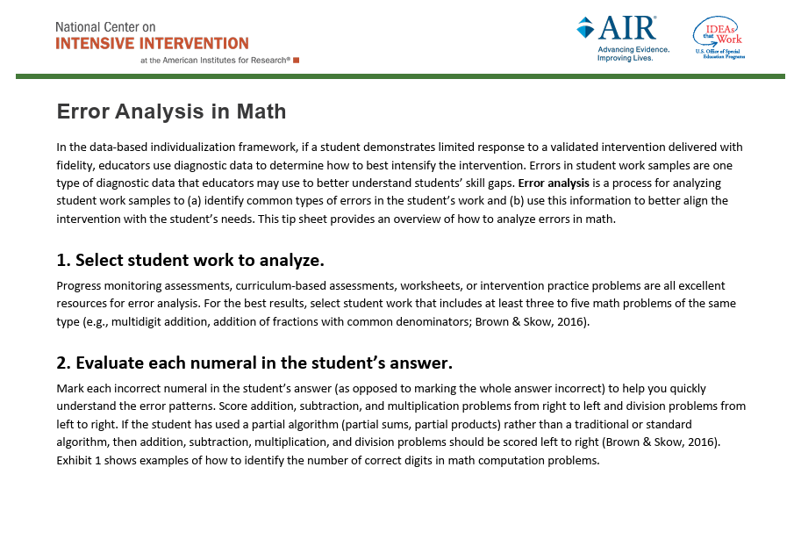
NCII Resource: Error Analysis
    The resource helps educators identify common types of errors in students’ math work and use this information to better align the intervention with the student’s needs.

Slide 45
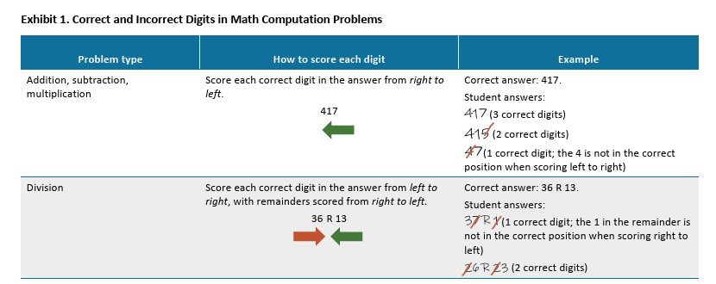
Demonstrates how to evaluate each numeral in the student’s answer

Slide 46
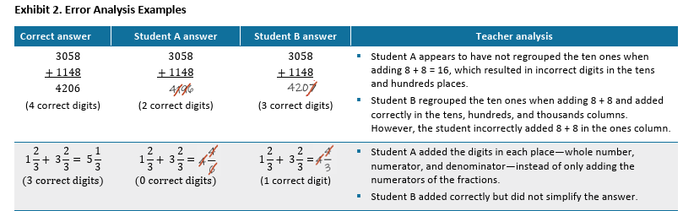
Provide examples of error analysis

Slide 47
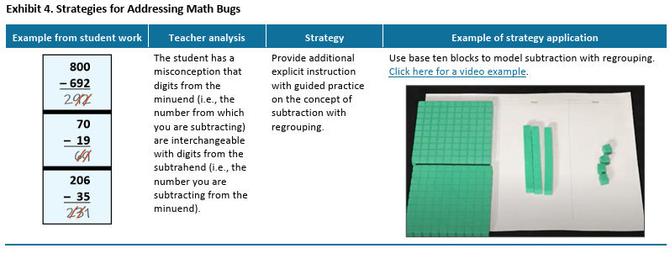
Provides example instructional strategies based on error patterns

Slide 48

Upcoming Error Analysis Webinar
Error Analysis in Writing with Dr. Katie Valentine (June 24, 3:00 ET)

Slide 49
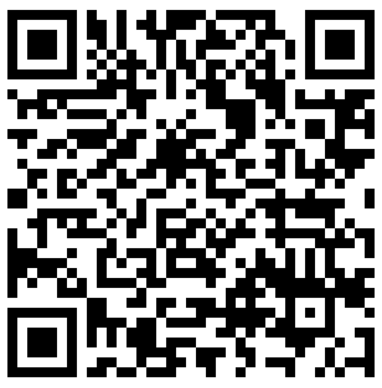
Event Survey
Please fill out this survey to help us improve future events!

Slide 50
NCII Disclaimer
This presentation was produced under the U.S. Department of Education, Office of Special Education Programs, Award No. H326Q160001. Celia Rosenquist serves as the project officer. The views expressed herein do not necessarily represent the positions or policies of the U.S. Department of Education. No official endorsement by the U.S. Department of Education of any product, commodity, service, or enterprise mentioned in this resource is intended or should be inferred.

