Slide 1

Good Vibrations: Leading the Wave of Change
Intensive Intervention Institute: Day 1

Slide 2

Introduction
Principal Investigator
Education Service Center Implementation Grant
Intensive TA Coordinator
National Center on Intensive Intervention
Senior Advisor
Texas Special Populations Diagnostic
State Liaison
National Center on Systemic Improvement
Sarah Benz, PhD
Principal Researcher
American Institutes for Research
Special Education Director and Special Education Teacher

Slide 3

FUN FACT
…and 12 other elementary schools!

Slide 4
Agenda
Time | Topic
10:45 a.m. – 11:30 a.m. | “I’m Picking Up Good Vibrations”: Welcome, Introductions, Overview
11:30 a.m. - 1:00 p.m. | Lunch
1:00 p.m. – 1:30 p.m. | “Wouldn’t It Be Nice”: Assessing your Capacity
1:30 p.m. – 2:40 p.m. | “I Get Around”: Digging Into the Components of Implementing DBI at the State
2:40 p.m. – 3:00 p.m. | Surf’s Up Dudes! (Break)
3:00 p.m. – 3:55 p.m. | Surfin’ U.S.A.: Learning About State Implementation Efforts
3:55 p.m. – 4:00 p.m. | Heading Back to the Shore: Previewing Day 2

Slide 5

Objectives
By the end of the institute, state participants will be able to:
  Identify and apply six critical factors that support sustainable implementation of DBI systems;
  Develop action items to help strengthen the state’s DBI implementation efforts; and
  Engage in cross-state networking and collaborative learning.

Slide 6

Materials
Handouts packet
Pack of Sticky Notes
Notecard

Slide 7

“I’m Picking Up Good Vibrations”
Name, state, and role
Something FUN you hope to do while in California!
This Photo by Unknown Author is licensed under CC BY-NC-ND

Slide 8

What is Data-Based Individualization (DBI)?
DBI Process
DBI is a research-based process for individualizing and intensifying interventions for students with severe and persistent learning and behavioral needs.
The process integrates evidence-based intervention, assessment, and research-based adaptation strategies.
Implementing DBI well requires certain essential components are put in place.

Slide 9
Essential Components of DBI
  Data and Decision Making
  Data for the purpose of making decisions within a DBI framework
  Intervention
  Individualized intervention with a focus on addressing severe and persistent academic and/or behavioral needs of students
  Iterative Process
  The process for designing and delivering intensive intervention in academics and/or behavior to students in need

Slide 10
Different Layers of Support
Students
DBI happens here
Teachers
School Leadership
Effectiveness of DBI depends on what happens here
District Leadership
Sets the enabling context and drivers for DBI
State Education Agency

Slide 11


“Wouldn’t It Be Nice” – THINK
State of your state: Where is your state/department currently in implementing DBI (e.g., just starting, have some components going, implementing but in small places, fully implemented and ready to scale)?
Why is it important for your state to implement DBI?
By the end of the institute, what do you hope to know, do, or lead more effectively?

Slide 12

“Wouldn’t It Be Nice” – PAIR
Where is your state/department currently in implementing DBI (e.g., exploration, initial implementation, scaling, or sustaining/refining)?
Why is it important for your state to implement DBI?
By the end of the institute, what do you hope to know, do, or lead more effectively?

Slide 13

“Wouldn’t It Be Nice”– WHOLE GROUP
Where is your state/department currently in implementing DBI (e.g., exploration, initial implementation, scaling, or sustaining/refining)?
  only one person needs to share from your state/department
Why is it important for your state to implement DBI?
By the end of the institute, what do you hope to know, do, or lead more effectively?

Slide 14

A Peek at our “Fun, Fun, Fun”
When we come back from lunch:
  Complete the DBI Capacity Assessment
  Go deeply into each of the sections and explore how to improve.
This Photo by Unknown Author is licensed under CC BY-SA

Slide 15

Lunch Break!
11:30 a.m. – 1:00 p.m.

Slide 16
“Wouldn’t It Be Nice”: Assessing your Capacity

Slide 17
SEA-Level Implementation:
Infrastructure
Alignment
  The contextual fit and overlap of DBI within the state education agency’s current initiatives and work.
Internal Capacity
  The ability of the agency to self-sufficiently scale up and support DBI.
Implementation
The active process of supporting local education agencies (LEAs) with accurate and consistent implementation of DBI to support students.

Slide 18
Sustainability Factors
Alignment
Key Personnel | Personnel involved with making decisions regarding DBI and implementation.
Fit | The extent to which DBI fits within existing initiatives and structures.
Knowledge | The current knowledge or understanding of DBI across the department, including expertise and experience with DBI.
Resource Allocation | The tangible resources to support DBI, including fiscal, material, and people.
Training, Coaching | The technical assistance delivery system to provide training and coaching to LEAs on implementation of DBI.
Data-Based Decision Making | Implementation requires the gathering of implementation/fidelity and impact/outcome data to fully evaluate training and coaching efforts.
Internal Capacity
Implementation

Slide 19
“I Get Around”: Digging Into the Components of Implementing DBI at the State - Alignment

Slide 20
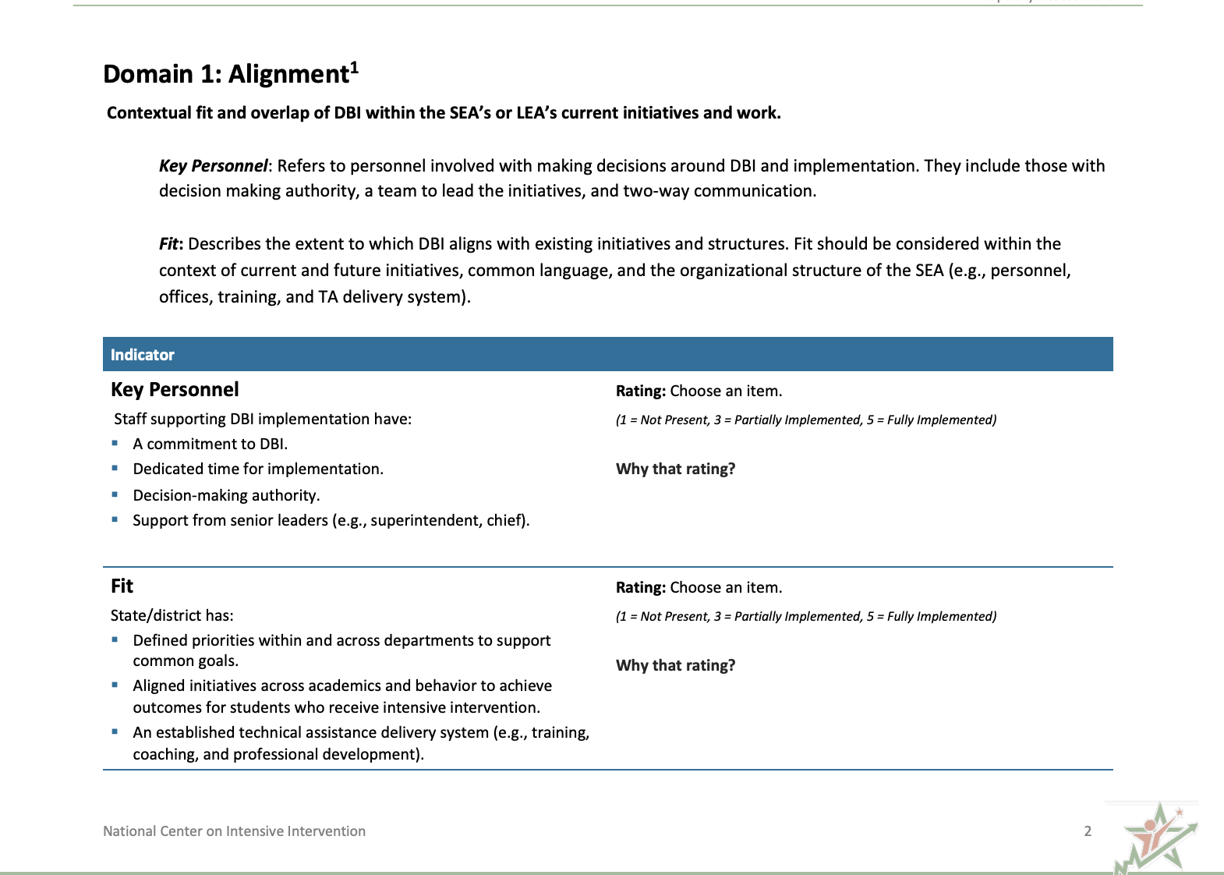
The DBI Capacity Assessment

Slide 21
Alignment
Alignment
  The contextual fit and overlap of DBI within the education agency’s current initiatives and work.

Slide 22
Why Is This Important?
Essential for creating a cohesive, efficient, and effective system
Ensures consistency in standards, resources, and practices
Promotes and encourages collaboration among stakeholders

Slide 23
Alignment 2
Alignment
  The contextual fit and overlap of DBI within the education agency’s current initiatives and work.
Key Personnel
Fit

Slide 24
Alignment 3
Alignment
  The contextual fit and overlap of DBI within the education agency’s current initiatives and work.
Key Personnel

Slide 25

Alignment: Key Personnel
Refers to personnel involved with making decisions around DBI and implementation.
This should include—
  Those with decision-making authority
  A team to lead the initiatives
  Two-way communication

Slide 26
Team-Based Leadership
A policy or program has been mandated or adopted, and, with minimal supports, practitioners are expected to translate information to practice. Practitioners are held accountable for intended outcomes.
Letting it happen
A policy or program has been mandated or adopted with materials, training resources, and websites to support practitioners. Practitioners are left to figure out how to solve problems while being held accountable for achieving positive outcomes.
Helping it happen
A policy or program has been mandated or adopted. Active and purposeful implementation best practices are used to support practitioners and administrators.
An Implementation Team is accountable for developing the implementation support systems, resolving organization and system issues, and achieving positive outcomes.
Making it happen
Resource: Implementation Teams Overview, National Implementation Research Network

Slide 27
Alignment 4
Alignment
  The contextual fit and overlap of DBI within the education agency’s current initiatives and work.
Fit

Slide 28

Alignment: Fit
How well does DBI align with existing initiatives and structures?
Consider:
  Current and future initiatives
  Common language
  Organizational structure of the SEA (e.g., personnel, offices, training, and TA delivery system)

Slide 29
Where Does DBI Fit in Your State Initiatives?
English Learners
Assessment
English Language Arts
DBI?
MTSS
Instructional Coaching
School Improvement
Special Education

Slide 30

Do You Need to De-implement Competing Initiatives or Practices?
De-implementation is “the discontinuation of interventions [or other practices] that should no longer be provided.” (McKay et al., 2018)
  Can DBI replace or refine an existing practice?
    Student Study Teams (SST)?
    Child Study Teams (CST)?
    Data Teams?

Slide 31

State Example of Alignment
Colorado’s story
  Internal capacity building
  External capacity building

Slide 32
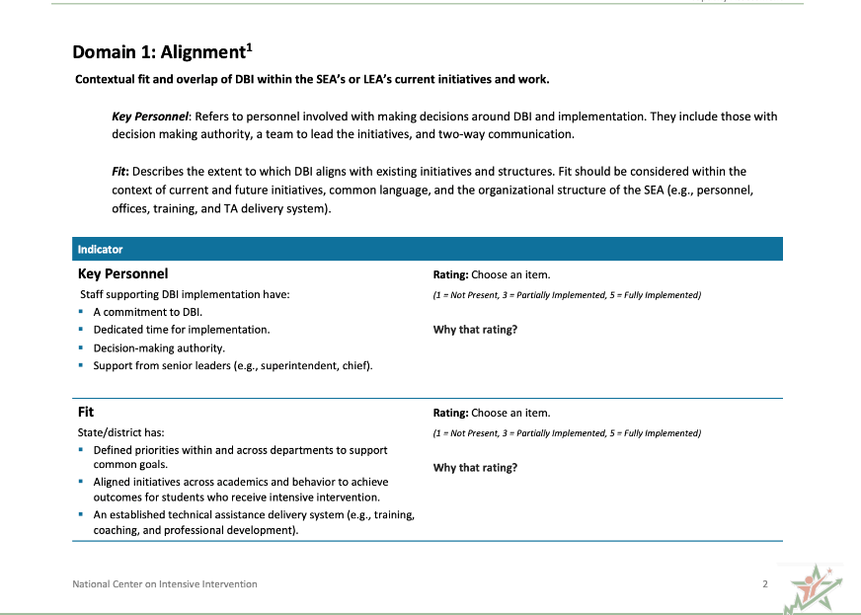
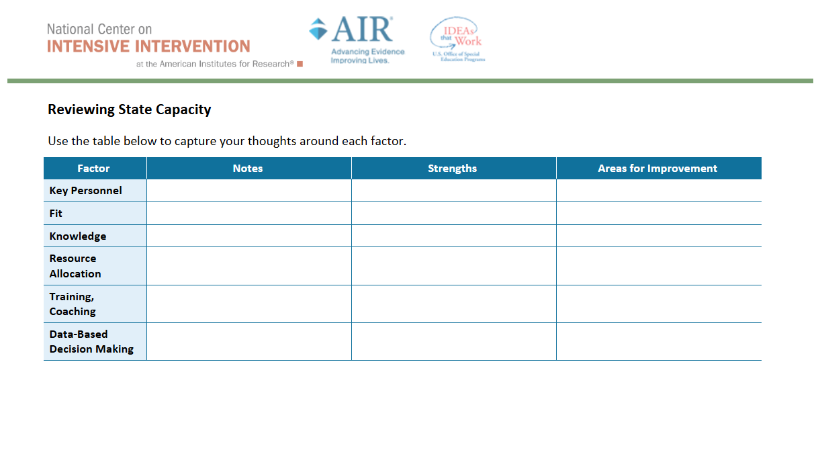
Action Plan: Reflect and Capture Notes
Fill out the ”Alignment” section of the DBI Capacity Rubric
Use this document to capture your notes and thinking

Slide 33
“I Get Around”: Digging Into the Components of Implementing DBI at the State - Internal Capacity

Slide 34
Internal Capacity
Internal Capacity
  The ability of the agency to self-sufficiently scale up and support DBI.

Slide 35
Internal Capacity 2
Internal Capacity
  The ability of the agency to self-sufficiently scale up and support DBI.
Knowledge
Resource Allocation

Slide 36
Internal Capacity 3
Internal Capacity
  The ability of the agency to self-sufficiently scale up and support DBI.
Knowledge

Slide 37

Knowledge
The current knowledge and understanding of DBI across the department,
including expertise and experience with DBI

Slide 38

Knowledge 2
Start With the Multi-Tiered System of Supports (MTSS) Team?
Start with building knowledge and understanding of DBI within the office where DBI will live

Slide 39
Internal Capacity: Knowledge
Foundational DBI knowledge among key staff
Specialized knowledge among some staff
(e.g., job-embedded coaching)
Implementation science knowledge

Slide 40
Internal Capacity 4
Internal Capacity
  The ability of the agency to self-sufficiently scale up and support DBI.
Resource Allocation

Slide 41
Internal Capacity: Resource Allocation
Refers to resources available to support DBI, including the following:
Money
Time
Materials
People

Slide 42

Resource Allocation 1
SEAs can examine funding streams to blend, braid, reallocate, and/or secure new resources for funding.

Slide 43
Resource Allocation 2
Training content
What is our capacity to provide virtual or in-person? Do we have personnel?

Slide 44
Resource Allocation 3
Who can train and/or coach LEAs?
Is there capacity to train school teams?

Slide 45
Why Is This Important? 2
Sustainability of implementation
Common language and messaging
Aligned practices

Slide 46

State Example of Building Knowledge

Slide 47
Action Plan: Reflect and Capture Notes 2
Fill out the “Internal Capacity” section of the DBI Capacity Rubric
Use this document to capture your notes and thinking

Slide 48
“I Get Around”: Digging Into the Components of Implementing DBI at the State - Implementation

Slide 49
Implementation
Implementation
The active process of supporting local education agencies (LEAs) with accurate and consistent implementation of DBI to support students.

Slide 50
Implementation Is Messy
What we want implementation to look like:
Our DBI Plan
DBI Implementation Reality
What implementation can often look like:
Our DBI Plan
DBI Implementation Reality

Slide 51
Implementation 2
Implementation
The active process of supporting local education agencies (LEAs) with accurate and consistent implementation of DBI to support students.
Training and Coaching
Data-Based Decision Making

Slide 52

Implementation: Training and Coaching
Develop a TA delivery system that includes—
Initial and ongoing training
  In person, virtual, synchronous, asynchronous
Opportunities to practice learned skills
Ongoing, job-embedded coaching
A plan for scaling up (e.g., pilot sites, cohorts, etc.)
Feedback data to drive future TA
Explicit guidance on how new information fits into existing practice
Honoring the unlearning process

Slide 53
Implementation 3
Implementation
The active process of supporting local education agencies (LEAs) with accurate and consistent implementation of DBI to support students.
Training and Coaching

Slide 54
Implementation 4
Implementation
The active process of supporting local education agencies (LEA) with accurate and consistent implementation of DBI to support students.
Data-Based Decision Making

Slide 55
Data-Driven Feedback Loops
“In short, if we want to make the education system better, we could try to concoct the perfect intervention—the new curriculum, the new model—and hope for the best. Or we could settle for a pretty good solution that’s equipped with so many built-in feedback loops that it can’t help but get better over time.”
Heath (2020)

Slide 56
Examine Fidelity and Outcomes Together
High fidelity
Result: System is not working
Next Step: Change your system
Result: System is working
Next Step: Continue to improve
Low student outcomes
High student outcomes
Result: Something is not working
Next Step: Improve fidelity
Result: Something is working
Next Step: ???
Low fidelity

Slide 57
Factors That Can Impact Implementation
Do staff know what and how to implement?
  If no, provide sufficient training and support.
Are staff able to implement?
  If no, provide resources (time, materials, staffing) and remove barriers.
Are staff motivated to implement?
  If no, revisit “the why” and try to better understand the adaptative challenges.

Slide 58
Why Is This Important? 3
Ensures high-quality implementation
Allows for continuous improvement
Maximizes student outcomes
Promotes accountability and transparency
Facilitates sustainability and scalability

Slide 59
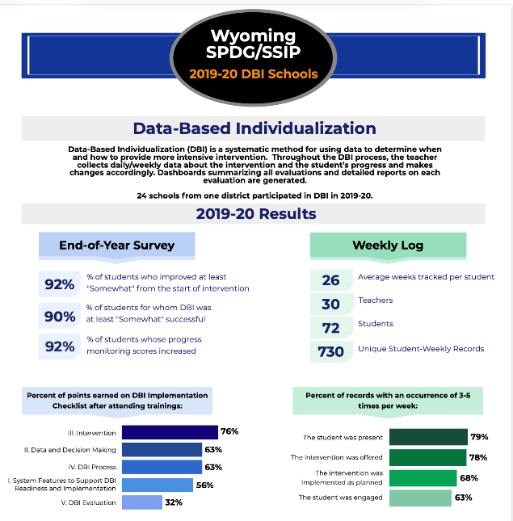

Wyoming State Level Example

Slide 60
Action Plan: Reflect and Capture Notes 3
Fill out the “Implementation” section of the DBI Capacity Rubric
Use the action plan document to capture your notes and thinking

Slide 61
Surfin’ U.S.A.: Learning About State Implementation Efforts

Slide 62

Fun – Tivity!
Station Rotations!
  Four groups
    Read each story (5 minutes)
    Use a sticky note to answer the following prompt:
      What implementation strength stands out?
        Put that sticky note under the component of DBI implementation that it most closely aligns with
    Rotate to the next state story! (REPEAT ☺)

Slide 63

Whole Group Debrief
Which implementation factors appeared across multiple states?
What lessons feel more urgent for your state?
Where do you see opportunities for adaptation?

Slide 64

What’s Coming Up for Tomorrow?
Tools Chart presentation and how SEAs are leveraging NCII’s tools charts.
Action Planning
Gallery Walk and Share Out
This Photo by Unknown Author is licensed under CC BY-NC-ND

Slide 65

Good Vibrations: Leading the Wave of Change 2
This Photo by Unknown Author is licensed under CC BY-SA
Intensive Intervention Institute: Day 2
65

Slide 66

Warm-Up Day 2
What did you do to unwind or relax last night?
This Photo by Unknown Author is licensed under CC BY-NC-ND

Slide 67
Agenda 2
Time | Topic
10:30 a.m. – 11:30 a.m. | Tools Chart Presentation
11:30 a.m. – 1:00 p.m. | Lunch
1:00 p.m. – 1:30 p.m. | “Help Me Rhonda”: Action Planning
1:30 p.m. – 2:45 p.m. | “Way Down in Kokomo”: Gallery Walk and Share Out
2:45 p.m. – 3:00 p.m. | Feeling Stoked! Wrap Up and Next Steps

Slide 68
Tools Chart

Slide 69

Lunch!
This Photo by Unknown Author is licensed under CC BY-NC-ND
11:30 a.m. – 1:00 p.m

Slide 70
“Help Me Rhonda”: Action Planning

Slide 71
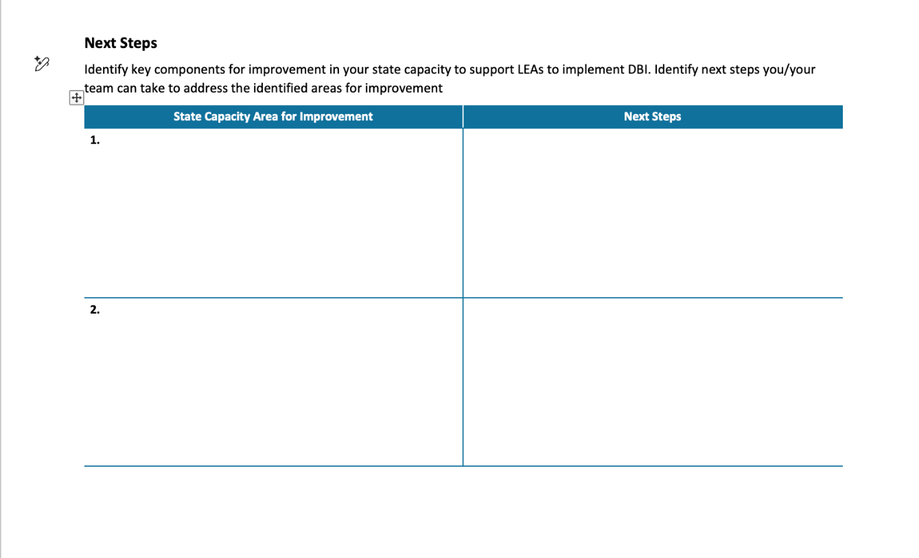
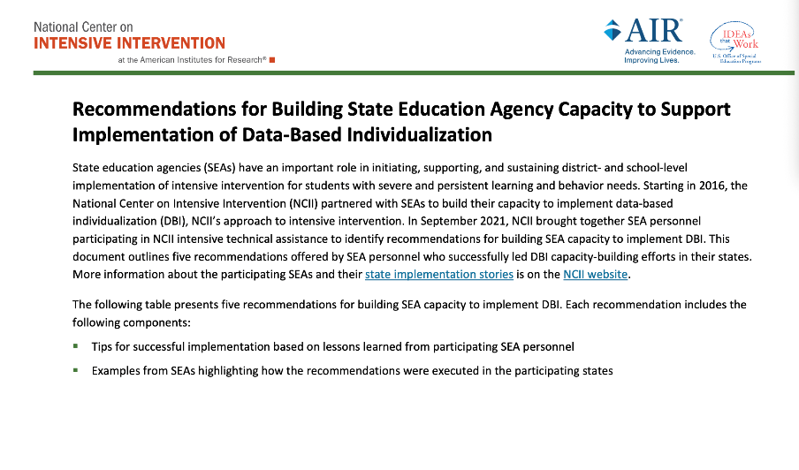
Let’s (start to) Put Plans Into ACTION
Given all of the TUBULAR information that you’ve learned across the two days, spend some time thinking/planning your next steps.

Slide 72
“Way Down in Kokomo”: Gallery Walk
A Peer Evaluation Activity

Slide 73

Creating the Gallery
Each SEA grab a sticky poster paper
Write the following (see example):
  Your state
  1 bright spot
  1 major challenge
  1 priority next step
This Photo by Unknown Author is licensed under CC BY-SA

Slide 74

Gallery Walk Time
Grab a pack of sticky notes
  Comment one or more of the following for each poster:
    What resonates with you?
    What ideas or questions are emerging?

Slide 75

Whole Group Debrief 2
Each SEA to present their poster
  Clarify any questions that were posed
  What themes are coming up

Slide 76
Revisit Your Notecard – Self Check
By the end of the institute, what do you hope to know, do, or lead more effectively?
  Did you accomplish this? If not, what more do you need to do to feel ready?

Slide 77
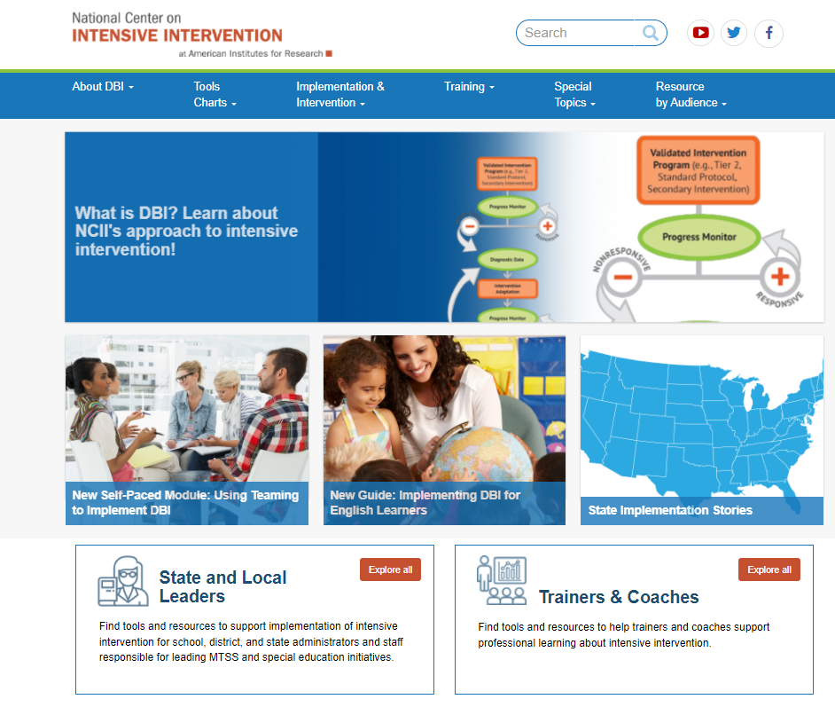
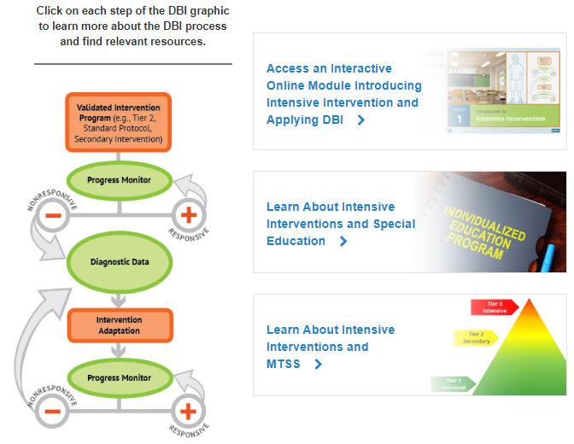
Explore the many resources available on NCII’s Website

Slide 78
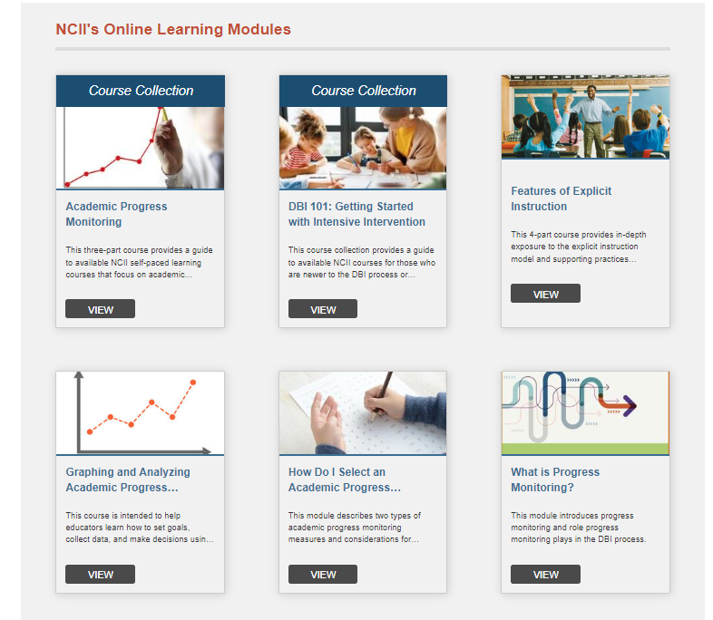
How can you learn more? Self-Directed Learning Opportunities
Self-paced online courses focused on
  Introduction to Intensive Intervention
  Progress Monitoring
  Taxonomy of Intervention Intensity
  Teaming
  Explicit Instruction
  Intensive Intervention in Mathematics

Slide 79
How can you learn more?
Targeted TA
  Short term request or presentations
Reach out to us – we cannot support every request but want to hear what you're doing and how we can help!

Slide 80
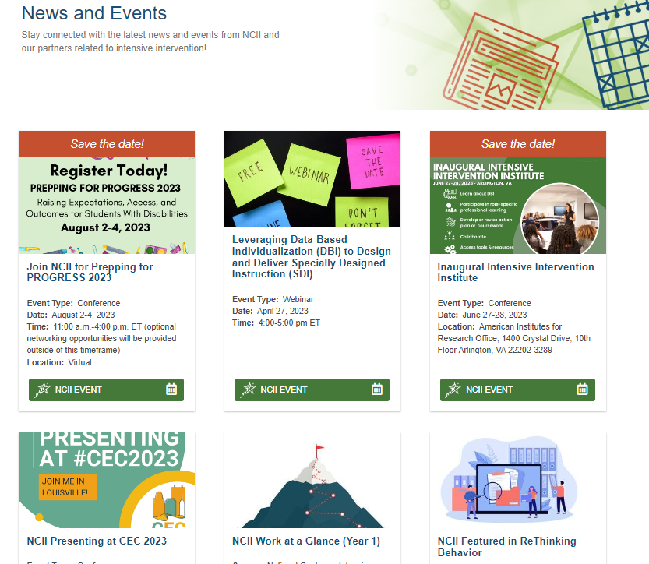


How can you stay connected?
https://www.linkedin.com/in/national-center-on-intensive-intervention
https://www.facebook.com/TheNCII/
https://twitter.com/TheNCII
Sign-up on the bottom of each page of the NCII website)

Slide 81


Let Us Know What You Thought
Interested in a certificate of attendance? Please indicate this in your survey. We will gather this information from our evaluators and send certificates to everyone who requests one.
https://meadowscenter.ca1.qualtrics.com/jfe/form/SV_6L0XMY8SSeuIGjA

Slide 82
NCII Disclaimer
This presentation was produced under the U.S. Department of Education, Office of Special Education Programs, Award No. H326Q260001. Celia Rosenquist serves as the project officer. The views expressed herein do not necessarily represent the positions or policies of the U.S. Department of Education. No official endorsement by the U.S. Department of Education of any product, commodity, service, or enterprise mentioned in this resource is intended or should be inferred.

Slide 83

Contact NCII

