Slide 1

Building Capacity at the Local Level: Day 1
June 16-17, 2026
2026 Intensive Intervention Institute
Jon Potter, Technical Assistance Provider
Jason Harlacher, Technical Assistance Provider

Slide 2


Welcome and Introductions
Jon Potter
Technical Assistance Provider
Jason Harlacher
Technical Assistance Provider

Slide 3




Welcome and Introductions 2
Please share:
Your name, organization, and role.
Which picture best describes DBI implementation in your district (or district you work with)?
What are you hoping to get out of the next two days?
1 – Yay!
2 – Ok
3 – Umm
4 – Oof
Images generated with Azure Open AI ImageGen

Slide 4
Meeting Guidelines
Access materials using the QR code
Take care of needs.
Call back routine.
Stay engaged and participate in talk times.
Take notes when needed.

Slide 5
What to Expect
Some information will be new
Some information will be review
Some information may challenge you
Some next steps that you (and your team) will want to do

Slide 6
Objectives/Agenda (2026)
Session | Objective
Day 1 – 10:45-11:30 | Welcome and Introductions. Discuss technical problems and adaptive challenges.
Day 1 – Afternoon 1:00 – 4:00 | Identify strengths and areas for improvement for DBI infrastructure and processes. Examine the NCII Tools Charts
Day 2 – Morning 10:30 – 11:30 | Debrief Day 1 Introduce district-level factors that promote sustainable DBI implementation.
Day 2 – Afternoon 1:00 – 3:00 | Examine district-level factors that promote sustainable DBI implementation. Develop or revise a plan for next steps.

Slide 7
Different Layers of Support
Students
DBI happens here
Teachers
School Leadership
Effectiveness of DBI depends on what happens here
District Leadership

Slide 8
Technical Problems and Adaptive Challenges

Slide 9

Activity 1: Connect the Dots
Connect all nine dots using four straight lines.
Do not lift your pencil from the paper once you start.
Do not retrace any lines.

Slide 10

Consider the Following
Your current system is working the way that it is designed to work.

Slide 11

Consider the Following 2
Your current system is working the way that it is designed to work.
Getting different results requires changes in your system.

Slide 12

Consider the Following 3
Your current system is working the way that it is designed to work.
Getting different results requires changes in your system.
Systems change is incremental, and the product of repeated and distributed changes in peoples’ beliefs, attitudes, priorities, and habits.

Slide 13

Consider the Following 4
Your current system is working the way that it is designed to work.
Getting different results requires changes in your system.
Systems change is incremental, and the product of repeated and distributed changes in peoples’ beliefs, attitudes, priorities, and habits.
People don’t resist change. They resist loss.

Slide 14

Consider the Following 5
Your current system is working the way that it is designed to work.
Getting different results requires changes in your system.
Systems change is incremental, and the product of repeated and distributed changes in peoples’ beliefs, attitudes, priorities, and habits.
People don’t resist change. They resist loss.
How can you make change easier and reduce feelings of loss?

Slide 15

DBI Implementation
Issues with implementation and systems change can be related to technical problems and adaptive challenges
Buying the tools and teaching people the skills and knowledge for DBI can be straight-forward, but the application and navigation of barriers requires adaptive solutions.

Slide 16


Technical Problems
The problem exists because of a lack of technology, knowledge, or practice. The solution is clear, easy to identify, and resolved with authoritative expertise.
The solution is out there.
Taking a medication to lower blood pressure
Buying an intervention program to address a need
Photo by danilo.alvesd on Unsplash

Slide 17


Adaptive Challenges
The problem exists because of a lack of application and context. The solution is hard to identify and requires creativity, flexibility, and changes in systems or thinking about the current context.
The solution is in here.
Changing lifestyle to reduce blood pressure
Adjusting schedule or roles to implement an intervention
Photo by VD Photography on Unsplash; Photo by Jo Szczepanska on Unsplash

Slide 18

Technical Problems and Adaptive Challenges 2
Most technical problems include adaptive challenges.
“The most common leadership failure stems from trying to apply technical solutions to adaptive challenges.”
—Ron Heifetz

Slide 19
Implementation Problem Example
DBI Implementation Problem:
Inconsistent identification of students who need DBI
Technical Problems Solutions are known and can be resolved through authoritative expertise. | Adaptive Challenges Solutions are unknown, and require reflection, learning, and time.
Clear decision rules (a flowchart!)
Letting go of teacher referral process
Get some new assessments
Teachers don’t trust the data
Train staff
Unconscious biases leading to over-referral of some student groups

Slide 20

Discussion
What are some barriers your site experiences with implementing DBI?
Are your barriers more technical problems, adaptive challenges, or a bit of both?
Technical Problems:
Resolved with increase in
knowledge or buying a new product.
Problem is out there.
Adaptive Challenges:
Resolved with changes in systems or beliefs. Requires creativity and flexibility.
Problem is in here.

Slide 21
General Theme for Adaptive Solutions
Leadership should anchor people to what is staying the same and what needs to change.

Slide 22
Considerations for Adaptive Solutions
Take a view from the balcony.

Slide 23
Considerations for Adaptive Solutions 2
Take a view from the balcony.
Build bridges.

Slide 24
Considerations for Adaptive Solutions 3
Tolerance for change is too much
Take a view from the balcony.
Build bridges.
Find the sweet spot.
Zone of
Productive Change
No learning occurs

Slide 25
Considerations for Adaptive Solutions 4
Take a view from the balcony.
Build bridges.
Find the sweet spot.
Make continuous learning and reflection the norm.

Slide 26
Activity 2. Finding Adaptive Solutions
If DBI implementation goes well and is a great success, whose thinking and behavior would have to change?
Which of these strategies is most needed in your site to support the change?
Take a view from the balcony.
Build bridges.
Find the sweet spot.
Make continuous learning and reflection the norm.

Slide 27
Leadership
“ People inevitably expect you to treat adaptive challenges as if they were technical—to provide a remedy that will restore equilibrium with the least amount of pain and in the shortest amount of time.
That puts an enormous amount of pressure to have an ‘answer,’ rather than raise (and sit with) the . . . tough questions.”
—Ron Heifetz

Slide 28
DBI Infrastructure and Processes
Key Components of School Implementation

Slide 29
What is Data-Based Individualization (DBI)?
DBI Process
DBI is a research-based process for individualizing and intensifying interventions for students with severe and persistent learning and behavioral needs.
The process integrates evidence-based intervention, assessment, and research-based adaptation strategies.
Implementing DBI well requires certain essential components are put in place.

Slide 30
Essential Components of DBI
  Data and Decision Making
  Data for the purpose of making decisions within a DBI framework
  Intervention
  Individualized intervention with a focus on addressing severe and persistent academic and/or behavioral needs of students
  DBI Process
  The process for designing and delivering intensive intervention in academics and/or behavior to students in need

Slide 31

Data and Decision Making
Process to identify students in need of intensive intervention
  Moving away from teacher referral towards a data-based system that identifies students who:
    are non-responsive to Tier 2 interventions,
    have persistent or intensive needs, or
    have a relevant diagnosis or disability that requires intensive intervention.

Slide 32

Data and Decision Making 2
Process to identify students in need of intensive intervention
Academic and behavior progress monitoring tools
Progress monitoring procedures

Slide 33
Graphing Data Is Essential
Date | Sep 13 | Sep 20 | Sep 27 | Oct 7 | Oct 13 | Oct 20 | May 28 (GOAL)
Oral Reading Fluency Words Correct per Minute | 32 | 37 | 41 | 46 | 43 | 45 | 87
Aimline
Words Correct per Minute
Goal
Data
Date
33

Slide 34

Data and Decision Making 3
Process to identify students in need of intensive intervention
Academic and behavior progress monitoring tools
Progress monitoring procedures
Diagnostic assessment

Slide 35
DBI Process
DBI Process
Validated intervention program, delivered
with fidelity
Progress monitoring
Diagnostic data used to develop a hypothesis
Adaptation to validated intervention
Continued progress monitoring, with adaptations occurring whenever needed to ensure adequate progress

Slide 36

Diagnostic Data: The DBI “Bridge”
“We implemented an intervention to support the student, but our plan isn’t working.”
“Here’s a new plan that will provide better support for the student.”
“Why is our plan not working?”
Step 1:
Validated Intervention Program
Step 4:
Intervention Adaptation
Step 3: Diagnostic Data
Step 2: Progress Monitoring
Step 5: Progress Monitoring

Slide 37

Why Do Students Experience Challenges?

Slide 38
Educationally Relevant and Alterable Variables
Do you collect and use diagnostic data that examines the learner and the learning context?
Scope and sequence
Level of difficulty
Match to learner need
High-quality materials
Curriculum
Clear expectations
Positive reinforcement
Positive interactions
Positive feedback
Explicit instruction
Pacing (opportunities to respond)
Corrective feedback
Engagement strategies
Learner
Instruction
Environment

Slide 39

Data and Decision Making 4
Process to identify students in need of intensive intervention
Academic and behavior progress monitoring tools
Progress monitoring procedures
Diagnostic assessment
Fidelity of assessment implementation

Slide 40
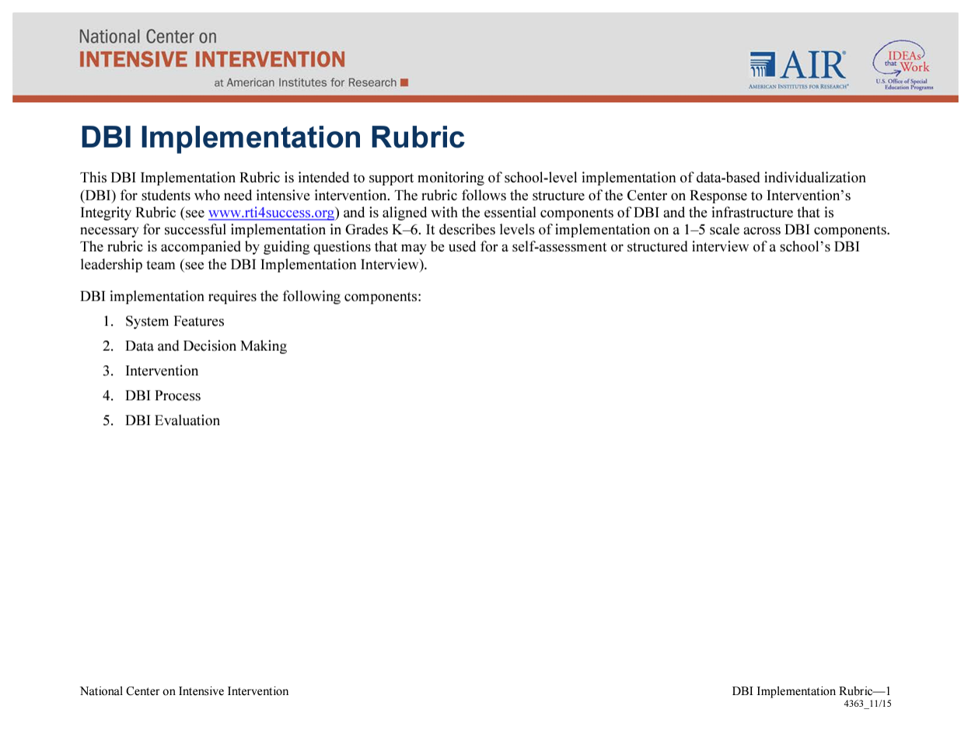
Activity: Rate Your Data and Decision Making Systems
Review the Data and Decision Making section of the DBI Implementation Rubric and highlight the ratings that currently best describe your district:
  Process to identify students in need of intensive intervention
  Academic progress monitoring tools
  Behavior progress monitoring tools
  Progress monitoring procedures
  Diagnostic assessment
  Fidelity of assessment implementation
Source: DBI Implementation Rubric

Slide 41
Essential Components of DBI: Intervention
  Intervention
  Individualized intervention with a focus on addressing severe and persistent academic and/or behavioral needs of students

Slide 42

Intervention
Intensive intervention
  Designed from an evidence-based platform (when available).
  Reasonably aligned to student needs.
  Intensified appropriately (more intensive than Tier 2).

Slide 43

Tier 2 (Standardized) vs. Tier 3 (Individualized)
Photo by Ava Tyler on Unsplash

Slide 44
Intervention 2
Intensive intervention
Adaptation of intervention
Increase alignment to student need.
Increase explicitness of instruction.
Increase dosage (e.g., OTRs).
Increase support for transfer across settings.
Increase behavior supports.

Slide 45

Intervention 3
Intensive intervention
Adaptation of intervention
Fidelity of implementation of intervention

Slide 46
Fidelity of Implementation of Intervention
Did we deliver the intervention?
Did the student receive the intervention?
  Are we providing the program as designed, with sufficient time, in a high-quality way?
  Did the student attend the intervention?
Observation
checklists
Self-report
checklists
Review permanent products
Student attendance logs
Ways to assess fidelity:
Resource: Considerations for Effective Implementation: 5 Elements of Fidelity

Slide 47

Intervention 4
Intensive intervention
Adaptation of intervention
Fidelity of implementation of intervention
Interventionist characteristics

Slide 48

Intervention 5
Intensive intervention
Adaptation of intervention
Fidelity of implementation of intervention
Interventionist characteristics
Relationship to core instruction

Slide 49
Activity: Rate Your Intervention Systems
Review the Intervention section of the DBI Implementation Rubric and highlight the ratings that currently best describe your district:
  Intensive intervention
  Adaptation of intervention
  Fidelity of implementation of intervention
  Interventionist characteristics
  Relationship to core instruction
Source: DBI Implementation Rubric

Slide 50
Essential Components of DBI: DBI Process
  DBI Process
  The process for designing and delivering intensive intervention in academics and/or behavior to students in need

Slide 51

DBI Process 2
Team or appropriate support mechanism
Regular meetings

Slide 52

DBI Process 3
Team or appropriate support mechanism
Regular meetings
Data review

Slide 53
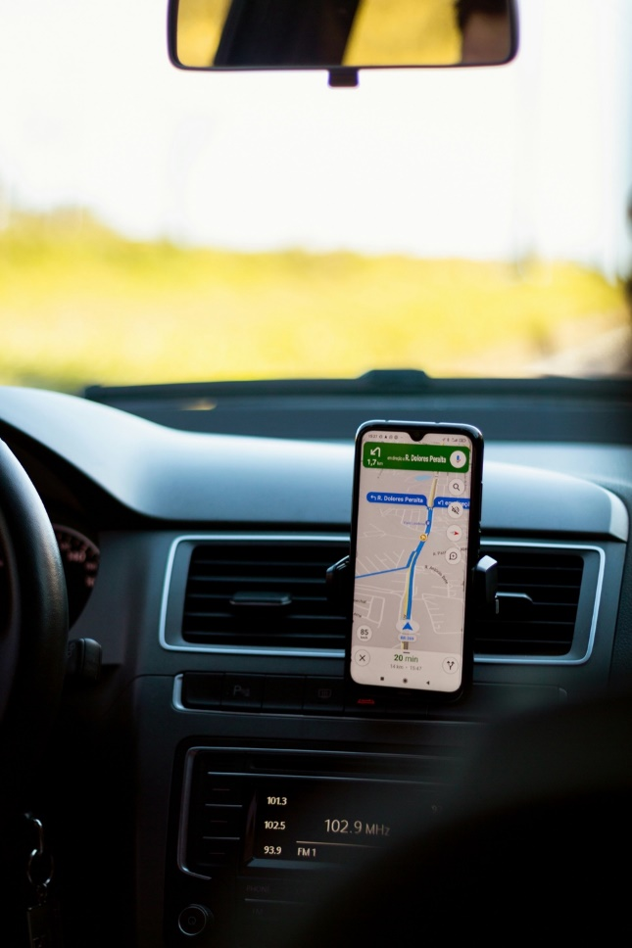


Data-Based Decision Making Is Everywhere
Navigation
Selecting an outfit for the day
Selecting a place to eat, stay, or do business with

Slide 54

DBI Process 4
Team or appropriate support mechanism
Regular meetings
Data review
Documentation

Slide 55

DBI Process 5
Team or appropriate support mechanism
Regular meetings
Data review
Documentation
Decision rules

Slide 56
Why Use Data and Decision Rules?
Using data, along with decision rules, can help to mitigate bias and reduce cognitive errors in our decision making.
Example
Favoring instructional practices that align with your educational philosophy and avoiding practices that do not.
Confirmation Bias
Making decisions that only confirm your pre-existing beliefs and attitudes.
Believing a student is having academic difficulty due to internal factors, instead of a lack of sufficient instruction.
Fundamental Attribution Error
Mistakenly attributing another’s actions to their inherent traits instead of the context and situation.

Slide 57
Which Line is Longer?
Intuitions can be deceiving
Which line looks longer?

Slide 58

Data and Decision Rules
Provide an “if-then” guide to help decision making.
Increase efficiency by doing some of the thinking before it is needed.
Provide clarity and consistency for staff, students, and families (when documented and clearly communicated).

Slide 59
Decision Rules for Analyzing Progress Monitoring Data
https://intensiveintervention.org/resource/decision-rules-academic-progress-monitoring-data

Slide 60

DBI Process 6
Team or appropriate support mechanism
Regular meetings
Data review
Documentation
Decision rules
Overall implementation of DBI process

Slide 61
Activity: Rate Your DBI Process
Review the DBI Process section of the DBI Implementation Rubric and highlight the ratings that currently best describe your district:
  Team or appropriate support mechanism
  Regular meetings
  Data review
  Documentation
  Decision rules
  Overall implementation of DBI process
Source: DBI Implementation Rubric

Slide 62

Activity 6: Reviewing
DBI Infrastructure and Processes
Review your ratings for (1) Data and Decision Making, (2) Intervention, and (3) DBI Process.
Using the note taking handout, identify:
  1–2 areas of strength
  1–2 areas for improvement
Be prepared to share out.

Slide 63

Breaktime!
Images generated with Azure Open AI ImageGen

Slide 64

Understanding the NCII Tools Chart
June 2026
Communicating About and Using the Tools Chart
Caitlyn Majeika | Aleksis Kincaid

Slide 65


Introductions
Caitlyn Majeika, PhD, BCBA
Research Translation and Capacity-building Specialist
Aleksis Kincaid, PhD
Knowledge Development Task Lead

Slide 66
Goal of Today’s Session
Improve knowledge of and ability to communicate about NCII’s suite of tools charts.

Slide 67
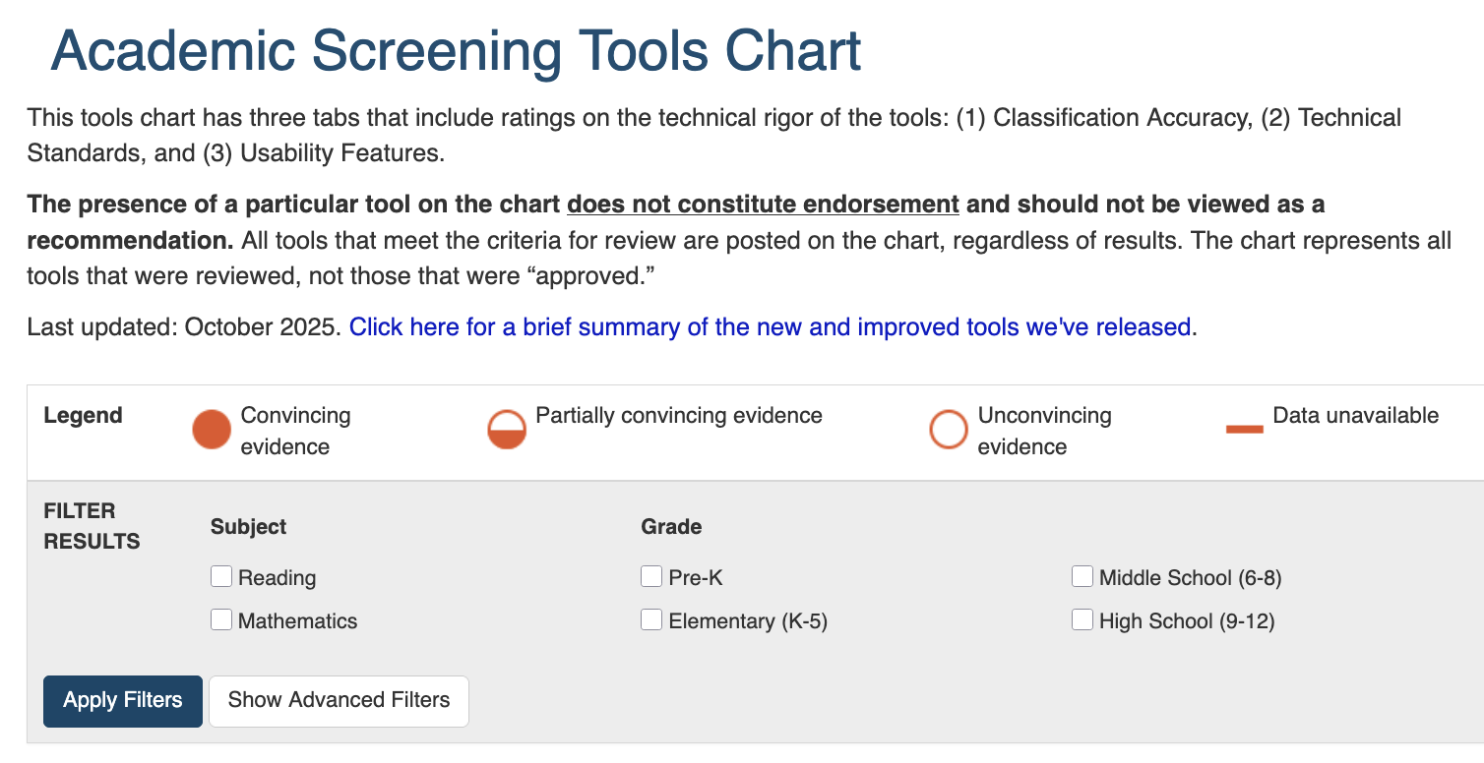
Purpose of NCII Tools Charts
NCII’s tools charts assist educators and families in becoming informed consumers who can select academic and behavioral assessment tools and interventions that meet standards for technical rigor and address their specific needs.

Slide 68
Tools Chart Fact and Fiction
A tools chart:
A tools chart does not:
Helps educators ask stronger questions about evidence
Tell districts what they “must” buy
Makes technical evidence more accessible
Replace professional judgment
Creates a common review standard across tools
Capture every contextual factor that matters
Tools chart is a flashlight, not a GPS

Slide 69



Tools Charts & Consumer Reports Comparison
Can you think of other metaphors for describing the tools charts?

Slide 70
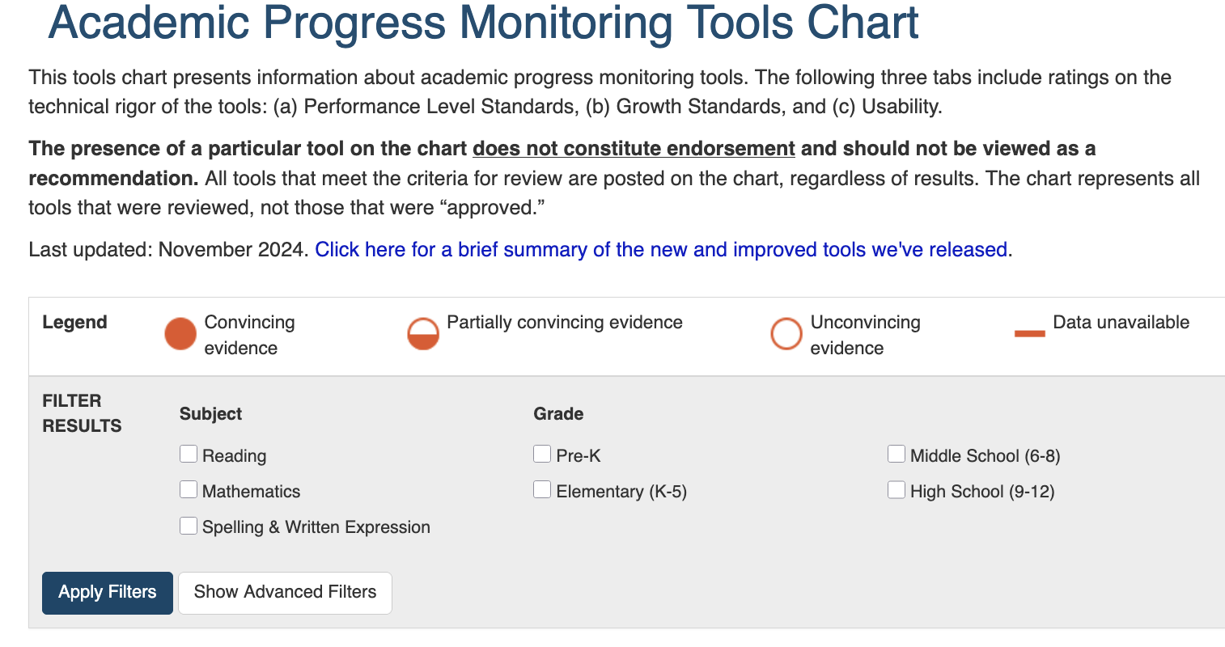
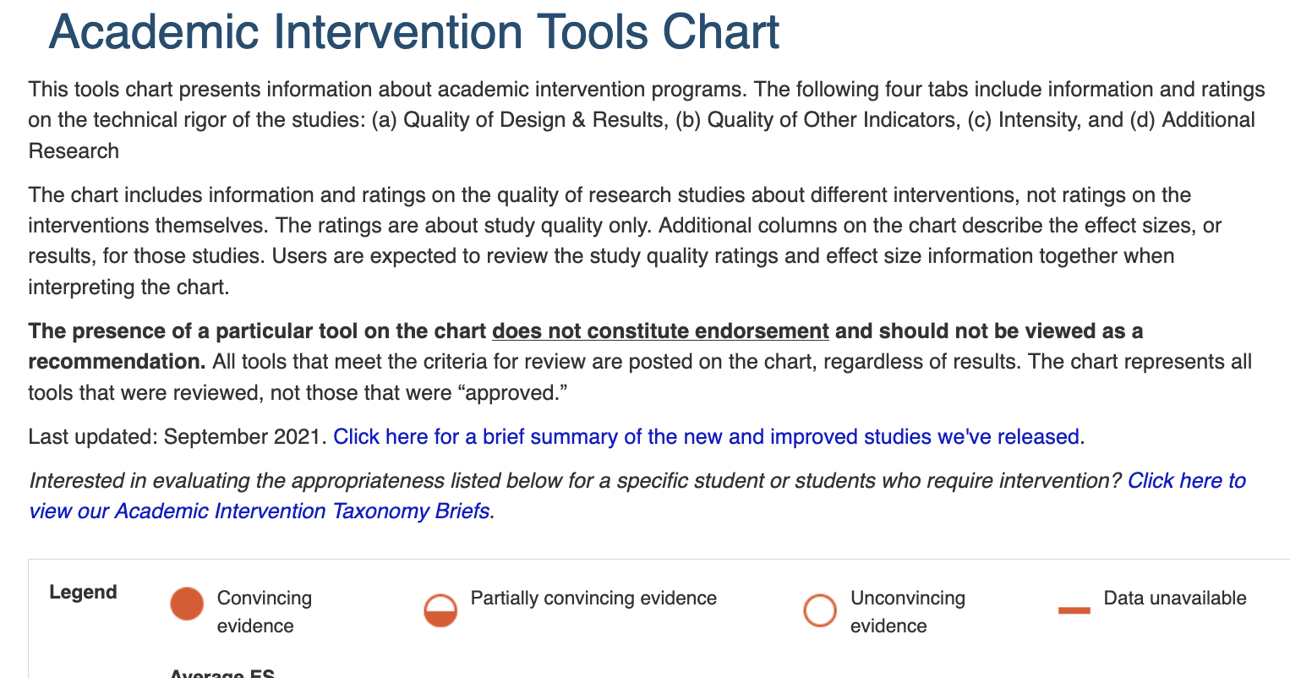
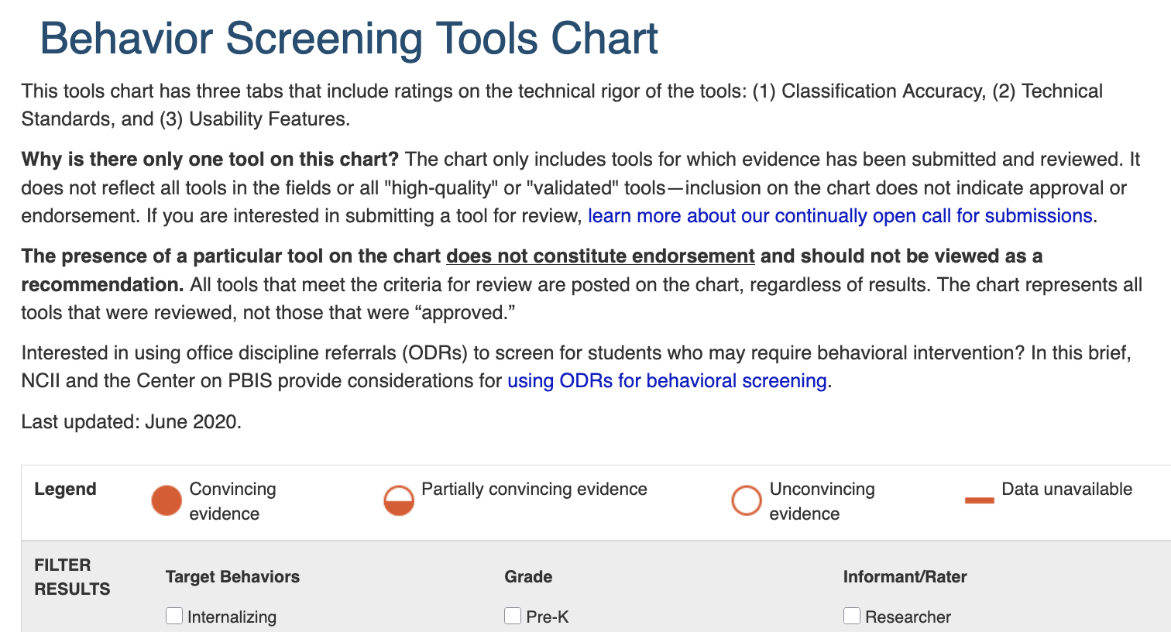
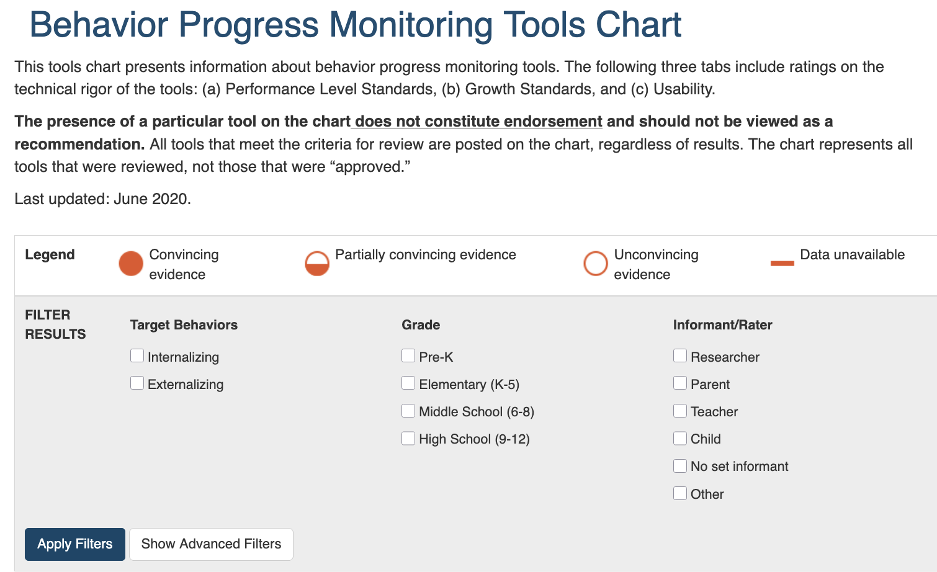
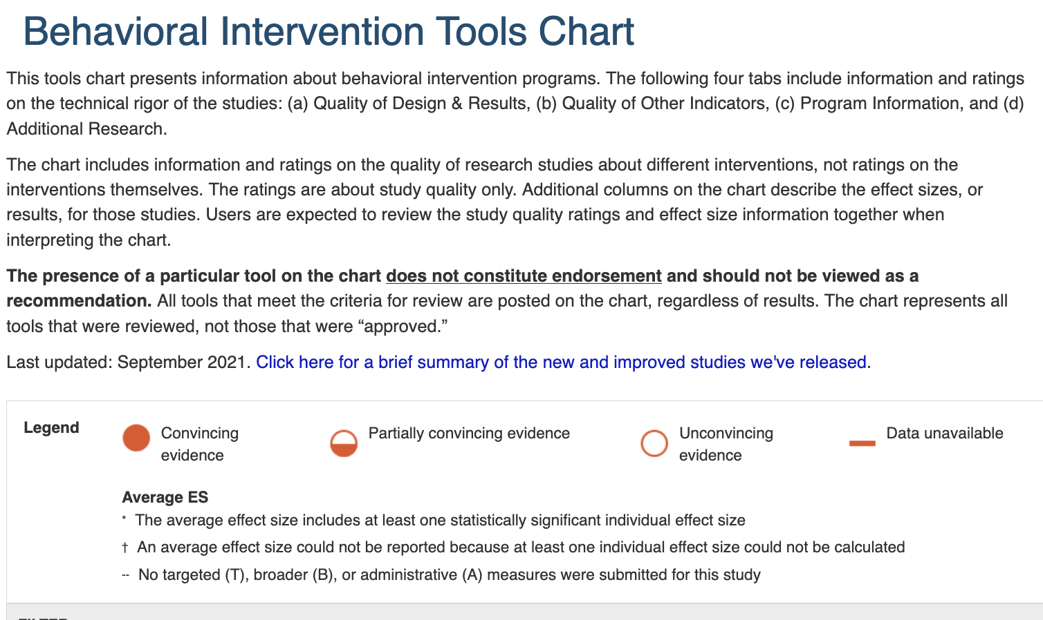
Suite of Tools Charts
Academic Screening
Academic Progress Monitoring
Academic Intervention
Behavior Screening
Behavior Progress Monitoring
Behavior Intervention

Slide 71
Turn & Talk
With a partner, discuss the following:
    You are chatting with fellow school and district leaders. How would you describe the purpose of the tools chart in a conversational manner?

Slide 72
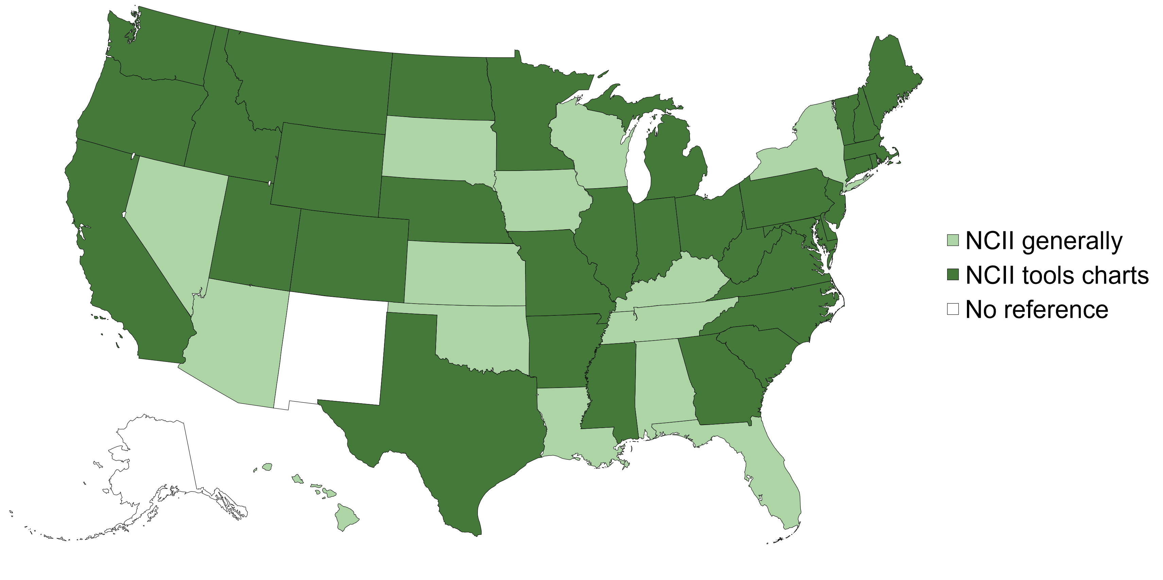
Tools Chart Impact Across States
State Education Agency (SEA) Websites Mentioning NCII or Tools Charts
Data gathered spring 2024

Slide 73
Specific Tools Chart References on SEA Websites
Tools Chart | Percentage of SEA Websites
Academic Screening | 47.1%
Academic Progress Monitoring | 27.5%
Academic Intervention | 25.5%
Behavior Progress Monitoring | 9.8%
Behavior Screening | 7.8%
Behavior Intervention | 7.8%
Data gathered spring 2024

Slide 74

What about state legislation?
Delaware, Indiana, and Massachusetts referenced the tools charts in their state legislation.
References are all related to literacy screening and interventions.
Data gathered spring 2024

Slide 75
Time to Share
Does the state where you work reference NCII? What, if anything, about the representation of other states is expected or surprising?

Slide 76
Tools Chart Review Process
Call for submissions
Eligibility screening
Review by Technical Review Committee (TRC)
Publication on tools chart
Vendors of evidence-based tools invited to respond to calls for submissions
NCII staff review submissions for eligibility against our criteria.
Final list of tools and their ratings are published.
TRCs review tools against rigorous evidence standards.

Slide 77
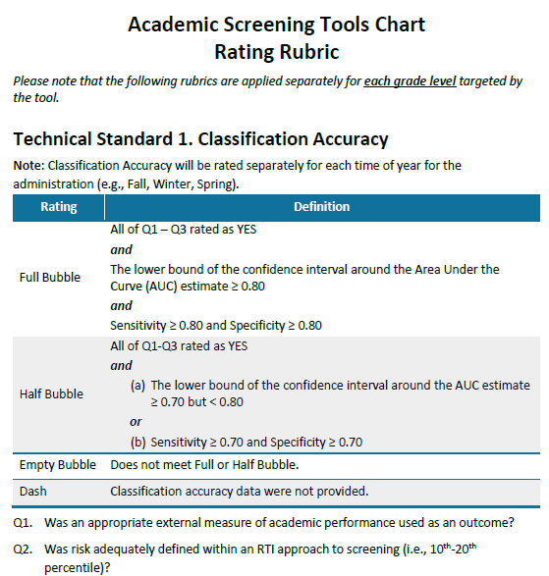
Example Rating Rubric: Academic Screening
Why is it important that we have a detailed rubric for each tools chart?

Slide 78
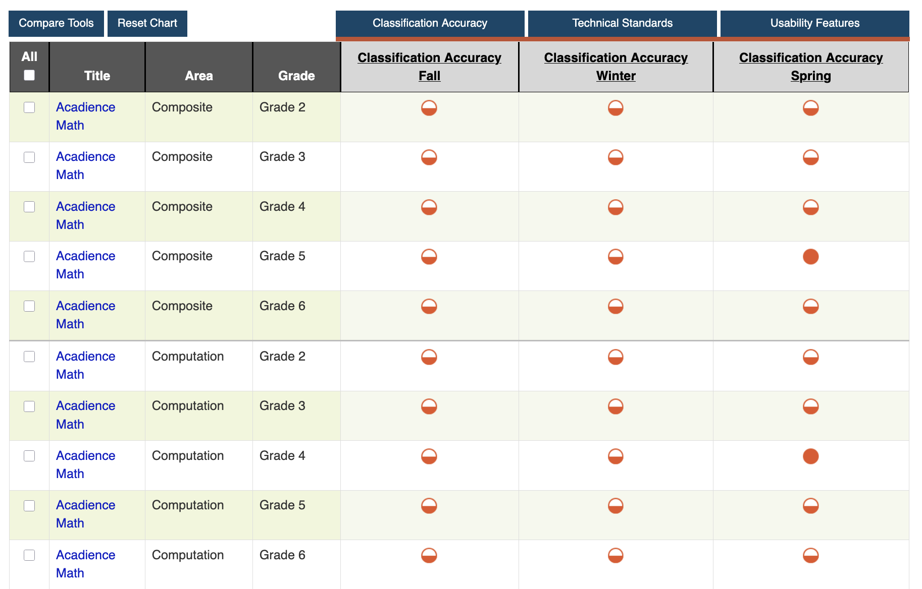
Final List of Tools & Ratings
Example from academic screening tools chart

Slide 79
Turn & Talk 2
With a partner, discuss the following:
    Why are there misconceptions that a tools chart is a list of “approved” assessments?
    How can you communicate about the tools chart in a way that dismantles this misconception?

Slide 80
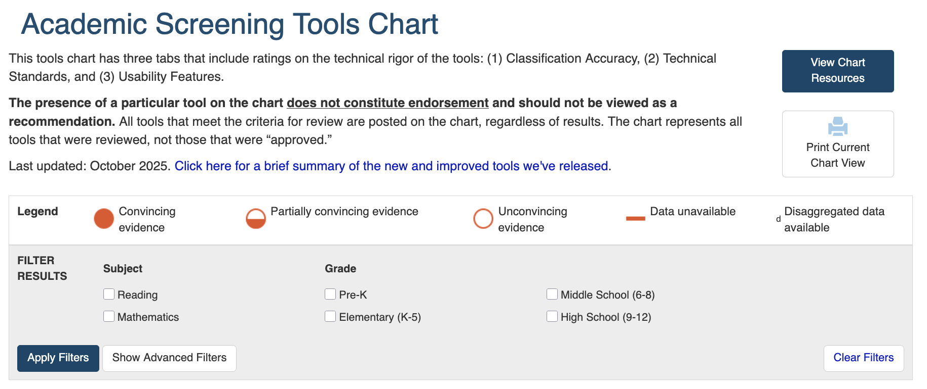
Navigating the Tools Chart
Updates
Ratings
Filter
Example from academic screening tools chart

Slide 81
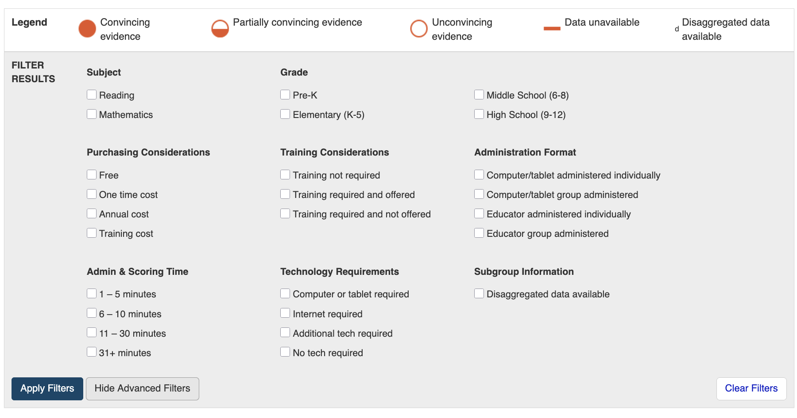
Advanced Filter
What is the most meaningful category on here for you?
Example from academic screening tools chart

Slide 82
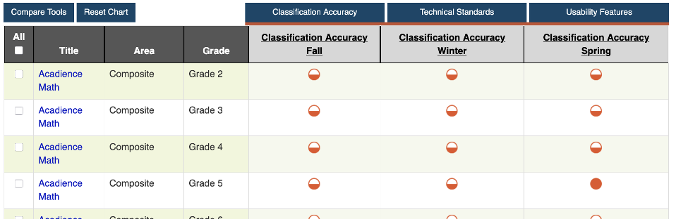
Tools Chart Features
Tool Information
Technical Standards
Usability Features
Example from academic screening tools chart

Slide 83
Bubble Ratings
Rating | Description | General Interpretation
 | Convincing evidence. |  | Good to go!
 | Partially convincing evidence. |  | Yield & learn more.
 | Unconvincing evidence. |  | Stop & consider.
 | Data unavailable

Slide 84
Preview: Let’s Explore Ratings!
Visit the academic screening tools chart OR academic progress monitoring tools chart
Academic Screening Tools Chart
Explore evidence for reliability of the slope
Choose one tool and one grade level
Explore evidence for classification accuracy
Academic Progress Monitoring Tools Chart
Choose one tool and one grade level

Slide 85

Understand Ratings in Context: CA
The main goal of classification accuracy is to understand how well scores on a screening assessment correctly identify students who are at risk versus those not at risk.
Example: TSA screening at the airport

Slide 86

Reliability of the Slope
Reliability of the slope tells us how well a student’s rate of improvement reflects real growth in skills as opposed to differences across progress monitoring forms.

Slide 87
Tips for Using the Tools Chart
Gather a team.
Determine your needs.
Determine your priorities.
Familiarize yourself with the content and language of the chart.
Review the data.
Ask for more information.

Slide 88
Wrap Up: Tools Charts and DBI

Slide 89
Questions

Slide 90
Preview of Day 2
Students
DBI happens here
Teachers
School Leadership
Effectiveness of DBI depends on what happens here
District Leadership

Slide 91
Building Capacity at the Local Level: Day 2
June 2026
2026 Intensive Intervention Institute
Jon Potter, Technical Assistance Provider
Jason Harlacher, Technical Assistance Provider

Slide 92
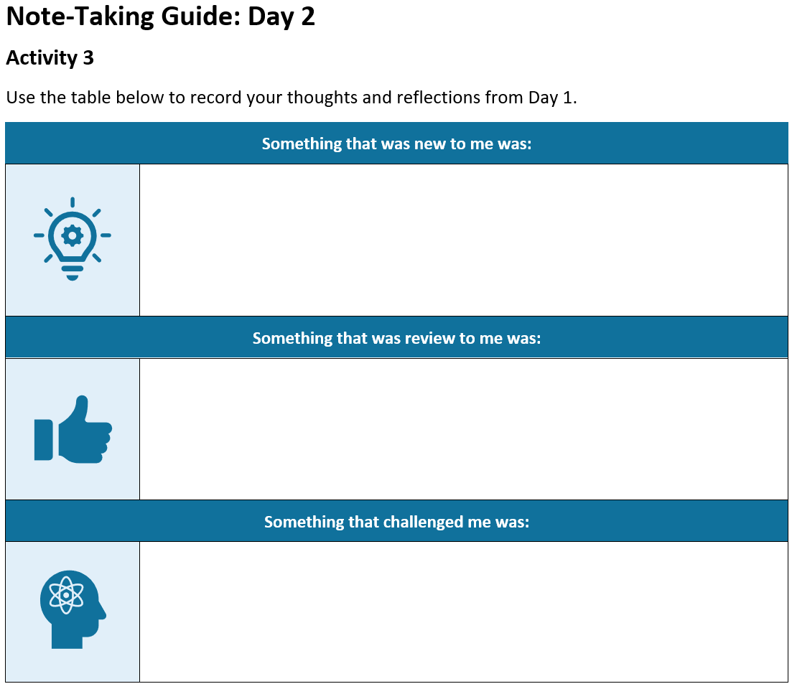
Activity 7
Reflect on what you heard yesterday.
Write down your thoughts on the note taking guide.
Find someone in the room not from your team and share what you wrote.

Slide 93
Supporting and Sustaining Implementation of DBI
How districts can support DBI

Slide 94

Reflect and Share Out
What are some challenges of district-level initiatives?
What barriers have you encountered?

Slide 95
LEA-Level Implementation:
Infrastructure
Alignment
  The contextual fit and overlap of DBI within the education agency’s current initiatives and work.
Internal Capacity
  The ability of the agency to self-sufficiently scale up and support DBI.
Implementation
The active process of supporting school sites with accurate and consistent implementation of DBI to support students.

Slide 96
Alignment
Alignment
  The contextual fit and overlap of DBI within the education agency’s current initiatives and work.
Key Personnel

Slide 97

Alignment: Key Personnel
Refers to personnel involved with making decisions around DBI and implementation.
This should include—
  Those with decision-making authority
  A team to lead the initiatives
  Two-way communication

Slide 98
Team-Based Leadership
A policy or program has been mandated or adopted, and, with minimal supports, practitioners are expected to translate information to practice. Practitioners are held accountable for intended outcomes.
Letting it happen
A policy or program has been mandated or adopted with materials, training resources, and websites to support practitioners. Practitioners are left to figure out how to solve problems while being held accountable for achieving positive outcomes.
Helping it happen
A policy or program has been mandated or adopted. Active and purposeful implementation best practices are used to support practitioners and administrators.
An Implementation Team is accountable for developing the implementation support systems, resolving organization and system issues, and achieving positive outcomes.
Making it happen
Resource: Implementation Teams Overview, National Implementation Research Network

Slide 99
Building Your Leadership Teams
What roles are included on your team?
What roles are missing?
Keep team size manageable (3-8 people)
Aim to include diverse and representative roles, skills, and viewpoints:
  Authority to allocate resources and set policy
  Expertise instruction and curriculum
  Expertise in data use
  Practitioner experience
  Implementation experience
  Adaptive skills for managing difficult situations
  Highly respected by staff
  Representation of family and community voice

Slide 100
Alignment 2
Alignment
  The contextual fit and overlap of DBI within the education agency’s current initiatives and work.
Key Personnel
Fit

Slide 101

Alignment: Fit
How well does DBI align with existing initiatives and structures?
Consider:
  Current and future initiatives
  Common language
  Organizational structure of the LEA (e.g., personnel, offices, training, and TA delivery system)

Slide 102
Where Does DBI Fit in Your District?
English Learners
Assessment
English Language Arts
DBI?
MTSS
Instructional Coaching
School Improvement
Special Education

Slide 103

Do You Need to De-implement Competing Initiatives or Practices?
De-implementation is “the discontinuation of interventions that should no longer be provided.” (McKay et al., 2018)
  Can DBI replace or refine an existing practice?
    Student Study Teams (SST)?
    Child Study Teams (CST)?
    Data Teams?

Slide 104
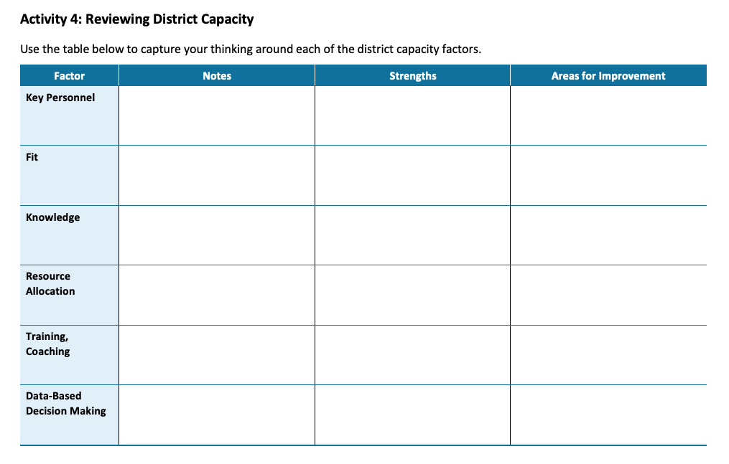
Activity 8:
Key Personnel and Fit
Use the note-taking guide to identify strengths and areas for improvement in the Key Personnel and Fit for DBI in your district.

Slide 105
Internal Capacity
Internal Capacity
  The ability of the agency to self-sufficiently scale up and support DBI.
Knowledge

Slide 106
Internal Capacity: Knowledge
What is the current knowledge and understanding of DBI across your
district staff, including expertise and experience with DBI?

Slide 107
Different Layers of Support 2
Students
DBI happens here
Teachers
School Leadership
Effectiveness of DBI depends on what happens here
District Leadership

Slide 108



Teaching and Coaching Your Staff Requires Knowledge and Expertise
Driving
Sports
Music

Slide 109
Ensuring Effective and Consistent DBI
Students in need of intensive intervention
School A
School B
School C
School D
School A staff knowledge of DBI
School B staff knowledge of DBI
School C staff knowledge of DBI
School D staff knowledge of DBI
District staff knowledge of DBI

Slide 110
Internal Capacity: Knowledge 2
Foundational DBI knowledge among key staff
Specialized knowledge among some staff
(e.g., job-embedded coaching)
Implementation science knowledge

Slide 111
Build Knowledge
General trainings for all district-level personnel
Specific trainings and ongoing support to coaches and/or schools
DBI Process
Administering, scoring, and entering data
Graphing the data
Setting goals
Using decision rules to interpret the data

Slide 112
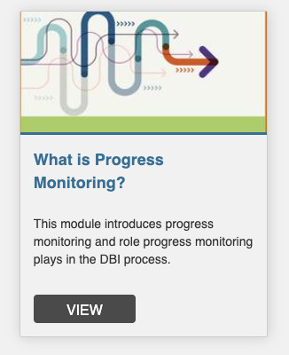


NCII Resources for Building Knowledge:
Progress Monitoring
General trainings for all district-level personnel
Specific trainings and ongoing support to coaches and/or schools
Build general understanding of progress monitoring
Learn how to collect and use progress monitoring data for decision making

Slide 113
Context Matters
DBI Process
What does this look like:
  In your setting?
  With your staff and students?
  With your resources/tools?
  With your schedule?

Slide 114
Active Implementation Formula
DBI Process
How do we sequence implementation?
How do we provide the needed support?
How do we provide the conditions that facilitate successful implementation?
Effective Practice
Effective Implementation
Enabling Context
Socially Significant Outcomes
Source: Active Implementation Overview Module, National Implementation Research Network (NIRN), 2023

Slide 115
Internal Capacity 2
Internal Capacity
  The ability of the agency to self-sufficiently scale up and support DBI.
Knowledge
Resource Allocation

Slide 116
Internal Capacity: Resource Allocation
Refers to resources available to support DBI, including the following:
Money
Time
Materials
People
Does your LEA have the capacity to train and/or coach schools, and the ability to restructure roles to do so?

Slide 117
Internal Capacity in Two Questions
Internal Capacity
  The ability of the agency to self-sufficiently scale up and support DBI.
Knowledge
Do staff know what and how to implement?
Resource Allocation
Are staff able to implement?

Slide 118
Activity 8:
Knowledge and Resource Allocation
Use the note-taking guide to identify strengths and areas for improvement in the Knowledge and Resource Allocation for DBI in your district.

Slide 119
Implementation
Implementation
The active process of supporting school sites with accurate and consistent implementation of DBI to support students.

Slide 120
Implementation Is Messy
What we want implementation to look like:
Our DBI Plan
DBI Implementation Reality
What implementation can often look like:
Our DBI Plan
DBI Implementation Reality

Slide 121
Implementation 2
Implementation
The active process of supporting school sites with accurate and consistent implementation of DBI to support students.
Training and Coaching

Slide 122

Implementation: Training and Coaching
Develop a TA delivery system that includes—
Initial and ongoing training
  In person, virtual, synchronous, asynchronous
Opportunities to practice learned skills
Ongoing, job-embedded coaching
A plan for scaling up (e.g., pilot sites, cohorts, etc.)
Feedback data to drive future TA
Explicit guidance on how new information fits into existing practice
Honoring the unlearning process

Slide 123

Remember
People don’t resist change. They resist loss.

Slide 124
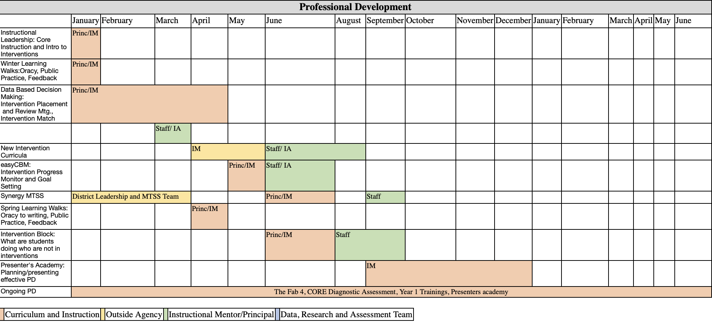
Purposeful Professional Learning
Do you have a professional learning plan?
Data use
Interventions
Progress monitoring

Slide 125
Implementation 3
Implementation
The active process of supporting school sites with accurate and consistent implementation of DBI to support students.
Training and Coaching
Data-Based Decision Making

Slide 126
Data-Driven Feedback Loops
“In short, if we want to make the education system better, we could try to concoct the perfect intervention—the new curriculum, the new model—and hope for the best. Or we could settle for a pretty good solution that’s equipped with so many built-in feedback loops that it can’t help but get better over time.”
Heath (2020)

Slide 127
Implementation: Data-Based Decision Making
Systems to gather data on fidelity of implementation efforts.
Systems to gather data on outcomes or impact of implementation efforts.
Data-based processes used by key personnel to make decisions.

Slide 128
Examine Fidelity and Outcomes Together
High fidelity
Result: System is not working
Next Step: Change your system
Result: System is working
Next Step: Continue to improve
Low student outcomes
High student outcomes
Result: Something is not working
Next Step: Improve fidelity
Result: Something is working
Next Step: ???
Low fidelity

Slide 129
Factors That Can Impact Implementation
Do staff know what and how to implement?
  If no, provide sufficient training and support.
Are staff able to implement?
  If no, provide resources (time, materials, staffing) and remove barriers.
Are staff motivated to implement?
  If no, revisit “the why” and try to better understand the adaptative challenges.

Slide 130
Activity 8:
Training and Coaching and DBDM
Use the note-taking guide to identify strengths and areas for improvement in the Training and Coaching and Data-Based Decision Making for DBI in your district.

Slide 131

Closing Thoughts
Your system has areas for improvement in DBI structure and processes.
The technical solution is to train your staff or to secure additional resources.
Training and/or additional resources will not sufficiently solve adaptive challenges.
Building district capacity ensures you are equipped to implement both technical and adaptive solutions.

Slide 132
Keep The Focus On…
Simple plans
Relentless
implementation
Focus on a few areas/strategies.
Communicate, train, support, and follow up.

Slide 133
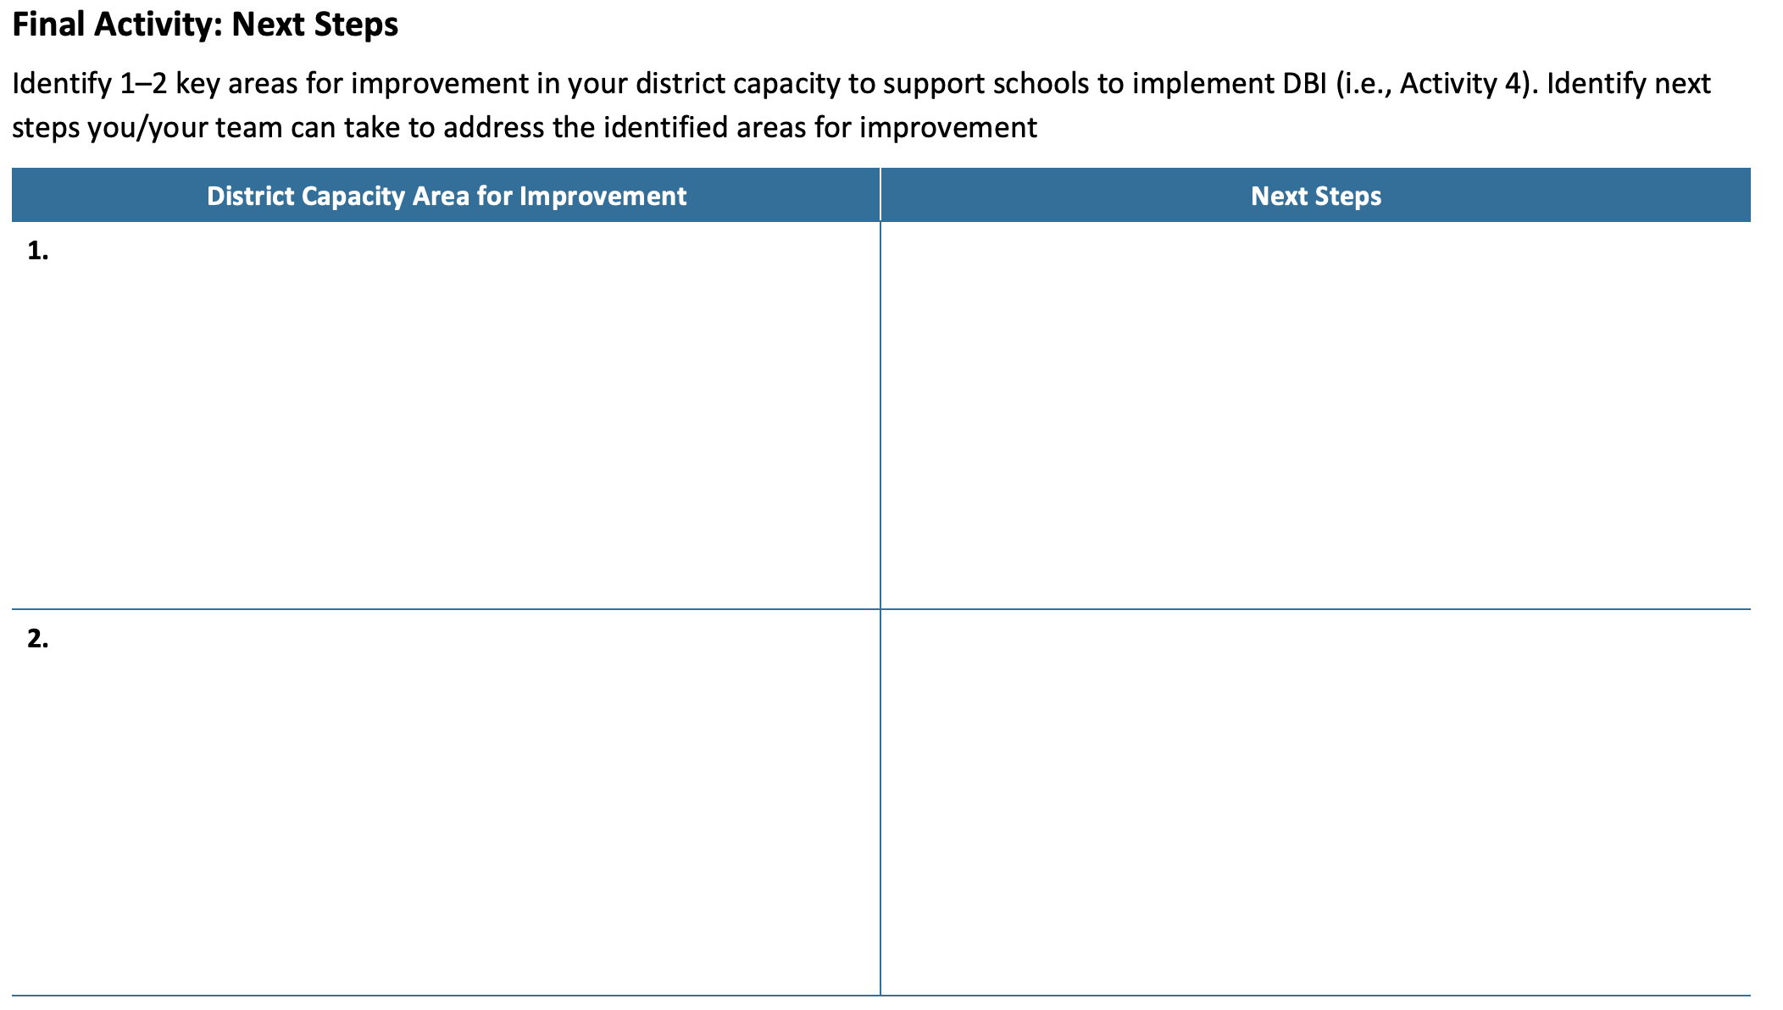
Final Activity: Next Steps
Using the final page of the note-taking handout:
Identify 1–2 key areas for improvement in your district capacity to support DBI.
Identify next steps to address those areas for improvement.

Slide 134

Questions 2

Slide 135

We Appreciate You!
NCII cannot do what we do without you!
We appreciate your attendance, investment, and enthusiasm for our work and ongoing commitment to installing DBI in schools across the country.
Our work is always in service of doing right by kids and educators. We’d love to stay connected and learn more about your impact.
This Photo by Unknown Author is licensed under CC BY

Slide 136
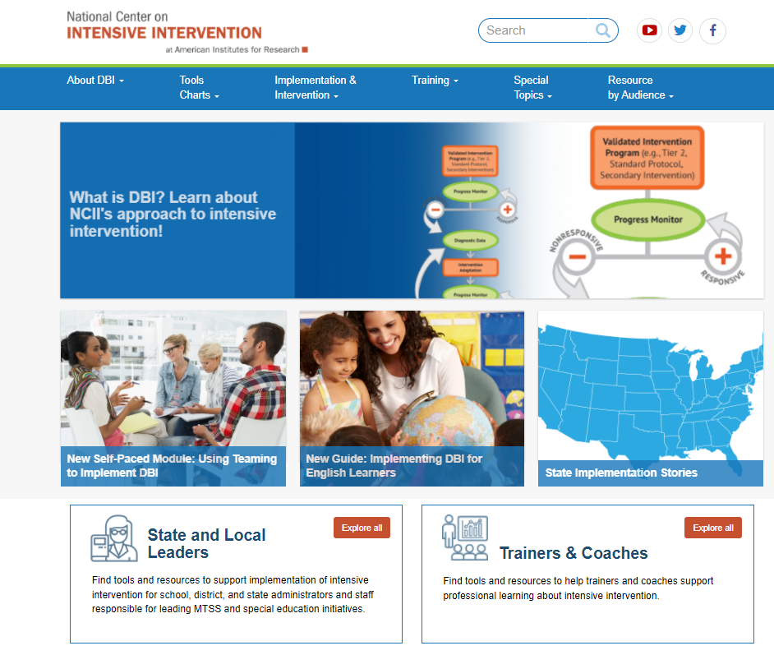
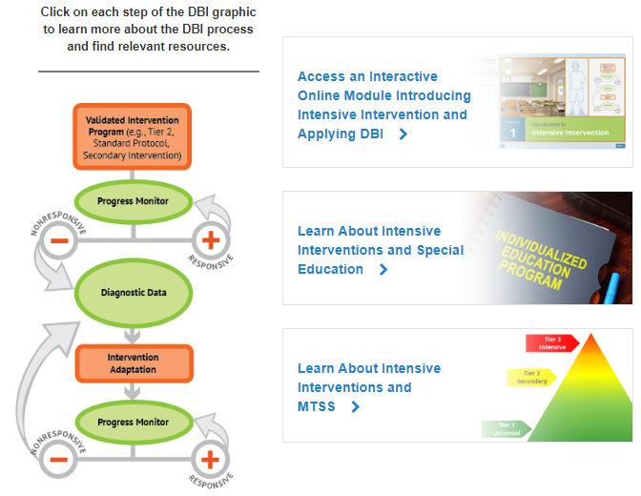
How can you learn more? Explore the many resources available on NCII’s Website

Slide 137
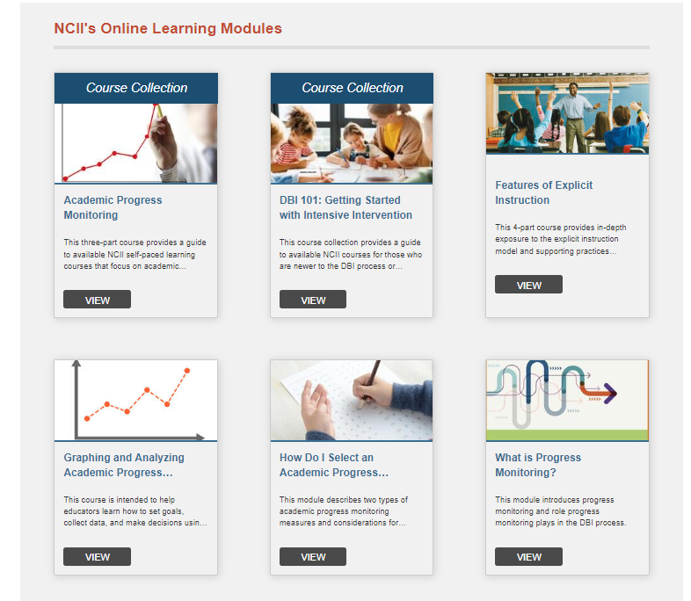
How can you learn more? Self-Directed Learning Opportunities
Self-paced online courses focused on
  Introduction to Intensive Intervention
  Progress Monitoring
  Taxonomy of Intervention Intensity
  Teaming
  Explicit Instruction
  Intensive Intervention in Mathematics

Slide 138



How can you stay connected?
https://www.linkedin.com/in/national-center-on-intensive-intervention
https://www.facebook.com/TheNCII/
https://twitter.com/TheNCII
Sign-up on the bottom of each page of the NCII website)

Slide 139


Let Us Know What You Thought
Interested in a certificate of attendance? Please indicate this in your survey. We will gather this information from our evaluators and send certificates to everyone who requests one.
https://meadowscenter.ca1.qualtrics.com/jfe/form/SV_6L0XMY8SSeuIGjA

Slide 140
THANK YOU!!
jopotter@air.org
jharlacher@air.org

Slide 141
NCII Disclaimer
This presentation was produced under the U.S. Department of Education, Office of Special Education Programs, Award No. H326Q260001. Celia Rosenquist serves as the project officer. The views expressed herein do not necessarily represent the positions or policies of the U.S. Department of Education. No official endorsement by the U.S. Department of Education of any product, commodity, service, or enterprise mentioned in this resource is intended or should be inferred.

