Slide 1

Data-Based Individualization 101
June 2026
Intensive Intervention Institute
Cat Merkle and Kyle Allen

Slide 2


Welcome!
Cat Merkle
NCII Technical Assistance Provider
Kyle Allen, MA
NCII Technical Assistance Provider

Slide 3

Logistics
Materials
  Participant handouts with notetaking space
  PowerPoint slides and spotlighted resources available through links
  Share lessons learned and reflections on Twitter/X: @TheNCII

Slide 4
Agenda – Day 1
10:45 am – 11:30 am: Introduction to DBI
11:30 am – 1:00 pm: Lunch on Your Own
1:00 pm – 3:00 pm: Breaking Down the DBI Process
3:00 pm – 3:15 pm: Break
3:15 pm – 4:00 pm: Game Time!

Slide 5
Housekeeping
Stay engaged.
Be mindful of others.
Take care of needs.
Participate in talk times.
Place phones on silent/vibrate.
Take notes when needed.

Slide 6

Learner Outcomes
By the end of the strand, participants will be able to:
Describe the steps in the data-based individualization (DBI) process.
Identify lessons learned to improve implementation of DBI
Access and use NCII resources to support implementation of DBI
Assess your current capacity to support DBI and develop next steps

Slide 7
What to expect
Some information is new
Some information is review
Some information may challenge you

Slide 8
Activity: Four Corners
Each corner of the room represents a statement (strongly agree, agree, disagree, strongly disagree)
For each prompt, move to the corner whose statement you most agree with.
Briefly introduce yourselves, discuss why you chose the response you did.
Each corner shares response.
Repeat for next prompt.
Strongly Agree
Agree
Disagree
Strongly Disagree

Slide 9
Introduction to DBI
NCII’s Approach to Intensive Intervention

Slide 10
National Center on Intensive Intervention (NCII)
National technical assistance center funded by the U.S. Department of Education's Office of Special Education Programs (OSEP)
Our mission is to build knowledge and capacity of state and local leaders, faculty and professional development providers, educators, and other stakeholders to support implementation of intensive intervention for students with severe and persistent learning and/or behavioral needs using data-based individualization (DBI).

Slide 11

What is data-based individualization (DBI)?
DBI Process
Data-based individualization (DBI) is a research-based process for individualizing and intensifying interventions for students with severe and persistent learning and behavioral needs.
The process integrates evidence-based intervention, assessment, and strategies.

Slide 12
DBI Process
Validated intervention program, delivered
with fidelity
Progress monitoring
Diagnostic data used to develop a hypothesis
Adaptation to validated intervention
Continued progress monitoring, with adaptations occurring whenever needed to ensure adequate progress

Slide 13
DBI Fact and Fiction
DBI is:
DBI is not:
A process
A one-time fix
Individualized based on student need
A single approach or preset program
A process to identify and organize resources to support students with intensive needs
A series of boxes to check before identifying a student with a disability
A process to support students with and without disabilities
A process that ends if a student is identified with a disability

Slide 14



Why do we need intensive intervention?
Validated programs are not universally effective programs; 3% to 5% of students need more help (NCII, 2013)
Students with intensive needs often require 10–30 times as much practice as their peers to learn new information
(Gersten et al., 2009)
For students with intensive needs, co-occurring academic and behavioral needs are the rule not the exception
(Kuchle & Riley-Tillman, 2019)

Slide 15
Who Needs DBI?
Students who are non-responsive to interventions
Students with persistently low academic achievement and/or high-frequency/intensity behavior
Students with disabilities who are not making adequate progress in their current instructional program and not meeting individualized education program (IEP) goals

Slide 16
Do I Need a DBI Team to Implement DBI?
No. Individual teachers can independently implement DBI.
But three (or more) heads are always better than one when engaging in problem solving!

Slide 17
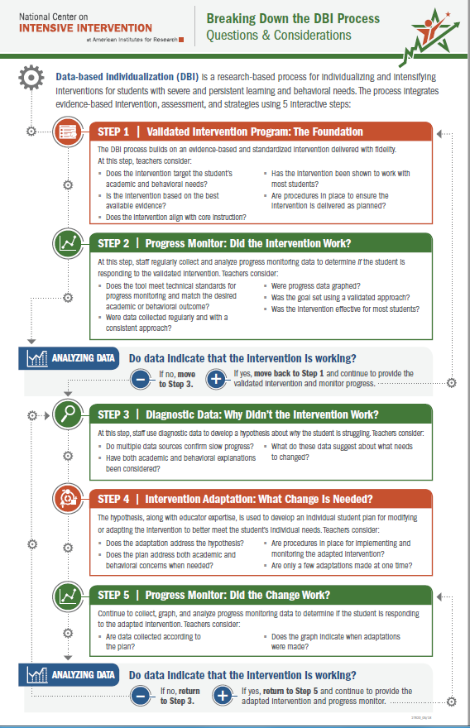
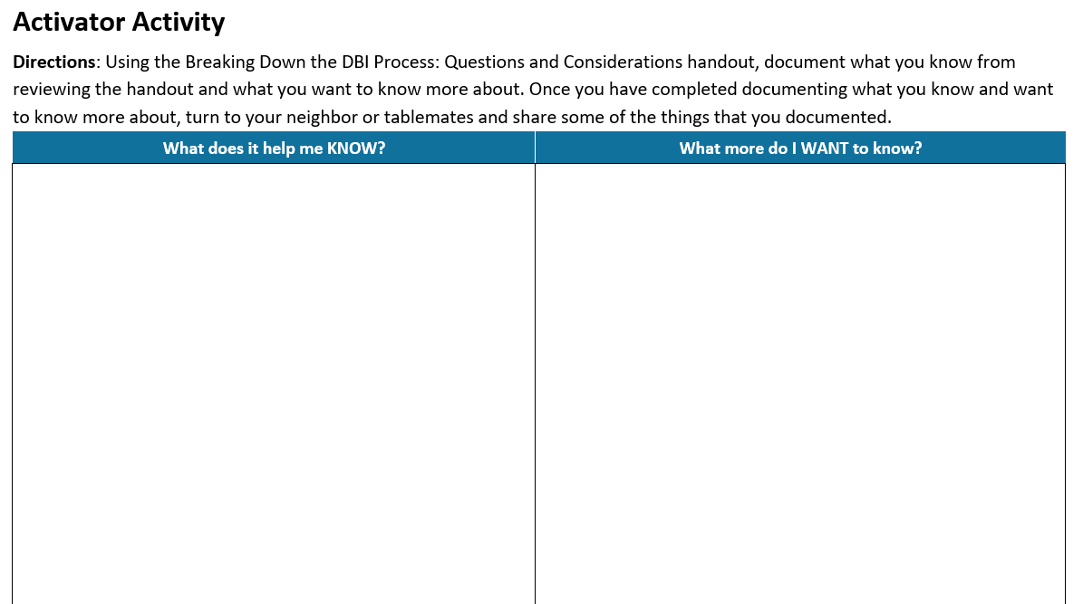
Activator Activity

Slide 18
Breaking Down the DBI Process

Slide 19

Shout out a word that represents how your body feels after sitting all day.

Slide 20

Real Life Back Pain Scenario

Slide 21
DBI Process 2
Validated intervention program, delivered
with fidelity
Progress monitoring
Diagnostic data used to develop a hypothesis
Adaptation to validated intervention
Continued progress monitoring, with adaptations occurring whenever needed to ensure adequate progress

Slide 22
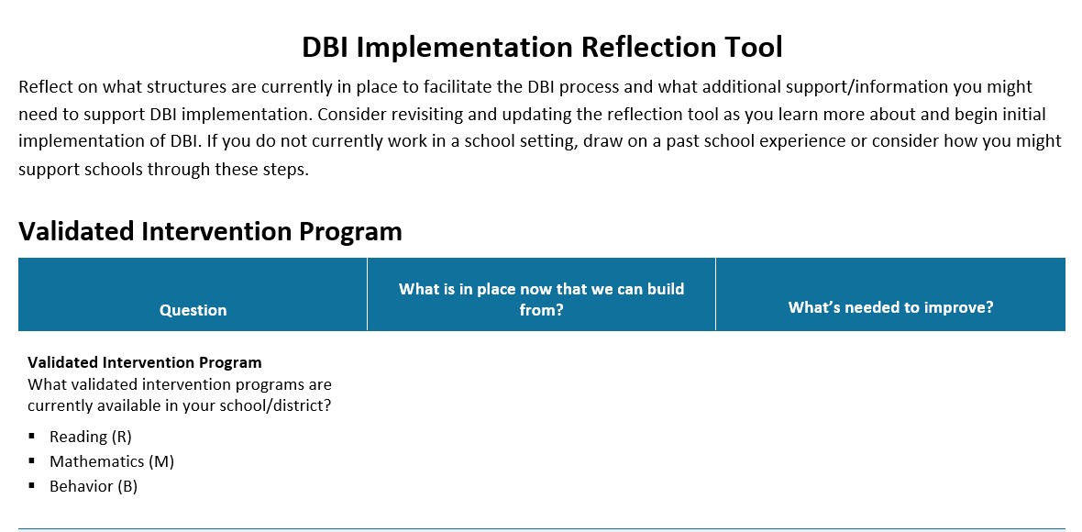
DBI Reflection Tool

Slide 23
DBI Step 1: Lay the foundation for DBI.
STEP 1: Start with a standardized, validated intervention program.

Slide 24

Scenario: If you were me, how would you decide which treatment to try first for something common like general back pain?

Slide 25

Scenario: DBI Step 1
STEP 1: Start with a standardized, validated intervention program.
  Over-the-counter medication
  Physical therapy (PT)

Slide 26

Validated Intervention Program
Standardized, evidence-based programs or instructional practices.
Targeted instruction in a specific skill or set of skills (e.g., phonemic awareness, vocabulary, math problem solving, social skills).
Matched to students’ needs or the function of their behavior.
Delivered with fidelity.

Slide 27

Why start with standardize, evidence-based programs?
They are effective
They can be easy to deliver
They are efficient
They can be cost effective
They are consistent

Slide 28
Ensure Intervention Fidelity
Did we deliver the intervention as planned?
Did the student receive the intervention?
  Are we providing the program as designed, with sufficient time, in a high-quality way?
  Did the student attend the intervention sessions?
  If not, why not?
Ways to assess fidelity:
Observation
checklists
Self-report
checklists
NCII Student Intervention Implementation Log
Source. National Center on Intensive Intervention (NCII) (n.d.c)

Slide 29
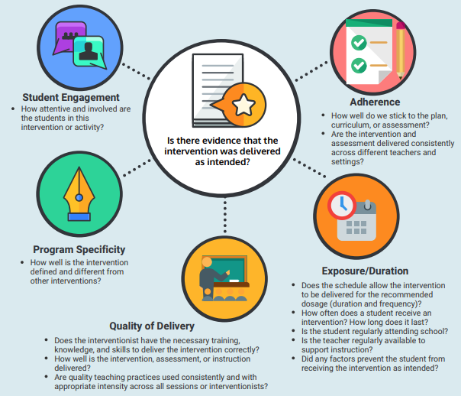
Five Elements of Fidelity
(Dane & Schneider, 1998; Gresham et al., 1993; O’Donnell, 2008)
Considerations for Effective Implementation: 5 Elements of Fidelity | NCII

Slide 30
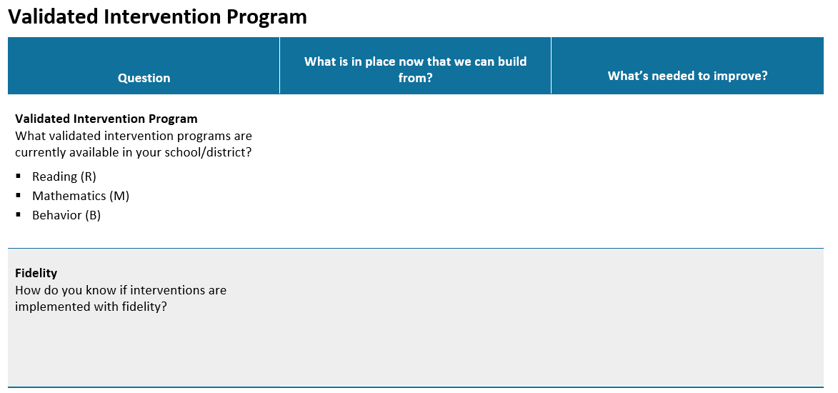
Think, Pair, Share: Validated Intervention Programs
Spend 8 minutes on your own filling out your worksheet.
Pair up with a partner and share your answers. If you came in a team, you may chat together.

Slide 31
DBI Step 2: Did the intervention work?
STEP 2: Progress monitor.
Develop and implement a progress monitoring plan that includes:
  A valid and reliable progress monitoring tool.
  An ambitious and attainable goal.
  Decision rule to help evaluate student responsiveness to the intervention.

Slide 32

Scenario: How do you know if the intervention (PT) is working?

Slide 33
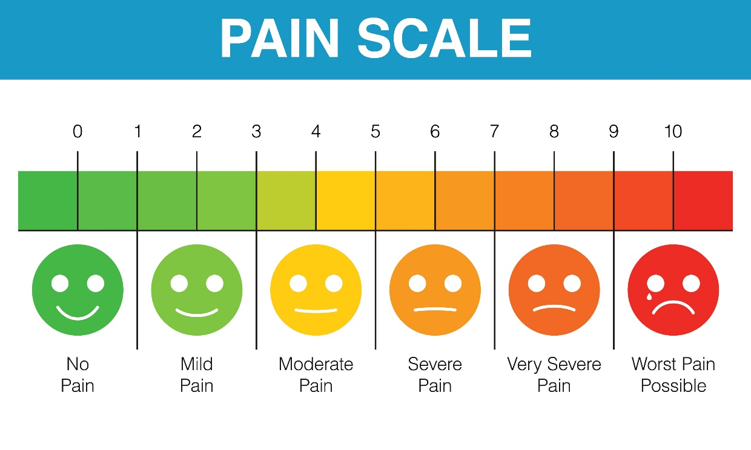
Scenario: DBI Step 2
STEP 2: Progress monitor using a plan that includes an ambitious goal.
  Goal: sit through a workday with less than a 2/10 pain scale
  Track pain levels each day in a log

Slide 34

What Is Progress Monitoring?
Progress monitoring is repeated measurement of student performance over the course of intervention to index/quantify responsiveness to instruction or intervention and to thus determine, on an ongoing basis, when adjustments to the program are needed to improve performance.

Slide 35
Monitoring Progress Versus Progress Monitoring
Monitoring Progress
Often informal or unstandardized
Can occur during daily instruction
Provides data for immediate, real-time instructional decisions
Used for all students
Assesses learning of directly taught skills
Progress Monitoring
Valid and reliable tools, standardized delivery
Frequency depends on intensity of instruction
Requires ongoing graphed data and a goal for valid interpretation
Used for students receiving interventions
Assesses generalization, consolidation, and application of taught skills to new content
Examples:
Questioning, daily formative assessments, lesson checkouts, exit slips
Examples:
Curriculum-Based Measures (CBM)
General Outcome Measures (GOM)

Slide 36
Stand Up if it is an Example of Progress Monitoring:
Giving a quiz after a lesson

Slide 37
Stand Up if it is an Example of Progress Monitoring: 2
Using a General Outcome Measure (GOM) for writing fluency across the semester

Slide 38
Stand Up if it is an Example of Progress Monitoring: 3
Collecting homework and scanning for common errors

Slide 39
Stand Up if it is an Example of Progress Monitoring: 4
Walking around the room and noting who is struggling

Slide 40
Stand Up if it is an Example of Progress Monitoring: 5
Administering the same standardized probe under consistent conditions each time

Slide 41
Stand Up if it is an Example of Progress Monitoring: 6
Using Oral Reading Fluency every two weeks for students in Tier 2

Slide 42




What to Look for in a Progress Monitoring Measure
Brief and easy to administer
Able to be used repeatedly across time
Sensitive to changes in student performance
Valid, reliable, and evidence based

Slide 43






Common Challenges With
Progress Monitoring
The assessment does not align with the content of the intervention.
The assessment does not align with the student need.
The goal for student progress is inappropriate.
Lack of clarity about the logistics of collecting progress monitoring data (i.e., who, what, when, where).
The assessment is not administered in a consistent way.
Data are not collected frequently enough to allow for timely decisions.

Slide 44
What Is Meant by “Student Responsiveness”?
A student is “responsive” to the intervention if progress monitoring data indicate that they are on-track to meet their goal for the intervention.

Slide 45
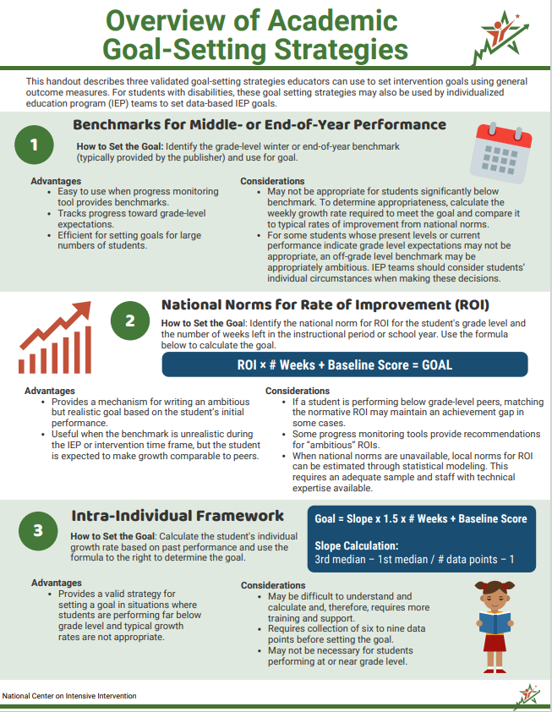
Set an Attainable Yet Ambitious Goal
There are three approaches to setting goals:
Benchmarking
National norms for weekly ROI
Intra-individual framework
Overview of Academic Goal-Setting Strategies | NCII

Slide 46
Using Progress Monitoring Data
Collecting, graphing, and analyzing progress monitoring data is important for:
  understanding student responsiveness and
  determining when changes are needed.

Slide 47
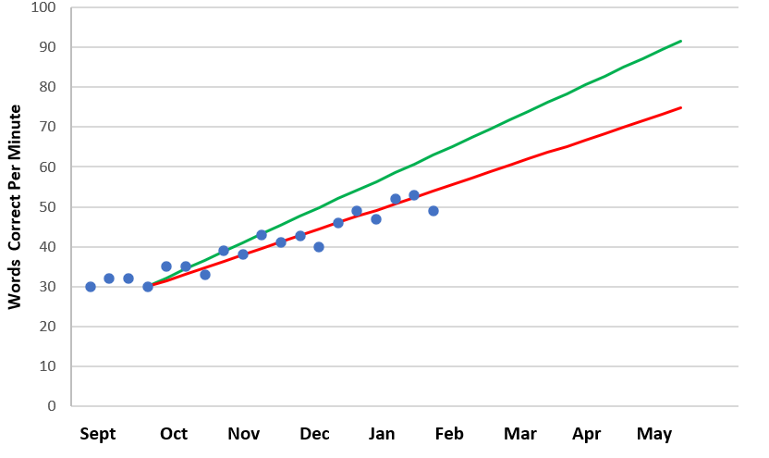
The Importance of Graphing Data
Goal
Goal line
Phase line
Trend line
PM data points
Baseline

Slide 48
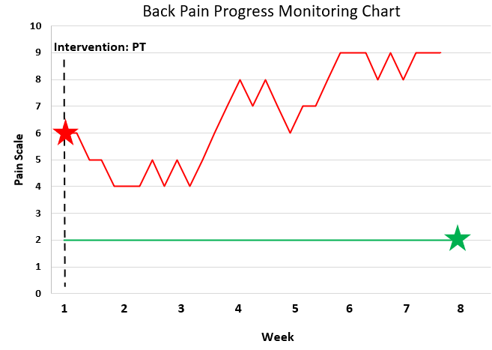

Scenario: Graphing My Pain

Slide 49
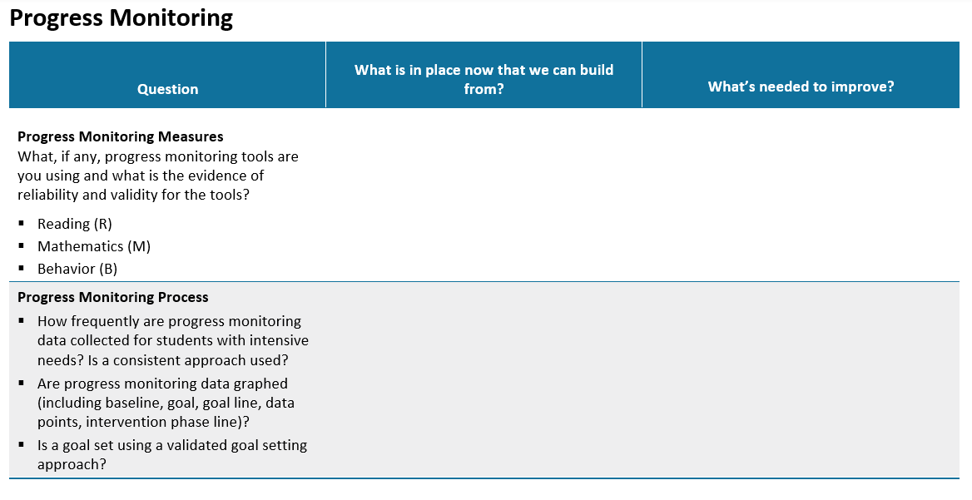
Think, Pair, Share: Progress Monitoring
Spend 8 minutes on your own filling out your worksheet.
Pair up with a partner and share your answers.

Slide 50
DBI Step 3: Why didn’t the intervention work?
STEP 3: Use informal diagnostic data to develop a hypothesis about WHY the student is not responding.

Slide 51
Scenario: If a treatment isn’t working, what would you want to know before trying something new?

Slide 52

Scenario: DBI Step 3
STEP 3: Use informal diagnostic data to develop a hypothesis about WHY the student is not responding.
  Data: new and increased symptoms
  Hypothesis: Nerve issue (probably cannot be fixed with PT)

Slide 53

Why do students experience challenges?

Slide 54
Educationally Relevant and Alterable Variables
Curriculum
Scope and sequence
Level of difficulty
Match to learner need
High-quality materials
Clear expectations
Positive reinforcement
Positive interactions
Positive feedback
Explicit instruction
Pacing (opportunities to respond)
Corrective feedback
Engagement strategies
Learner
Instruction
Environment

Slide 55
Behavior: Integration of Academics and Behavior
Skill deficit
Avoidance behavior
Removal from task

Slide 56
Exploring Hypotheses Within DBI
Step 3 of DBI
Step 4 of DBI
Use Existing Data To Develop A Hypothesis
Collect and Review
Diagnostic Data
Adapt Intervention to Match Hypothesis
Progress Monitoring
Intervention Data
Confirm Hypothesis
Identify Different Hypothesis
Instruction
Curriculum
Environment
Where do we start?

Slide 57
Where Do We Start?
Review What We’ve Already Done
DBI Process
Check intervention implementation fidelity.
  Did we deliver the intervention as planned?
  Did the student receive the intervention?
Check your progress monitoring practices.
  Are you using the right progress monitoring tool?
  Are we using the progress monitoring tool in the right way?

Slide 58

Collect and Review Informal Diagnostic Data Related to the Identified Focus
Possible informal diagnostic data sources include the following:
  Analysis of student errors in work samples and progress monitoring data (curriculum)
  Classroom observations (instruction, environment)
  Interviews with the student or family (instruction, curriculum, environment)
  Intervention-specific assessments (curriculum)

Slide 59
Where Do We Start? Questions to Consider
When students are not making adequate progress, ask the following questions to guide your hypothesis development
Are we teaching the most needed skills?
Are we teaching with sufficient explicitness?
Are we providing sufficient practice opportunities?
Are we providing sufficient support for transfer across settings?
Are we providing needed individualized behavior supports?

Slide 60
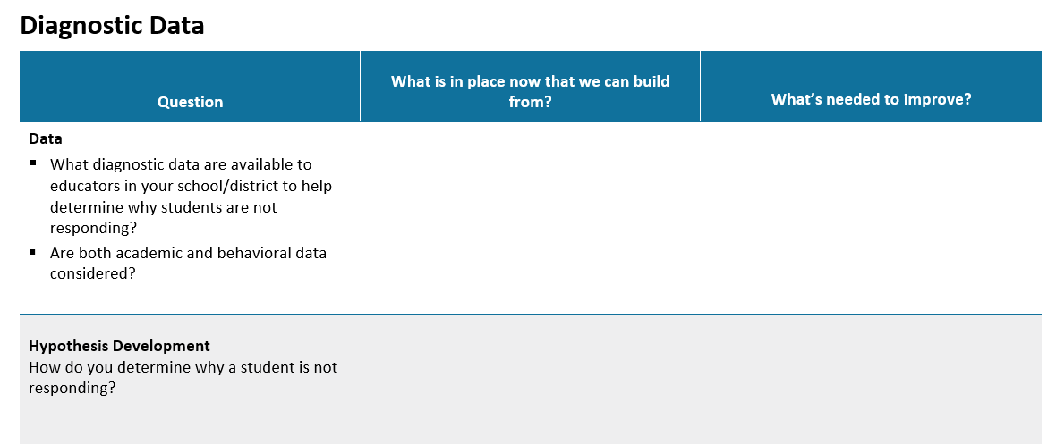
Think, Pair, Share: Diagnostic Data
Spend 8 minutes on your own filling out your worksheet.
Pair up with a partner and share your answers.

Slide 61
DBI Step 4: What change is needed?
STEP 4: Intensify and individualize the intervention to address the hypothesis.

Slide 62
Scenario: How can I change my treatment according to my new hypothesis?

Slide 63
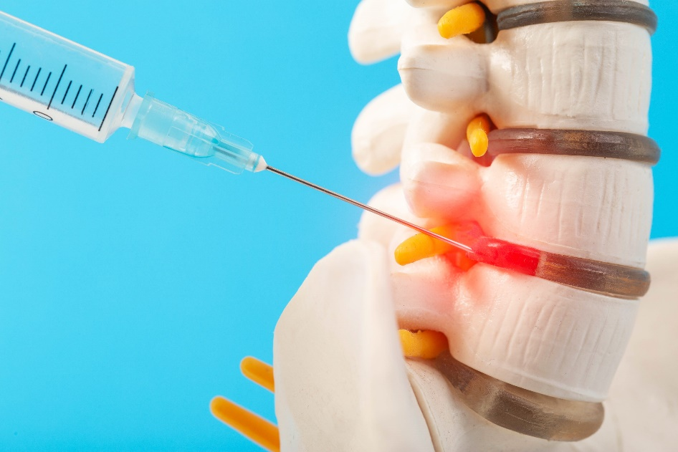
Scenario: DBI Step 4
STEP 4: Intensify and individualize the intervention to address the hypothesis.
    Spinal injections to target the nerve pain more directly.

Slide 64
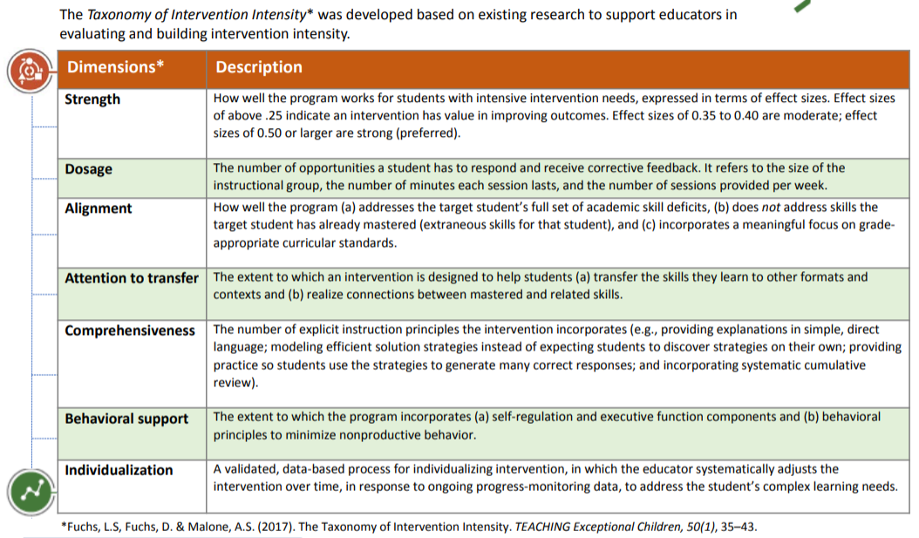
Taxonomy of Intervention Intensity
Taxonomy of Intervention Intensity

Slide 65
Shrink the Choices:
Adapt Dimensions That Address Your Hypothesis 6
Data-based Hypothesis
Dimensions to Adapt
Actions to Take
There is a mismatch between skills needed and skills being taught.
Alignment
Increase instructional time for the target skill(s).
Supplement intervention with additional materials.
Use an alternative program that addresses student’s needs.
The instruction is not explicit enough.
Comprehensiveness
  Use simple, direct language and break steps into smaller chunks.
  Provide additional modeling, guided practice and independent practice.
  Use visual aides, graphic organizers, manipulatives, and other scaffolds.
The dosage of the instruction is not sufficient.
Dosage
Increase minutes per session or frequency of sessions.
Reduce group size.
Increase student opportunities to respond (OTRs).
The student is not transferring skills other environments.
Attention to Transfer
Align instructional routines and language across tiers.
Teach students when and how to use learned strategies across the day.
Provide visual scaffolds to help student apply skills across environments.
Behavior needs are not being sufficiently addressed across settings.
Integrate Behavior and Academic Support
  Create a motivation plan that provides frequent feedback.
  Teach and reinforce clear expectations and routines.
  Conduct a functional behavior assessment to determine the function of the behavior.

Slide 66
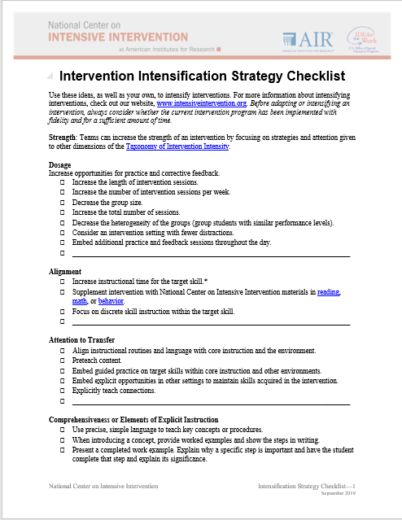
Adapting the Intervention
Tips for Successful Intensification
Select strategies that address the hypothesis.
Select a few important strategies.
Intensification Strategy Checklist | NCII

Slide 67
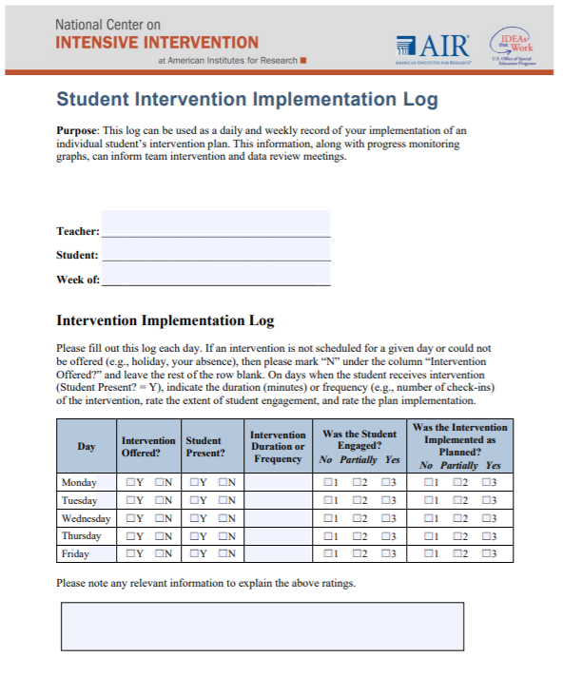
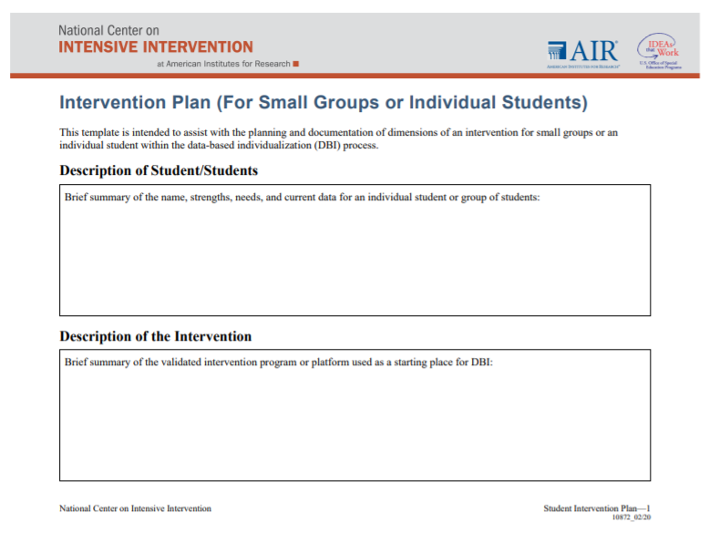
Implementation Monitoring: Was the adapted intervention delivered with fidelity?
Fidelity is still important!
  Focus on fidelity to the adapted student plan.
Student_Intervention_Plan
Student Intervention Implementation Log

Slide 68
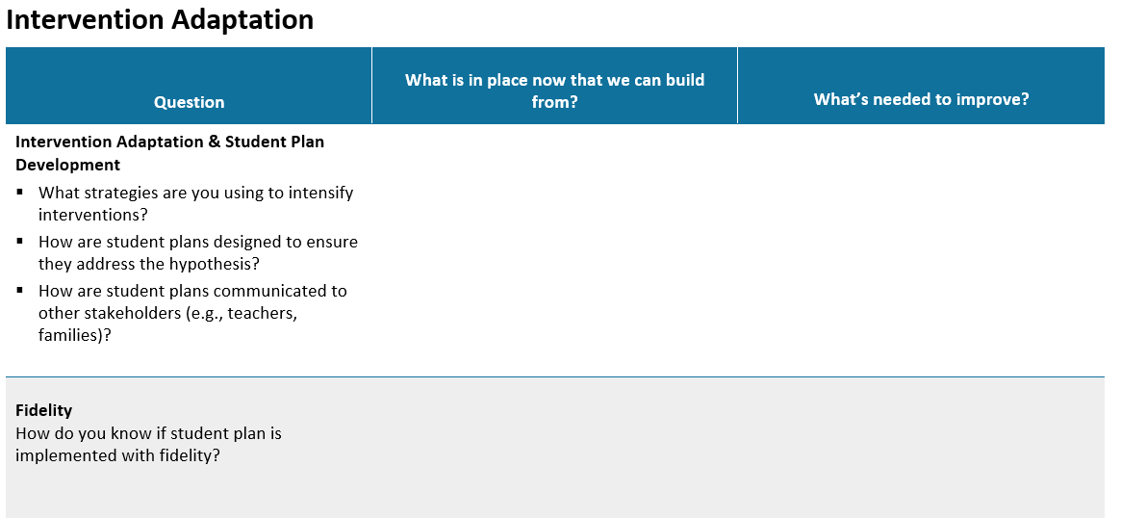
Think, Pair, Share: Intervention Adaptation
Spend 8 minutes on your own filling out your worksheet.
Pair up with a partner and share your answers.

Slide 69
DBI Step 5: Did the change work?
STEP 5: Monitor the student’s response to the adaptation (at least 4–6 data points).

Slide 70
DBI Step 5: Did the change work? 2
STEP 5: Monitor the student’s response to the adaptation (at least 4–6 data points).

Slide 71
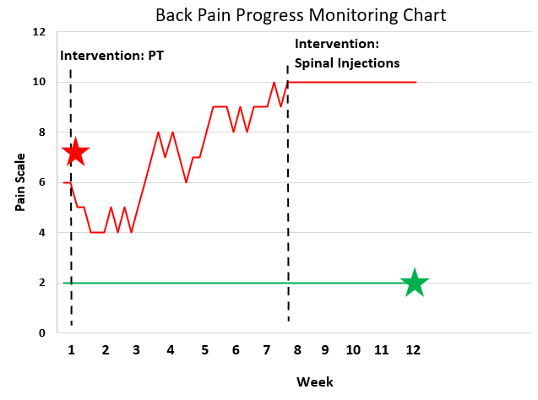

Scenario: DBI Step 5
STEP 5: Monitor the student’s response to the adaptation

Slide 72
Scenario: Why would I keep progress monitoring after the surgery seems to be initially effective?

Slide 73
Academics: Is the student responding to the adapted intervention?
Intervention
Adaption 1 Phase Line
Words Correct
Per Minute
Date

Slide 74
Behavior: Is the student responding to the adapted intervention?
Instances of Engagement
Date

Slide 75
Scenario: An Ongoing Process

Slide 76
Progress Monitoring (Advanced)
To understand student responsiveness and determine when changes are needed, you must:
  Examine data patterns and consider additional factors
  Use consistent decision rules

Slide 77
Data Pattern 1: Little or No Progress
Consider: Have we implemented the intervention plan as intended?
Have scheduling conflicts reduced instructional time?
Does the student seem unmotivated during instruction?
Is the setting distracting for the student?
Does the interventionist need clarification or training in the intervention or plan?

Slide 78
Data Pattern 2: Very Low Scores
Consider:
Is the measurement level too difficult for the student (i.e., floor effect)?
Is the student motivated to do well on the assessment?
Does the measurement align with the content of your instruction?

Slide 79
Data Pattern 3: Highly Variable Scores
Consider:
Does the progress monitoring measure have evidence of validity and reliability?
Is the assessment being administered consistently?
  If not, why not?
Does the student’s engagement or motivation level vary from day to day?

Slide 80
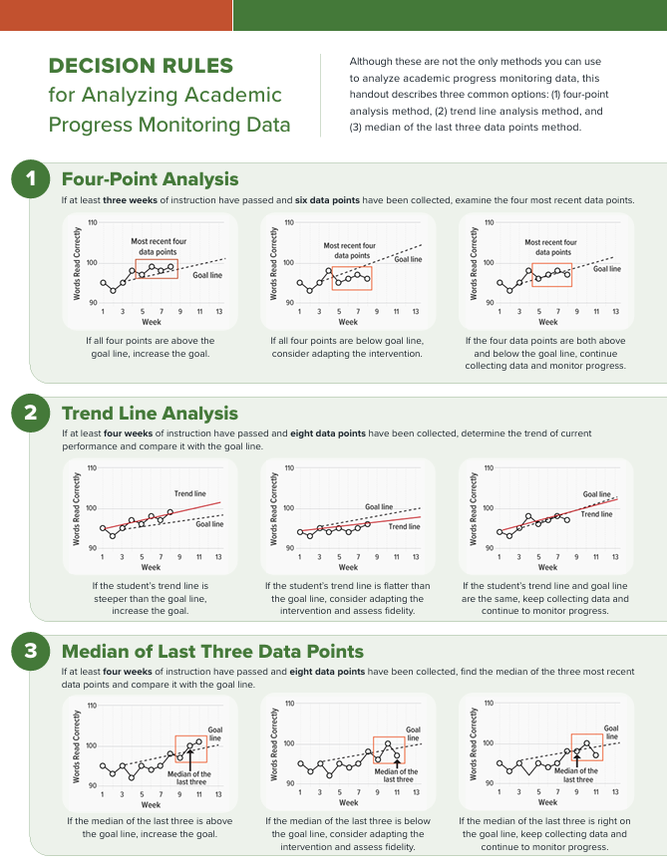


Decision Rules for Analyzing
Progress Monitoring Data Consistently
Four-Point Rule
Trend Line Analysis
Median of Last Three Points
Decision Rules for Analyzing Academic Progress Monitoring Data | NCII

Slide 81
Keep The Focus On…
All students can learn given the right support!
Simple plans
Relentless
implementation

Slide 82
Day 2 Agenda
10:30 am – 11:30 am: DBI in Practice (Mia Case Study)
11:30 am – 1:00 pm: Lunch on Your Own
1:00 pm – 2:30 pm: Basic Principles of Behavior
2:30 pm – 3:00 pm: Wrap Up and Action Planning

Slide 83
Day 1 Reflection
Think:
Reflect on yesterday, what components do you think are most critical for your school/district to focus on for DBI implementation to be successful?
  If you do not currently work in a school setting, what components are most critical for your role in DBI implementation?
What are potential challenges or barriers to DBI implementation in your school/district/role? What are some potential solutions?
Share one barrier and one solution with a partner!

Slide 84
DBI in Action: Mia Case Study

Slide 85

Before We Jump In: DBI Process Review
Yesterday, we learned that DBI is a structured process for intensifying intervention when students need more support.
As we work through Mia’s case, watch for how the team:
Identifies the concern using multiple data sources
Reviews intervention quality and progress monitoring data
Uses diagnostic information to develop a hypothesis
Adapts the intervention based on the hypothesis
Monitors progress to determine whether Mia is responding

Slide 86


Background
Mia is in second grade.
She scored in the 19th percentile on fall reading screening (on composite score).
  Well below benchmark in Nonsense Word Fluency.
She has difficulty decoding most CVC words.
Her teacher referred her to the school’s student support team (SST).

Slide 87
Step 1: Validated Intervention Program
Mia receives a small group phonics intervention, four times per week for 30 minutes per session. Includes:
  Matching letter sounds to pictures.
  Teaching students to blend letter-sounds.
  Reading word lists with focus letter-sound correspondences.
  Reading decodable text.

Slide 88
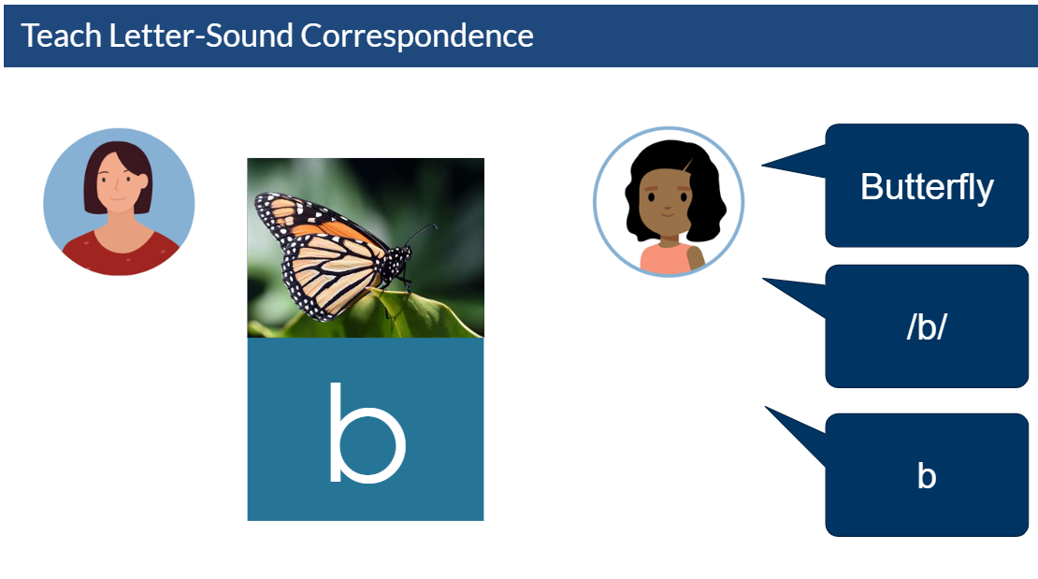
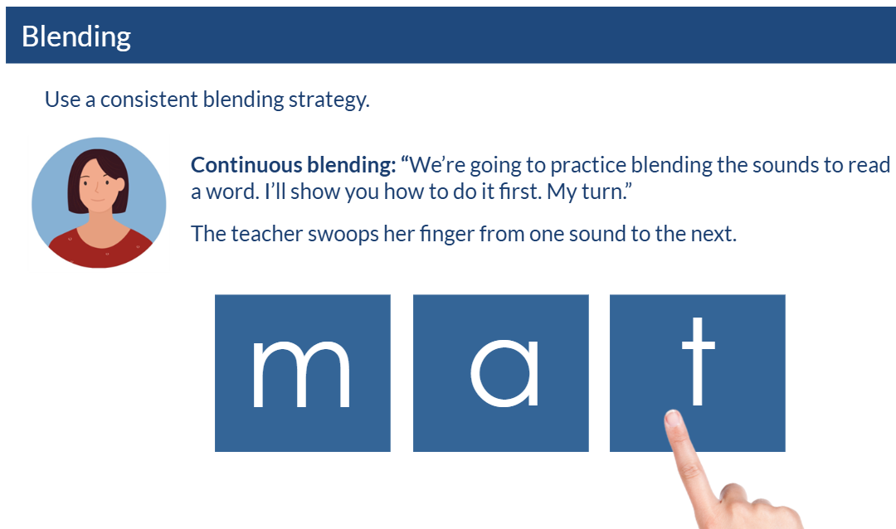
Example Instructional Activities

Slide 89

Select the Progress Monitoring Plan
Based on Mia’s background and intervention, discuss:
What skill should the team progress monitor?
What measure would align with that skill?
What would you want to know before setting a goal?

Slide 90
Step 2: Progress Monitoring 2
Mia was progress monitored using the first grade Nonsense Word Fluency (NWF) assessment because she has not yet reached benchmark on that measure/skill.
Mia’s baseline performance is 12 correct letter sounds per minute.
The team set a goal of 58 correct letter sounds by late January.
Given Mia’s scores and an intervention focused on phonics, what is an appropriate progress monitoring tool?

Slide 91
Evaluate Progress Monitoring Data
After implementing the intervention and collecting data for 6 weeks, Mia’s trendline was flat, indicating that she was not on track to meet the goal of 58 correct letter sounds.

Slide 92
Step 3: Diagnostic Data
As an initial step, the SST reviewed fidelity data, the quality of the progress monitoring process, and Mia’s behavioral needs.
Intervention Fidelity
Mia was present and engaged for most sessions.
Progress Monitoring
The NWF assessment is aligned to Mia’s needs.
Behavior Needs
No concerns about Mia’s behavior.

Slide 93

Initial Hypothesis
Mia’s progress monitoring data showed little to no growth toward her decoding goal.
Intervention data showed Mia’s accuracy with CVC words remained below 90%, suggesting she was still in an early learning phase.
Based on a phonemic awareness/phonics survey and a review of the intervention curriculum, the team hypothesized that:
  the intervention content was generally aligned to Mia’s need, but
  the instruction was not explicit enough to help Mia accurately blend sounds when decoding words.
Mia would likely benefit from additional modeling, guided practice, and corrective feedback focused on blending sounds in CVC words.

Slide 94
Hypothesis Development
At the end of the lesson, can Mia decode CVC words with at least 90% accuracy? (No)
Hypothesis 1: The intervention curriculum is not fully aligned with the student’s needs.
Hypothesis 2: The instruction is not explicit enough.
Review data from phonemic awareness inventory.
Review intervention curriculum and evaluate alignment to Mia’s needs.
Observe intervention for the use of explicit instruction.

Slide 95
Initial Hypothesis 2
Mia would benefit from additional modeling and guided practice on blending sounds when decoding words.

Slide 96
Step 4: Intervention Adaptation
The SST decided to focus on increasing the amount of modeling, guided practice, and immediate corrective feedback that Mia receives in the intervention.
Intensification Strategies for Mia
Provide guided practice using magnetic letters and sound boxes.
Increase the amount of immediate corrective feedback.
Model how to decode words using sound boxes.

Slide 97
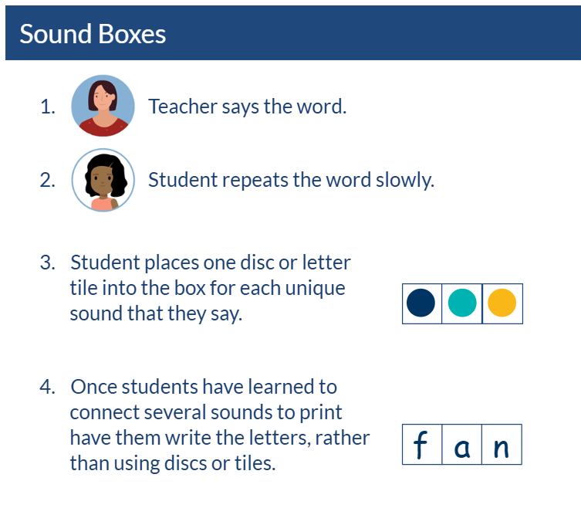
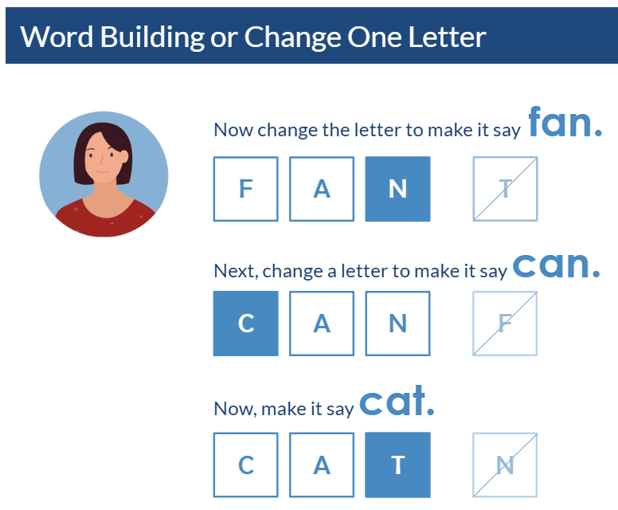
Example Instructional Activities 2

Slide 98
Step 5: Progress Monitoring (Round 2)
After an additional 6 weeks of intervention, Mia’s trend line increased but the rate of improvement was not sufficient to meet the goal.

Slide 99
Step 3: Diagnostic Data (Round 2)
After 6 additional weeks, Mia’s progress improved, but not enough to meet her goal.
The SST reviewed Mia’s intervention and progress monitoring data to determine why growth was still limited.
The team confirmed:
  Mia received the adapted intervention with adequate fidelity.
  Mia could decode CVC words accurately during instruction.
  Mia had difficulty retaining the skill across lessons.

Slide 100
Hypothesis Development (Round 2)
At the end of the lesson, can Mia decode CVC words with at least 90% accuracy? (Yes)
If Mia demonstrated initial acquisition of the new skill, can she perform it with at least 90% accuracy the next day? (No)
Hypothesis 3: The dosage of instruction is not sufficient.
Observe intervention for the use of OTRs.

Slide 101
Hypothesis #2
Mia would benefit from systematically increasing the number of OTRs during intervention sessions and from increased practice outside of the intervention.

Slide 102
Step 4: Intervention Adaptation (Round 2)
The SST determined they would increase practice opportunities by using flashcards to build Mia’s fluency with reading CVC words.
Adaptation #1
Provide guided practice using magnetic letters and sound boxes.
Increase the amount of immediate corrective feedback.
Model how to decode words using sound boxes.
Adaptation #2
Ten minutes of tablet-based CVC word reading practice three times per week during independent learning time
Five minutes of additional flashcard practice each day

Slide 103

Continuing the DBI Process
Progress monitoring will continue, and the SST will review Mia’s progress in 6 weeks.
The SST will further adapt the intervention if Mia does not make adequate progress.

Slide 104
What Mia’s Example Showed Us
Mia’s case study showed illustrated how teams use DBI to:
Start with student data
Identify whether current support is enough
Look more closely when progress is limited
Make an instructional adjustment based on need
Continue monitoring to see whether the change worked

Slide 105
Connecting the Case Study to the DBI Process
DBI gives teams a structure for moving from a broad concern to a precise instructional response.
From: This student needs help.
To: This is the specific support we will provide, and this is how we will know whether it is working
The goal is not to copy Mia’s plan. The goal is to understand the process the team used: start with data, identify the specific need, adjust support, and continue monitoring progress.

Slide 106
Think, Pair, Share 2
In Mia’s example, what stood out to you the most?
How did the team use data to decide what Mia needed next?

Slide 107
Focusing on the Function of Behavior Within the Context of DBI

Slide 108

Introduction
Caitlyn Majeika, PhD, BCBA
Research Translation and Capacity-building Specialist

Slide 109
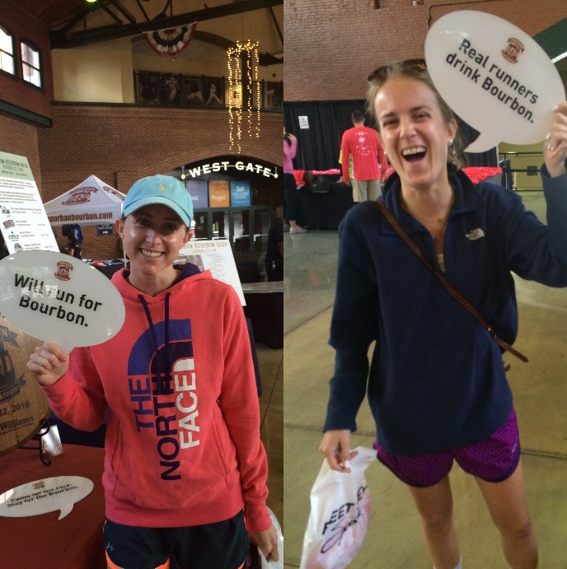
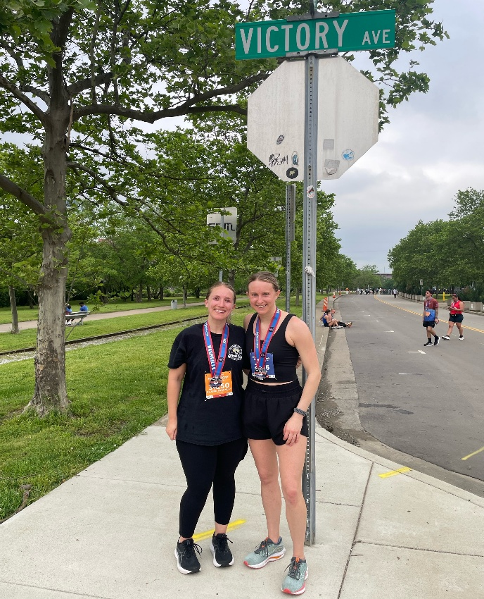
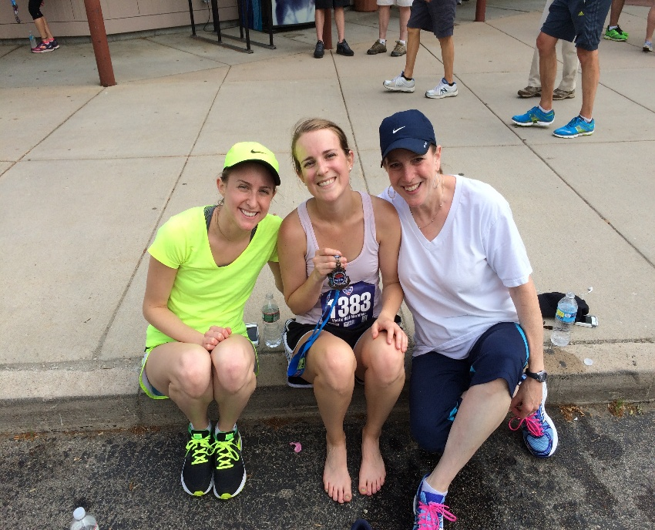
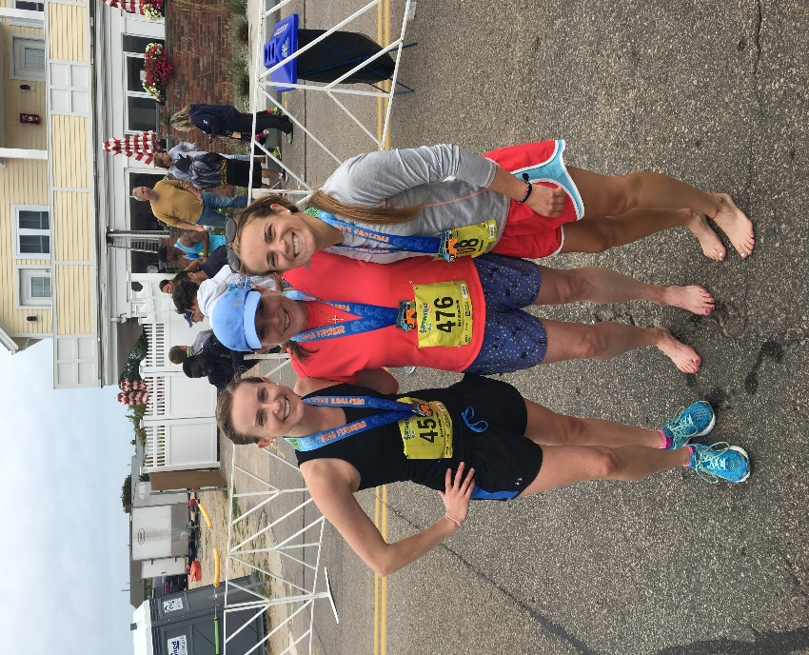

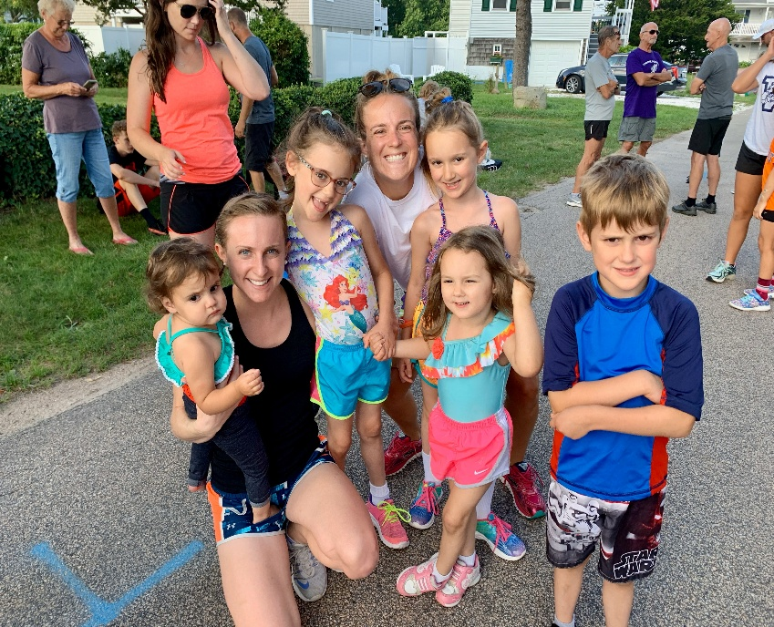
About Caitlyn

Slide 110



Behavior Basics & DBI

Slide 111
Revisiting Mia
As an initial step, the SST reviewed fidelity data, the quality of the progress monitoring process, and Mia’s behavioral needs.
Intervention Fidelity
Mia was present and engaged for most sessions.
Progress Monitoring
The NWF assessment is aligned to Mia’s needs.
Behavior Needs
No concerns about Mia’s behavior.

Slide 112
Learner Outcomes 2
By the end of this session, you will be able to do the following:
  List three ways the function of behavior is important.
  Name at least four common functions of behavior.
  Describe how a function can be used within the diagnostic behavioral assessment process.

Slide 113
Setting the Scene

Slide 114
Mr. Robinson’s Perspective
Mr. Robinson is a seventh-grade reading interventionist. He has growing concerns about his sixth-period group, specifically his student Jasmine. Jasmine frequently talks to her peers during instruction and shouting out. Mr. Robinson believes he has tried everything—politely asking her to stop, providing a correction when Jasmine calls out, and speaking with Jasmine in the hallway. He admits he has even yelled a few times. His team recommended a token economy for Jasmine, but that has not worked either. He is frustrated and thinks this is impacting his ability to teach and other students’ ability to learn.

Slide 115
Think, Pair, Share 3
Individually: Take 30 seconds to reflect on the scenario presented in the previous slide. In what ways can you relate to Mr. Robinson? What would you do in his situation?
Pair: With someone you don’t know in your group, introduce yourself and discuss.
Share: Whole group share out.

Slide 116
Jasmine’s Perspective
Jasmine is in Mr. Robinson’s sixth-period reading intervention group. Jasmine often feels like Mr. Robinson only pays attention to the students who get the answers right. Jasmine is struggling with reading and has not been getting many answers correct lately. However, Mr. Robinson does pay attention to her when she talks to her friends or when she calls out. Sometimes he even speaks with her in the hallway! Jasmine wants to be a good student, and she knows she shouldn’t be calling out, but how else can she get Mr. Robinson to pay attention to her?

Slide 117
Think, Pair, Share 4
Individually: Take 30 seconds to reflect on the scenario in the previous slide. In what ways are Mr. Robinson’s and Jasmine’s perspectives of the same situation different? How could these differences impact Mr. Robinson’s approach?
Pair: With someone you don’t know in your group, introduce yourself and discuss.
Share: Whole group share out.

Slide 118
Understanding the Function of Behavior
Understanding the function of behavior is important to:
ensure teachers do not inadvertently reinforce problem behavior;
help identify, teach, and reinforce socially and contextually appropriate replacement behaviors; and
guide individualization of behavior support.

Slide 119
Review of Behavioral Principles

Slide 120
Turn and Talk
With a partner, discuss any assumptions you’ve made about a student’s behavior in the past.

Slide 121
Behavior Is Learned
Do not assume children know the rules, expectations, or social skills.
Every social interaction you have with a child teaches him or her something.

Slide 122
Behavior Communicates a Need
Children engage in behavior to “get” or “avoid” something.
Determining what the student is trying to get or avoid is determined by observing what happens prior to and immediately after the behavior.

Slide 123
Three-Term Contingency
A
B
C
Antecedent
Behavior
Consequence

Slide 124
Antecedents in the Three-Term Contingency
An antecedent is any event that happens immediately before a
behavior occurs.
A
B
C

Slide 125
Behavior in the Three-Term Contingency
Behavior is the observable, measurable actions of
an individual.
A
B
C

Slide 126
How can we define behavior?
Operational definition: Breaking down a broad concept of behavior into its observable and measurable components.
  An observable definition describes what the student does, not what student does not do.
  A measurable definition describes something an observer can count.

Slide 127
Consequences in the Three-Term Contingency
A consequence is any event that happens immediately after a behavior occurs.
A
B
C

Slide 128
Types of Consequences
Reinforcement increases behavior
Consequence
decreases behavior

Slide 129
Positive and Negative Reinforcement
Positive reinforcement: Adding something pleasant or desirable to make a target behavior more likely to occur.
Negative reinforcement: Taking away something unpleasant or undesirable to make a target behavior more likely to occur.

Slide 130
Which is the best example of reinforcement?
Nathan and Shara argue over a toy. Nathan hits Shara. Shara lets go of the toy and Nathan takes it. Nathan hits peers often during play time the next day.
Nathan and Shara argue over a toy. Nathan hits Shara. Shara lets go of the toy and Nathan takes it.
Nathan and Shara argue over a toy. Nathan hits Shara.
Shout it out!

Slide 131
Positive and Negative Punishment
Positive punishment: Adding something unpleasant or undesirable that makes a behavior less likely to occur.
Negative punishment: Removing something pleasant or desirable that makes a behavior less likely to occur.

Slide 132
Which is the best example of punishment?
Lola’s teacher praises her for raising her hand. Lola raises her hand more often in science class.
Lola raises her hand to answer a question in science class.
Lola raises her hand to answer a question in her science class. Her teacher loudly praises her for raising her hand. Lola is embarrassed by the praise. She doesn’t raise her hand for the rest of the week.
Shout it out!

Slide 133
Reminder: Reinforcement and Punishment
Whether a behavior is reinforced or punished depends on the learner and the future occurrences of behavior.
  Reinforcement has occurred only if the behavior maintains or increases.
  Punishment has occurred only if the behavior decreases or stops.

Slide 134
Why Does This Matter?
Antecedents and consequences can be changed to help reduce problem behavior and increase prosocial behavior.
A
B
C
Understanding function helps us identify how to change antecedents and consequences.

Slide 135
Function of Behavior

Slide 136

What is the function of behavior?
Behavior always serves a purpose or function (i.e., to obtain a desired outcome or goal).

Slide 137
Example of Functions
Access to attention, tangibles, a preferred activity, or sensory stimulation
Avoidance of tasks, specific environment or situations, social interaction, or unpleasant sensory stimulation

Slide 138
Common Functions of Behavior
To Access, Obtain, or Get: | To Avoid or Escape From:
Peer attention | Difficult task
Adult attention | Boring task
Desired activity | Easy task
Desired object or items | Physical demand
Sensory stimulation (e.g., auditory, tactile) | Nonpreferred activity
 | Peer attention
 | Staff attention
 | Reprimands

Slide 139
Function and the Three-Term Contingency
A
B
C
A student engages in a behavior and the consequence may provide access to something preferred or escape from something nonpreferred. If so, the problem behavior is reinforced and maintained.

Slide 140
Example of Function
Ms. Hernandez tells the students to raise their hand when they want to answer a question.
Joanie raises her hand during math class.
Ms. Hernandez smiles, thanks Joanie for raising her hand, and asks her for her response. Joanie raises her hand every day.
Maintaining Consequence and Function

Slide 141
What is a possible function of Joanie’s behavior?
To Access, Obtain, or Get: | To Avoid or Escape From:
Peer attention | Difficult task
Adult attention | Boring task
Desired activity | Easy task
Desired object or items | Physical demand
Sensory stimulation (e.g., auditory, tactile) | Nonpreferred activity
 | Peer attention
 | Adult attention
 | Reprimands

Slide 142
What is a possible function of Joanie’s behavior? 2
To Access, Obtain, or Get: | To Avoid or Escape From:
Peer attention | Difficult task
Adult attention | Boring task
Desired activity | Easy task
Desired object or items | Physical demand
Sensory stimulation (e.g., auditory, tactile) | Nonpreferred activity
 | Peer attention
 | Adult attention
 | Reprimands

Slide 143
Another Example of Function
Mr. Young asks each student to read independently.
Xiamora loves reading with a buddy. She loudly complains.
Mr. Young lets Xiamora read with a friend.
Maintaining Consequence and Function

Slide 144
What is a possible function of Xiamora’s behavior?
To Access, Obtain, or Get: | To Avoid or Escape From:
Peer attention | Difficult task
Adult attention | Boring task
Desired activity | Easy task
Desired object or items | Physical demand
Sensory stimulation (e.g., auditory, tactile) | Nonpreferred activity
 | Peer attention
 | Adult attention
 | Reprimands

Slide 145
What is a possible function of Xiamora’s behavior? 2
To Access, Obtain, or Get: | To Avoid or Escape From:
Peer attention | Difficult task
Adult attention | Boring task
Desired activity | Easy task
Desired object or items | Physical demand
Sensory stimulation (e.g., auditory, tactile) | Nonpreferred activity
 | Peer attention
 | Adult attention
 | Reprimands

Slide 146
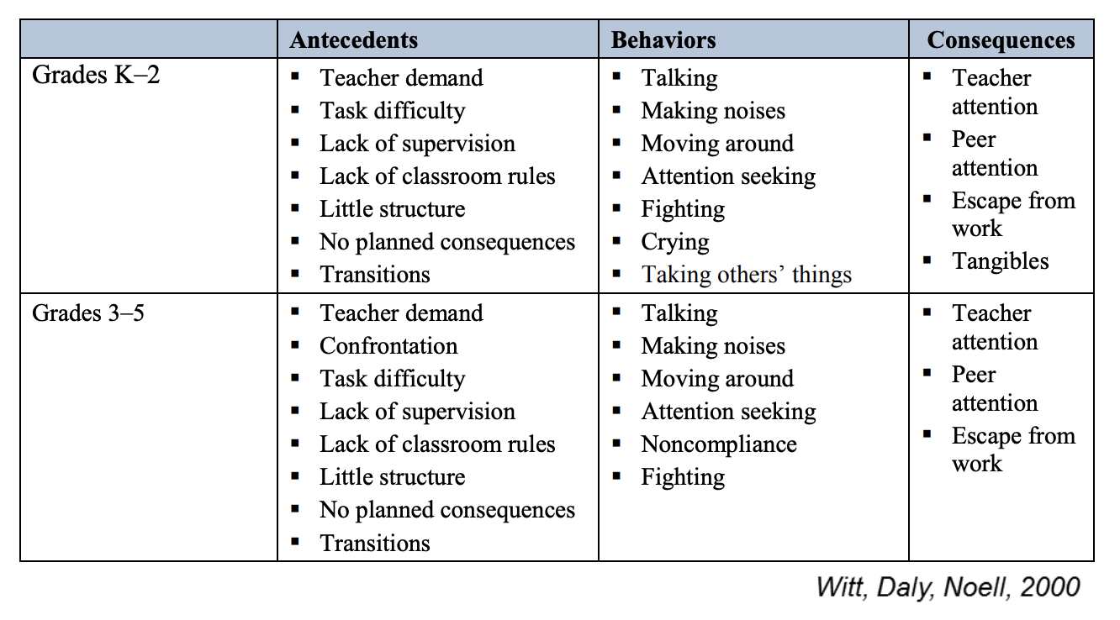
Problem Behaviors and Some Usual Suspects for
Functional Antecedents and Consequences
Witt,. C, Daly, E. M., & Noell, G. H. (2000). Functional assessments: A step-by-step guide to solving academic and behavior problems. Longmont, CO: Sopris W

Slide 147
Activity 1: Function of Behavior
Workbook

Slide 148
Activity 1: Time to Share

Slide 149
Why determine a behavior’s function?
Because we know:
  behaviors always serve a function,
  behaviors are contextual and vary by individual, and
  identifying a behavior’s function can help us pinpoint a plan to reduce problem behavior and increase prosocial behavior.

Slide 150
Diagnostic Behavioral Data and Data-Based Individualization (DBI)
When do we consider the function of behavior?

Slide 151
Function and Diagnostic Behavioral Data
Function is a key part of diagnostic behavior data and can be used to:
  develop a hypothesis for why the student is not responding,
  develop function-based interventions, and
  determine how to adapt an intervention.

Slide 152

Function and DBI
https://intensiveintervention.org/

Slide 153

Diagnostic Behavioral Data
A common way to collect diagnostic behavioral data is through a functional behavioral assessment (FBA) to identify the function of behavior.

Slide 154
FBAs
Informal
Formal
Want to learn more about conducting FBAs?​
  Center on PBIS FBA Guide​
  IRIS Center Module on FBA

Slide 155
Function-Based Interventions
When adapting interventions, we use function to change A, B, and C.
Antecedent
Problem behavior
Maintaining consequence and function
Targeted Routine
FUNCTION
Function should guide the selection of prevention strategies.

Slide 156
Turn and Talk 5
With a partner, discuss any experience you’ve had with considering the function of behavior when adapting interventions.

Slide 157
When can we consider function as part of diagnostic behavior assessment?
As part of the DBI process
When developing an individualized education program (IEP)
When developing a Behavior Intervention Plan (BIP)

Slide 158
Review

Slide 159
Review: Big Ideas
Behavior is learned, serves a function, and is related to the context in which it occurs.
Understanding function of behavior is one component of DBI and diagnostic behavioral assessment.
Functions of behavior include access to or avoidance of attention, tasks, activities, or sensory stimulation.

Slide 160
Pause and Reflect
How will you apply the concepts related to the function of behavior you learned today?

Slide 161
Questions?

Slide 162
Related Resources
Behavior Basics
NCII Behavior Basics: Understanding Principles of Behavior
NCII Defining, Measuring, and Monitoring Behavior
Conducting an FBA
  Center on PBIS FBA Guide
  IRIS Center Module on FBA
  NCII Using an ABC Report Form with an FBA
  NCII ABC Checklist

Slide 163
Lessons Learned

Slide 164
1. Support From Leadership is Essential.
Establishes purpose and focus to build a shared vision:
  What is the work that you are trying to implement, and why is this work important to you and others you work with?
  Why should we care about DBI and intensive intervention?
Shapes culture and expectations
Communicates with and promotes buy-in and involvement of staff in decision making
Provides supporting resources and structures, including assessments, interventions, professional development, and staff time

Slide 165
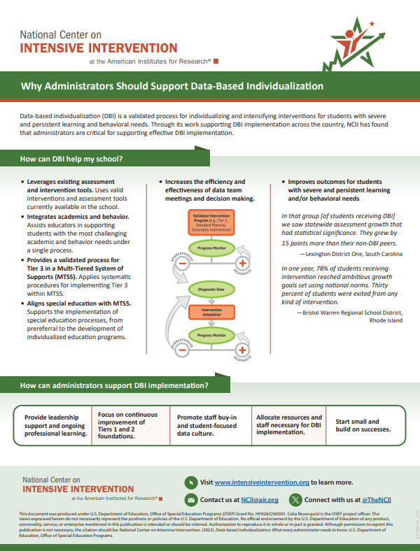
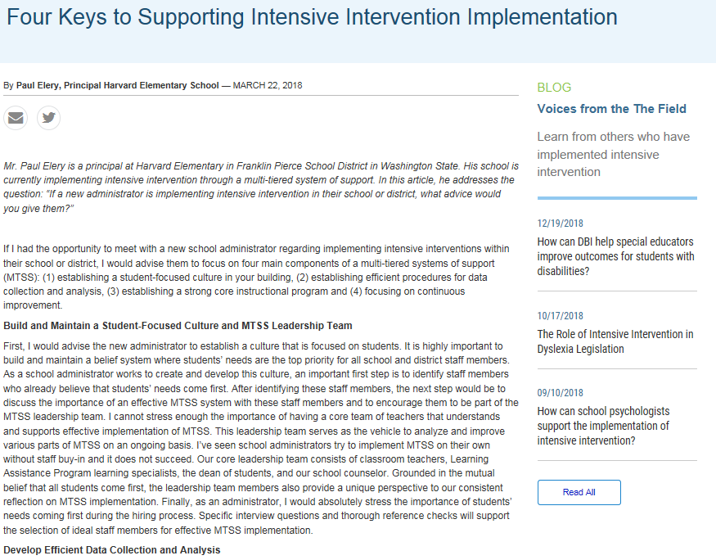
Leadership Resources
Four Keys to Support Intensive Intervention
Administrators & DBI

Slide 166

2. Ensure Solid Tier 1 and 2.
Starting with a solid foundation helps to ensure the right students are identified for additional support and that teachers can focus on those students.
Ensure appropriate infrastructures are in place:
    Screening
    Progress monitoring
    Data-based decision making
    High-quality instruction and intervention

Slide 167
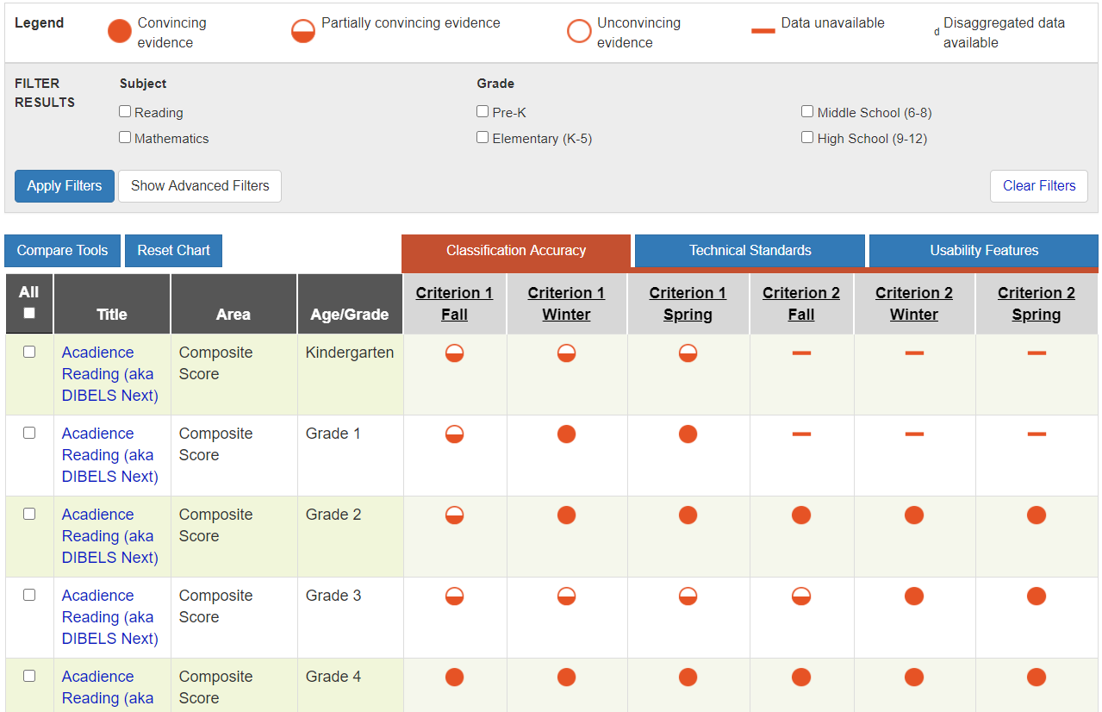
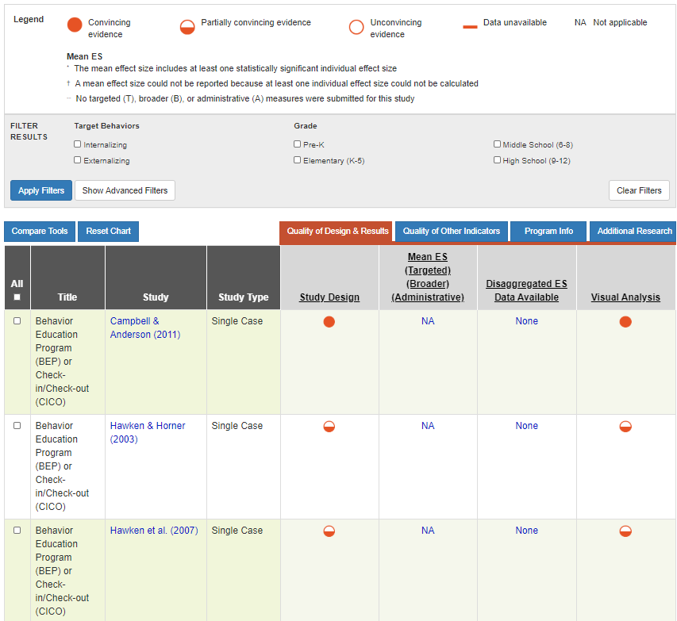
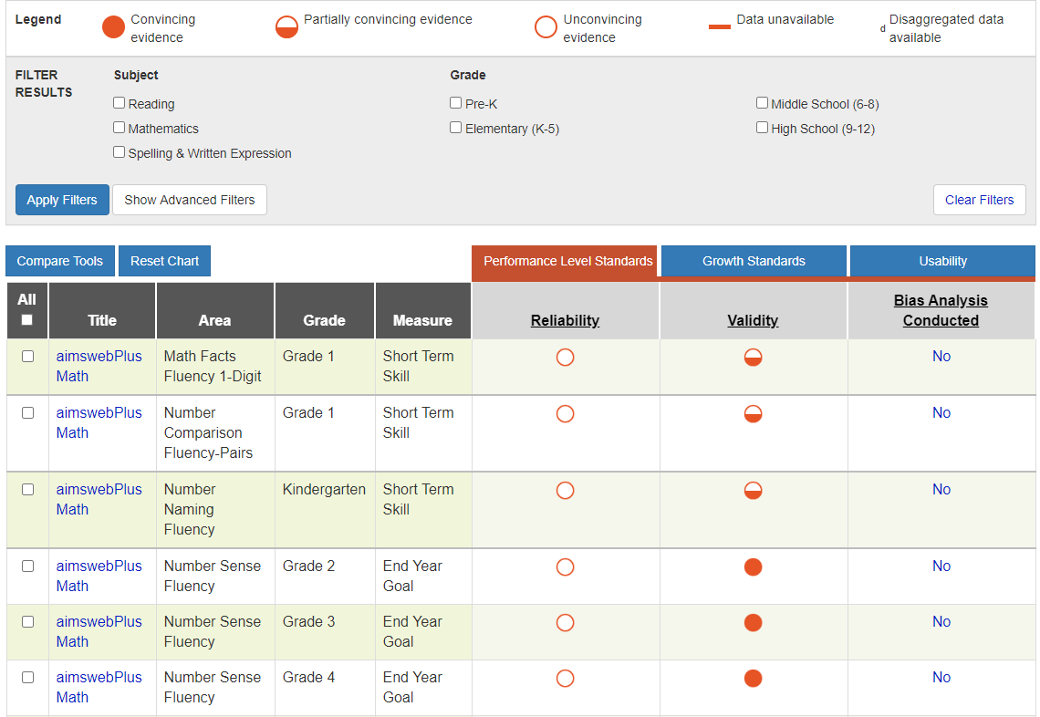
Tier 1 and 2 Resources: Academic and Behavior Assessment and Intervention Tools Charts
Screening Tools Chart
Intervention Tools Chart
Progress Monitoring Tools Chart

Slide 168
3. Start Small and Focus on One Step at a Time.
Staff shared: Small-scale implementation allowed them to concentrate on understanding the DBI process and learning how to integrate the process into their instruction.
Leaders shared: Not overcommitting in the early stages of DBI implementation was critical to ensuring that teachers were not overwhelmed or frustrated and to allowing them to experience initial successes.

Slide 169
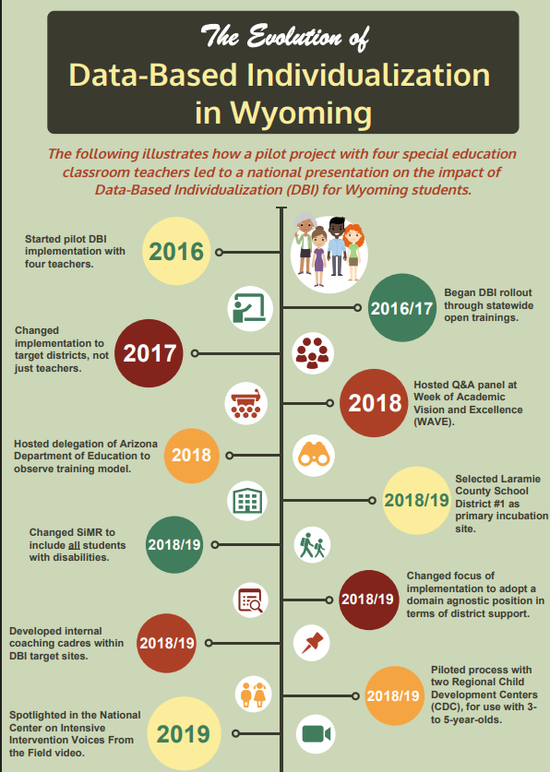
Resource: State Example
Started with just 4 teachers
Expanded to district level
  Used early adopters as coaches
Expanded across districts
Embedded in state strategic plan
Wyoming State Story | NCII

Slide 170
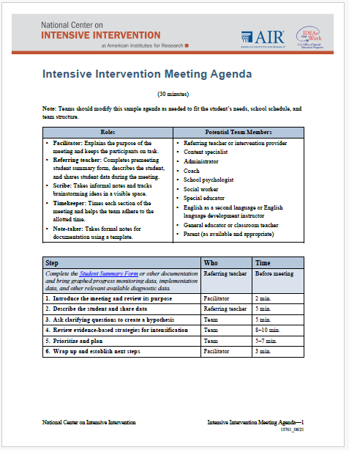
4. Use Formalized Procedures and Standard Protocols.
Ensure processes are clearly documented (e.g., scripted meeting agendas and clear guidelines).
Provide ongoing professional development to ensure that the knowledge is not placed with a few key individuals and to maintain sustainability when staffing changes.

Slide 171
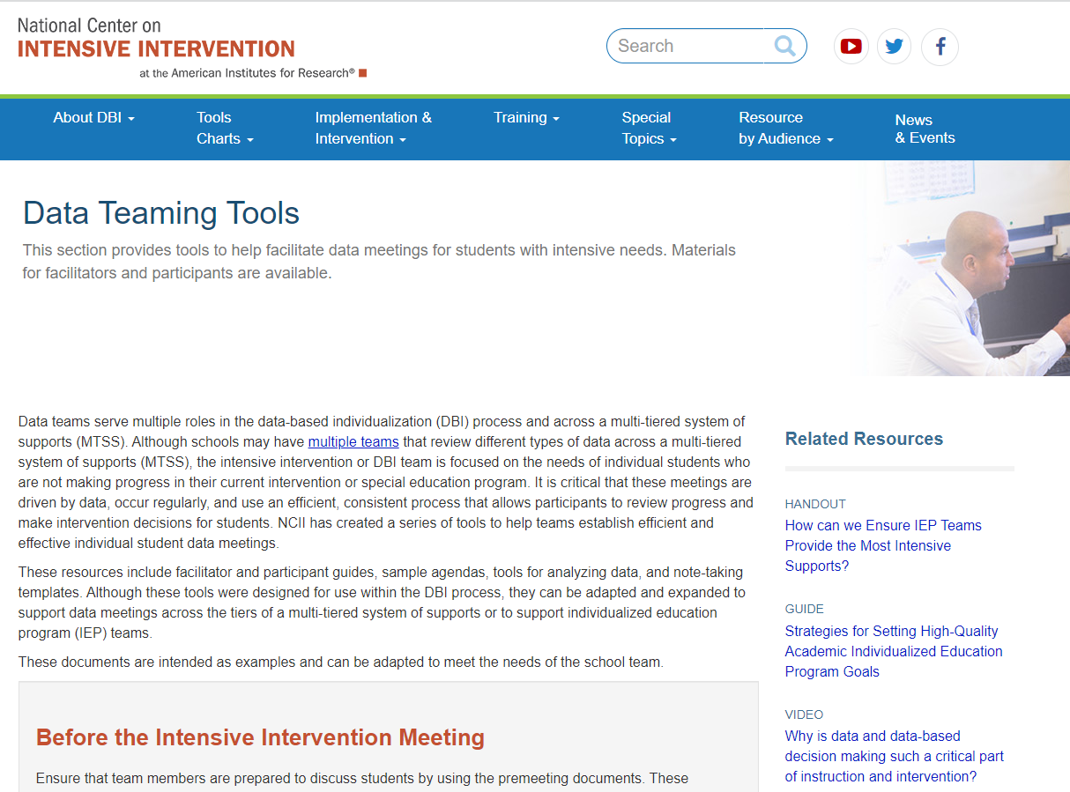
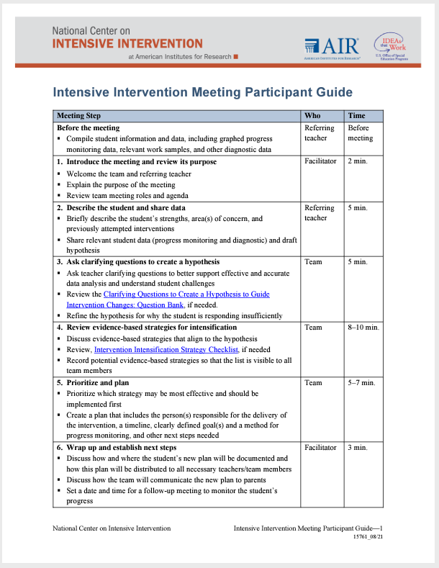
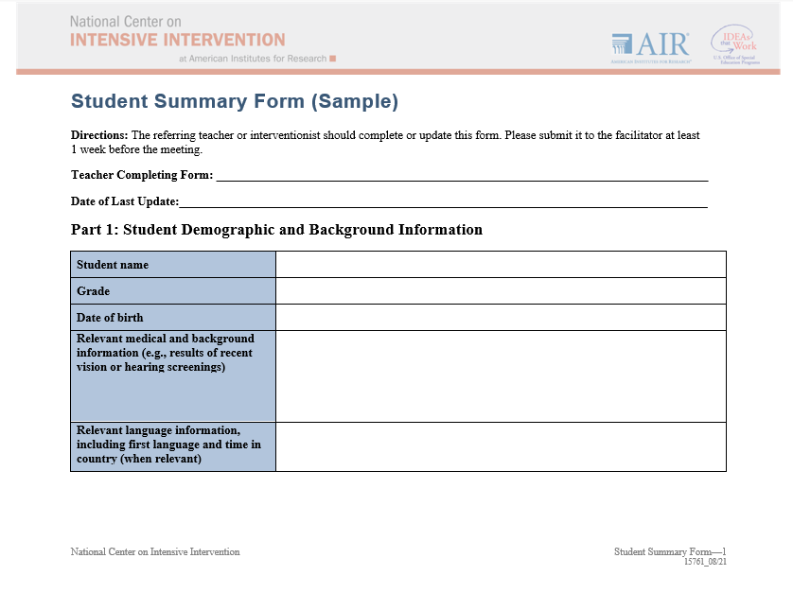
Facilitated Meetings to Review Data
https://intensiveintervention.org/implementation-intervention/data-teaming

Slide 172
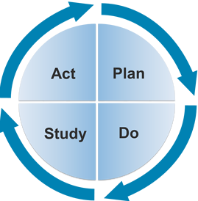
5. Commit to the Process.
It is important to commit to implementing the DBI process for an
extended period and to know that the process will likely be bumpy along the way.
“Data-based decision making is not for wimps . . . You really got to go in knowing that it’s hard work. . . . Once you’ve made that commitment, you can’t just give up. . . . The only answer we’ve found so far is sometimes just going ahead and doing what we need to do and having the people look at the success.” (TA Recipient NCII 2012-2016)

Slide 173
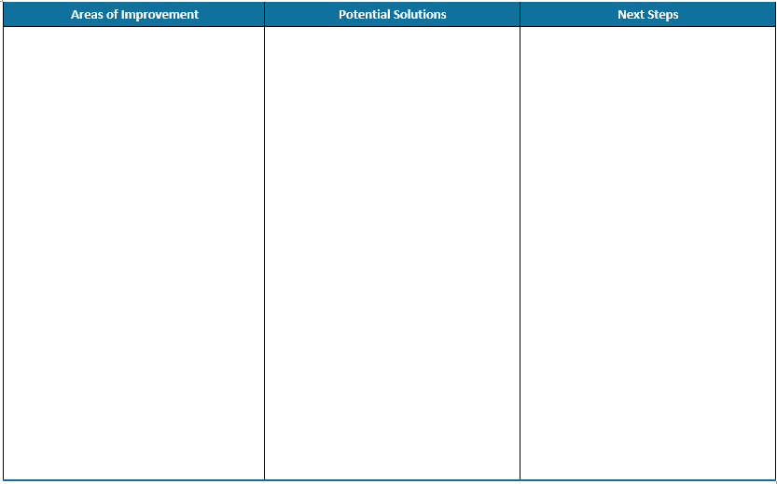
Action Planning
Check out the implementation stories on our website to get some ideas:
Lexington District One | NCII
State Implementation Stories | NCII

Slide 174
What Did You Learn?
Using a fist to five, now how familiar are you with data-based individualization (DBI) now?
0 | 1 | 2 | 3 | 4 | 5
Never heard of it |  |  |  |  | We use it and I could explain it to others

Slide 175
Did we achieve our outcomes?
Can you…
explain the rationale for intensive intervention?
describe the steps in the data-based individualization (DBI) process?
apply lessons learned to improve implementation of DBI?
access and use NCII resources to support implementation of DBI?
identify next steps?

Slide 176

We Appreciate You!
NCII cannot do what we do without you!
We appreciate your attendance, investment, and enthusiasm for our work and ongoing commitment to installing DBI in schools across the country.
Our work is always in service of doing right by kids and educators. We’d love to stay connected and learn more about your impact.
This Photo by Unknown Author is licensed under CC BY

Slide 177
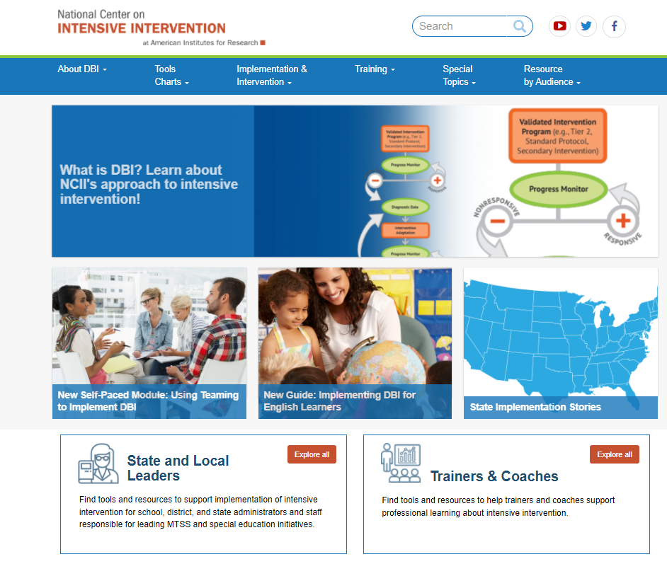
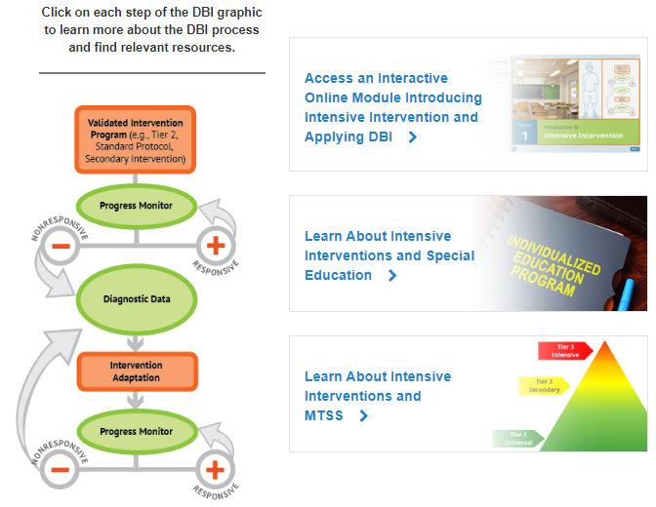
How can you learn more? Explore the many resources available on NCII’s Website

Slide 178
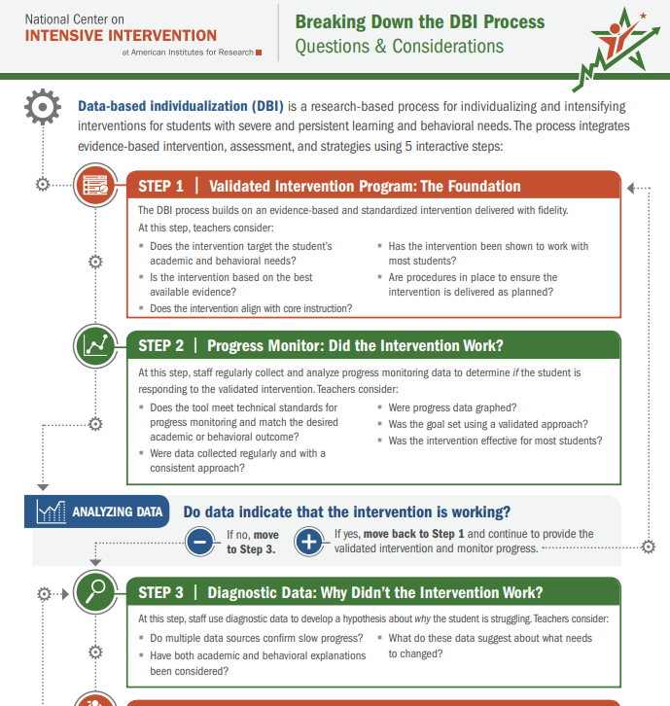
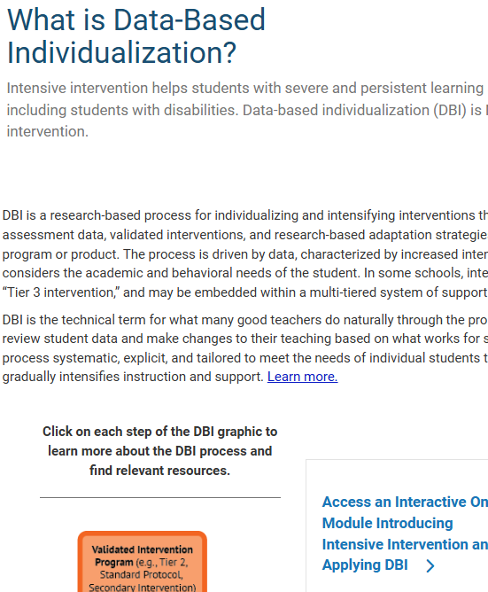
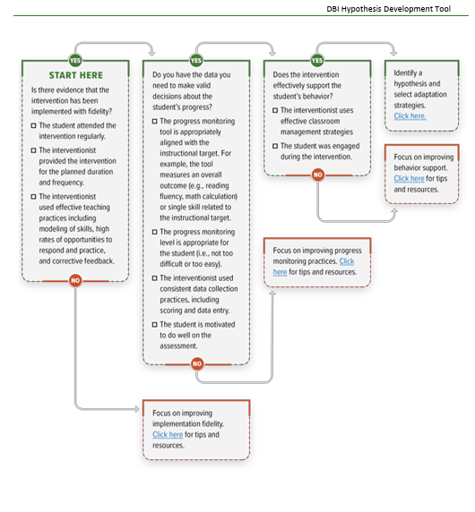
Resources
Breaking Down the DBI Process Questions & Considerations | NCII
Data Based Individualization: Intensive Intervention | NCII
Data-Based Individualization Hypothesis Development Tool

Slide 179
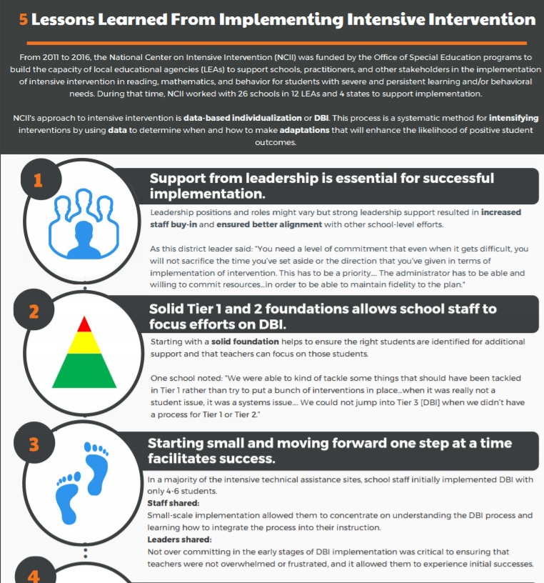
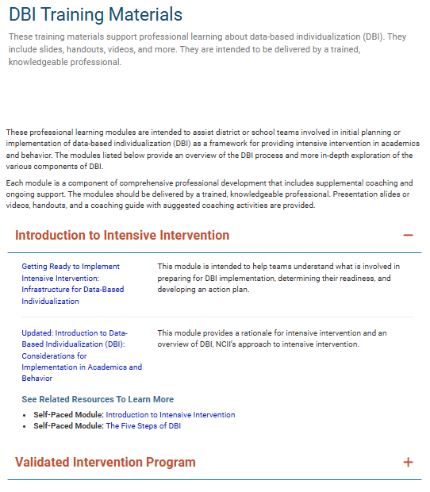
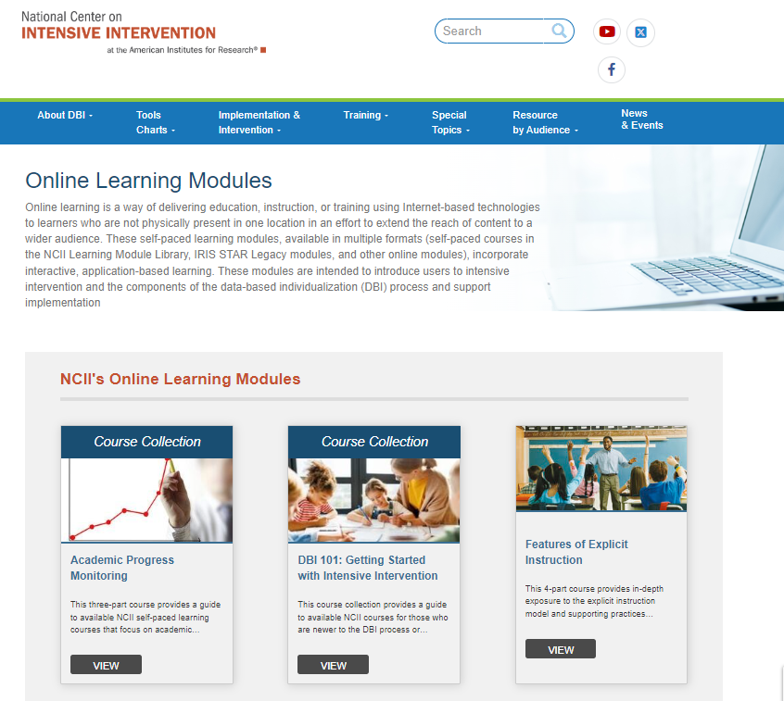
Resources 2
5 Lessons Learned From Implementing Intensive Intervention
DBI Training Materials | NCII
Online Learning Modules | NCII

Slide 180



How can you stay connected?
https://www.linkedin.com/in/national-center-on-intensive-intervention
https://www.facebook.com/TheNCII/
https://twitter.com/TheNCII
Sign-up on the bottom of each page of the NCII website)

Slide 181
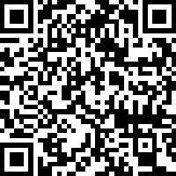

Let Us Know What You Thought
Interested in a certificate of attendance? Please indicate this in your survey. We will gather this information from our evaluators and send certificates to everyone who requests one.
https://meadowscenter.ca1.qualtrics.com/jfe/form/SV_6L0XMY8SSeuIGjA

Slide 182
Thank you

Slide 183
References
Blackorby, J., Knokey, A., Wagner, M., Levine, P., Schiller, E., & Sumi, C. (2007). What makes a difference? Influences on outcomes for students with disabilities. Menlo Park, CA: SRI International. Retrieved June 12, 2007.
Capizzi, A. M., & Fuchs, L. S. (2005). Effects of Curriculum-Based Measurement With and Without Diagnostic Feedback on Teacher Planning. Remedial and Special Education, 26(3), 159–174.
Cortiella, C. (2011). The state of learning disabilities: Facts, trends, and indicators. Washington, DC: National Center for Learning Disabilities.
Dane, A. V. and Schneider, B. H. (1998) Program integrity in primary and early secondary prevention: are implementation effects out of control? Clinical Psychology Review, 18, 23–4.
Fuchs, L. S., Deno, S. L., & Mirkin, P. K. (1984). The effects of frequent curriculum-based measurement and evaluation on pedagogy, student achievement, and student awareness of learning. American Educational Research Journal, 21(2), 449–460.
Fuchs, L., Fuchs, D., & Capizzi, A. (2005). Identifying appropriate test accommodations for students with learning disabilities. Focus on Exceptional Children, 37(6). https://doi.org/10.17161/fec.v37i6.6812

Slide 184
References 2
Fuchs, L. S., Fuchs, D., & Hamlett, C. L. (1989). Effects of instrumental use of curriculum-based measurement to enhance instructional programs. RASE: Remedial & Special Education, 10(2), 43–52.
Fuchs, L. S., Fuchs, D., & Malone A. S. (2017). The taxonomy of intervention intensity. Teaching Exceptional Children, 50(1), 35–43.
Gersten, R., Compton, D., Connor, C.M., Dimino, J., Santoro, L., Linan-Thompson, S., and Tilly, W.D. (2009). Assisting students struggling with reading: Response to Intervention and multi-tier intervention for reading in the primary grades. A practice guide. (NCEE 2009-4045). Washington, DC: National Center for Education Evaluation and Regional Assistance, Institute of Education Sciences, U.S. Department of Education. Retrieved from https://ies.ed.gov/ncee/wwc/PracticeGuide/3
Gresham, F. M., Gansle, K. A., Noell, G. H., Cohen, S., et al. (1993). Treatment integrity of school-based behavioral intervention studies: 1980–1990. School Psychology Review, 22(2), 254–272.
Jung, P. G., McMaster, K. L., Kunkel, A. K., Shin, J., & Stecker, P. M. (2018). Effects of data‐based individualization for students with intensive learning needs: A meta‐analysis. Learning Disabilities Research & Practice, 33(3), 144–155

Slide 185
References 3
Kuchle, L. B., & Riley-Tillman, T. C. (2019). Integrating behavior and academics in intervention planning. In R.Z. Edmonds, A.G. Gandhi, & L.C. Danielson (Eds.). Essentials of intensive intervention (pp. 51-70). The Guilford Press.
National Center on Intensive Intervention. (2013). Data-based individualization: A framework for intensive intervention. Washington, DC: American Institutes for Research. Retrieved from https://intensiveintervention.uat.air.org/resource/data-based-individualization-framework-intensive-intervention
Newman, L., Wagner, M., Knokey, A. M., Marder, C., Nagle, K., Shaver, D., et al. (2011). The post-high school outcomes of young adults with disabilities up to 8 years after high school: A report from the National Longitudinal Transition Study-2 (NLTS2) (NCSER 2011–3005). Washington, DC: National Center for Special Education Research.
O’Donnell, C. L. (2008). Defining, Conceptualizing, and Measuring Fidelity of Implementation and Its Relationship to Outcomes in K–12 Curriculum Intervention Research. Review of Educational Research, 78(1), 33–84.
Sanford, C., Newman, L., Wagner, M., Cameto, R., Knokey, A. M., & Shaver, D. (2011). The post-high school outcomes of young adults with disabilities up to 6 years after high school: Key findings from the National Longitudinal Transition Study-2 (NLTS2) (NCSER 2011-3004). Washington, DC: National Center for Special Education Research.

Slide 186
References 4
Scammacca, N. K., Fall, A. M., & Roberts, G. (2015). Benchmarks for expected annual academic growth for students in the bottom quartile of the normative distribution. Journal of Research on Educational Effectiveness, 8(3), 366–379.
Stark, P., & Noel, A. M. (2015). Trends in High School Dropout and Completion Rates in the United States: 1972-2012. Compendium Report. NCES 2015-015. National Center for Education Statistics.
Stetser, M. C., & Stillwell, R. (2014). Public high school four-year on-time graduation rates and event dropout rates: School years 2010–11 and 2011–12. First look (NCES 2014-391). Washington, DC: National Center for Education Statistics.
Wagner, M., Newman, L., Cameto, R., Levine, P., & Garza, N. (2006). An overview of findings from wave 2 of the National Longitudinal Transition Study-2 (NLTS2) (NCSER 2006–3004). Washington, DC: National Center for Special Education Research.

