Slide 1

Error Analysis in Reading:
May 19, 2026
Using Oral Reading Errors to Inform Instructional Decisions
Jessica R. Toste, PhD • The University of Texas at Austin
Associate Professor of Special Education
University Distinguished Teaching Professor

Slide 2

Welcome!
Dr. Jessica Toste
Associate Professor in the Department of Special Education and Distinguished Teaching Professor at The University of Texas at Austin

Slide 3
Session Overview
Data-Based Individualization
  Primary Data Sources for DBI
What is Error Analysis?
Conducting CBM ORF Error Analysis
  Four Steps
Resources
Presentation content © 2026 Toste Team

Slide 4
Data-Based Individualization
DBI is a systematic, ongoing process of using student data to determine when and how to intensify intervention to meet individual student’s learning needs
DBI results in significant improvements in academic performance of students with learning disabilities, and even larger effects associated with greater use of data to guide instruction (Filderman et al., 2018; Fuchs et al., 2021; Jung et al., 2018; Stecker et al., 2005)
DBI begins with the implementation of a validated intervention—an evidence-based instructional program that has been shown to be effective
During intervention, assessment data inform ongoing instructional decisions

Slide 5

Primary Data Sources for DBI
There are two key decision points in DBI:
  First, to determine whether to adjust instruction
  Then, if there is a need to adjust instruction, to decide how to do so
Two sources of data relevant to these decision points
Progress Monitoring
Diagnostic Assessment

Slide 6
Progress Monitoring
Repeated measurement of student performance to evaluate whether intervention is producing desired growth – sensitive to small changes over time
Most useful are general outcome measures, which assess overall reading proficiency by sampling performance from a broad skill
  GOMs reflect cumulative learning and can be used to compare student growth over time and across contexts
  Curriculum-based measurement (CBM)

Slide 7
Progress Monitoring
Oral reading fluency (ORF) CBM is most relevant for progress monitoring during reading intervention – number of words correct in 1 min passage reading
Fluency serves as a proxy of overall reading achievement
  ORF scores are strongly associated with standardized measures of reading
Questions these data can address:
Is the current intervention producing meaningful growth?
Is the student’s rate of growth sufficient to meet individualized goals?
Is there a need to intensify, modify, or maintain current intervention?

Slide 8
Diagnostic Assessment
In-depth information about student’s specific reading strengths and weaknesses and are used to individualize instruction
  May assess discrete academic skills or behavioral or motivational factors
Typically administered when progress data indicate inadequate response to intervention or when learning profile is unclear
Questions these data can address:
What hypotheses can be generated about the student’s learning needs?
How should instruction be tailored or intensified to meet those needs?

Slide 9

Image generated by Jessica Toste via ChatGPT (2026)

Slide 10
What is Error Analysis?
CBM ORF data are reliable and valid, and the fine-grained analysis of a student’s errors on this assessment can directly inform instructional decision-making
Error analysis examines which words students misread — and what features those words share — to uncover specific learning needs
Through this diagnostic assessment, educators are able to identify the specific word features causing difficulty and use them to set targeted instructional priorities within the intervention

Slide 11
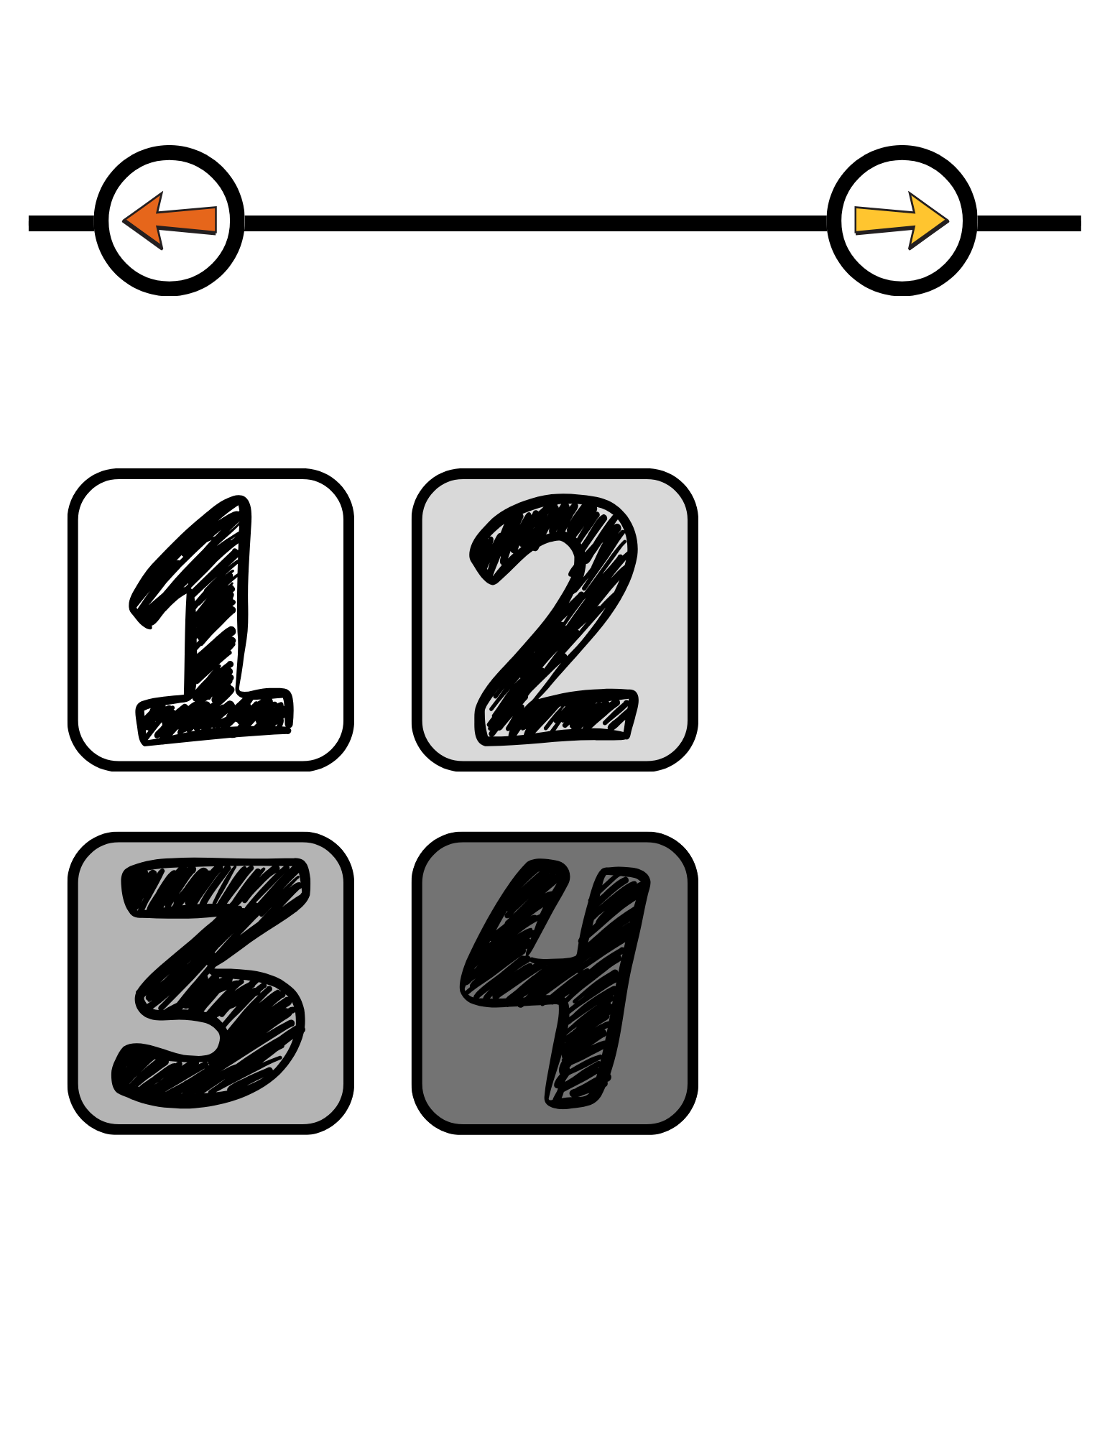
CBM ORF Error Analysis
Administer ORF Assessment
Identify All Student Errors
Categorize and Analyze Errors
Use Error Analysis Data to Inform Instructional Adjustments

Slide 12
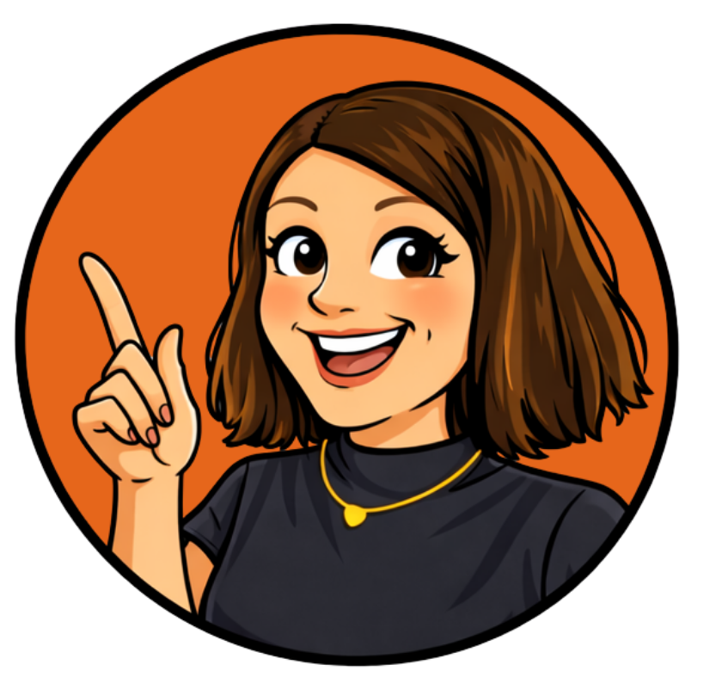
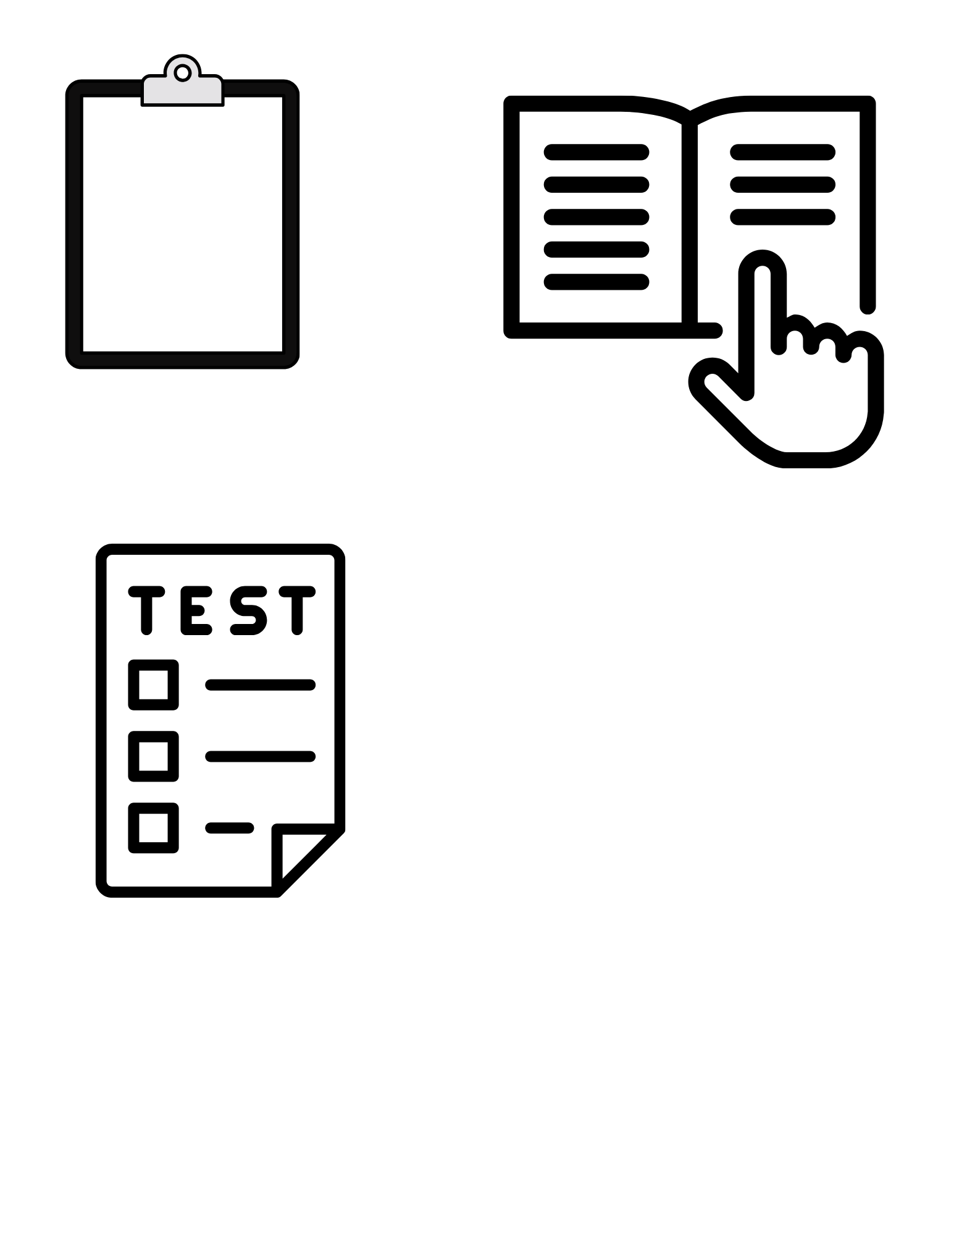
Administer ORF Assessment
Examiner Script
Pen
Student Passage
Timer
Clipboard

Slide 13

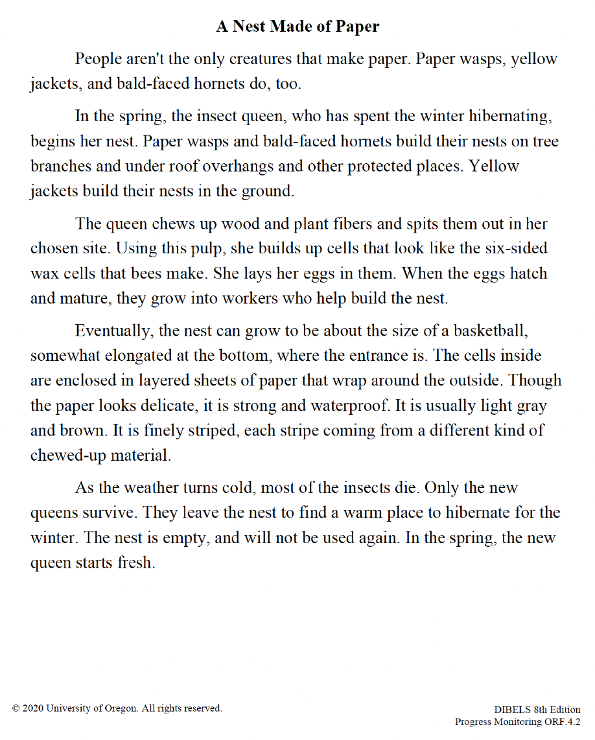
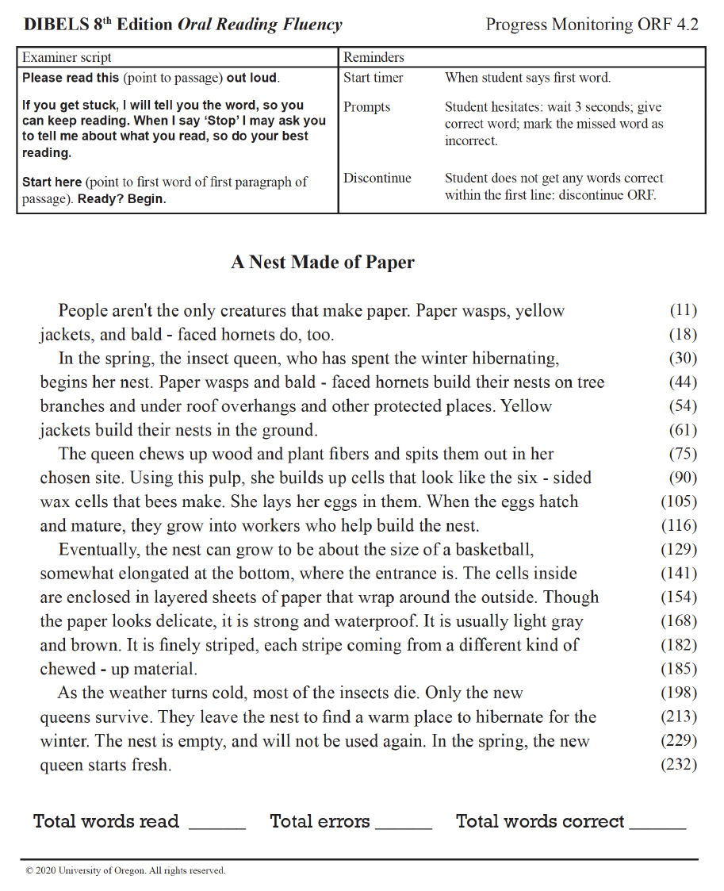
Sample CBM ORF Probe
Progress Monitoring ORF 4.2
A Nest Made of Paper
https://dibels.uoregon.edu/materials/dibels

Slide 14
CBM ORF Procedures
Start
Read script/directions to students as written
Start the timer when the student says the first word
Record student responses
Attend to rules for correct response versus error
Stop the student when timer goes off at 60 seconds
Mark the last word read
Read
End

Slide 15
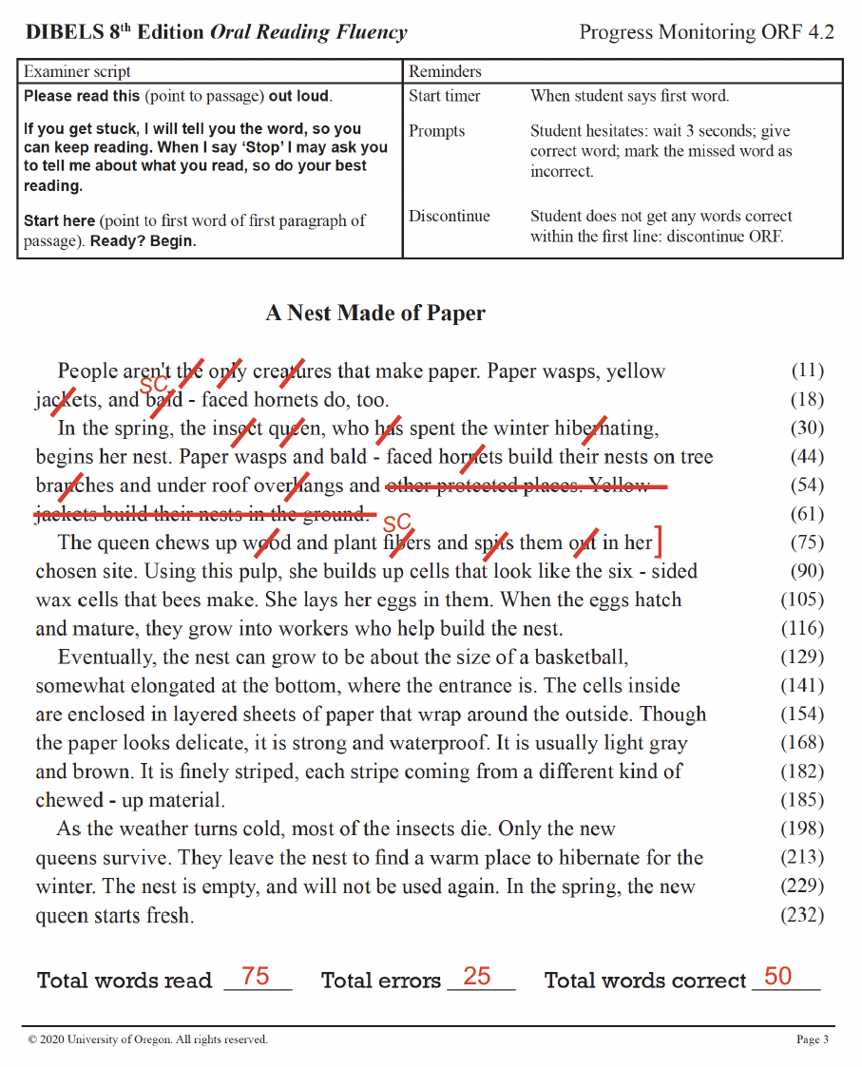
Identify All Student Errors

Slide 16
Types of Deviations: Counted as Errors
Mispronunciations Saying nonword or similar word | father [read as] “faster”
Substitutions Replacing with another word | front of the car [read as] “front of the truck”
Reversals Changing word order | she said [read as] “said she”
Omissions Skipping word, phrase, or line | the big dog ran fast [read as] “the dog ran fast”
Hesitation Pausing for 3+ seconds | Examiner provides word

Slide 17
Types of Deviations: Not Counted as Errors
Insertions Adding words not in the text | the big green ball [read as] “the green ball”
Repetitions Repeating a word or phrase | “it was floating… was floating up and away”
Self-Corrections Fixing an error independently | blank [read as] “black… blank”
Mispronunciations due to dialect or speech variation are not errors
Conventions may vary by ORF tool being used (e.g., circles, underlines, slashes)

Slide 18
Calculating ORF Score
Words Correct Per Minutes (WCPM)
75
75
- 25
50

Slide 19

Using CBM ORF for Error Analysis
CBM ORF Score (WCPM)
Mark all deviations and note spoken word exactly as pronounced by student

Slide 20
Using CBM ORF for Error Analysis
cr/ē//ǎ/tures
face
sent
hibernate
the
r/ǔ/f
overhang
f/ǐ/bers
sits
ch/uː/sen
pup
sixth
]
20

Slide 21
Categorize and Analyze Errors
Student Errors |  | Error Type Category
Printed Word | Student Response | Phonemic | Orthographic | Morphemic | High Frequency

Slide 22
Phonemic Errors
Student does not accurately represent all sounds (i.e., phonemes) in a printed word; retrieving incorrect phoneme for corresponding grapheme or omitting a phoneme
sent
sits
pup

Slide 23
Orthographic Errors
Deviations from one-to-one grapheme-phoneme mappings, violations of common English rules, or syllable-based boundary errors for vowels in multisyllabic word
cr/ē//ǎ/tures
r/ǔ/f
f/ǐ/bers
ch/uː/sen

Slide 24
Morphemic Errors
Students does not accurately represent meaningful word parts in multisyllabic words — changing, dropping, or mispronouncing prefixes and suffixes
face
hibernate
overhang

Slide 25
High Frequency
Word Errors
Student has difficulty reading a word that is commonly occurring in the English language and often includes an irregular spelling
the
sixth

Slide 26
Student Errors |  | Error Type Category
Printed Word | Student Response | Phonemic | Orthographic | Morphemic | High Frequency
creatures | cr/ē//ǎ/tures |  | ✔
faced | face |  |  | ✔
spent | sent | ✔
hibernating | hibernate |  |  | ✔
her | the |  |  |  | ✔
roof | r/ǔ/f |  | ✔
overhangs | overhang |  |  | ✔
fibers | f/ǐ/bers |  | ✔
spits | sits | ✔
chosen | ch/uː/sen |  | ✔
pulp | pup | ✔
six | sixth |  |  |  | ✔
26

Slide 27


Inform Instructional Adjustments

Slide 28
Phonemic Errors
Why
Most common in early readers, but may persist for students with reading difficulty
Underdeveloped phonemic awareness
Incomplete knowledge of grapheme-phoneme correspondences (GPCs)
How to Support
Strengthen phonemic awareness — blending and segmenting
Systematic phonics instruction with explicit teaching of GPCs
Opportunities to read taught GPCs in isolated words and connected text

Slide 29
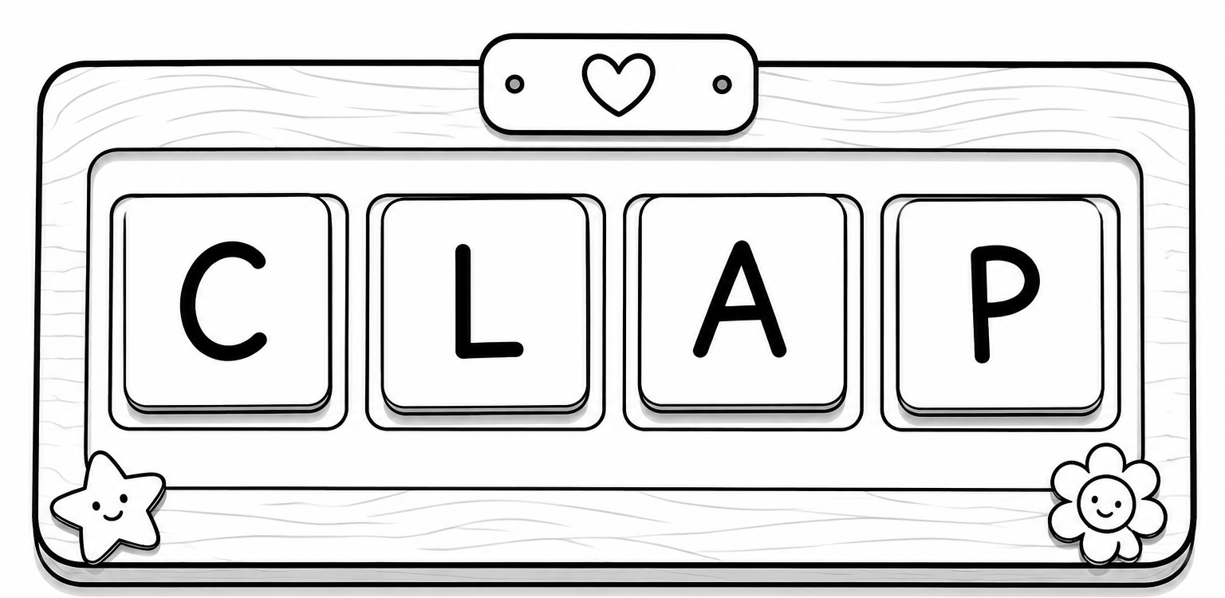
Phonemic Errors: Instructional Target
Blending Routine
Student pushes a chip into a box for each sound in clap (/k/ /l/ /a/ /p/)
Model slow blending → choral → individual ("/k/.../l/.../a/.../p/... clap!")
Practice word chains
  Change one sound at a time (cap → clap → clip)

Slide 30
Orthographic Errors
Why
Surfaces as students encounter advanced patterns; especially common and persistent for students with reading difficulty
Gaps in knowledge of English spelling rules and complex GPC relations
Difficulty recognizing vowel teams and syllable boundaries
How to Support
Explicitly teach high-utility vowel patterns
Practice patterns in isolation and connected text
Build syllable awareness to inform vowel pronunciations

Slide 31
Orthographic Errors: Instructional Target
High-Utility Vowel Patterns
Let’s talk about vowel teams!
A vowel team is when two or more vowels work together to make a single sound. One example is the vowel team ‘ea.’ When you see ‘ea’ in a word, it often makes the /ē/ sound, like in the word ‘beach.’ Let’s say the word ‘beach’ together slowly: /b/ /ē/ /ch/. Great! Did you hear the long /ē/ sound in the middle?
Let’s look at some more examples where ‘ea’ makes the /ē/ sound. Listen as I read them: leaf, mean, and team. Can you hear the /ē/ sound in each word? Now let’s say them together: leaf, mean, team.
Now it’s your turn! I’ll show you a word, and you read it out loud. If you see the ‘ea’ vowel team, say the /ē/ sound. Ready? (Students practice.)

Slide 32
Orthographic Errors: Instructional Target
Review alternate vowel sounds
Teach the ESHALOV strategy
Practice ESHALOV strategy
Use mispronunciation prompts
Syllabication Routine
ESHALOV Strategy
Underline vowels
Circle known affixes
Count syllables
Break the word apart
Read the word aloud
Make it a real word.
energeetic
→ energetic
glor-eye-us
→ glorious
Flex it!

Slide 33
Morphemic Errors
Students are faced with increased multisyllabic words
Phonics instruction hasn’t advanced beyond single-syllable words
Low morphological awareness, especially common in students with reading difficulty
Pronunciation of morphemes can vary across different words, even though the spelling remains consistent
Why
Explicitly teach common prefixes and suffixes (meaning + function)
Show how pronunciation shifts across related words
How to Support

Slide 34
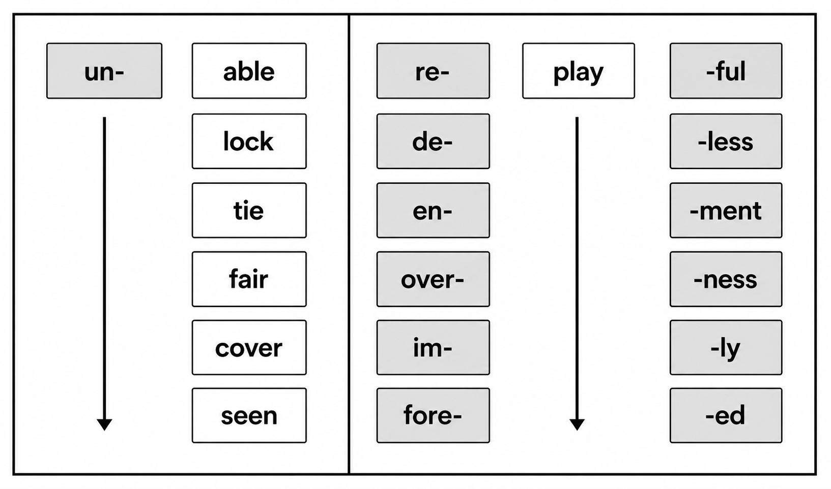
Morphemic Errors: Instructional Target
Teach high-frequency affixes
  Name, define, and provide sample words
Engage students in “peel-off” reading
  Identify affixes and read in isolation
  Read words
Build words
  Combine base words + affixes
  Read each word part, blend, and then read whole word aloud
Morphology Routine

Slide 35
High Frequency Word Errors
Why
These words appear in nearly all text
Irregular spellings don’t follow predictable GPCs
Requires repeated exposure to build automatic recognition
How to Support
Build recognition through repeated practice with corrective feedback

Slide 36
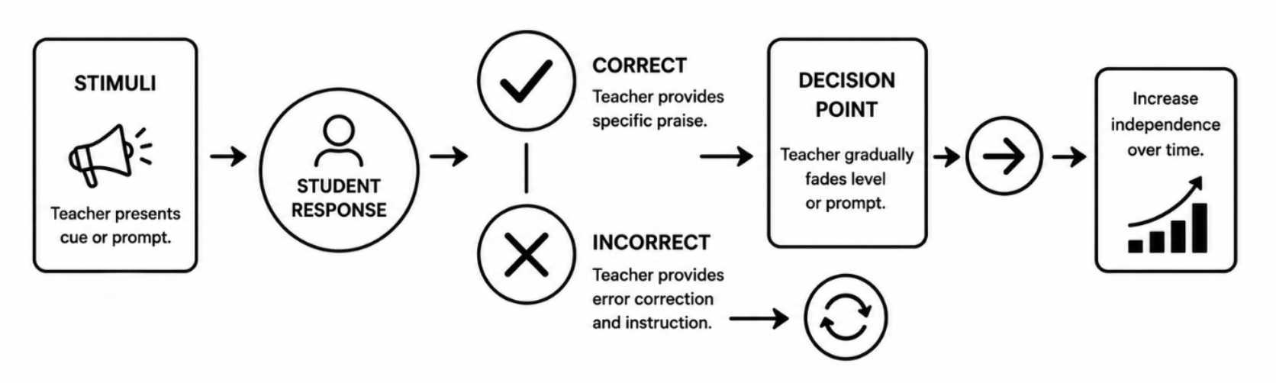
High Frequency Word Errors: Instructional Target
Incremental Rehearsal
Introduce single high frequency word on flashcard
Engage in strategic incremental rehearsal
Gradually integrate previously learned words to create a flashcard deck where students practice reading through the cards Incorporate new words with known words to enhance retention focused on mastery

Slide 37
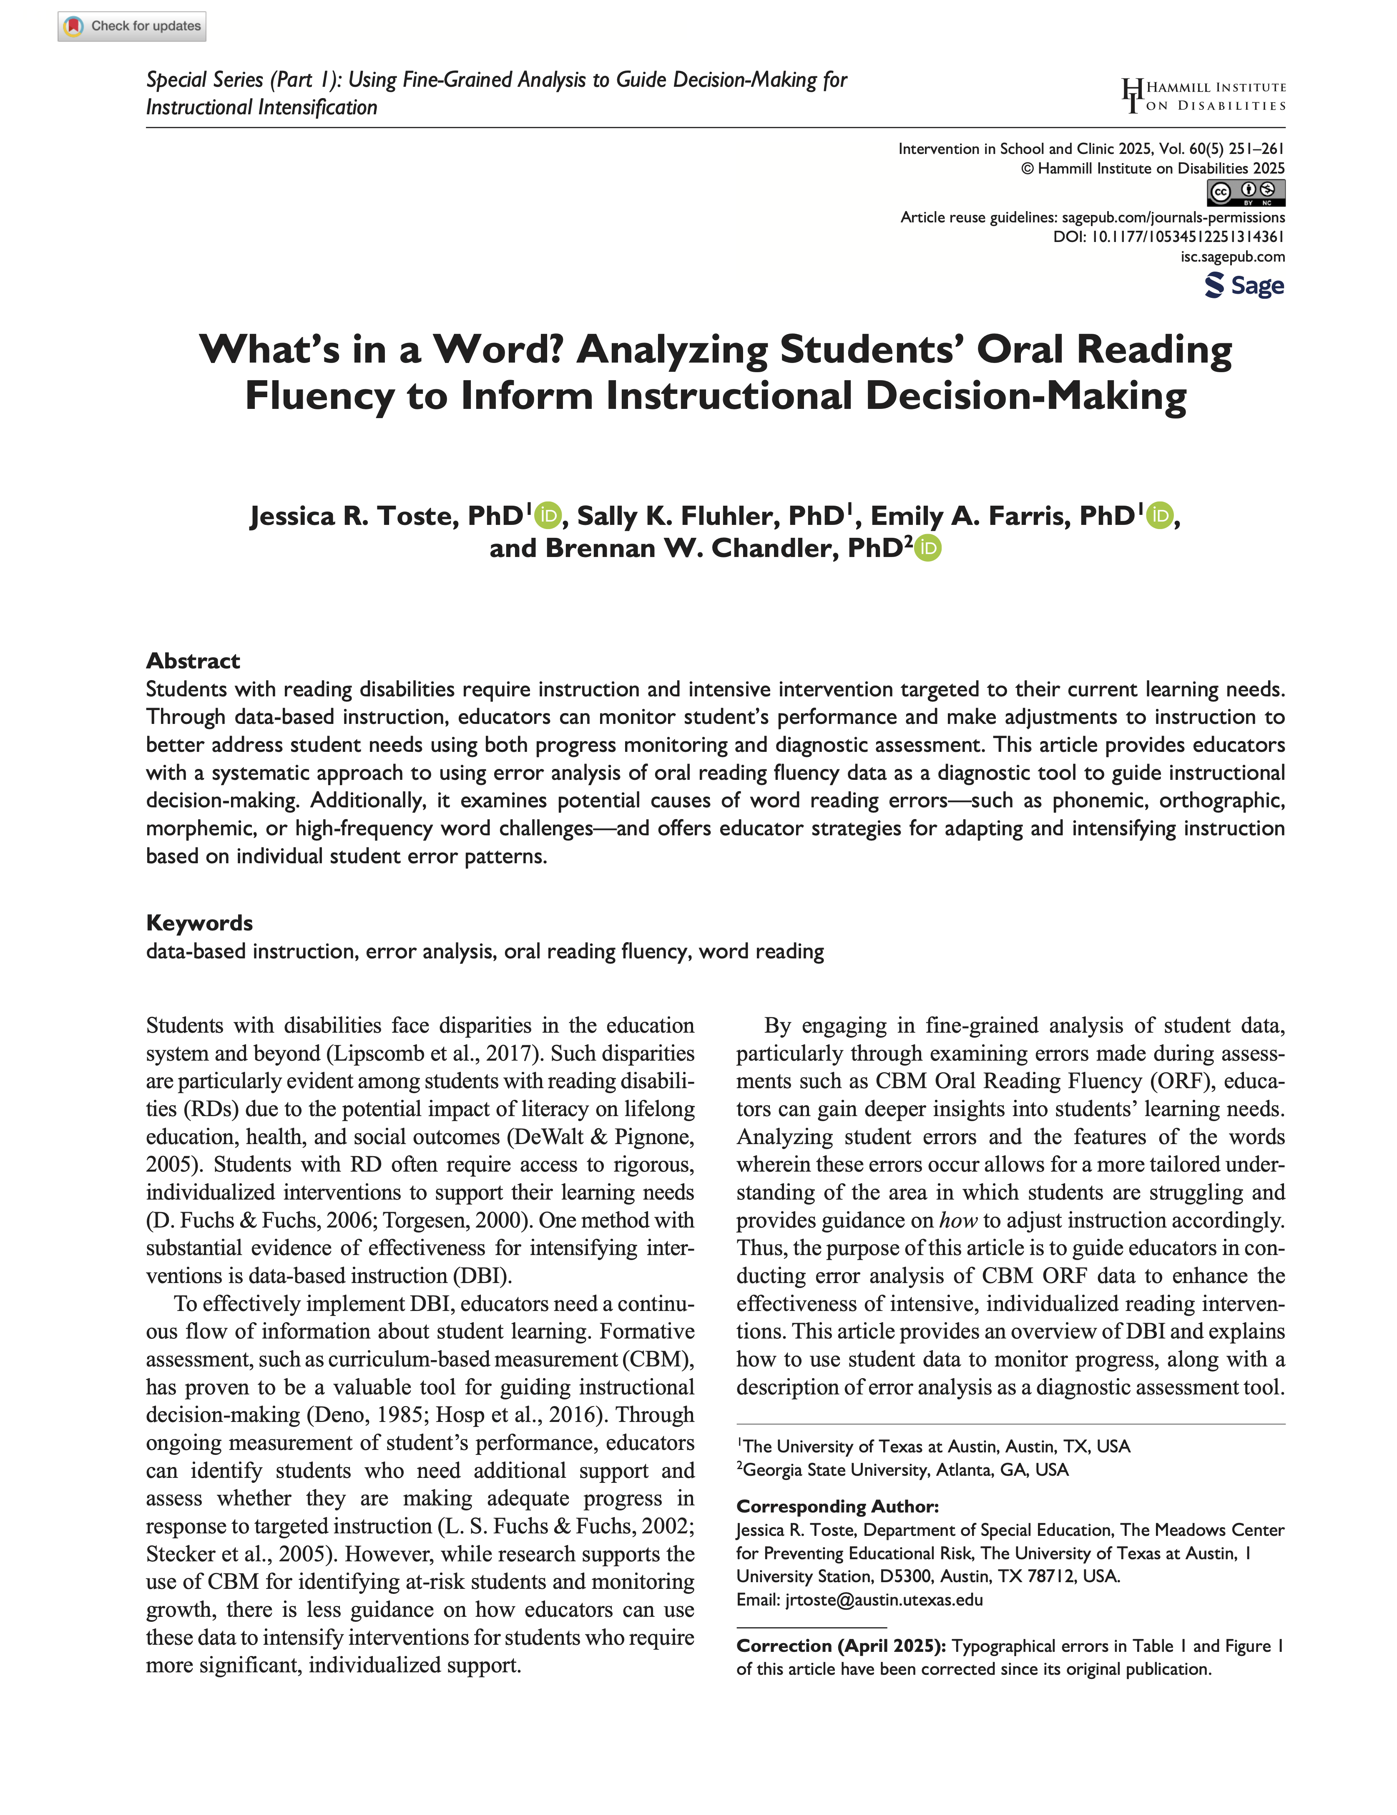
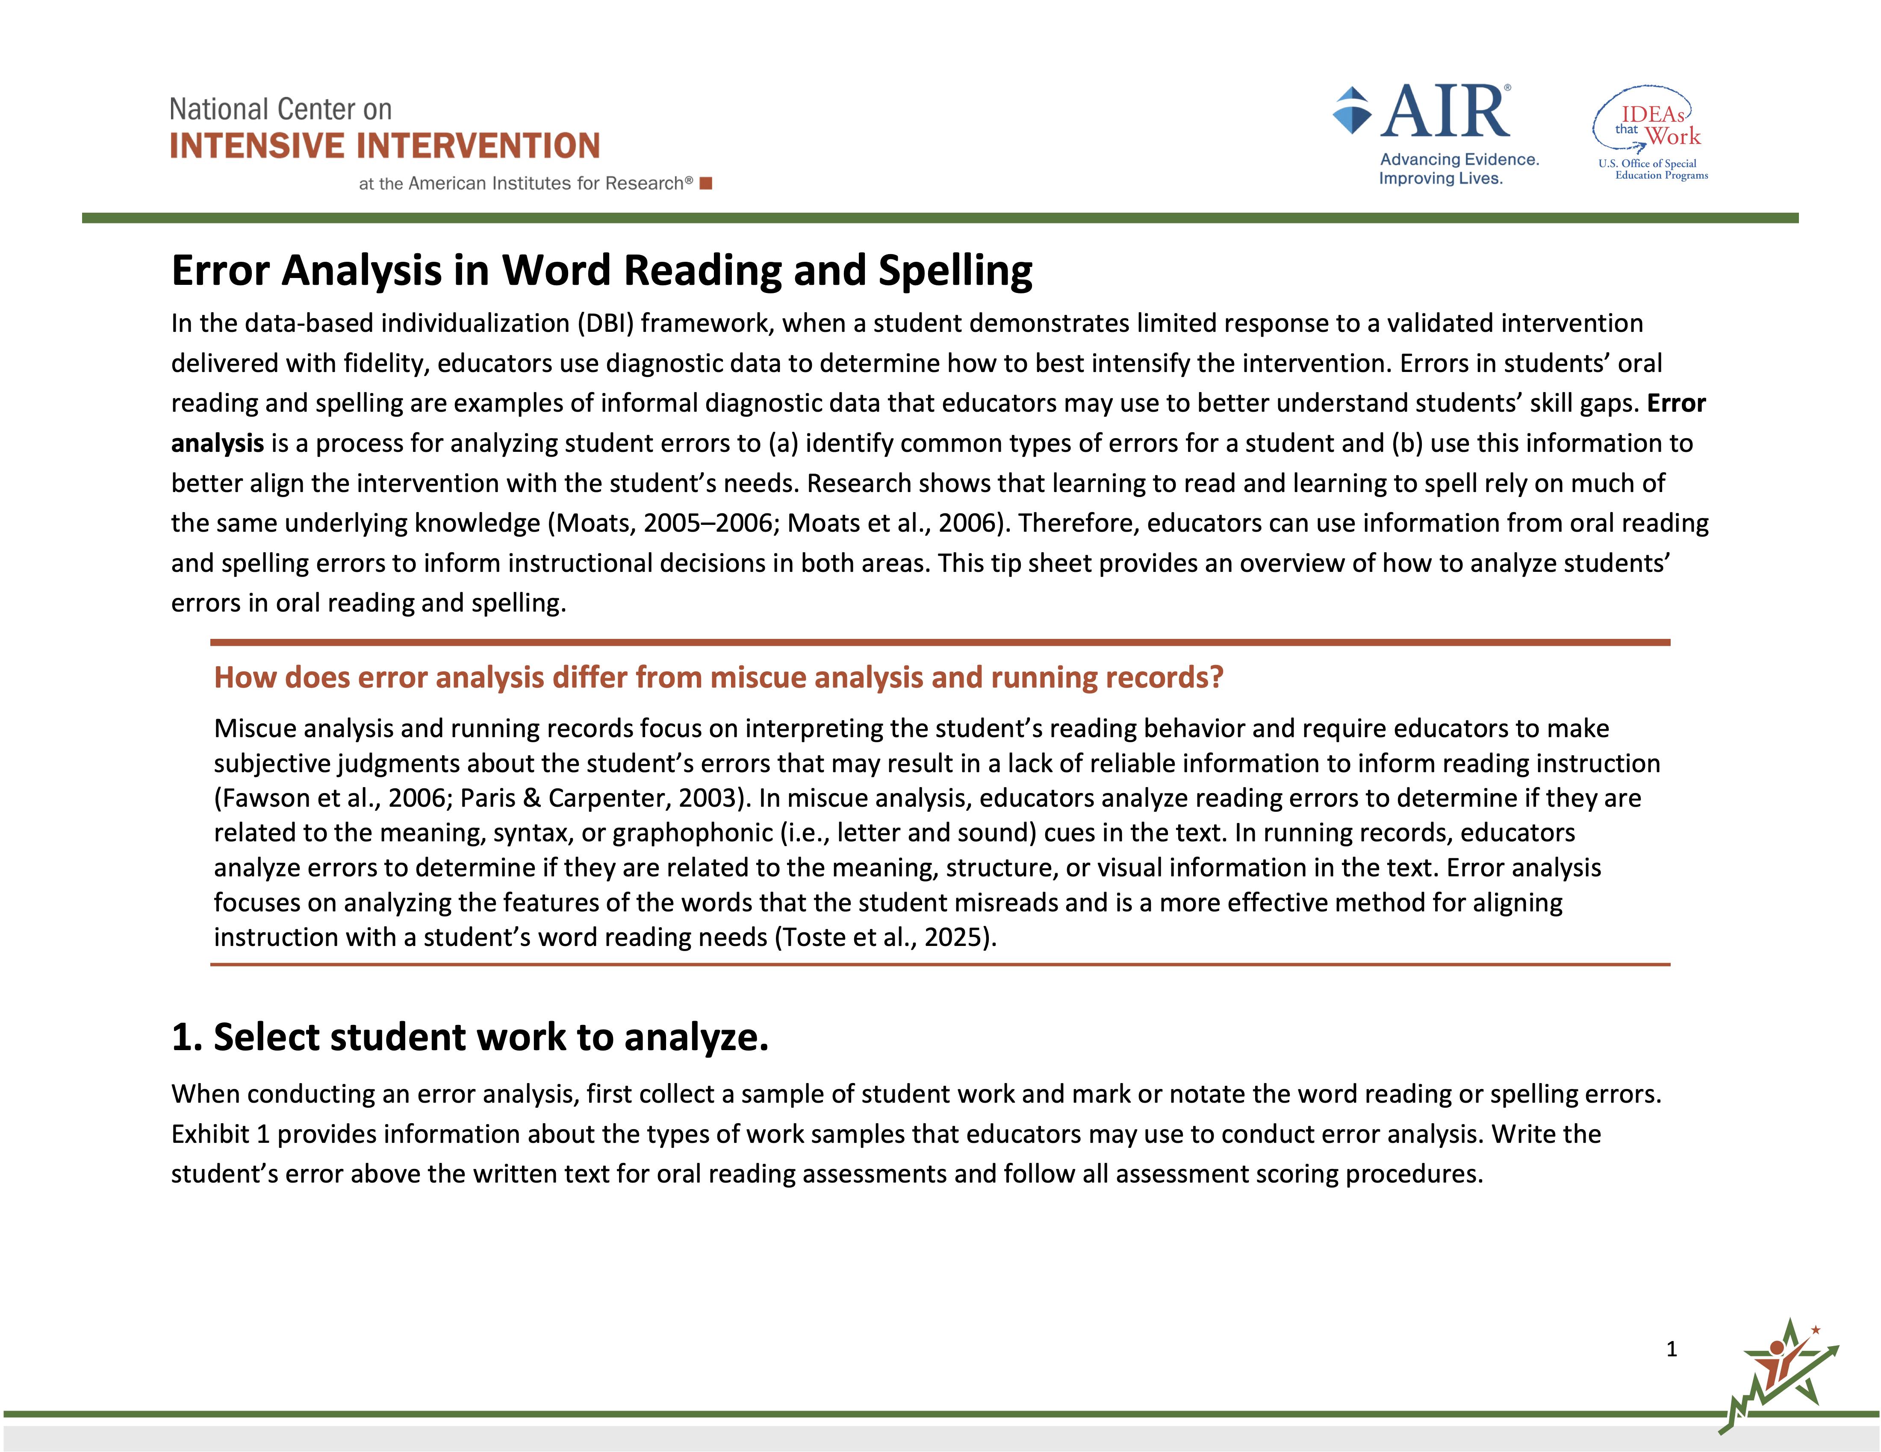
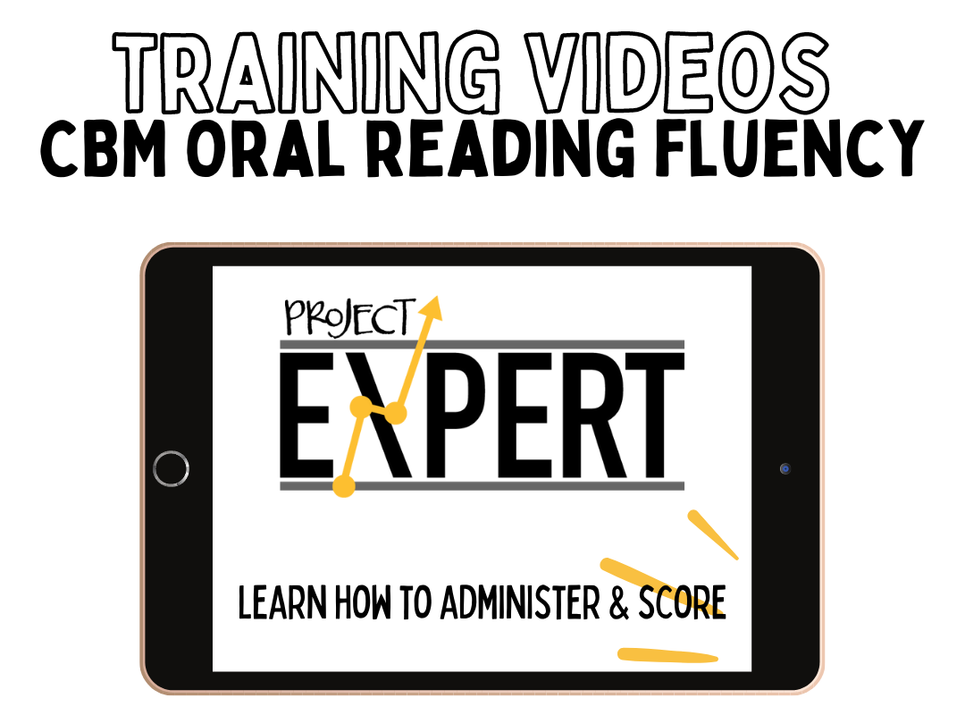
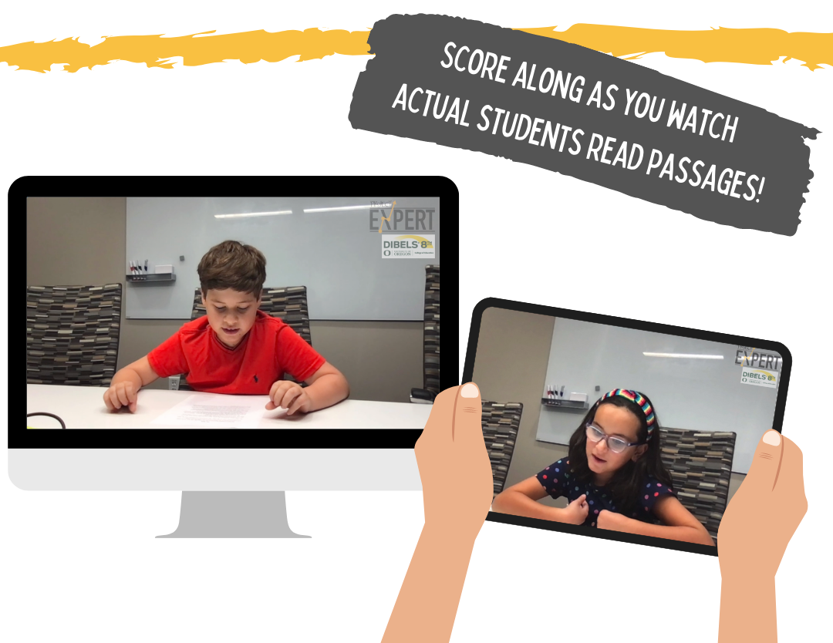
Resources
https://intensiveintervention.org/resource/
reading-spelling-error-analysis
https://tinyurl.com/Toste2025isc
https://www.youtube.com/@Project_EXPERT

Slide 38
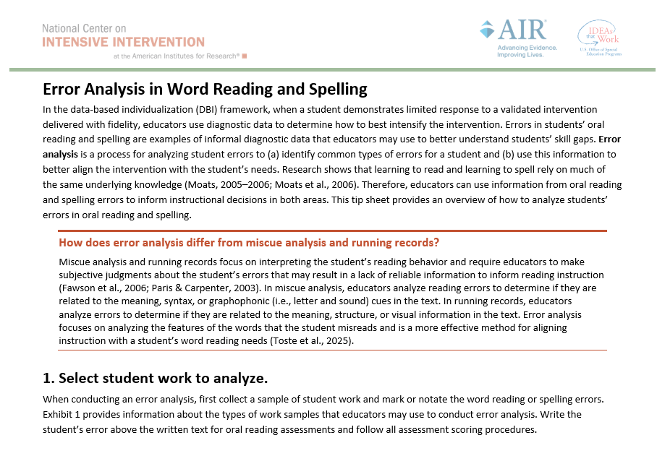
NCII Resource: Error Analysis in Word Reading and Spelling
    The resource helps educators identify common types of errors in students’ oral reading and spelling and use this information to better align the intervention with the student’s needs.

Slide 39
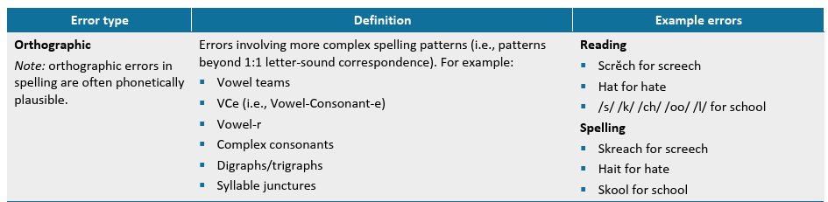
Defines Common Error Types

Slide 40
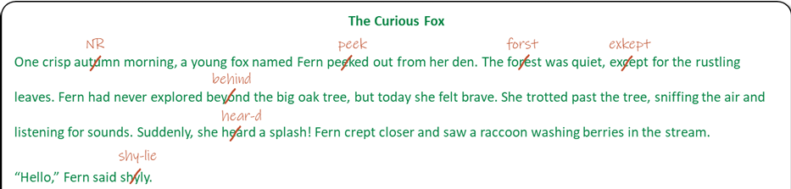
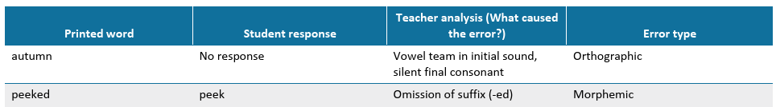
Demonstrates Error Analysis

Slide 41
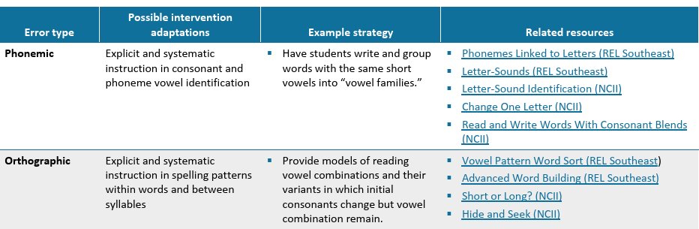
Provides Possible Intervention Adaptations and Related Resources by Error Type

Slide 42

Jessica R. Toste, PhD
The University of Texas at Austin
Department of Special Education
Email • jrtoste@austin.utexas.edu
Presentation content © 2026 Toste Team

