Slide 1

Full Eyes, Clear Problem Solving:
Using Diagnostic Data to Intensify Interventions
March 24, 2026
Jason Harlacher, Technical Assistance Provider

Slide 2

Introductions
In the chat, share:
  Name
  Role
  A question or challenge you have experienced with intensifying or modifying interventions.
Jason Harlacher
Technical Assistance Provider

Slide 3
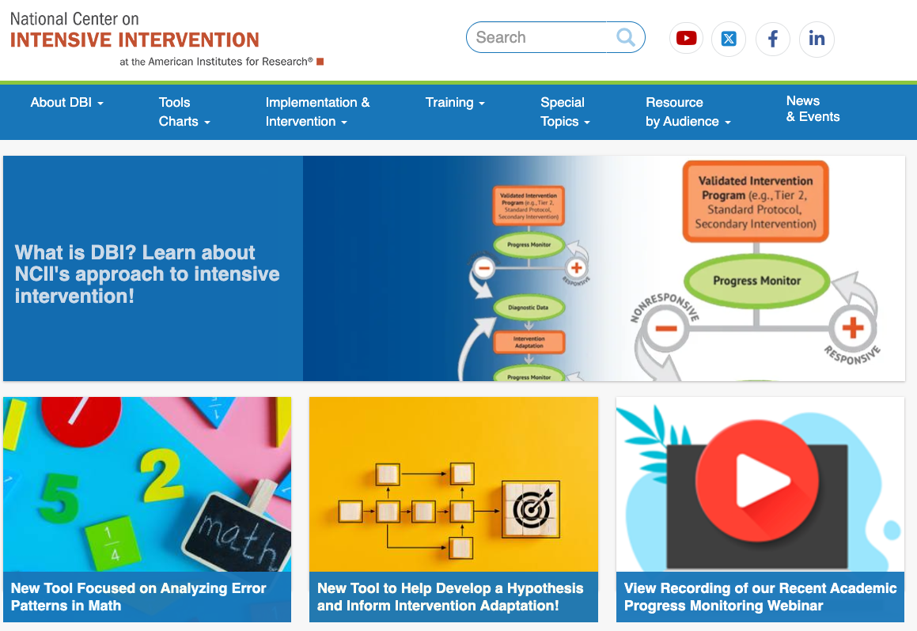
National Center on
Intensive Intervention
The mission of the NCII is to build knowledge and capacity of state and local leaders, faculty and professional development providers, educators, and other stakeholders to support implementation of intensive intervention for students with severe and persistent learning and/or behavioral needs using data-based individualization (DBI).

Slide 4

Today’s Objectives
Review possible hypotheses that explain why a student may not make sufficient growth
Learn tools to assist with gathering diagnostic data
Identify instructional factors to adjust based on diagnostic information

Slide 5

Data-Based Individualization
A systematic method for using data to determine when and how to provide more intensive intervention.
It is an ongoing process that requires progress monitoring data, fidelity data, and methods to intensify interventions.

Slide 6
Data-Based Individualization 2
When students are not making sufficient progress, we gather diagnostic data at Step 3 to determine intervention adaptations.
That data then informs intervention adaptations at Step 4.

Slide 7



What Do You See Here?
https://www.pngegg.com/en/png-iuxhp
https://all-free-download.com/free-vector/download/pacman_56054.html

Slide 8
Our perceptions and interpretations are influenced by our background knowledge, schemas about the world, and personal experiences.
Fundamental Attribution Error
Attributing our behavior to the situation, but attributing others’ behavior to their personality.
Confirmation Bias
We highlight evidence to confirm our views and ignore those that conflict with it.
Sunken Cost Fallacy
We over-value things that we’ve invested in, even though they may be ineffective or harmful.

Slide 9
Hypotheses for Diagnostic Data Collection

Slide 10








Step 3 of DBI
Step 4 of DBI
Use Existing Data To Develop An Initial Hypothesis
Collect and Review
Diagnostic Data
Adapt Intervention to Match Hypothesis
Progress Monitoring
Intervention Data
Confirm Initial Hypothesis
Identify Alternate Hypothesis
Instruction
Curriculum
Environment
Where do we start?

Slide 11

Hypothesis 1:
The Student Isn’t Being Taught the Right Skill(s).
Are we teaching the right skill?
Compare skills needed to skills taught (e.g., error analysis)
Student is making little to no progress
Are we teaching with enough explicitness?
Examine use of explicit instruction

Slide 12
The Student Is Making Little to No Progress
Also, may notice from the student:
Not passing intervention lesson checkouts
Difficulty retaining content taught during intervention
Low levels of accurate responses
Words correct per minute
Date
12

Slide 13
How Do I Know If The Intervention Curriculum Is Aligned With The Student’s Needs?
Skills the student needs
Skills we teach
Conduct error analysis
Administer diagnostic assessment (e.g. phonics inventory)
Administer intervention placement test
Observe accuracy of responding during instruction
Intervention scope and sequence
Skills taught in intervention and core (small group)

Slide 14
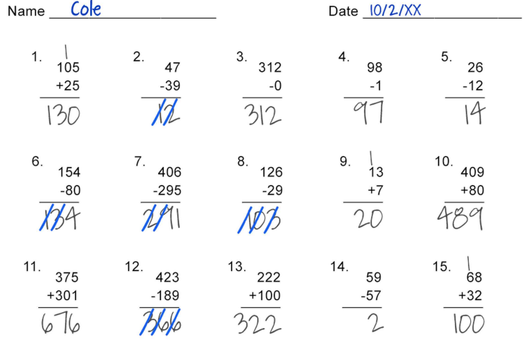
Example Error Analysis
Review student errors and categorize them to identify skills to target.
What error pattern do you see?
A slip is a careless mistake.
A bug is a misunderstanding of a math concept (e.g., operations).
Neither slip nor bug is lacking a prerequisite skill (e.g., computation).
https://intensiveintervention.org/sites/default/files/2025-10/math-error-analysis.pdf
https://iris.peabody.vanderbilt.edu/wp-content/uploads/modules/dbi2/pdf/dbi2_07_student1_wrksheet.pdf#content

Slide 15




Interventions Are Effective
When Matched to the Student’s Need
The student’s instructional need:
Strategy/intervention matches need:
Strategy/intervention doesn’t match need:
Misuse of math operations
Visual representations
Timed activities
Low decoding skills
Phonics-based intervention
Fluency intervention
https://ies.ed.gov/ncee/WWC/PracticeGuide/26

Slide 16
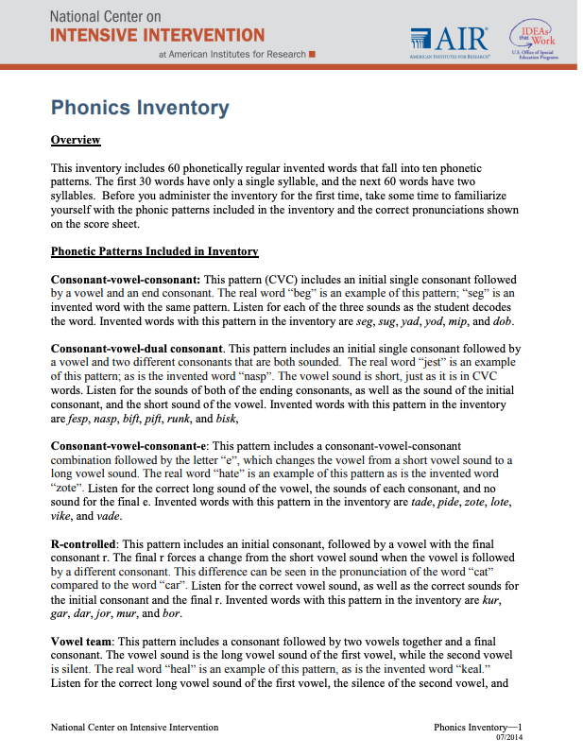
Resources:
Alignment to Student Need
Phonics inventory
Error Analysis
Alignment of Instruction Tool

Slide 17

Adapt Dimensions That Address Alignment
If data indicates the intervention is not aligned with student needs, develop a more targeted hypothesis to consider the following adaptations:
For example, the student with operations errors needs reteaching on regrouping when subtracting double-digit numbers.
Increase instructional time for the target skill(s).
Place the student at a different level in the current program.
Supplement the intervention with additional materials.
Use an alternative program that addresses student’s needs more fully.
Enhance language support (for multilingual learners).

Slide 18
Hypothesis 2:
The Student Isn’t Being Taught With Enough Explicitness.
Are we teaching the right skill?
Compare skills needed to skills taught (e.g., error analysis)
Student is making little to no progress
Are we teaching with enough explicitness?
Examine use of explicit instruction

Slide 19
The Instruction Is Not Explicit Enough
Teacher Modeling
Guided Practice
Independent Practice
My turn. This word is /s/ /a/ /t/, “sat”
Do it with me. This word is /s/ /a/ /t/, “sat”
Your turn. Sound it out and say the word.
I do
We do
You do
Corrective feedback
Additional look-fors:
Clear objectives
Background knowledge activated
Logical sequencing of skills
Complex skills broken into smaller chunks
Clear, concise teacher language

Slide 20
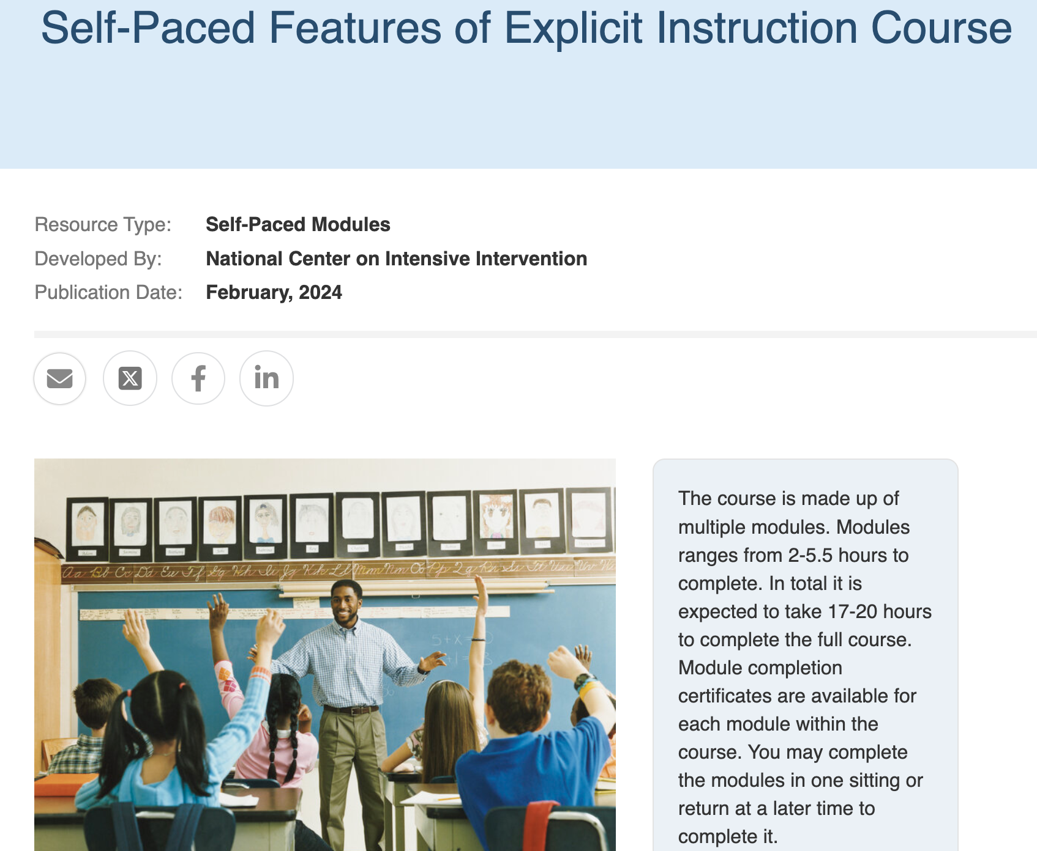
Resources: Explicit Instruction
Self-Assessment of Explicit Instruction
Explicit Instruction Course

Slide 21

Adapt Dimensions That Explicit Instruction
If data indicates the intervention is not explicit enough, develop a more targeted hypothesis to consider the following adaptations:
  Provide additional modeling, and guided practice.
  Use simple, direct language.
  Break lesson steps into smaller, simpler chunks.
  Increase opportunities to respond (i.e., independent practice).
  Increase the use of specific and immediate corrective feedback
  Use visual aides, graphic organizers, manipulatives, and other scaffolds.

Slide 22

Hypothesis 3:
The Intensity of Instruction Isn’t Sufficient.
Student is making some progress but not enough
Are we teaching with enough intensity?
Analyze pacing and dosage (e.g., measure opportunities to respond)

Slide 23
Some Progress But Not Enough
Also may notice from the student:
Passing lesson checkouts
Good retention of content taught during intervention
Moderate/high levels of accurate responses
Increased accuracy as a result of corrective feedback
Words correct per minute
Date

Slide 24






Opportunities to Respond
Opportunities to respond are “behaviors that require responses and are usually followed by feedback” (Martin et al., 2018, p.5).
Who responds?
How do they respond?
Choral
Responses
Partner
Responses
Individual
Responses
Verbal
Responses
Written
Responses
Action
Responses

Slide 25
Recommended Rates of OTRs
Setting | Rate
Large-group | 3–6/minute on average
Small-group | 8–12/minute on average
New material | 4–6/minute with at least 80% accuracy
Review material | 8–12/minute with at least 90% accuracy
Students with intensive needs or disabilities | 10/minute on average
Improving from suboptimal rates has benefit on academic and behavior outcomes.
Lower rates during some activities are expected (i.e., longer student responding impacts rates).
Gunter et al., 2004; Haydon et al., 2009; 2010; MacSuga-Gage & Simonsen, 2015; Sutherland et al., 2002; 2003
25

Slide 26
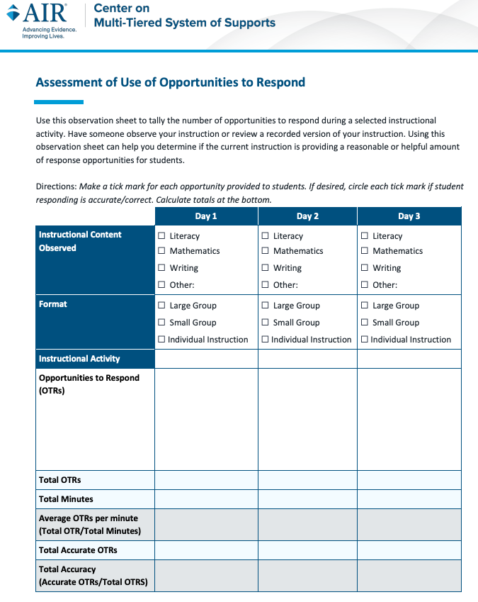

Resources: Opportunities to Respond and Dosage
Assessment of Use of OTR
Strategies for Scheduling

Slide 27

Adapt Dimensions That Address OTRs/Dosage
If data indicates the dosage of intervention is not sufficient, develop a more targeted hypothesis to consider the following adaptations:
Increase student opportunities to respond (OTRs) during intervention.
Increase minutes per intervention session or frequency of sessions.
Reduce group size.
Embed additional practice and feedback throughout the day.

Slide 28

Hypothesis 4:
The Student Isn’t Being Taught to Transfer Skills.
Student is doing well in some settings but not others
Are we teaching the student to transfer skills?
Evaluate generalization strategies

Slide 29


Progress in One Setting But Difficulty in Other Settings
Success in the intervention
Successful on lesson checkouts and formative assessments
Good retention of intervention content
Moderate/high levels of accurate responding
Increased accuracy as a result of corrective feedback
Cooperating with peers and asking for help when frustrated
Difficulty outside of the intervention
Difficulty using learned strategies outside of intervention time
Exhibits behavioral difficulties outside of intervention time

Slide 30
Supporting Transfer and Generalization
Intervention Setting
Transfer Setting
(Core Curriculum)
Instruction:
Skill(s) taught and reinforced
Instruction:
Practice and receive feedback on skill(s)
Instruction:
Prompting
Instruction:
Tangible prompt
or cue
Curriculum:
Materials and language
Curriculum:
Similar materials and language
Environment:
Clear expectations, acknowledgement, etc.
Environment:
Similar structures

Slide 31
What Are You Doing Outside of the Intervention to Help the Student Use the Skill?
Schedule
Morning Meeting
Core Reading/Writing
PE
Science/Social Studies
Lunch/Recess
Specials
“What I Need” Time
Math
  Does the student practice the targeted skill in the general education setting and receive feedback on its use (e.g., practice skill across classrooms)?
  Are there visual scaffolds to prompt use of the skill (e.g., a bookmark that illustrates a 4-step routine for multi-syllabic words)?
Reading Intervention

Slide 32


Does the Curriculum Support
Transfer and Generalization?
Also, consider if the language (e.g., bossy E versus silent E) and materials (e.g., color-coded letters) are consistent across settings.
B

Slide 33
Resource:
Assessment of Generalization Practices
Can be used to determine the features of effective generalization practices.
Assessment of Generalization Practices

Slide 34

Adapt Dimensions That Address Your Hypothesis: Generalization (Attention to Transfer)
If data indicates the support for transfer is not sufficient, develop a more targeted hypothesis to consider the following adaptations:
Align instructional routines and language across tiers.
Teach students when and how to use learned strategies across the day.
Provide visual scaffolds to help student apply skills across environments.
Embed guided practice on target skills in core instruction and other environments.
Individualize behavior and social-emotional supports (if needed).

Slide 35
Hypothesis 5:
The Student Isn’t Receiving the Right Behavioral Support.
Student is doing well in some settings but not others
Is the behavioral support sufficient?
Evaluate classroom management strategies

Slide 36
Effective Classroom Management Principles
Academic effects
Identify and teach expectations.
d = .76
Praise rates can serve as markers of classroom climate and quality of relationships
Establish procedures and structure.
d = .76
d = -0.80 for problematic behavior
(29 percentile point reduction)
Actively engage students.
d = .62
Reinforcement and acknowledgement.
d = .98
Manage unwanted behavior.
d = .74
Build relationships.
d = .72
Note. Effect sizes from Hattie (2009)
36

Slide 37
Types of Praise
General Praise
Behavior-Specific Praise
Praise that indicates a positive or beneficial action but is not tied to a specific behavior.
Praise that indicates a positive or beneficial action that is tied to a specific behavior.
Contributes to a positive climate and builds relationships
Is an instructional tool

Slide 38
Resource:
Self-Assessment of Classroom Management
This tool can be used as an observation tool or a self-assessment.
Users rate the extent to which effective classroom management practices are in place.
https://mtss4success.org/resource/self-assessment-classroom-management

Slide 39

Adapt Dimensions That Address Your Hypothesis: Behavioral Support
If data indicates the need for behavioral support, develop a more targeted hypothesis to consider the following adaptations:
Reteach expectations and/or routines
Increase or adjust praise for 5:1 ratio
Vary responses for engagement
Create activities that build or strengthen relationships.
Use a range of methods to address unwanted behaviors.

Slide 40





Choosing an Initial Hypothesis:
Where Do We Start?
When students are not making adequate progress, ask the following questions:
Are we teaching the most needed skills?
Conduct diagnostic assessment (e.g., error analysis)
Are we teaching with sufficient explicitness?
Examine use of explicit instruction
Are we providing sufficient practice opportunities?
Measure opportunities to respond (OTRs)
Are we providing sufficient support for transfer across settings?
Evaluate generalization strategies
Is the behavioral support sufficient?
Review classroom management strategies

Slide 41

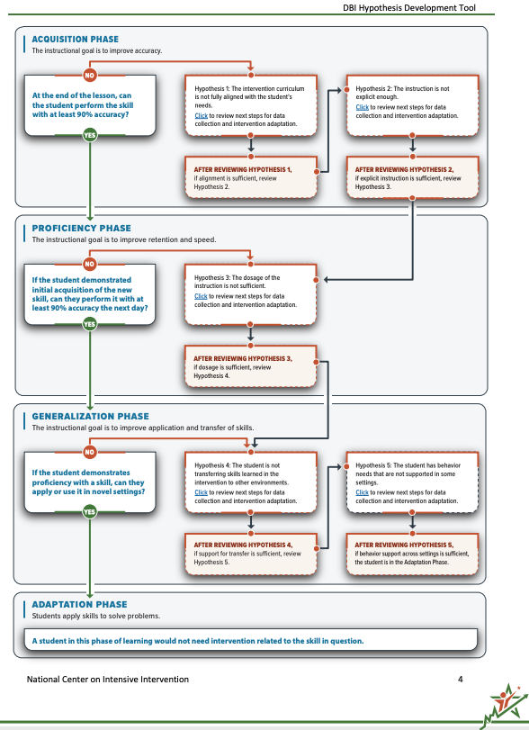
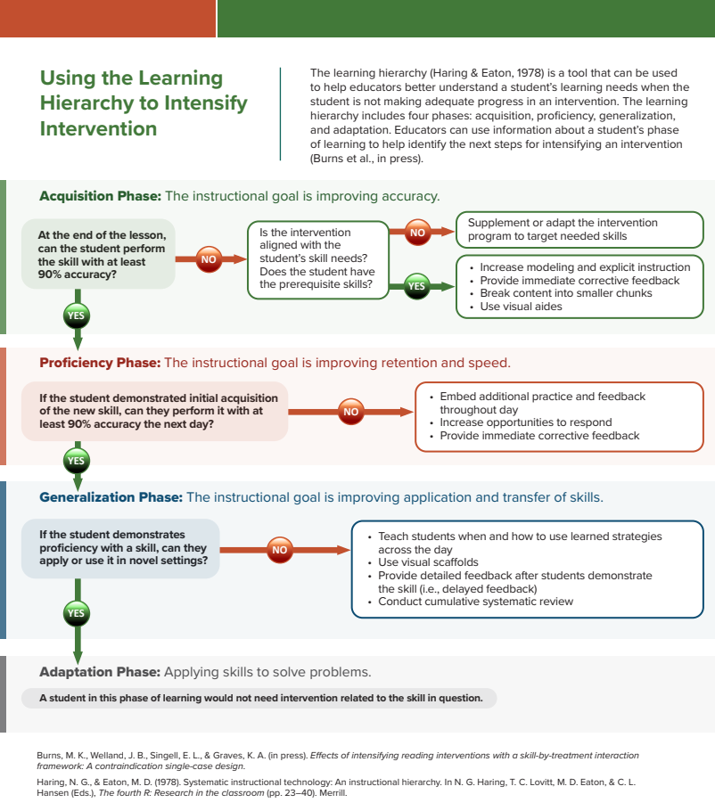
Resources for Collecting and Using Diagnostic Data
Using Diagnostic Data to Inform Intervention Planning
Data-Based Individualization Hypothesis Development Tool
Using the Learning Hierarchy

Slide 42
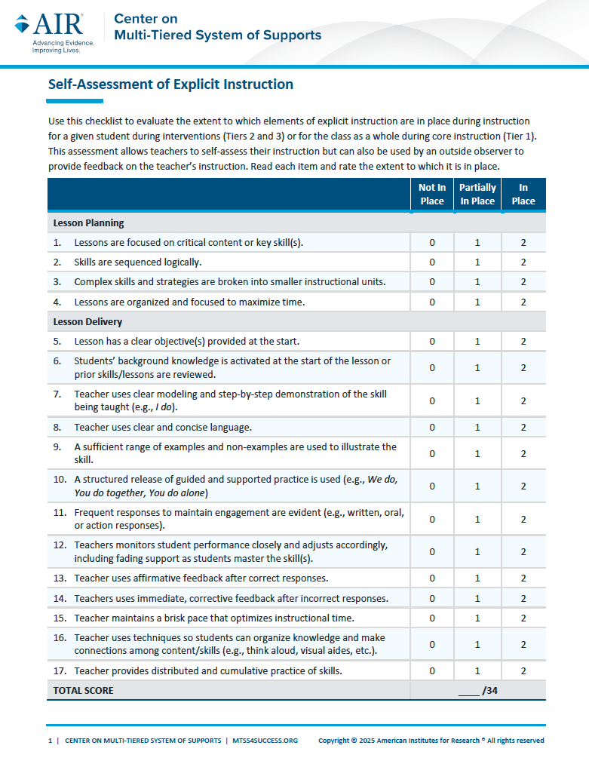
Resources for Collecting and Using Diagnostic Data 2
Hypothesis 1: Is the intervention aligned to student need?
Hypothesis 2: Is the instruction explicit enough?
Hypothesis 3: Are we providing sufficient practice opportunities?
Alignment of Instructional Need Tool
Self-Assessment of Explicit Instruction
Assessment of Use of Opportunities to Respond

Slide 43
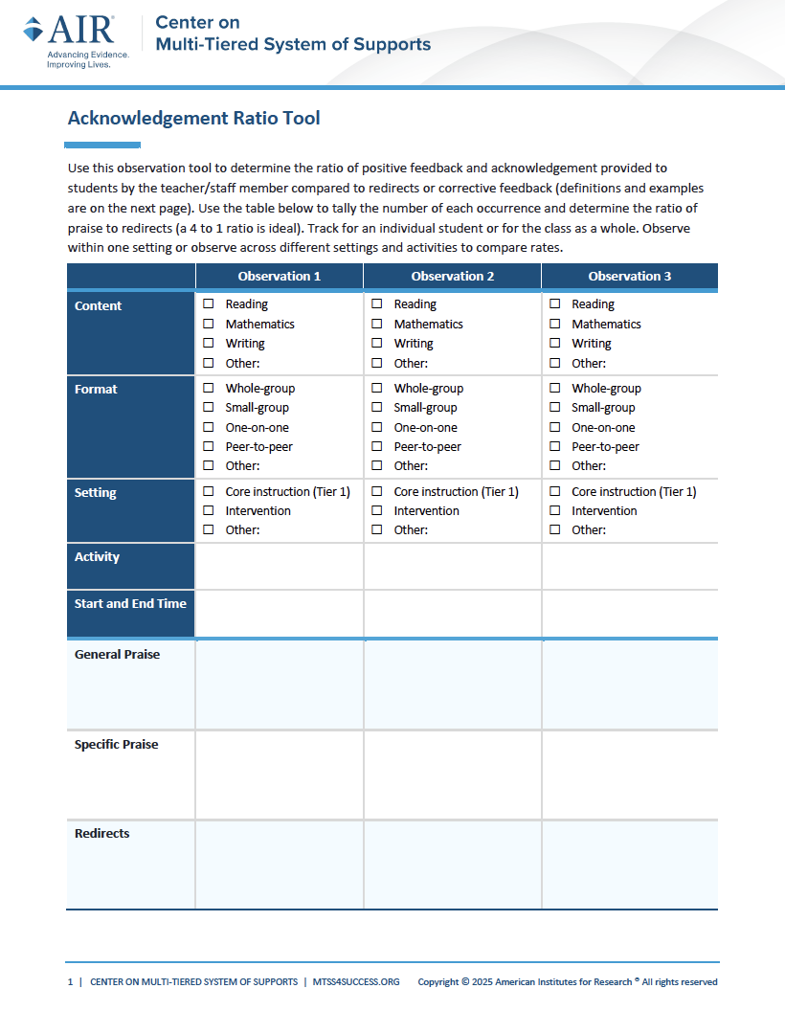
Resources for Collecting and Using Diagnostic Data 3
Hypothesis 4: Is there sufficient support for transfer of skills?
Hypothesis 5: Is behavior support sufficient?
Assessment of Generalization Practices
Self-Assessment of Classroom Management Practices
Acknowledgement Ratio Tool
https://mtss4success.org/resource/assessment-opportunities-respond

Slide 44

Summary
Gather diagnostic data to objectively examine student’s needs
Consider the five questions shared in this webinar to determine where to start
Make intervention adaptations based on the diagnostic data gathered
“Clear eyes, full heart,
can’t lose!”

Slide 45
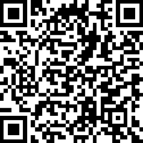
Event Survey
Please fill out this event survey to help us improve future events!

Slide 46
Upcoming Diagnostic Data Workshop Series
April 7:
What To Do When Students Are Making Little To No Progress
Attend this workshop series to learn how to gather diagnostic data to inform intervention adaptations. This three-part series shares user-friendly tools and practical adaptations for students.
Register here!
April 21:
What To Do When Students Are Making Some Progress, But Not Enough
May 12:
What To Do When Students Are Making Progress In One Setting But Not Others

Slide 47
NCII Disclaimer
This presentation was produced under the U.S. Department of Education, Office of Special Education Programs, Award No. H326Q160001. Celia Rosenquist serves as the project officer. The views expressed herein do not necessarily represent the positions or policies of the U.S. Department of Education. No official endorsement by the U.S. Department of Education of any product, commodity, service, or enterprise mentioned in this resource is intended or should be inferred.

Slide 48
Jason Harlacher, PhD
Technical Assistance Provider
jharlacher@air.org

