Slide 1

Navigating Barriers for Successful DBI Implementation
January 13, 2025
Jason Harlacher, PhD

Slide 2
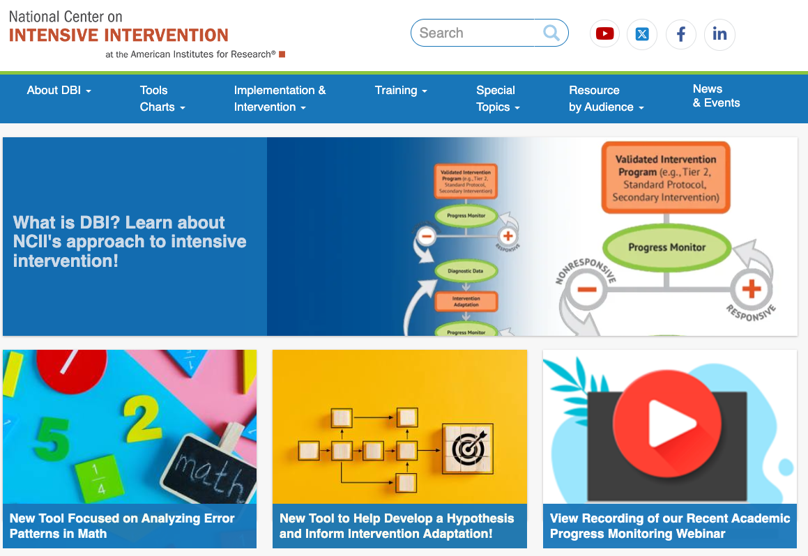
National Center on
Intensive Intervention
The mission of the NCII is to build knowledge and capacity of state and local leaders, faculty and professional development providers, educators, and other stakeholders to support implementation of intensive intervention for students with severe and persistent learning and/or behavioral needs using data-based individualization (DBI).

Slide 3

Jason Harlacher, PhD
Jason is a senior researcher at the American Institutes for Research® (AIR®), where he provides technical assistance (TA) to state agencies and school districts. He has expertise in intensive intervention, classroom management,
data-informed decision making, and implementation of a multi-tiered system of supports (MTSS). He is the director of the MTSS Center, co-director for the Wyoming MTSS Center, and TA provider for NCII. He is an award-winning author and presents nationally on topics related to MTSS.
In the chat box:
Name, role, location
New Year’s resolution you wouldn’t do?

Slide 4

Are you willing to change what you’re doing?
Copy the diagram on the right on scrap/note paper.
Connect all nine dots using four straight lines.
Do not lift your pencil from the paper once you start.
Do not retrace any lines.

Slide 5
How did you solve it?
5

Slide 6
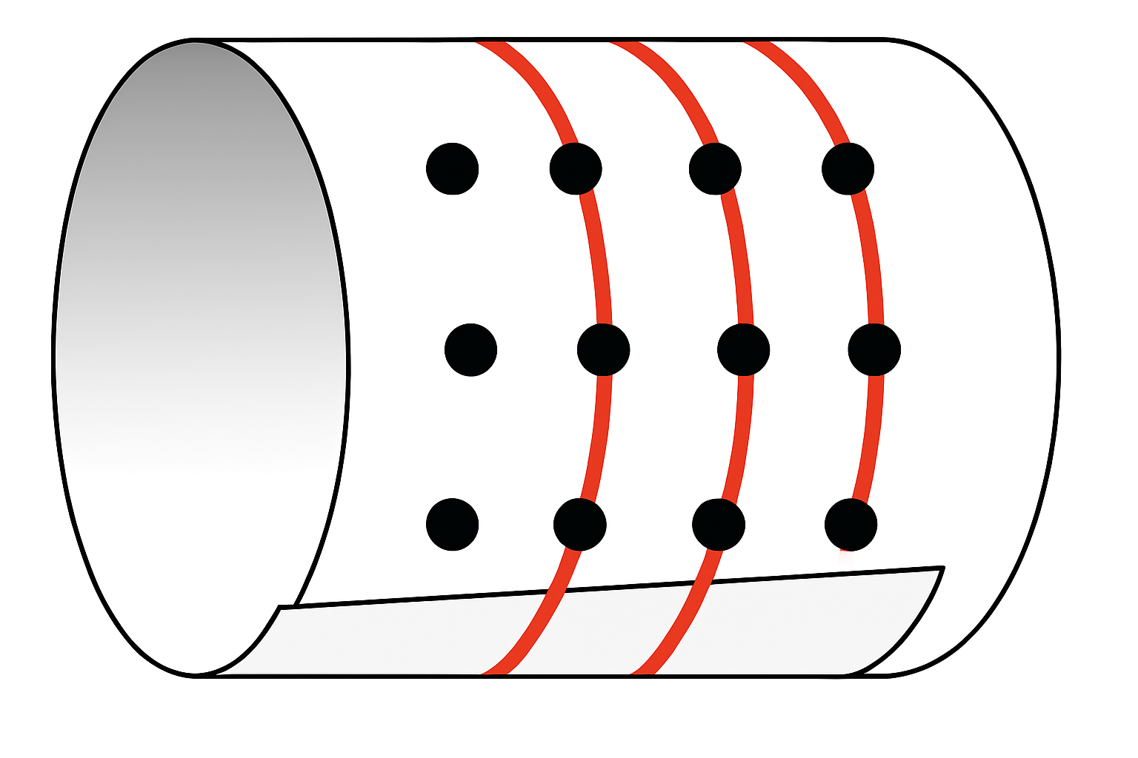
Multiple Ways to Approach a Problem
Image created with Co-Pilot

Slide 7

Objectives
Identify and understand technical problems versus adaptive challenges within DBI implementation
Learn strategies to develop adaptive solutions

Slide 8

Data-Based Individualization
A systematic method for using data to determine when and how to provide more intensive intervention
An ongoing process that requires progress-monitoring data, fidelity data, and methods to intensify interventions

Slide 9
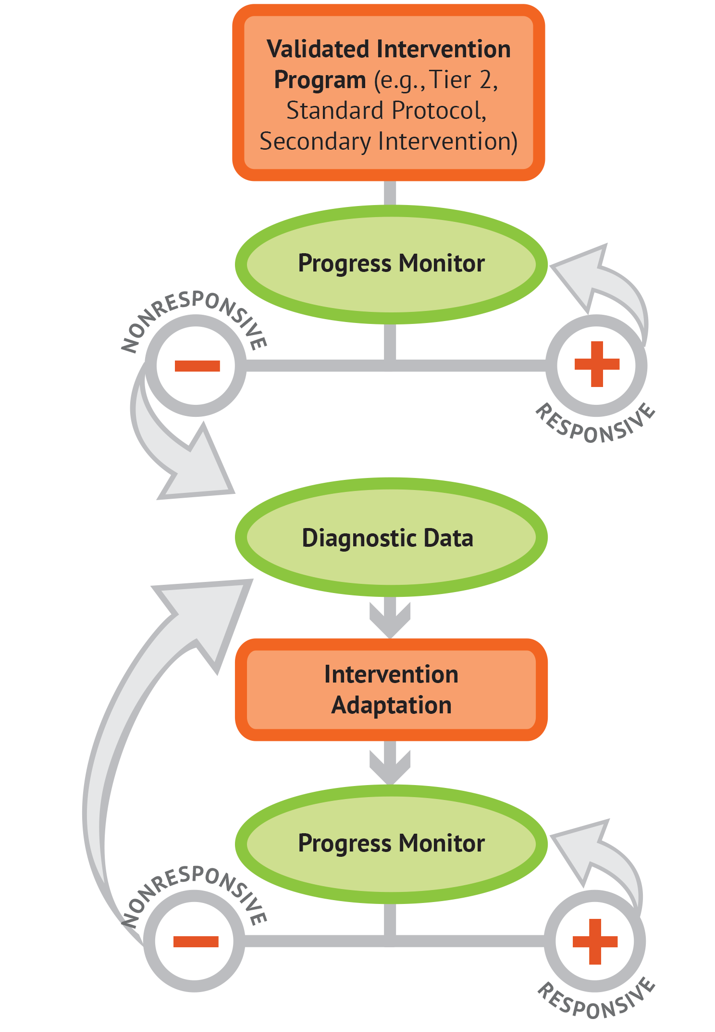
Step 1: Lay the Foundation for DBI
Start with a validated intervention program that is
standardized and evidence-based,
targeted and matched to student need, and
delivered with fidelity.

Slide 10
Step 2: Assess Our Impact
Develop and implement a progress monitoring plan that includes
a valid and reliable progress monitoring tool,
an ambitious and attainable goal, and
a decision rule to help evaluate student responsiveness to the intervention.
Resource: https://intensiveintervention.org/resource/overview-academic-goal-setting (Goal Setting)
Resource: https://intensiveintervention.org/resource/decision-rules-academic-progress-monitoring-data (Decision Rules)

Slide 11
Step 3: Develop a Hypothesis
Use informal diagnostic data to develop a hypothesis about why we might need to adapt our intervention.

Slide 12
Step 4: Make a Change
Adapt and individualize the intervention to address the hypothesis.

Slide 13
Step 5: Reevaluate Our Impact
Monitor the student’s response to any adaptations.

Slide 14
Question
Activity
What are common barriers or challenges you encounter when implementing DBI or providing interventions to students?

Slide 15

DBI Implementation
Issues with implementation may be both technical and adaptive.
Buying the tools and teaching people the skills and knowledge for DBI is relatively straightforward, but the application and navigation of barriers require adaptive solutions.

Slide 16


Technical Problems
The problem exists because of a lack of technology, knowledge, or practice. The solution is clear, easy to identify, and resolved with authoritative expertise.
The solution is out there.
Taking a medication to lower blood pressure
Buying an intervention program to address a need
Photo by danilo.alvesd on Unsplash

Slide 17

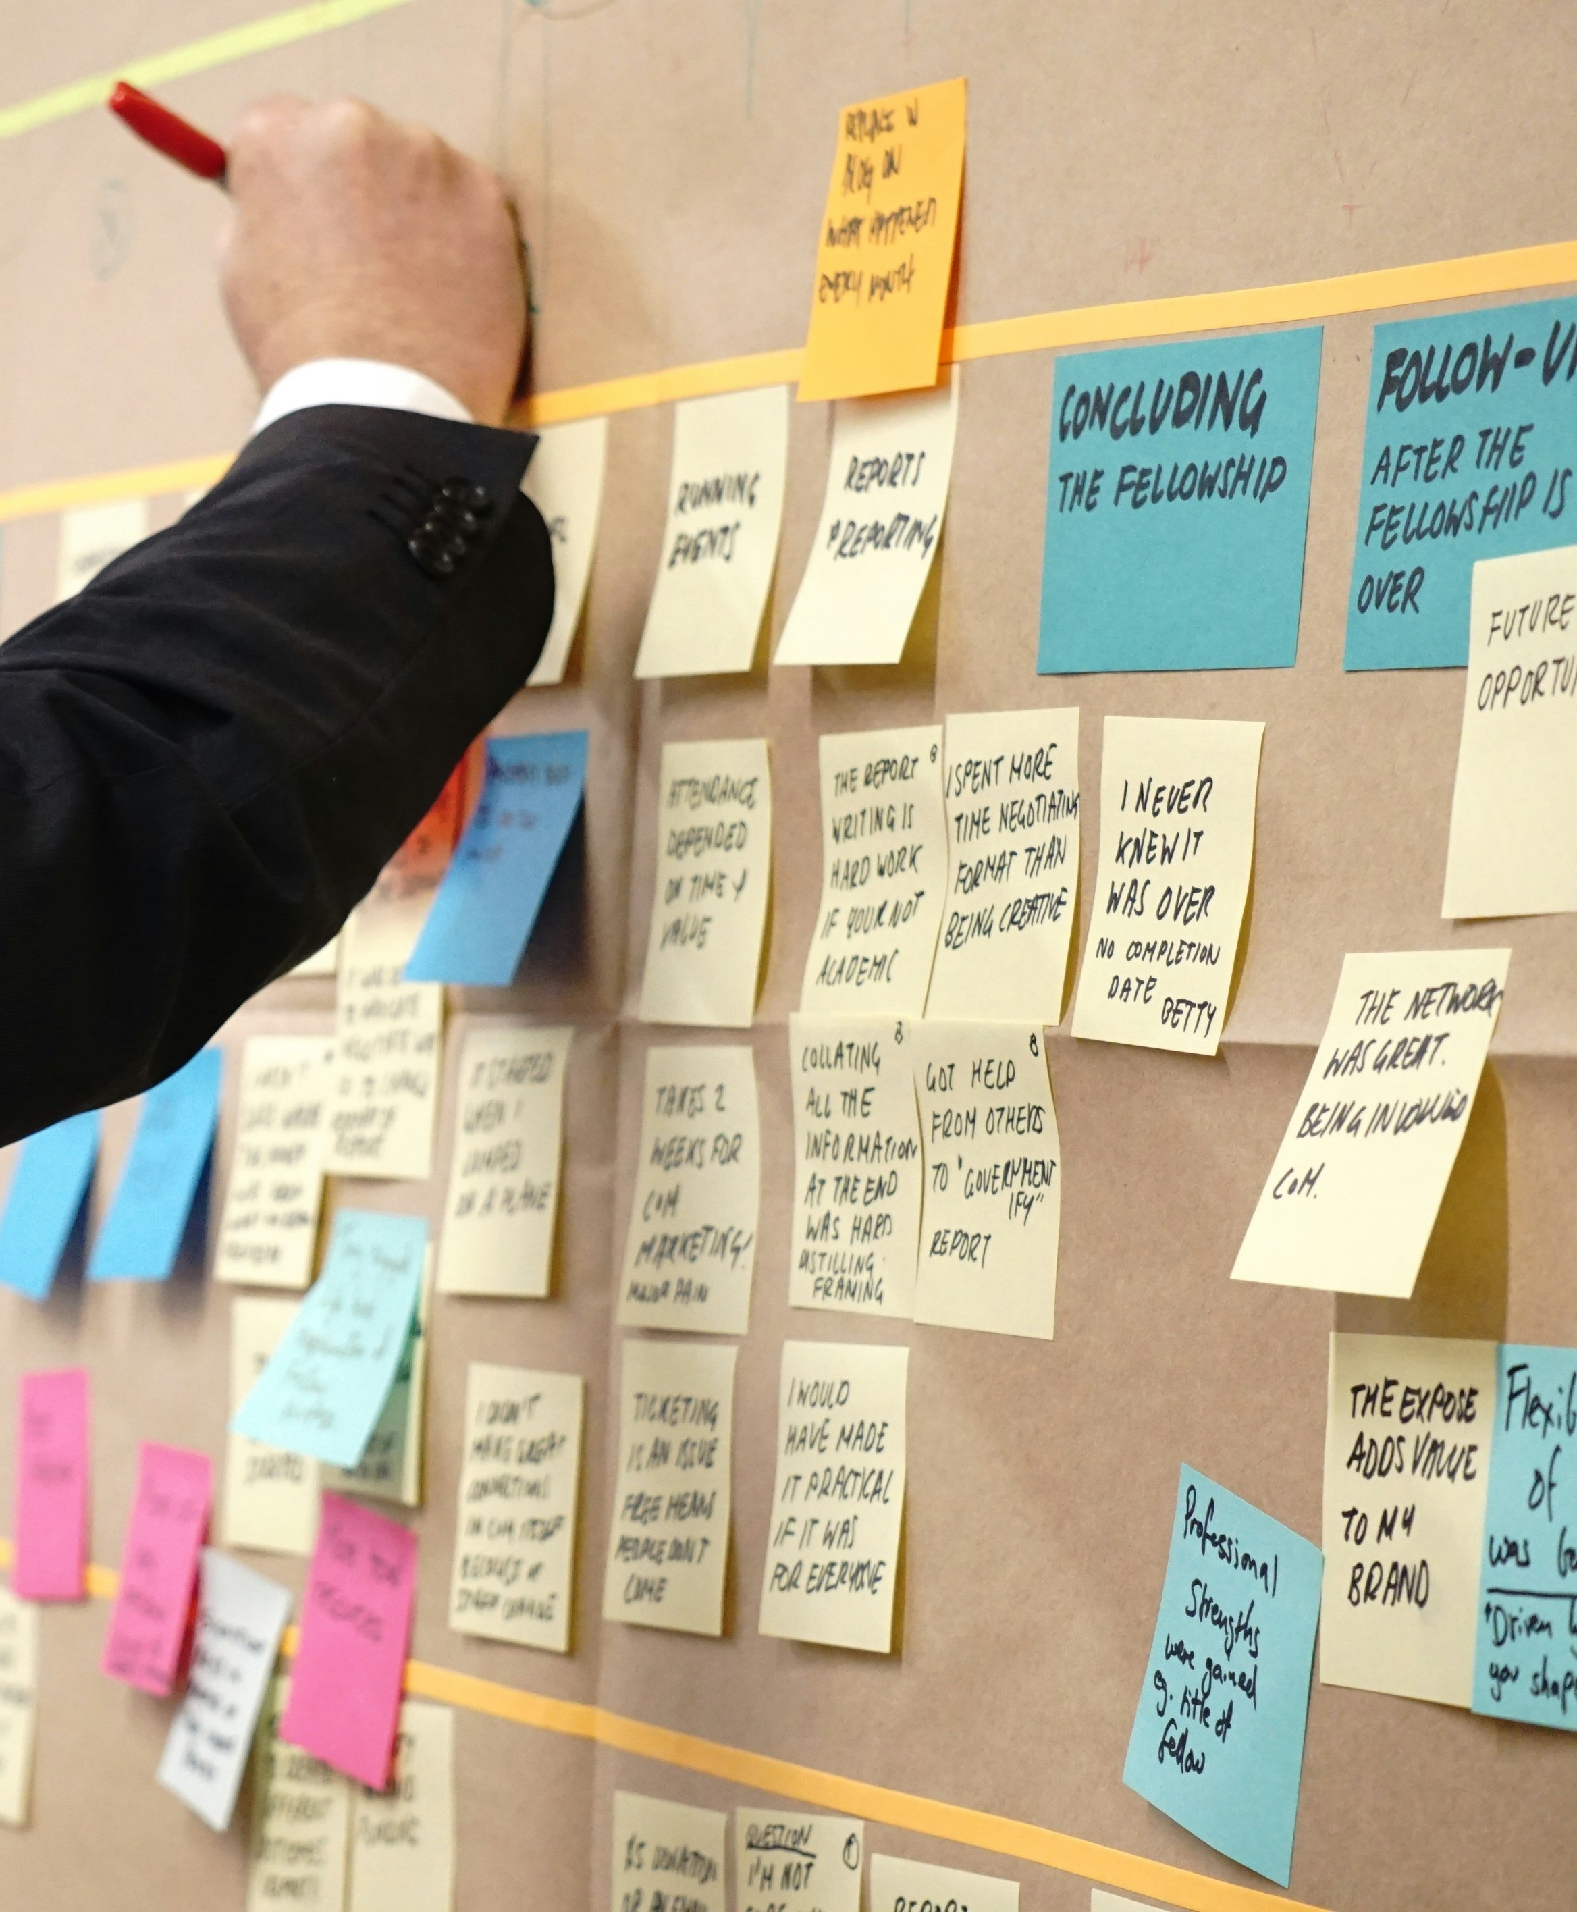
Adaptive Challenges
The problem exists because of a lack of application and context. The solution is hard to identify and requires creativity, flexibility, and changes in systems or thinking about the current context.
The solution is in here.
Changing lifestyle to reduce blood pressure
Adjusting schedule or roles to implement an intervention
Photo by VD Photography on Unsplash; Photo by Jo Szczepanska on Unsplash

Slide 18
Technical Vs. Adaptive
Technical
Adaptive
Buying an evidence-based intervention to address a common need of students
Adjusting the roles of staff to coordinate use of the intervention

Slide 19
Technical vs. Adaptive 2
Technical
Adaptive
Buying a progress-monitoring tool
Changing team structures to include examining progress- monitoring data
Discussing the difference between progress monitoring and monitoring progress and making changes to data collection

Slide 20
Technical vs. Adaptive 3
Technical
Adaptive
Administering diagnostic data tools to pinpoint skill needs in students
Changing beliefs about alterable variables to see the value of gathering data on instruction, curriculum, and the environment

Slide 21
Technical vs. Adaptive 4
Technical
Adaptive
Believing all students can learn, given the right support, so the team continues to problem solve creatively to adapt interventions
Adding additional interventions to a student’s plan
Having teachers collaborate to support the use of adaptations

Slide 22
Examples: Technical Problems Versus
Adaptive Challenges
Problem | Technical | Adaptive
Low reading scores | Buy an intervention program that is evidence based. | Ensure coaching support for staff to use the program.
Not using certain social skills | Teach student the steps for using a certain skill (e.g., steps to greet someone). | Student doesn’t use steps across settings, so staff prompt the use of the steps.
Lack of data in system | Buy a data system to store the data. | Discuss value of data and illustrate impact to ensure staff input the data.
High rate of referrals for minor incidences | Have staff use a consistent process to address minor incidences. | Discuss beliefs about student behavior to increase use/acceptability of the process.

Slide 23
Discussion
Activity
What do you think are, or have you seen, indicators of adaptive challenges with DBI implementation?

Slide 24
Indications of Adaptive Challenges in Systems
Resistance to change.

Slide 25

Indications of Adaptive Challenges in Systems 1
Resistance to change.
Leadership supports change, but there is limited action.

Slide 26

Indications of Adaptive Challenges in Systems 2
Resistance to change.
Leadership supports change, but there is limited action.
Avoidance of saying what’s on your mind.

Slide 27

Indications of Adaptive Challenges in Systems 3
Resistance to change.
Leadership supports change, but there is limited action.
Avoidance of saying what’s on your mind.
Shifting responsibility.

Slide 28
Question 2
Activity
Are your barriers more technical problems, adaptive challenges, or a bit of both?
Technical Problems:
Resolved with increase in
knowledge or buying a new product.
Problem is out there.
Adaptive Challenges:
Resolved with changes in systems or beliefs. Requires creativity and flexibility.
Problem is in here.

Slide 29
Finding Solutions

Slide 30
Technical Problems Versus Adaptive Challenges
“The most common leadership failure stems from trying to apply technical solutions to adaptive challenges.”
—Ron Heifetz

Slide 31

General Theme for Adaptive Solutions
Leadership should anchor people on what is staying the same and what needs to change.

Slide 32

Considerations for Adaptive Solutions
Take a view from the balcony.

Slide 33

Considerations for Adaptive Solutions 1
Take a view from the balcony.
Build bridges.

Slide 34

Considerations for Adaptive Solutions 2
Take a view from the balcony.
Build bridges.
Reframe resistance to change as resistance to loss.

Slide 35
Considerations for Adaptive Solutions 3
Tolerance for change is too much
Take a view from the balcony.
Build bridges.
Reframe resistance to change as resistance to loss.
Find the sweet spot.
Zone of
Productive Change
No learning occurs

Slide 36

Considerations for Adaptive Solutions 4
Take a view from the balcony.
Build bridges.
Reframe resistance to change as resistance to loss.
Find the sweet spot.
Make continuous learning and reflection the norm.

Slide 37
Complex Change Model
Vision
Skills
Incentives
Resources
Action Plan
Change
+
+
+
+
=
If missing
Confusion
Anxiety
Resistance
Frustration
False Start
Image source: Harlacher, J. E. (2026). Simplifying MTSS. Five Principes to Support Change. Guilford. Model is Knoster-Lippit.

Slide 38
Reflection
Take a view from the balcony.
Build bridges.
Reframe resistance to change as resistance to loss.
Find the sweet spot.
Make continuous learning and reflection the norm.
Which of these strategies are most needed in your site?

Slide 39

Ask these questions when finding solutions
Question | Likely issue
Do your staff know what to do? | Communication related to technical or adaptive
Do your staff know how to do it? | Technical
Are your staff able to do it? | Adaptive
Are your staff willing to do it? | Adaptive
If this goes really well and is a great success, whose thinking and behavior would have to change?

Slide 40
Leadership
“ People inevitably expect you to treat adaptive challenges as if they were technical—to provide a remedy that will restore equilibrium with the least amount of pain and in the shortest amount of time.
That puts an enormous amount of pressure to have an ‘answer,’ rather than raise (and sit with) the . . . tough questions.”
—Ron Heifetz

Slide 41
NCII Disclaimer
This presentation was produced under the U.S. Department of Education, Office of Special Education Programs, Award No. H326Q160001. Celia Rosenquist serves as the project officer. The views expressed herein do not necessarily represent the positions or policies of the U.S. Department of Education. No official endorsement by the U.S. Department of Education of any product, commodity, service, or enterprise mentioned in this resource is intended or should be inferred.
41

