Slide 1


Academic Progress Monitoring in Intensive Intervention
September 25th, 2025
Introduction to Academic Progress Monitoring
Kyle Allen, TA Consultant

Slide 2
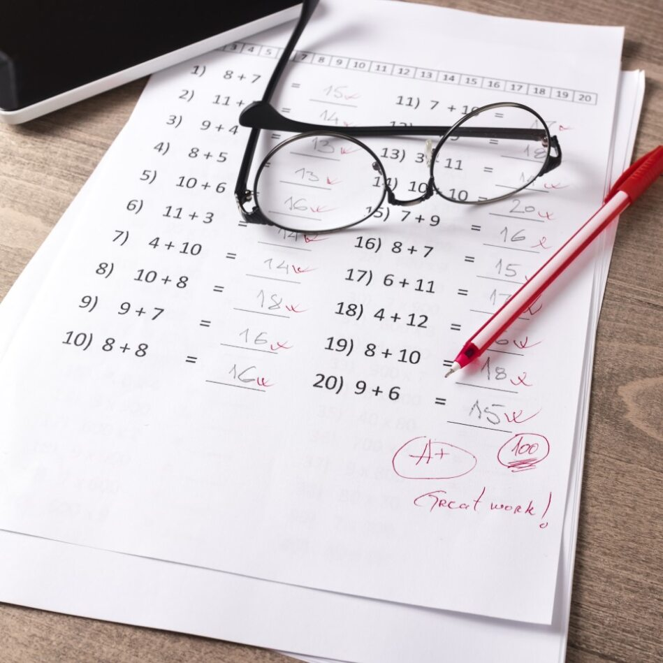
Objectives
By the end of this training, you will be able to do the following:
  Define progress monitoring
  Understand the role of progress monitoring in the data-based individualization (DBI) process
  Describe the features of the progress monitoring process

Slide 3

What Is Progress Monitoring?
Progress monitoring is repeated measurement of student performance over the course of intervention to index/quantify responsiveness to instruction or intervention and to thus determine, on an ongoing basis, when adjustments to the program are needed to improve performance.

Slide 4
Types of Assessment
Type | When? | Why?
Summative | After | Assessment of learning
Diagnostic | Before | Identify skill strengths and weaknesses
Formative | During | Assessment for learning

Slide 5


Formative and Summative Assessments

Slide 6

Diagnostic Assessment
Determine the student’s strengths and skill gaps.
Identify factors within the instruction, curriculum, and environment that impact learning.

Slide 7
How Are Progress Monitoring and Screening Related?
Progress
Monitoring
Screening
Both:
Formative
Same tool (often)
Valid and reliable
Grade level or skill level
Rate of growth
Students at risk (Tier 2, Tier 3)
Monthly, biweekly, or weekly, daily (behavior)
All students
Three times per year
Grade level
Risk status

Slide 8
Monitoring Progress Versus Progress Monitoring
Monitoring Progress
Can occur daily
Occurs during instruction
Provides data for immediate, real-time instructional decisions
Often informal or unstandardized
Used for all students
Progress Monitoring
Standardized delivery
Requires valid and reliable measures
Frequency depends on intensity of instruction and developer recommendations
Requires ongoing data (i.e., six to nine data points) for valid interpretation
Requires graphed data
Used for students receiving targeted and intensive intervention

Slide 9
Why Is Progress Monitoring Important?
Progress monitoring data allow us to . . .
Compare the efficacy of different forms of instruction.
Identify students who are not demonstrating adequate progress.
Support communication with parents and students.
Determine when an instructional change is needed.
Estimate rates of improvement (ROI) across time.
Support the development of a rigorous individualized education program for students with disabilities.

Slide 10
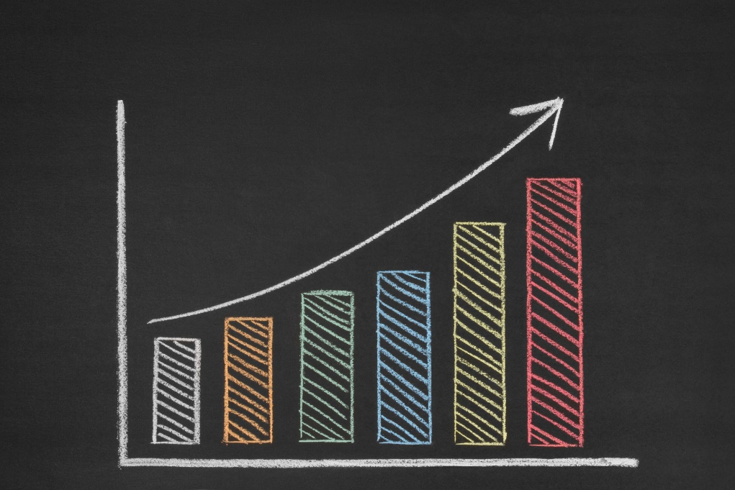
Benefits of Progress Monitoring
Research into the effectiveness of progress monitoring has been ongoing for nearly 40 years. Several studies have found positive associations between progress monitoring and student outcomes, especially for low-performing students, students with disabilities, and English learners.

Slide 11


Benefits of Progress Monitoring:
Parent and Teacher Perspectives
“Looking at her graphs with her, I feel like we’re on the same page because it shows me what her progress is. It lets me know that she’s not just staying at the same level; she’s learning something, getting better, and starting to comprehend what she’s doing day to day.”—Parent
“I think it’s really improved my relationships with students. Being able to talk to them about where they can improve and then have those same conversations with parents and other teachers.”
—Teacher

Slide 12
How Does Progress Monitoring Fit Within DBI?
Progress monitoring is important for
  understanding student responsiveness and
  determining when changes are needed.
Collecting, graphing, and analyzing progress monitoring data.

Slide 13
What Is Meant by “Student Responsiveness”?
A student is “responsive” to the intervention if progress monitoring data indicate that they are on-track to meet their goal for the intervention.

Slide 14
Progress Monitoring Across the Five Steps of the DBI Process

Slide 15


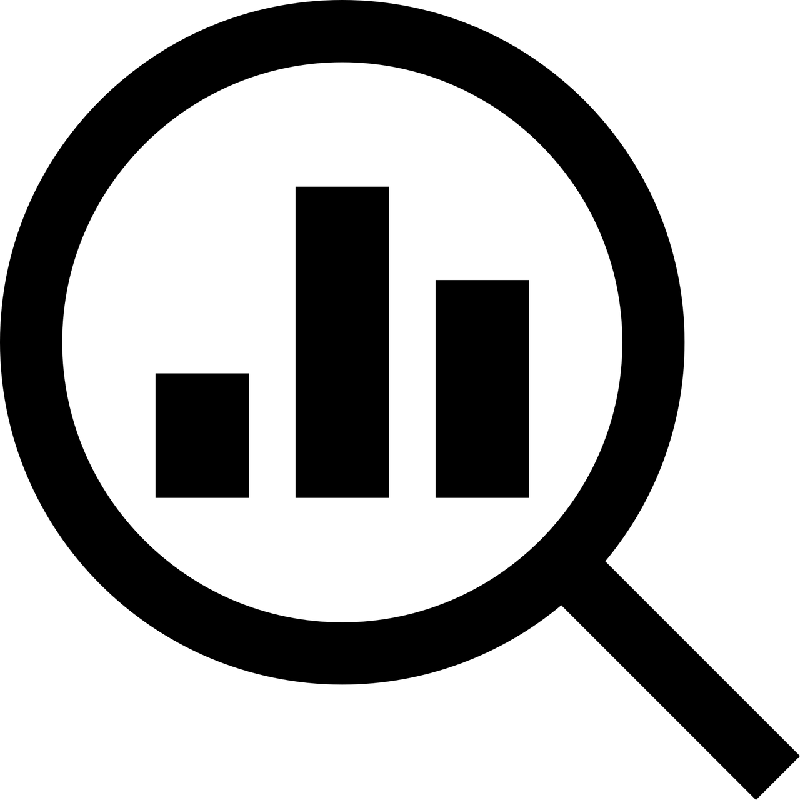

Getting Started With Progress Monitoring
Identify Target Behavior and Select Tool
Establish a Progress Monitoring Plan
Collect and Graph Data
Evaluate Student Responsiveness

Slide 16
Getting Started With Progress Monitoring 1
Identify Target Behavior and Select Tool
Establish a Progress Monitoring Plan
Collect and Graph Data
Evaluate Student Responsiveness

Slide 17

What Is a Target Behavior?
The target behavior is the outcome of interest for the student.

Slide 18
What Are Examples of “Target Behaviors” in Academics?
Passage reading fluency
Quantity discrimination
Total words written
Word identification fluency

Slide 19




What to Look for in a Progress Monitoring Measure
Brief and easy to administer
Able to be used repeatedly across time
Sensitive to changes in student performance
Valid, reliable, and evidence based

Slide 20

Considerations for Selecting
Progress Monitoring Measures for DBI
  Avoid using a progress monitoring measure that
  cannot be administered weekly,
  takes a long time (e.g., 20 minutes) to administer,
  does not have evidence demonstrating validity and reliability, and
  does not have equal interval data.

Slide 21
Getting Started With Progress Monitoring 2
Identify Target Behavior and Select Tool
Establish a Progress Monitoring Plan
Collect and Graph Data
Evaluate Student Responsiveness

Slide 22
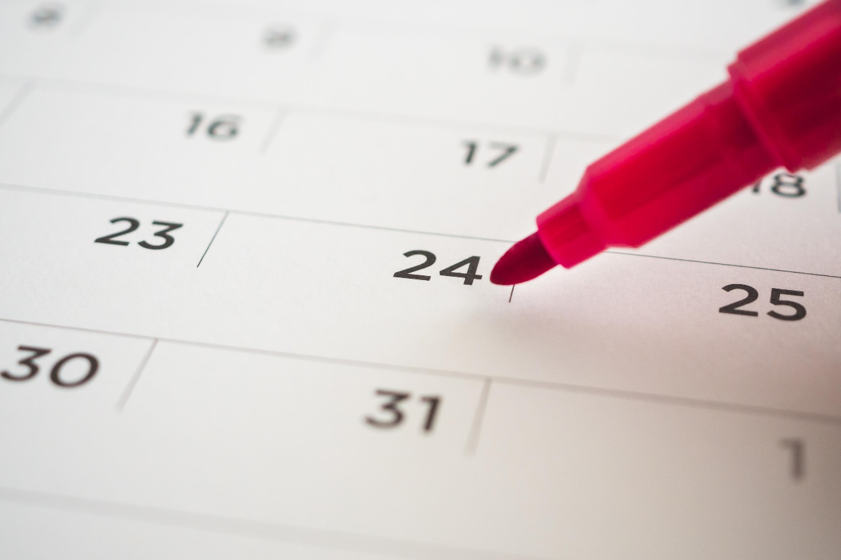
Establishing a Progress Monitoring Plan
The plan should identify
who will collect the data,
how often data will be collected,
what tool will be used to collect the data,
timeline and frequency of data collection, and
the baseline data and goal.

Slide 23

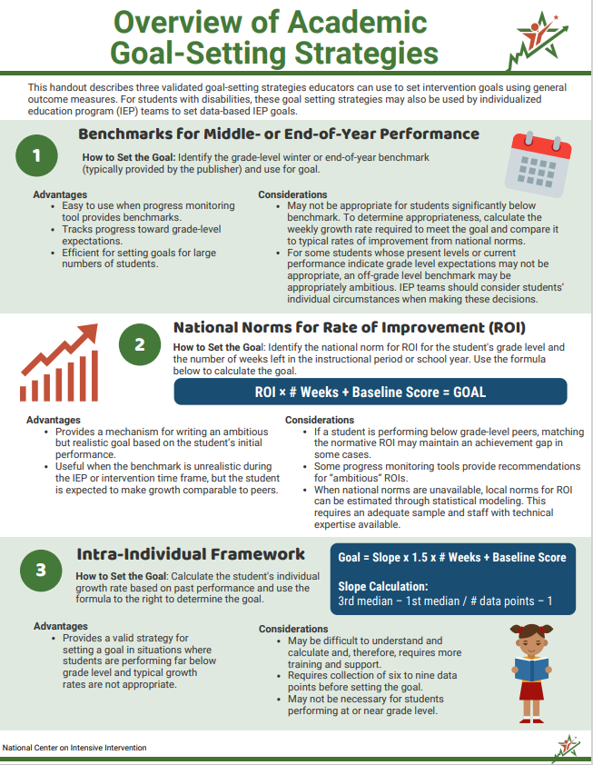
Choosing a Goal-Setting Strategy
There are three approaches to setting goals:
Benchmarking
National norms for weekly ROI
Intra-individual framework

Slide 24
Getting Started With Progress Monitoring 3
Identify Target Behavior and Select Tool
Establish a Progress Monitoring Plan
Collect and Graph Data
Evaluate Student Responsiveness

Slide 25

Why Is Graphing Data Important?
Allows for visual analysis using trend lines
Allows for quick and easy decision making
Simplifies communication about student responsiveness
Indicates possible data collection quality concerns

Slide 26
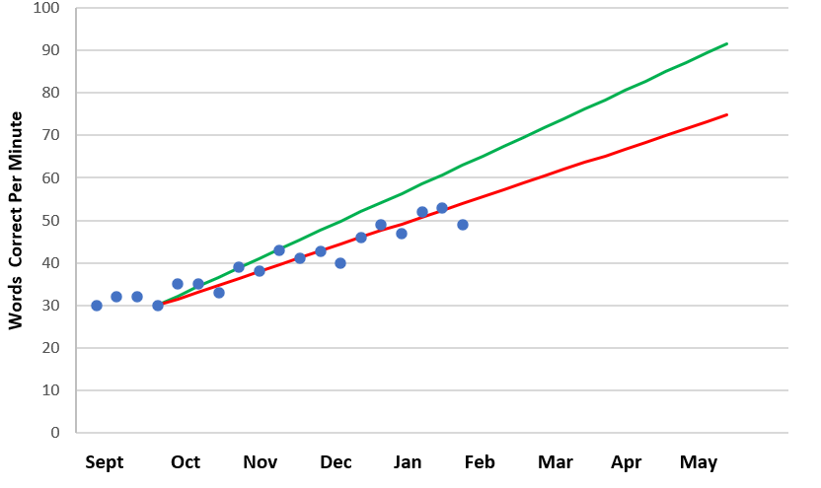
Parts of the Graph
Goal
Goal line
Phase line
Trend line
PM data points
Baseline

Slide 27

Data Quality Considerations
Inconsistent Assessment Administration
Changes to the Environment
Incorrect or Variable Instructions
Data Entry Errors
Inappropriate Assistance
Altered Assessment Protocols
Errors in Scoring Assessments

Slide 28
Getting Started With Progress Monitoring 4
Identify Target Behavior and Select Tool
Establish a Progress Monitoring Plan
Collect and Graph Data
Evaluate Student Responsiveness

Slide 29
Interpreting Progress Monitoring Graphs
  Use graphed data to make timely decisions about student responsiveness.
  If a student is not responding adequately, it is time to make a change to the intervention.

Slide 30
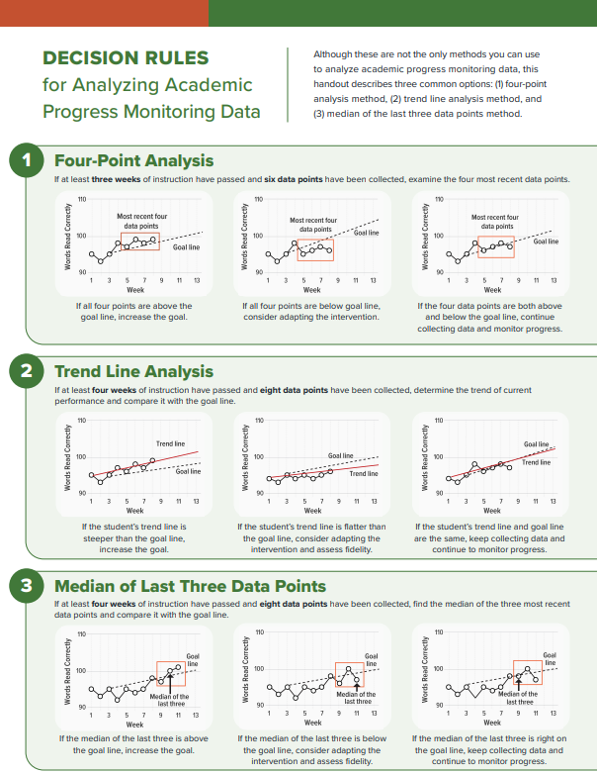
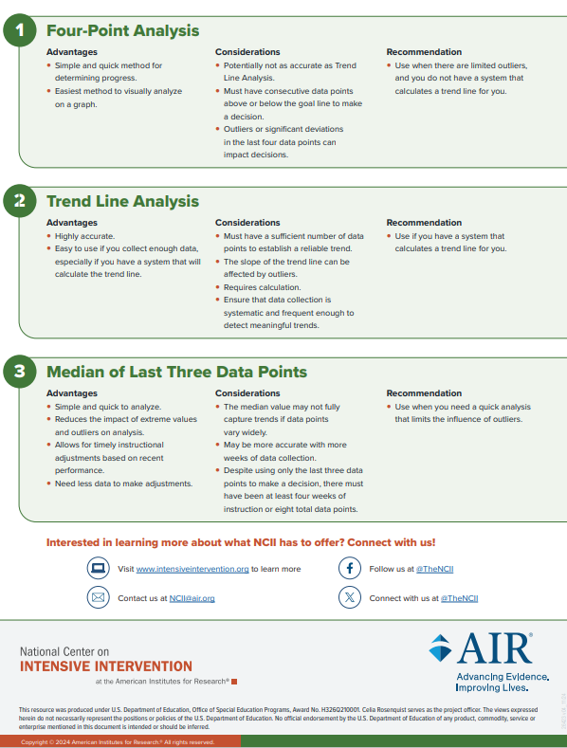
Decision Rules for Analyzing
Progress Monitoring Data

Slide 31
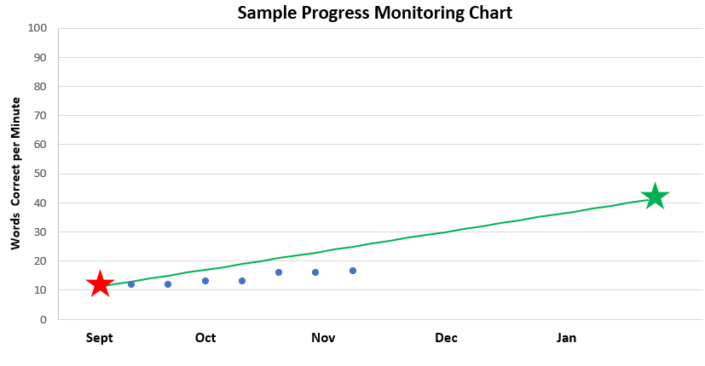
Example: Four-Point Analysis Method
Based on the four most recent data points, what analysis or decision should be made about this student’s progress?
WRC = words read correctly.

Slide 32
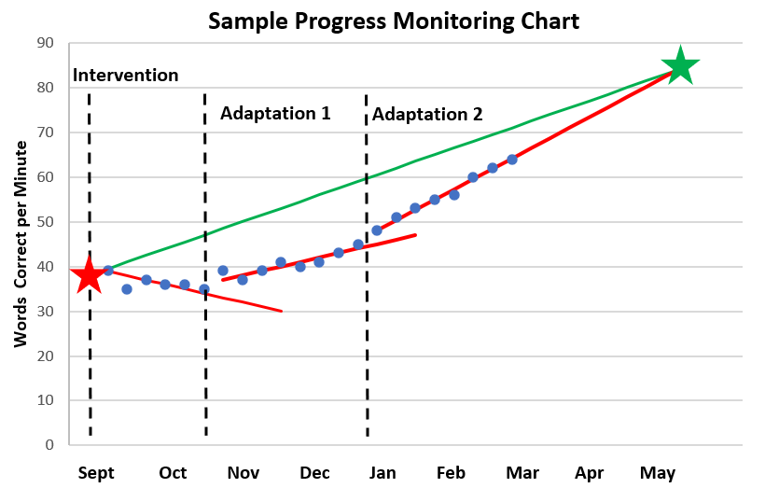
Example: Trend Line Analysis Method

Slide 33

Example: Median of the Last Three Points Method​
Based on the median of the last three data points, what analysis or decision should be made about this student’s progress?

Slide 34
Conclusion

Slide 35




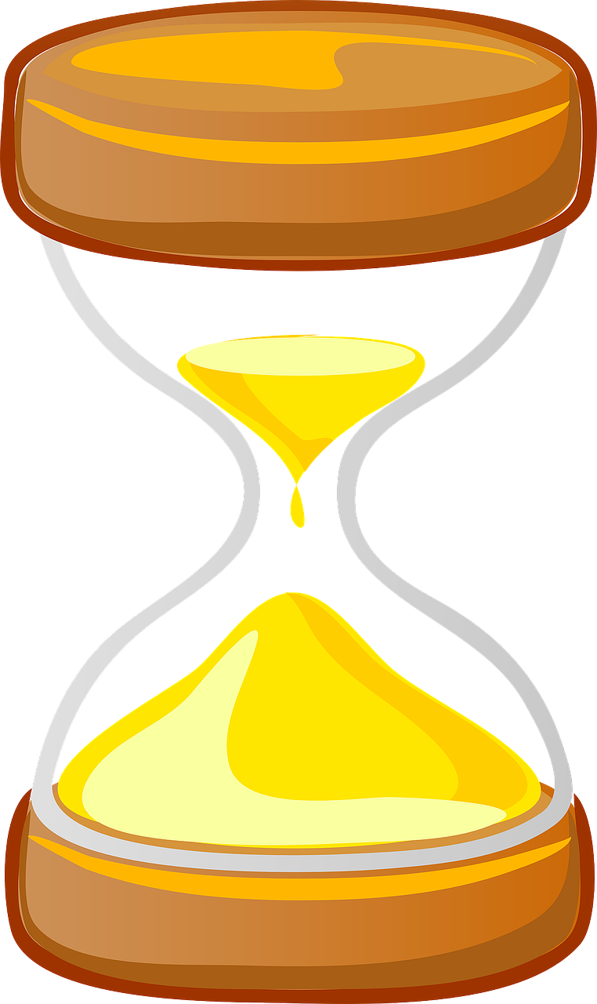

Common Challenges With Academic
Progress Monitoring
The assessment does not align with the content of the intervention.
The level of the assessment is too difficult or too easy for the student.
The goal for student progress is inappropriate.
Lack of clarity about the logistics of collecting progress monitoring data (i.e., who, what, when, where).
The assessment is not administered in a consistent way.
Data are not collected frequently enough to allow for timely decisions.

Slide 36
What’s Next in the DBI Process?
If the student is not responsive, use diagnostic data to develop a hypothesis about why the student has not yet made adequate progress in the intervention.

Slide 37
In Summary
In the DBI process, progress monitoring is an important step in determining whether an intervention is working for an individual student.
Progress monitoring has four main steps:
  Identifying the target behavior and selecting a tool
  Establishing a progress monitoring plan
  Collecting and graphing data
  Evaluating student responsiveness
In the next sessions, we will discuss each step in detail.

Slide 38
Join us…
2-Part Academic Progress Monitoring Workshop
  Session 1: Selecting and Implementing Progress Monitoring Measures
    October 9th, 3:30-4:45 EST
  Session 2: Developing a Progress Monitoring Plan & Using Data to Drive Instruction
    October 30th, 3:30-4:45 EST

Slide 39
NCII Disclaimer
This presentation was produced under the U.S. Department of Education, Office of Special Education Programs, Award No. H326Q260001. Celia Rosenquist serves as the project officer. The views expressed herein do not necessarily represent the positions or policies of the U.S. Department of Education. No official endorsement by the U.S. Department of Education of any product, commodity, service, or enterprise mentioned in this resource is intended or should be inferred.

Slide 40

Contact Us at ncii@air.org

