Slide 1

Data-Based Individualization 101
August 2025
Cat Merkle and Caitlyn Majeika

Slide 2


Welcome!
Cat Merkle
Technical Assistant
NCII
Caitlyn Majeika
Research Translation and Capacity-building Specialist
NCII

Slide 3


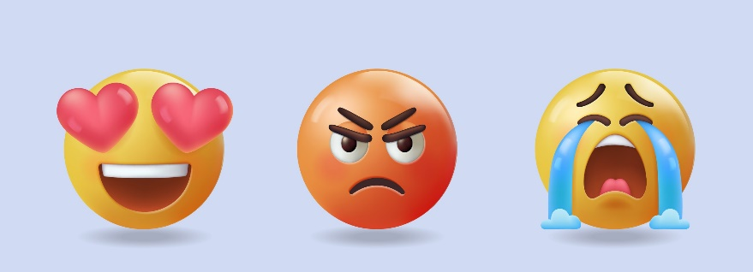
Put an emoji in the chat that represents how your body feels after sitting all day.
Answer in the chat!

Slide 4

Real Life Back Pain Scenario

Slide 5

Learner Outcomes
By the end of the webinar, participants will be able to:
Explain the rationale for intensive intervention
Describe the steps in the data-based individualization (DBI) process.
Access and use National Center on Intensive Intervention (NCII) resources to support implementation of DBI

Slide 6
Why is Intensive Intervention Important?

Slide 7



Why do we need intensive intervention?
Validated programs are not universally effective programs; 3% to 5% of students need more help (NCII, 2013)
Students with intensive needs often require 10–30 times as much practice as their peers to learn new information
(Gersten et al., 2009)
For students with intensive needs, co-occurring academic and behavioral needs are the rule not the exception
(Kuchle & Riley-Tillman, 2019)

Slide 8

Who needs intensive intervention?
    Students with disabilities who are not making adequate progress in their current instructional program and not meeting individualized education program (IEP) goals
    Students with persistently low academic achievement and/or high-frequency and/or high-intensity behavior
    Students in a tiered intervention program who are nonresponsive to interventions delivered with fidelity

Slide 9
Overview of DBI
NCII’s Approach to Intensive Intervention

Slide 10
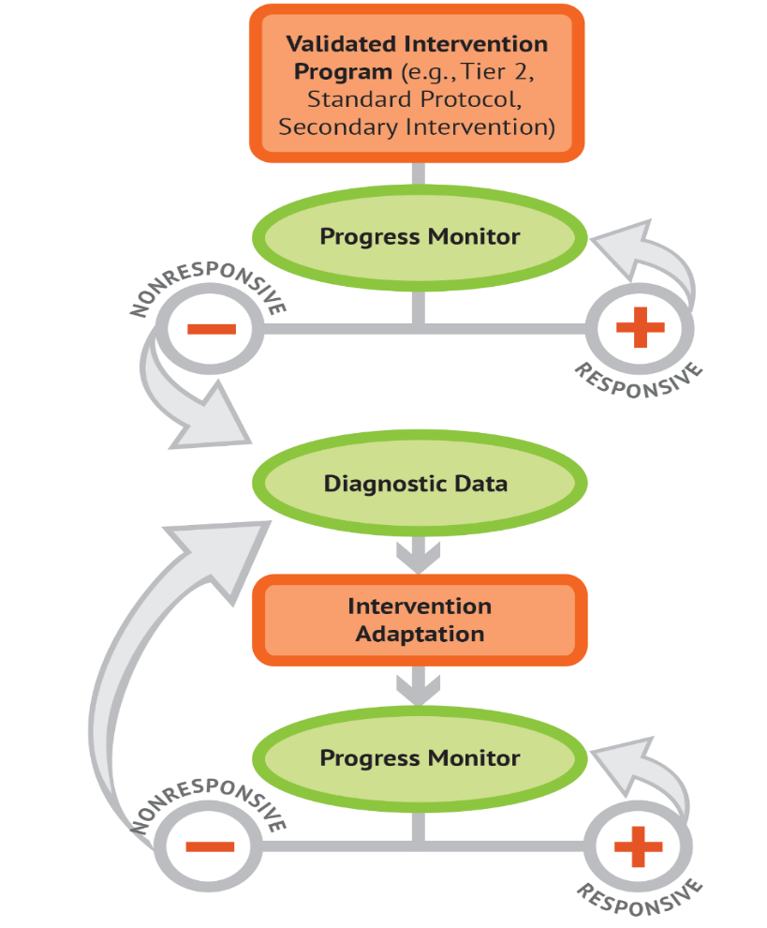
What is data-based individualization (DBI)?
DBI Process
Data-based individualization (DBI) is a research-based process for individualizing and intensifying interventions for students with severe and persistent learning and behavioral needs.
The process integrates evidence-based intervention, assessment, and strategies.

Slide 11
DBI Process
Validated intervention program, delivered
with fidelity
Progress monitoring
Diagnostic data used to develop a hypothesis
Adaptation to validated intervention
Continued progress monitoring, with adaptations occurring whenever needed to ensure adequate progress

Slide 12
DBI Step 1: Lay the foundation for DBI.
STEP 1: Start with a standardized, validated intervention program.

Slide 13

Scenario: If you were me, how would you decide which treatment to try first for something common like general back pain?
Answer in the chat!

Slide 14

Scenario: DBI Step 1
STEP 1: Start with a standardized, validated intervention program.
  Over-the-counter medication
  Physical therapy (PT)

Slide 15




Validated Intervention Program
Standardized, evidence-based programs or instructional practices.
Targeted instruction in a specific skill or set of skills (e.g., phonemic awareness, vocabulary, math problem solving, social skills).
Matched to students’ needs or the function of their behavior.
Delivered with fidelity.

Slide 16






Why start with standardize, evidence-based programs?
They are effective
They can be easy to deliver
They are efficient
They can be cost effective
They are consistent

Slide 17
Ensure Intervention Fidelity
Did we deliver the intervention as planned?
Did the student receive the intervention?
  Are we providing the program as designed, with sufficient time, in a high-quality way?
  Did the student attend the intervention sessions?
  If not, why not?
Ways to assess fidelity:
Observation
checklists
Self-report
checklists
NCII Student Intervention Implementation Log
Source. National Center on Intensive Intervention (NCII) (n.d.c)

Slide 18
DBI Step 2: Did the intervention work?
STEP 2: Develop a progress monitoring plan that includes an ambitious goal.

Slide 19
Scenario: How do you know if the intervention (PT) is working?
Answer in the chat!

Slide 20
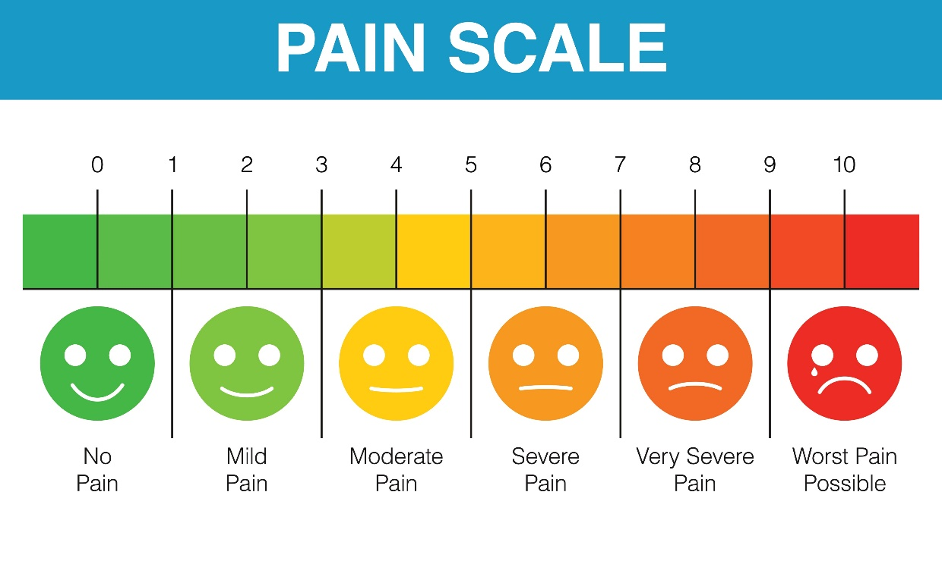
Scenario: DBI Step 2
STEP 2: Develop a progress monitoring plan that includes an ambitious goal.
  Goal: sit through a workday with less than a 2/10 pain scale
  Track pain levels each day in a log

Slide 21
Monitoring Progress Versus Progress Monitoring
Monitoring Progress
Often informal or unstandardized
Can occur during daily instruction
Provides data for immediate, real-time instructional decisions
Used for all students
Assesses learning of directly taught skills
Progress Monitoring
Valid and reliable tools, standardized delivery
Frequency depends on intensity of instruction
Requires ongoing graphed data and a goal for valid interpretation
Used for students receiving interventions
Assesses generalization, consolidation, and application of taught skills to new content
Examples:
Questioning, daily formative assessments, lesson checkouts, exit slips
Examples:
Curriculum-Based Measures (CBM)
General Outcome Measures (GOM)

Slide 22




What to Look for in a Progress Monitoring Measure
Brief and easy to administer
Able to be used repeatedly across time
Sensitive to changes in student performance
Valid, reliable, and evidence based

Slide 23
We Collected Data. Now What?
Collecting, graphing, and analyzing progress monitoring data is important for:
  understanding student responsiveness and
  determining when changes are needed.

Slide 24
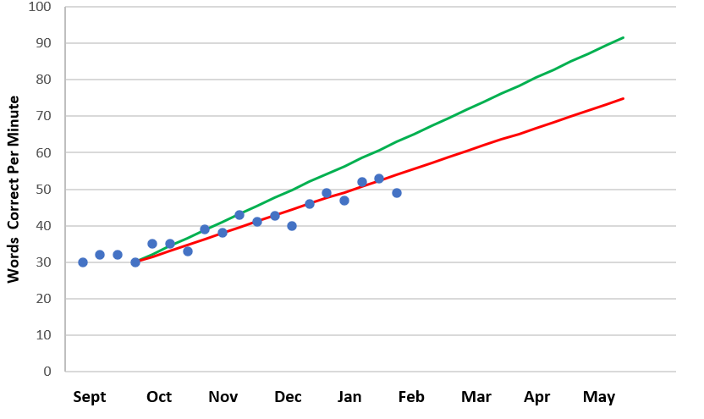
The Importance of Graphing Data
Goal
Goal line
Phase line
Trend line
PM data points
Baseline

Slide 25
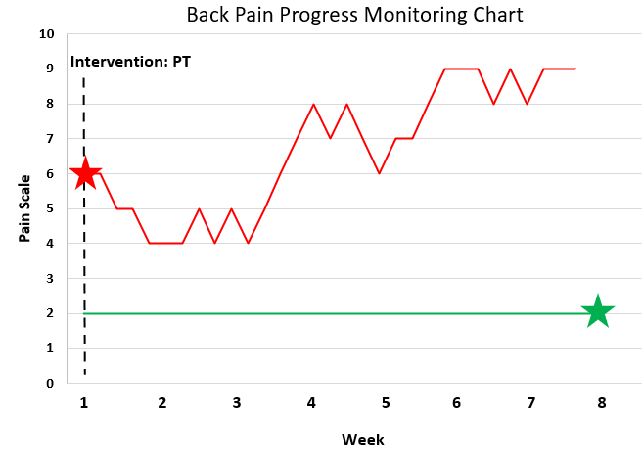

Scenario: Graphing My Pain

Slide 26
DBI Step 3: Why didn’t the intervention work?
STEP 3: Use informal diagnostic data to develop a hypothesis about WHY the student is not responding.

Slide 27
Scenario: If a treatment isn’t working, what would you want to know before trying something new?
Answer in the chat!

Slide 28

Scenario: DBI Step 3
STEP 3: Use informal diagnostic data to develop a hypothesis about WHY the student is not responding.
  Data: new and increased symptoms
  Hypothesis: Nerve issue (probably cannot be fixed with PT)

Slide 29

Why do students experience challenges?

Slide 30




Educationally Relevant and Alterable Variables
Curriculum
Scope and sequence
Level of difficulty
Match to learner need
High-quality materials
Clear expectations
Positive reinforcement
Positive interactions
Positive feedback
Explicit instruction
Pacing (opportunities to respond)
Corrective feedback
Engagement strategies
Learner
Instruction
Environment

Slide 31


Next Steps for Informal Diagnostic Data
The student is not responsive to the intervention, and other students receiving the intervention are responsive.
We addressed issues with fidelity of implementation and progress monitoring.
What do we do now?

Slide 32






What Do We Do Next?
Develop a Hypothesis to Guide Adaptation
Use Existing Data To Develop An Initial Hypothesis
Collect and Review Informal Diagnostic Data
Adapt Intervention to Match Hypothesis
Progress Monitoring
Intervention Data
Confirm Initial Hypothesis
Identify Alternate Hypothesis
Instruction
Curriculum
Environment

Slide 33
Identify the Focus
(i.e., Instruction, Curriculum, Environment)
For each scenario on the left, the questions on the right provide a possible starting point for the diagnostic data process.
The student is making little to no progress (they are unsuccessful in the intervention).
Is there a mismatch between skills the student needs and skills taught in the intervention? (Curriculum)
The student is making some progress but not enough to reach the goal.
Is the dosage of the intervention sufficient for the student to reach the goal? (Instruction)
The student is making progress in the intervention but has difficulty applying skills in other settings.
Have we explicitly taught the student how to generalize skills? (Instruction)
Does the student have behavioral needs that are not supported in some settings? (Environment)
Is the instruction explicit enough? (Instruction)

Slide 34

Collect and Review Informal Diagnostic Data Related to the Identified Focus
Possible informal diagnostic data sources include the following:
  Analysis of student errors in work samples and progress monitoring data (curriculum)
  Classroom observations (instruction, environment)
  Interviews with the student or family (instruction, curriculum, environment)
  Intervention-specific assessments (curriculum)

Slide 35
Behavior: Integration of Academics and Behavior
Skill deficit
Avoidance behavior
Removal from task

Slide 36
DBI Step 4: What change is needed?
STEP 4: Intensify and individualize the intervention to address the hypothesis.

Slide 37
Scenario: How can I change my treatment according to my new hypothesis?
Answer in the chat!

Slide 38
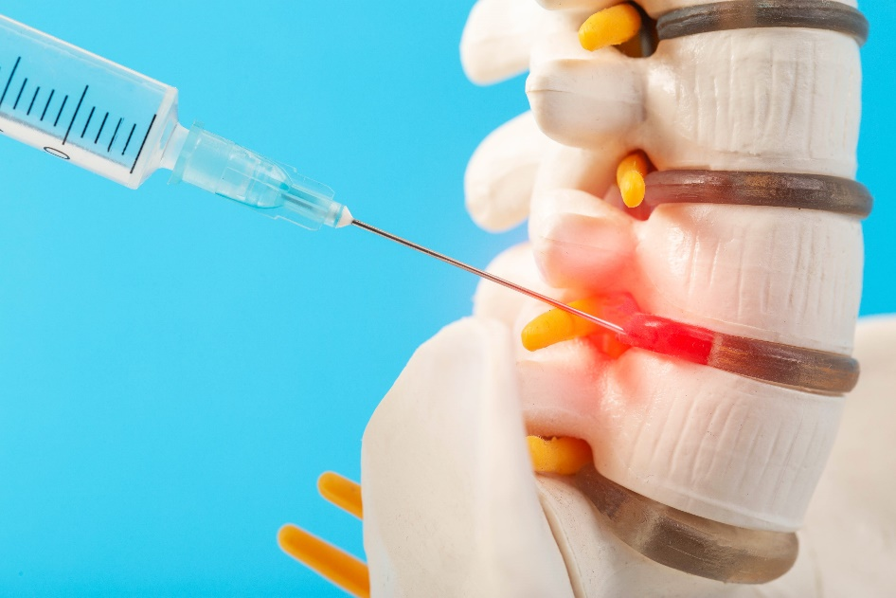
Scenario: DBI Step 4
STEP 4: Intensify and individualize the intervention to address the hypothesis.
    Spinal injections to target the nerve pain more directly.

Slide 39
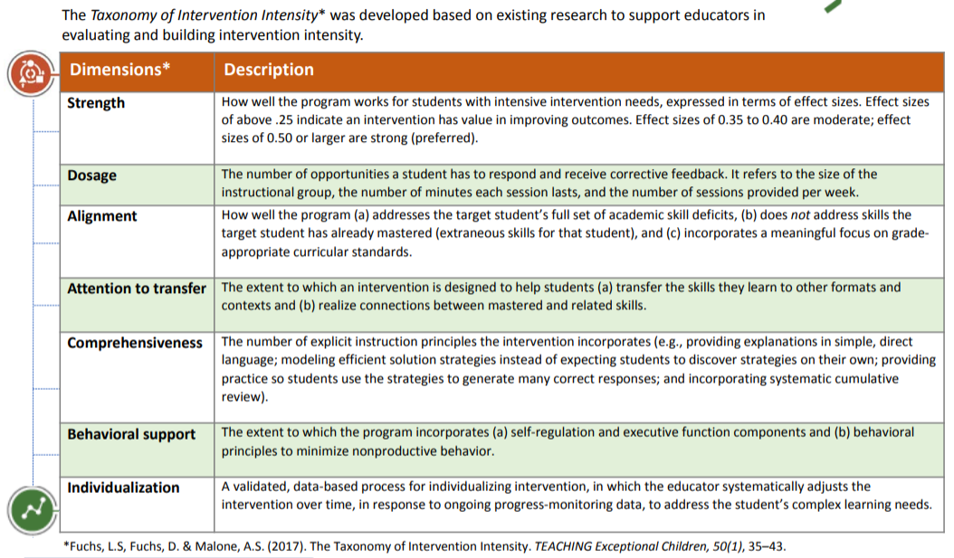
Taxonomy of Intervention Intensity
Taxonomy of Intervention Intensity

Slide 40
Shrink the Choices:
Adapt Dimensions That Address Your Hypothesis 6
Data-based Hypothesis
Dimensions to Adapt
Actions to Take
There is a mismatch between skills needed and skills being taught.
Alignment
Increase instructional time for the target skill(s).
Supplement intervention with additional materials.
Use an alternative program that addresses student’s needs.
The instruction is not explicit enough.
Comprehensiveness
  Use simple, direct language and break steps into smaller chunks.
  Provide additional modeling, guided practice and independent practice.
  Use visual aides, graphic organizers, manipulatives, and other scaffolds.
The dosage of the instruction is not sufficient.
Dosage
Increase minutes per session or frequency of sessions.
Reduce group size.
Increase student opportunities to respond (OTRs).
The student is not transferring skills other environments.
Attention to Transfer
Align instructional routines and language across tiers.
Teach students when and how to use learned strategies across the day.
Provide visual scaffolds to help student apply skills across environments.
Behavior needs are not being sufficiently addressed across settings.
Integrate Behavior and Academic Support
  Create a motivation plan that provides frequent feedback.
  Teach and reinforce clear expectations and routines.
  Conduct a functional behavior assessment to determine the function of the behavior.

Slide 41
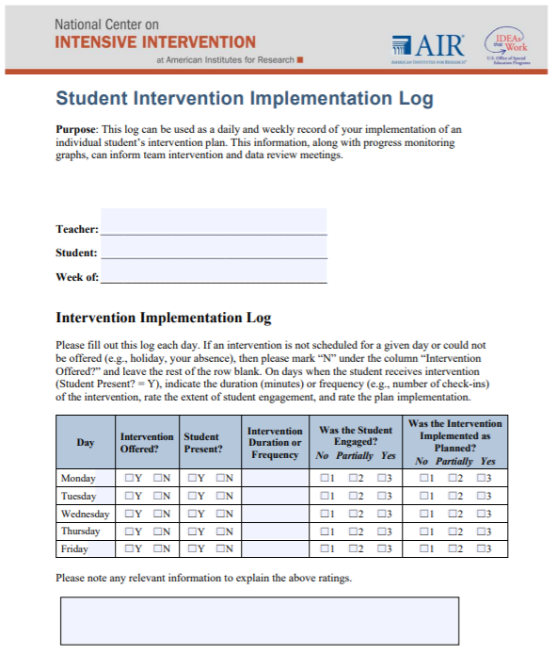
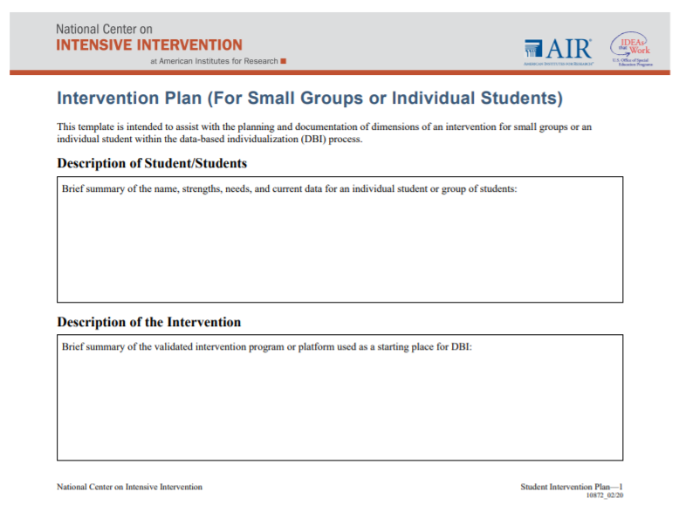
Implementation Monitoring: Was the adapted intervention delivered with fidelity?
Fidelity is still important!
  Focus on fidelity to the adapted student plan.
Student_Intervention_Plan
Student Intervention Implementation Log

Slide 42
DBI Step 5: Did the change work?
STEP 5: Monitor the student’s response to the adaptation (at least 4–6 data points).

Slide 43
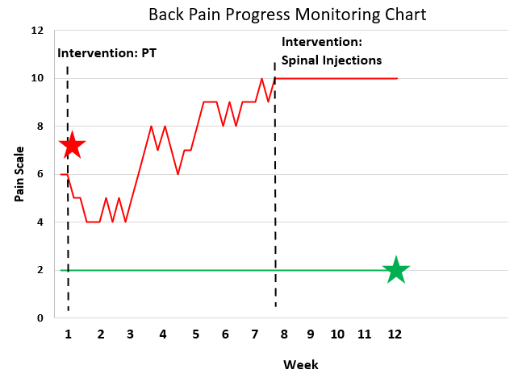

Scenario: DBI Step 5
STEP 5: Monitor the student’s response to the adaptation

Slide 44
Scenario: An Ongoing Process

Slide 45
Scenario: Why would I keep progress monitoring after the surgery seems to be initially effective?
Answer in the chat!

Slide 46
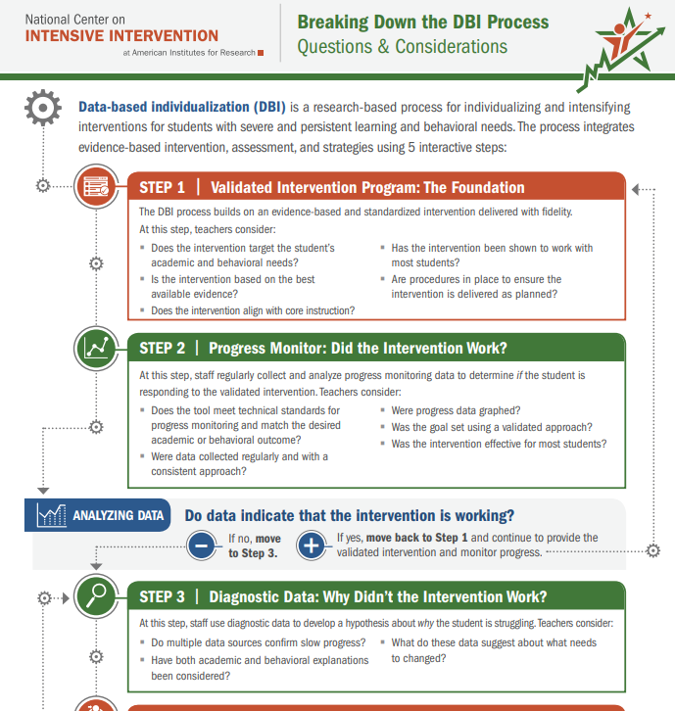
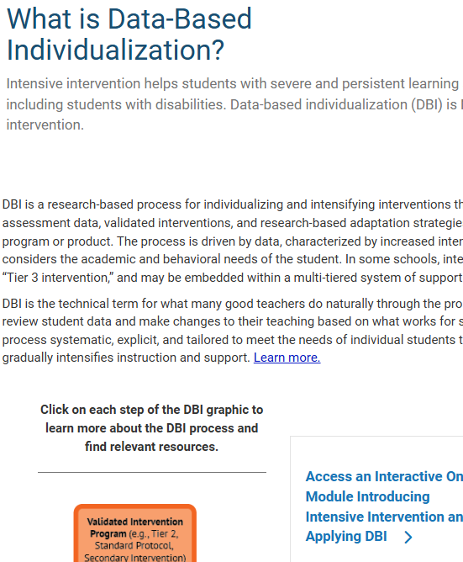
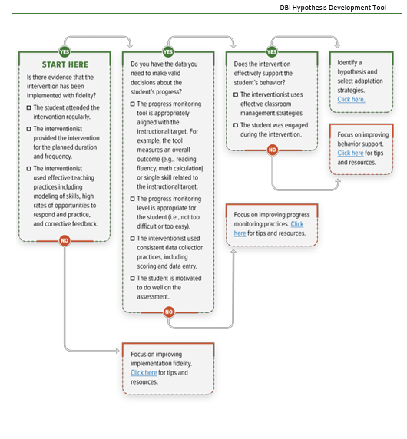
Resources
Breaking Down the DBI Process Questions & Considerations | NCII
Data Based Individualization: Intensive Intervention | NCII
Data-Based Individualization Hypothesis Development Tool

Slide 47
Questions?

Slide 48
Upcoming Webinars
What | When
Academic Progress Monitoring | September 25, 2025
Diagnostic Data | March 10, 2026

Slide 49
Upcoming Workshops & CoPs
What | When
Two-part Academic Progress Monitoring Workshop | October 9, 2025 October 30, 2025
Implementing DBI in Rural Settings CoP | January 28, 2026 February 11, 2026 February 25, 2026
Three-part Diagnostic Data Workshop | March 31, 2026 April 14, 2026 April 28, 2026

Slide 50
NCII Disclaimer
This presentation was produced under the U.S. Department of Education, Office of Special Education Programs, Award No. H326Q160001. Celia Rosenquist serves as the project officer. The views expressed herein do not necessarily represent the positions or policies of the U.S. Department of Education. No official endorsement by the U.S. Department of Education of any product, commodity, service, or enterprise mentioned in this resource is intended or should be inferred.

Slide 51
Thank you

Slide 52
References
Gersten, R., Compton, D., Connor, C.M., Dimino, J., Santoro, L., Linan-Thompson, S., and Tilly, W.D. (2009). Assisting students struggling with reading: Response to Intervention and multi-tier intervention for reading in the primary grades. A practice guide. (NCEE 2009-4045). Washington, DC: National Center for Education Evaluation and Regional Assistance, Institute of Education Sciences, U.S. Department of Education. Retrieved from https://ies.ed.gov/ncee/wwc/PracticeGuide/3
Kuchle, L. B., & Riley-Tillman, T. C. (2019). Integrating behavior and academics in intervention planning. In R.Z. Edmonds, A.G. Gandhi, & L.C. Danielson (Eds.). Essentials of intensive intervention (pp. 51-70). The Guilford Press.
National Center on Intensive Intervention. (2013). Data-based individualization: A framework for intensive intervention. Washington, DC: American Institutes for Research. Retrieved from https://intensiveintervention.uat.air.org/resource/data-based-individualization-framework-intensive-intervention

