Slide 1

Using Informal Diagnostic Data to Individualize Academic Intervention
Month XX, 20XX
Presenter’s Name and Title | Presenter’s Name and Title
Notes:
Welcome to the National Center on Intensive Intervention’s presentation: ” Using Informal Diagnostic Data to Individualize Academic Intervention”
The preferred citation for this presentation is: National Center on Intensive Intervention (2024). Using informal diagnostic data to individualize academic intervention. National Center on Intensive Intervention at the American Institutes for Research.

Slide 2
Session Objectives
Define the role of informal diagnostic data within the data-based individualization (DBI) process.
Identify relevant and alterable variables that impact a student’s success in an intervention.
Describe practical and efficient approaches to collecting informal diagnostic data.
Understand a process for using informal diagnostic data to develop a hypothesis about why a student has not yet responded to an intervention.
Notes:
After this session, participants will be able to:
Define the role of diagnostic data within the data-based individualization, or DBI, process
Identify relevant and alterable variables that impact a student’s success in an intervention
Describe practical and efficient approaches to collecting informal diagnostic data.
Understand a process for using informal diagnostic data to develop a hypothesis for why a student has not yet responded to an intervention.

Slide 3
Diagnostic Data and DBI
What is the role of diagnostic data within the DBI process?
Notes:
We’ll begin by reviewing the DBI process and discuss how educators can use diagnostic data to develop a hypothesis for why a student may not be responding to the intervention. In this slide deck, we are focused on using diagnostic data to determine why a student is not responding to an academic intervention. Therefore, throughout the module, we focus on students who are not making expected progress within an academic intervention.

Slide 4

What Is DBI?
A systematic method for using data to determine when and how to provide more intensive intervention
An ongoing process—not a single intervention
Intended for students with severe and persistent learning and behavioral needs
Notes:
Before we focus on diagnostic data, let’s briefly review the DBI process. DBI is a research-based process for individualizing and intensifying interventions by systematically using assessment data, validated interventions, and research-based adaptation strategies. DBI is the technical term for what many good teachers do naturally through the problem-solving process: frequently reviewing student data and making changes to their teaching based on what works for students. DBI, however, makes this process systematic, explicit, and tailored to meet the needs of individual students through a multistep process that gradually intensifies instruction and support.
DBI is an ongoing process, not a single intervention. It is intended for a small percentage of students with severe and persistent learning and behavioral needs, including those who
are not making adequate progress in their current intervention program (often, a Tier 2, evidence-based intervention),
are not meeting individualized education program goals,
have persistently low academic achievement, and
have high-intensity/frequency behavior.

Slide 5

Diagnostic Data in DBI
  When a student’s progress is insufficient, diagnostic data can help educators develop a hypothesis about why.
  We suggest a team approach. It’s helpful to collaborate with others who know the student best!
Notes:
For students who are not responsive to the validated intervention program, educators use diagnostic data to develop a hypothesis about why the student has not yet made expected progress. Diagnostic data are used to understand a student’s specific strengths and skill deficits and to identify factors that impact learning and behavior. This information helps you understand how to adapt the intervention to better meet the student’s needs.
During the diagnostic data step, it’s helpful to collaborate with others who know the students well to gather input on the student’s strengths and areas of need and suggestions for how to make the intervention more successful.

Slide 6

When Do We Use Diagnostic Data in DBI?
If progress monitoring data show that a student is not sufficiently responsive to an intervention, move to the diagnostic data step of DBI.
Notes:
The image of the graph in the bottom left of the slide shows example progress monitoring data for a student receiving intensive intervention. For this student, the trend of graphed data points indicates that they are unlikely to meet the goal, indicated by the red star. The data demonstrate that the student is not responding adequately to the intervention. Therefore, educators must determine why the student is not making adequate progress and implement an adaptation to the student’s intervention.

Slide 7
Two Types of Diagnostic Data
When collecting diagnostic data, we recommend starting with informal diagnostic data.
Informal diagnostic data sources
  are commonly available,
  require less time to administer than formal diagnostic assessments, and
  may include existing data (e.g., student work samples).
Formal measures (e.g., standardized achievement tests) often require
  specialized training and
  significant time to administer and interpret.
Notes:
There are two types of diagnostic data: formal and informal. We recommend starting the diagnostic data process by using informal diagnostic data sources. Informal diagnostic data sources are commonly available, require less to administer than formal diagnostic assessments, and may include the existing data.
Formal diagnostic data include standardized achievement tests, including neuropsychological tests typically administered by a school psychologist as part of a comprehensive evaluation. These measures require specialized training and significant time to administer and interpret. While these measures may be necessary for some students, in many cases we can rely on informal diagnostic data sources.

Slide 8

Examples of Informal
Diagnostic Sources and Methods
Error analysis of progress monitoring data
Analysis of student work (e.g., classroom tests and assignments)
Observation and anecdotal notes
Student or family interviews and checklists
Intervention or curricula-specific diagnostic tools
Intervention fidelity data
Notes:
We can use a variety of informal diagnostic data sources to help us understand why students are not making progress. Informal diagnostic data sources include progress monitoring data, student work, observations, student and family interviews, intervention-specific diagnostic measures, and intervention fidelity data.

Slide 9

Why Do Students Experience Challenges?
Notes:
Let's discuss why students experience challenges and may not be making progress in the intervention. As part of reviewing diagnostic data, our goal is to understand the full context and all possible variables that may explain why a student is not making adequate progress.
Let’s a consider a pet goldfish. If your pet goldfish was not feeling well, what might be some of the potential causes?
Take responses. (Clean the water, change the food, too much/too little food, bowl too small, fish is bored…)
Ask: what is the key takeaway from these responses? What do they all have in common?
Suggested summary: The key takeaway from this conversation is that when your goldfish is sick, you consider external factors and variables that you can change to improve the health of your fish. We focus on what we can control (e.g., fresh water, clean tank, amount of food).
Ask: How then, might this relate to students who are not making progress?
Suggested response: It’s important that we consider the contextual variables that surround the student such as the instruction we provide, the curriculum, and the environment. We want to understand the student’s context so that we can identify variables that we can adjust.

Slide 10
Educationally Relevant and Alterable Variables
When a student is not making the progress that you had hoped for, identify factors within the instruction, curriculum, and environment that may impact learning.
Instruction
Curriculum
Environment
Notes:
When a student is not making expected progress or the student presents a challenging behavior, we often want to focus on the learner first. What about the student is causing the lack of progress or interfering with learning? However, as with the goldfish, we should focus on what we can control. These factors under our control can be grouped into three categories: 1. the instruction, 2. the curriculum, and 3. the classroom and school environment. These are important variables to consider when a student is not making progress because we have control over these variables and can make adaptations to each variable.

Slide 11




Educationally Relevant and Alterable Variables 2
Scope and sequence
Level of difficulty
Match to learner need
High-quality materials
Culturally relevant materials
Curriculum
Clear expectations
Positive reinforcement
Positive interactions
Inclusive classrooms
Positive feedback
Explicit instruction
Pacing (opportunities to respond)
Corrective feedback
Culturally relevant pedagogy
Engagement strategies
Learner
Instruction
Environment
Notes:
This slide provides examples of what we mean by Instruction, Curriculum, and Environment and represents how each of these factors impacts the learner in the middle of the graphic.
Instruction includes the quality with which educators deliver instruction to the student, including the use of explicit instruction and culturally relevant pedagogy.
Curriculum includes the quality and organization of the content and materials, including the scope and sequence, level of difficulty, and cultural relevance of the materials.
Environment includes the quality of the classrooms and settings in which students receive intervention and includes behavioral expectations, positive interactions with peers and teachers, and inclusiveness.
You can remember these variables using the mnemonic ICE.

Slide 12
Questions to Consider When Reviewing Data
Is the intervention aligned with the student’s needs? (curriculum)
Does the interventionist use appropriate teaching practices? (instruction)
Does the classroom environment support learning in a positive, proactive way? (environment)
What factors outside of school could be affecting the student’s performance? (environment)
Notes:
As mentioned, in step 3 of DBI, educators use diagnostic data to develop a hypothesis about why a student is not making sufficient progress in an intervention. This slide shows examples of the types of questions educators may ask themselves in the diagnostic data step. As shown, we want to ask questions about the instruction, curriculum, and environment, since we have control over these factors. For example:
Is the intervention aligned with the student’s needs? (curriculum)
Does the interventionist use quality teaching practices? (instruction)
Does the classroom environment support learning in a positive, proactive way? (environment)
What factors outside of school are affecting the student’s performance? (environment)

Slide 13
Getting Started With Informal Diagnostic Data
Review and improve fidelity of implementation and progress monitoring practices.
Notes:
Now that we’ve introduced the role of diagnostic data in the DBI process, let’s take a closer look at how to get started using informal diagnostic data. Specifically, it’s important to first consider the fidelity with which educators implement the intervention as well as the quality of the practices that educators use to monitor students’ progress in the intervention.

Slide 14
Using Progress Monitoring Graphs to Inform a Hypothesis
Progress monitoring graphs can provide useful information to inform a hypothesis about why a student is not yet responding to the intervention.
Two important considerations when reviewing graphed data:
Fidelity of Implementation
Progress Monitoring Practices
Notes:
Two important considerations when reviewing graphed data are fidelity of implementation and data and progress monitoring practices. First, it’s critical to consider fidelity of implementation to ensure that the student has received the intervention as intended. If the student has not received the intervention as intended, we should not expect them to achieve the goal that we’ve set. Next, we need to ensure that our progress monitoring practices are strong. This is critical to ensure that lack of progress in the intervention is not due to problems with the progress monitoring tool or assessment practices.
In this section, we introduce four common patterns that educators may see in progress monitoring graphs and discuss what these patterns may tell you about fidelity of implementation and progress monitoring practices.

Slide 15

Analyzing Student Progress
Ms. Liu is reviewing her students’ progress monitoring data from the past 6 weeks. She sees a variety of trends in the progress monitoring data. Some students are on track to meet their goals while others have made limited or no progress in the intervention.
Notes:
Consider this teacher’s experience: Ms. Liu is reviewing trends in his students’ progress monitoring data. Among the students in her intervention group, there is a range of student responsiveness to the intervention. How should she interpret the trends that he sees in the data? Can the progress monitoring graphs help her develop a hypothesis for why some students are not showing adequate progress in the intervention?

Slide 16
Data Pattern 1: Little or No Progress
Consider: Have we implemented the intervention plan as intended?
Have scheduling conflicts reduced instructional time?
Does the student seem unmotivated during instruction?
Is the setting distracting for the student?
Does the interventionist need clarification or training in the intervention or plan?
Notes:
This graph shows one type of trend that educators may find in their students’ data. In this example, the trend line of the student’s scores is flat, indicating that the student’s performance isn’t changing. Based on this graph, the student is not making sufficient progress to meet the goal. In this situation, you’ve given your plan a chance to work, but it hasn’t so far.
Graphs that show little to no progress may indicate that there have been problems with the implementation of the intervention. For example, consider the following questions:
Have scheduling conflicts reduced your instructional time?
Does your student seem unmotivated during instruction?
Is the setting distracting for the student?
Does the interventionist need clarification or training in the intervention or plan?

Slide 17
Check Intervention Implementation Fidelity
Did we deliver the intervention as planned?
Did the student receive the intervention?
  Are we providing the program as designed, with sufficient time, in a high-quality way?
  Did the student attend the intervention sessions?
  If not, why not?
Ways to assess fidelity:
Observation
checklists
Self-report
checklists
Review permanent products
NCII Student Intervention Implementation Log
Source. National Center on Intensive Intervention (NCII) (n.d.c)
Notes:
When a student or group of students are not making adequate progress, begin by examining intervention fidelity. Fidelity of implementation refers to the extent to which the intervention is delivered as planned. Fidelity data are important because they allow teams to rule out inconsistent implementation as a potential cause for a student’s lack of progress.
Important questions to consider when evaluating fidelity of implementation include:
Did we deliver the intervention as planned? Are we providing the program as designed, with sufficient time, in a high-quality way?
Did the student receive the intervention? Did the student attend the intervention sessions? If not, why not?
What are some ways to assess fidelity? Validated interventions may include fidelity checklists to allow educators to document the delivery of specific intervention components. Teams also may collect data on adherence to the intervention plan, using tools such as NCII’s Student Intervention Implementation Log.

Slide 18

Ways to Improve Fidelity
If data show that the intervention has not been delivered with fidelity
ensure that the interventionist has the necessary training, knowledge, and skills;
limit disruptions during intervention sessions;
address barriers in scheduling;
work with the student to improve attendance; and
determine how to boost student engagement during sessions.
Notes:
If data show that the intervention has not been delivered with fidelity, first consider how to strengthen consistent implementation of the intervention. For example, fidelity depends on the training and knowledge of those delivering the intervention, limiting interruptions to sessions, addressing barriers in scheduling, maintaining session attendance and increasing engagement within sessions. If you identify an issue with how the intervention is implemented, determine the specific barrier and create a plan for improving the fidelity of the intervention in that area.
The NCII resource Clarifying Questions to Create a Hypothesis to Guide Intervention Changes: Question Bank provides several guiding questions related to fidelity that teams may use to clarify or narrow the hypothesis.

Slide 19
Data Pattern 2: Very Low Scores
Consider:
Is the measurement level too difficult for the student (i.e., floor effect)?
Is the student motivated to do well on the assessment?
Does the measurement align with the content of your instruction?
Notes:
This graph shows another trend that educators may see in student progress monitoring data: very low scores. In this scenario, progress monitoring scores are very low and fall very close to the bottom of the graph, and it is clear the student is not making sufficient progress to meet the goal.
Very low scores may indicate issues with your progress monitoring measure or process. Consider the following questions:
Is the measurement level too difficult for the student?
Is the student motivated to do well on the assessments?
Does the measurement align with the content of your instruction?

Slide 20
Data Pattern 3: Highly Variable Scores
Consider:
Does the progress monitoring measure have evidence of validity and reliability?
Is the assessment being administered consistently?
  If not, why not?
Does the student’s engagement or motivation level vary from day to day?
Notes:
This graph shows a trend where the student’s scores are highly variable and “bounce” from high to low from day to day. In this scenario, the trend line shows that the student is making some progress, but it is difficult to say if the student will be able to consistently achieve the goal due to the high level of variation in scores.
If the graph show highly variable scores, consider the following questions:
Does the progress monitoring measure that you are using have evidence of validity and reliability?
Is the assessment is being administered consistently? If not, why not?
Does the student’s engagement or motivation level vary from day to day?

Slide 21
Data Pattern 4: Some Progress, But Not Enough
Consider:
Is the goal ambitious AND realistic for the student?
Notes:
This graph displays a trend where the student’s scores are increasing but not as steeply as the goal line. In this scenario, the student is making progress and is benefitting from the intervention, but the rate of improvement is not fast enough for the student to reach the goal by the end of the year.
If you notice that this trend is occurring, consider the following question:
Is the goal ambitious but also realistic for the student?
Three validated goal setting approaches include benchmarks, rate of improvement, and intra-individual goal setting.
For students who are significantly behind their peers, it is especially important to consider whether the goal that was set is feasible and if the goal was set using an appropriate method.
For instance, does the goal represent a weekly growth rate that is significantly higher than the average rate of improvement for that grade level? If so, this may be an unrealistic goal for the student.

Slide 22
Check Your Progress Monitoring Practices
Are we using the right progress monitoring tool?
Are we using the progress monitoring tool the right way?
  Does the progress monitoring tool have strong technical adequacy?
  Is the progress monitoring tool aligned with the content of the intervention?
  Are we collecting data at the right level?
  Are we collecting data frequently enough?
  Are we consistent in administration and scoring of the assessment?
  Have we set an appropriate goal for progress?
Notes:
Progress monitoring data that appear to show a lack of progress could be indicative of issues with the progress monitoring tool or process itself. If the progress monitoring tool is lacks technical adequacy, the student data collected will be inaccurate. Even with the right progress monitoring tool, missteps in the data collection process will also result in data that misrepresents the students’ actual progress.
Important questions to consider when evaluating the quality of progress monitoring tools and practices include:
Are we using the right progress monitoring tool?
Does the progress monitoring tool have strong technical adequacy? Check the available research and consider using the NCII Progress Monitoring Tools Chart to check the evidence of reliability and validity.
Is the progress monitoring tool aligned with the content of the intervention? Ensure that the assessment aligns with the focus of the intervention and the student's instructional needs.
Are we using the progress monitoring tool the right way?
Are we collecting data at the right level? Progress monitoring should occur at the student's instructional level.
Are we collecting data frequently enough? Data should be collected at least weekly for academics and daily or weekly for behavior.
Have we set an appropriate goal for progress? Use a valid method (i.e., benchmark, national norms for rate of improvement, or intra-individual framework) for setting a for student progress in the intervention.

Slide 23

How to Improve Progress Monitoring Processes
Select a tool that
  has evidence of reliability and validity and
  aligns with the content of the intervention
  (i.e., the target behavior).
Ensure that interventionists
  use a validated approach to set a goal that is ambitious and appropriate for the student,
  collect data regularly (e.g., weekly) using a consistent approach, and
  score assessments and graph data using standard procedures to allow for visual analysis.
Notes:
So, what are the indicators of a robust progress monitoring process? Ensure that you use a tool that has evidence of reliability and validity and is aligned with intervention content. Also ensure that interventionists set ambitious and appropriate goals for students based on a validated goal-setting approach, regularly collect and score data in a consistent manner, and visually analyze graphed data.

Slide 24
Using Informal Diagnostic Data to Develop a Hypothesis
Notes:
In this section, we focus on how to use diagnostic data to develop and confirm a hypothesis for why a student has not yet responded to an academic intervention delivered with fidelity.

Slide 25

Next Steps for Informal Diagnostic Data
The student is not responsive to the intervention, and other students receiving the intervention are responsive.
We addressed issues with fidelity of implementation and progress monitoring.
What do we do now?
Notes:
If we’ve established that the student is not responsive to the intervention and other students receiving the intervention are responsive, and we’ve addressed issues with fidelity of implementation and progress monitoring, what is the next step?
Let’s discuss the process for how to use diagnostic data to develop a hypothesis.

Slide 26
Process for Using Informal Diagnostic Data
Review the Student’s Progress
Identify Focus (i.e., instruction, curriculum, environment)
Collect and Review Informal Diagnostic Data
Develop a Hypothesis
What do we know about the student’s progress in the intervention?
Based on the student’s progress, are the student’s challenges most likely related to the instruction, curriculum, or environment?
Collect and review informal diagnostic data related to the identified focus (i.e., instruction, curriculum, or environment). Collect additional data, if needed.
Use the informal diagnostic data to develop a specific and actionable hypothesis for why the student has not yet made sufficient progress.
Notes:
It can be helpful to use a consistent process for developing a hypothesis. This slide shows a process for using data in step 3 of DBI.
First, we review existing progress monitoring data and ask, “What do we know about the student’s progress in the intervention?”.
Second, we identify the focus for improvements (i.e., whether the student’s challenges are most likely related to the instruction, curriculum, or environment)
Next, we collect and review informal diagnostic data related to the identified focus (i.e., instruction, curriculum, or environment) and collect additional data if needed.
Finally, we use the informal diagnostic data to develop a specific and actionable hypothesis for why the student has not yet made sufficient progress.
The following slides provide more information about each of these steps.

Slide 27

Review the Student’s Progress
What do we know about the student’s progress in the intervention? Common scenarios include the following:
The student is making little to no progress (they are unsuccessful in the intervention).
The student is making some progress but not enough to reach the goal.
The student is making progress in the intervention but has difficulty applying skills in other settings.
Notes:
Begin by reviewing existing progress monitoring data. This slide shows three common scenarios that educators may find when reviewing existing data.
The student is making little to no progress (they are unsuccessful in the intervention).
The student is making some progress but not enough to reach the goal.
The student is making progress in the intervention but has difficulty applying skills in other settings.
Which of these scenarios fits best for your student? Each scenario points to a focus area that is most likely related to the student’s challenges, given the type of progress the student is making.

Slide 28
Identify the Focus
(i.e., Instruction, Curriculum, Environment)
For each scenario on the left, the questions on the right provide a possible starting point for the diagnostic data process.
The student is making little to no progress (they are unsuccessful in the intervention).
Is there a mismatch between skills the student needs and skills taught in the intervention? (Curriculum)
The student is making some progress but not enough to reach the goal.
Is the intensity of the intervention sufficient for the student to reach the goal? (Instruction)
The student is making progress in the intervention but has difficulty applying skills in other settings.
Have we explicitly taught the student how to generalize skills? (Instruction)
Does the student have behavioral needs that are not supported in some settings? (Environment)
Notes:
For each scenario on the left, the questions on the right provide a possible starting point for the diagnostic data process. In this way, educators can use existing progress monitoring data to identify the focus area (i.e., instruction, curriculum, or environment) that is most likely related to the student’s challenges.
Note that these questions are only meant as possible starting points – there may be multiple reasons that a student is experiencing challenges.

Slide 29

Collect and Review Informal Diagnostic Data Related to the Identified Focus
Possible informal diagnostic data sources include the following:
  Analysis of student errors in work samples and progress monitoring data (curriculum)
  Classroom observations (instruction, environment)
  Interviews with the student or family
  Intervention-specific assessments (curriculum)
Notes:
After identifying the focus (i.e., instruction, curriculum, or environment), we collect and review informal diagnostic data related to the identified focus to help us understand more about the challenges the student is experiencing. Remember to select data sources that are related to the identified focus. For example, when focusing on curriculum, consider analyzing errors in student work or in formative assessments and comparing the student’s errors to the skills included in the intervention curriculum. When focusing on instruction, you might conduct an observation of the teacher’s use of effective instructional practices. When focusing on environment, you could conduct an observation of the classroom environment to learn more about classroom management. Interviews with individuals who know the student well can provide information on the identified focus. These data sources all provide information that helps us ensure our hypothesis is accurate, meaning we have evidence to support the hypothesis.

Slide 30

Develop a Hypothesis
Use the informal diagnostic data to develop a hypothesis that is specific and actionable:
  If Gina receives more practice opportunities, she will increase her math fact fluency.
  If Matteo's teachers use consistent routines across classrooms during writing instruction, he will increase his ability to apply writing strategies in a variety of contexts.
  If Darius receives more explicit instruction in vowel teams and ending sounds, he will increase his accuracy in reading connected text.
Notes:
After reviewing informal diagnostic data, educators should write a specific and actionable hypothesis for why the student has not yet responded to the intervention. Consider these examples: each example identifies an alterable variable (i.e., practice opportunities, behavior supports, explicit instruction) and the hypothesized outcome of providing these supports.
If Gina receives more practice opportunities, she will increase her math fact fluency.
If Matteo's teachers use consistent routines during writing instruction, he will increase his ability to apply writing strategies in a variety of contexts.
If Darius receives more explicit instruction in vowel teams and ending sounds, he will increase his accuracy reading connected text.
In the next section, we’ll discuss informal diagnostic data scenarios and explore how a practitioner works through a diagnostic data process, including developing a hypothesis.

Slide 31
Informal Diagnostic Data Scenario
The student is making little to no progress (they are unsuccessful in the intervention).
Notes:
Let’s look at our first diagnostic data scenario: progress monitoring data shows the student is making little or no progress in the intervention.

Slide 32

Example 1: Ms. Kim and Alex
Ms. Kim works with three students in her reading intervention group. One student, Alex, has not made any progress after 4 weeks of progress monitoring, while the other students have improved. Ms. Kim wants to know why Alex isn’t responding to the intervention, despite delivering the intervention with high fidelity.
Notes:
Consider this interventionist’s situation: Ms. Kim works with 3 students in her reading intervention group. One student, Alex, has not made any progress after 4 weeks of progress monitoring, while other students have improved. Ms. Kim wants to know why Alex isn’t responding to the intervention, despite delivering the intervention with high fidelity.

Slide 33
The Student Is Making Little to No Progress
Also, may notice from the student:
Not passing intervention lesson checkouts
Difficulty retaining content taught during intervention
Low levels of accurate responses
33
Notes:
In this case the student is making little to no progress in the intervention. After 8 weeks of intervention, the student’s trend line has not noticeably changed from the baseline. The graph clearly indicates the student will not meet the end of year goal.
What might this scenario look like in the classroom? The student may not be passing lesson checkouts, has difficulty retaining content, and is showing low levels of accurate responses.

Slide 34
Informal Diagnostic Data Process Example: Curriculum Dimension
When the student is making little to no progress in the intervention, there may be a mismatch between the skills the student needs and the skills the teacher is teaching (curriculum).
Review the Student’s Progress
Identify the Focus
Collect and Review Informal Diagnostic Data
Develop a Hypothesis
The student is making little to no progress (they are unsuccessful in the intervention).
Is there a mismatch between skills needed and skills taught? (curriculum)
Conduct error analysis of work samples and compare the student’s skill gaps to the intervention curriculum.
Notes:
As we discussed in the previous section, when the student is making little to no progress in the intervention, there may be a mismatch between the skills the student needs and the skills the teacher is teaching (curriculum).
In this case, we want to examine if there is a mismatch between the skills a student needs to attain, and the skills being taught in the intervention.
When a student is making little to no progress, the alignment of the intervention to the student’s needs is a good place to focus as a starting point.
Once we’ve determined that there could be a mismatch between the skills needed and the skills taught in the intervention, we can collect and review informal diagnostic data (e.g., error analysis) to compare the student’s current needs with the skills addressed in the intervention.

Slide 35
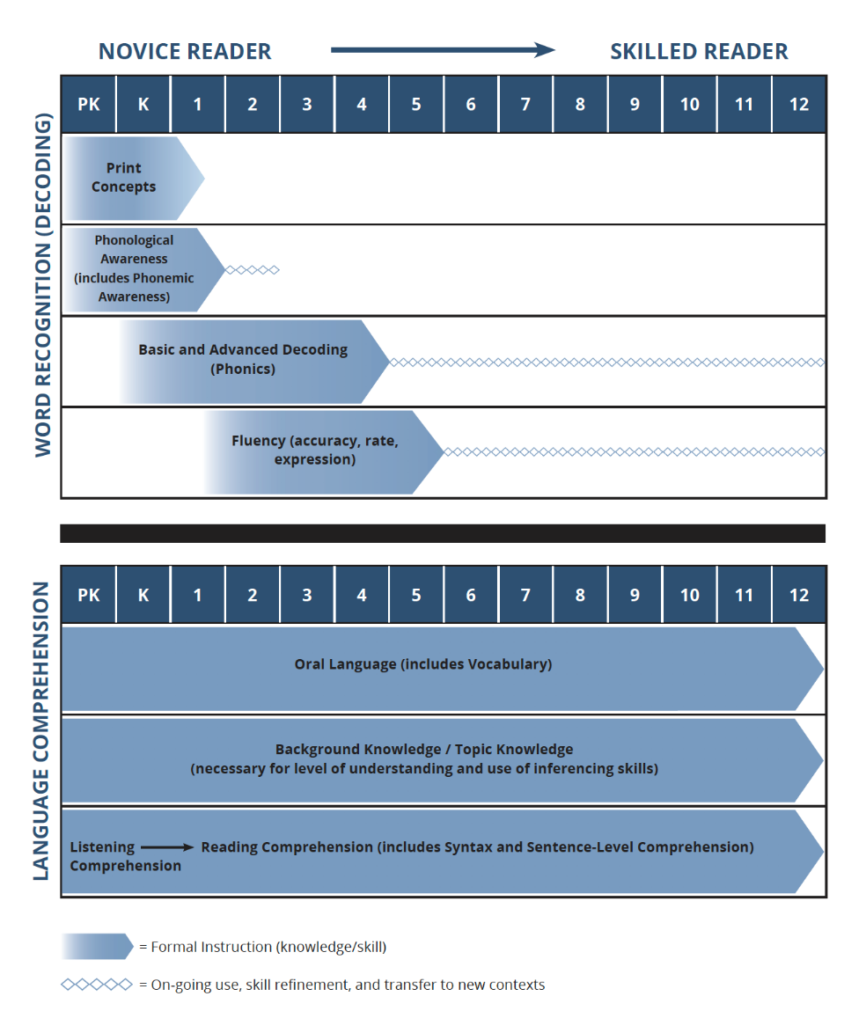
Curriculum: Match to Student Need
Does the intervention match what the student needs?
Identify the student’s current need and then determine whether there is alignment across supports and/or within a given support/intervention.
Source. St. Martin et al. (2020)
Notes:
One possible explanation for why students don’t make progress is that the content of a curriculum or intervention is not teaching the skills that a student needs. Are we teaching the skills that students needs and not wasting time teaching skills the student has already mastered? To answer this question, it is necessary to know the student’s current needs and determine if the content in the curriculum is aligned to support those needs.
For example, if a reading intervention or curriculum is focused on improving reading fluency, but the student still has needs to build accuracy in word reading and decoding, they are unlikely to respond to the intervention. The intervention is not addressing the student’s needs in decoding and word identification.

Slide 36
Instructional Hierarchy
Acquisition
Initial learning of skills​
Fluency
Developing automaticity
Generalization
Can perform skill in new context​
Requires a lot of working memory
Requires less working memory
Easily transferable skills
Adaptation
Can modify skills and adapt to new settings
Source. Haring and Eaton (1978)
Notes:
Another factor to consider is the student’s needs within an instructional hierarchy (Haring & Eaton, 1978). Are we teaching students at the right level within the instructional hierarchy? The instructional hierarchy describes stages of learning, from acquisition (initial learning), through adaptation (advanced application of skills).
Although the content may be addressing the specific areas of a need for a student, instruction may not be aligned with the student’s progression within the learning hierarchy, and this is hindering student progress toward a goal. For example, once a student has acquired the skill of decoding words with the vowel blends of “ea” and “ee”, the interventionist should next provide fluency practice and generalization opportunities.
According to Burns (2021):
Students in the acquisition phase have low accuracy with a task (e.g., less than 90% for most facts or lower than 93% accuracy for reading connected text).
Students in the fluency building phase have sufficient accuracy with a task (e.g., greater than 90% accuracy for facts) but lack fluency (e.g., below benchmarks for correct digits per minute).
Students in the generalization phase can accurately perform the skill with fluency but struggle to apply it in different contexts (e.g., when reading connected text or when presented with a word problem).
Students in the adaptation phase can generalize the skill to new contexts and would be unlikely to need intensive intervention.
Burns, M.K. (2021). Intensifying reading interventions through a skill-by-treatment interaction: What to do when nothing else worked. Communiqué, 50(4), 30-32.
Haring, N. G., & Eaton, M. D. (1978). Systematic instructional technology: An instructional hierarchy. In N. G. Haring, T. C. Lovitt, M. D. Eaton, & C. L. Hansen (Eds.), The fourth R: Research in the classroom (pp. 23–40). Merrill.

Slide 37
Instructional Priorities Across the Hierarchy
Acquisition
Increase explicit instruction with modeling and feedback to improve accuracy.
Fluency
Increase practice opportunities with the target skill to build fluency.
Generalization
Help the student transfer the skill to new contexts.
Adaptation
Build problem solving skills and provide opportunities to apply skills in new contexts.
Source. Burns (2021)
Notes:
This slide shows instructional priorities for the interventionist for students in the acquisition, fluency, generalization, and adaptation stages of the instructional hierarchy. Students in adaptation stages are unlikely to need intensive intervention in the target skill.
Acquisition: Increase explicit instruction with modeling and feedback to improve accuracy.
Fluency: Increase practice opportunities with the target skill to build fluency.
Generalization: Help the student transfer the skill to new contexts.
Adaptation: Build problem solving skills and provide opportunities to apply skills in new contexts.

Slide 38

Analyzing Student Errors
Analyze student errors to
identify patterns that describe academic strengths and weaknesses and
help align instructional adaptations with student need.
Notes:
Analyzing student errors is a critical tool for developing an accurate understanding of the student’s needs. The same progress monitoring assessments that tell us when an instructional change is needed also may reveal error patterns that will provide information on student strengths and weaknesses. Once educators identify specific skill deficits, they can develop a hypothesis related to the alignment of the intervention with those needs. Sometimes, errors may indicate a need for additional diagnostic assessment and guide the selection of a more formal measure, if needed.
When analyzing errors, consider:
What is the specific skill the student needs to master?
In which stage is the student in the instructional hierarchy? (i.e., acquisition, fluency-building, generalization, adaptation)

Slide 39
Guiding Questions for Error Analysis
Academic domain | Guiding questions for error analysis
Reading | In which letter-sound patterns (e.g., CVC, CVCC, digraphs, blends, R-controlled vowels) does the student need additional instruction? Are there letter-sound patterns with greater than 10% errors? If so, focus on these.
Writing and spelling | Are the student’s errors mostly phonological (e.g., incorrect letter-sound relationships), orthographic (e.g., incorrect spelling patterns), or morphological (e.g., incorrect prefixes, suffixes, and root word combinations)?
Mathematics | Are the errors procedural (e.g., not aligning decimals) or conceptual (e.g., choosing the wrong operation)? What are the common error categories (e.g., misunderstanding of regrouping, applying whole number values to fractions)?
Notes:
This slide shows guiding questions for error analysis in reading, writing and spelling, and mathematics. These questions will help you identify needed skills and areas of focus for the student.
The NCII module Informal Academic Diagnostic Assessment: Using Data to Guide Intensive Instruction (DBI Professional Learning Series Module 5), Part 3 has detailed information about how to conduct error analysis.

Slide 40
Ms. Kim: Using Informal Diagnostic Data
Based on the trend of the progress monitoring data, Ms. Kim thinks that the intervention may not be aligned with Alex’s needs. Ms. Kim reviewed Alex’s most recent oral reading fluency progress monitoring data. Alex read below 90% accuracy for multisyllabic words, suggesting he is in the acquisition stage of the instructional hierarchy in this skill.
Notes:
Returning to Ms. Kim’s diagnostic thinking about her student Alex: Ms. Kim reviewed Alex’s most recent oral reading fluency progress monitoring data. Alex read below 90% accuracy for multisyllabic words suggesting he is in the acquisition stage of the instructional hierarchy in this skill. Ms. Kim considers whether the intervention curriculum is providing Alex with enough practice opportunities with multisyllabic words to move from acquisition to fluency.

Slide 41
Alex’s Plan: Intensify Alignment
Ms. Kim writes a hypothesis that states “If Alex receives more explicit instruction in decoding multisyllabic words, he will increase his accuracy when reading connected text”. Ms. Kim is going to provide supplementary instruction on multi-syllabic words to help Alex generalize the word identification skills he has learned.
Notes:
For Adam, Ms. Kim is going to provide supplementary instruction on multisyllabic word reading to address any gaps in the intervention curriculum on this skill.. Additionally, Ms. Kim will look for opportunities to integrate word reading practice into content area instruction, to help Adam generalize the skill.

Slide 42
Informal Diagnostic Data Scenario 2
The student is making some progress but not enough to reach the goal.
Notes:
Let’s look at a second diagnostic data scenario: the student is making some progress in the intervention, but not enough to meet a benchmark or end-of-year goal.

Slide 43

Example 2: Ms. Torres and Ava
After 4 weeks of instruction, Ms. Torres reviewed Ava’s math computation fluency progress monitoring data. While Ava’s data are on an upward trend, Ms. Torres sees that the current trend indicates Ava will not meet her 8-week benchmark goal. Ms. Torres is going to explore why Ava is not yet making enough progress to meet her goal.
Notes:
Consider Ms. Torres and her student Ava: After 4 weeks of instruction, Ms. Torres reviewed Ava’s math computation fluency progress monitoring data. While Ava’s data are on an upward trend, Ms. Torres sees that the current trend indicates Ava will not meet her 8-week benchmark goal. Ms. Torres is going to explore why Ava is not yet making enough progress to meet her goal.

Slide 44
Some Progress But Not Enough
Also may notice from the student:
Passing lesson checkouts
Good retention of content taught during intervention
Moderate/high levels of accurate responses
Increased accuracy as a result of corrective feedback
Notes:
In this example graph the student is making some progress in the intervention, but not enough to meet the goal. The student’s trend line remains below the goal line, and she will not meet her end of year goal.
With this type of trend in progress monitoring data we might expect to see the student passing most lesson checkouts, showing good retention of content, and moderate to high levels of accurate responses during intervention sessions. In addition, we might notice that corrective feedback provided to the student results in increased accuracy. In other words, the student is making progress but still needs a boost to reach the goal that we’ve set.

Slide 45
Informal Diagnostic Data Process Example: Instruction Dimension
When the student is making some progress in the intervention but not enough to reach the goal that we’ve set, the intervention may not be intense enough. (Instruction)
Review the Student’s Progress
Identify the Focus
Collect and Review Informal Diagnostic Data
Develop a Hypothesis
The student is making some progress but not enough.
Is the intensity of the intervention sufficient for the student to reach the goal? (Instruction)
Observe for explicit instructional routines, opportunities to respond, and use of corrective feedback.
Notes:
As we discussed, when the student is making some progress in the intervention but not enough progress to reach the goal that we’ve set, the intervention may not be intense enough. (Instruction)
In this case, we want to examine how instructional variables may be impacting student progress. The instructional delivery, which includes the intensity of delivery, should be reviewed as potential cause of lack of progress. Essentially, we are looking at the quality of instruction, and if the instruction is intense enough.
When progress monitoring data indicate that a student is making some progress in the intervention, but not enough to reach the goal that we’ve set, intensity of instruction is a good place to start.
Once we’ve identified that the intervention may not be intense enough, we can observe instruction for the use of explicit instructional routines, opportunities to respond, and the use of immediate and clear corrective feedback.

Slide 46
Instruction – Explicit Instruction
Teacher Modeling
Guided Practice
Independent Practice
My turn. This word is /s/ /a/ /t/, “sat”
Do it with me. This word is /s/ /a/ /t/, “sat”
Your turn. Sound it out and say the word.
I do
We do
You do
Corrective feedback
See NCII’s Self-Paced Features of Explicit Instruction Course and Features of Explicit Instruction Course Content for more information on explicit instruction.
Notes:
One indicator of instructional quality is the degree to which the instruction includes the principles of explicit instruction. Explicit instruction features:
Teacher Modeling in which the teacher demonstrates the skill using clear and concise language
Guided Practice in which the teacher practices the skill with the students, providing a “just right” amount of support
Independent practice in which the student independently applies what they have learned.
Throughout an explicit instruction lesson, the teacher provides immediate corrective feedback as well as positive feedback. Teachers use precise language to inform the student which parts of the task they performed incorrectly.

Slide 47






Instruction – Opportunities to Respond
Opportunities to respond are “behaviors that require responses and are usually followed by feedback” (Martin et al., 2018, p.5).
Who responds?
How do they respond?
Choral
Responses
Partner
Responses
Individual
Responses
Verbal
Responses
Written
Responses
Action
Responses
Notes:
When collecting diagnostic data about the quality of instruction, it is valuable to review the use of opportunities to respond or OTRs. OTRs are important because they promote active student engagement in the content and provide teachers with opportunities to correct student misunderstandings. The more OTRs, the more chances for students to be exposed to and practice the target skill as well as receive feedback on the skill. There are a variety of methods for eliciting responses from students, including choral responses, partner responses, and individual responses. In addition, educators may elicit verbal responses, written responses, or responses that require students to perform an action.

Slide 48
Recommended Rates of OTRs
Setting | Rate
Large-group | 3–6/minute on average
Small-group | 8–12/minute on average
New material | 4–6/minute with at least 80% accuracy
Review material | 8–12/minute with at least 90% accuracy
Students with intensive needs or disabilities | 10/minute on average
Improving from suboptimal rates has benefit on academic and behavior outcomes.
Lower rates during some activities are expected (i.e., longer student responding impacts rates).
Sources. Gunter et al. (2004); MacSuga-Gage and Simonsen (2015); Martin et al. (2018); Moore-Partin et al. (2010); Sutherland and Wehby (2001)
48
Notes:
The ideal frequency of OTRs varies based on the size of the group and whether the lesson focuses on teaching new content or reviewing content. For students with intensive needs and students with disabilities, research suggests that 10 OTRs per minute is ideal when teaching basic facts in a direct instruction format.
The average person needs 8 repetitions to learn a new word, with the range being 3-8. Students with intensive needs sometimes needs well above 8 repetitions, even dozens at times, so high OTRs is a key instructional factor for these students.

Slide 49

Resource: Assessment of Use of Opportunities to Respond
Can be used to measure the number of student opportunities to respond (OTRs) across settings and activities and better understand places where OTRs can be increased.
Source. Center on MTSS (n.d.a)
Notes:
An informal way to collect data on OTRS is a tally sheet to track the frequency of OTRs per minute.

Slide 50
Ms. Torres: Using Informal Diagnostic Data
Based on the trend of Ava’s progress monitoring data, Ms. Torres thinks that the current intervention may not be intensive enough for Ava to reach her goal. She uses the OTR assessment resource to track the number of OTRs Ava has over several intervention sessions. Ms. Torres confirms that Ava’s OTR/minute rate in the small group is low—only 1–2 per minute.
Notes:
Ms. Torres hypothesizes that the current intervention as delivered may not include enough OTRs. She uses the OTR assessment resource to track the amount of responses Ava has over several intervention sessions. Ms. Torres confirms that Ava’s OTR/minute rate in the small group is low – only 1-2 per minute. A rate of 10 OTR/minute is recommended for helping students with intensive needs learn basic facts.

Slide 51
Ava’s Plan: Intensify Dosage
Ms. Torres develops a hypothesis that states, “If Ava receives more opportunities to practice and receive feedback on math facts, she will increase her math fact fluency.” To address the hypothesis, Ms. Torres is going to increase the number of OTRs during math intervention sessions and find times throughout the day for brief practice sessions.
Notes:
For Ava, Ms. Torres is going to adjust the instruction to increase the number of opportunities to respond. She will develop a systematic way to include more opportunities for practice and feedback opportunities for Ava. In reviewing the data, Ms. Torres sees that Ava’s fact fluency accuracy is high (about 95%), but since she has slow retrieval of facts, instructional changes should focus on building Ava’s fact fluency and move to the generalization stage. Adding more fact practice opportunities is feasible, requires minimal change to materials, and will provide the fluency repetition and feedback Ava needs. Ms. Torres will slightly modify the intervention script and add additional checks for understanding to increase the rates of OTRs for Ava.

Slide 52
Informal Diagnostic Data Scenario
The student is making progress in the intervention but having difficulty in other settings.
Notes:
Let’s look at a third diagnostic data scenario: The student is making progress in the intervention but having difficulty in other settings.

Slide 53

Example 3: Ms. Hunter and Adam
At the parent-teacher conference, Ms. Hunter, the reading interventionist, and Adam’s mom discuss Adam’s reading scores. Adam’s progress monitoring scores in his intervention show moderate gains, and he is engaged in lessons. However, his general education teacher reports that Adam continues to struggle in reading and is not engaged in whole-group lessons.
Notes:
Consider this scenario: At the parent-teacher conference, Ms. Hunter, the reading interventionist, and Adam’s mom discuss Adam’s reading scores. Adam’s progress monitoring scores in the intervention show moderate gains and he is engaged in lessons. However, his general education teacher reports that Adam continues to struggle in reading and is not engaged in whole-group lessons.

Slide 54


Making Progress in the Intervention But Having Difficulty in Other Settings
Success in the intervention
Passing lesson checkouts
Successful on formative assessments
Good retention of intervention content
Moderate/high levels of accurate responding
Increased accuracy as a result of corrective feedback
Cooperating with peers
Asking for help when frustrated
Difficulty outside of the intervention
Difficulty using learned strategies outside of intervention time
Exhibits behavioral difficulties outside of intervention time
Notes:
In this scenario, the student may be having success in the intervention but having difficulty applying strategies outside of the intervention. For example, the student may correctly use reading strategies within the intervention block, but not apply them during content lessons, like social studies or science. Similarly, students might manage their behavior when in small group time with the school counselor for a social-emotional lesson but make poor choices at recess immediately after.

Slide 55
Informal Diagnostic Data Process Example: Instruction Dimension
When the student is doing okay in some settings but not in others, it may be a transfer issue, in which the teacher needs to support the student with applying the skill across settings. (instruction)
Review the Student’s Progress
Identify the Focus
Collect and Review Informal Diagnostic Data
Develop a Hypothesis
The student is making progress in the intervention but having difficulty in other settings.
Have we explicitly taught the student how to generalize skills to new settings? (Instruction)
Observe instruction across multiple settings to identify needed supports (e.g., consistent routines).
Notes:
As we discussed, when the student is doing ok in some settings but not in others, it may be a transfer issue in which the teacher needs to support the student with applying the skill across settings (instruction).
In this case, we want to examine how teachers support the student with transferring the skill to a range of contexts.
When data indicate that a student is making progress in the intervention but having difficulty in other settings, reviewing how the teacher supports generalization of skills is a good place start.
Once we’ve determined that the student is having difficulty transferring skills across settings, we can observe instruction across multiple settings to better understand how to support the student with transferring and generalizing skills.

Slide 56
Transfer and Generalization Across Settings
Schedule
Morning Meeting
Core Reading/Writing
PE
Science/Social Studies
Lunch/Recess
Specials
Reading Intervention
Math
Are students able to generalize and apply skills learned during the intervention to the rest of their day?
How can we support students to transfer skills across settings?
  Offer opportunities to practice that vary the context.
  Provide cumulative systematic review.
  Teach metacognitive strategies and self-regulation.
Notes:
Students with intensive needs tend to struggle with transfer and generalization (recognizing that the skills and strategies they’ve learned can be applied in other contexts). A key goal for intervention is that students can “generalize”, or apply, the skills they learned in intervention across the school day.
For example, if a student is taught during a reading intervention to decode multisyllabic words by chunking the syllables, we want the student to apply this strategy to decode words in the core reading class. Students might show mastery of this skill during intervention time but have difficulty using it other times. We can support students to transfer skills by:
Providing a variety of opportunities to practice that explicitly vary the context (e.g., different topics, genres, settings)
Providing cumulative systematic review
Teaching metacognitive strategies and self-regulation (e.g., using strategies and checklists, setting goals, and self-evaluating their work).
For more in-depth information on how to promote transfer, see the NCII Taxonomy of Intervention Intensity Training Materials.

Slide 57
Informal Diagnostic Data Process Example: Environment Dimension
When the student is making progress in the intervention but having difficulty in other settings, it may be that the student has behavioral needs that are not supported. (Environment)
Review the Student’s Progress
Identify the Focus
Collect and Review Informal Diagnostic Data
Develop a Hypothesis
The student is making progress in the intervention but having difficulty in other settings.
Does the student have behavioral needs that are not supported in some settings? (Environment)
Observe classroom management and instruction across settings to identify needed supports.
Notes:
As we discussed, when the student is doing ok in some settings but not in others it could also be that the student has behavioral needs that are not supported (environment).
In this case, we want to consider classroom management and instruction across settings.
When a student is making progress in the intervention but having difficulty in other settings, observing classroom management and instruction is a good place start.
Once we’ve identified that the student has behavioral needs that are not supported, we can observe classroom management and instruction across settings to identify needed supports.

Slide 58
Effective Classroom Management Principles
Academic effects
Identify and teach expectations.
d = .76
Establish procedures and structure.
d = .76
d = -0.80 for problematic behavior
(29 percentile point reduction)
Actively engage students.
d = .62
Reinforcement and acknowledgement.
d = .98
Manage unwanted behavior.
d = .74
Build relationships.
d = .72
Note. Effect sizes from Hattie (2009)
58
Notes:
Research suggests that effective classroom management reduces unwanted behavior and has a positive impact on academic outcomes. This slide shares several principles of effective classroom management and demonstrates their positive impact. Teachers who use effective classroom management practices can expect a significant reduction of disruptive, inappropriate, or aggressive behavior from students.
When observing for effective use of classroom management, consider the extent to which educators apply these classroom management principles.

Slide 59
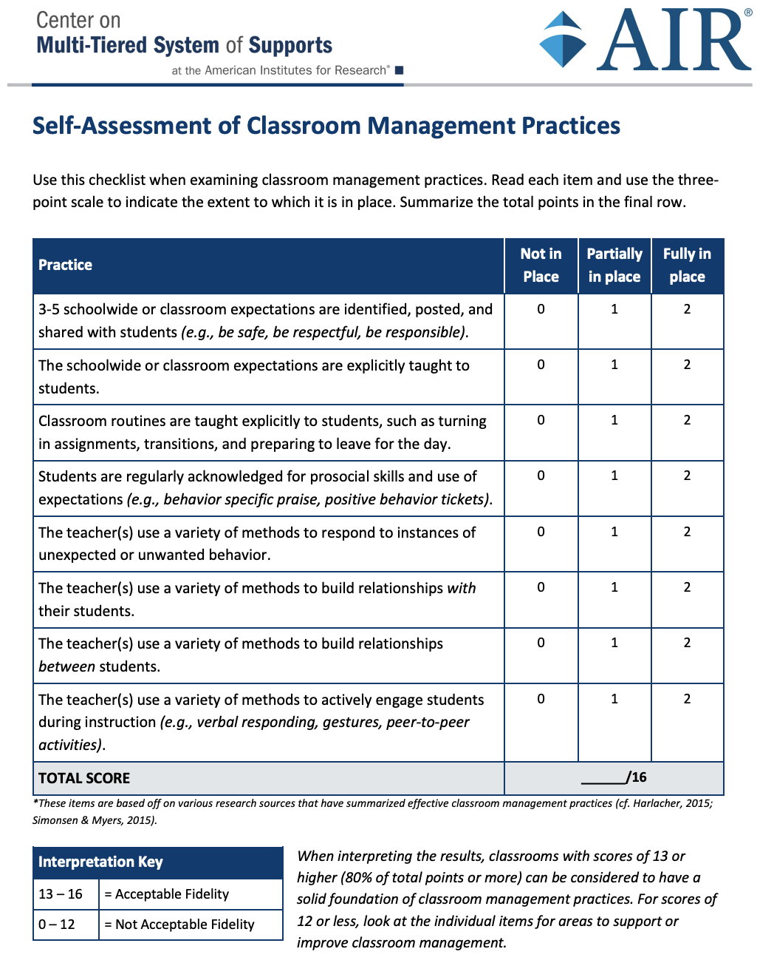

Resource: Self Assessment of Classroom Management
Can be used as a self-assessment or interview questionnaire to gauge overall use of practices and improve areas of need.
Source. Center on MTSS (n.d.b)
Notes:
This self assessment of classroom management practices is a resource that educators may use to gauge the use of effective classroom management practices.

Slide 60

What Can Classroom Observations Tell Me?
  Identify environmental factors that might be affecting student response:
  Time on task and student engagement
  Antecedents and consequences of behavior
  How instructional time is being spent
Notes:
To gather more information on the environment, classroom observations can be used to identify factors that could be affecting student response. Some factors include student engagement and the percentage of time on task, possible antecedents to behavior and outcomes of behavior, and how time in the instructional block is spent: how much time is spent in whole-group instruction, small-group instruction, or independent work.

Slide 61

Family, Student, and Support Team Interviews
  Interviews may identify additional contextual and student-level factors that might be affecting student’s success.
  When age-appropriate, consider interviewing the student.
Notes:
It is important to collect multiple perspectives. Interviewing family members and including parents can be an integral and vital part of the diagnostic data collection process because they provide important context to the other diagnostic data sources such as classroom observations Parents and caregiver have a unique perspective on other home-level variables that could be affecting instruction. In addition to parents, school professionals (support team) can be interviewed. This can include school counselors, school psychologist, case managers and content teachers. When age-appropriate, consider interviewing students as well.

Slide 62

Integrating Supports for Behavior
Are you considering that a student is supported both academically and behaviorally? Are your supports integrated?
Students with intensive needs often have overlapping needs in both academics and social behavior. It is necessary to make sure your supports for students are integrated across academic and behavior domains.
Notes:
Students with intensive needs often have overlapping needs in both academics and behavior. It is necessary to make sure your supports for students are integrated across academic and behavior domains.

Slide 63
Ms. Hunter: Using Informal Diagnostic Data
Adam’s mom wonders what might be different in the core instruction setting that could be affecting his focus and engagement with the lessons. She thinks that Adam may need additional behavior supports to stay engaged during core instruction. Ms. Hunter conducts an informal classroom observation and finds that there are fewer behavioral supports available in this setting (e.g., fewer classroom routines, less use of positive reinforcement).
Notes:
Adam’s mom wonders what might be different in the large group setting that could be affecting Adam’s focus and engagement with the lessons. Ms. Hunter agrees to conduct an informal classroom observation. The observation data will be used to determine what instructional or environmental changes need to be made. After observing Adam in the general education classroom, Ms. Hunter sees that some strategies that have been successful for Adam in the small group are used with less consistency in core instruction.

Slide 64

Adam’s Plan: Intensify Behavior Supports
Ms. Hunter and Adam’s mom develop a hypothesis that states, “If Adam’s teachers use consistent behavior expectations and classroom routines, Adam will be more engaged during core reading instruction”. Ms. Hunter will collaborate with Adam’s general education teacher to ensure consistent procedures and expectations across classrooms and offer a positive phone call home, as Adam chose this as an incentive.
Notes:
Ms. Hunter is going to collaborate with Adam’s general education teacher in order ensure the behavioral expectations are the same across classroom settings, and together determine what might motivate Adam across both settings. She and Adam will check in daily at the end of the day to review his behavior card and notes from the general education teacher, and call home to mom when he meets his goal of 5 stars.

Slide 65
Conclusion
Notes:
Let’s review some of the key points about using diagnostic data and discuss what comes next in the DBI process.

Slide 66
Review: Educationally Relevant and Alterable Variables
Scope and sequence
Level of difficulty
Match to learner need
High-quality materials
Culturally relevant materials
Curriculum
Clear expectations
Positive reinforcement
Positive interactions
Inclusive classrooms
Positive feedback
Explicit instruction
Pacing (opportunities to respond)
Corrective feedback
Culturally relevant pedagogy
Engagement strategies
Learner
Instruction
Environment
Notes:
When a student is not making the progress that you had hoped for, identify factors within the instruction, curriculum, and environment that impact learning. These are important variables to consider when a student is not making progress because we have control over these variables and can make adaptations to each variable.

Slide 67
Review: Identify the Focus
(i.e., Instruction, Curriculum, Environment)
For each scenario on the left, the questions on the right provide a possible starting point for the diagnostic data process.
The student is making little to no progress (they are unsuccessful in the intervention).
Is there a mismatch between skills the student needs and skills taught? (Curriculum)
The student is making some progress but not enough.
Is the intensity of the intervention sufficient for the student to reach the goal? (Instruction)
The student is making progress in the intervention but has difficulty applying skills in other settings.
Have we explicitly taught the student how to generalize skills? (Instruction)
Does the student have behavioral needs that are not supported in some settings? (Environment)
Notes:
For each scenario on the left, the questions on the right provide a possible starting point for the diagnostic data process. In this way, educators can use existing progress monitoring data to identify the focal area (i.e., instruction, curriculum, or environment) that is most likely related to the student’s challenges.
Remember: these questions are only meant as possible starting points – there may be multiple reasons that a student is experiencing challenges.

Slide 68
Process for Using Informal Diagnostic Data 2
Review the Student’s Progress
Identify Focus (i.e., instruction, curriculum, environment)
Collect and Review Informal Diagnostic Data
Develop a Hypothesis
What do we know about the student’s progress in the intervention?
Based on the student’s progress, are the student’s challenges most likely related to the instruction, curriculum, or environment?
Collect and review informal diagnostic data related to the identified focus (i.e., instruction, curriculum, or environment). Collect additional data, if needed.
Use the informal diagnostic data to develop a specific and actionable hypothesis for why the student has not yet made sufficient progress.
Notes:
In this presentation, we introduced a process for developing a hypothesis.
First, we review existing progress monitoring data and ask, “What do we know about the student’s progress in the intervention?”.
Second, we identify the focus for improvements (i.e., whether the student’s challenges are most likely related to the instruction, curriculum, or environment)
Next, we collect and review informal diagnostic data related to the identified focus (i.e., instruction, curriculum, or environment) and collect additional data if needed.
Finally, we use the informal diagnostic data to develop a specific and actionable hypothesis for why the student has not yet made sufficient progress.

Slide 69
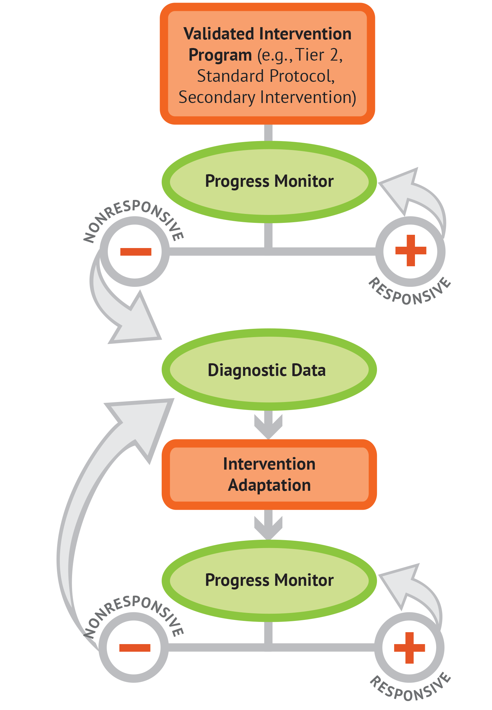
Next Steps: Adapt Intervention and Progress Monitor
    The hypothesis will drive decisions about how to adapt the intervention.
    Focus adaptations on alterable variables within the instruction, curriculum, and environment that address the hypothesis.
    If the student is not responsive to the adapted intervention, return to the diagnostic data step.
Notes:
Once you’ve developed a hypothesis, the next step in the DBI process is to plan for how to adapt the intervention to address the hypothesis. The goal is to focus changes to variables that are feasibly changed and directly address the hypothesis. Remember, the DBI process is an iterative process, meaning it may be necessary to return to a previous step. If a student does not show improvement after an intervention is adapted, return to the diagnostic data step and repeat the informal diagnostic data process.

Slide 70
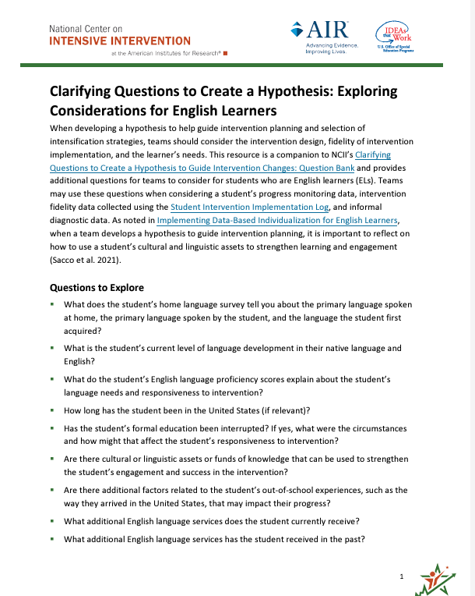
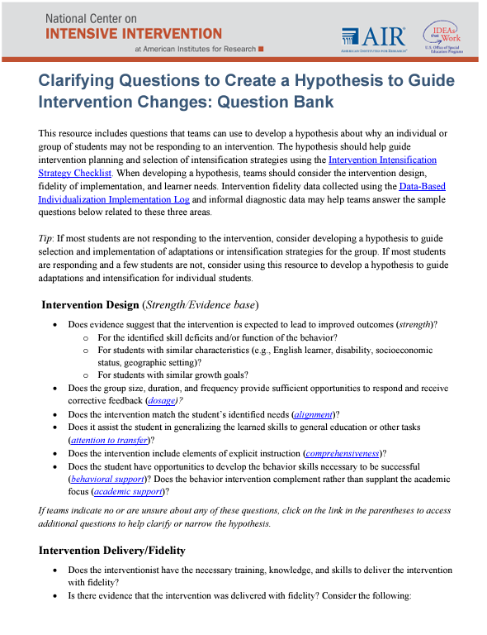
NCII Resources to Support Hypothesis Development
Clarifying Questions to Create a Hypothesis to Guide Intervention Changes: Question Bank
Includes questions that teams can use to develop a hypothesis about why an individual or group of students may not be responding to an intervention
Notes:
NCII developed two resources to support teams in developing a hypothesis. This question bank includes questions that teams can use to develop a hypothesis about why an individual or group of students may not be responding to an intervention. The hypothesis should help guide intervention planning and selection of intensification strategies.

Slide 71
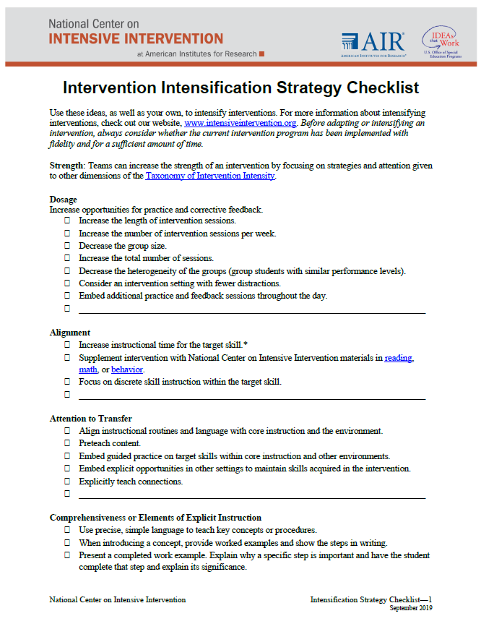
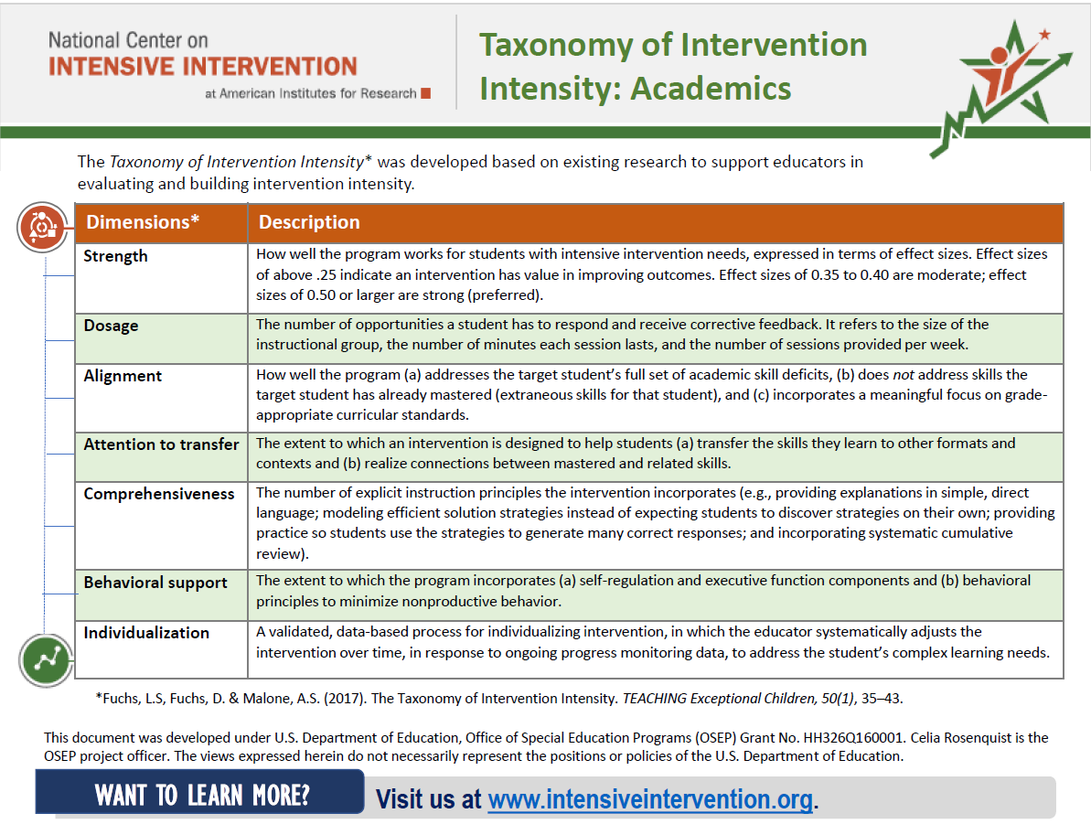
NCII Resource to Support Intervention Adaptation
    The NCII Intensification Strategy Checklist describes methods for intensifying and individualizing intervention.
    The Taxonomy of Intervention Intensity can guide the adaptation and intensification of an intervention.
    Sample Lessons for Intervention Adaptation are also available.
Notes:
NCII developed a resource to support Intervention Adaptation This checklist can be used by teams to help identify ideas to intensify interventions based on their hypothesis for why the student may not be responding to an intervention. The checklist is aligned with the dimensions of the Taxonomy of Intervention Intensity. NCII website contains several tools and resources, including online modules, to learn about the Taxonomy can support intervention adaptation within the DBI process. Last, sample lesson plans for literacy, math and behavior support are also available as templates for adaptation.

Slide 72

Thank you!

Slide 73
References
Burns, M. K. (2021). Intensifying reading interventions through a skill-by-treatment interaction: What to do when nothing else worked. Communiqué, 50(4), 30–32.
Center on Multi-Tiered System of Supports. (n.d.a). Assessment of use of opportunities to respond. https://mtss4success.org/sites/default/files/2023-10/measuring_opportunities_respond.pdf
Center on Multi-Tiered System of Supports. (n.d.b). Self-assessment of classroom management practices. https://mtss4success.org/sites/default/files/2023-07/classroom-management-assessment.pdf
Gunter, P. L., Reffel, J. M., Barnett, C. A., Lee, J. M., & Patrick, J. (2004). Academic response rates in elementary-school classrooms. Education and treatment of Children, 27(2) 105–113.
Hattie, J. A. C. (2009). Visible learning: A synthesis of over 800 meta-analyses relating to achievement. Routledge.
Haring, N. G., & Eaton, M. D. (1978). Systematic instructional technology: An instructional hierarchy. In N. G. Haring, T. C. Lovitt, M. D. Eaton, & C. L. Hansen (Eds.), The fourth R: Research in the classroom (pp. 23–40). Merrill.

Slide 74
References 2
MacSuga-Gage, A. S., & Simonsen, B. (2015). Examining the effects of teacher-directed opportunities to respond on student outcomes: A systematic review of the literature. Education and Treatment of Children, 38(2), 211–239.
Martin, B., Sargent, K., Van Camp, A., & Wright, J. (2018). Intensive intervention practice guide: Increasing opportunities to respond as an intensive intervention. U.S. Department of Education, Office of Special Education Programs. https://files.eric.ed.gov/fulltext/ED591076.pdf
Moore-Partin, T. C. M., Robertson, R. E., Maggin, D. M., Oliver, R. M., & Wehby, J. H. (2009). Using teacher praise and opportunities to respond to promote appropriate student behavior. Preventing School Failure: Alternative Education for Children and Youth, 54(3), 172–178.
National Center on Intensive Intervention. (n.d.a). Clarifying questions to create a hypothesis to guide intervention changes: Question bank. https://intensiveintervention.org/sites/default/files/Clarifying_Questions_Hypothesis_508.pdf
National Center on Intensive Intervention. (n.d.b). Clarifying questions to create a hypothesis: Exploring considerations for English learners. https://intensiveintervention.org/sites/default/files/resources/tools-tips/EL-hypothesis-508.pdf

Slide 75
References 3
National Center on Intensive Intervention. (n.d.c). Considerations for effective implementation: 5 elements of fidelity. https://intensiveintervention.org/sites/default/files/5_Elements_Fidelity_508.pdf
National Center on Intensive Intervention. (n.d.d). Intensification strategy checklist. https://intensiveintervention.org/sites/default/files/Intensification_Strategy_Checklist_2019.dotx
St. Martin, K., Vaughn, S., Troia, G., Fien, H., & Coyne, M. (2020). Intensifying literacy instruction: Essential practices. MiMTSS Technical Assistance Center, Michigan Department of Education.
Sutherland, K. S., & Wehby, J. H. (2001). Exploring the relationship between increased opportunities to respond to academic requests and the academic and behavioral outcomes of students with EBD: A review. Remedial and Special Education, 22(2), 113–121.

