Slide 1



Academic Progress Monitoring in Intensive Intervention: Part 4
Collecting, Graphing, and Analyzing Progress Monitoring Data

Slide 2
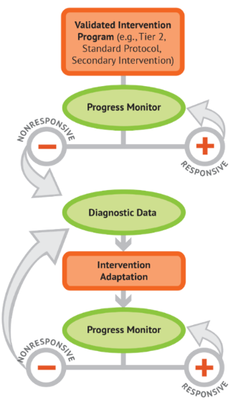
Objectives
By the end of this training, you will be able to
  describe key considerations for collecting and graphing progress monitoring data,
  analyze graphed progress monitoring data to make decisions in the DBI process, and
  use decision-making rules for interpreting progress monitoring data.
Notes:
By the end of this training, you will be able to
describe key considerations for collecting and graphing progress monitoring data,
analyze graphed progress monitoring data to make decisions in the DBI process, and
use decision-making rules for interpreting progress monitoring data.

Slide 3
How Does Progress Monitoring Fit Within DBI?
Progress monitoring is important for
  understanding student responsiveness and
  determining when changes are necessary.
Collecting, graphing, and analyzing progress monitoring data.
Notes:
Now let’s review how progress monitoring fits into data-based individualization, also known as DBI. Progress monitoring is a key component of DBI, which is NCII’s approach to intensive intervention.
DBI is a systematic method for using data to determine when and how to provide more intensive intervention.
As you can see in the DBI process graphic, frequently collecting, graphing, and analyzing progress monitoring data occurs in the second and fifth steps in the DBI process and informs decisions about student responsiveness to both the validated intervention program and the adapted intervention.

Slide 4




What to Look for in a Progress Monitoring Measure
Brief and easy to administer
Able to be used repeatedly across time
Sensitive to changes in student performance
Valid, reliable, and evidence based
Notes:
Progress monitoring tools should have the following characteristics:
Brief and easy to administer: Some progress monitoring tools take as little as a few minutes to administer, whereas others take much longer. Be sure to consider the ease of administration when selecting a tool.
Able to be used repeatedly across time: Progress monitoring for intensive intervention should occur at least weekly. Make sure that the tool you select can be used repeatedly across time. For academics, this means having multiple forms of equal difficulty or using a computer adaptive format.
Sensitive to changes in student performance: Progress monitoring measures should capture small changes in student performance. In other words, when the student learns new skills, the student’s score on the measure should reflect this change.
Valid, reliable, and evidence based
A progress monitoring tool is valid if it accurately measures what it is intended to measure. For student performance, this means the tool should effectively assess the specific skill or knowledge area it claims to measure. Validity ensures that the conclusions drawn from the tool’s results are accurate and applicable to the student’s abilities. A reliable tool produces consistent results across time and different groups of students.
Reliability ensures that the outcomes are stable and reproducible, meaning that if the same student were to take the assessment multiple times under similar conditions, the results would be similar each time.
An evidence-based tool is one that has been tested and proven effective through rigorous research and empirical studies. This means the tool has a strong foundation in scientific evidence supporting its accuracy, effectiveness, and utility in monitoring student progress. Using evidence-based tools ensures that educators are employing methods validated by the educational research community.

Slide 5

Establishing a Progress Monitoring Plan
The plan should identify
who will collect the data,
what tool will be used to collect the data,
the timeline and frequency of data collection, and
the baseline data and goal.
Notes:
After identifying the target behavior and the progress monitoring measure, the teacher can create the progress monitoring plan. This plan should identify the person responsible for collecting the progress monitoring data, the progress monitoring tool, the overall timeline and frequency for gathering data, and the student’s baseline data and goal. Having a clear plan and a consistent process also can ensure that progress monitoring is well integrated into teachers’ existing schedules and routines.

Slide 6


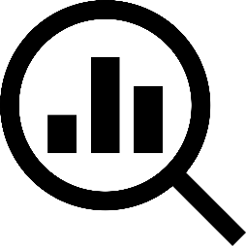

Getting Started With Progress Monitoring
Identify Target Behavior and Select Tool
Establish a Progress Monitoring Plan
Collect and Graph Data
Evaluate Student Responsiveness
Notes:
Getting started with progress monitoring has four main steps. The first two steps, selecting a tool and establishing a plan, were covered in previous trainings. Today, we will begin with how to collect and graph data.

Slide 7
Collecting and Graphing Progress Monitoring Data
Notes:
Collection and analysis of progress monitoring data are critical for making decisions throughout the DBI process. Teams or individual teachers should regularly review student data to determine if and when a change to the student’s intervention might be necessary.

Slide 8
How Frequently Should We Collect Academic Progress Monitoring Data for Students With Intensive Needs?
Recommendation:
Progress monitoring should occur at least weekly for students receiving intensive intervention.
Why?
Teachers must collect at least
six to nine data points to set a reliable trend line before analyzing a student’s progress.
Weekly progress monitoring allows for timely decision making about whether the intervention is working for the student, while maintaining feasibility for teachers.
Notes:
It is critical to frequently collect and analyze progress monitoring data for students with intensive needs. NCII recommends that teachers collect progress monitoring data for students with intensive needs at least once per week. Collecting weekly progress monitoring data will allow teachers to closely monitor the progress of students with intensive needs and make decisions about the effectiveness of their interventions on a frequent basis. Research suggests that we need six to nine data points to make informed decisions about student responsiveness.
Although academic progress monitoring typically takes place weekly or biweekly, behavioral progress monitoring is usually more frequent.

Slide 9
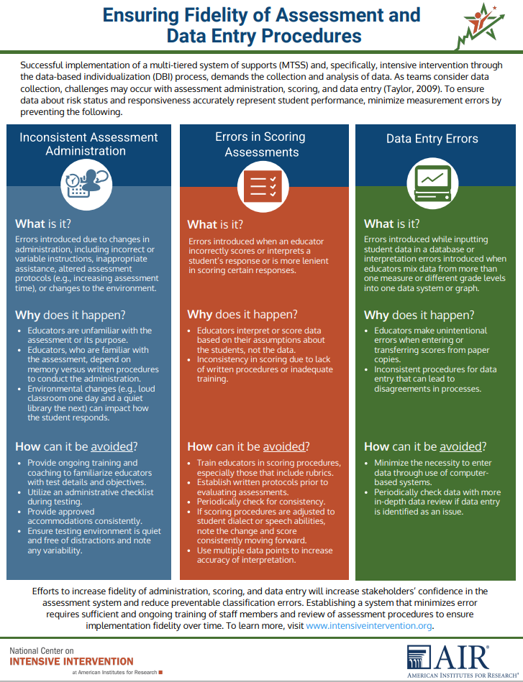
Data Quality Considerations
Inconsistent Assessment Administration
Data Entry Errors
Errors in Scoring Assessments
https://intensiveintervention.org/sites/default/files/DataFidelity_Final508.pdf
Notes:
Collecting data frequently to inform decisions is important, but it is important to also ensure that data are collected consistently to minimize measurement errors. Let’s explore three main considerations that may impact data quality:
Inconsistent administration
Errors in scoring
Data entry errors
Progress monitoring measures should be administered and scored using standardized procedures. Standardized procedures for administering the tool ensure that all students are assessed under the same conditions. Standardization includes following a specific set of instructions for delivering the assessment, ensuring a consistent environment, and providing uniform materials. Standardization minimizes variability from external factors, allowing the tool to measure student performance more accurately. Standardized scoring involves using a consistent and objective method to evaluate and interpret student responses. This ensures that scoring is fair and unbiased, providing reliable data that can be compared across different students and time points. Standardized scoring procedures often include detailed rubrics or scoring guides that outline how to evaluate each response, ensuring consistency among different assessors and settings.
Photo is a link to PDF

Slide 10




Inconsistent Assessment Administration
Changes to the environment
Incorrect or variable instructions
Inappropriate assistance
Altered assessment protocols
Notes:
It is important to ensure that errors are not introduced by changes in administration. This might include changing the environment in which the student is taking the assessment, providing incorrect or variable instructions, providing inappropriate assistance, or using altered assessment protocols.
Progress monitoring measures should be administered and scored using standardized procedures. Standardized procedures for administering the tool ensure that all students are assessed under the same conditions. Standardization includes following a specific set of instructions for delivering the assessment, ensuring a consistent environment, and providing uniform materials. Standardization minimizes variability from external factors, allowing the tool to measure student performance more accurately.
Let’s go into each area in detail:
Changes to the environment: Consistency must be maintained. For example, you should not collect data in a busy classroom one week and then in a quieter room another week and then move back to the main classroom another week. If you change the location, you should maintain that location every time you collect data (to the extent feasible).
Incorrect or variable instructions
Sometimes educators will vary their instructions when administering an assessment. For example, for mathematics progress monitoring, it might be important to tell a student that they can skip a problem that they don’t know the answer to. This could potentially allow the student more time to answer the questions they do know.
However, if you do not give the student the same instruction every time and there is variance in the data from week to week, it is difficult to determine if the variance is caused by the student’s ability or the discrepancy in the instructions.
Inappropriate assistance
Sometimes when students are struggling with an assessment, educators will add extra incentives and try to motivate them. While encouraging students is helpful, it also is important to provide the same amount of encouragement every time.
Differing amounts of encouragement can lead to variable scores, which can make for difficult analysis of student performance.
Altered assessment protocols
For example, sometimes educators may allow students additional time on the assessment.
When more time is given to a student, it can look as if the effectiveness of the instruction is positive when in fact the student obtained a higher score simply because the student had more opportunities with the additional time.

Slide 11

Errors in Scoring Assessments
Ensure consistency in scoring.
Consider regional or dialectical differences in pronunciation.
Always consult the assessment manual when making decisions about scoring.
Notes:
Standardized scoring involves using a consistent and objective method to evaluate and interpret student responses. This process ensures that scoring is fair and unbiased, providing reliable data that are comparable across different students and time points. Standardized scoring procedures often include detailed rubrics or scoring guides that outline how to evaluate each response, ensuring consistency among different assessors and settings.
We need to pay attention to errors that may be introduced during scoring. This might include incorrectly scoring or interpreting a student’s response. You must do the following:
Ensure consistency in what you allow for a correct response. It is important that if you allow responses as a correct response on one assessment that you always count it as correct. For example, students with a speech concern might say “twee” instead of “tree.” It is important that if you allow this as a correct response on one assessment that you always count it as correct.
Consider regional differences or dialectical differences in pronunciation when scoring and maintain consistency in what is considered acceptable.
Always consult the assessment manual when making decisions about scoring.

Slide 12

Data Entry Errors
Use alternate forms of the same progress monitoring measure (e.g., Oral Reading Fluency [ORF], Nonsense Word Fluency [NWF]) within the same system (e.g., Dynamic Indicators of Basic Early Literacy Skills, aimswebPlus) every time you collect data.
Don’t assume that using different assessments that measure the same skill are comparable to measure growth.
Notes:
Finally, we must pay attention to errors that are introduced when inputting student data into a database or graphing the data. These might include mixing data from multiple assessments or grade levels on one graph.
Remember:
It is important to collect data using the same progress monitoring measure within the same system every time you collect data.
Often, educators assume if they use different assessments that measure the same skill, then these data are comparable to measure growth. They assume that the data they get from various assessments are all the same. However, these data are not equivalent and should not be combined on one graph to determine growth.
It is advised to pick one system and stick with that system.

Slide 13

Why Is Graphing Data Important?
Allows for visual analysis using trend lines
Allows for quick and easy decision making
Simplifies communication about student responsiveness
Indicates possible data collection quality concerns
Notes:
Once we collect our data, we must graph the points. But why?
Graphing data enhances visual analysis and facilitates quick comparisons and trend identification. It is easier and faster to make decisions about student responsiveness when you can visualize a trend, rather than looking at numbers on a page. Graphs simplify communication about student responsiveness and make a statement about the previously covered quality considerations for data collection.

Slide 14
Analyzing Data: Graphing Data Is Essential
Date | Sep 13 | Sep 20 | Sep 27 | Oct 7 | Oct 13 | Oct 20 | May 28 (GOAL)
ORF Words Correct | 32 | 37 | 41 | 46 | 43 | 45 | 87
Date
Notes:
Start with the raw data table displayed.
Take a moment to look at the data in this table. Here, we have a student’s oral reading fluency measured over several weeks. Can anyone quickly tell whether the student is making adequate progress toward their goal?
Pause for audience reaction—let them discuss briefly.
Some of you might say yes, others no, and some might be unsure. This highlights a common issue when we rely solely on raw data: It can be difficult to determine if the student is making adequate growth toward the goal.
Advance the slide to reveal the graph.

Slide 15
Analyzing Data: Graphing Data Is Essential
Date | Sep 13 | Sep 20 | Sep 27 | Oct 7 | Oct 13 | Oct 20 | May 28 (GOAL)
ORF Words Correct | 32 | 37 | 41 | 46 | 43 | 45 | 87
Goal Line
Words Correct per Minute
Goal
Data
Date
Notes:
Now, let’s look at the same data, but this time the data are in graph form. Notice how much easier it is to immediately see that this student is making steady progress toward their goal. The upward trend is clear, and the visual representation allows us to make a quick and confident assessment.
Conclusion
Thus, graphing data is essential. It transforms numbers into a visual story, making it easier for educators to see and monitor progress, identify trends, and make data-driven decisions. When we use graphs, we can better support our students on their journey to achieving their goals.

Slide 16
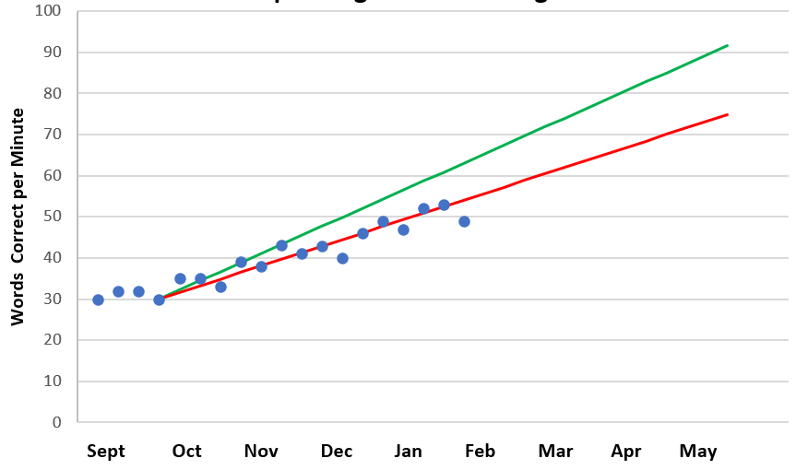
Parts of the Graph
Goal
Goal Line
Phase Line
Trend Line
PM Data Points
Baseline
Notes:
Educators graph progress monitoring data to inform decision making. On the progress monitoring graph, the horizontal axis, or x-axis, represents the number of weeks of instruction, whereas the vertical axis, or y-axis, displays the score or value from the progress monitoring assessment. This score could represent the number of words read correctly, the number of problems answered correctly, or other relevant measures based on the specific assessment used.
Let’s discuss some key terms to keep in mind when creating and analyzing these graphs:
Baseline: This is the student’s starting performance level, which we show with a red star.
Goal: The target score by the end of the instructional period, represented here by a green star.
Goal Line: This line, illustrated in green, connects the baseline to the goal, showing the expected progress across time.
Data Points: Each blue dot on the graph represents the student’s score on each progress monitoring probe.
Trend Line: The solid red line through the data points shows the student’s actual performance trend based on the collected data.
Phase Line: This black dashed vertical line marks a change, such as moving from baseline to intervention or adjusting the intervention. Including the phase line helps us track the effects of changes across time.
Most progress monitoring systems will automatically graph these data, but educators also can create graphs by hand or use the NCII Excel Graphing Tool.
Optional discussion prompts: Are any of these features unfamiliar to you? Which parts of the graph would you like to explore further?

Slide 17
Ways to Graph Data
By Hand
Purchased Data System or
Graphing Tool
More time consuming
Can engage students in graphing their own data
Easier to implement
Typically includes norms, benchmarks, and goal lines
May have additional cost
May have limitations in output (e.g., drawing phase lines)
Notes:
There are a few ways to graph progress monitoring data. You can graph by hand, using a pencil and graph paper. This process can be more time consuming, but it also becomes an opportunity for engaging students in examining and graphing their own data.
You can use a digital graphing tool. A purchased data system may include norms, benchmarks, and goal lines that may make graphing and analyzing data easier in the long run. In additional to a potential cost associated with these systems, there may be a lack of user flexibility and personalization.

Slide 18
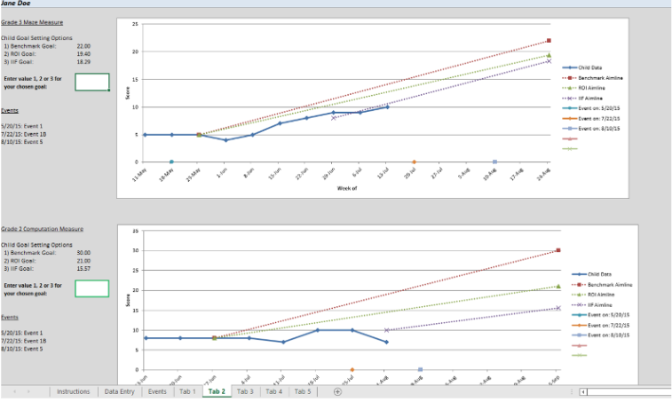
NCII’s Excel Graphing Tool
Data Collection & Graphing Tool: Data & Goal Setting | NCII (intensiveintervention.org)
Notes:
NCII offers an Excel tool designed to help educators collect academic progress monitoring data across multiple measures as part of the DBI process. This tool allows educators to store data for multiple students (across multiple measures), graph student progress, and set individualized goals for a student on specific measures.
If time allows, have participants explore the tool and play with the sample data provided. If you are low on time, encourage people to explore the tool on their own.
Data Collection & Graphing Tool: Data & Goal Setting

Slide 19
Analyzing Academic Progress Monitoring Data for Decision Making
Notes:
Now that we have covered collecting and graphing progress monitoring data, we will discuss how to use these data to make decisions.

Slide 20
Getting Started With Progress Monitoring 2
Identify Target Behavior and Select Tool
Establish a Progress Monitoring Plan
Collect and Graph Data
Evaluate Student Responsiveness
Notes:
After setting a goal, collecting progress monitoring data, and graphing progress monitoring data, we can analyze and use these data to make instructional decisions. In this section, we provide guidance on how to begin analyzing graphed progress monitoring data.

Slide 21
Analyzing Data to Make Decisions
  If a student is not sufficiently responding to the validated intervention program, use diagnostic data to develop a hypothesis.
  If the response to individualized intervention is not adequate, make new adaptations or change intervention.
Notes:
Analyzing the data will help us determine if a student is responsive or not, which will tell us if we should continue with the current intervention or make a change. Progress monitoring data help us decide when a change needs to be made but not necessarily what changes should be made (use diagnostic assessment to identify instructional needs).
Note: See NCII’s diagnostic assessment materials.

Slide 22
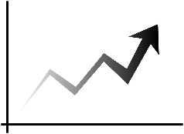

Analyzing Graphed Data
Is the student’s performance improving?
Is the student’s performance improving
sufficiently to meet their goals?
Notes:
There are two main guiding questions to keep in mind when interpreting academic progress monitoring data:
Is the student’s performance improving?
Is the student’s performance improving sufficiently to meet their goals?

Slide 23
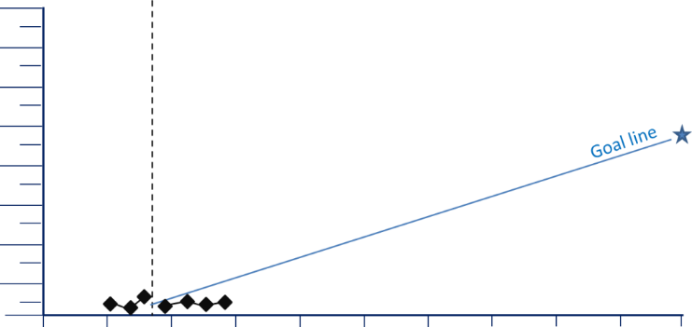
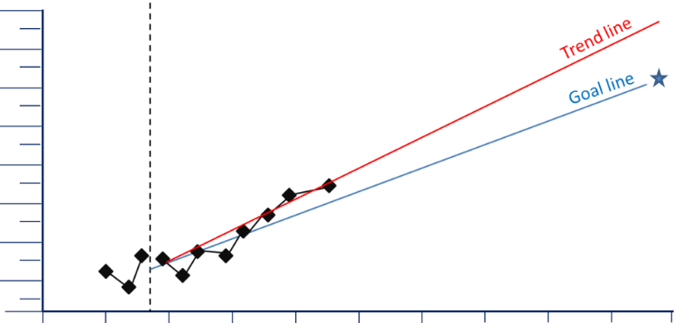
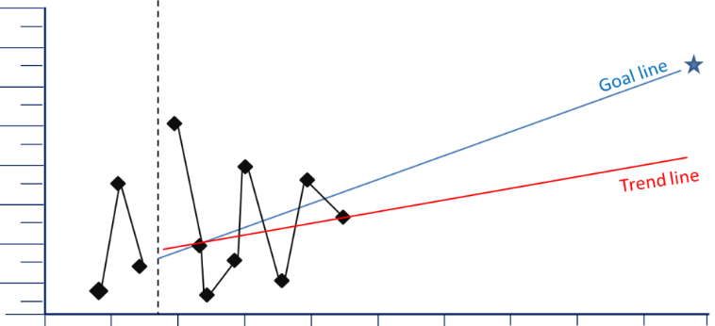
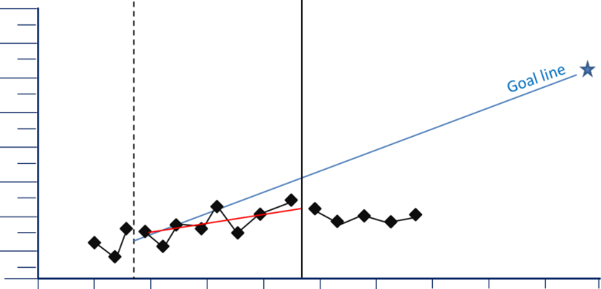
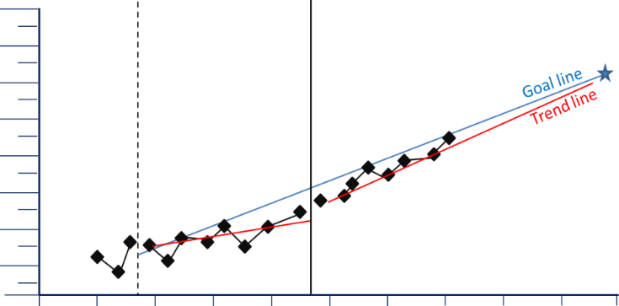
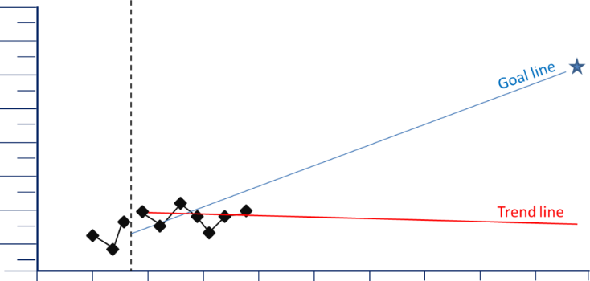
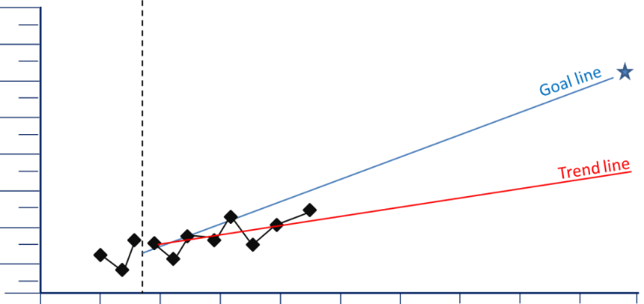
What Can a Graph Tell You?
Notes:
The first step in using progress monitoring data to inform instructional decisions is to examine the graph. Reviewing graphed data not only tells us how a student is responding to an intervention but also reveals patterns that indicate specific considerations for future data collection or intervention changes that may be necessary. This section of the training will examine each of these graphs to explore some considerations for interpretation and possible adaptations (or other changes) needed. Let’s review each graph to learn more about what that kind of graph can tell you.

Slide 24
Example Graph 1: Very Low Scores
The situation: Your student’s scores are very low, close to the bottom of the graph.
Consider: Are there issues with your progress monitoring measure or process?
Notes:
The graph represents a particular trend that teachers may see in student progress monitoring data: very low scores. In this scenario, progress monitoring scores are very low and fall very close to the bottom of the graph, and it is clear that the student is not making sufficient progress to meet the goal.
Very low scores may indicate issues with your progress monitoring measure. Consider the following questions:
Is the measurement level too difficult for the student? Consider an easier level that will better reflect growth.
Is the student motivated to do well on the assessments? If not, consider adding a motivational component.
Does the measurement correspond to the content of your instruction? If not, consider a more appropriate measure.

Slide 25
Example Graph 2: Highly Variable Scores
Consider:
Are there issues with your progress monitoring
measure or process?
Is the assessment consistently administered?
Does the student’s motivation or engagement
vary from day to day?
The situation: Your student’s scores are highly variable with a lot of “bounce” from day to day.
Notes:
This graph shows a trend in which the student’s scores are highly variable and “bounce” from high to low day by day. In this scenario, the trend line shows that the student is making some progress, but it is difficult to say if the student will be able to consistently achieve the goal given the high level of variation in scores.
Highly variable scores could be an indication that the progress monitoring measure is not valid or reliable. Consider examining the technical data about the reliability and validity of the measure to ensure that it provides an accurate reflection of student progress. This information typically can be found in the information or a manual from the tool’s developer, on the developer’s website, or on the NCII’s progress monitoring tools chart.
Highly variable scores also could be an indication that the assessment is being administered inconsistently. Perhaps the student performs better in certain settings or during certain times of day than others. To ensure that consistency of assessment administration is not causing highly variable scores, make a plan for consistent administration. This should include how the assessment is delivered (e.g., the instructions the teacher uses to explain the assessment to the student), the day(s) of the week the assessment is delivered, the time of day, and the setting.
In addition, the student’s engagement or motivation level may vary from day to day, which could result in highly variable scores. If this is the case, try adding a strategy for engagement or motivation to the student’s plan, or including the student in their goal setting and monitoring.

Slide 26
Example Graph 3: Flat Trend Line
The situation: The trend line of your student’s scores is flat or going down.
Consider: Has the plan been implemented as intended?
Notes:
This graph shows a trend in which the trend line of a student’s scores is flat or is going down, indicating that the student’s performance isn’t changing. In this scenario, it is clear that the student is not making sufficient progress to meet the goal.
In this situation, you don’t have any evidence that your instructional plan is producing the results you want to see. You’ve given your plan a chance to work, but it hasn’t. One possibility is problems with implementing your plan. For example, have scheduling conflicts reduced your instructional time? Does your student seem unmotivated during instruction? Is the setting distracting for the student? Does the interventionist need clarification or training in the intervention or plan? If this is the case, determine the specific barrier and create a plan for improving the fidelity of the intervention in that area. For instance, if there have been issues with the instructional time or setting, look for solutions to those problems. If the student seems unmotivated, consider adding a motivational element to your instruction, such as the possibility of earning prizes for on-task behavior. If the student appears motivated and there are no implementation issues, then change your instruction. You might address a different skill or perhaps try a different approach.
Note that flat scores that also are very low could be an indicator that the progress monitoring measure is too difficult and therefore won’t detect change.

Slide 27
Example Graph 4: Goal Line Steeper
Than the Trend Line
The situation: The trend line is increasing but not as steeply as the goal line.
Consider
Was the appropriate method used to set the goal?
Intensifying the intervention rather than trying something new.
Notes:
This graph displays a trend in which the student’s scores are increasing but not as steeply as the goal line. In this scenario, the student is making progress and is benefitting from the intervention, but the rate of improvement is not fast enough for the student to reach the goal by the end of the year.
If you notice that this trend is occurring, it is important to first consider whether the teacher or team used an appropriate procedure/method to set the goal. Three common goal-setting approaches include benchmarks, rate of improvement, and intra-individual goal setting. Each method is appropriate in different scenarios. For students who are significantly behind their peers, it is especially important to consider whether the goal that was set is feasible and if the goal was set using an appropriate method. For instance, does the goal represent a weekly growth rate that is significantly higher than the average rate of improvement for that grade level? If so, this may be an unrealistic goal. The teacher should not lower the goal but instead select a more appropriate goal-setting method.
Once you have determined that the goal was set using an appropriate method, consider building on or modifying the approach rather than trying something completely different. We know that the student is responding to the instruction and that the teacher is doing something that works, so teachers should try to build on that to achieve even better progress. For example, continue to use the same instructional methods but increase the amount of instructional time, providing the student with more time for engaged practice opportunities with feedback. Also consider incorporating new skills into the same instructional format.

Slide 28
Example Graph 5: Trend Line Steeper
Than Goal Line
The situation: The trend line is steeper than the goal line.
Consider: Was the original goal appropriately ambitious given the student’s circumstances?
Notes:
This graph represents a scenario in which the trend line from a student’s scores is increasing more steeply than the goal line. This is a good problem to have! This means that your student is improving at a faster rate than you originally estimated. Your instructional plan is working well for the student.
If a student is making faster growth than you originally anticipated, consider whether the original goal is ambitious enough. Research has shown that ambitious but realistic goals, coupled with data-based decision making, lead to better student achievement. Consider raising the student’s goal to see if you can effect even better progress for your student.

Slide 29
Example Graph 6: Scores Flat After Change
The situation: After an instructional change, progress monitoring data do not indicate improved performance.
Consider: Why might the original intervention have worked better for the student?
Notes:
This graph shows a scenario in which, after an instructional change, a student’s scores do not improve. This is a good opportunity to put experimental teaching into action. Think about what the graph is telling you about your student’s learning. (Pause for discussion and ask participants to share their thoughts.)
Under your first instructional intervention, the student was making some progress but not sufficient progress to meet the end-of-year goal. The data indicated a change in instruction was in order. The vertical line on the graph shows when you made the change.
We know that your original instructional intervention was more effective than the change that you made. You should change your instruction again, but this time, think back to your original intervention. Why might that intervention have worked better for your student? Use that insight to help you decide how to change your instruction this time. Then keep collecting data to see if it helps your student achieve better progress.

Slide 30
Example Graph 7: Scores Improving After Change
The situation: After an instructional change, the trend line is steeper than before the change was made.
Consider: Continue the intervention and monitor the student’s progress through the end of the year.
Notes:
This graph represents a scenario in which the student’s trend line becomes steeper after an instructional change. If your graph looks like this, congratulations! You identified a progress monitoring measure and level that reflect your student’s progress, and your student’s steadily improving performance is on target to reach the end-of-year goal. From the graph, you can see that your first intervention was effective, but the change or modification that you made has been even more effective.
This graph reveals that what you’re doing is working, and there is no need to make an instructional change now. Remember to continue monitoring the student’s progress through the end of the year and continue to evaluate data to ensure that the student is still responding sufficiently.

Slide 31

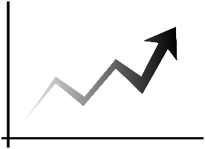
Decision Rules for Analyzing Progress Monitoring Data
Four-Point Rule
Trend Line Analysis
Median of the Last Three Points
Notes:
Sometimes, it may be clear just looking at the graph that a student is or is not responding to the intervention. Using clear and consistent decision rules to help guide your decisions is important to ensure accurate and consistent decisions. Let’s review three decision rules that teams can use when analyzing academic progress monitoring data: the four-point rule, trend line analysis, and median of the last three data points. Please note that these are not the only methods of analysis you can use; they are some of the most commonly used methods in progress monitoring.

Slide 32
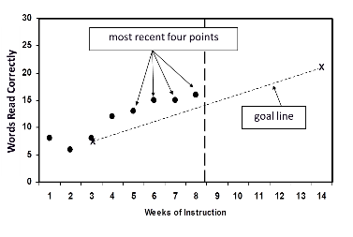
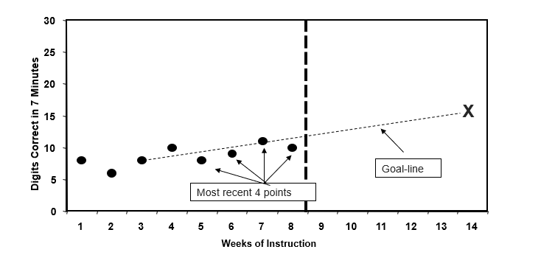
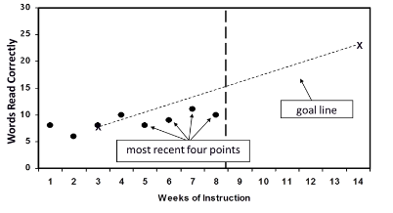
The Four-Point Analysis Method
If at least 3 weeks have passed and six data points have been collected, examine the four most recent data points.
Responsive
Nonresponsive
Questionable
If all four points are above the goal line, increase the goal.
If all four points are below goal line, consider adapting the intervention.
If the four data points are both above and below the goal line, keep collecting data and continue to monitor progress.
Notes:
For the four-point rule, if 3 weeks of instruction have occurred AND at least six data points have been collected, examine the four most recent data points.
If all four data points are above the goal line, consider increasing the goal.
If all four data points are below the goal line, consider making an instructional change.
If the data points are a mix of above, below, or on the goal line, continue to monitor progress.
It is important to note that the four-point analysis method is less sensitive than other methods; therefore, the teacher’s interpretation of the data may change with additional data points across time.

Slide 33
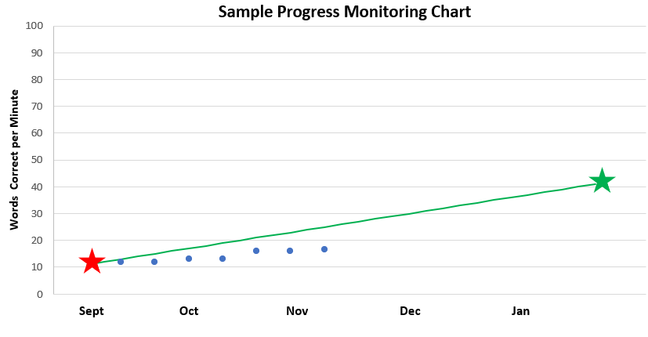
Example: Four-Point Analysis Method
Based on the four most recent data points, what analysis or decision should be made about this student’s progress?
WRC = words read correctly.
Notes:
Let’s look at an example. This student has four data points below the goal line, so the teacher determines the student is not responding to the intervention. The team may consider adapting the intervention now to help the student get back on track to meet their goal. Note that if the goal was set using an appropriate goal-setting approach, you should never decrease the goal. Instead, adapt the intervention and supports to help improve student progress.

Slide 34
The Four-Point Analysis Method 2
Advantages
Considerations
Recommendation
  A simple and quick method for determining progress.
  The easiest method to visually analyze on a graph.
  Potentially not as accurate.
  Must have consecutive data points above or below the goal line to make a decision.
  Outliers or significant deviations in the last four data points can impact decisions.
  Collect data more frequently (e.g., weekly) to ensure timely information timely information to inform intervention adaptation.
  Consider this method when an easy-to-understand approach is necessary.
Notes:
When using the four-point analysis method for analyzing progress monitoring data, there are several key considerations, advantages, and recommendations to keep in mind.
The main advantage of this method is its simplicity. It is a quick method that allows us to easily visualize progress on a graph.
However, there are some considerations to keep in mind. The method may not be as accurate as others. For a reliable decision, you need consecutive data points either above or below the goal line. Outliers or significant deviations in the last four data points can impact decisions.
A recommendation is to collect data more frequently, such as weekly, to ensure timely information for immediate intervention. This method is especially useful when an easy-to-understand approach is necessary for making decisions.

Slide 35
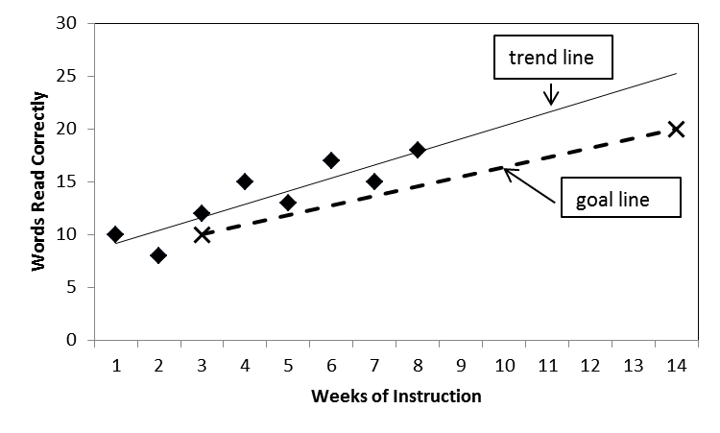
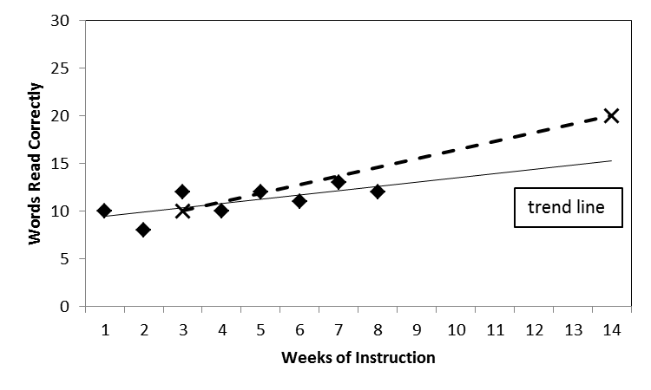
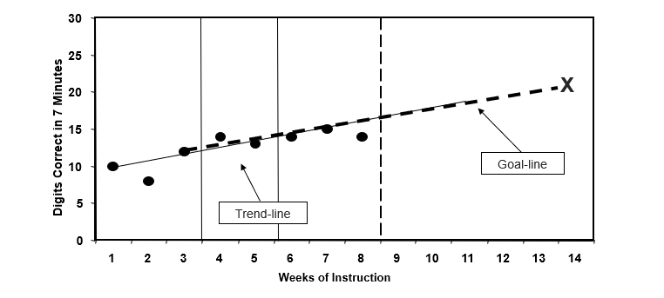
Trend Line Analysis
If at least 4 weeks have passed and eight data points have been collected, determine the trend of current performance and compare it with the goal line.
Responsive
Nonresponsive
Questionable
goal line
If the student’s trend line is steeper than the goal line, increase the goal (if the goal is below the benchmark).
If the student’s trend line is flatter than the goal line, consider adapting the intervention and assess fidelity.
If the student’s trend line and goal line are the same, keep collecting data and continue to monitor progress.
Notes:
The trend line analysis method compares the student’s actual performance, shown via the trend line, with their expected performance, shown via the goal line. The trend line analysis requires more data points than four-point analysis; therefore, the trend line analysis is more sensitive than a four-point analysis.
If the student’s trend line is steeper than the goal line (i.e., projecting a final score above the goal), the teacher should consider increasing the goal.
If the student’s trend line is flatter than the goal line (i.e., projecting a final score below the goal), the teacher should consider if a change is necessary.
If the student’s trend line and goal line are close together, the teacher should continue to collect data and analyze whether the student remains on track to reach their goal.

Slide 36
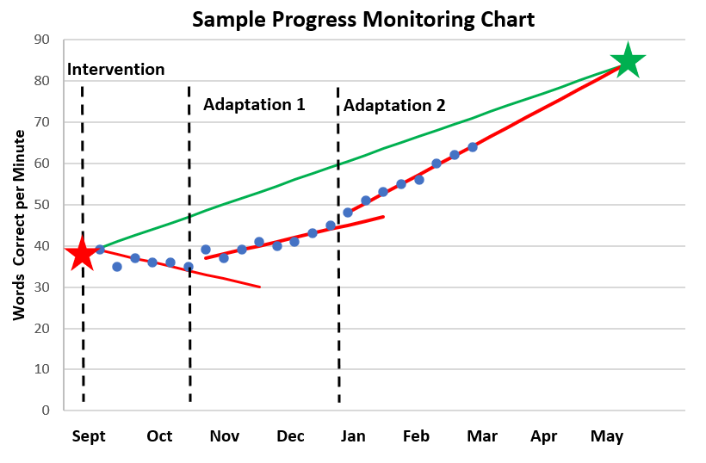
Example: Trend Line Analysis Method
Notes:
Let’s look at an example of how trend line analysis can be used within the DBI process.
In this example, the teacher collected and graphed initial data starting in September. In October, the team convened to review the data. The team compared the student’s trend line with their goal line and realized that the student was not responding to the intervention as designed. The team considered fidelity of implementation and other diagnostic data as they developed a hypothesis and adapted the intervention plan. They drew a phase line on the graph to illustrate the change in the plan (Adaptation 1). The teacher implemented the adapted intervention with fidelity and continued to collect progress monitoring data. When the team reconvened, they reviewed the student data by comparing the trend line of the data representing the adapted intervention with the goal line. They saw that the student was responding but not quickly enough. What would you do next if you were a member of the team?
If you said you would consider making a further adaptation, you are right. The team determines they need to tweak the intervention further to ensure that the student can meet their goal (Adaptation 2). After implementing this intervention, when the teacher comes back to the team, they see that the student is now on track to meet their goal. This is great news. The team determines they will continue to implement the intervention with the two adaptations to support the student in reaching their goal. If the student continued to be on track across time, they may consider raising the goal or scaling back supports.

Slide 37
Trend Line Analysis 2
Advantages
Considerations
Recommendation
  Highly accurate.
  It is easy to look at and use if you collect enough data, especially if you have a system that will calculate it for you.
  Must have a sufficient number of data points to establish a reliable trend.
  Outliers can affect the slope of the trend line.
  Requires tool or hand calculation.
  Ensure that data collection is systematic and frequent enough to detect meaningful trends.
  Use if you have a system that calculates a trend line for you.
Notes:
The trend line analysis method is highly accurate and is easier to use if you have a system that collects and calculates the trend line for you.
However, this method requires a sufficient number of data points to establish a reliable trend. Outliers can affect the slope of the trend line, and you may need to calculate the trend line manually or with a tool.
It is crucial to ensure that data collection is systematic and frequent enough to detect meaningful trends. This method is particularly effective if you have a system that can automate the trend line calculations.

Slide 38
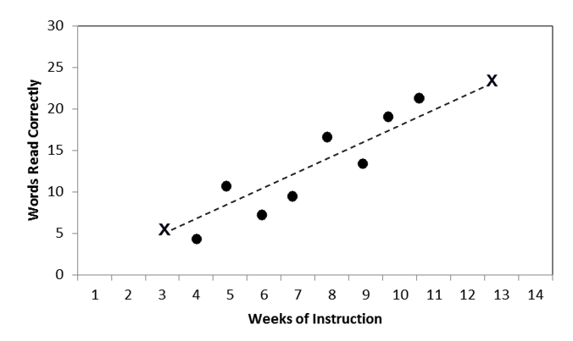
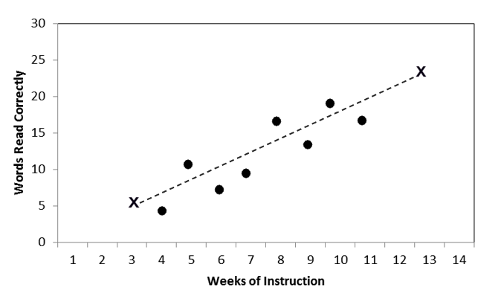
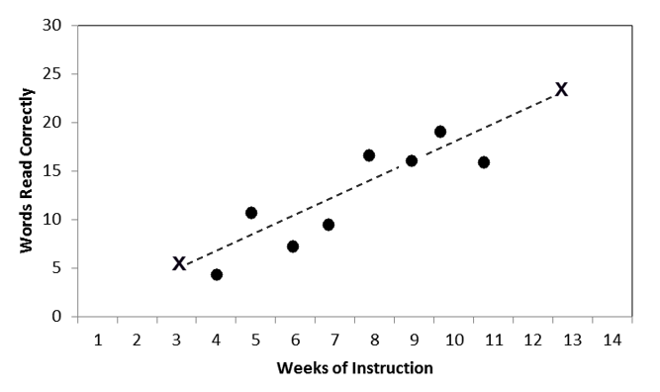
Median of the Last Three Data Points​
If at least 4 weeks have passed and eight data points have been collected, find the median of the three most recent data points and compare the median with the goal line.
Responsive
Nonresponsive
Questionable
Median of the last three
Median of the last three
Median of the last three
If the median of the last three is above the goal line, increase the goal.
If the median of the last three is below the goal line, consider adapting the intervention and assess fidelity.
If the median of the last three is right on the goal line, keep collecting data and continue to monitor progress.
Notes:
The median of the last three data points method compares the student’s actual performance, shown by the median of the three most recent data points, with their expected performance, shown via the goal line. This method requires at least eight data points and provides a snapshot of the student's recent performance compared with the goal.
If the median of the last three data points is above the goal line, the teacher should consider increasing the goal.
If the median of the last three data points is below the goal line, the teacher should consider if a change in instruction or intervention is necessary.
If the median of the last three data points is close to the goal line, the teacher should continue to collect data and analyze whether the student remains on track to reach their goal.
This method allows for timely adjustments to instructional strategies based on recent performance trends.

Slide 39

Example: Median of the Last Three Points Method​
Based on the median of the last three data points, what analysis or decision should be made about this student’s progress?
Notes:
Let’s look at an example. The median of the last three data points is slightly below the goal line, so the teacher determines that the student is not responding adequately to the intervention. The team may consider adapting the intervention now to help the student get back on track to meet their goal. If the goal was set using an appropriate goal-setting approach, you should never decrease the goal. Instead, you should adapt the intervention and supports to help improve student progress.

Slide 40
Median of the Last Three Data Points 2​
Advantages
Considerations
Recommendation
  Simple and quick to analyze.
  Reduces the impact of extreme values and outliers on analysis.
  Allows for timely instructional adjustments based on recent performance.
  Need less data to make adjustments.
  The median value may not fully capture trends if data points vary widely.
  May be more accurate with more weeks of data collection.
  Might cause implementation issues if people think they do not have to collect as much data.
  Consider using when educators want a method that allows for quick analysis and limits the influence of outliers to assess trends in variable student performance.
Notes:
The median of the last three data points method is simple and quick to analyze. It reduces the impact of extreme values and outliers, thus making it easier to adjust instruction based on recent performance. It also requires fewer data points to make necessary adjustments.
However, the median value might not fully capture trends if data points vary widely. It also might be more accurate with more weeks of data collection. There is a risk of implementation issues if people think they do not need to collect as much data.
This method is ideal when educators want a quick analysis that limits the influence of outliers. It is particularly useful when assessing trends in variable student performance.

Slide 41
Comparing the Decision Rules
Let’s use each decision rule on the following graph and compare. Do they all give you the same answer?
x
x

Slide 42
Comparing the Decision Rules: Answers
Four-Point
Trend Line
Median of the Last Three
x
x
x
x
x
x
When the last four consecutive data points are not below the goal line, continue the intervention.
When the trend line is less steep than the goal line, make a change.
When the median of the last three data points is below the goal line, make a change.
Notes:
Regardless of the advantages and disadvantages of each method, it is crucial to choose the method that works best for your specific context and stick with it. Consistency in the application of decision rules is essential. Changing decision rules frequently can lead to inconsistent and potentially misleading analyses of student progress.

Slide 43

Software
Many assessment tools have built-in software that allow for
  automation of data collection and analysis and
  clear visual representations of data trends and progress.
If software has decision rules built in, use those.
Notes:
Many assessment tools come with built-in software features that significantly enhance the process of progress monitoring. These tools offer several advantages:
Automation of data collection and analysis: This feature helps streamline the process, reducing the manual effort required to gather and interpret data. Automation ensures consistency and accuracy in data handling, thus allowing educators to focus more on instruction and intervention.
Clear visual representations of data trends and progress: Visual tools within the software provide intuitive graphs and charts that illustrate student performance across time. These visual aids make it easier to identify patterns, trends, and areas needing attention, thus facilitating more informed decision making.
If the software includes built-in decision rules, it is highly recommended to use these features.
By leveraging these technological advantages, educators can enhance the efficiency and effectiveness of their progress monitoring efforts, ultimately supporting better educational outcomes for students with intensive needs.

Slide 44


Using Decision Rules
Provides an “if → then” guide for our decision making.
Increases clarity and consistency for staff and students (when documented and clearly communicated to staff).
Increases equity in decision making across schools, classrooms, and students.
The data do not make decisions; we do.
Notes:
Let's talk about decision rules and why they are critical to our data-based decision-making process.
First, decision rules provide us with an “if-then” framework for our decision making. This framework enhances our ability to make consistent and clear decisions across different contexts, which is crucial for maintaining fairness and transparency in our schools.
When we document and clearly communicate these decision rules to our staff, it leads to greater clarity and consistency for not only educators but also students. This consistency ensures that everyone knows what to expect, thus reducing uncertainty and promoting a stable learning environment.
Moreover, decision rules help us increase equity in our decision-making process across schools, classrooms, and students. By applying the same criteria uniformly, we minimize biases and ensure that all students are treated fairly.
Finally, it is essential to remember that although data inform our decisions, data do not make decisions for us. We, as educators, interpret and apply these data using decision rules to guide our actions in a way that best supports our students' needs.
So, using well-defined decision rules not only simplifies our decision-making process but also ensures that we are equitable and transparent in our approach.

Slide 45
Conclusion

Slide 46
In Summary
Weekly progress monitoring allows for timely decision making about whether the intervention is working for the student, while maintaining feasibility for teachers.
It is important to ensure that data are collected consistently to minimize measurement errors.
Graphing data enhances visual analysis and facilitates quick comparisons and trend identification.
Reviewing graphed data tells us how a student is responding to an intervention and may reveal patterns that indicate needed changes to the student’s intervention or data collection.
Using clear and consistent decision rules to help guide your decisions is important to ensure accurate and consistent decisions.
Notes:
First, we discussed considerations for collecting academic progress monitoring data and the features of a progress monitoring graph.
Next, we discussed how progress monitoring data can be used to evaluate student responsiveness.
We discussed three important questions to keep in mind, including whether the student’s progress in improving and improving sufficiently to meet their goal. To help us understand these questions, we reviewed some considerations from example graphs and three decision rules: the four-point rule, trend line analysis, and the median of the last three data points.

Slide 47
Summary Questions
What three areas should teachers consider to ensure quality data collection?
Why should teachers establish a regular process for analyzing progress monitoring data?
When analyzing graphed progress monitoring data, what can the graph tell you about your student’s progress?
What are some considerations for using the three common decision rules to analyze graphed progress monitoring data?
What resources could help you graph progress monitoring data?
Notes:
In your notes, respond to these quick summary questions.
Sample answers:
To ensure quality data collection, it is important to maintain consistent administration and accurate scoring and to avoid data entry errors.
Establishing a regular process for analyzing graphed progress monitoring data is critical for determining student responsiveness and knowing if and/or when instructional adaptations are necessary.
Visually analyzing the graph can indicate issues with progress monitoring measures, inconsistent administration, student motivation and engagement, or the effectiveness of instructional changes, among other things. Comparing the student’s trend line to their goal line can show if the student is on track to meet their goal or if an instructional change is necessary.
The four-point rule typically requires at least 3 weeks of intervention and six data points. Trend line analysis requires more data points (at least eight) but is more sensitive. The median of the last three data points may not fully capture trends if data points vary widely.
NCII’s Student Progress Monitoring Graphing Tool could help you graph progress monitoring data. You also can purchase data systems with progress monitoring tools, which often provide enhanced graphing and goal-setting capacity.

Slide 48
NCII Disclaimer
This presentation was produced under the U.S. Department of Education, Office of Special Education Programs, Award No. H326Q260001. Celia Rosenquist serves as the project officer. The views expressed herein do not necessarily represent the positions or policies of the U.S. Department of Education. No official endorsement by the U.S. Department of Education of any product, commodity, service, or enterprise mentioned in this resource is intended or should be inferred.

Slide 49

Thank you!

