Slide 1

From Data to Action: Supporting Students With Behavioral and Mental Health Challenges
October 22, 2024
with Dr. Elizabeth Talbott, Dr. Allison Bruhn, and Dr. Nate von der Embse

Slide 2



Our Panelists
Dr. Allison Bruhn
Professor of Special Education at the University of Iowa
Dr. Elizabeth Talbott
Professor and Associate Dean for Research and Faculty Development at the William and Mary
School of Education
Dr. Nate von der Embse
Professor of School Psychology at the University of South Florida

Slide 3
What is school mental health, and why does it matter?

Slide 4
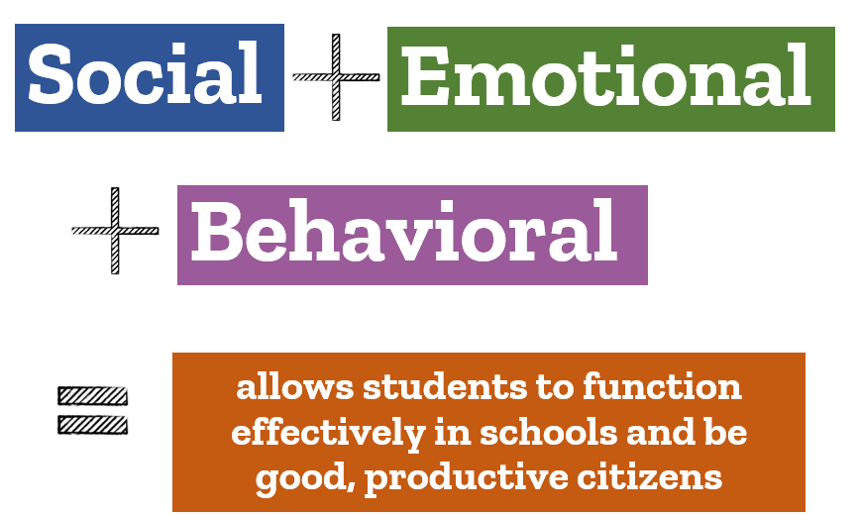

What is school mental health?

Slide 5

1 in 5 students faces mental health challenges
Source. U.S. Department of Education, Office of Special Education and Rehabilitative Services (2021)

Slide 6
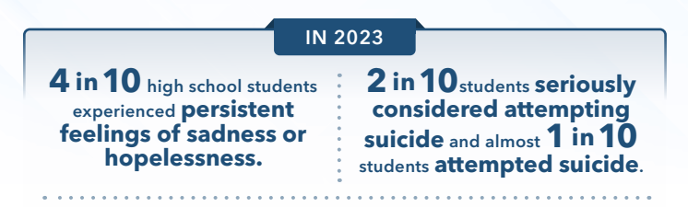
Youth Risk Behavior Survey Report (2013-2023)
Source. Centers for Disease Control and Prevention (2024)

Slide 7

50% of all lifetime cases of mental illness begin by age 14.
Source. National Alliance on Mental Illness (2023)

Slide 8

Prevalence-to-Service Gap
Only about 20% of students with mental health issues receive services for them.
  Of these, schools are the most common location for services.
Sources. U.S. Department of Education, Office of Special Education and Rehabilitative Services (2021); National Association of School Psychologists (2021)

Slide 9

Schools as a Source of Support
Opportunity for connectedness and belonging
Consistent place to go for needs being met
Multi-tiered systems that prioritize
  Clear expectations
  Positive social interactions with peers and adults
  Interventions matched to need
  Data-driven decisions

Slide 10
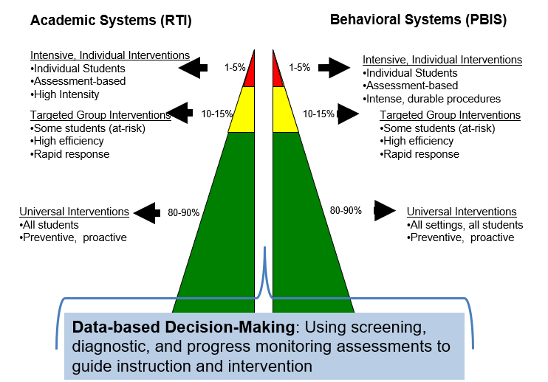
Multi-Tiered Systems of Support
RTI: Response to Intervention
PBIS: Positive Behavioral Interventions and Supports

Slide 11
Tier 1

Slide 12

Barriers to Effective Practice
Decades of randomized controlled trials, meta-analyses, and online clearinghouses, yet there is still a research-to-practice gap.
Resource-intensive (e.g., research-practice partnerships) and time-intensive (e.g., technical assistance) processes often fail to generalize to other schools and maintain initial effectiveness.
Sources. Dunst et al. (2019); Korthagen (2016)

Slide 13

Barriers to Effective Practice 2
The focus on should (i.e., research evidence in support of practice) and how (i.e., implementation science, measurement of fidelity) often ignores the could (i.e., Could this work at my school?).
We have an abundance of
  what works and how it works
  but not where, when, and for whom it works.
Source. Orr et al. (2019)

Slide 14

How are decisions made?
Decisions …
tend to rely on district data and trusted colleagues.
make limited use of peer-reviewed or outside research.
will adapt outside evidence to localized routines and tools.
Sources. Graves & Moore (2018); Neal et al. (2019)

Slide 15

What’s in the building?
Resource mapping
  What do we have?
Determining who can implement
  Who do we have?
Determine base rate of risk
  What is our need?

Slide 16
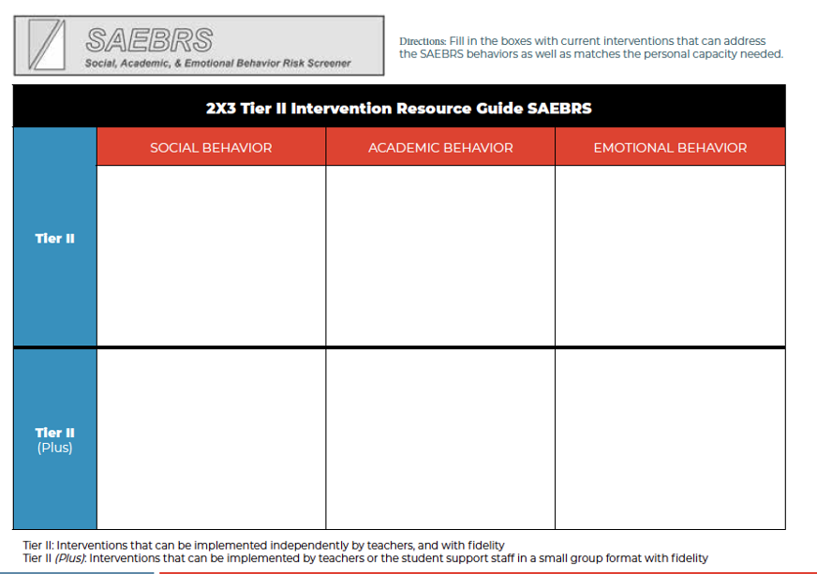
Example: SAEBRS Tier II Intervention Resource Guide
Source. von der Embse & Latimer (n.d.).

Slide 17
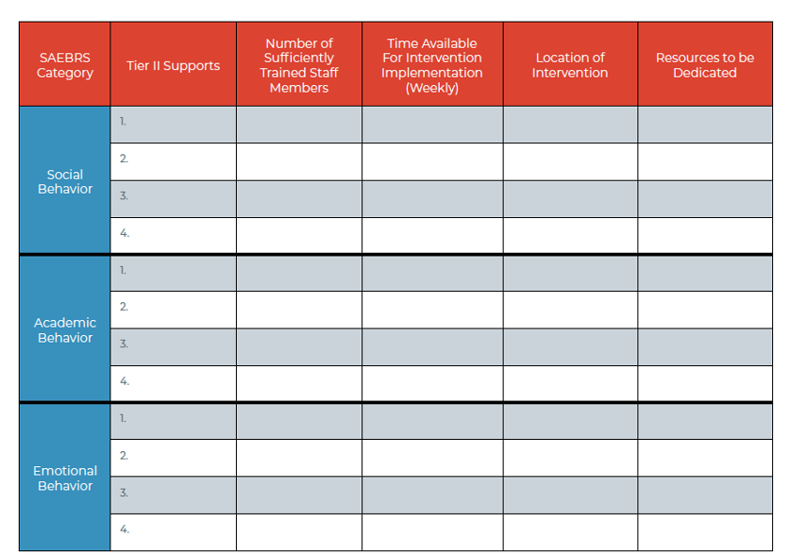
Example: SAEBRS Tier II Supports Table
Source. von der Embse & Latimer (n.d.).

Slide 18
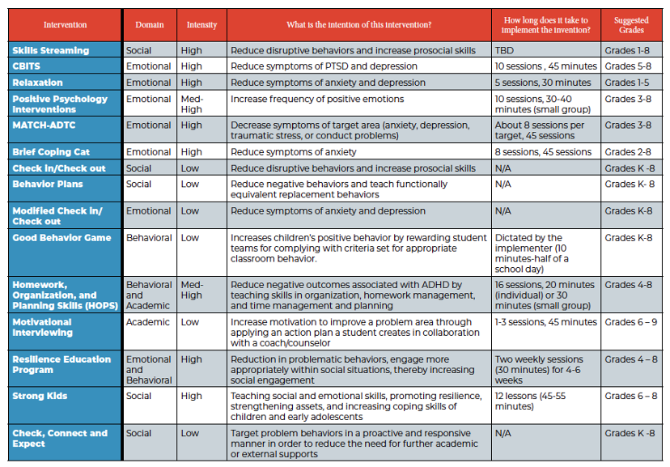
Example: SAEBRS Intervention Table
Source. von der Embse & Latimer (n.d.).

Slide 19
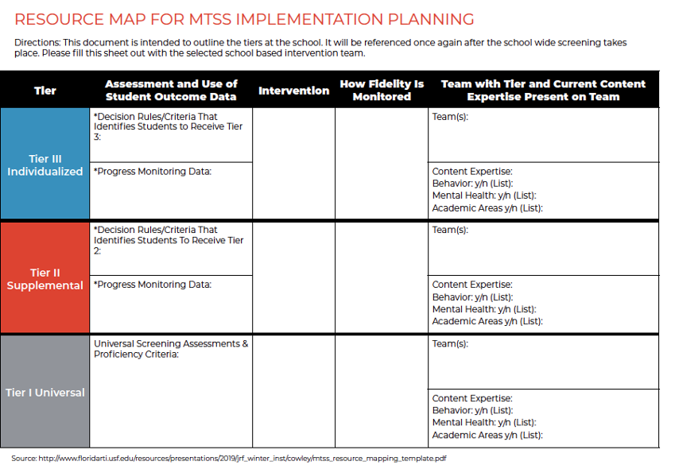
Example: SAEBRS Resource Map
Source. von der Embse & Latimer (n.d.).

Slide 20
What’s in the building? 2
At your meeting to discuss the serviceable base rate of risk, you learn that
  5 teachers have been implementing the Good Behavior Game in their classrooms for 20 minutes a day;
  10 student services team members serve as check-in/check-out (CICO) mentors in the cafeteria for 5 minutes in the morning and 5 minutes in the afternoon;
  the school psychologist also mentions that she has been implementing the 8-session, 45-minute Brief Coping Cat intervention for 6 students at lunch bunch; and
  there are 12 teachers who have been trained in the HOPS intervention but are currently not implementing it, although it is typically implemented for 20 minutes for each of the 11 sessions.

Slide 21
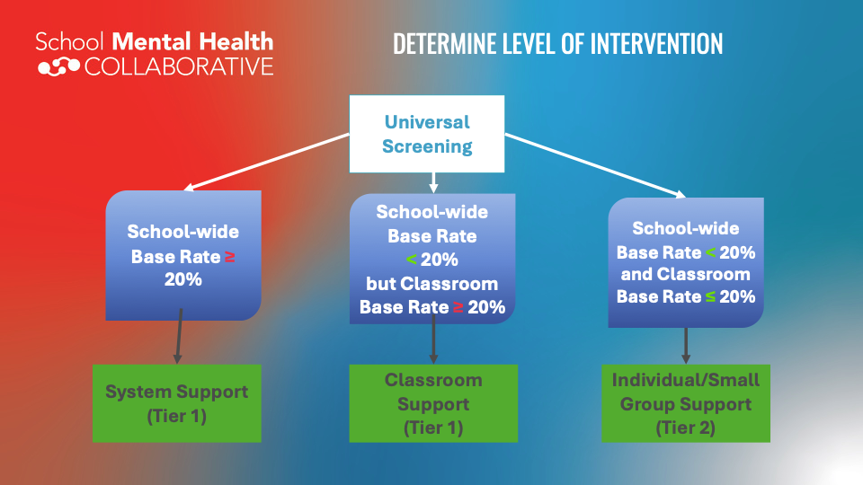
Determine level of Intervention
Source. https://www.renaissance.com/products/saebrs/

Slide 22
Tier 2
Screening and Progress Monitoring

Slide 23
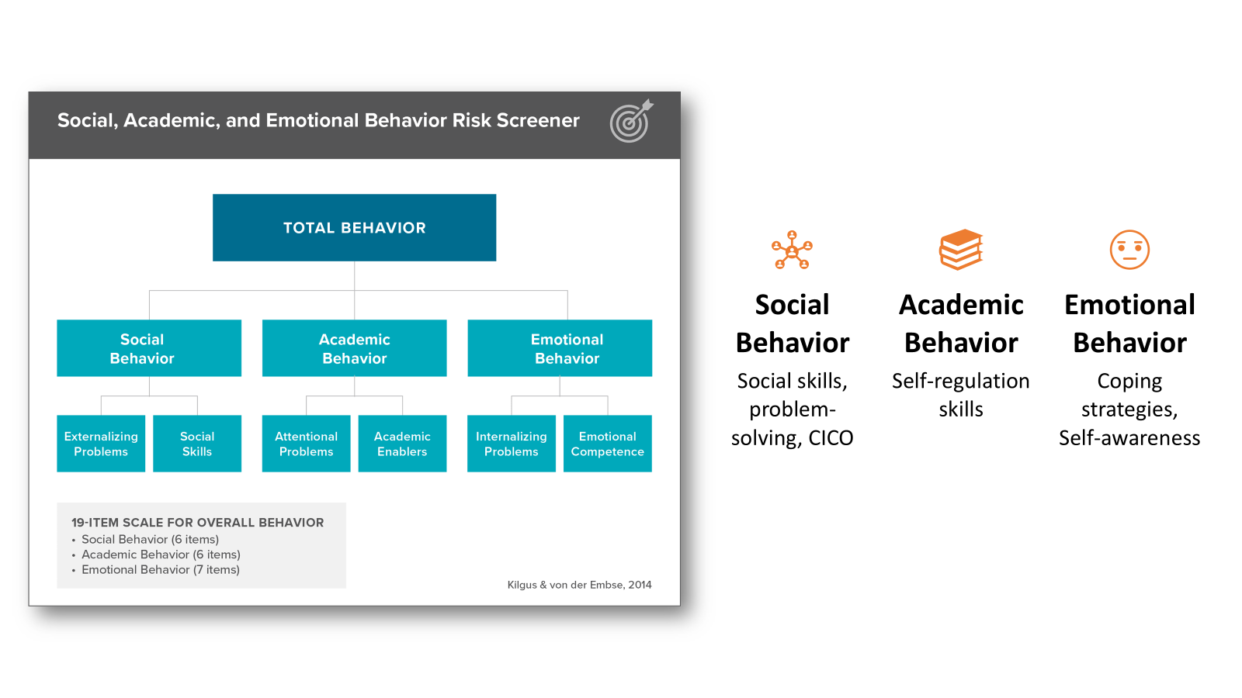
Example: SAEBRS
Source. https://www.renaissance.com/products/saebrs/

Slide 24
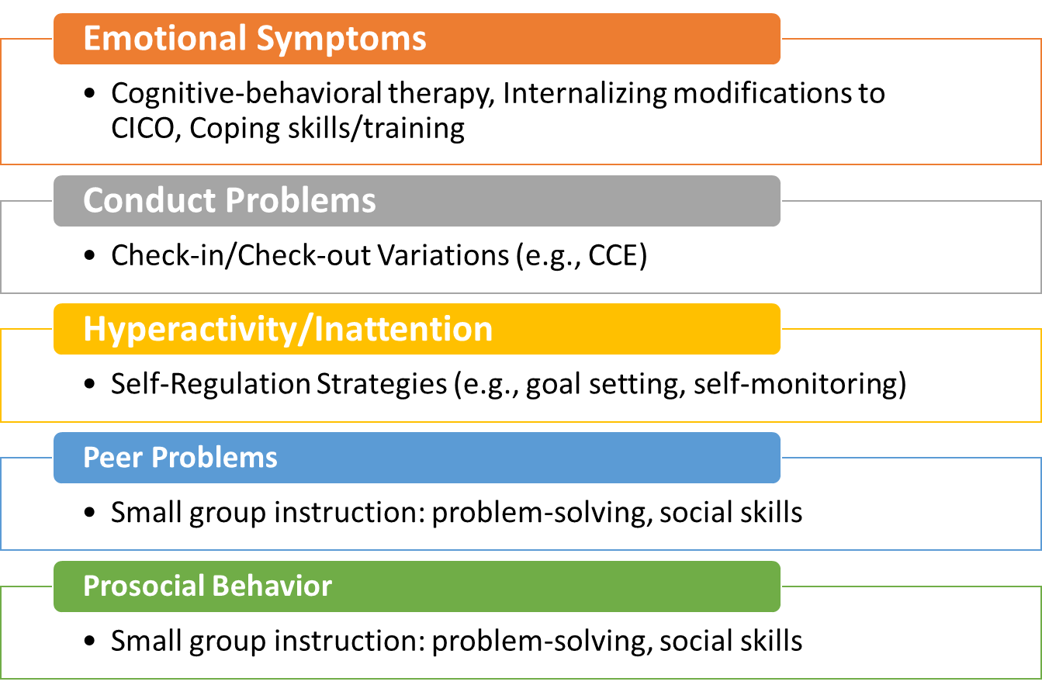
Strengths and Difficulties Questionnaire

Slide 25
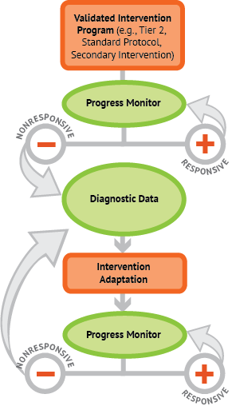
Data-Based
Individualization

Slide 26
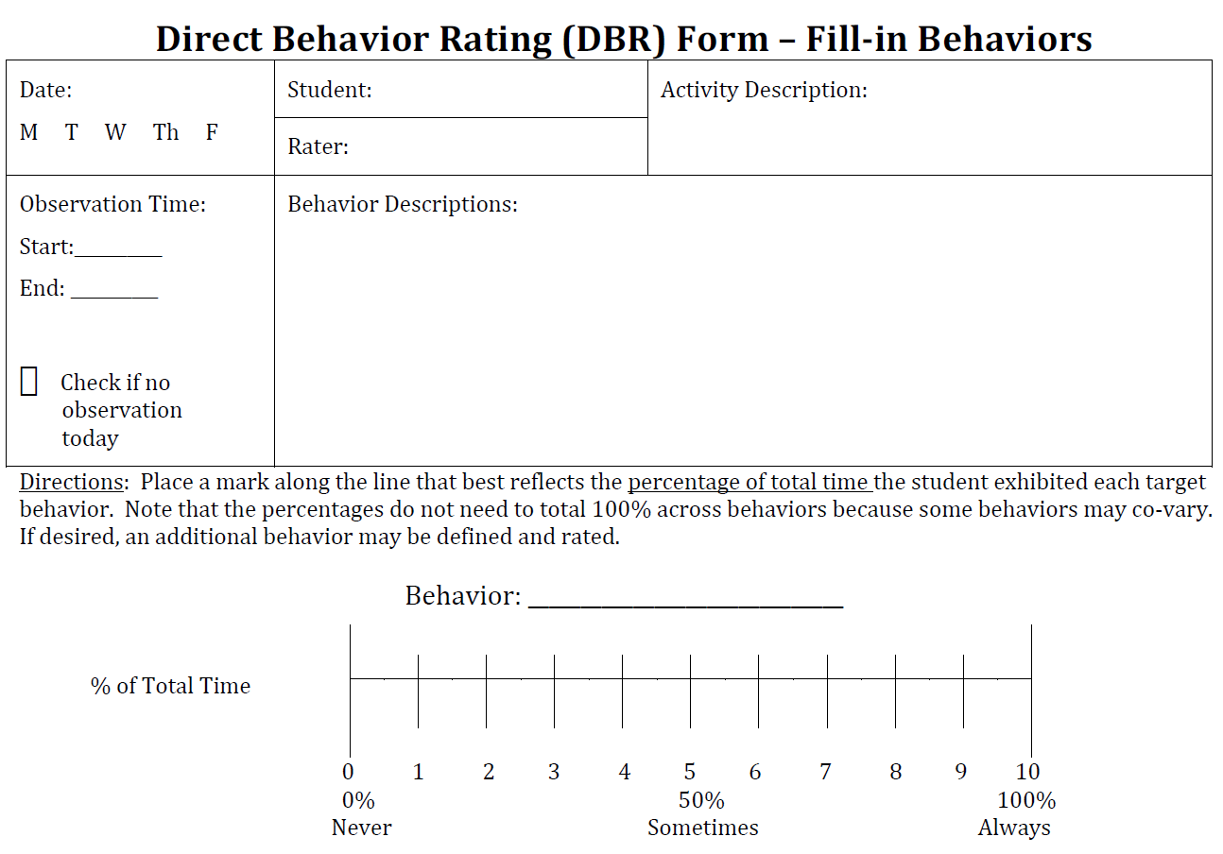
Direct Behavior Rating (DBR): Standard Form
DBR: Teacher rating of student behavior on
0–10 scale immediately at end of observation session
Each behavior has operational definition with examples and nonexamples.
Fill in your own target behaviors.
Lower scores for disruptive behaviors are desirable.
(Chafouleas, Riley-Tillman, & Christ, 2010)
Permission for use granted by authors for educational purposes only.
Source. www.directbehaviorratings.org

Slide 27
Direct Observation
Direct observation: Direct measure of student behavior in real time (i.e., recording behavior as it occurs in the setting of concern)
Generally regarded as the gold standard
for behavioral assessment measures
  Teacher options: frequency,
  momentary time sampling
Interval | Occurred | Did not Occur
1 | X
2 |  | X
3 | X
4 |  | X
5 | X
6 |  | X
7 | X
8 |  | X
9 | X
10 | X
 | 6/10=60% | 4/10=40%
Larry | IIII I
Bobby | IIII
Tony | IIII II
Linda | IIII

Slide 28
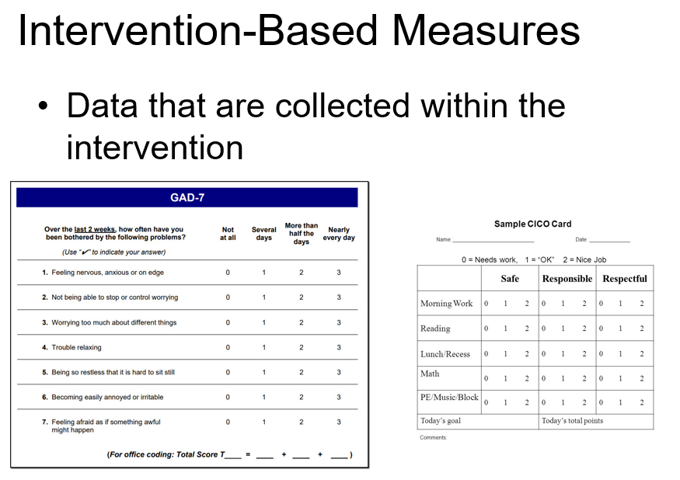
Intervention-Based Measures
Data that are collected within the intervention:
Sources. https://therapymeetsnumbers.com/made-to-measure-gad-7/
https://www.slideserve.com/amber/implementing-check-in-check-out

Slide 29


Treatment Fidelity
According to data, is the student responding to the intervention?
Yes
No
Is the intervention being implemented with fidelity?
Is the intervention being implemented with fidelity?
No
Yes
No
Yes
There are likely factors outside of the intervention contributing to improved student behavior.
Begin to fade the intervention to promote maintained behavioral change.
Provide training to interventionists to improve intervention implementation.
Give a different/ more intense intervention or conduct additional evaluation.

Slide 30
Tier 3
Addressing the behavioral and mental health needs of individual youth:
Assessment and interventions happen in context (situational specificity).

Slide 31

Youth have many strengths— and complex needs.
Needs include
Externalizing problems: aggression, rule-breaking behavior
Internalizing problems: depression, anxiety

Slide 32

Evidence-based interventions can address youth needs.
But … youth with disabilities and youth from diverse backgrounds are more likely than their peers to experience exclusionary discipline (suspensions, expulsions)—not evidence-based.
Yet … educators (teachers, school psychologists, social workers, counselors, nurses) have the tools to address youth needs in the settings where they occur.

Slide 33

Therefore, adults, set goals.
Build, sustain, and repair positive relationships with students.
Use low-intensity interventions frequently (set clear expectations; use behavior-specific praise, student choice, behavioral momentum, active supervision).
Keep an open mind; practice mindfulness in the moment.

Slide 34
Adults: Mindfulness is for you.
Pay attention to your breathing, entering and exiting moment by moment.
When your mind drifts, notice what you are thinking, and then bring your mind back to your breathing.
When a strong sensation or emotion arises, notice the sensation or emotion and return to your breathing.
Practice focusing on your breathing as you observe your thoughts or the sensations in your body.
Shift back to your breathing, entering and exiting moment by moment.
Source. Adapted from Gauthier et al. (2015).

Slide 35
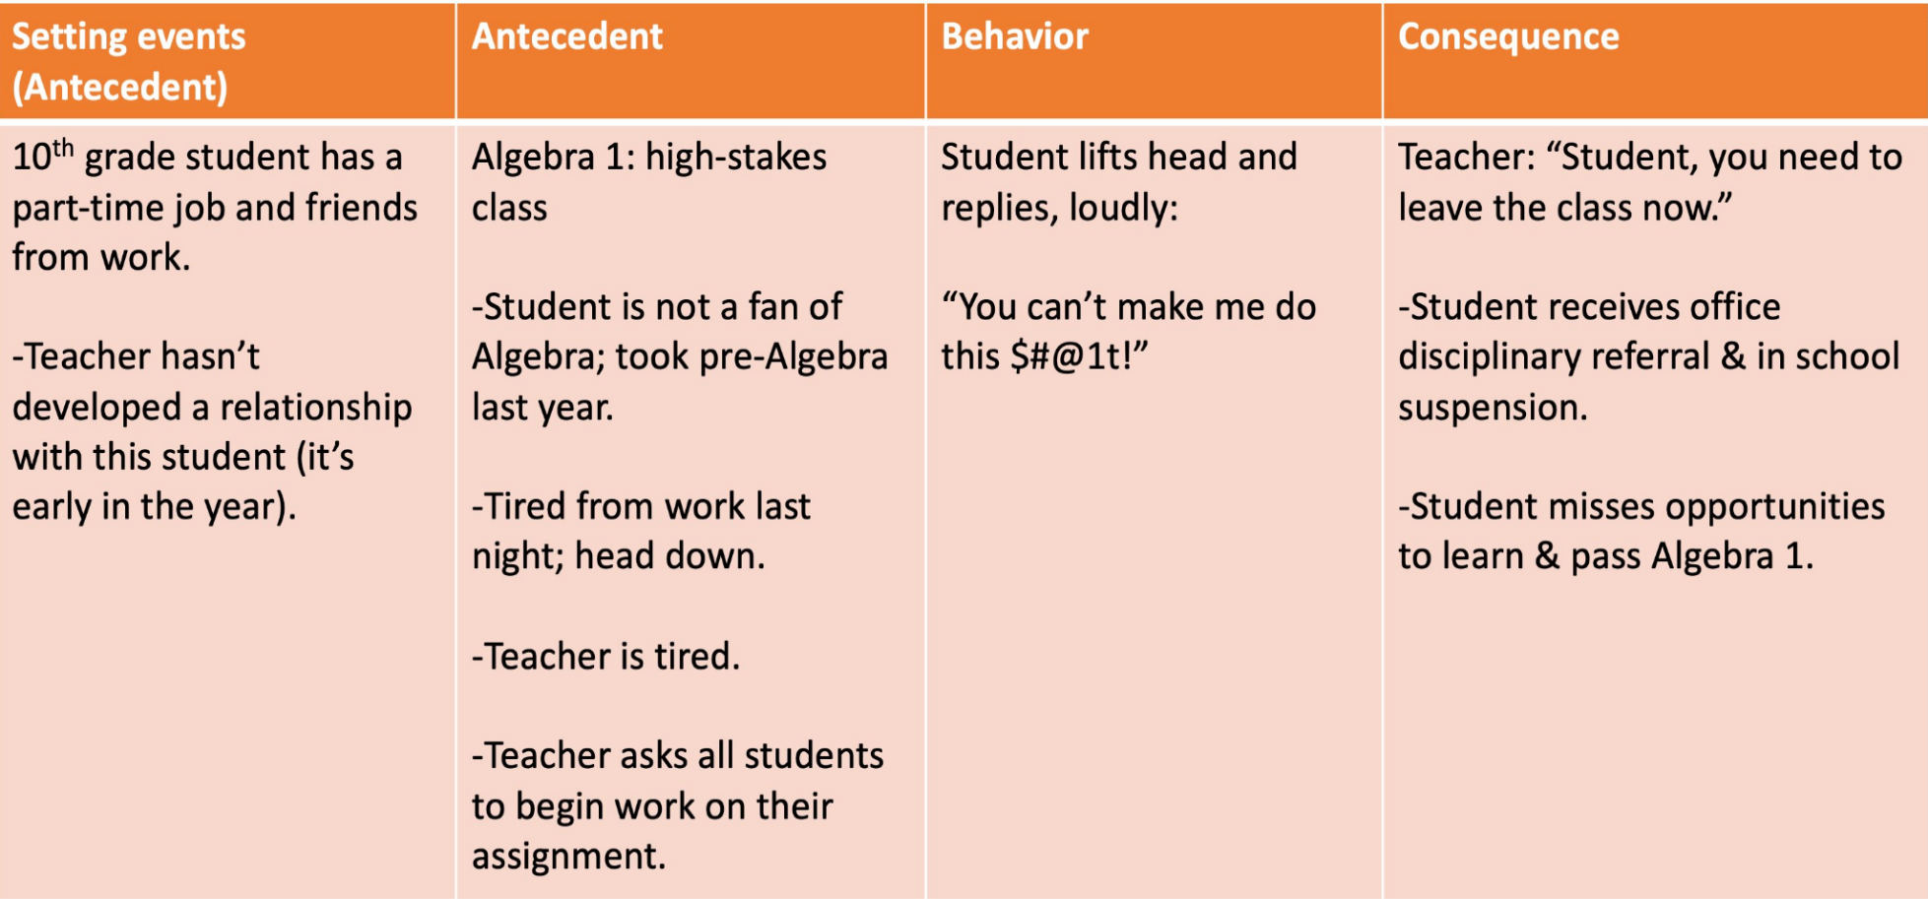
ABC Analysis Sets the Stage: A Common Pattern
Adapted from McIntosh et al. (2021)

Slide 36
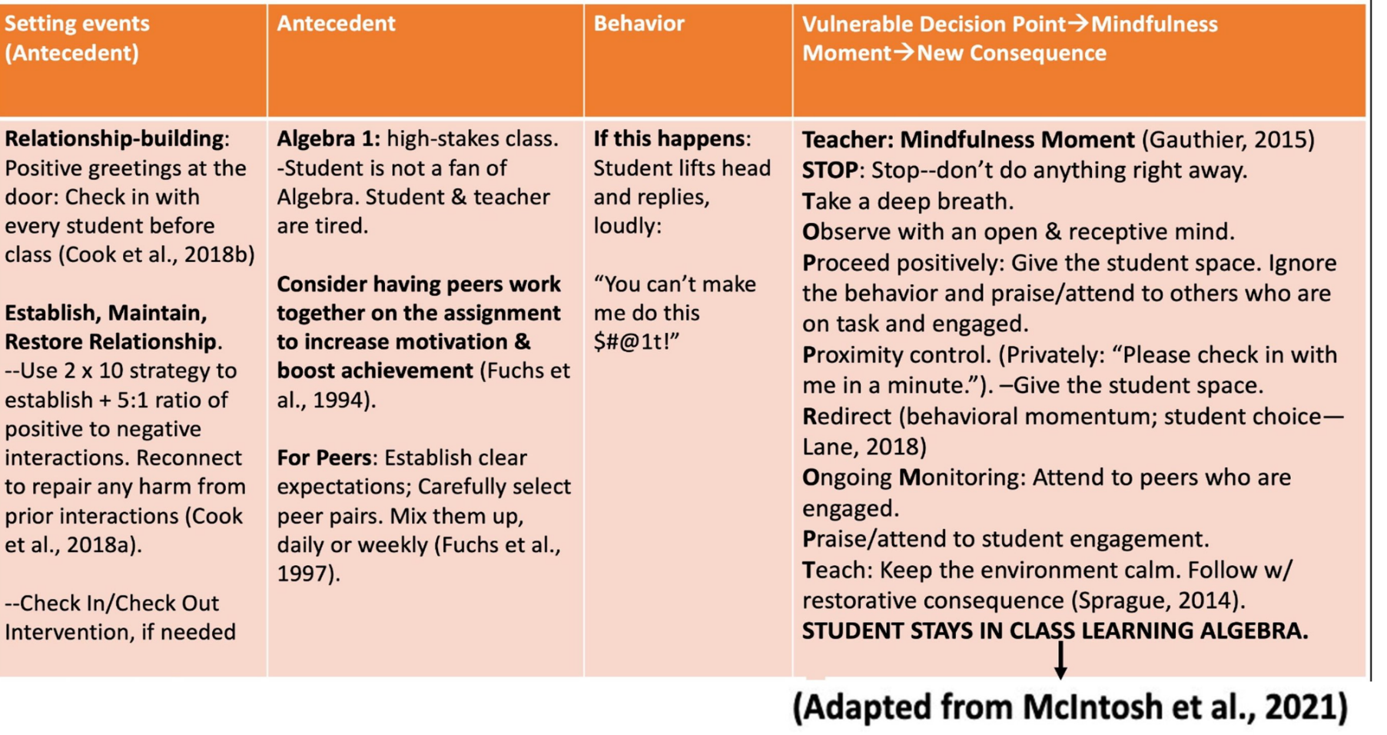
ABC Context for Evidence-Based Interventions

Slide 37
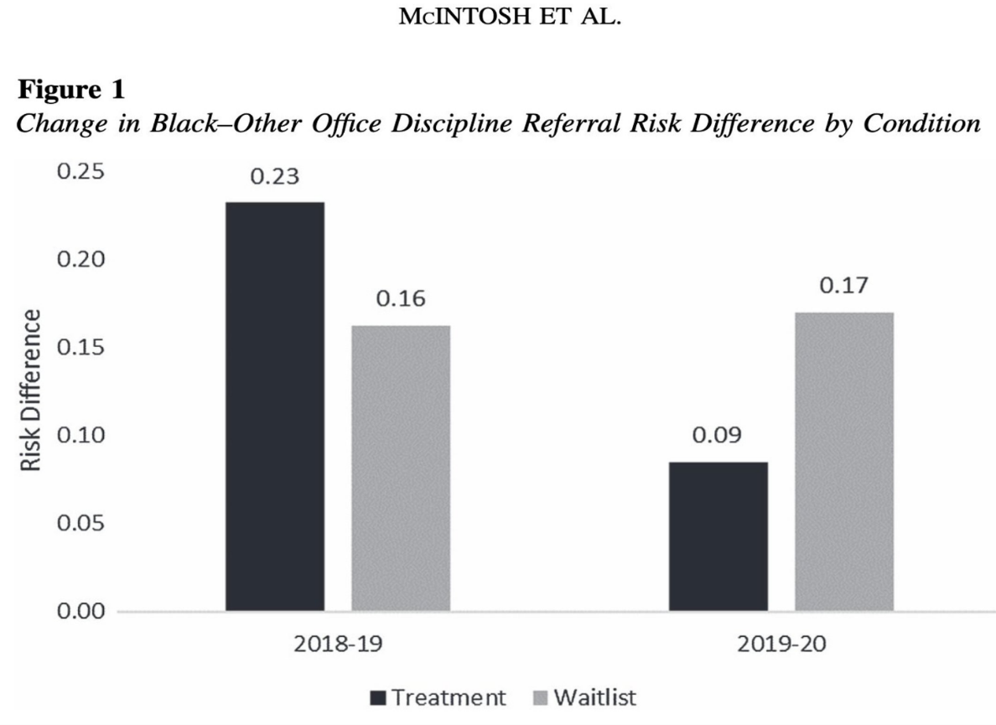
Promising Findings

Slide 38

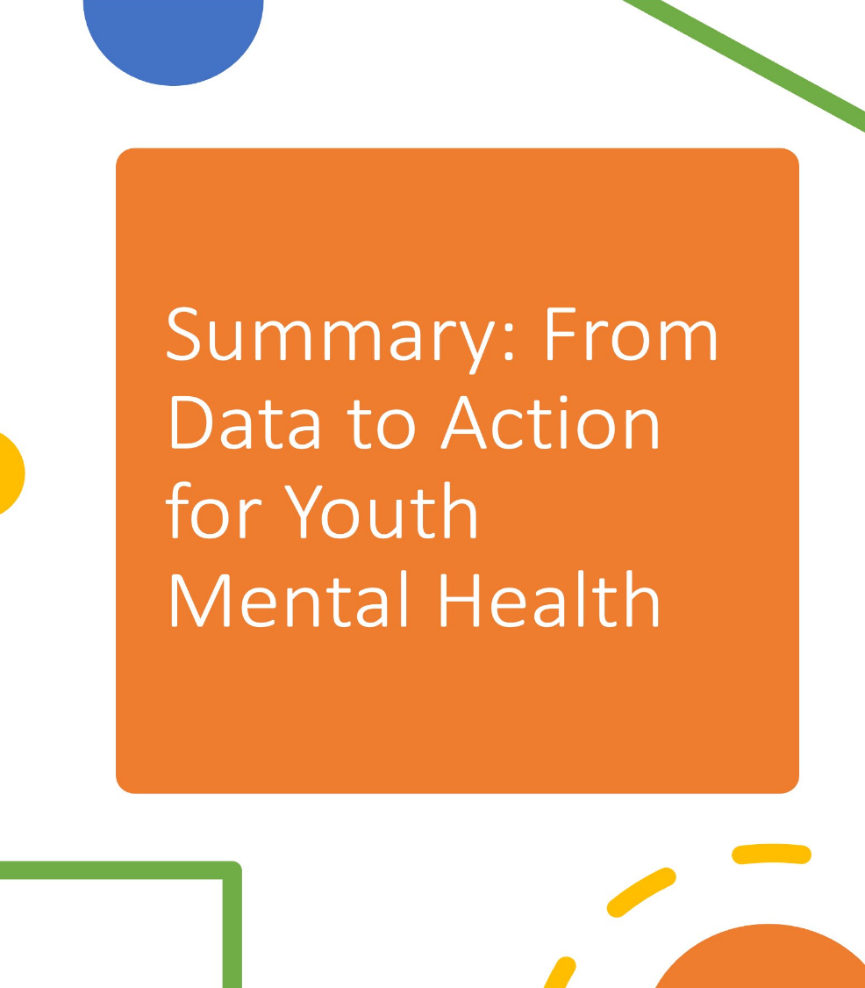
Summary

Slide 39
Q&A

Slide 40
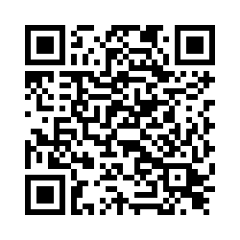
Thank you!
Thank you for attending this session. Please complete this short survey to share feedback on the webinar and help us improve future events.
https://meadowscenter.ca1.qualtrics.com/jfe/form/SV_br8iLZNE5feYv6C

Slide 41

NCII Disclaimer
This presentation was produced under the U.S. Department of Education, Office of Special Education Programs, Award No. H326Q260001. Celia Rosenquist serves as the project officer. The views expressed herein do not necessarily represent the positions or policies of the U.S. Department of Education. No official endorsement by the U.S. Department of Education of any product, commodity, service, or enterprise mentioned in this resource is intended or should be inferred.

Slide 42
References
Centers for Disease Control and Prevention. (2024). Youth risk behavior survey data summary and trends report: 2013–2023. U.S. Department of Health and Human Services.
Cook, C. R., Coco, S., Zhang, Y., Fiat, A. E., Duong, M. T., Renshaw, T. L., Long, A. C., & Frank, S. (2018a). Cultivating positive teacher–student relationships: Preliminary evaluation of the establish-maintain-restore (EMR) method. School Psychology Review, 47(3), 226–243.
Cook, C. R., Fiat, A., Larson, M., Daikos, C., Slemrod, T., Holland, E. A., Thayer, A. J., & Renshaw, T. (2018b). Positive greetings at the door: Evaluation of a low-cost, high yield proactive classroom management strategy. Journal of Positive Behavior Interventions, 20(3), 149–159.
Dunst, C. J., Annas, K., Wilkie, H., & Hamby, D. W. (2019). Scoping review of the core elements of technical assistance models and frameworks. World Journal of Education, 9(2), 109–122. https://doi.org/10.5430/wje.v9n2p109
Fuchs, D., Fuchs, L. S., Mathes, P. G., & Simmons, D. C. (1997). Peer-assisted learning strategies: Making classrooms more responsive to diversity. American Educational Research Journal, 34(1), 174–206.
Fuchs. L. S., Fuchs, D., Bentz, J., Phillips, N. B., & Hamlett, C. L. (1994). The nature of student interactions during peer tutoring with and without prior training and experience. American Educational Research Journal, 31(1), 75–103.

Slide 43
References 2
Gauthier, T., Meyer, R. M. L., Grefe, D., & Gold, J. I. (2015). An on-the-job mindfulness-based intervention for pediatric ICU nurses: A pilot. Journal of Pediatric Nursing, 30(2), 402–409.
Graves, S., & Moore, A. (2018). How do you know what works, works for you? An investigation into the attitudes of senior leaders to using research evidence to inform teaching and learning in schools. School Leadership & Management, 38(3), 259–277. https://doi.org/10.1080/13632434.2017.1366438
Korthagen, F. (2016). Inconvenient truths about teacher learning: Towards professional development 3.0. Teachers and Teaching, 23(4), 387–405.
Lane, K. L. (2018). Special series: Effective low-intensity strategies to enhance school success. Beyond Behavior, 27(3), 127–176.
McIntosh, K., Girvan, E. J., Fairbanks Falcon, S., McDaniel, S. C., Smolkowski, K., Bastable, E., Santiago-Rosario, M. R., Izzard, S., Austin, S. C., Nese, R. N. T., & Baldy, T. S. (2021). Equity-focused PBIS approach reduces racial inequities in school discipline: A randomized controlled trial. School Psychology, 36(6), 433–444.

Slide 44
References 3
National Alliance on Mental Illness. (2023, April). Mental health by the numbers. https://www.nami.org/About-Mental-Illness/Mental-Health-By-the-Numbers/#:~:text=1%20in%206%20U.S.%20youth%20aged%206-17%20experience,by%20age%2014%2C%20and%2075%25%20by%20age%2024
National Association of School Psychologists. (2021). Comprehensive school-based mental and behavioral health services and school psychologists [Handout]. https://www.nasponline.org/resources-and-publications/resources-and-podcasts/mental-and-behavioral-health/additional-resources/comprehensive-school-based-mental-and-behavioral-health-services-and-school-psychologists
Neal, J. W., Neal, Z. P., Mills, K. J., Lawlor, J. A., & McAlindon, K. (2019). What types of brokerage bridge the research-practice gap? The case of public school educators. Social Networks, 59, 41–49. https://doi.org/10.1016/j.socnet.2019.05.006
Orr, L. L., Olsen, R. B., Bell, S. H., Schmid, I., Shivji, A., & Stuart, E. A. (2019). Using the results from rigorous multisite evaluations to inform local policy decisions. Journal of Policy Analysis and Management, 38(4),
978–1003. https://doi.org/10.1002/pam.22154

Slide 45
References 4
Sprague, J. (2014). Integrating PBIS and restorative discipline. The Special Edge: Student Behavior, 11–15.
U.S. Department of Education, Office of Special Education and Rehabilitative Services. (2021). Supporting child and student social, emotional, behavioral, and mental health needs. https://www.pbis.org/resource/supporting-child-and-student-social-emotional-behavioral-and-mental-health-needs
von der Embse, N. & Latimer, J. (n.d). Consultation Resource Guide for School Leadership Teams. University of South Florida. smhc-consultation-resource-guide.pdf

