Slide 1



Academic Progress Monitoring in Intensive Intervention: Part 3
Establishing Baseline and Setting Goals
Notes:
Presenter should add their name and title.

Slide 2




Getting Started With Progress Monitoring
Identify Target Behavior and Select Tool
Establish a Progress Monitoring Plan
Collect and Graph Data
Evaluate Student Responsiveness
Notes:
In this series thus far, we have discussed identifying a target behavior and selecting a tool. This training will focus on the second aspect of progress monitoring: establishing a progress monitoring plan.

Slide 3

Objectives
By the end of this session, you will be able to
  develop a progress monitoring plan that includes a baseline score, an ambitious goal, and a data collection schedule; and
  describe three strategies for setting an academic progress monitoring goal.
Notes:
By the end of this training, you will be able to
develop a progress monitoring plan with a baseline score, an ambitious goal, and a data collection schedule; and
describe three strategies for setting an academic progress monitoring goal.

Slide 4
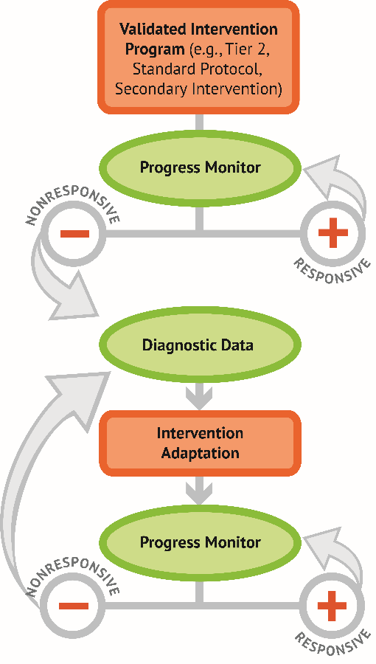
How Does Progress Monitoring Fit Within DBI?
Progress monitoring is important for
  understanding student responsiveness and
  determining when changes are necessary.
Collecting, graphing, and analyzing progress monitoring data.
Notes:
Now let’s review how progress monitoring fits into data-based individualization, also known as DBI. Progress monitoring is a key component of DBI, which is NCII’s approach to intensive intervention.
DBI is a systematic method for using data to determine when and how to provide more intensive intervention.
As shown in the DBI process graphic, frequently collecting, graphing, and analyzing progress monitoring occurs in the second and fifth steps in the DBI process and informs decisions about student responsiveness to both the validated intervention program and the adapted intervention.

Slide 5
Considerations When Selecting the
Target Academic Behavior
Reading
In which of the five big ideas will the intervention focus?
Mathematics
Will the intervention focus on early numeracy skills, computation, or concepts and application?
Spelling and Written Expression
Will the intervention focus on improving spelling or writing fluency?
Notes:
The target behavior is the outcome of interest for the student. In the last training, we discussed target behaviors and common progress monitoring measures. Let’s review some considerations when selecting the target behavior.
Choosing the appropriate target behavior depends on the goals of the teacher and the focus of the intervention.
For reading, think about which of the big ideas you will be focusing on during the intervention. For example, if the intervention will focus on developing the student’s phonological awareness skills, you would identify a target behavior that involves the student manipulating letter sounds or phonemes.
For mathematics, consider if the intervention will focus mostly on developing early numeracy skills (e.g., number identification), computation, or concepts and applications. Target behaviors in early numeracy are for students who cannot yet add or subtract.
For written expression, think about whether the intervention will focus on developing spelling skills or fluency with writing.

Slide 6
Sample Target Academic Behaviors: Reading
Target academic behaviors: Reading | Recommended grade levels
Letter naming fluency | K
Letter sound fluency (LSF) | K
Phoneme segmentation fluency | K
Nonsense word fluency | Late K−1
Word identification fluency (WIF) | 1
Passage reading fluency (PRF), also called oral reading fluency | Late 1−4
Maze or maze fluency | 4+
Notes:
Here are some examples of target behaviors in reading.
The table illustrates examples of target behaviors across different domains of reading—phonological awareness, decoding, fluency, and comprehension.
The table also notes recommended grade levels often associated with each target behavior. For example, some common target behaviors for kindergarten and first-grade students are nonsense word fluency and word identification fluency, whereas oral reading fluency is commonly for students in first through fourth grades.
The grade levels provide a guide, but the target behavior should be selected based on student age, instructional level, and need.

Slide 7




What to Look for in a Progress Monitoring Measure
Brief and easy to administer
Able to be used repeatedly across time
Sensitive to changes in student performance
Valid, reliable, and evidence based
Notes:
After you identify the target behavior, the next step is to select a progress monitoring measure to assess the target behavior. Progress monitoring tools should have the following characteristics:
Brief and easy to administer: Some progress monitoring tools take as little as a few minutes to administer, whereas others take much longer. Be sure to consider the ease of administration when selecting a tool.
Able to be used repeatedly across time: Progress monitoring for intensive intervention should occur at least weekly. Make sure that the tool you select can be used repeatedly across time. For academics, this means having multiple forms of equal difficulty or using a computer adaptive format.
Sensitive to changes in student performance: Progress monitoring measures should capture small changes in student performance. In other words, when the student learns new skills, the student’s score on the measure should reflect this change.
Valid, reliable, and evidence based: There should be evidence for the reliability and validity of the progress monitoring tool when used with students with intensive needs.

Slide 8

Establishing a Progress Monitoring Plan
The plan should identify
who will collect the data,
what tool will be used to collect the data,
the timeline and frequency of data collection, and
the baseline data and goal.
Notes:
Once the target behavior and the progress monitoring measure have been identified, the teacher can create the progress monitoring plan. This plan should identify the person responsible for collecting the progress monitoring data, the progress monitoring tool, the overall timeline and frequency for gathering data, and the student’s baseline data and goal. Having a clear plan and a consistent process also can ensure that progress monitoring is well integrated into teachers’ existing schedules and routines.

Slide 9
Establishing a Progress Monitoring Plan 2
Data Collection Plan
Person responsible for collecting progress monitoring data | Special education teacher
Progress monitoring measure tool | Passage Reading Fluency (PRF) in second grade
Frequency of progress monitoring data collection | Progress monitoring data will be collected once per week.
How will we know if the intervention is working? Is there a clearly defined goal? | Goal: The student will be able to read a second-grade-level text at a rate of 75 words per minute in a 1-minute timed reading exercise by the end of the school year.
How will we know if the intervention was implemented as intended? | Fidelity plan: The school psychologist will conduct fidelity checks twice per week during intervention times.
How do we set a goal?
Notes:
Here is an example of what a progress monitoring plan could look like. This template is from NCII’s Intervention Plan for small groups or individual students.
In this example, the special education teacher will monitor progress once per week using the Passage Reading Fluency (PRF) second-grade tool. We will know if the intervention is working if the student reads grade-level text at a rate of 75 words per minute in a 1-minute timed reading exercise by the end of the school year.
So, how do we develop this goal? Let's take a look on the next slide.

Slide 10



Setting Academic Goals for Progress Monitoring
Establish Baseline Performance
Choose a Goal-Setting Strategy
Write a Measurable Goal
Notes:
The teacher needs to follow three main steps to set an academic progress monitoring goal: establish baseline performance, choose which goal-setting strategy to use, and write the goal in a measurable way. We’ll discuss each step in detail.

Slide 11
Establishing Baseline Performance
Notes:
In this section, we will discuss how to establish a student’s baseline and why it is useful for goal setting.

Slide 12

Meet Andrew
Now we’ll review a case example to help us learn how to set a goal. Let’s meet Andrew:
Andrew is in second grade, has a learning disability with eligibility in basic reading, and struggles with decoding.
Throughout this training, we will help establish a baseline, use each goal-setting strategy, and write a measurable goal for Andrew.
Notes:
Read slide.

Slide 13


How to Establish the Baseline
Baseline: the student’s initial performance on the target academic skill.
For students with disabilities, baseline data should be part of their present levels statement.
Notes:
The first step is establishing the baseline. The baseline indicates the student’s initial performance on the target academic skill. In other words, it is the starting point for which we will measure progress. For students with disabilities, baseline data should be part of their present levels statement.

Slide 14


How to Establish the Baseline 2
Baseline scores should be established using the same tool used to collect progress monitoring data.
Two options:
  Identify the student’s score from universal screening and use that score as the baseline.
  Baseline scores should be established using alternate forms of the same tool used to collect progress monitoring data. Administer three progress monitoring probes and select the median score.
Notes:
The baseline scores should be established using the same tool used to collect ongoing progress monitoring data. This training covers two primary ways to establish a baseline score:
Option 1: Identify the student’s score from universal screening and use that score as the baseline.
Option 2: Administer three progress monitoring probes and select the median score.

Slide 15

Establishing a Baseline: Option 1
Use the score from the most recent universal screening administration as the baseline.
Use this option only if the following criteria are met:
  The tools used for screening and progress monitoring are the same.
  The baseline is established immediately after a screening administration.
  The grade-level screening measure is appropriate and likely to detect change given the student’s current level of functioning. For students well below grade level, grade-level measures are not sufficiently sensitive to change.
Notes:
Option 1 is the easiest option. This option simply uses the student’s score from the most recent universal screening assessment. This score can be used only if the screening measure is the same as the progress monitoring measure and the baseline is set immediately after the screening occurred. For example, you can use this option if you use Aimsweb for both universal screening and progress monitoring and you are setting the goal shortly after the fall screening administration.

Slide 16

Establishing Baseline: Option 2
Administer three progress monitoring probes and use the median score.
Use this option if the following criteria are met:
  The tools used for screening and progress monitoring are not the same.
  The baseline is not being established immediately after a screening administration.
Notes:
Option 2 is to administer three progress monitoring probes and use the median score. The median is the middle score when you line the scores up in order from lowest to highest. The median is used because it can help reduce the influence of outliers, or extreme scores.
This method for setting the baseline should be used if the same tool is not being used for screening and progress monitoring or if you are not setting the baseline directly after a screening administration. For example, if your universal screener is STAR but you use DIBELS for progress monitoring, you would not be able to use option 1. In this case, you would use the median of three DIBELS probes to establish the baseline.
The progress monitoring probe should be administered over a relatively short period of time (e.g., one testing session or during the course of 1 week).

Slide 17


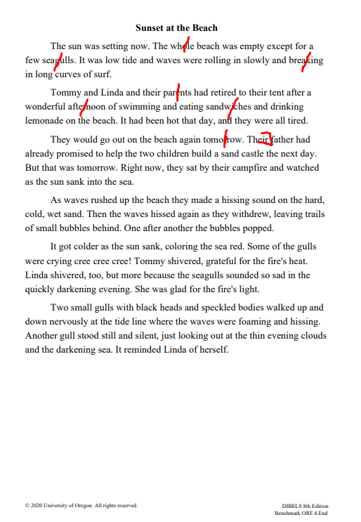
Establishing Baseline: Option 2 Example
83 words—2 errors
72 words—6 errors
79 words—7 errors
81 cwpm
66 cwpm
72 cwpm
66 cwpm, 72 cwpm, 81 cwpm
cwpm = correct words per minute
Notes:
In this example, the teacher administered and scored three PRF probes. For this assessment, scores are presented as the total words read in 1 minute minus errors. This gives you the correct words per minute (cwpm). Using the median helps reduce the influence of outliers, or extreme scores. In this example, the baseline would be 72 cwpm.

Slide 18

Andrew: Baseline
Andrew’s teacher reviewed existing data and determined that Andrew needs to focus on decoding strategies. She selected Word Identification Fluency (WIF), which is typically used to assess first graders.
She administered three WIF probes, during which Andrew has 1 minute to identify as many words as possible correctly from a given list.
Andrew’s scores were 14, 16, and 13 correct words per minute.
What is Andrew’s baseline?
Notes:
Let’s use Andrew to walk through an example of how to determine a student’s baseline.
Andrew’s teacher reviewed existing data and determined that Andrew needs to focus on decoding strategies. Based on our sample target behaviors for reading table, Andrew’s teacher determined that Word Identification Fluency (WIF) may be a good fit for progress monitoring. Andrew has 1 minute to identify as many words as possible correctly from a given list. Andrew’s scores on the first three probes were 14, 16, and 13 correct words per minute (cwpm). Let’s determine Andrew’s baseline.
Answer: 14. Discuss any questions as a group.

Slide 19
Choosing a Goal-
Setting Strategy

Slide 20

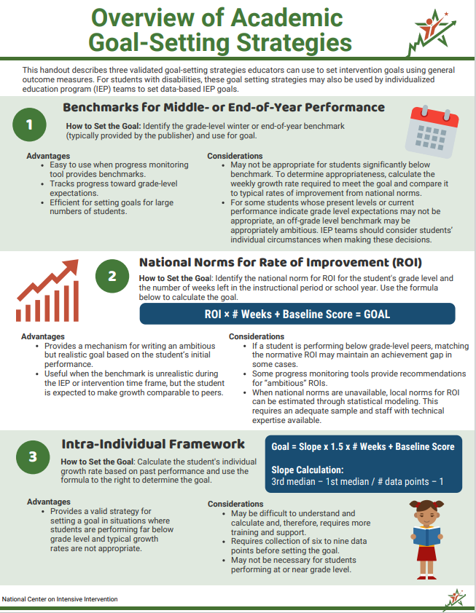
Choosing a Goal-Setting Strategy
There are three approaches to setting goals:
Benchmarking
National norms for weekly rate of improvement (ROI)
Intra-individual framework
Notes:
Once we have established the baseline, we can use the baseline to help establish the goal. In this training, we will review three validated approaches to setting goals using general outcome measures. These are benchmark, national norms for weekly rate of improvement (ROI), and the intra-individual framework. Each approach has pros and cons, so it is important to consider the context when selecting which goal setting strategy to use.
Overview of Academic Goal-Setting Strategies | NCII (intensiveintervention.org)

Slide 21

Andrew: Choosing a Goal-Setting Strategy
As we learn about goal setting, help set a goal for Andrew using each strategy.

Slide 22
Goal-Setting Strategy Option 1: Benchmarks
The benchmark specifies the level of performance expected on a specific measure at a specific point in time, usually the end of the student’s grade level.
Steps for setting a goal using benchmarks:
  Identify the appropriate grade-level benchmark for the time frame.
  Graph the benchmark and draw a line between the baseline and goal.
Goal
Baseline
Notes:
Animated slide.
One of the simplest ways to set a goal is to use the midyear or end-of-year benchmark for that assessment. A benchmark specifies the level of performance expected on a specific measure at a specific point in time, usually the end of the student’s present grade level.
For this approach, the teacher first identifies an appropriate grade-level benchmark for the time frame of the instructional period they wish to monitor, based on either the student’s grade or the grade level of the progress monitoring tool. Then the teacher graphs the benchmark, drawing a goal line between the baseline and the goal.

Slide 23
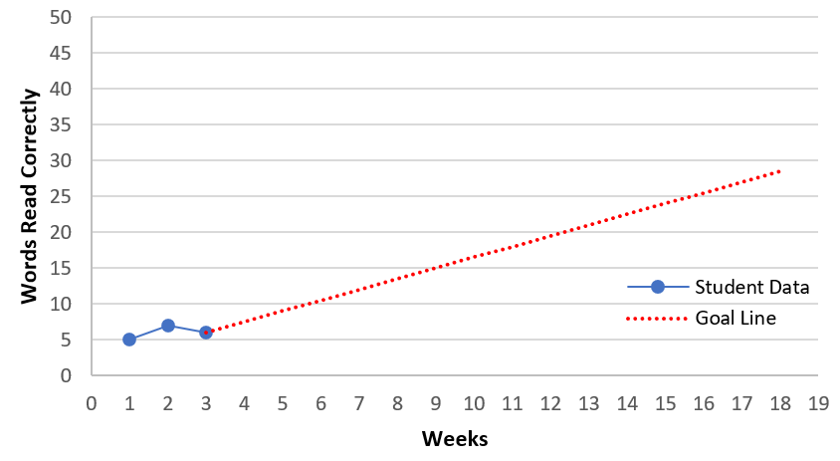
Goal-Setting Strategy Option 1: Benchmarks 2
End-of-Year Benchmark
Notes:
For example, if the end-of-year benchmark was 30 words read correctly, then the teacher would place a star or an X at the end of the instructional period. The teacher would then draw a line between the baseline and the goal to create the goal line. This graph shows an end-of-year benchmark. The team also could use a midyear benchmark to monitor progress over a shorter interval.

Slide 24
Goal-Setting Strategy Option 1: Benchmarks 3
Advantages
Considerations
Recommendation
  Ambitious.
  Goal puts student on track to close the achievement gap.
  Easy to use when progress monitoring tool provides benchmarks.
  Tracks progress toward grade-level expectations.
  May not be appropriate for students significantly below benchmark.
  For some students, an off-grade-level benchmark may be appropriately ambitious.
  Use benchmarks if a student is close to grade level.
Notes:
Here we list the advantages, considerations, and NCII’s recommendations for using the benchmark goal-setting strategy.
Advantages:
Easy to use when the progress monitoring tool provides benchmarks.
Tracks progress toward grade-level expectations.
Efficient for setting goals for numbers of students.
Considerations:
Using benchmarks may not be appropriate for students significantly below benchmark. To determine appropriateness, calculate the weekly growth rate required to meet the goal and compare it with typical rates of improvement from national norms.
For some students whose present levels or current performance indicate grade-level expectations may not be appropriate, an off-grade-level benchmark and subsequent progress monitoring may be appropriately ambitious. Individualized education program (IEP) teams should consider students’ individual circumstances when making these decisions.
Recommendation:
Use benchmarks if a student is close to grade level.

Slide 25

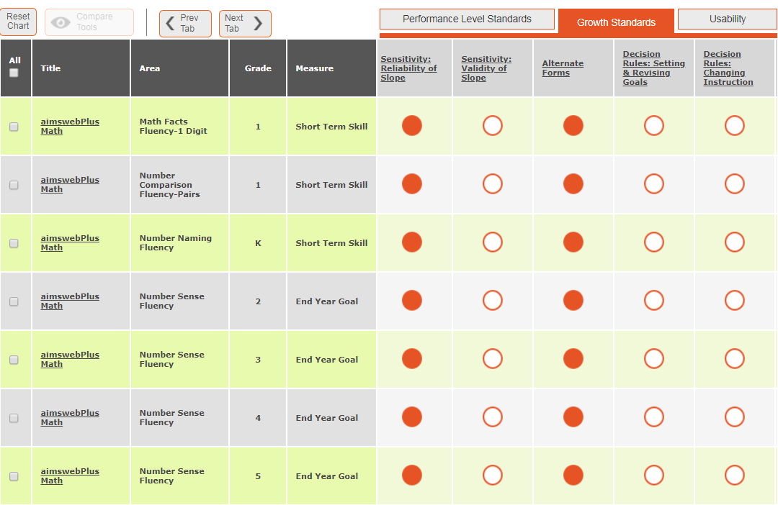
Where Do You Find Benchmarks?
Published Research
Publisher Data Systems
Notes:
Some assessments and published research include benchmarks by grade and percentile. Many publishers also provide information about benchmarks. NCII’s tools charts provides information on whether an academic progress monitoring tool includes benchmarks.
https://intensiveintervention.org/resource/update-compiled-orf-norms
https://charts.intensiveintervention.org/chart/progress-monitoring

Slide 26

Andrew: Goal Setting Using Benchmarks
Andrew is at a first-grade reading level.
Using these grade-level benchmarks for
a reading task, determine which end-of-year benchmark should be used for Andrew.
Grade | Reading task
Kindergarten | 40 sounds/minute (LSF)
Grade 1 | 60 words/minute (WIF)
Grade 2 | 75 words/minute (PRF)
Notes:
Previously, the team determined that a first-grade WIF was more appropriate for Andrew’s skill level. Let’s determine which benchmark should be used for Andrew.
Please note that these benchmarks are examples and should not be used in practice. Use benchmarks provided by the vendor for each tool.
Answer: We use the norms for the level of assessment where we are monitoring: 60 words/minute.

Slide 27
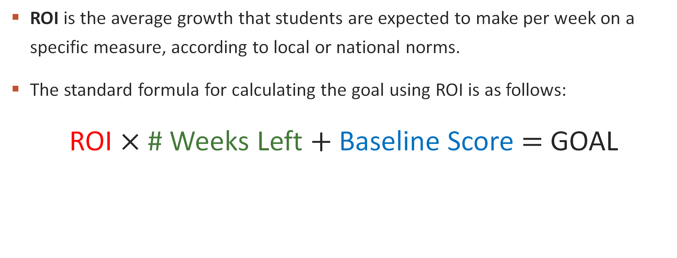
Goal-Setting Strategy Option 2:
National Norms for Rate of Improvement
ROI is the average growth that students are expected to make per week on a specific measure, according to local or national norms.
The standard formula for calculating the goal using ROI is as follows:
ROI $×$ # Weeks Left $+$ Baseline Score $=$ GOAL
(given)
(weeks left in instructional period)
(median of the most recent three scores)
Notes:
The second goal-setting option uses weekly ROIs. The ROI is the average growth that students are expected to make per week on a specific measure according to local or national norms (i.e., typical growth rates across all students). The goal is set using a standardized formula that multiplies the ROI by the number of weeks of instruction within the instructional period to calculate a target growth rate. This number is then added to the student’s baseline score (median of the most recent three scores) to identify the student’s goal. The baseline score is calculated using the three most recent data points.
Many data systems will help educators calculate goals based on growth rates.
When identifying the weeks of instruction, use the number of weeks left in the instructional period (when we want the goal to be reached). Typically, weeks in which instruction is not provided are not included. This may be the case if your intervention period covers vacation periods.

Slide 28
Goal-Setting Strategy Option 2:
National Norms for Rate of Improvement 2
Example: Fourth-grade mathematics computation
Most recent scores: 10, 9, and 11 (collected weekly)
Time frame: 10 weeks left in the instructional period
ROI = .7
Grade | Computation—ROI for digits correct
1 | .35
2 | .30
3 | .30
4 | .70
5 | .70
6 | .40
Notes:
Here is an example we can review as a group before you try one individually. Please note that these ROIs are samples and should not be used in practice. Use the norms provided by the vendor for each tool.
Review slide. Sample workout on next slide.

Slide 29
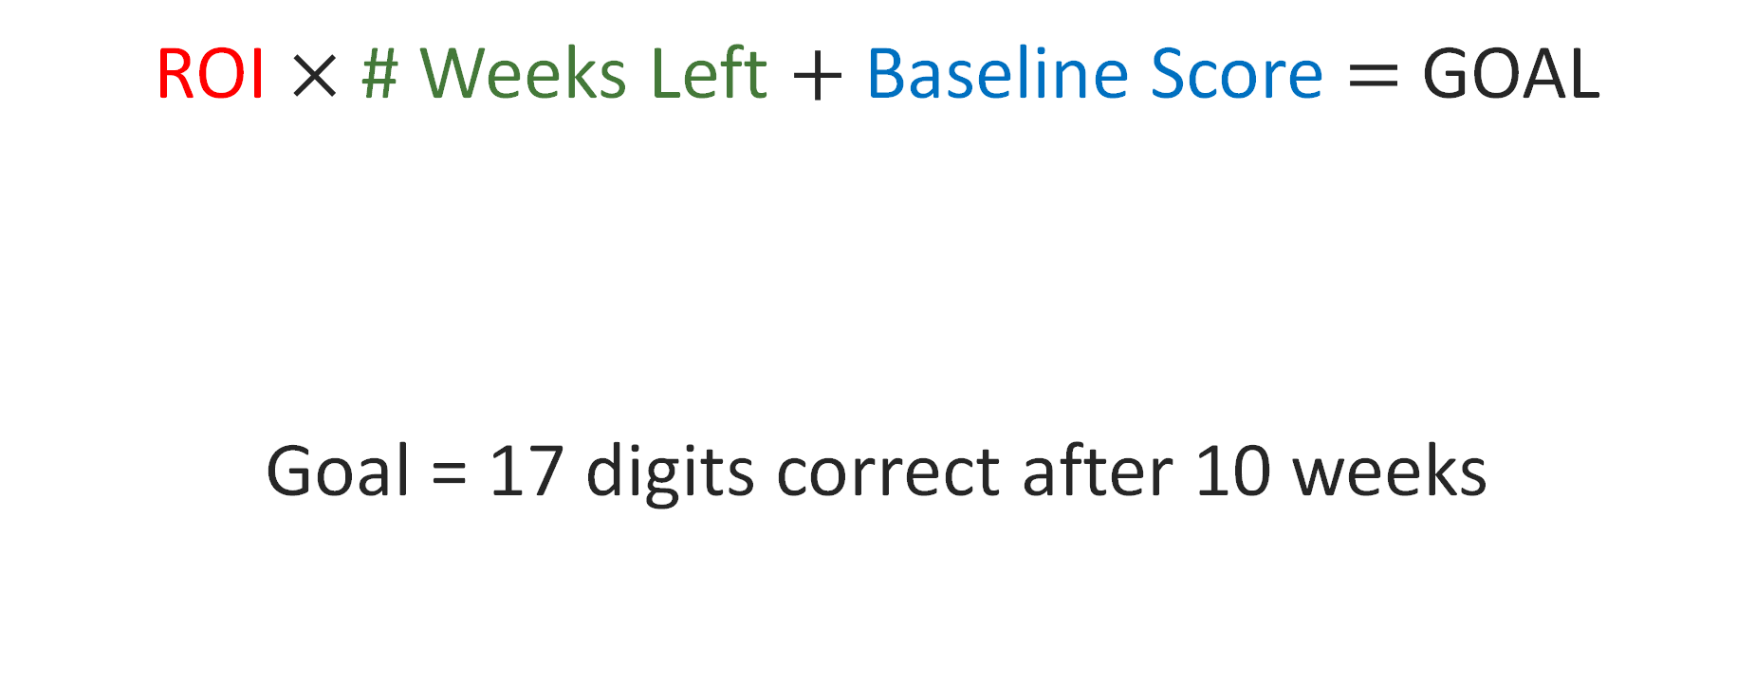
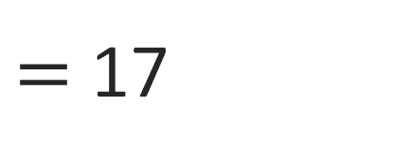


Goal-Setting Strategy Option 2:
National Norms for Rate of Improvement 3
ROI $×$ # Weeks Left $+$ Baseline Score $=$ GOAL
Goal = 17 digits correct after 10 weeks
0.7
$$×$$
10
$$+$$
10
$=$ 17
(given ROI)
(10 weeks left)
(median of 9, 10, and 11)
Notes:
Review slide.

Slide 30
Goal-Setting Strategy Option 2:
National Norms for Rate of Improvement 4
Advantages
Considerations
Recommendation
  Fairly ambitious yet realistic.
  May be reasonable for students who learn at a typical rate.
  If a student is performing significantly below grade level, matching the ROI norm will maintain the same level of achievement gap.
  Without ROI norms, use local norms or estimate ROI.
  Some progress monitoring tools provide recommendations for “ambitious” ROIs.
  Use ROI if a student is learning at a typical rate and end-of-year benchmarks are inappropriate given current functioning.
Notes:
Here we list the advantages, considerations, and recommendations for using the ROI goal-setting strategy.
Advantages:
Provides a mechanism for writing an ambitious but realistic goal based on the student’s initial performance.
Useful when the benchmark is unrealistic during the IEP or intervention time frame, but the student is expected to make growth comparable to peers
Considerations:
If a student is performing below grade-level peers, matching the normative ROI may maintain an achievement gap in some cases.
Some progress monitoring tools provide recommendations for “ambitious” ROIs.
When national norms are unavailable, local norms for ROI can be estimated through statistical modeling. This requires an adequate sample and staff with technical expertise available.
Recommendation:
Use ROI if a student can learn at a typical rate but the benchmark is too high.

Slide 31
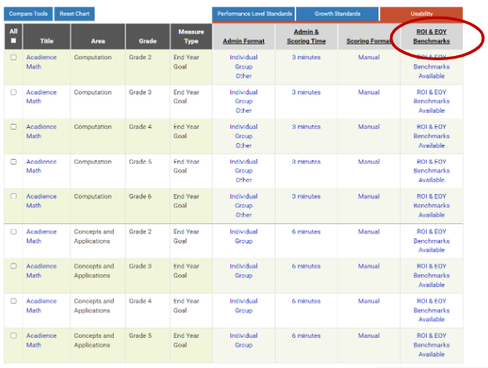
Goal-Setting Strategy Option 2:
National Norms for Rate of Improvement 5
Notes:
Similar to benchmarks, many tools already have established rates of improvement. Information about whether an ROI is available can be found on the NCII tools chart. As noted previously, if national norms are not available or appropriate, you can calculate local norms.
31

Slide 32

Andrew: Goal Setting Using ROI Norms
Andrew’s most recent scores are 17, 18, and 20, and there are 12 weeks left of instruction..
Using the correct national ROI, set a goal for Andrew.
Grade | Reading—ROI
K | 1.0 (LSF)
1 | 1.5 (WIF)
2 | 1.8 (PRF)
Notes:
Let’s set a goal for Andrew using ROI norms. Please note that these norms are samples and should not be used in practice. Use the norms provided by the vendor for each tool.
Discuss the following answer as a group.
To review, this is the formula for calculating a goal based on ROI norms. First, we calculate Andrew’s baseline score by taking the median of his most recent three WIF scores. Looking at a table of reading ROI norms by grade, we select the first-grade WIF measure because that is what we are using to monitor Andrew’s progress. We multiply this ROI by the 12 remaining weeks of instruction. This product is 18. We then add it to the baseline score of 18 to get our goal of 36 cwpm.

Slide 33

Goal Setting Strategy Option 3:
Intra-Individual Framework
Often used for students performing far below grade level or with very low skills, such that goals based on typical growth rates are not appropriate.
Use the three most recent data points to calculate the baseline score.
Calculate the student’s rate of improvement (slope) based on at least eight data points.
Notes:
The third goal-setting option, the intra-individual framework, often is used for setting IEP goals or for those students performing far below grade level. To use this option, identify the weekly ROI for the target student under baseline conditions, using at least eight data points. Because the student’s performance is being compared with their previous performance (not a national or local norm), sufficient data are necessary to demonstrate the existing performance level or rate.

Slide 34
Terminology Check
Slope: The student’s current rate of improvement during the data collection period
First median: The middle value of the first three data points
Last median: The middle value of the most recent three data points
Baseline weeks: If data are collected weekly, baseline weeks =
# of data points – 1
Number of weeks left: The number of weeks left in the instruction period
Notes:
Let’s review some of the terminology that we’ll use when setting a goal using the intra-individual framework.

Slide 35
Goal Setting Strategy Option 3:
Intra-Individual Framework 2
Slope
Target growth rate
Baseline
  Represents the student’s current rate of improvement, not a national or local norm.
  Need six to nine data points to calculate.
  Reflects growth needed to close the achievement gap.
  For example, if the student needs to make 50% more progress, the target growth rate would be 1.5.
  Median of most recent three data points.
Notes:
The standard formula for the intra-individual framework is similar to the formula for ROI using national or local norms. There are three primary differences that differentiate the formula for the intra-individual framework.
The slope represents the student’s current rate of improvement, not a national or local norm.
The slope is multiplied by a target growth rate. In this example, to close the achievement gap, the student needs to make 50% more progress than what they are currently making. Therefore, we multiply the student’s current ROI by 1.5. The team may decide on a different multiplier to set an achievable and ambitious goal for the student.
The baseline represents the median of the three most recent data points. As a reminder, to calculate the student’s current rate of improvement, you will need to collect six to nine data points. To establish the baseline, rather than using the median of the first three data points that were collected, you will use the median of the last three data points collected.

Slide 36
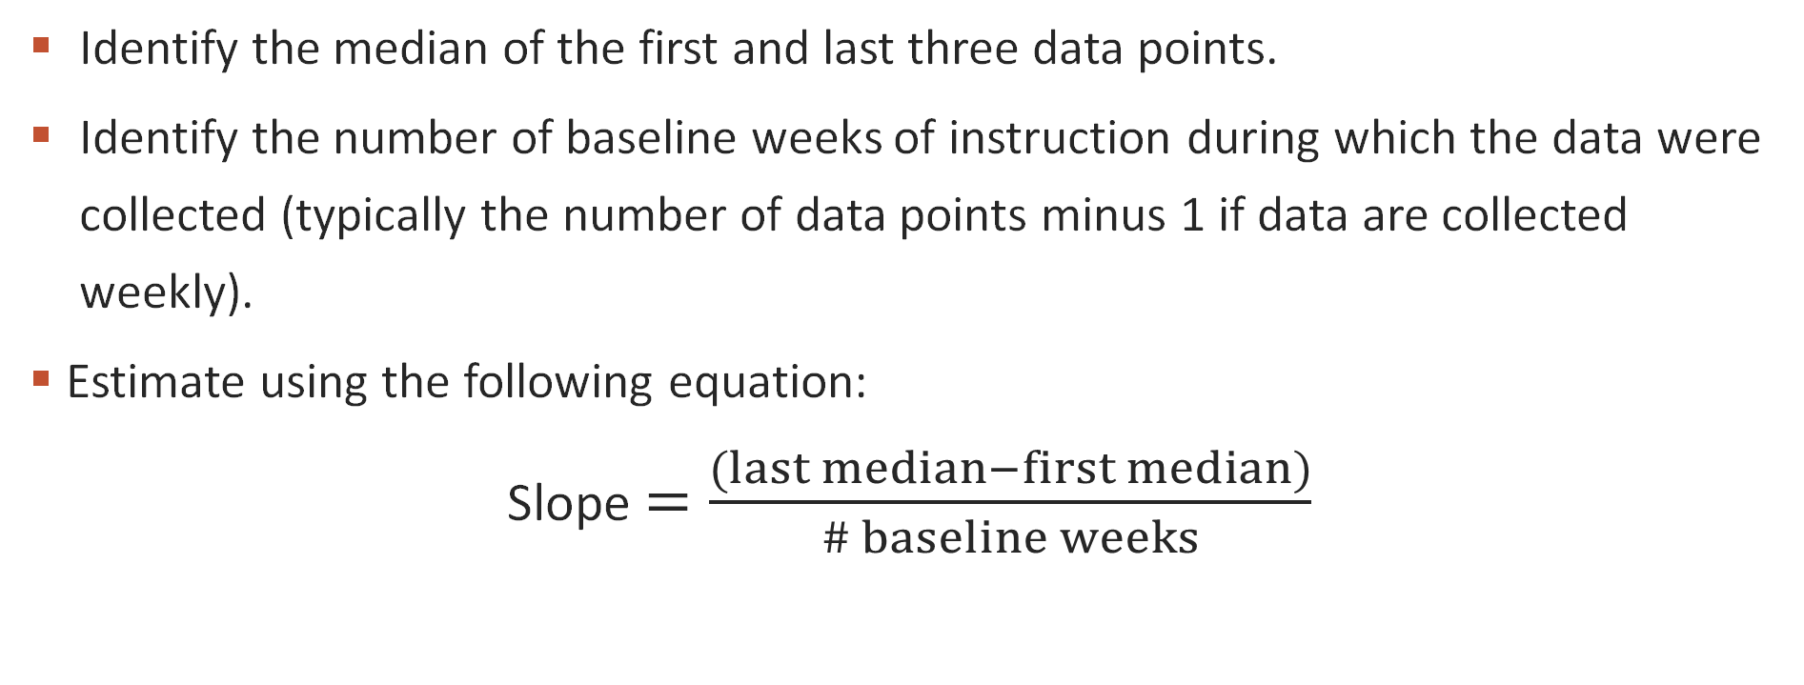
Goal Setting Strategy Option 3:
Intra-Individual Framework 3
Identify the median of the first and last three data points.
Identify the number of baseline weeks of instruction during which the data were collected (typically the number of data points minus 1 if data are collected weekly).
Estimate using the following equation:
Slope $=\frac{(last median−first median)}{\# baseline weeks}$
Notes:
As noted, to calculate slope, we need a sufficient number of data points to demonstrate the existing performance level or rate. Slope can be calculated by hand; however, if available, software can provide a more accurate estimate of the student’s rate of improvement.
To calculate slope by hand, you will need to identify the median of the last three data points, the median of the first three data points (which we call the original baseline), and the number of weeks of prior instruction (the number of weeks during which these data were collected). The number of weeks of instruction is typically the total number of data points minus one, if data are collected weekly. You can then use the following formula:
Slope or student’s rate of improvement = (median of the last three data points − median of the first three data points) ÷ number of weeks of instruction

Slide 37
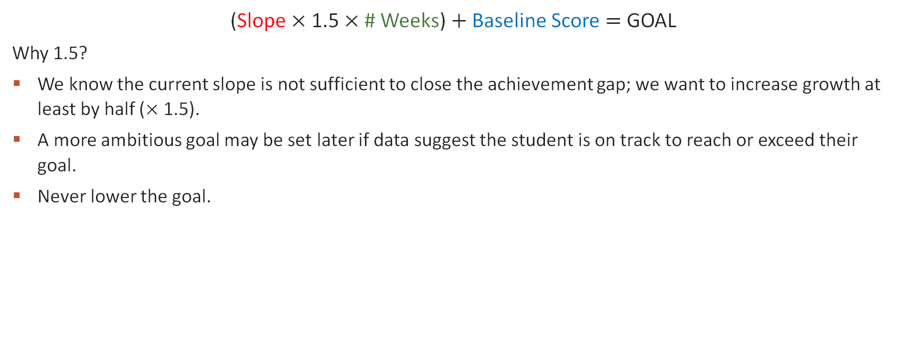
Goal Setting Strategy Option 3:
Intra-Individual Framework 4
(Slope $×$1.5 $×$# Weeks) $+$ Baseline Score $=$ GOAL
Why 1.5?
We know the current slope is not sufficient to close the achievement gap; we want to increase growth at least by half ($×$ 1.5).
A more ambitious goal may be set later if data suggest the student is on track to reach or exceed their goal.
Never lower the goal.
Notes:
Explanation of formula: The slope is multiplied by 1.5 and the number of weeks left in the instructional period. This product, representing target growth, is then added to the student’s baseline score, based on the three most recent data points, to find the goal. A more ambitious goal may be set if appropriate (e.g., if after several weeks of progress monitoring, the current slope exceeds the goal).
Never lower the goal. Instead, the instructional program should be tailored to bring a student’s scores up so that the scores match or surpass the goal line.

Slide 38

Goal Setting Strategy Option 3:
Intra-Individual Framework 5
Example:
Third-grade reading connected text
Baseline: Eight most recent scores (during
7 instructional weeks): 8, 7, 9, 8, 11, 10, 11, and 12
Time frame: 10 weeks left in the instructional period
Notes:
Here is an example we can review as a group before you try one individually. Review slide and answers on the next slide.

Slide 39
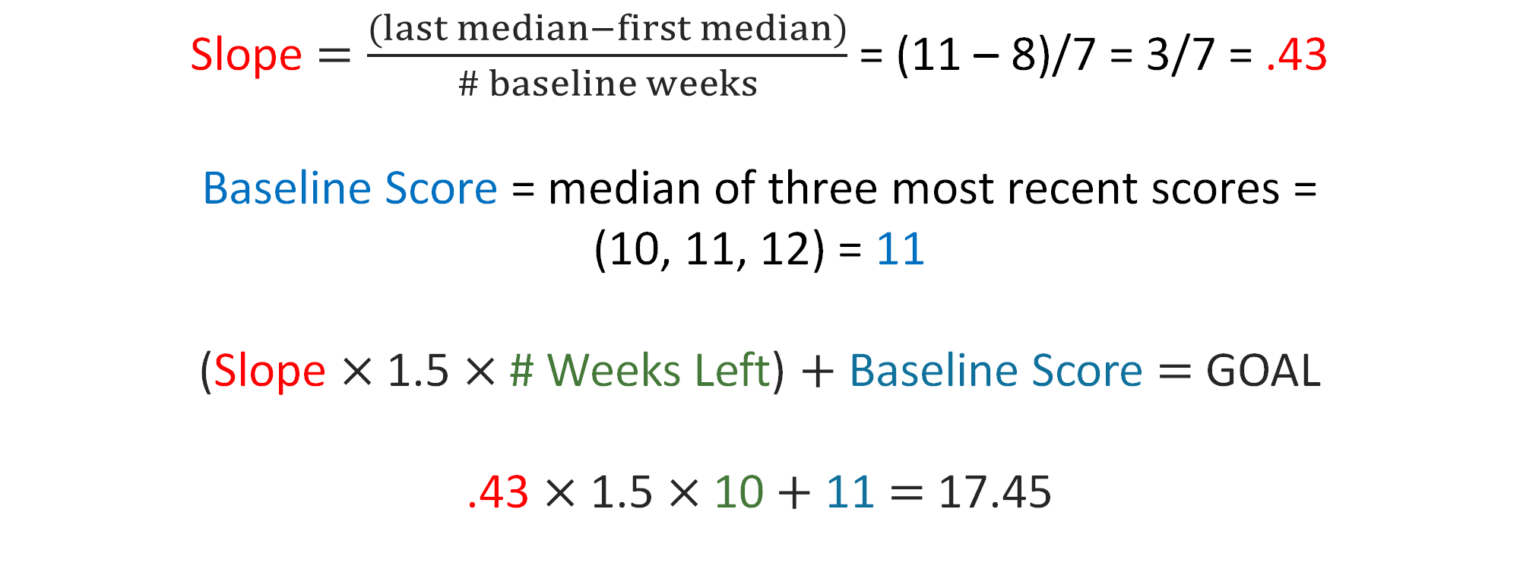
Goal Setting Strategy Option 3:
Intra-Individual Framework 6
Slope $=\frac{(last median−first median)}{\# baseline weeks}$ = (11 – 8)/7 = 3/7 = .43
Baseline Score = median of three most recent scores =
(10, 11, 12) = 11
(Slope $×$1.5 $×$# Weeks Left) $+$ Baseline Score $=$ GOAL
.43 $×$ 1.5 $×$10 $+$ 11 $=$ 17.45
Notes:
Animated slide. Review answers.

Slide 40
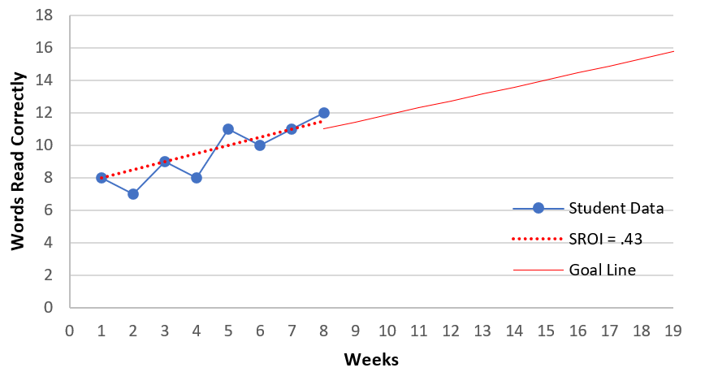
Goal Setting Strategy Option 3:
Intra-Individual Framework 7
Goal = 17 cwpm
Target ROI = 1.5 cwpm
Baseline = 11 cwpm
Notes:
Let’s look at what a graph for the intra-individual framework might look like. Here you can see that we don’t mark the baseline on our graph at Week 1. Instead, the baseline is set after the 7 weeks of instruction that provided the data we used to calculate the slope. As a result, our baseline will be marked at Week 8, and our goal will be set 10 weeks after that point.

Slide 41
Goal Setting Strategy Option 3:
Intra-Individual Framework 8
Advantages
Considerations
Recommendation
  Helpful when the benchmark is unrealistic, or the student’s rate of improvement (slope) has been persistently very low.
  May be difficult to understand and calculate.
  Requires the collection of six to nine data points before setting the goal.
  May not be necessary for students performing at or near grade level.
  Use when data or prior experience suggest that other approaches are unlikely to be appropriate or realistic.
  Revisit data frequently, increasing goal if possible.
Notes:
Here we list the advantages, considerations, and recommendations for using the intra-individual framework goal-setting strategy.
Using an intra-individual framework allows for goals that are ambitious yet achievable for students who are performing below expectations. It is useful when a student is performing far below grade level and standard growth rates are not appropriate. As you may have seen with the calculations we just reviewed, it may take additional training and support to understand and calculate the intra-individual framework. In addition, we must have sufficient data to establish the slope. Although data from past progress monitoring data collection can be used (if available and using the same tool to collect data), if the teacher does not have any prior progress monitoring data, the intra-individual framework approach may take longer given the need to collect 8 weeks of data before setting the goal.
In the previous example, slope was calculated using eight data points from 7 weeks of instruction. This does not necessarily mean we have to wait 7 weeks to make an instructional decision. We can use progress monitoring data that we have already collected for this student. You can draw data from a goal that had been set using a different option, such as benchmarks, or you can use data from the year preceding setting of the new IEP goal.
Advantages:
Provides a valid strategy for setting a goal in situations in which students are performing far grade level and typical growth rates are not appropriate.
Considerations:
May be difficult to understand and calculate and, therefore, requires more training and support.
Requires collection of six to nine data points before setting the goal.
May not be necessary for students performing at or near grade level.
Recommendations:
Use when data or prior experience suggest other approaches unlikely to be appropriate or realistic.
Revisit data frequently, increasing goal if possible.

Slide 42

Andrew: Goal Setting
Using the Intra-Individual Framework
Set a goal for Andrew using the intra-individual framework.
WIF scores were collected weekly (during 7 weeks), so eight scores are available to calculate Andrew’s slope: 14, 16, 13, 10, 17, 17, 18, and 20 cwpm.
There are 12 weeks left of instruction for the
remainder of the year.
Notes:
Let’s set a goal for Andrew using the intra-individual framework.
Review answer as a group. First, we need to calculate Andrew’s slope. We take the median of his last three scores (baseline), which is 18, and subtract the median of the first three scores (original baseline), which is 14. We then divide by 7, the number of weeks of instruction during which these data were collected, to find his slope of .57.
The # weeks is the 12 weeks of instruction left in the school year. His baseline score is the median of his most recent three scores (18). Now that we have all the needed pieces, we multiply his slope by 1.5 and 12 weeks and then add his baseline score of 18. His goal is 28 cwpm.

Slide 43
Andrew: Choosing a Goal
The three methods resulted in different goals:
  Benchmarks: 60 cwpm
  ROI norms: 36 cwpm
  Intra-individual framework: 28 cwpm
The team would decide, based on their knowledge
of Andrew, which strategy is most appropriate.
Notes:
Now that we have tried each goal-setting strategy, let’s review what we got for each. Read slide.
We won’t choose a goal because the information we could include in one training is not enough to determine which goal is best. Educators should consider the advantages, considerations, and recommendations presented in this training, along with the information about their student, to determine which goal strategy is the best for them.

Slide 44

Practicing Goal Setting
For more practice using all three approaches, download NCII’s Strategies for Setting High-Quality Academic Individualized Education Program Goals and try out the goal setting examples in Appendix A.
You can check your answers in Appendix B.
Notes:
The guide Strategies for Setting High-Quality Academic Individualized Education Program Goals reviews the three validated goal-setting strategies discussed in this training and provides practice opportunities to learn more.

Slide 45
Writing a Measurable Goal
Notes:
Now that we have chosen a goal-setting strategy for Andrew, let’s discuss how we can write that goal.

Slide 46


Writing a Measurable Goal 1
Graphing a student’s goals is an important part of the DBI process, but you also may want to develop a written goal statement for the student.
This statement should include the
  condition or context in which the skill will be performed,
  target of the goal, and
  level of proficiency or timeline.
Notes:
Graphing student goals is an important part of the DBI process, which we will learn more about in the next training. You also may want to develop a written goal statement for the student. This is especially important when setting IEP goals. This statement should include the condition or context in which the skill will be performed, the target of the goal, and the level of proficiency or timeline.

Slide 47
Writing a Measurable Goal 2
Component | May include | Examples
Condition | Material/tool Grade level Setting Timing | When given 30 first-grade sight words, . . . When given a third-grade reading passage, . . .
Target | Target goal | Student will read 30 of 30 high frequency words . . . Student will read 60 words correctly . . .
Level of proficiency/timeline | Timeline Number of trials | Three consecutive probes By spring benchmarking
Notes:
This table shows examples of how to use these elements to create a goal statement. All goal statements should describe measurable skills that have relevance to overall competence in a domain (e.g., reading, mathematics), use a valid and reliable assessment tool, and focus on the desired outcomes. For more information about writing measurable annual goals, particularly for students with disabilities, view the PROGRESS Center course: The What and Why of Measurable Annual Goals.
Prompt the audience to think about what a written goal for Andrew might look like. Discuss and flip to the example on the next slide.

Slide 48

Andrew: Writing a Measurable Goal
End-of-Year Goal: Andrew will improve his reading skills to 28 cwpm on WIF by the June reporting period. Achievement of this goal will be determined by the median of his final three WIF scores.
Notes:
Here is an example of what a written goal might look like for Andrew.

Slide 49
Conclusion

Slide 50
Summary
Establishing a baseline, goal, and data collection schedule are essential components of a progress monitoring plan.
Using the three goal-setting strategies—benchmarks, national norms for ROI, and the intra-individual framework—educators can better support and monitor student progress.
In the next training, we’ll discuss considerations for collecting, graphing, and analyzing academic progress monitoring data to evaluate student responsiveness.
Notes:
Establishing a plan that includes setting a baseline, goal, and data collection schedule. We shared two strategies for setting baseline and three validated approaches to goal setting, including benchmark, ROI, and the intra-individual framework, and discussed considerations for using these strategies. We also discussed why it is recommended that we collect data weekly for students with intensive needs.

Slide 51
Summary Questions
What are the main components of a progress monitoring plan?
What are the three validated goal-setting strategies that use general outcome measures?
What are some considerations when selecting a goal-setting strategy?
What are the critical features of a goal?
What resources are available for developing a progress monitoring plan and setting goals? (See next slide)
Notes:
In your notes, respond to these quick summary questions.
Suggested answers:
A progress monitoring plan should document the following details: the person responsible for data collection, the progress monitoring tool selected, the overall timeline for data collection, the frequency of data collection, the student’s baseline data, and the student’s goal.
The three validated goal-setting strategies that use general outcome measures are benchmarks, national norms for the weekly ROI, and the intra-individual framework.
When selecting a strategy, consider if the goal is realistic yet ambitious, based on the student’s skills and grade level. Benchmarks are easy to use and efficient, but they may not be suitable for students whose skills are far below grade level. An ROI using national norms provides a mechanism for writing an ambitious, yet realistic goal based on the student’s initial performance, but it may maintain achievement gaps in some cases. The intra-individual framework requires more data and uses calculations that may be difficult to understand. It is the least ambitious goal-setting strategy and is unlikely to be necessary for students performing at or near grade level. To determine appropriateness, calculate the weekly growth rate required to meet the goal and compare it with typical ROIs from national norms.
A goal should include the condition or context in which the skill will be performed, the target of the goal, and the level of proficiency or timeline.
Intervention Planning Document Overview of Academic Goal-Setting Strategies Academic Progress Monitoring Tools Chart Strategies for Setting High-Quality Academic Individualized Education Program Goals Ensuring Fidelity of Assessment and Data Entry Procedures Student Progress Monitoring Graphing Tool The What and Why of Measurable Annual Goals

Slide 52
Resources
Intervention Planning Document (NCII)
Overview of Academic Goal-Setting Strategies (NCII)
Academic Progress Monitoring Tools Chart (NCII)
Strategies for Setting High-Quality Academic Individualized Education Program Goals (NCII)
Ensuring Fidelity of Assessment and Data Entry Procedures (NCII)
Student Progress Monitoring Graphing Tool (NCII)
The What and Why of Measurable Annual Goals (PROGRESS Center)
Notes:
Links to resources

Slide 53
NCII Disclaimer
This presentation was produced under the U.S. Department of Education, Office of Special Education Programs, Award No. H326Q260001. Celia Rosenquist serves as the project officer. The views expressed herein do not necessarily represent the positions or policies of the U.S. Department of Education. No official endorsement by the U.S. Department of Education of any product, commodity, service, or enterprise mentioned in this resource is intended or should be inferred.

Slide 54

Thank you!

