Slide 1

Scaling Up Data-Based Individualization at the State Level: Lessons Learned and Action Planning
June 25, 2024
Day 1

Slide 2



Meeting Guidelines
ENGAGE EVERYONE
MATERIALS AT:
https://tinyurl.com/3v4r649m
MEET YOUR NEEDS

Slide 3
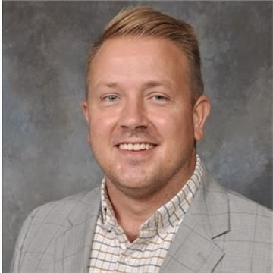
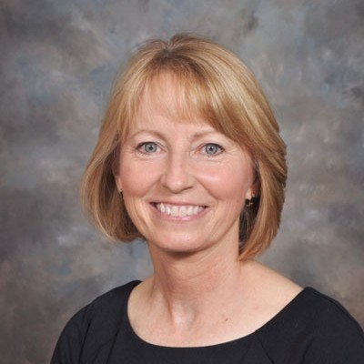

Introductions
Kyle Allen
TA Consultant
American Institutes for Research
Nancy Goosen
Program Manager, Policies & Procedures
Oklahoma Department of Education
Jason Harlacher, PhD
Senior Researcher
American Institutes for Research

Slide 4

Warm-Up
Name and role
What state are you from and what is something you love about your state?

Slide 5
Objectives
Learn six factors for sustainability.
Develop an action plan for those factors.
Network and hear from colleagues.

Slide 6
Agenda
June 25 | Topic
10:45 a.m. | Welcome, Introductions, Overview
11:00 a.m. | Internal Capacity (Knowledge, Resource Allocation)
11:45 a.m. | Break/Lunch
1:15 p.m. | Alignment (Fit, Key Personnel)
1:45 p.m. | Implementation (Training/Coaching, Data-Based Decision Making)
2:30 p.m. | Break
2:45 p.m. | Self-Rate
3:00 p.m. | Action Planning
June 26 | Topic
9:00 a.m. | Reflection From Day One
9:15 a.m. | Action Planning
9:45 a.m. | Critical Friends Activity
10:30 a.m. | Share-Out & Wrap-Up

Slide 7
OSDE Background

Slide 8

Brainstorm
What are some challenges of state-level initiatives? What barriers have you encountered?
What are some challenges of state-level initiatives?
What barriers have you encountered?

Slide 9

OSDE Data Analysis
Indicator 3B Data Results of 544 districts regarding students on IEPs.
  0% proficiency – 2 years in a row for both reading and math per grade level:
    4th grade = 88 districts
    8th grade = 260 districts
    11th grade = 113 districts
  0% proficiency – 2 years in a row for ALL grade levels in reading and math
    27 Oklahoma school districts

Slide 10

Sundown Severe Discrepancy in 8 Years
Begin Response to Scientific, Research-Based Intervention

Slide 11
OSDE Background (1)
8-Year Plan
Key Message
Years 1–2
Discovery
Years 2–4
Engage
Years 4–8
Activate
Refine
Align
Define

Slide 12
Infrastructure

Slide 13
State-Level Implementation:
Infrastructure
Alignment
Internal Capacity
Implementation
Define these terms in relation to state-level capacity (e.g., scaling up data-based individualization [DBI]).

Slide 14
State-Level Implementation:
Infrastructure (2)
Alignment
Internal Capacity
Implementation
The contextual fit and overlap of DBI within the state education agency’s (SEA’s) current initiatives and work.
The ability of the SEA to self-sufficiently scale up and support DBI.
The active process of supporting local education agencies (LEAs) with accurate and consistent implementation of DBI to support students.

Slide 15
Sustainability Factors
Alignment
Key Personnel | Personnel involved with making decisions regarding DBI and implementation.
Fit | The extent to which DBI fits within existing initiatives and structures.
Knowledge | The current knowledge or understanding of DBI across the department, including expertise and experience with DBI.
Resource Allocation | The tangible resources to support DBI, including fiscal, material, and people.
Training, Coaching | The technical assistance delivery system to provide training and coaching to LEAs on implementation of DBI.
Data-Based Decision Making | Implementation requires the gathering of implementation/fidelity and impact/outcome data to fully evaluate training and coaching efforts.
Internal Capacity
Implementation

Slide 16
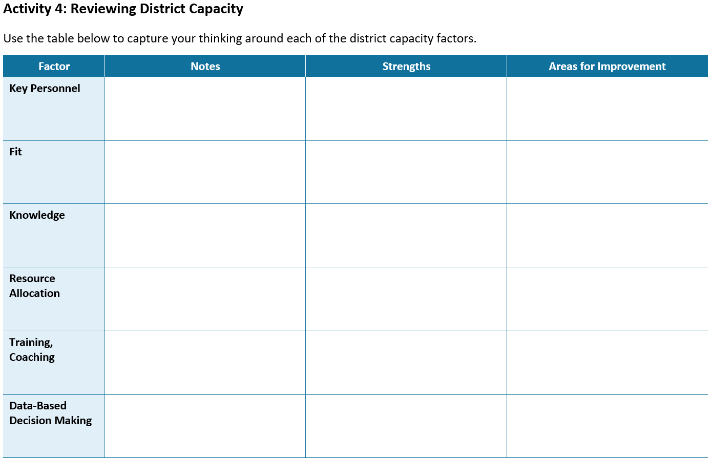
Action Plan: Reflect and Capture Notes
Use the action plan document to capture your notes and thinking.

Slide 17
Internal Capacity
Knowledge
Resource Allocation

Slide 18

Internal Capacity (1)
The ability of the SEA to self-sufficiently scale up and support DBI.
The ability of the SEA to self-sufficiently scale up and support DBI.

Slide 19


State-Level Implementation
Knowledge
Resource Allocation

Slide 20
Knowledge
The current knowledge and understanding of DBI across the department,
including expertise and experience with DBI

Slide 21

Knowledge 2
Start With the Multi-Tiered System of Supports (MTSS) Team
Start with building knowledge and understanding of DBI within the office where DBI will live

Slide 22



Build Knowledge
General trainings for all personnel at the SEA
Provide specific trainings to coaches and/or districts/schools

Slide 23

Resource Allocation
The tangible resources to support DBI, including fiscal, material, and people.

Slide 24

Why Is This Important?
Sustainability of implementation
Common language and messaging
Aligned practices

Slide 25
OSDE Timeline Year 1
Summer 2024
  AIR MTSS Implementation Needs Assessment June 10, 11, 17, 18
  DBI Training at CCOSA June 14
  MTSS Summer Conference June 25, 26
Winter 2023
  Developing MTSS-OSDE Leadership
  OKMTSS DATA Management System
  MTSS Winter Conference January 26
Fall 2023
  DBI Training w/OSDE October 26 & 27
Spring 2024
  OSDE Training OKMTSS on EDPlan
  IRIS Early Career Educator PD
  SPDG Instructional Coach

Slide 26
OSDE Timeline Year 2
Winter 2024
  DBI Training with OSPA
  SSIP Strategic Leadership Team
  OKMTSS on EDPlan
  SPDG Instructional Coach
  OKMTSS Winter Conference
  Tiered LEA DBI Scale-Up Plan
Summer 2025
  AIR MTSS Implementation Needs Assessment
  MTSS Summer Conference
  DBI Training with OSPA
Spring 2025
  SPDG Instructional Coach
  SSIP Strategic Leadership Team
  Tiered LEA DBI Scale-Up Plan
Fall 2024
  SABERS
  SSIP Data Retreat
  SSIP Strategic Leadership Team
  OKMTSS on EDPlan
  SPDG Instructional Coach
  Refresher DBI Training w/OSDE October
  Tiered LEA DBI Scale-Up Plan

Slide 27


OSDE Internal Capacity

Slide 28
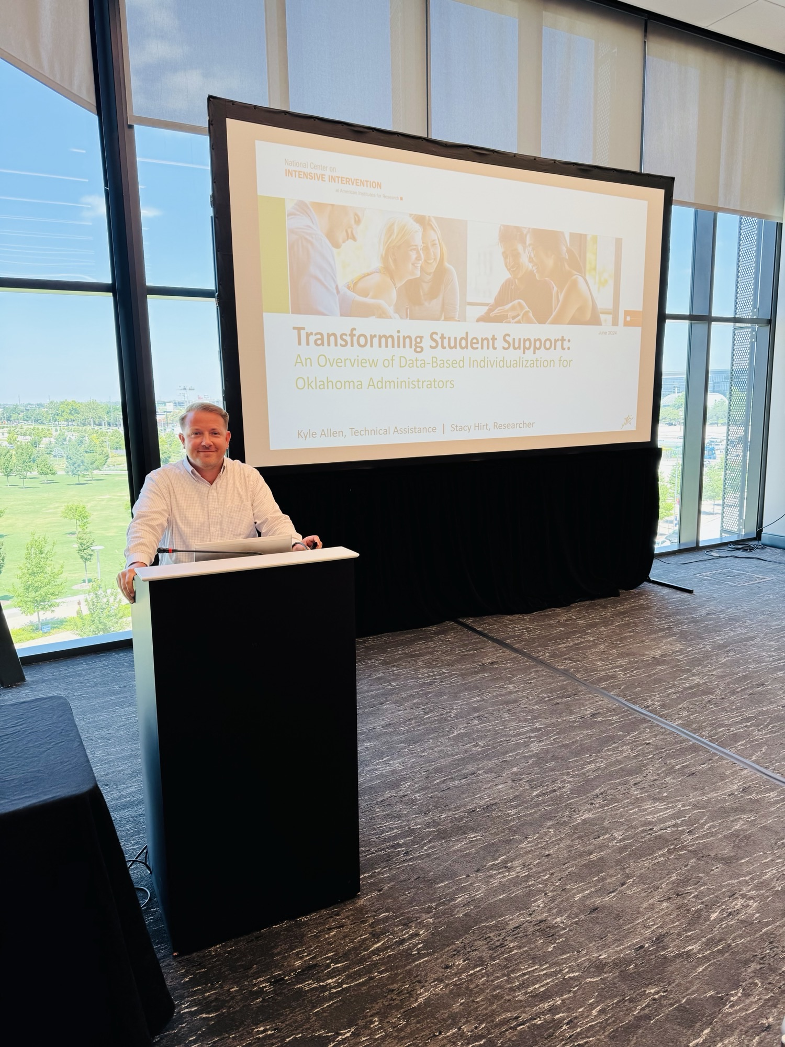
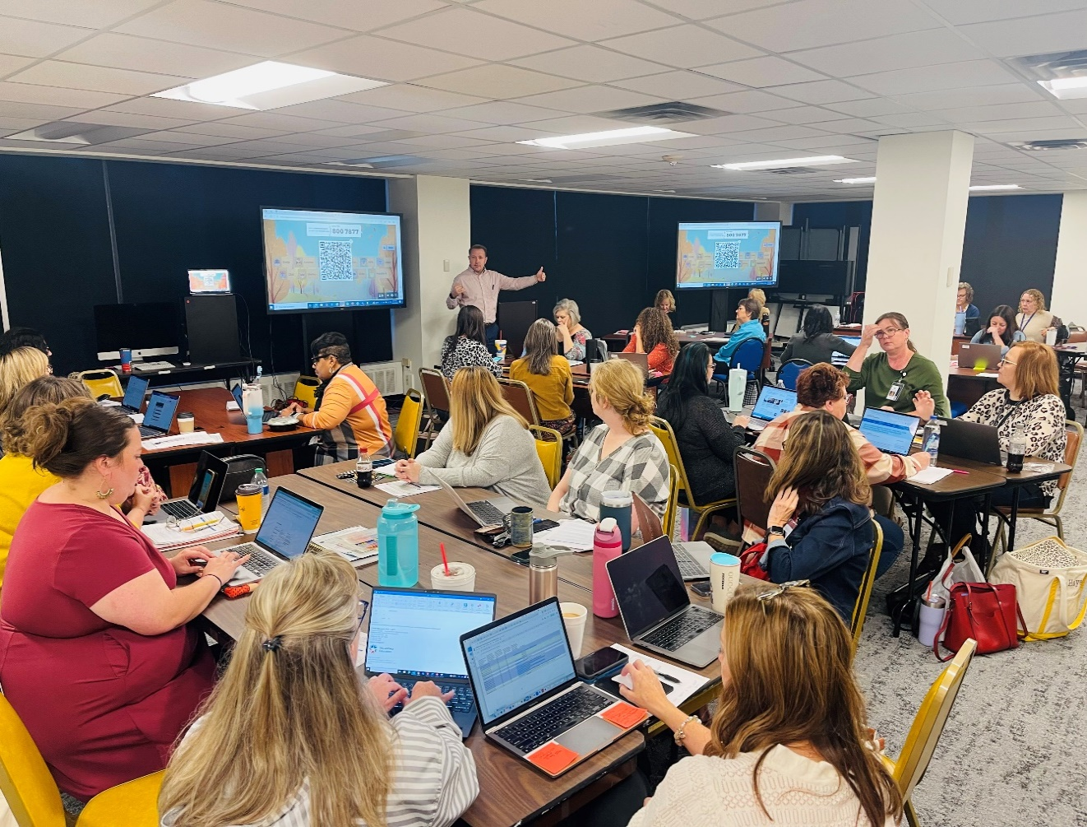
OSDE Internal Capacity (2)

Slide 29




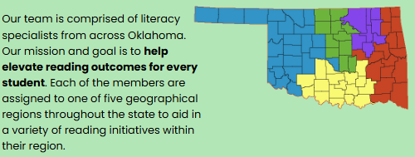
OSDE Internal Capacity

Slide 30
Action Plan: Reflect and Capture Notes (2)
Use the action plan document to capture your notes and thinking.

Slide 31
Alignment
Key Personnel
Fit

Slide 32

Alignment (1)
The contextual fit and overlap of DBI within the state education agency’s (SEA’s) current initiatives and work.

Slide 33


State-Level Implementation (2)
Key Personnel
Fit

Slide 34
Key Personnel
Personnel involved with making decisions regarding DBI and implementation.

Slide 35
Fit
The extent to which DBI fits within existing initiatives and structures.

Slide 36
Activity: Models Audit
Across your department, what are the models used for problem solving, data use, or intensive interventions for students?
What level do they target (e.g., region, district, school, student)?

Slide 37


Why Is This Important? (2)
Essential for creating a cohesive, efficient, and effective system
Ensures consistency in standards, resources, and practices
Promotes equity and encourages collaboration among stakeholders

Slide 38
OSDE Timeline Year 1 (2)
Summer 2024
  AIR MTSS Implementation Needs Assessment June 10, 11, 17, 18
  DBI Training at CCOSA June 14
  MTSS Summer Conference June 25, 26
Winter 2023
  Developing MTSS-OSDE Leadership
  OKMTSS DATA Management System
  MTSS Winter Conference January 26
Fall 2023
  DBI Training w/OSDE October 26 & 27
Spring 2024
  OSDE Training OKMTSS on EDPlan
  IRIS Early Career Educator PD
  SPDG Instructional Coach

Slide 39
OSDE Timeline Year 2 (2)
Winter 2024
  DBI Training with OSPA
  SSIP Strategic Leadership Team
  OKMTSS on EDPlan
  SPDG Instructional Coach
  OKMTSS Winter Conference
  Tiered LEA DBI Scale-Up Plan
Summer 2025
  AIR MTSS Implementation Needs Assessment
  MTSS Summer Conference
  DBI Training with OSPA
Spring 2025
  SPDG Instructional Coach
  SSIP Strategic Leadership Team
  Tiered LEA DBI Scale-Up Plan
Fall 2024
  SABERS
  SSIP Data Retreat
  SSIP Strategic Leadership Team
  OKMTSS on EDPlan
  SPDG Instructional Coach
  Refresher DBI Training w/OSDE October
  Tiered LEA DBI Scale-Up Plan

Slide 40

OSDE Alignment

Slide 41
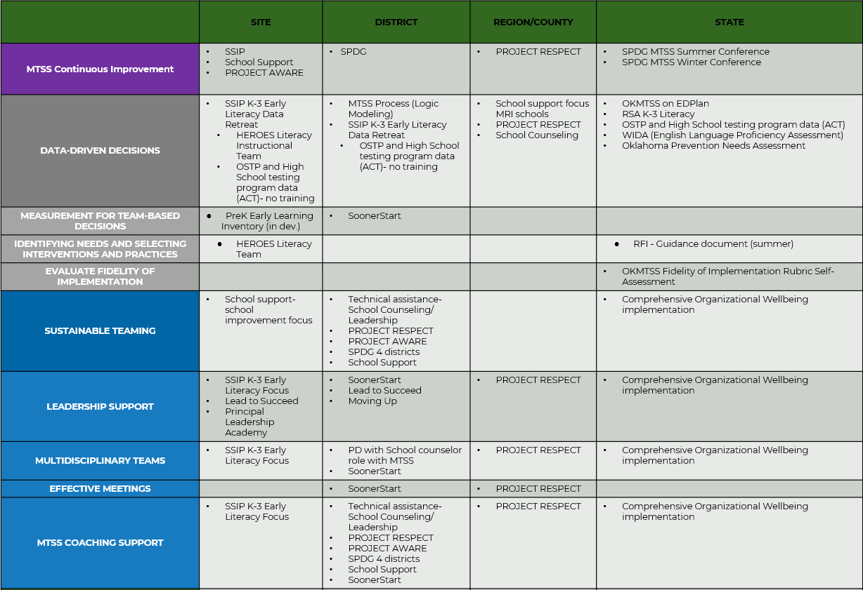
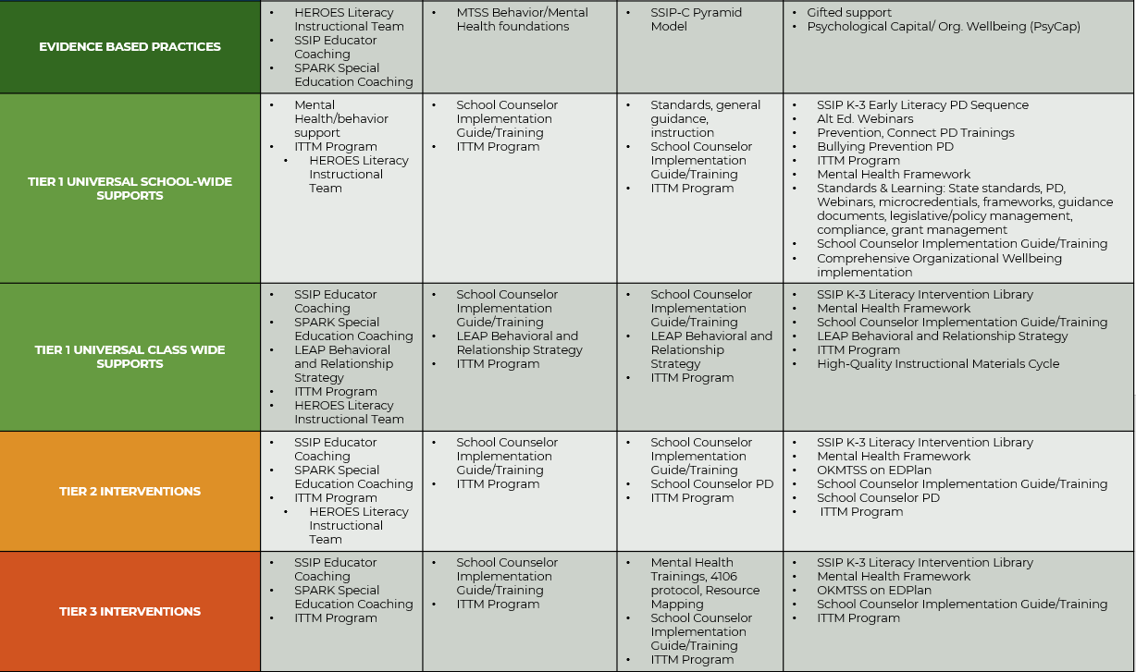
OSDE Alignment (2)
MTSS Team – Key Personnel

Slide 42
Action Plan: Reflect and Capture Notes (3)
Use the action plan document to capture your notes and thinking.

Slide 43
Implementation
Training/Coaching
Data-Based Decision Making

Slide 44

Implementation (1)
The active process of supporting local education agencies (LEAs) with accurate and consistent implementation of DBI to support students.

Slide 45


State-Level Implementation (3)
Training/Coaching
Data-Based Decision Making

Slide 46
Training/Coaching
The technical assistance delivery system to provide training and coaching to LEAs on implementation of DBI.

Slide 47
Data-Based Decision Making
Implementation requires the gathering of implementation/fidelity and impact/outcome data to fully evaluate training and coaching efforts.

Slide 48



Why Is This Important? (3)
Ensures high-quality implementation
Allows for continuous improvement
Maximizes student outcomes
Promotes accountability and transparency
Facilitates sustainability and scalability

Slide 49
OSDE Timeline Year 1 (3)
Summer 2024
  AIR MTSS Implementation Needs-Assessment June 10, 11, 17, 18
  DBI Training at CCOSA June 14
  MTSS Summer Conference June 25, 26
Winter 2023
  Developing MTSS-OSDE Leadership
  OKMTSS DATA Management System
  MTSS Winter Conference January 26
Fall 2023
  DBI Training w/OSDE October 26 & 27
Spring 2024
  OSDE Training OKMTSS on EDPlan
  IRIS Early Career Educator PD
  SPDG Instructional Coach

Slide 50
OSDE Timeline Year 2 (3)
Winter 2024
  DBI Training with OSPA
  SSIP Strategic Leadership Team
  OKMTSS on EDPlan
  SPDG Instructional Coach
  OKMTSS Winter Conference
  Tiered LEA DBI Scale-Up Plan
Summer 2025
  AIR MTSS Implementation Needs Assessment
  MTSS Summer Conference
  DBI Training with OSPA
Spring 2025
  SPDG Instructional Coach
  SSIP Strategic Leadership Team
  Tiered LEA DBI Scale-Up Plan
Fall 2024
  SABERS
  SSIP Data Retreat
  SSIP Strategic Leadership Team
  OKMTSS on EDPlan
  SPDG Instructional Coach
  Refresher DBI Training w/OSDE October
  Tiered LEA DBI Scale-Up Plan

Slide 51
OSDE Implementation
Intensive
LEA DBI TA:
Five LEAs on-site DBI
TA with coaching follow-up
Targeted LEA DBI Technical Assistance:
Quarterly CoP DBI Training – Admin Training – School Psych Training – Conferences
Universal LEA DBI Technical Assistance:
DBI Modules on OSDE Website – EdPlan Platform Integration

Slide 52
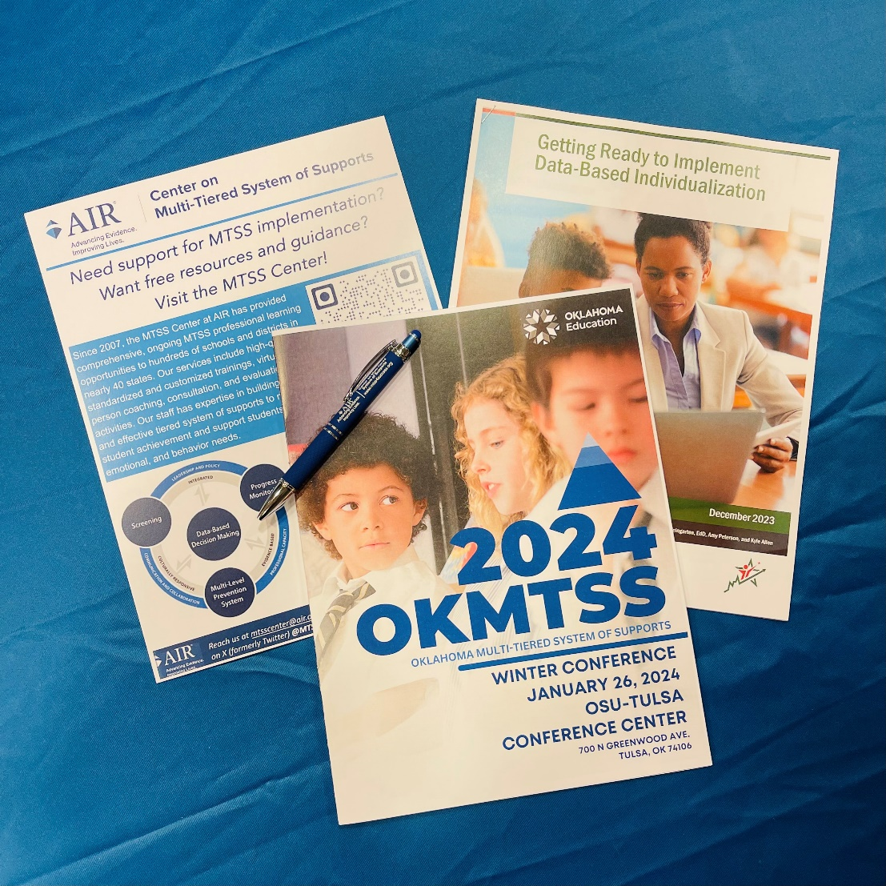
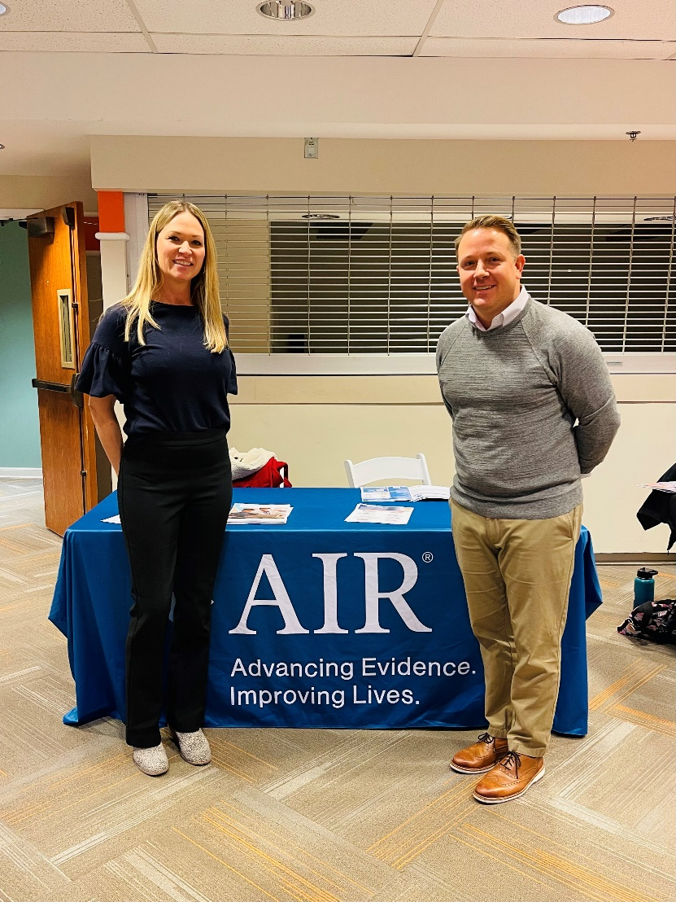
OSDE Implementation

Slide 53
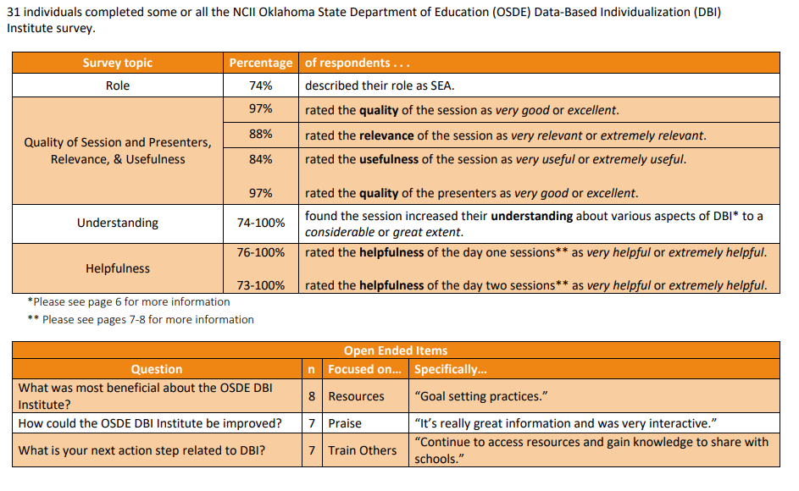
OSDE Implementation (2)

Slide 54
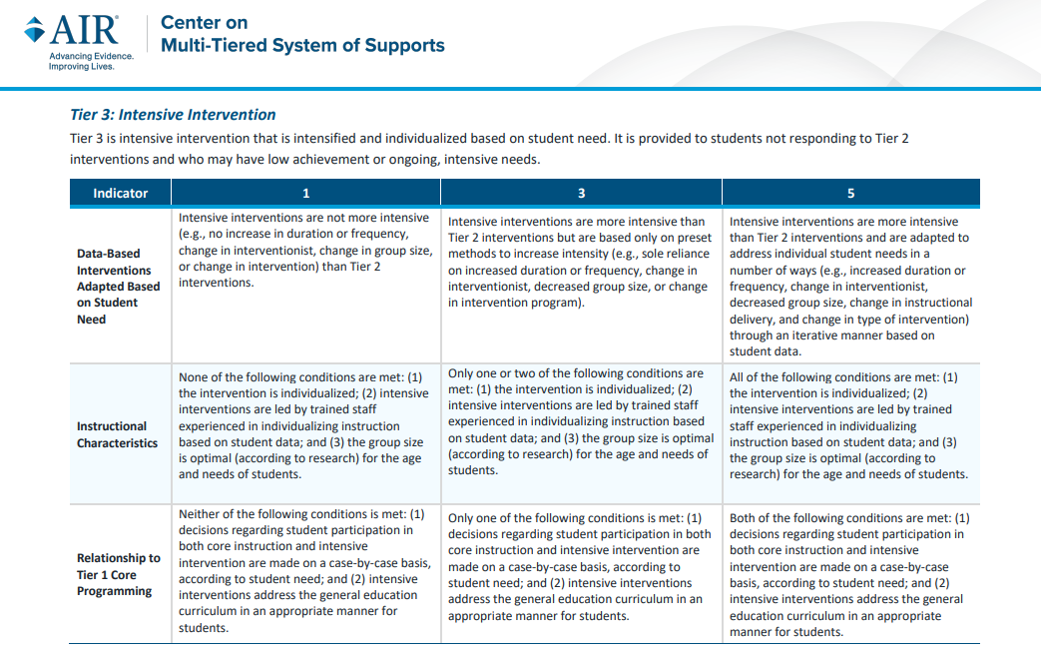
OSDE Implementation (3)

Slide 55
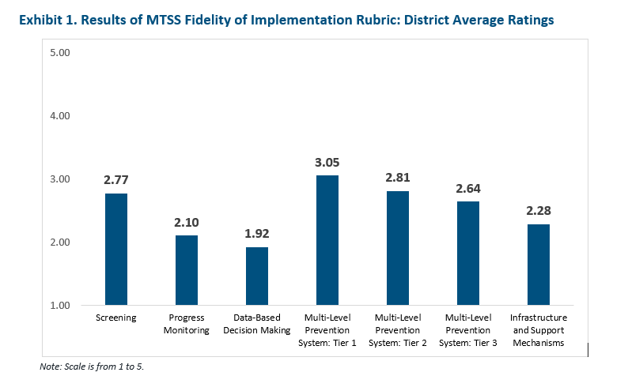
OSDE Implementation (4)

Slide 56
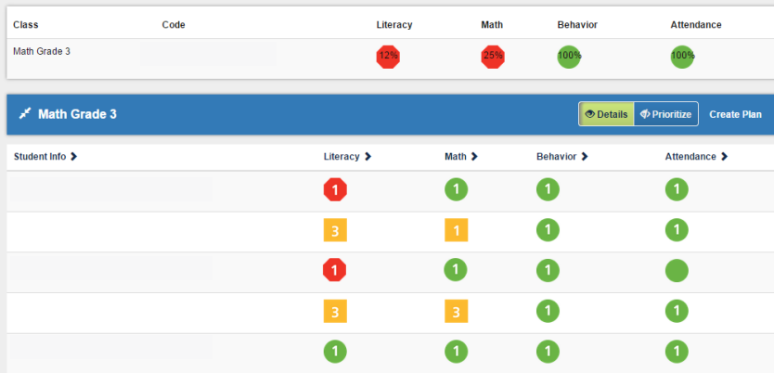
OSDE Implementation (5)

Slide 57
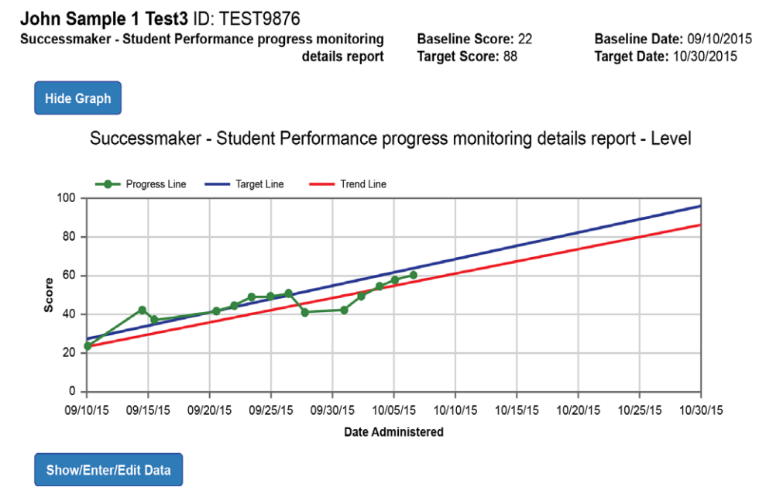
OSDE Implementation (6)

Slide 58

Activity
What could training and coaching look like in your state?
Review the materials provided as needed.

Slide 59
Action Planning: Reflect and Capture Notes
Use the action plan document to capture your notes and thinking.

Slide 60

Self-Rate
Briefly complete the survey to rate
your factors and their current implementation at your site.
https://forms.office.com/r/4KczK7kXpJ

Slide 61

Scaling Up Data-Based Individualization at the State Level: Lessons Learned and Action Planning Day 2
June 26, 2024
Day 2
61

Slide 62
Meeting Guidelines (2)
ENGAGE EVERYONE
MATERIALS AT:
https://tinyurl.com/3v4r649m
MEET YOUR NEEDS

Slide 63

Warm-Up Day 2
What did you do to unwind or relax last night?

Slide 64
Agenda (2)
June 27 | Topic
1:15 p.m. | Welcome, Introductions, Overview
1:30 p.m. | Alignment (Fit, Key Personnel)
2:15 p.m. | Break
2:30 p.m. | Internal Capacity (Knowledge, Resource Allocation)
3:00 p.m. | Implementation (Training/Coaching, Data-Based Decision Making)
3:45 p.m. | Self-Rating Action Planning
4:15 p.m. | Close
June 28 | Topic
9:00 a.m. | Reflection
9:15 a.m. | Action Planning
9:45 a.m. | Critical Friends Activity
10:30 a.m. | Share-Out and Wrap-Up

Slide 65
Reflection

Slide 66

Reflection on Day One
What are some key takeaways or questions when you reflect on yesterday?

Slide 67
Action Planning

Slide 68
Action Planning 2
Use this time to reflect on yesterday and develop action steps for building capacity or sustainability at your SEA.

Slide 69
Critical Friends
A Peer Evaluation Activity

Slide 70

Phase 1: Presentation
Presenting Group:
Describe their action plan, including plans for alignment, internal capacity, and implementation.
Critical Friends:
Friends remain silent. They are not allowed to ask clarifying or follow-up questions at this point.
5 min

Slide 71
Phase 2: Critique
Presenting Group:
Presenter(s) remain silent and are not allowed to respond to the comments of the “friends.”
5 min

Slide 72
Phase 2: Critique 2
Critical Friends:
Friends talk among themselves about the project as if the presenters were not in the room and use the phrases below to start each topic.
Start by focusing on the strengths, then on suggestions for improvement, and, last, ideas for “next steps.”
  I like the fact that ...
  I wonder if ...
  A next step might be ...
5 min

Slide 73
Phase 3: Response
Open discussion period for presenter(s) to respond to the comments of the “friends” and to follow up on ideas or suggestions.
5 min
Critical Friends:

Slide 74
Share-Out
Take a few minutes and share key learnings and action steps for your state.

Slide 75
NCII Disclaimer
This presentation was produced under the U.S. Department of Education, Office of Special Education Programs, Award No. H326Q260001. Celia Rosenquist serves as the project officer. The views expressed herein do not necessarily represent the positions or policies of the U.S. Department of Education. No official endorsement by the U.S. Department of Education of any product, commodity, service, or enterprise mentioned in this resource is intended or should be inferred.

Slide 76
Thank you!

