Slide 1

Building Capacity at the Local Level: Day 1
June 24-25, 2024
2024 Intensive Intervention Institute
Jon Potter, Senior Technical Assistance Consultant

Slide 2

Welcome and Introductions
Located in Portland, Oregon
Background in school psychology and special education
Previously worked for 13 years as a Statewide Coach for Oregon Response to Instruction and Intervention
Experience in RTI/MTSS, systems change, literacy instruction, data-based decision making, school culture
Recently co-authored the book Untangling Data-Based Decision Making: A Problem-Solving Model to Enhance MTSS
Jon Potter, PhD
Senior Technical Assistance Consultant

Slide 3




Welcome and Introductions (part 2)
Please share:
Your name, and current organization and role
Which picture best describes DBI implementation in your district?
1
2
3
4

Slide 4





Meeting Guidelines
Access materials at https://intensiveintervention.org/news-and-events/2024-intensive-intervention-institute-materials
Stay engaged.
Take care of needs.
Take notes when needed.

Slide 5




What to Expect
Some information will be new
Some information will be review
Some information may challenge you
Some next steps that you (and your team) will want to do

Slide 6
Objectives/Agenda
Session | Objective
Day 1 – Morning | Discuss technical problems and adaptive challenges.
Day 1 – Afternoon | Identify strengths and areas for improvement for DBI infrastructure and processes.
Day 2 | Examine district-level capacity factors that promote sustainable DBI implementation. Develop or revise a plan for next steps.

Slide 7









Different Layers of Support
Students
DBI happens here
Teachers
School Leadership
Effectiveness of DBI depends on what happens here
District Leadership

Slide 8
Technical Problems and Adaptive Challenges

Slide 9

Consider the Following
Your current system is working the way that it is designed to work.

Slide 10

Consider the Following (2)
Your current system is working the way that it is designed to work.
Getting different results requires changes in your system.

Slide 11

Consider the Following (3)
Your current system is working the way that it is designed to work.
Getting different results requires changes in your system.
Systems change is incremental, and the product of repeated and distributed changes in peoples’ beliefs, attitudes, priorities, and habits.

Slide 12

Consider the Following (4)
Your current system is working the way that it is designed to work.
Getting different results requires changes in your system.
Systems change is incremental, and the product of repeated and distributed changes in peoples’ beliefs, attitudes, priorities, and habits.
People don’t resist change. They resist loss.
Notes:
Photo by Jon Tyson on Unsplash

Slide 13

Consider the Following (5)
Your current system is working the way that it is designed to work.
Getting different results requires changes in your system.
Systems change is incremental, and the product of repeated and distributed changes in peoples’ beliefs, attitudes, priorities, and habits.
People don’t resist change. They resist loss.
How can you make change easier and reduce feelings of loss?

Slide 14

Technical Problems and Adaptive Challenges (1)
Technical Problems
Examples:
Lack of evidence-based interventions.
Lack of screening and progress monitoring tools.
No data system for managing data and tracking interventions.
Solutions are known and can be implemented efficiently.
  “A solution is out there.”
Can be resolved by authoritative expertise.
Don’t require large changes to existing structures or procedures.
Heifetz, Grashow, & Linsky, 2009

Slide 15

Technical Problems and Adaptive Challenges (2)
Adaptive Challenges
Examples:
Continual search for a "shiny new" program.
Disproportionate outcomes between student groups.
Overinvesting in too many initiatives at the expense of doing any of them well.
Lack of family and community partnerships.
Solutions are unknown, and require reflection, learning, and time.
  “The solution is in here.”
Must be resolved by those experiencing the challenge.
Require existing structures to be re-examined and changes to beliefs, roles, and ways of working.
Heifetz, Grashow, & Linsky, 2009

Slide 16

Technical Problems and Adaptive Challenges: Considerations
Most technical problems include adaptive challenges.
“The most common leadership failure stems from trying to apply technical solutions to adaptive challenges.”
– Ron Heifetz

Slide 17
Implementation Problem Example
DBI Implementation Problem:
Inconsistent identification of students who need DBI
Technical Problems Solutions are known and can be resolved through authoritative expertise. | Adaptive Challenges Solutions are unknown, and require reflection, learning, and time.
Clear decision rules (a flowchart!)
Letting go of teacher referral process
Get some new assessments
Teachers don’t trust the data
Train staff
Unconscious biases leading to over-referral of some student groups

Slide 18
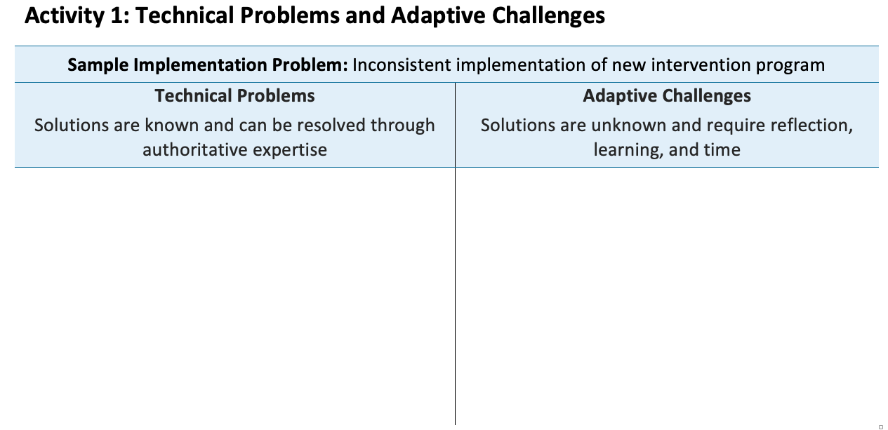
Activity 1: Implementation Problem Example
Training and coaching
Time for staff to learn
Fidelity checks
Staff liked the old intervention
Additional materials
Philosophical disagreements
Too many programs!!
Other?
Other?

Slide 19
DBI Infrastructure and Processes
Key Components of School Implementation

Slide 20



Essential Components of DBI
  Data and Decision Making
  Data for the purpose of making decisions within a DBI framework
  Intervention
  Individualized intervention with a focus on addressing severe and persistent academic and/or behavioral needs of students
  DBI Process
  The process for designing and delivering intensive intervention in academics and/or behavior to students in need

Slide 21

Data and Decision Making
Process to identify students in need of intensive intervention

Slide 22

Data and Decision Making (2)
Process to identify students in need of intensive intervention
Academic and behavior progress monitoring tools
Progress monitoring procedures
22

Slide 23
Graphing Data Is Essential
Date | Sep 13 | Sep 20 | Sep 27 | Oct 7 | Oct 13 | Oct 20 | May 28 (GOAL)
Oral Reading Fluency Words Correct per Minute | 32 | 37 | 41 | 46 | 43 | 45 | 87
Aimline
Words Correct per Minute
Goal
Data
Date
23

Slide 24

Data and Decision Making (3)
Process to identify students in need of intensive intervention
Academic and behavior progress monitoring tools
Progress monitoring procedures
Diagnostic assessment

Slide 25

DBI Process
DBI Process
Validated intervention program, delivered
with fidelity
Progress monitoring
Diagnostic data used to develop a hypothesis
Adaptation to validated intervention
Continued progress monitoring, with adaptations occurring whenever needed to ensure adequate progress

Slide 26

How Do We Bridge the Gap?
Student is nonresponsive
to our interventions.
Diagnostic Assessment
We need an effective plan.

Slide 27

Why Do Students Experience Challenges?

Slide 28



Educationally Relevant and Alterable Variables
Curriculum
Scope and sequence
Level of difficulty
Match to learner need
High-quality materials
Culturally relevant materials
Clear expectations
Positive reinforcement
Positive interactions
Inclusive classrooms
Positive feedback
Explicit instruction
Pacing (opportunities to respond)
Corrective feedback
Culturally relevant pedagogy
Engagement strategies
Learner
Instruction
Environment

Slide 29
Resource:
RIOT and ICEL Matrix
Provides guidance on:
What type of information can be collected:
  Instruction
  Curriculum
  Environment
  Learner
How it can be collected:
  Review
  Interview
  Observe
  Test
RIOT and ICEL Matrix

Slide 30

Data and Decision Making (4)
Process to identify students in need of intensive intervention
Academic and behavior progress monitoring tools
Progress monitoring procedures
Diagnostic assessment
Fidelity of assessment implementation

Slide 31
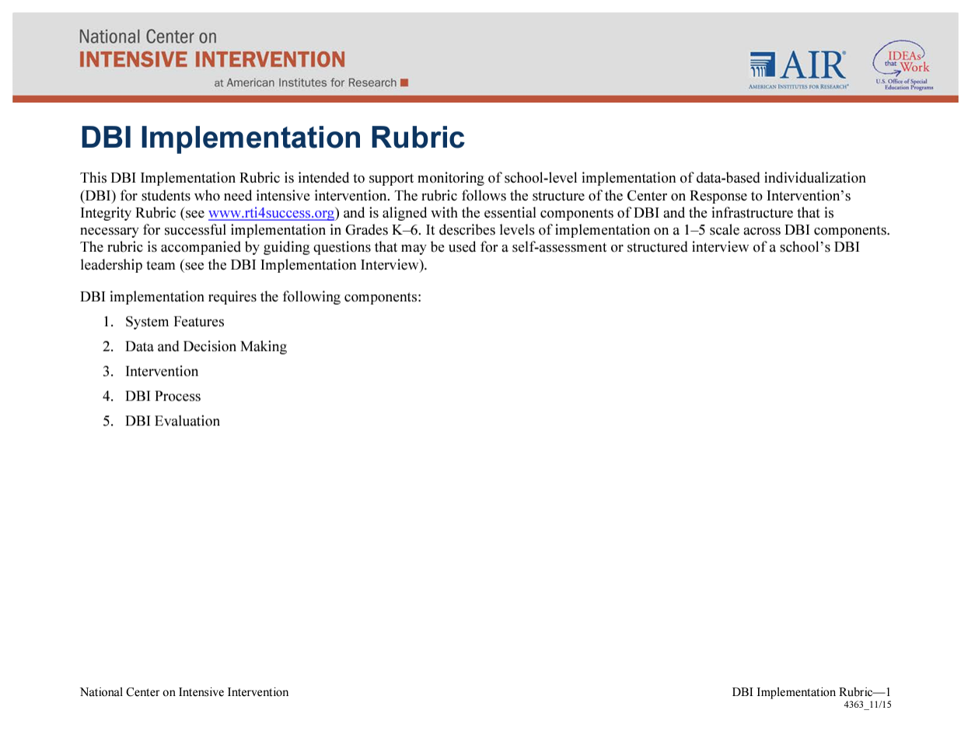
Activity: Rate Your Data and Decision Making Systems
Review the Data and Decision Making section of the DBI Implementation Rubric and highlight the ratings that currently best describe your district:
  Process to identify students in need of intensive intervention
  Academic progress monitoring tools
  Behavior progress monitoring tools
  Progress monitoring procedures
  Diagnostic assessment
  Fidelity of assessment implementation
Source: DBI Implementation Rubric

Slide 32

Intervention
Intensive intervention

Slide 33
Intervention (2)
Intensive intervention
Adaptation of intervention
Resource: Taxonomy of Intervention Intensity

Slide 34

Intervention (3)
Intensive intervention
Adaptation of intervention
Fidelity of implementation of intervention

Slide 35
Fidelity of Implementation of Intervention
Did we deliver the intervention?
Did the student receive the intervention?
  Are we providing the program as designed, with sufficient time, in a high-quality way?
  Did the student attend the intervention?
Observation
checklists
Self-report
checklists
Review permanent products
Ways to assess fidelity:
Resource: Considerations for Effective Implementation: 5 Elements of Fidelity

Slide 36

Intervention (4)
Intensive intervention
Adaptation of intervention
Fidelity of implementation of intervention
Interventionist characteristics

Slide 37

Intervention (5)
Intensive intervention
Adaptation of intervention
Fidelity of implementation of intervention
Interventionist characteristics
Relationship to core instruction

Slide 38
Activity: Rate Your Intervention Systems
Review the Intervention section of the DBI Implementation Rubric and highlight the ratings that currently best describe your district:
  Intensive intervention
  Adaptation of intervention
  Fidelity of implementation of intervention
  Interventionist characteristics
  Relationship to core instruction
Source: DBI Implementation Rubric

Slide 39

DBI Process (1)
Team or appropriate support mechanism
Regular meetings

Slide 40

DBI Process (2)
Team or appropriate support mechanism
Regular meetings
Data review

Slide 41
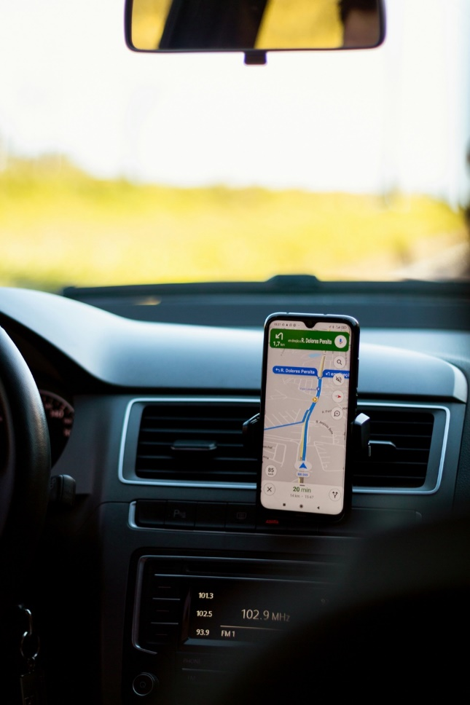


Data-Based Decision Making Is Everywhere
Navigation
Selecting an outfit for the day
Selecting a place to eat, stay, or do business with
Notes:
Photo 1 by Antony Freitas on Unsplash; Photo 2 is a stock PPT photo; Photo 3 by Gavin Allanwood on Unsplash

Slide 42

DBI Process (3)
Team or appropriate support mechanism
Regular meetings
Data review
Documentation
Notes:
Photo by Glenn Carstens-Peters on Unsplash

Slide 43

DBI Process (4)
Team or appropriate support mechanism
Regular meetings
Data review
Documentation
Decision rules
Notes:
Photo by Jon Tyson on Unsplash

Slide 44
Why Use Data and Decision Rules?
Using data, along with decision rules, can help to mitigate bias in decision making.
Example
Favoring instructional practices that align with your educational philosophy and avoiding practices that do not.
Confirmation Bias
Making decisions that only confirm your pre-existing beliefs and attitudes.
Believing a student is having academic difficulty due to internal factors, instead of a lack of sufficient instruction.
Fundamental Attribution Error
Mistakenly attributing another’s actions to their inherent traits instead of the context and situation.
Unconscious attitudes, judgments, and stereotypes toward different groups of people that aren’t reflective of individuals within those groups.
Setting different expectations for students based on their race, ethnicity, gender, etc.
Implicit Bias

Slide 45

Data and Decision Rules
Help us become more deliberate in our decision making.
Provide an “if-then” guide to help decision making.
Provide clarity and consistency for staff, students, and families (when documented and clearly communicated).

Slide 46

DBI Process (5)
Team or appropriate support mechanism
Regular meetings
Data review
Documentation
Decision rules
Overall implementation of DBI process
Notes:
Photo by Kelly Sikkema on Unsplash

Slide 47
Activity: Rate Your DBI Process
Review the DBI Process section of the DBI Implementation Rubric and highlight the ratings that currently best describe your district:
  Team or appropriate support mechanism
  Regular meetings
  Data review
  Documentation
  Decision rules
  Overall implementation of DBI process
Source: DBI Implementation Rubric

Slide 48

Activity 2
Review your ratings for (1) Data and Decision Making, (2) Intervention, and (3) DBI Process.
Using the note taking handout, identify:
  1–2 areas of strength
  1–2 areas for improvement
Be prepared to share out.

Slide 49
Preview of Day 2
Students
DBI happens here
Teachers
School Leadership
Effectiveness of DBI depends on what happens here
District Leadership

Slide 50
Building Capacity at the Local Level: Day 2
June 24-25, 2024
2024 Intensive Intervention Institute
Jon Potter, Senior Technical Assistance Consultant

Slide 51
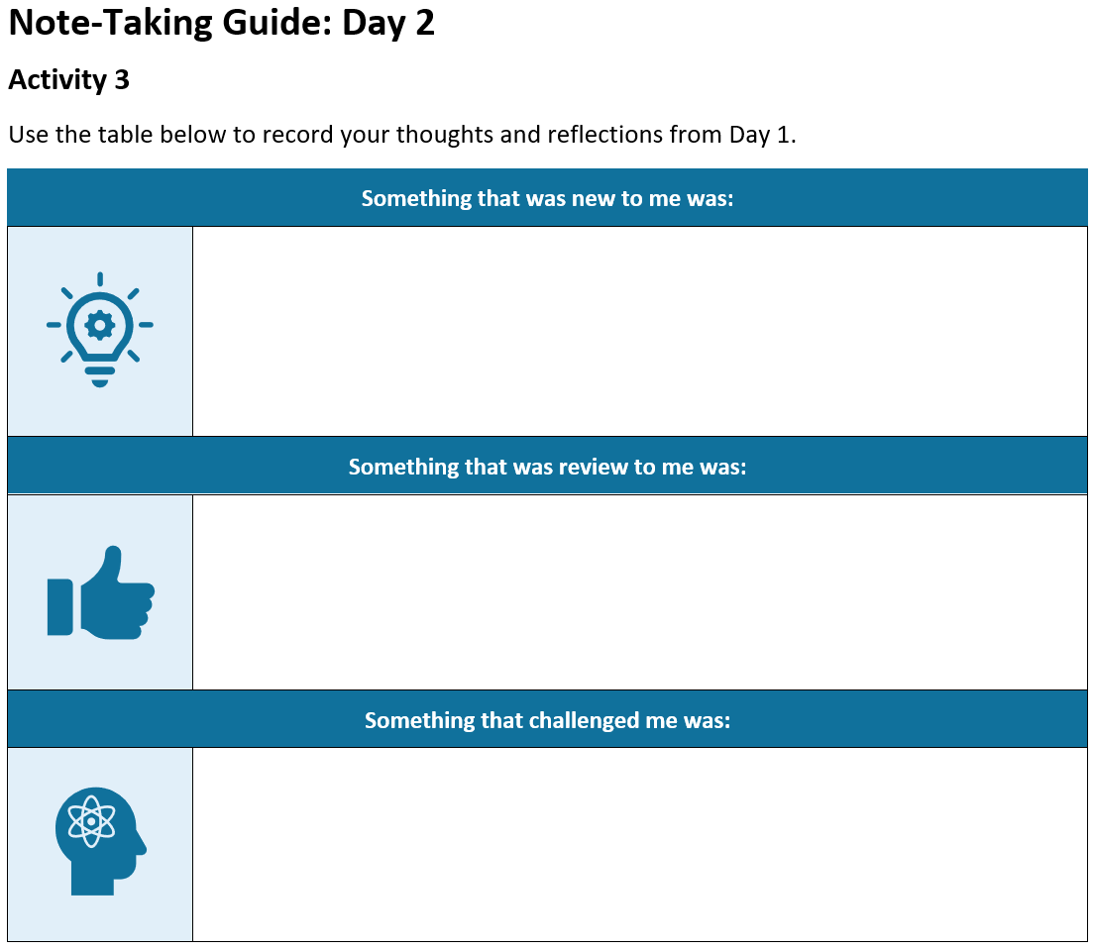
Activity 3
Reflect on what you heard yesterday.
Write down your thoughts on the note taking guide.
Find someone in the room not from your team and share what you wrote.

Slide 52
Supporting and Sustaining Implementation of DBI
How districts can support DBI

Slide 53

Reflect and Share Out
What are some challenges of district-level initiatives?
What barriers have you encountered?

Slide 54



LEA-Level Implementation:
Infrastructure
Alignment
  The contextual fit and overlap of DBI within the education agency’s current initiatives and work.
Internal Capacity
  The ability of the agency to self-sufficiently scale up and support DBI.
Implementation
The active process of supporting school sites with accurate and consistent implementation of DBI to support students.

Slide 55

Alignment
Alignment
  The contextual fit and overlap of DBI within the education agency’s current initiatives and work.
Key Personnel

Slide 56

Alignment: Key Personnel
Refers to personnel involved with making decisions around DBI and implementation.
This should include—
  Those with decision-making authority
  A team to lead the initiatives
  Two-way communication

Slide 57
Team-Based Leadership
A policy or program has been mandated or adopted, and, with minimal supports, practitioners are expected to translate information to practice. Practitioners are held accountable for intended outcomes.
Letting it happen
A policy or program has been mandated or adopted with materials, training resources, and websites to support practitioners. Practitioners are left to figure out how to solve problems while being held accountable for achieving positive outcomes.
Helping it happen
A policy or program has been mandated or adopted. Active and purposeful implementation best practices are used to support practitioners and administrators.
An Implementation Team is accountable for developing the implementation support systems, resolving organization and system issues, and achieving positive outcomes.
Making it happen
Resource: Implementation Teams Overview, National Implementation Research Network

Slide 58




Alignment: Key Personnel (2)
Commitment to DBI
Dedicated time for implementation
Decision-making authority
Support from senior leaders (e.g., superintendent, chief)

Slide 59

Alignment (2)
Alignment
  The contextual fit and overlap of DBI within the education agency’s current initiatives and work.
Key Personnel
Fit

Slide 60

Alignment: Fit
How well does DBI align with existing initiatives and structures?
Consider:
  Current and future initiatives
  Common language
  Organizational structure of the LEA (e.g., personnel, offices, training, and TA delivery system)

Slide 61
Where Does DBI Fit in Your District?
English Learners
Assessment
English Language Arts
DBI?
MTSS
Instructional Coaching
School Improvement
Special Education

Slide 62

Do You Need to De-implement Competing Initiatives or Practices?
De-implementation is “the discontinuation of interventions that should no longer be provided.” (McKay et al., 2018)
  Can DBI replace or refine an existing practice?
    Student Study Teams (SST)?
    Child Study Teams (CST)?
    Data Teams?

Slide 63
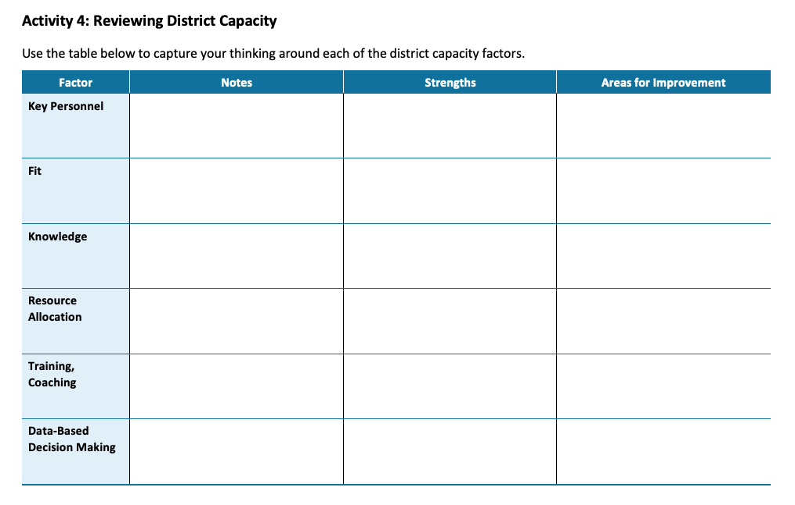
Activity 4:
Key Personnel and Fit
Use the note-taking guide to identify strengths and areas for improvement in the Key Personnel and Fit for DBI in your district.

Slide 64

Internal Capacity
Internal Capacity
  The ability of the agency to self-sufficiently scale up and support DBI.
Knowledge

Slide 65




Internal Capacity: Knowledge
What is the current knowledge and understanding of DBI across your
district staff, including expertise and experience with DBI?

Slide 66
Different Layers of Support (2)
Students
DBI happens here
Teachers
School Leadership
Effectiveness of DBI depends on what happens here
District Leadership

Slide 67



Teaching and Coaching Your Staff Requires Knowledge and Expertise
Driving
Sports
Music
Notes:
Photo 1 by Orkun Azap on Unsplash
Photo 2 and 3 are stock PPT photos

Slide 68

Ensuring Effective and Equitable DBI
Students in need of intensive intervention
School A
School B
School C
School D
School A staff knowledge of DBI
School B staff knowledge of DBI
School C staff knowledge of DBI
School D staff knowledge of DBI
District staff knowledge of DBI

Slide 69




Internal Capacity: Knowledge (2)
Foundational DBI knowledge among key staff
Specialized knowledge among some staff
(e.g., job-embedded coaching)
Implementation science knowledge

Slide 70


Build Knowledge
General trainings for all district-level personnel
Specific trainings and ongoing support to coaches and/or schools

Slide 71

Internal Capacity (2)
Internal Capacity
  The ability of the agency to self-sufficiently scale up and support DBI.
Knowledge
Resource Allocation

Slide 72




Internal Capacity: Resource Allocation
Refers to resources available to support DBI, including the following:
Money
Time
Materials
People
Does your LEA have the capacity to train and/or coach schools, and the ability to restructure roles to do so?

Slide 73
Activity 4:
Knowledge and Resource Allocation
Use the note-taking guide to identify strengths and areas for improvement in the Knowledge and Resource Allocation for DBI in your district.

Slide 74
Implementation
Implementation
The active process of supporting school sites with accurate and consistent implementation of DBI to support students.

Slide 75


Implementation Is Messy
What we want implementation to look like:
Our DBI Plan
DBI Implementation Reality
What implementation can often look like:
Our DBI Plan
DBI Implementation Reality

Slide 76

Implementation (2)
Implementation
The active process of supporting school sites with accurate and consistent implementation of DBI to support students.
Training and Coaching

Slide 77

Implementation: Training and Coaching
Develop a TA delivery system that includes—
Initial and ongoing training
  In person, virtual, synchronous, asynchronous
Opportunities to practice learned skills
Ongoing, job-embedded coaching
A plan for scaling up (e.g., pilot sites, cohorts, etc.)
Feedback data to drive future TA
Explicit guidance on how new information fits into existing practice
Honoring the unlearning process

Slide 78

Remember
People don’t resist change. They resist loss.
Notes:
Photo by Jon Tyson on Unsplash

Slide 79

Implementation (3)
Implementation
The active process of supporting school sites with accurate and consistent implementation of DBI to support students.
Training and Coaching
Data-Based Decision Making

Slide 80
Data-Driven Feedback Loops
“In short, if we want to make the education system better, we could try to concoct the perfect intervention—the new curriculum, the new model—and hope for the best. Or we could settle for a pretty good solution that’s equipped with so many built-in feedback loops that it can’t help but get better over time.”
Heath (2020)

Slide 81



Implementation: Data-Based Decision Making
Systems to gather data on fidelity of implementation efforts.
Systems to gather data on outcomes or impact of implementation efforts.
Data-based processes used by key personnel to make decisions.

Slide 82
Activity 4:
Training and Coaching and DBDM
Use the note-taking guide to identify strengths and areas for improvement in the Training and Coaching and Data-Based Decision Making for DBI in your district.

Slide 83

Closing Thoughts
Your system has areas for improvement in DBI structure and processes.
The technical solution is to train your staff or to secure additional resources.
Training and/or additional resources will not sufficiently solve adaptive challenges.
Building district capacity ensures you are equipped to implement both technical and adaptive solutions.

Slide 84
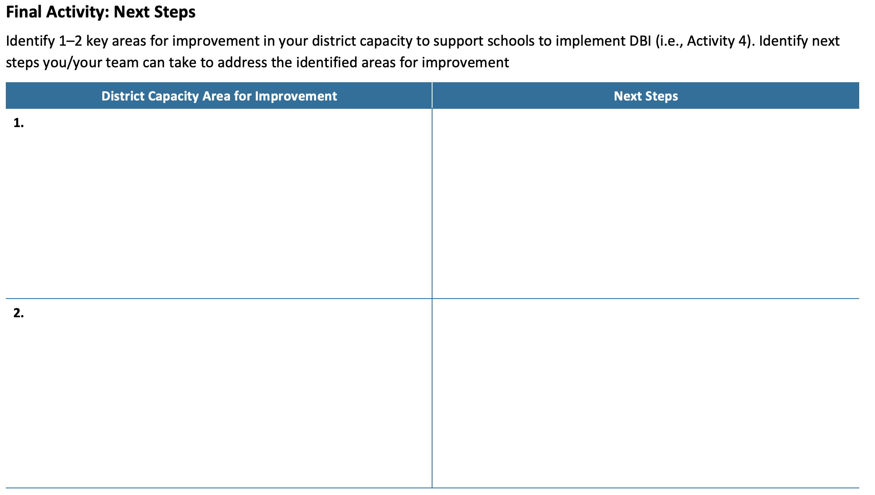
Final Activity: Next Steps
Using the final page of the note-taking handout:
Identify 1–2 key areas for improvement in your district capacity to support DBI.
Identify next steps to address those areas for improvement.

Slide 85

Questions

Slide 86
Thank you
THANK YOU!!
jopotter@air.org

Slide 87
NCII Disclaimer
This presentation was produced under the U.S. Department of Education, Office of Special Education Programs, Award No. H326Q260001. Celia Rosenquist serves as the project officer. The views expressed herein do not necessarily represent the positions or policies of the U.S. Department of Education. No official endorsement by the U.S. Department of Education of any product, commodity, service, or enterprise mentioned in this resource is intended or should be inferred.

Slide 88
References
Collins, A., & Harlacher, J. (2023). Effective bullying prevention: A comprehensive schoolwide approach. Guilford Press.
Fuchs, L. S., Fuchs, D., & Malone, A. S. (2017). The Taxonomy of Intervention Intensity. TEACHING Exceptional Children, 50(1), 35–43.
Harlacher, J., Potter, J., & Collins, A. (2024). Untangling data-based decision making: A problem solving model to enhance your MTSS. Marzano Resources.
Heath, D. (2020). Upstream: The quest to solve problems before they happen. Avid Reader Press.
Heifetz, R. A., Grashow, A., & Linsky, M. (2009). The practice of adaptive leadership: Tools and tactics for changing your organization and the world. Harvard Business Press.
McKay, V. R., Morshed, A. B., Brownson, R. C., Proctor, E. K., & Prusaczyk, B. (2018). Letting go: Conceptualizing intervention de-implementation in public health and social service settings. American Journal of Community Psychology, 62(1-2), 189–202.
National Implementation Research Network. (2023). Implementation team overview (module 3). https://implementation.fpg.unc.edu/resource/implementation-team-overview

