Slide 1
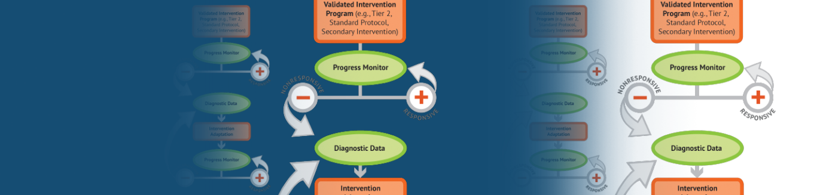
Intensive Intervention Institute
June 25-26, 2024
Building Knowledge and Capacity for State and Local Leaders to Support DBI Implementation

Slide 2

Welcome

Slide 3
Event Overview
Learn about the DBI process.
Discuss DBI research and implementation lessons with NCII staff, state and local implementers, and national experts.
Access professional learning and action planning opportunities.
Network with colleagues interested in supporting intensive intervention implementation.
Access freely available resources and tools to support intensive intervention implementation.

Slide 4

Welcome Activity
Find someone you do not know.
  Introduce yourself.
  Share what brought you to the Institute and what you are most excited to learn about DBI implementation.
Switch partners and repeat.

Slide 5







Introductions: NCII Staff

Slide 6

Materials
Agenda
Presenter Bios
Participant contact list
Dining Options
Additional materials will be shared in your strand sessions

Slide 7
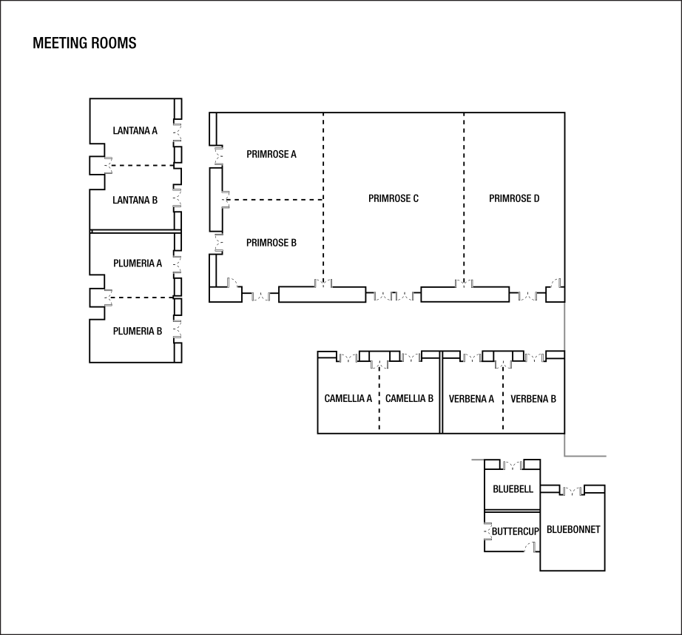
Strand Identification and Locations
DBI 101 (Primrose AB)
SEA (Plumeria B)
LEA (Plumeria A)

Slide 8
Institute Agenda & Logistics Day 1
When? | What? | Where?
9:00-9:30 a.m. | Welcome | Primrose AB
9:30-10:30 a.m. | Keynote: Five Lessons Learned from Data-Based Individualization (DBI) Implementation Dr. Sarah Powell, Professor in the Department of Special Education at the University of Texas at Austin | Primrose AB
10:30-10:45 a.m. | Break & Transition to Strand Sessions
10:45-11:45 a.m. | Strand Session | Primrose AB (DBI 101) Plumeria A (LEA) Plumeria B (SEA)
11:45 a.m.-1:15 p.m. | Lunch on your own
1:15-3:15 p.m. | Strand Sessions | See above
3:15-3:30 | Break
3:30-4:30 pm | Cross Strand Networking | Primrose AB

Slide 9
Institute Agenda & Logistics Day 2
When? | What? | Where?
9:00-11:00 a.m. | Strand Sessions | Primrose AB (DBI 101) Plumeria A (LEA) Plumeria B (SEA)
11:00-11:15 a.m. | Break
11:15 a.m.-12:30 p.m. | Implementer Panel | Primrose AB
12:30-1:00 p.m. | Closing & Adjourn | Primrose AB

Slide 10
Why are we here?

Slide 11







Why do we need intensive intervention?
  Students with disabilities have a history of poor outcomes in several areas, compared to their peers without disabilities:
          Academic achievement
          High school completion
          Postsecondary education
          Employment
          Involvement with the criminal justice system

Slide 12



Why do we need intensive intervention?
Validated programs are not universally effective programs; 3% to 5% of students need more help (NCII, 2013).
Students with intensive needs often require 10–30 times as much practice as their peers to learn new information (Gersten et al., 2009).
For students with intensive needs, co-occurring academic and behavioral needs are the rule not the exception (Kuchle & Riley-Tillman, 2019) .

Slide 13


What is intensive intervention?
Intensive intervention addresses severe and persistent learning and behavioral difficulties.
Characterized
by increased intensity and individualization
Driven by data

Slide 14
What is intensive intervention? Part 2
Intensive intervention is . . .
A process
Individualized based on student needs
More intense, often with substantively different content and pedagogy
A process that involves more frequent and precise progress monitoring
An approach that integrates academic and behavioral supports
Intensive intervention is not . . .
A one-time fix
A single approach
A manual
A preset program
More of the same Tier 1 instruction
More of the same Tier 2 instruction

Slide 15

Who needs intensive intervention?
    Students with disabilities who are not making adequate progress in their current instructional program and not meeting individualized education program (IEP) goals
    Students with persistently low academic achievement and/or high-frequency and/or high-intensity behavior
    Students in a tiered intervention program who are nonresponsive to interventions delivered with fidelity

Slide 16

About the National Center on Intensive Intervention
The mission of the NCII is to build knowledge and capacity of state and local leaders, faculty and professional development providers, educators, and other stakeholders to support implementation of intensive intervention for students with severe and persistent learning and/or social, emotional, or behavioral needs using data-based individualization (DBI).

Slide 17

What is data-based individualization (DBI)?
DBI Process
Data-based individualization (DBI) is a research-based process for individualizing and intensifying interventions for students with severe and persistent learning and behavioral needs.
The process integrates evidence-based intervention, assessment, and strategies.

Slide 18
DBI Process
Validated intervention program, delivered
with fidelity
Progress monitoring
Diagnostic data used to develop a hypothesis
Adaptation to validated intervention
Continued progress monitoring, with adaptations occurring whenever needed to ensure adequate progress

Slide 19

How Can DBI Support Students with Disabilities?
Students with disabilities should have access to all levels of instruction and intervention they require, including intensive intervention.
DBI can help support the design and implementation of the individualized education program (IEP).

Slide 20
How can DBI support IEP development and implementation?
Outlining needs, strengths, and baseline performance within the present levels of academic achievement and functional performance.
Designing and providing specially designed instruction based on student need.
Writing ambitious but realistic individualized education program (IEP) goals.
Evaluating progress toward IEP goals.
Intensifying specialized instruction for students who are not making adequate progress.
Planning for the whole child.

Slide 21

How can DBI support implementation of MTSS?
Successful implementation of intensive intervention DBI is more likely to occur in schools that have a well-functioning tiered system of support.
Key components of MTSS implementation are necessary for DBI implementation (evidence-based interventions, progress monitoring, data-based decision rules).

Slide 22

How Can DBI Support Equity?
The DBI process provides an opportunity to ensure equitable access and outcomes regardless of race, gender, ethnicity, economic status, language status, and disability status. To do so:
Educators must intentionally examine and consider the impact of unconscious bias within implementation as it relates to assessment and instructional programs, data interpretation, and instructional practices.
Leaders of educational systems must examine the impact of their policies and practices.

Slide 23




How can DBI meet the needs of the whole child?
The success of DBI hinges on educators intentionally considering students’ academic, social, emotional, and behavioral needs through an integrated approach and in designing an intensive intervention plan based on the unique needs and strengths of students.

Slide 24
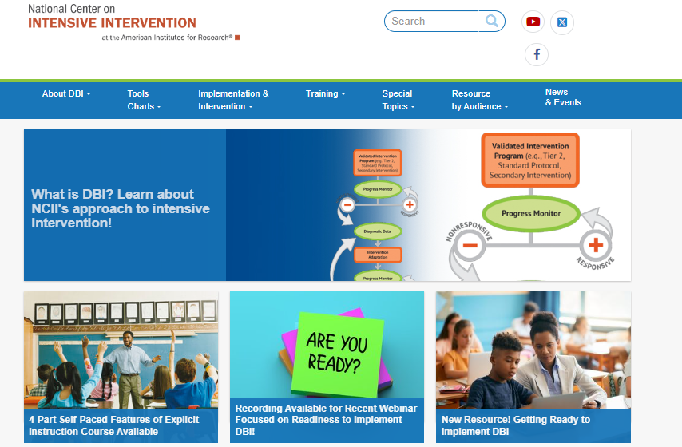
Tools and Resources from NCII

Slide 25
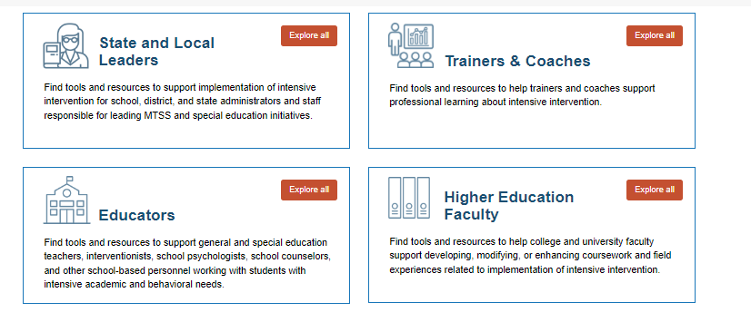
Curated Pages By Audience

Slide 26
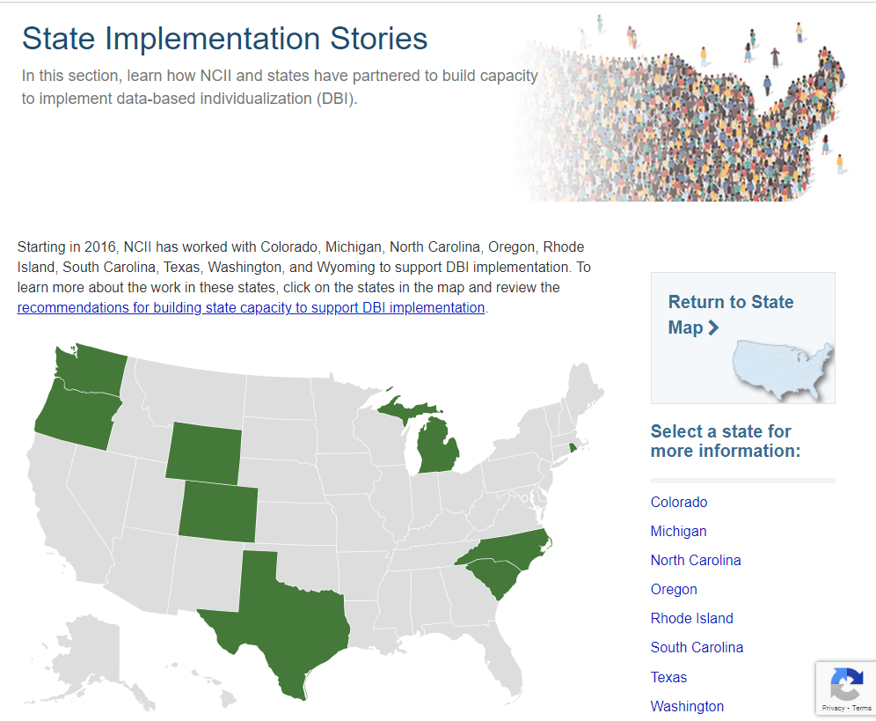
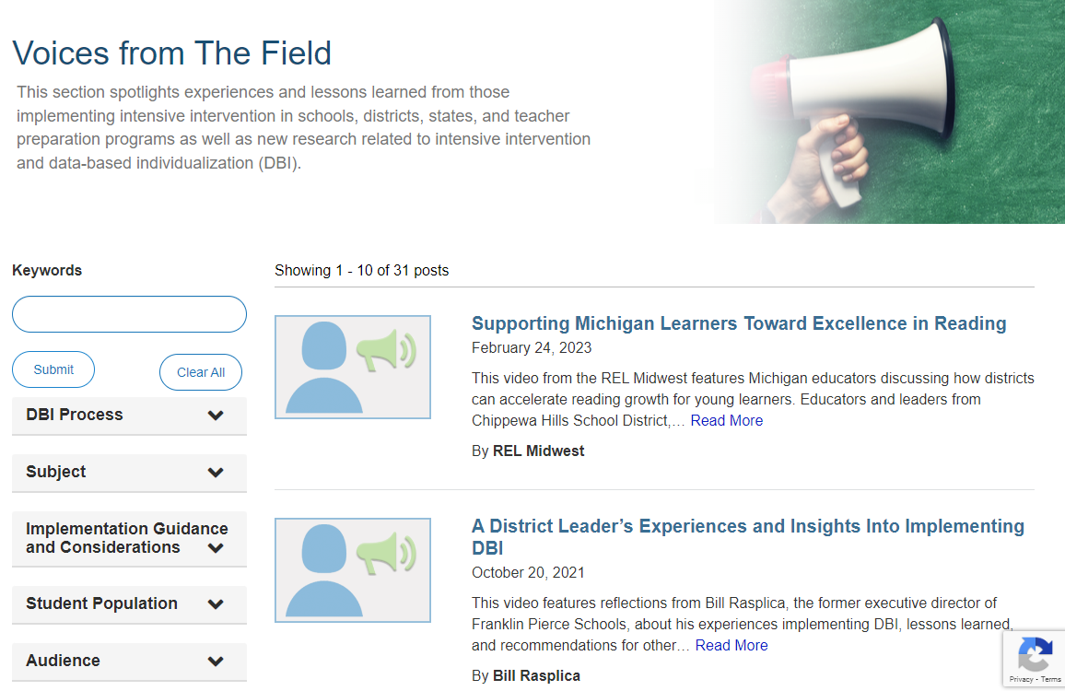
Stories from Implementers

Slide 27
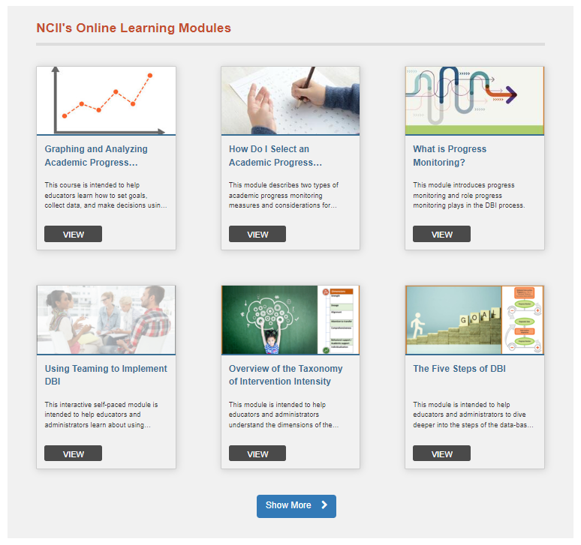
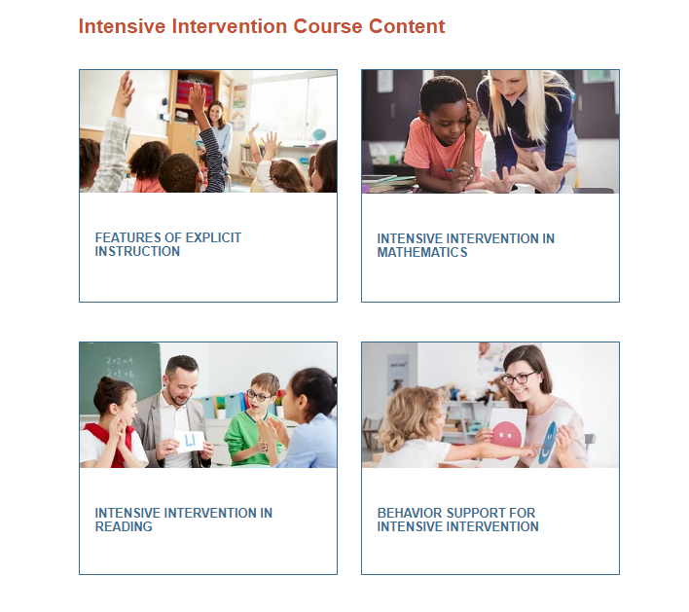
Self-Paced Courses and Course Content

Slide 28
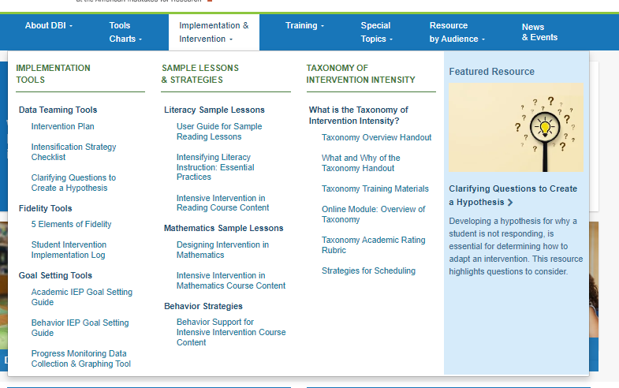
Implementation & Intervention Tools

Slide 29
How do we start a DBI movement?

Slide 30
So, how do we start a DBI movement?
Video https://www.ted.com/talks/derek_sivers_how_to_start_a_movement?language=en

Slide 31
What does it take to implement DBI?
Data-based decision making is not for wimps . . . You really got to go in knowing that it’s hard work. . . . Once you’ve made that commitment, you can’t just give up. . . . The only answer we’ve found so far is sometimes just going ahead and doing what we need to do and having the people look at the success.”
  (Participant of NCII 2012-2016)

Slide 32


Raffle

Slide 33

Do you have questions for our implementation panelists?
Jot them on a flashcard and place it in the bucket at registration.
Everyone has a couple of flashcards in your folder. If you need more, just ask.

Slide 34

Five Lessons Learned from Data-Based Individualization (DBI) Implementation
June 2024
Sarah Powell, Professor, The University of Texas at Austin

Slide 35


Introductions
Sarah R. Powell, Ph.D.
Professor
The University of Texas at Austin
srpowell@utexas.edu
@sarahpowellphd

Slide 36
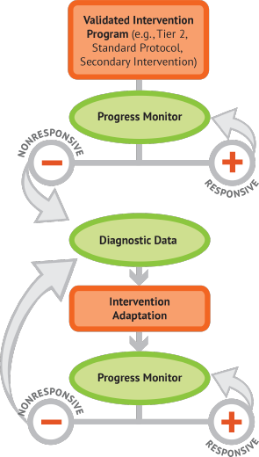
Data-Based Individualization (DBI)
A framework of instruction, assessment, and decision making designed to make timely decisions about a student’s instructional programming.

Slide 37
Data-Based Individualization (DBI) 1
Helps teachers be mindful
about evidence-based practices.
Helps teachers make timely decisions
and responses about student progress.
Can be used in different settings
(Tier 1, Tier 2, Tier 3, or special education).
Can be used across content areas
for both academics and behavior.

Slide 38

Data-Based Individualization (DBI) 2
Research supports the use of DBI for improving teacher outcomes.

Slide 39
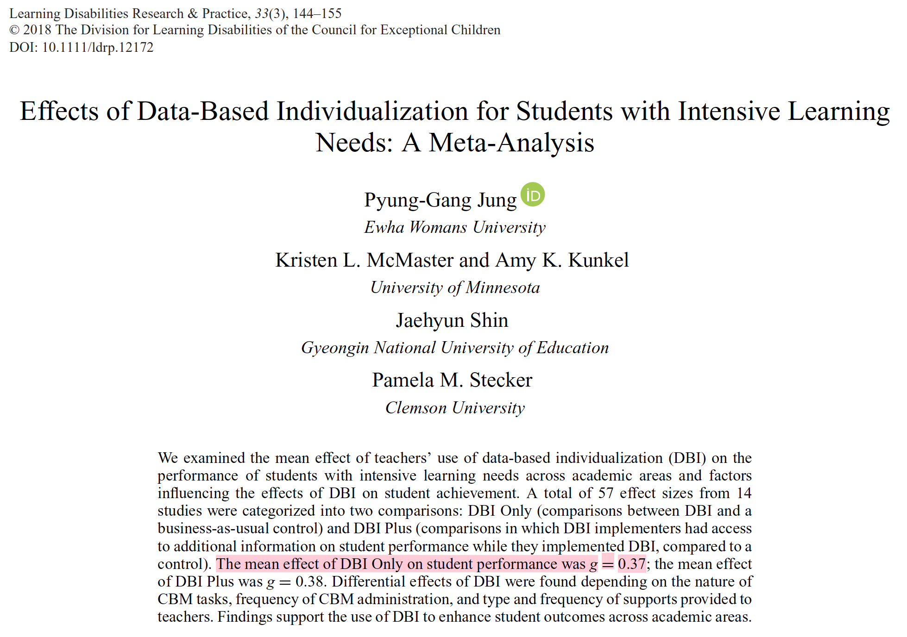
Data-Based Individualization (DBI) 3
Research supports the use of DBI for improving student outcomes.

Slide 40

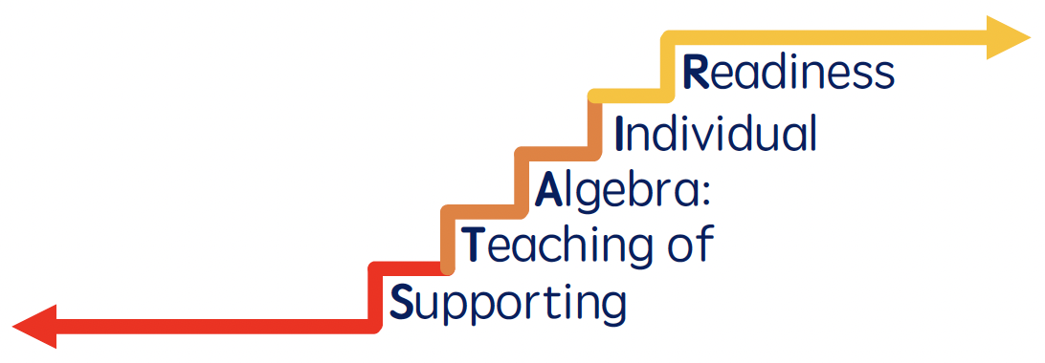
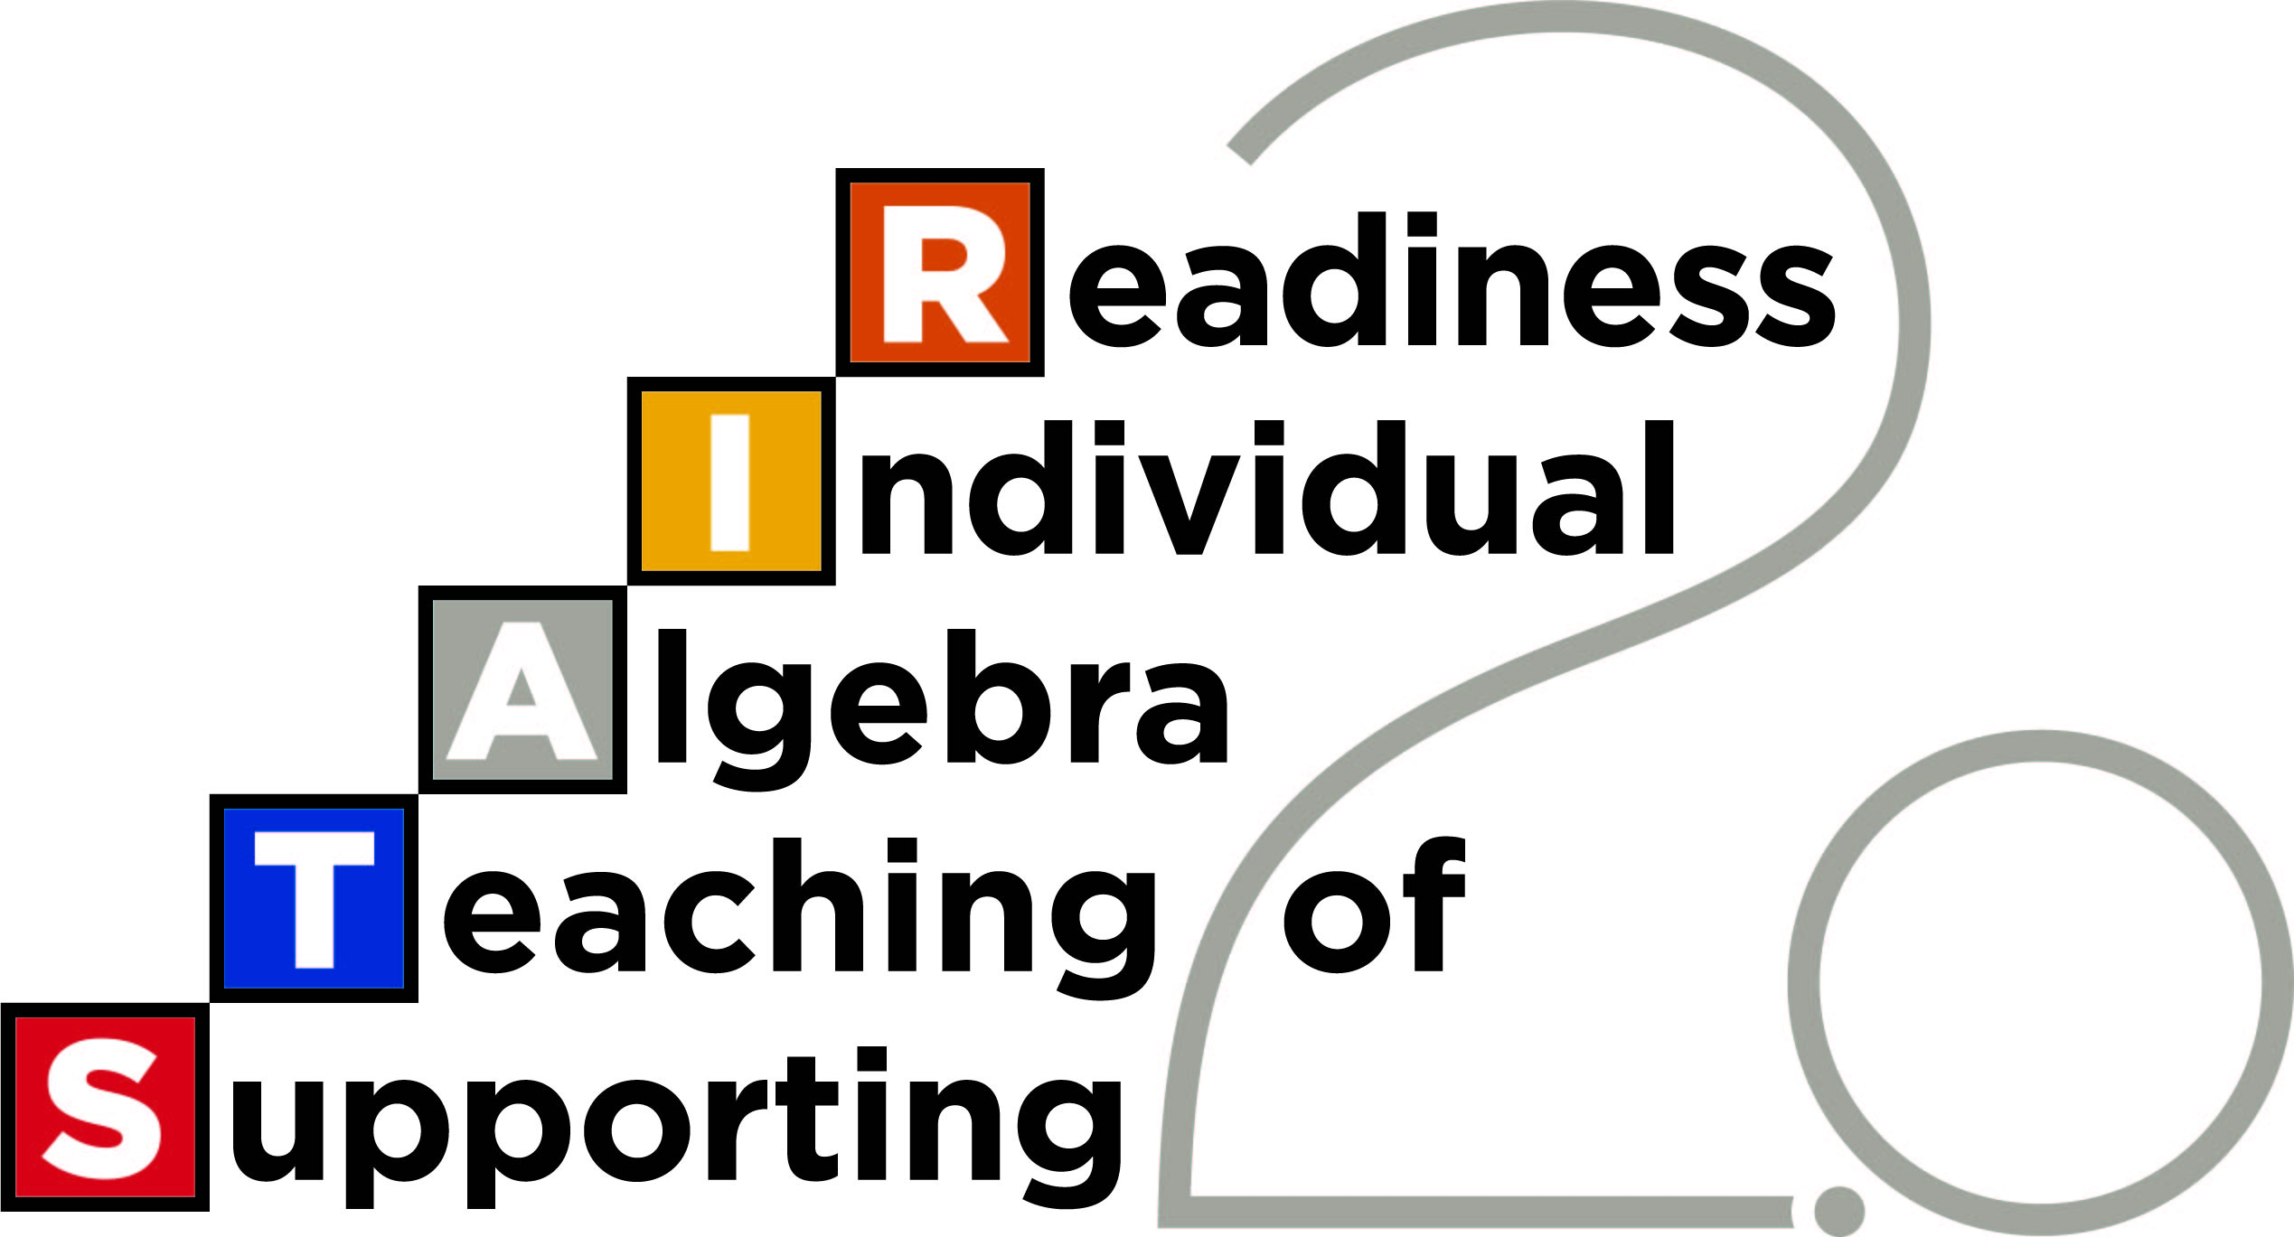
Five Lessons Learned

Slide 41
Five Lessons Learned 1
Importance of Teacher Training on the Instructional Platform
Complexities of Continuous Progress Monitoring
Necessity of Coaching About Decision Making
Timing of Diagnostic Data Collection
Structural Elements of the Schools and Districts

Slide 42
Importance of Teacher Training on the Instructional Platform

Slide 43


Instructional Platform
The instructional platform is the jumping off point for effective instruction.
The platform should include a suite of research-validated practices.

Slide 44
Instructional Platform 1
Identify research-validated practices
Provide training on knowledge and use of research-validated practices

Slide 45
Instructional Platform 2
Identify research-validated practices
Provide training on knowledge and use of research-validated practices

Slide 46

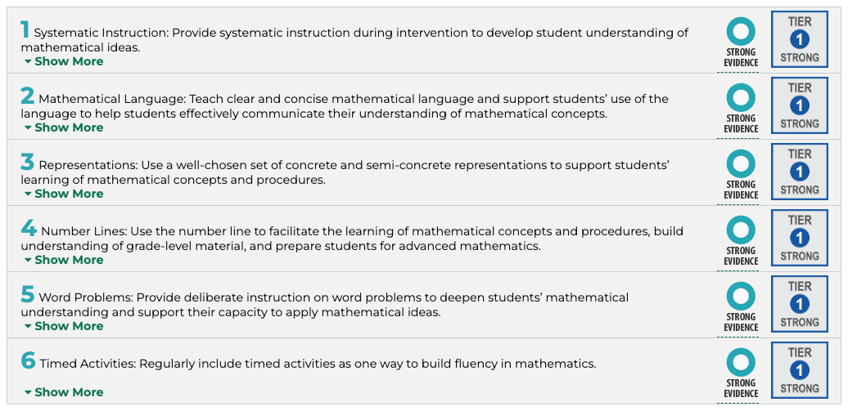
Instructional Platform 3
Source: https://ies.ed.gov/ncee/WWC/PracticeGuide/26

Slide 47
Instructional Platform 4
Identify research-validated practices
Provide training on knowledge and use of research-validated practices

Slide 48
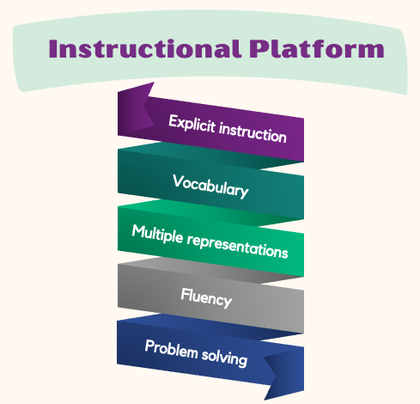
Instructional Platform 5
Source: https://mathspiral.com/

Slide 49
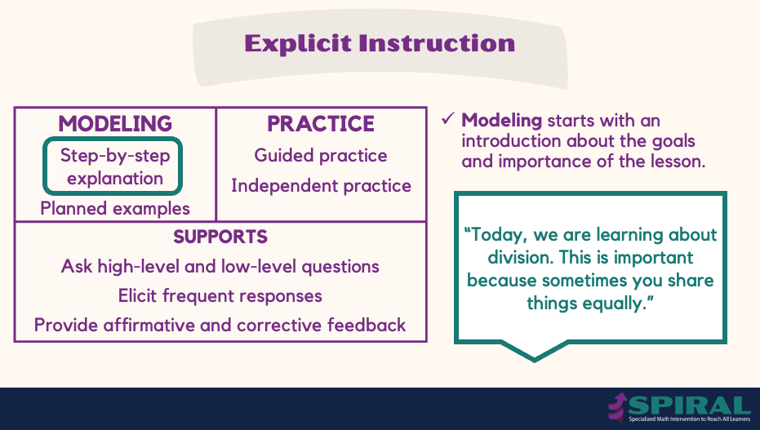
Explicit Instruction
Source: https://mathspiral.com/

Slide 50
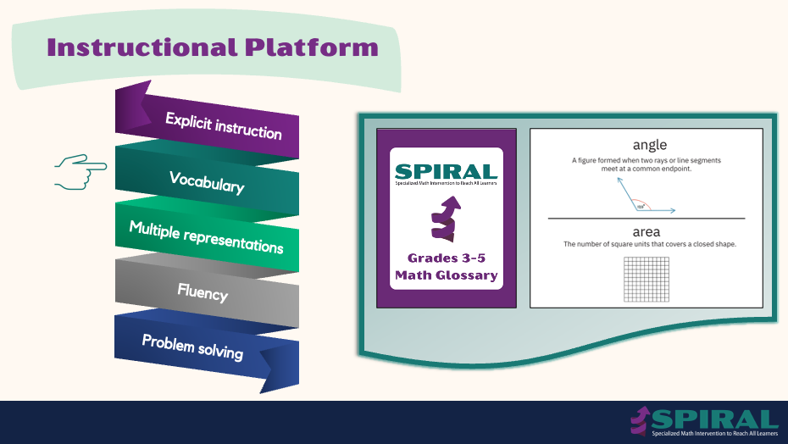
Instructional Platform 6
Source: https://mathspiral.com/

Slide 51
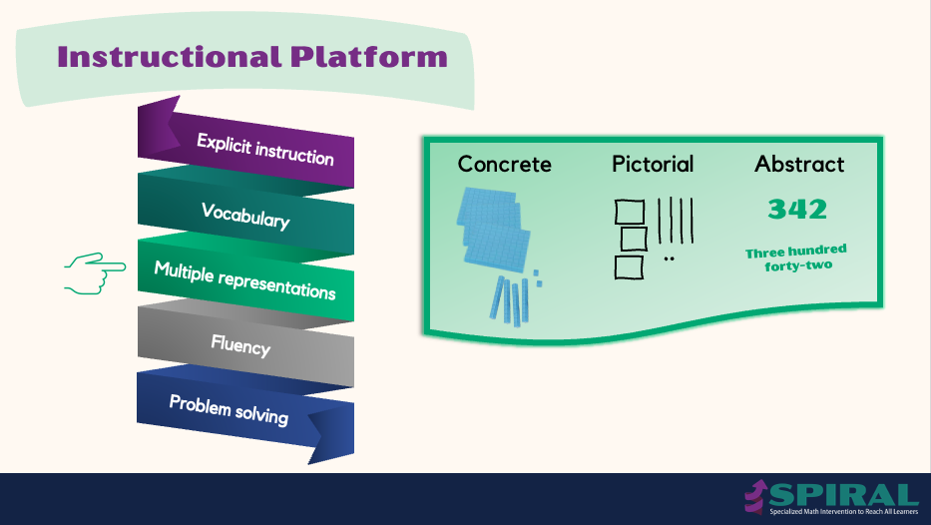
Instructional Platform 7
Source: https://mathspiral.com/

Slide 52
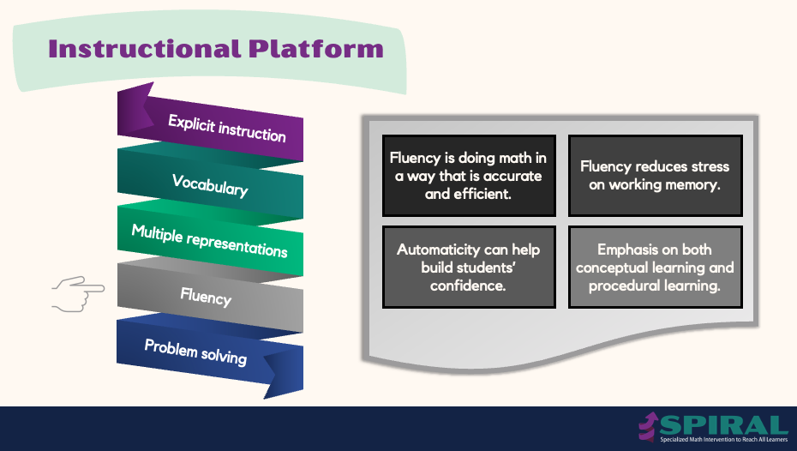
Instructional Platform 8
Source: https://mathspiral.com/

Slide 53
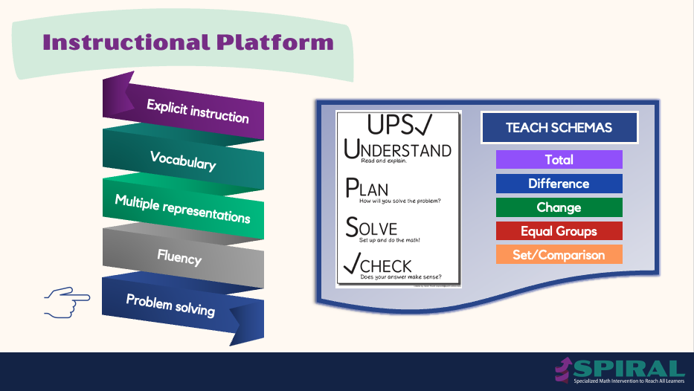
Instructional Platform 9
Source: https://mathspiral.com/

Slide 54
Instructional Platform 10
Provide training on the instructional platform as early as possible to establish shared language and expectations.

Slide 55

Instructional Platform 11
Share your experiences with identifying research-validated instructional practices.
Share your experiences providing training on knowledge and use of research-validated practices.

Slide 56
Complexities of Continuous Progress Monitoring

Slide 57


Progress Monitoring
Progress monitoring allows for timely decisions about whether the instructional platform is helpful for improving student performance.

Slide 58
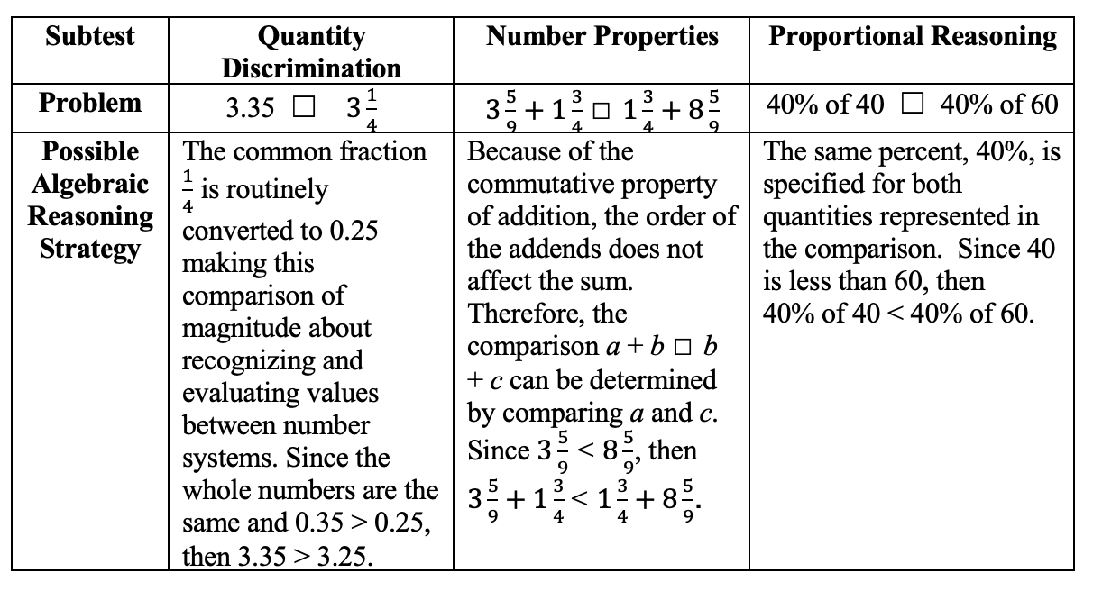
Progress Monitoring 1
Free access to measures through iStation.
Difficulties with access to iStation, particularly at some schools.
Asked teachers to graph.
Source: STAIR 1.0

Slide 59

Progress Monitoring 2
Moved to paper-and-pencil administration of measures.
Asked teachers to graph but had difficulty accessing the graphing resource.
Source: STAIR 1.0

Slide 60

Progress Monitoring 3
Provided free access to measures administered via technology.
Difficulties accessing the portal and using technology.
Lots of intervention from research team.
Source: STAIR 2.0

Slide 61
Progress Monitoring 4
Regular (weekly) administration
of measures
Accessing measures administered via technology
Scoring of paper-and-pencil measures
Graphing of data
Burden of additional
data collection
Easy to use data platform

Slide 62
Progress Monitoring 5
Even when providing free access to measures, it is difficult for teachers to administer measures regularly (i.e., weekly), score measures, and graph data.

Slide 63

Progress Monitoring 6
Share your experiences with administration of progress monitoring data.
Share what has worked well for you; share any challenges.

Slide 64
Necessity of Coaching About Decision Making

Slide 65


Decision Making
An analysis of trends with the progress monitoring data allows for timely decisions about the impact of the instructional platform.

Slide 66
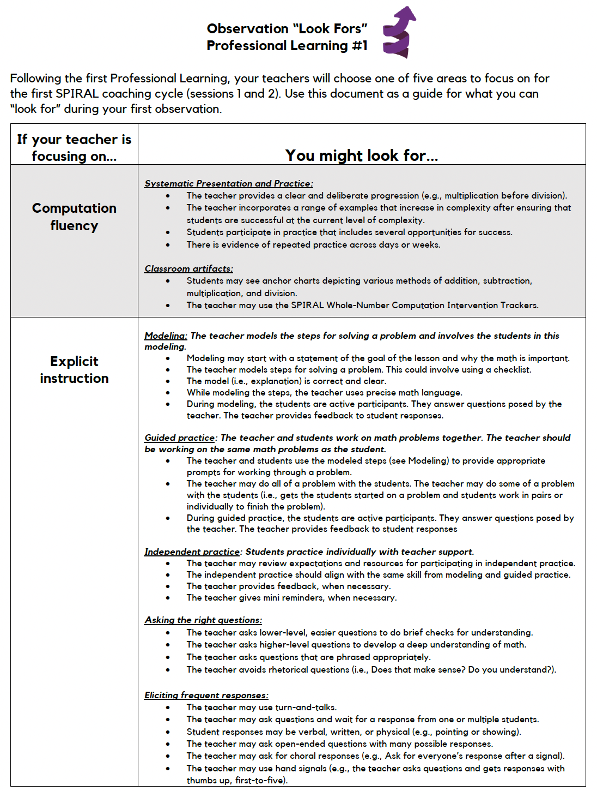
Coaching
Coaching involved a focus on the implementation of the instructional platform and a focus on looking at data and determining growth.
Source: www.mathspiral.com

Slide 67
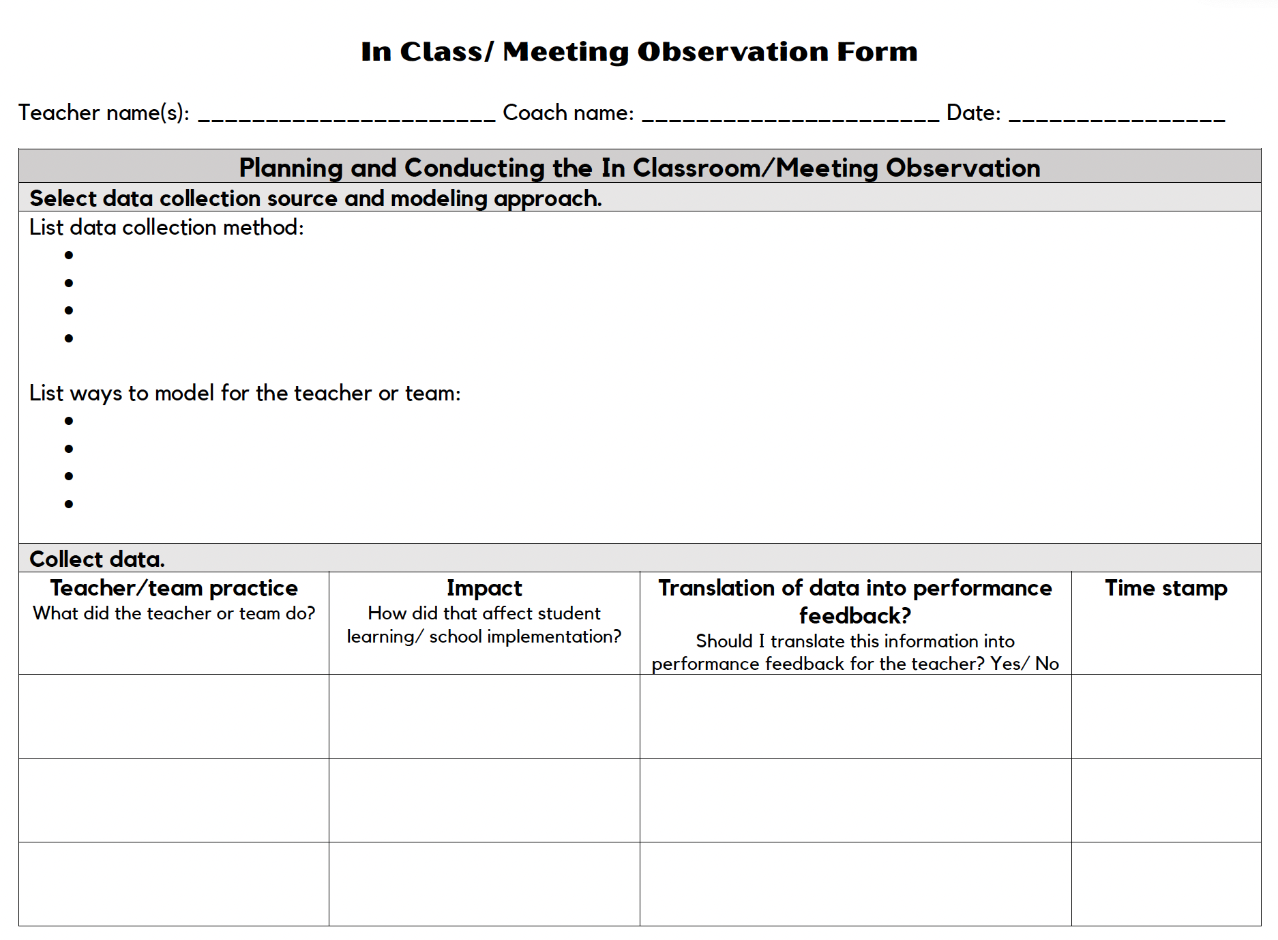
Coaching 2
Coaching involved a focus on the implementation of the instructional platform and a focus on looking at data and determining growth.
Source: www.mathspiral.com

Slide 68
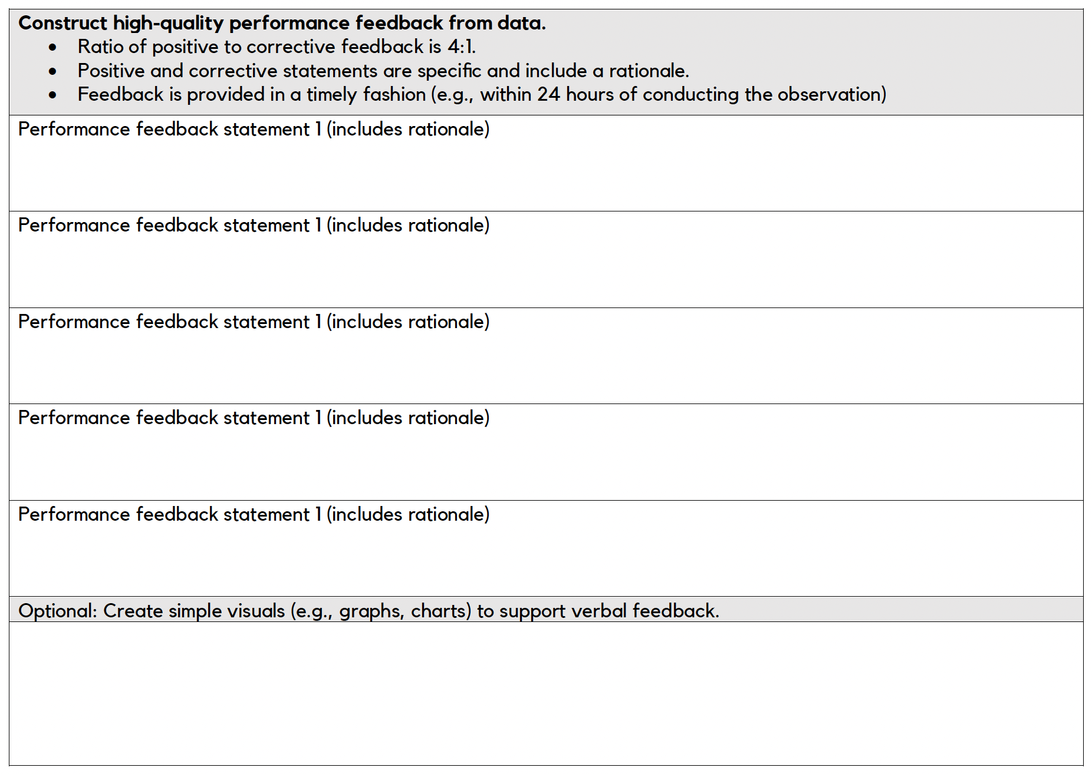
Coaching 3
Coaching involved a focus on the implementation of the instructional platform and a focus on looking at data and determining growth.
Source: www.mathspiral.com

Slide 69
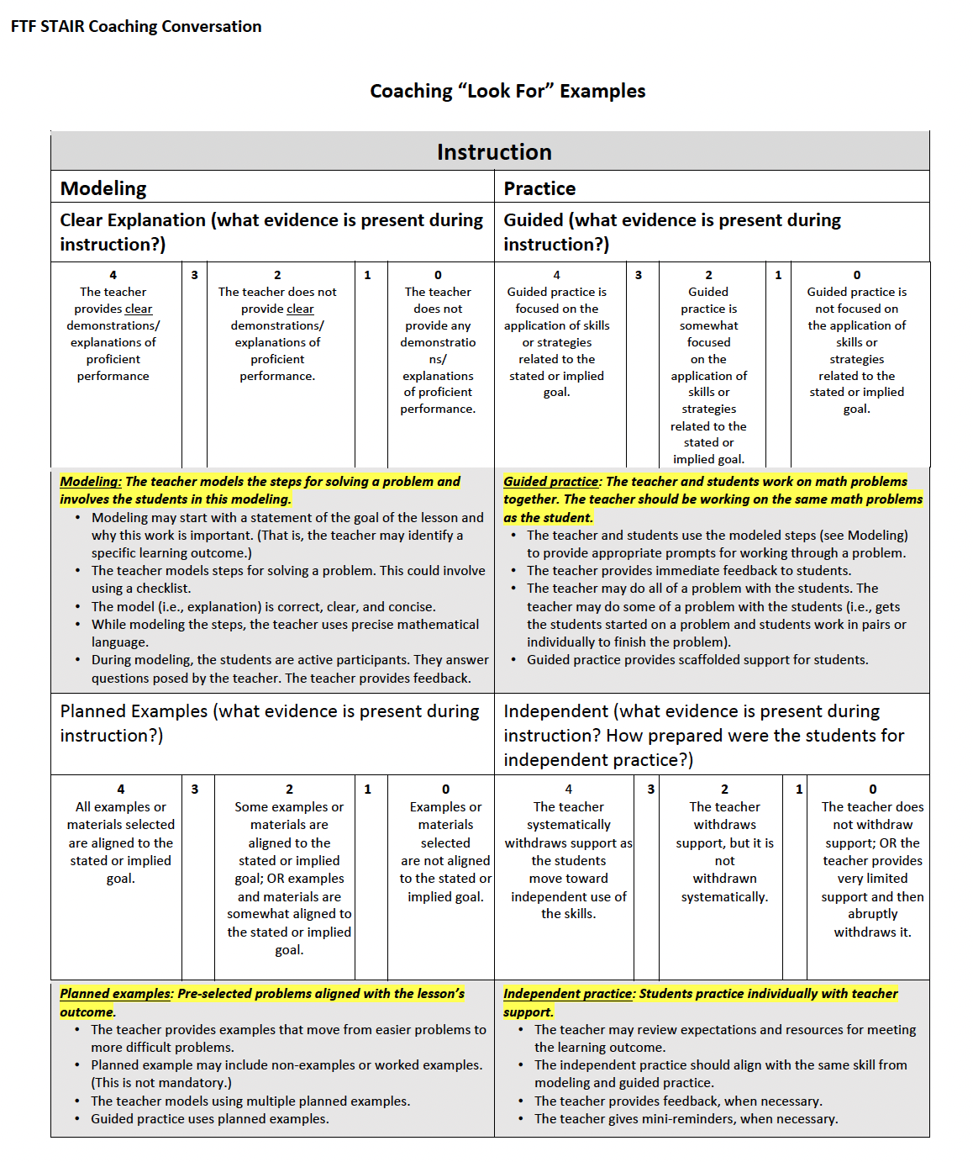
Coaching 4
Coaching involved a focus on the implementation of the instructional platform and a focus on looking at data and determining growth.
Source: STAIR 2.0

Slide 70
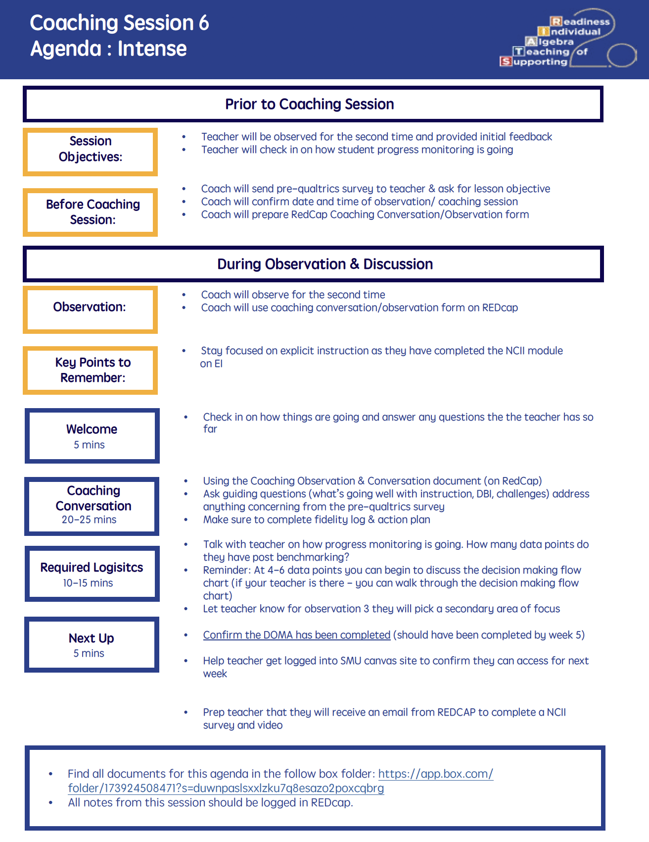
Coaching 5
Coaching involved a focus on the implementation of the instructional platform and a focus on looking at data and determining growth.
Source: STAIR 2.0

Slide 71
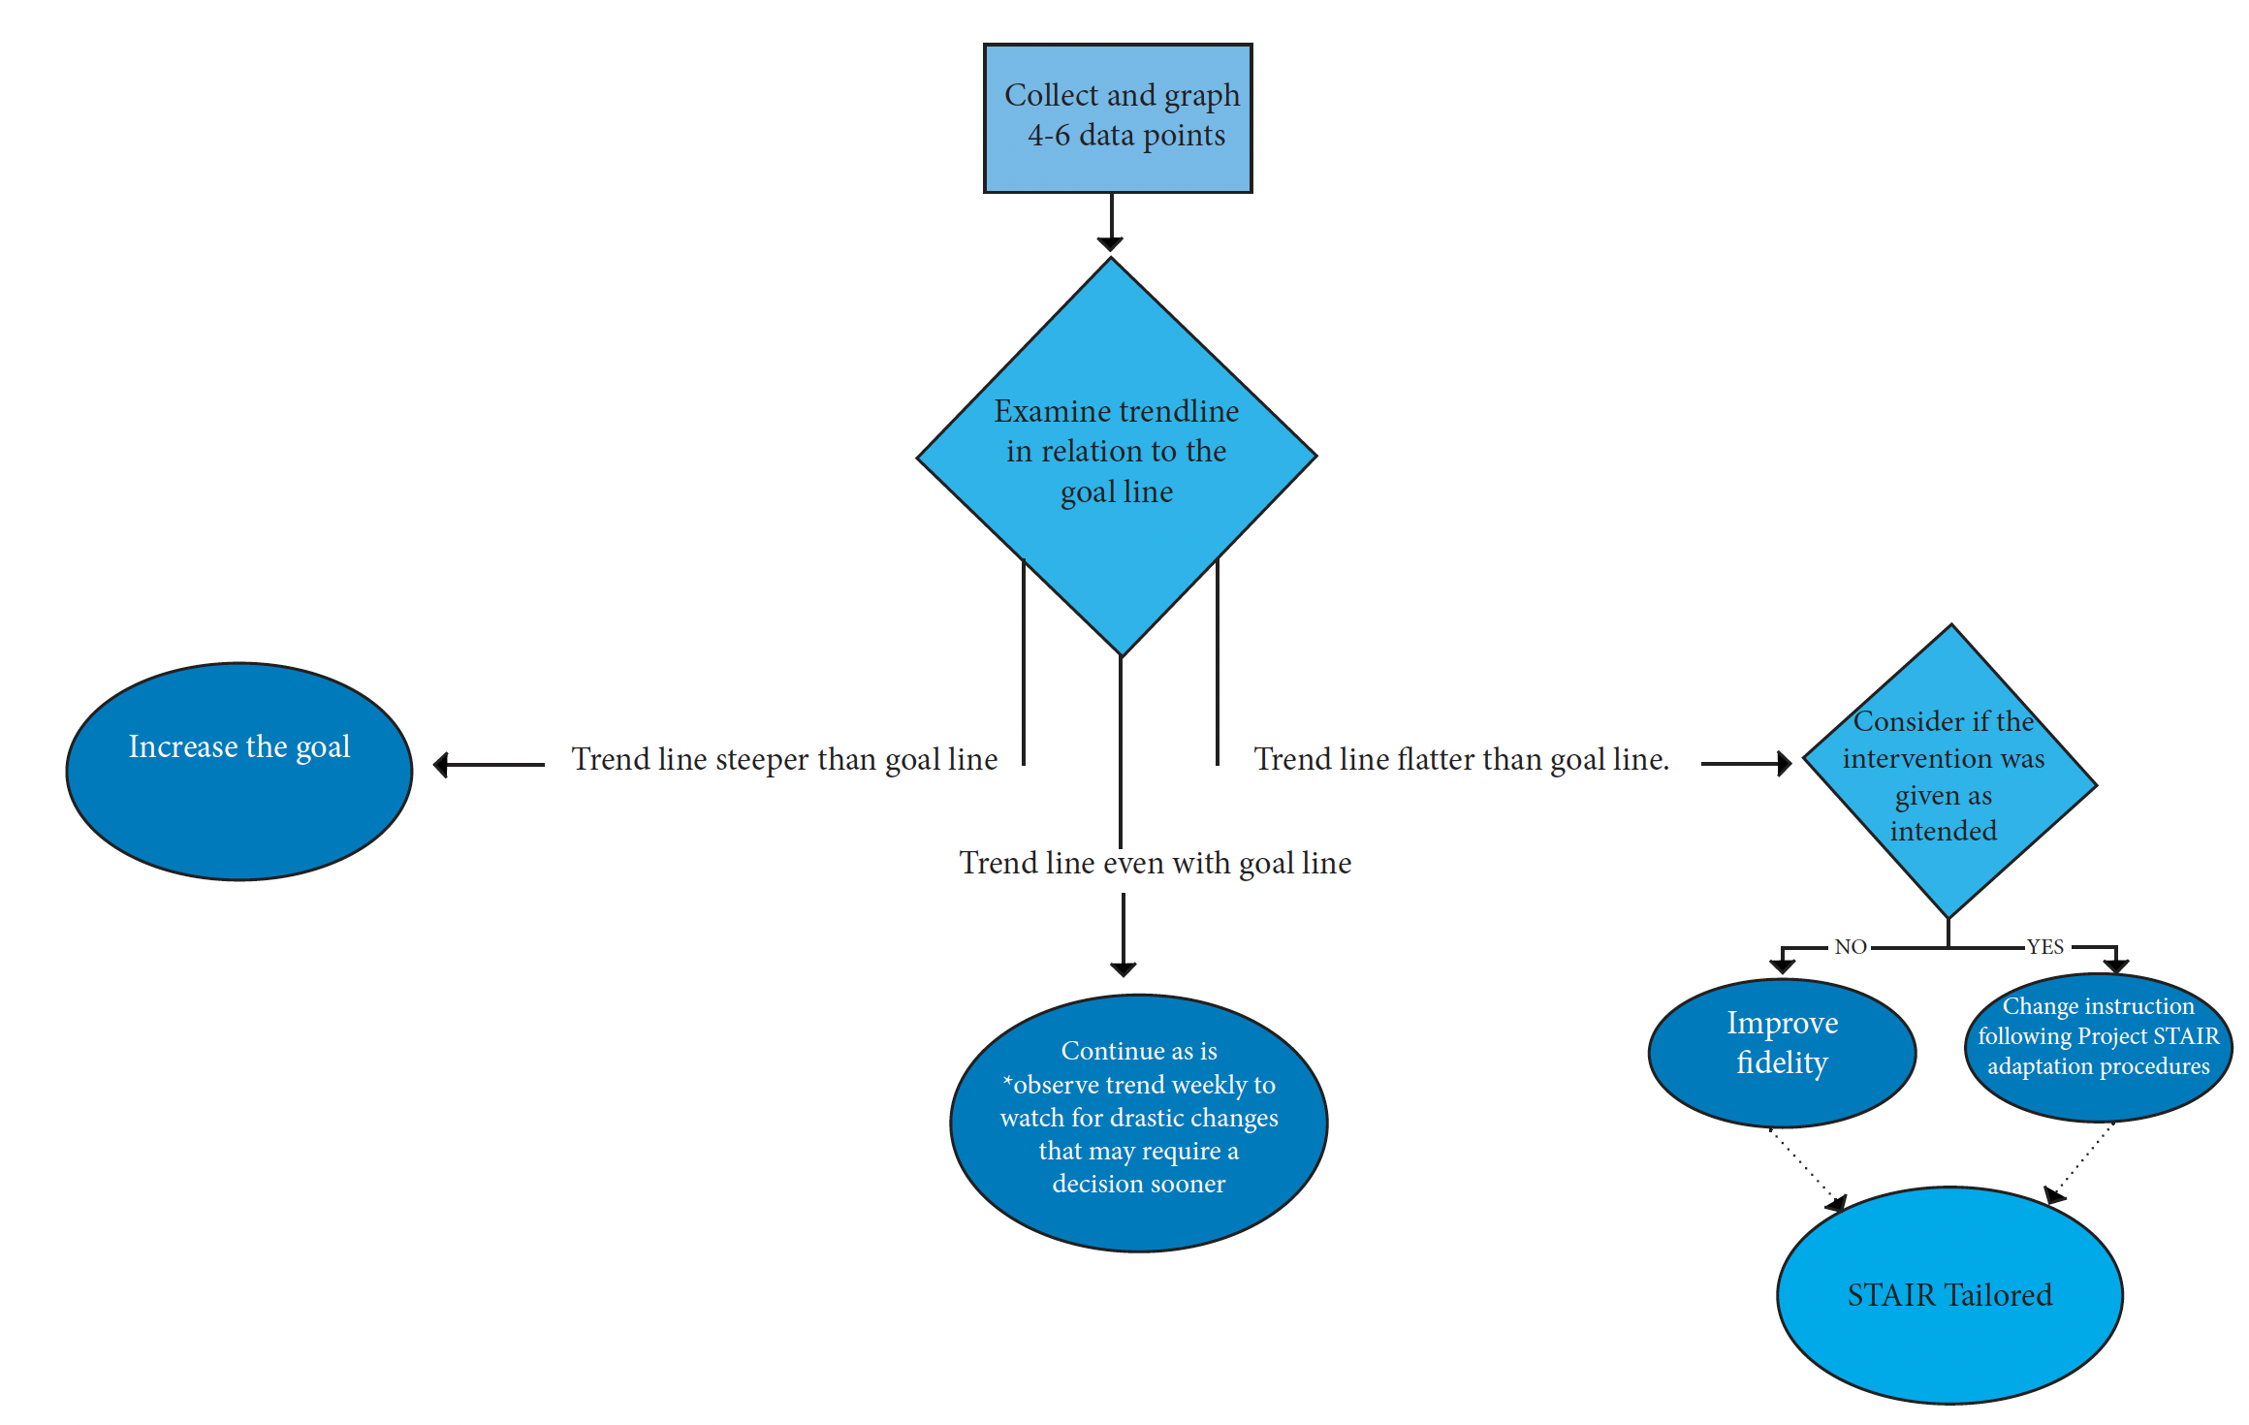
Coaching 6
Coaching involved a focus on the implementation of the instructional platform and a focus on looking at data and determining growth.
Source: STAIR 2.0

Slide 72
Coaching 7
Regular coaching meetings allowed for semi-regular review of data
Many coaching meetings focused on classroom management rather than mathematics or data
Coaching is essential yet time intensive
Hiring and training of coaches are critical

Slide 73
Decision Making 2
Even when providing regular coaching to teachers, the coaching conversations did not always focus on making decisions about student progress.
In some cases, it was difficult to find coaches who could adequately support teachers in mathematics (particularly secondary mathematics).

Slide 74

Coaching 8
Share your experiences with coaching in mathematics (or your favorite topic).
Share what has worked well for you; share any challenges.

Slide 75
Timing of Diagnostic Data Collection

Slide 76
Diagnostics
A diagnostic allows for wise decisions about instructional adaptations.

Slide 77


Diagnostics 1
Source: STAIR 1.0

Slide 78
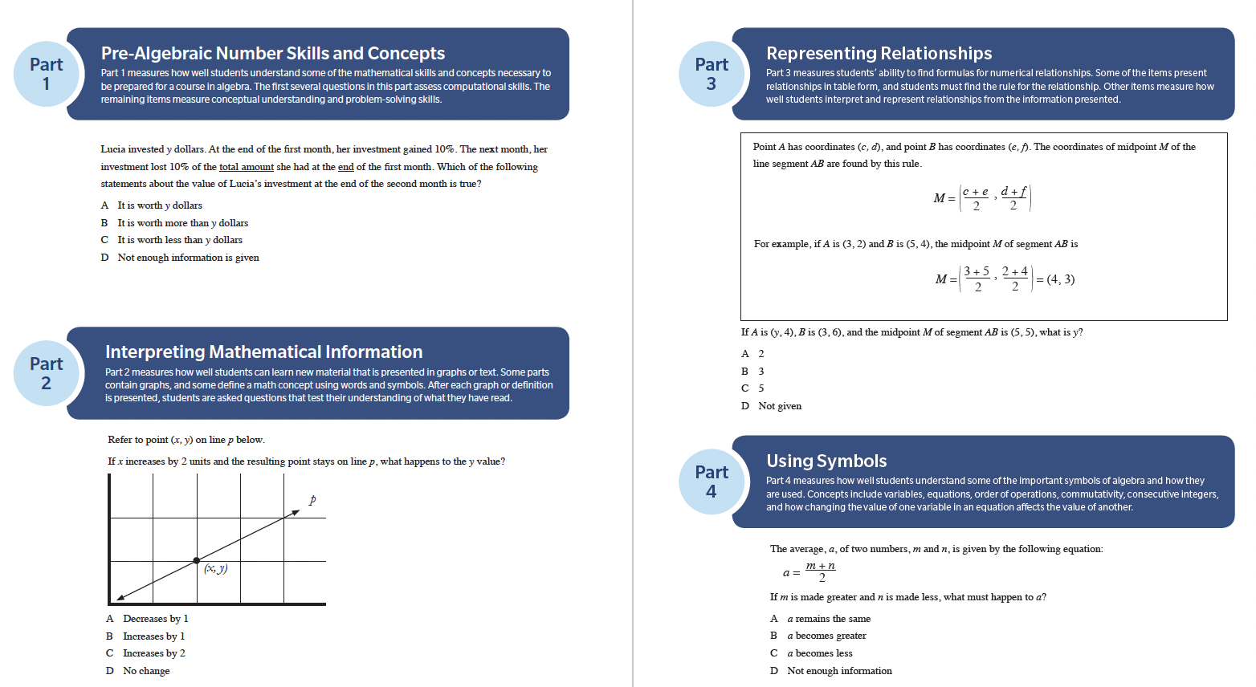

Diagnostics 2
Source: STAIR 2.0

Slide 79
Diagnostics 3
Take a long time to administer
When administered at the beginning of year, teachers did not need data immediately
When administered in the middle of year, harder to schedule
Diagnostic data relied on less than progress monitoring data and teacher observation

Slide 80
Adaptations
An adaptation to the instructional platform should lead to improved student performance.

Slide 81
Adaptations 1
Common adaptations included a greater focus on fluency or an emphasis on mathematics vocabulary
Adaptations that would be more intensive (e.g., word-problem solving) were rarely selected by teachers
Whether formal diagnostic data is necessary for adaptations is questionable

Slide 82
Diagnostics 4
A diagnostic allows for wise decisions about instructional adaptations.

Slide 83

Diagnostics 5
Share your experiences with diagnostics.
Share what has worked well for you; share any challenges.

Slide 84
Structural Elements of the Schools and Districts

Slide 85
DBI
DBI relies on structural elements that must be in place for DBI to have any chance of success.

Slide 86
Structural Elements
School district support
Regular planning time
Principal support
Common planning time
Teachers who volunteer
Regular schedule with students
Teams of teachers
Technology access

Slide 87

Structural Elements 2
Share the structural elements essential for success with DBI.
Share what has worked well for you; share any challenges.

Slide 88
Data-Based Individualization (DBI) 4
This framework is important for meeting the needs of individual students (or groups of students).
With the right plan, the right team, and the right structure, DBI can lead to improved teacher and student outcomes.

Slide 89
Thank You
Sarah R. Powell, Ph.D.
Professor
The University of Texas at Austin
srpowell@utexas.edu
@sarahpowellphd

Slide 90
NCII Disclaimer
This presentation was produced under the U.S. Department of Education, Office of Special Education Programs, Award No. H326Q260001. Celia Rosenquist serves as the project officer. The views expressed herein do not necessarily represent the positions or policies of the U.S. Department of Education. No official endorsement by the U.S. Department of Education of any product, commodity, service, or enterprise mentioned in this resource is intended or should be inferred.

Slide 91
ncii@air.org

