Slide 1
Planning for Success
May 2, 2024
Building Readiness to Implement Data-Based Individualization
Zach Weingarten, EdD| Steve Goodman, PhD| Amy McConnell, MA

Slide 2
Planning for DBI Implementation
How can we plan DBI implementation so it has the greatest chance of positively impacting the students who need it?
How can we make DBI implementation systemic and sustainable?

Slide 3
Presenters
Zach Weingarten
Amy McConnell
Steve Goodman
Product Development Coordinator, NCII
Director of Curriculum and Instruction for the Hood River County School District
Research Specialist, University of Connecticut and NCII Advisor

Slide 4
Why spend time with readiness?
Reduce “false starts”
Increase confidence that DBI is the right thing to do and that we can do it with fidelity
Address both adaptive and technical concerns
Promote the correct and consistent implementation of DBI (i.e., fidelity) with the understanding that fidelity leads to meaningful outcomes
Increase likelihood of sustainability
Increase likelihood of scalability
4

Slide 5
Focusing on the Implementation Process: Exploration and Adoption
Develop clear understanding of what is to be done, how it will be done, and the resources and timelines for doing it.
Commit to implement
Image from Center on Positive Behavioral Interventions and Supports (July 2023). Positive Behavioral Interventions and Supports (PBIS) Implementation Blueprint. University of Oregon. www.pbis.org.

Slide 6
Categories to Guide Adoption of DBI
Is it the right thing to do?
How do we help others to better understand and commit to DBI implementation?
Student need
Capacity to implement
Evidence of effectiveness
Usability
Fit with current initiatives
Can we do it in the right way?
Resources and supports
Adapted from Metz & Louison, 2019

Slide 7
Is it (DBI) the right thing to do?
Need
Are there data that illustrate an opportunity for improving outcomes for our students with significant and persistent need?
Is there a perception of need…
from educators?
from students?
from families?
Is the work of implementing DBI relevant to addressing our needs?

Slide 8
Is it (DBI) the right thing to do?2
Fit
Does the philosophy of DBI fit within the culture of the school staff?
Is there alignment with our values?
Is there room for this work to take place?
Usability
Do our staff perceive the DBI practices to be useable and practical?

Slide 9
Can we do it (DBI) in the right way?
Capacity
Do we have individuals who have basic skills to implement DBI?
Are they willing to implement DBI?
Supports
Can we provide professional learning for DBI?
Will there be a team to support implementation?
Will administration support DBI?

Slide 10
Pitfalls and Possible Solutions
Potential Pitfall | Addressing Pitfall
Perception of more effort and little pay-off | Highlight the direct link between the initiative and successful outcomes for their students
“We already did this” because of similar experiences to previous initiatives (that may not have been successful) | Explain why this is different than what was done in the past or how it will be better Establish ad-hoc exploration team to determine whether the school has the capacity to support implementation (funding, resources, time, skills)

Slide 11
How it started…
Hood River County School District has been implementing DBI or individual problem solving (IPS), as it is called in the district, since 2013.
In the beginning, systems were primarily focused on literacy in our five elementary schools.
We knew we needed to move in this direction because there was no common understanding of a clear way to determine which students needed additional support and HOW to support them.
We were guessing…guessing does not result in predictable outcomes.

Slide 12
Building a System
We had the bones of the system
Students were assessed and data were collected, but clear decision rules and systems were still being developed
District level teams came together regularly to learn and build a comprehensive MTSS Handbook
These district level teams included building administrators, reading specialists, and learning specialists. The school teams would then provide onsite PD to build capacity

Slide 13
Focusing on the Implementation Process: Installation
Setting up the infrastructure, developing skills to implement, and providing the resources needed for DBI implementation
Image from Center on Positive Behavioral Interventions and Supports (July 2023). Positive Behavioral Interventions and Supports (PBIS) Implementation Blueprint. University of Oregon. www.pbis.org.

Slide 14
Make Room for the Work: Deselection and alignment with key initiatives
Deselection
Educators have too many demands
For each initiative added, take two others away
Alignment
Aligned systems are more likely to be implemented correctly and sustained over time
Alignment builds on initiatives by leveraging funding, training, and evaluation in ways to improve DBI implementation.

Slide 15
Identify Implementers (Doers and Supporters)
Interventionists
DBI Team (use existing teams whenever possible)
Team members demonstrate:
understanding of student
understanding of DBI and intensifying interventions
understanding of context where intervention takes place
ability to assign priority and allocate resources

Slide 16
Plan for Professional Learning
Identify
Professional learning content
Provider(s) of professional learning
Receivers of professional learning (interventionists, intervention team)
Schedule for access to professional learning
Plan for coaching for feedback, technical assistance with problem-solving

Slide 17
Essential Professional Development Topics for DBI
Key topics
DBI process
Assessment for decision making
Progress monitoring
Diagnostic assessment
Intensive intervention practices
Student intervention planning meeting structures

Slide 18
Allocate Time for Planning and Doing
Intervention planning meeting
Planning, reviewing, modifying intervention plan
Utilize structured meeting agenda that utilizes data for problem-solving
Intervention time for working with student

Slide 19
Pitfalls and Possible Solutions2
Potential Pitfall | Addressing Pitfall
Not paying attention to need for installation or expecting staff to “just do it” | Consider supports needed to successfully implement Spend the effort to get these in place
Not providing time to get the work done | Allocate dedicated staff time to install necessary readiness components (training, teaming, data resources)
Failure to consider how to braid the practices into existing work | Look for opportunities to connect DBI with existing priorities and work demands

Slide 20
What we know now…
The system supporting DBI implementation is never “done” or “perfect”.
It is important to build systems that minimize the ability for “drifting”.
Create and implement district assessment calendars with fidelity.
Create meeting schedules that are followed with fidelity.
Develop intervention meeting agendas that lean into decision rules and help guide the conversation.
Create supporting documents that are easily accessible and minimize guessing.
Develop a long-term PD plan that supports maintenance.
Eventually, the system itself becomes the PD.

Slide 21
Current Reality
More than a decade later, we are still working on our systems.
We have infused other district initiatives into the MTSS/DBI implementation to support more robust core instruction.
We are also exploring different ways to review data to allocate resources based on need.

Slide 22
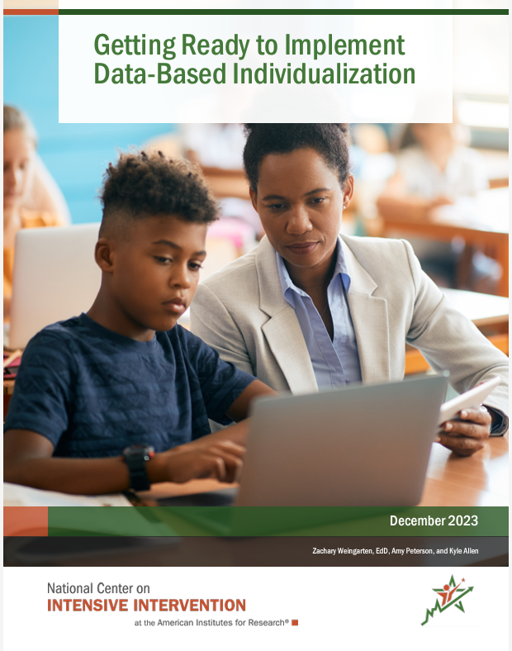
NCII Resource: Getting Ready to Implement DBI
“…implementation is a process, not an event. Implementation will not happen all at once, or proceed smoothly, at least at first.” (Fixsen et al., 2005)
Readiness brief

Slide 23
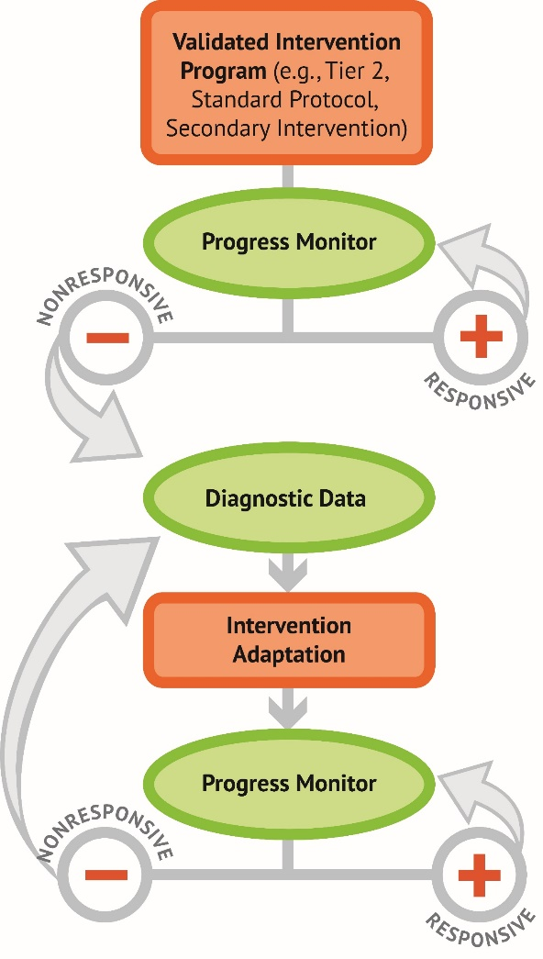
Determine the Need for DBI
How will DBI support the needs of students in the district or school?
What outcomes do you plan to improve with DBI?
What data sources will you use to identify student needs?

Slide 24
Why might we need DBI?
Improve performance of students with disabilities.
Refine Tier 3 and distinguish it from
Tier 2.
Help teachers better support students who have not yet responded to evidence-based interventions.
Inform the design and delivery of specially designed instruction.

Slide 25
Establish DBI Implementation Teams
Leadership Team:
Ensure that implementers have what they need to be successful (e.g., secure resources, select data systems, coordinate training)
Child Study or Student Assistance Team:
Apply the DBI process to address the needs of individual students.

Slide 26
Take Stock of Current Initiatives
Are there initiatives with similar features and intended outcomes that can be aligned?
Are existing programs effective and implemented with fidelity?
Are there current policies or practices that present barriers to DBI implementation?

Slide 27
Aligning DBI to District Priorities
Special education services
Family engagement
College and career readiness
MTSS / PBIS
Equity in student outcomes
DBI
How does DBI implementation build upon the work that work that educators are already doing?
The Hexagon: An Exploration Tool

Slide 28
Review Infrastructure to Support DBI Implementation
Setting up a hospitable environment:
Do we have the data systems, assessments, and interventions needed for DBI?
Is there time for intervention sessions and for data teams to meet?
What professional learning do staff need to implement DBI with fidelity?
District Capacity Assessment
DBI Implementation Rubric

Slide 29
Review Infrastructure to Support DBI Implementation2
To realize the potential impact of DBI, the process needs to be implemented correctly and consistently. Implementers need—
Knowledge
Skills
Information
Supports
Time to assess, plan, and implement
Competency development
Organization supports
Leadership

Slide 30
Develop an Implementation Plan With Built-In Feedback Loops
Develop a plan to address needs, gaps, and barriers to implementation.
Document your:
Goals for DBI implementation
Strategies to meet goals
Person(s) responsible
Benchmarks for success
Timeline for completion of goals

Slide 31
Engaging and Communicating with Partners
Establish communication loops among educators, families, and district and school leaders.
Share the status of how implementation is going
Seek input about how to make improvements
Celebrate accomplishments

Slide 32
Starting with a Pilot Project
Consider starting with a single content area, grade level, or a small number of students.
Learn from the work in a pilot project and quickly address challenges.
Apply learning from the pilot project when scaling up.
Use the pilot to build support for DBI and to promote buy-in when scaling up.

Slide 33
Commit to the Process
DBI implementation takes time and commitment!
Celebrate small successes (e.g., improvements in fidelity of implementation).
Identify implementation champions.
Address technical and adaptive challenges.

Slide 34
Questions/Reflections

Slide 35
References
Center on Positive Behavioral Interventions and Supports (July 2023). Positive Behavioral Interventions and Supports (PBIS) Implementation Blueprint. University of Oregon. www.pbis.org.
Fixsen, D. L., Naoom, S. F., Blase, K. A., Friedman, R. M. & Wallace, F. (2005). Implementation Research: A Synthesis of the Literature. Tampa, FL: University of South Florida, Louis de la Parte Florida Mental Health Institute, The National Implementation Research Network (FMHI Publication #231).
Metz, A. & Louison, L. (2019) The Hexagon Tool: Exploring Context. Chapel Hill, NC: National Implementation Research Network, Frank Porter Graham Child Development Institute, University of North Carolina at Chapel Hill.

Slide 36
NCII Disclaimer
This presentation was produced under the U.S. Department of Education, Office of Special Education Programs, Award No. H326Q260001. Celia Rosenquist serves as the project officer. The views expressed herein do not necessarily represent the positions or policies of the U.S. Department of Education. No official endorsement by the U.S. Department of Education of any product, commodity, service, or enterprise mentioned in this resource is intended or should be inferred.

Slide 37
Thank you

